Slide 1
Sub-fs SRF cavity control at CMTB (AMTF/ELBE)
13th MT ARD ST3 Meeting 2025 in DESY-Zeuthen
M. Hoffmann, A. Bellandi, F. Ludwig, U. Mavrič, H. Pryschelski, C. Schmidt, L. Springer, B. Szczepanski (DESY)
M. Kuntzsch, K. Zenker (HZDR)
Hamburg, 16.02.2024

Slide 2
Content
Motivation
Principle of the Carrier Suppression Interferometer
Carrier Suppression Interferometer integrated in LLRF systems
Measurements at
  CTMB : Inductive Output Tube (IOT)
  ΑΜΤF : Solid State Power Amplifier (SSPA)
  ELBE/HZDR : SSPA + beam + diagnostic (BAM)
Summary & outlook

Slide 3
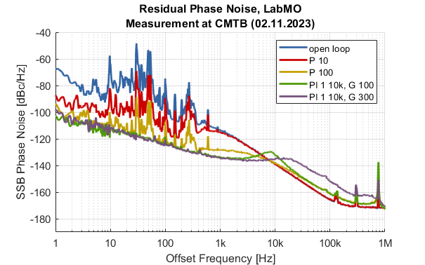
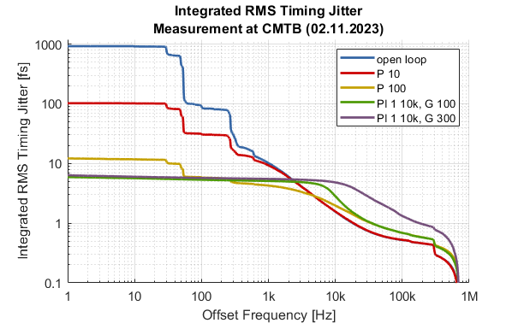
Motivation for a CSI based RF receiver
Performance without CSI (PI controller parameter sweep)
Example measurement from CMTB with a standard LLRF system (CW SRF cavity, 1.3GHz, QL 1e7)
As expected from theory: limited by noise contributions from the RF detector (mainly ADC noise)
Jitter limit is at ~6fs [1Hz..1MHz]
Expected noise floor of the CSI

Slide 4
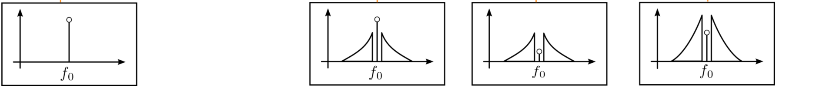
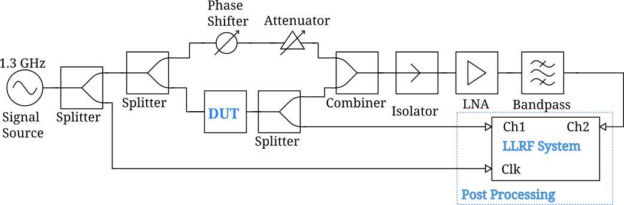
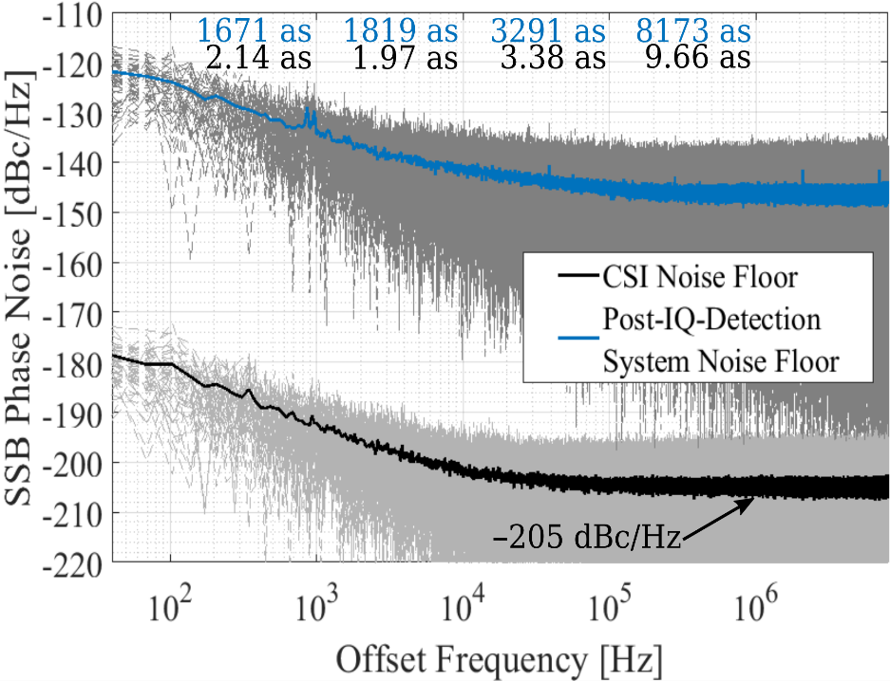
How does the CSI works?
Idea and concept
Concept from 1968
Overcome noise limits of the post detection system (ADC noise) by amplification of the noise sidebands
CSI performance scales linear with RF input power
Residual measurement of PM and AM noise
RF reference for phase and amplitude => low PM and AM noise of RF reference required
RF input power of +33 dBm measured at the DUT
L. Springer et al., "Phase Noise Measurements for L-Band Applications at Attosecond Resolution," in IEEE TIM;, doi: 10.1109/TIM.2022.3170975.

Slide 5
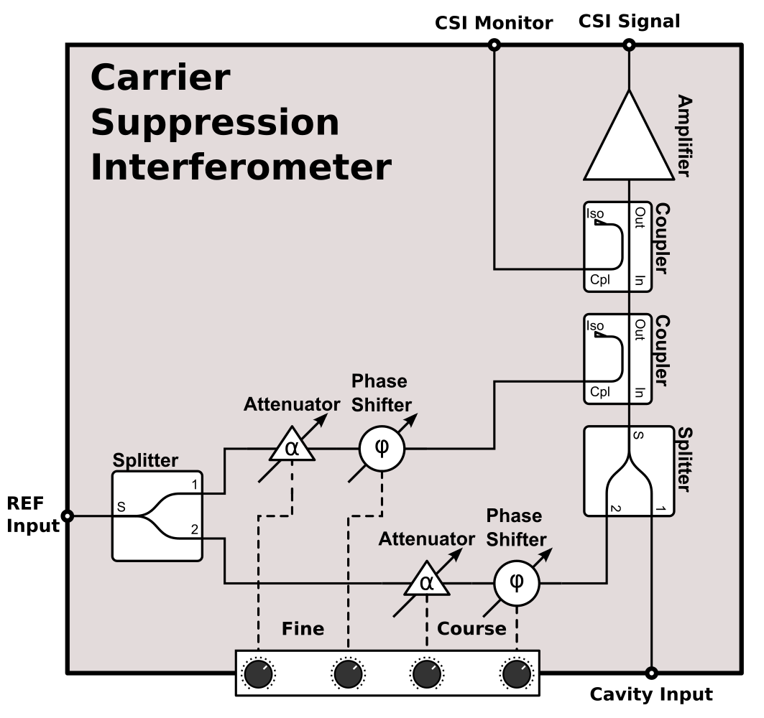
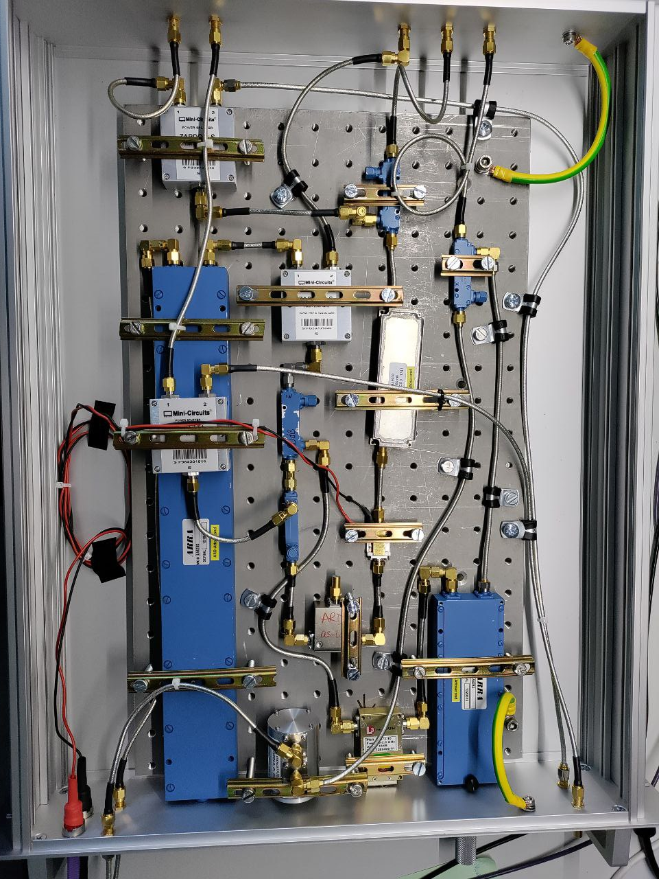
CSI & LLRF at CMTB/AMTF/ELBE
Overview diagram I
CSI in a 19-inch RF front-end box
Course and fine tuning branch (to improve suppression)
Some monitor outputs (for calibration purpose)
40dB ultra low noise amplifier
(NF 0.7dB)
External low noise power supply
Heavy base plate to prevent mechanical vibrations
Requires still some tuning by hand (e.g. external phase shift)

Slide 6
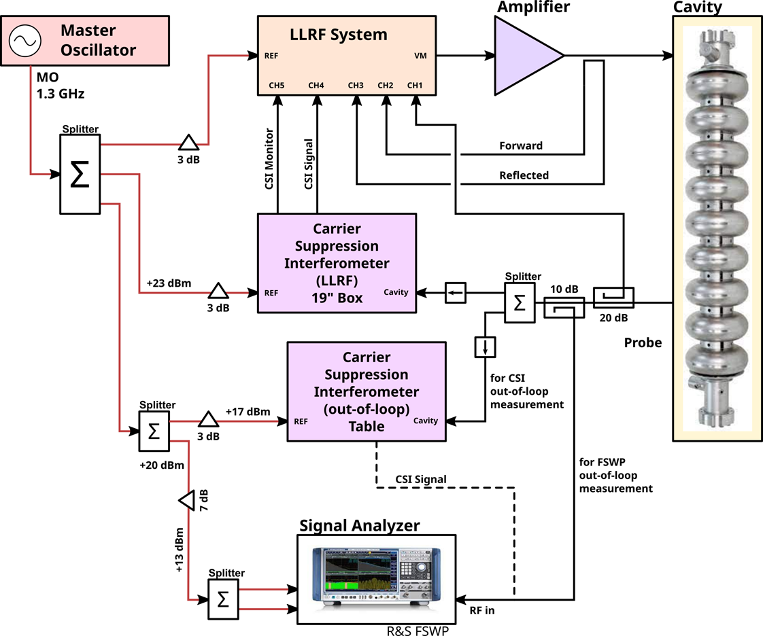
CSI & LLRF at CMTB/AMTF/ELBE
Overview diagram II
Split probe signal for:
  Standard single cavity LLRF system
  CSI in-loop
  CSI out-of-loop (performance evaluation)
  R&S FSWP (performance evaluation)
R&S FSWP used for absolute and residual measurement (MO as reference)
CSI signal contains no absolute information of amplitude and phase (no carrier)

Slide 7
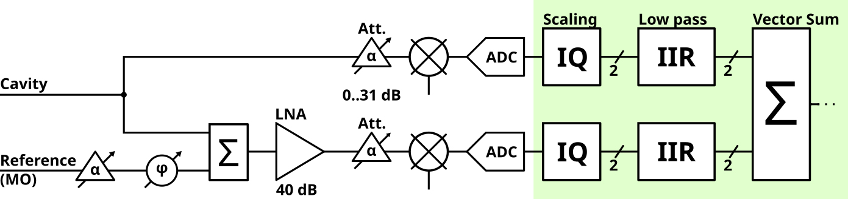
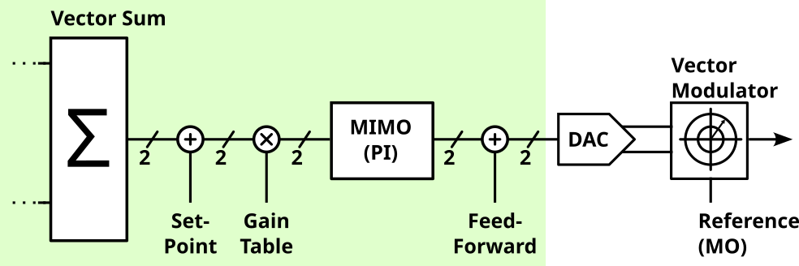
CSI & LLRF at CMTB/AMTF/ELBE
Overview diagram III
LLRF standard controller firmware
Add CSI signal via vector-sum to the controller
CSI signal as pre-amplified error signal
Adjust CSI contribution by IQ scaling and external RF attenuator on RTM

Slide 8
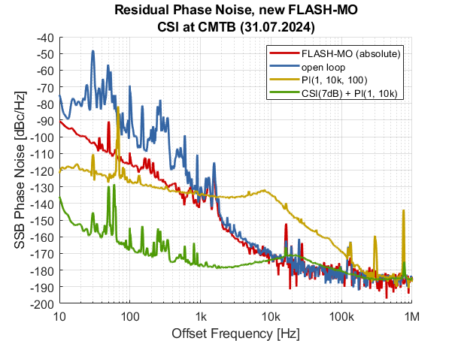
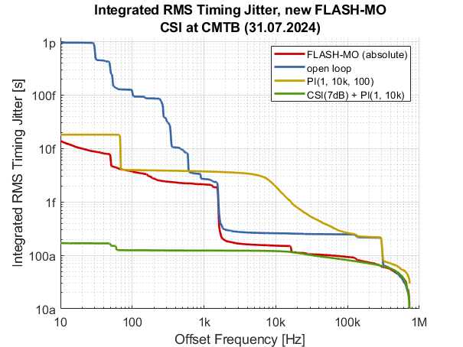
CSI @ CMTB (31.07.2024)
RF field stability with new FLASH-MO and IOT
CW SRF cavity at 1.3GHz, QL = 1e7 (65MHz half bandwidth)
White noise floor of -185dBc/Hz (1MHz), -165dBc/Hz at 100Hz
Reduce microphonics by ~70dB (with CSI and PI controller)
Excellent result of <200as RMS timing jitter [10Hz..1MHz]
Without CSI ~4fs (at 100Hz)

Slide 9
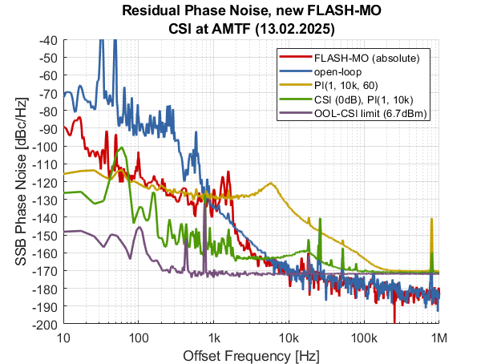
CSI @ AMTF (12./13.02.2025)
RF field stability with new FLASH-MO and SSPA
CW SRF cavity with QL of 1e7 (65Hz half bandwidth)
White noise floor limited by low power level from cavity pickup
With CSI: RMS timing jitter ~0.9fs (at 100Hz)
Reduce microphonics by 55dB (with CSI and PI controller)
CSI resolution only 0.5fs (-172dBc/Hz), due to low input power level
Optimized calibration procedures and hardware setup
  Calibration script with external injection
  OOL-CSI readout (online performance monitoring)
Handling of the CSI, optimized hardware setup, etc.

Slide 10
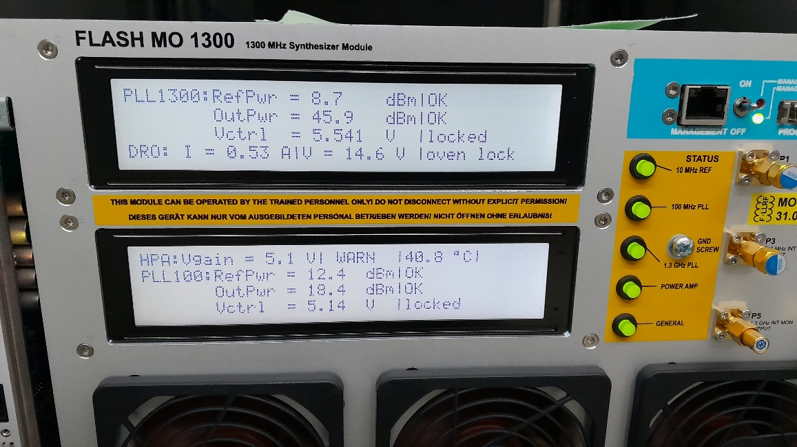
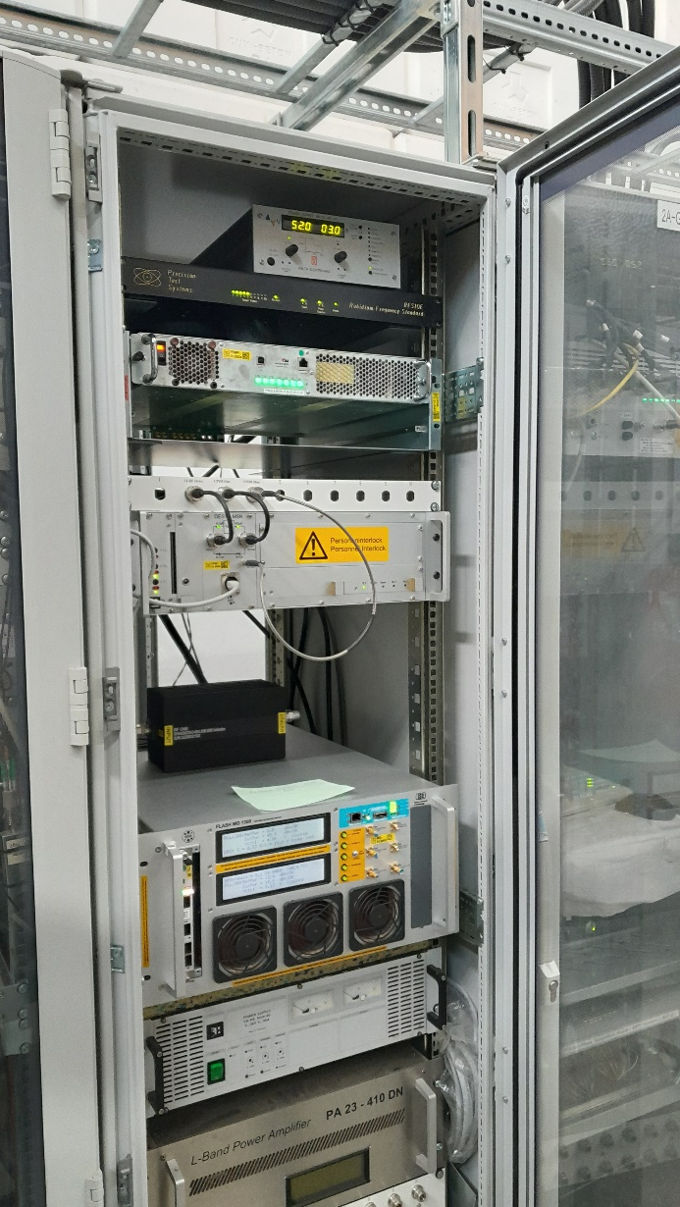
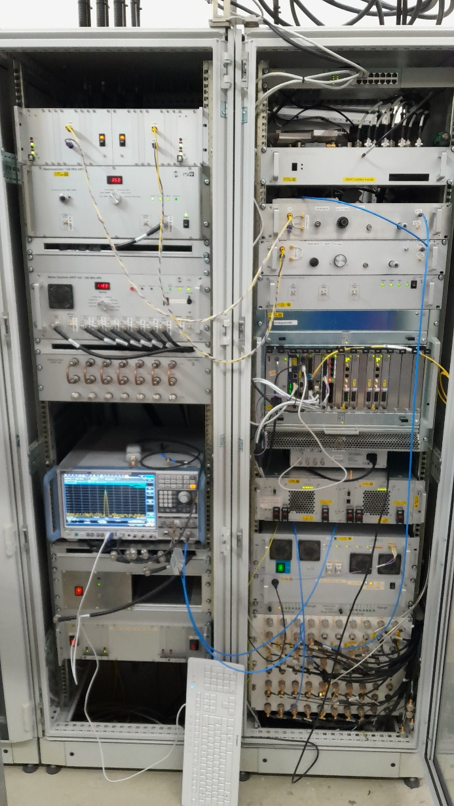
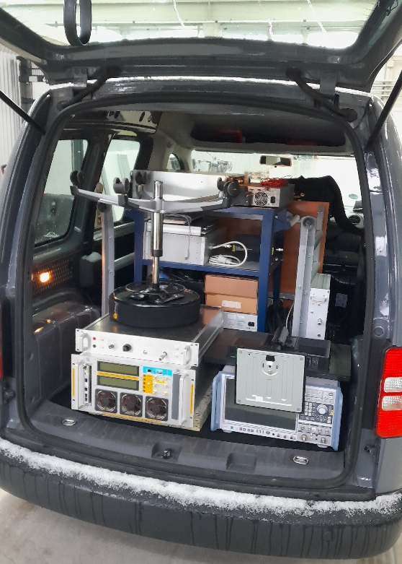
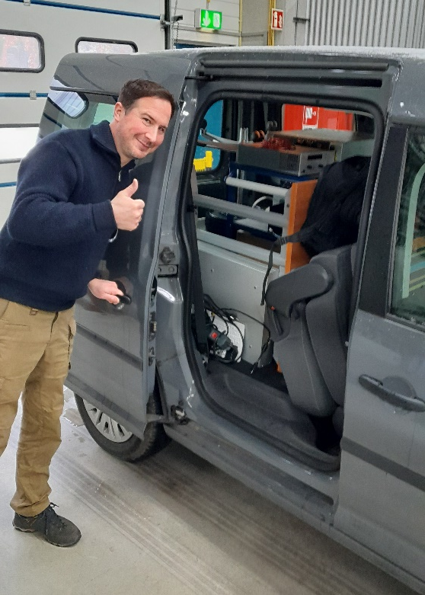
CSI @ AMTF (12./13.02.2025)
CSI & measurement setup

Slide 11
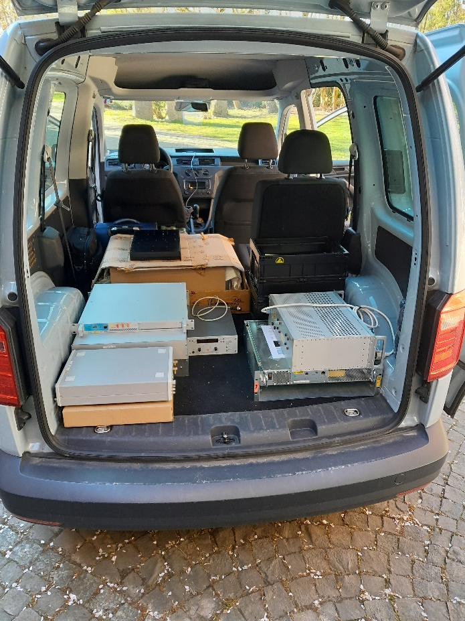
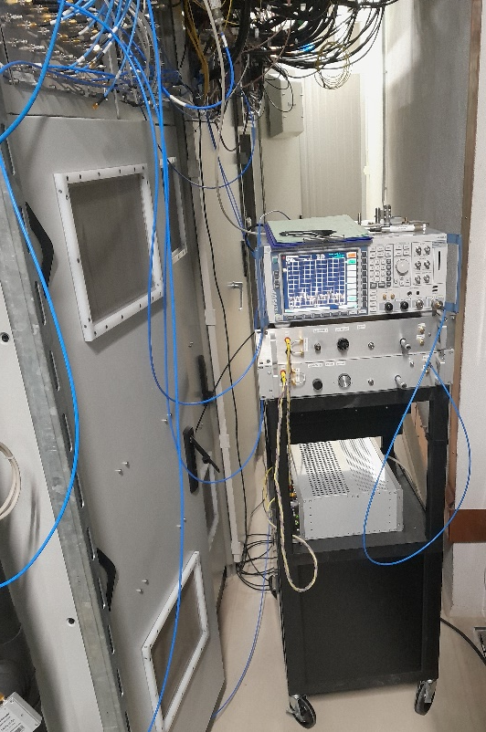
CSI @ ELBE/HZDR (04.-07.04.2025)
2nd run of testing CSI application as ultra high precision LLRF field detector
Measurement shifts at ELBE: 04.04. – 07.04.2025
Use new FLASH-MO for LLRF of cavity 3 and cavity 4
Control cavity 3 and cavity 4 with CSI and measure arrival time jitter with the BAM.
Learn how to handle CSI setup in real facility and with beam
Electron beam settings: 200pC, 50kHz, THz setup (0.7THz), SRF Gun
Issues and Limits:
We couldn’t lock the FLASH-MO to the ELBE-MO via the 10MHz reference
Frequency tolerance/tuning range of FLASH-MO is very narrow (20Hz)
All the following measurements were done with ELBE-MO
Not optimal power levels from ELBE-MO and cavities
AM-noise limit by ELBE-MO

Slide 12
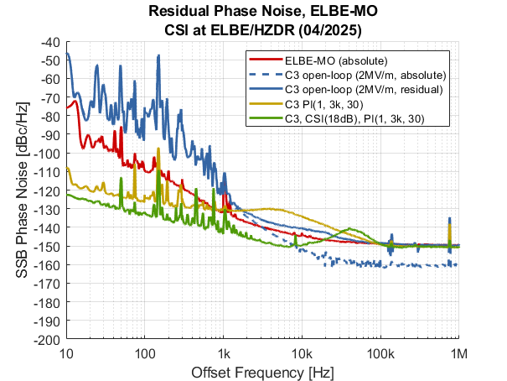
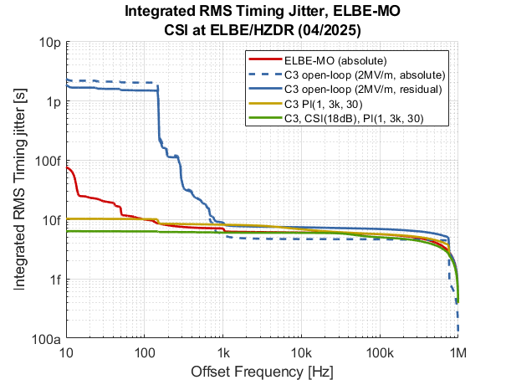
CSI @ ELBE/HZDR (04.-07.04.2025)
Compare different feedback controller settings
White noise floor limited by ELBE-MO at -150dBc/Hz
1/f-noise contributions from AM-noise of ELBE-MO
Improvement with CSI 1kHz..20kHz
RMS timing jitter of 6fs with CSI + PI (10fs with PI)
High contributions from noise >10kHz
Better MO required for as-performance

Slide 13
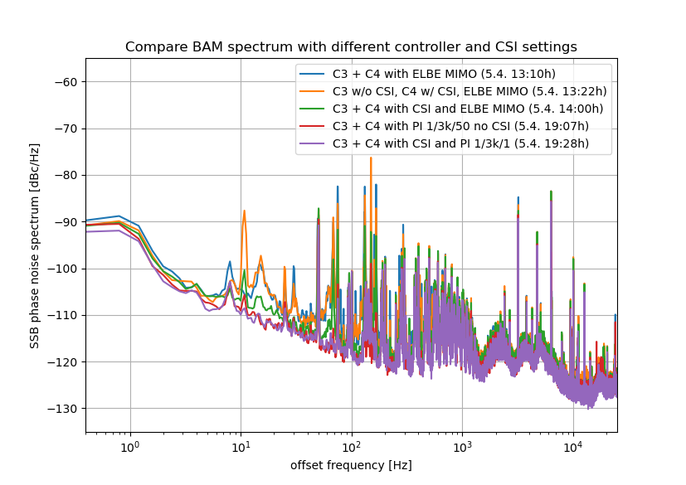
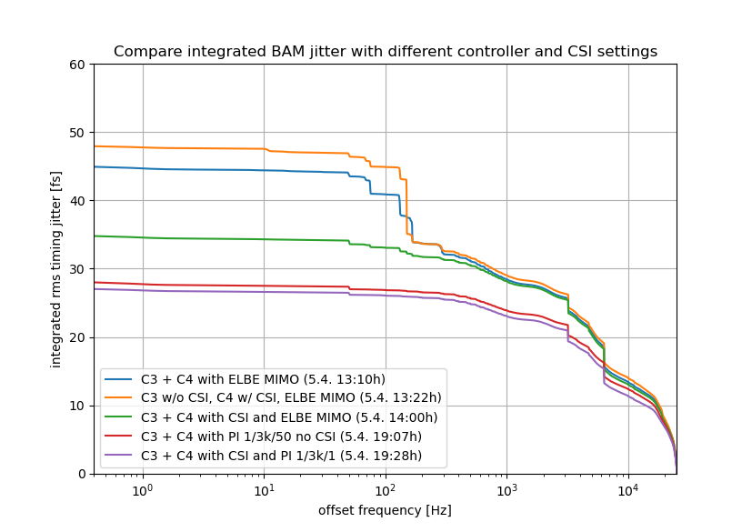
CSI @ ELBE/HZDR (04.-07.04.2025)
Evaluation of BAM data from CW RF operation
50kHz beam repetition rate
Multiple disturbances in the BAM signal visible
mainly 50Hz and multiple harmonics
Feedback action visible below 100Hz
RMS timing jitter of 27fs with CSI + PI
28fs without CSI, with PI
No time to further investigate the sources of disturbances
More contributors: injector, laser synchronization, etc.

Slide 14
Summary & Outlook
What we achieved so far and what comes next.
Summary
Achieved RMS phase jitter below 200as (at CMTB)
Reached resolution limit of FSWP => OOL-CSI to measure performance
At AMTF: gained a lot of experience of handling of the CSI, optimizing hardware setup and calibration procedures, etc.
Power level from cavity and RF reference are crucial to reach as-performance!
At ELBE:
  stable CSI feedback operation on two cavities over night without issues!
  No big effects of beam transients on CSI signals!
  Operation: Tuning of RF and beam by CSI tuning knobs!
Outlook
Development of low noise electrical actuators for automation
High performance RF reference sources are required, with ultra low PM and AM stability
Firmware upgrade: implementation of separate/independent controller path for the CSI
Optimize packaging and housing (reduce size)
Facility required with CW SRF cavity + beam + sub-fs beam diagnostic => ELBE/HZDR

Slide 15
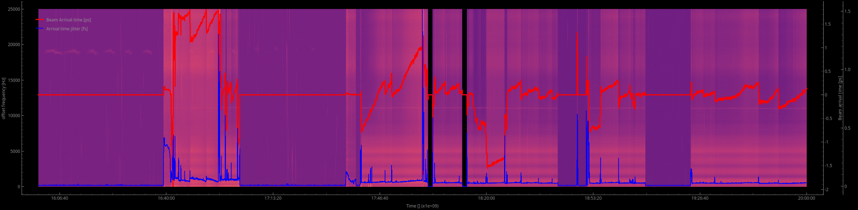
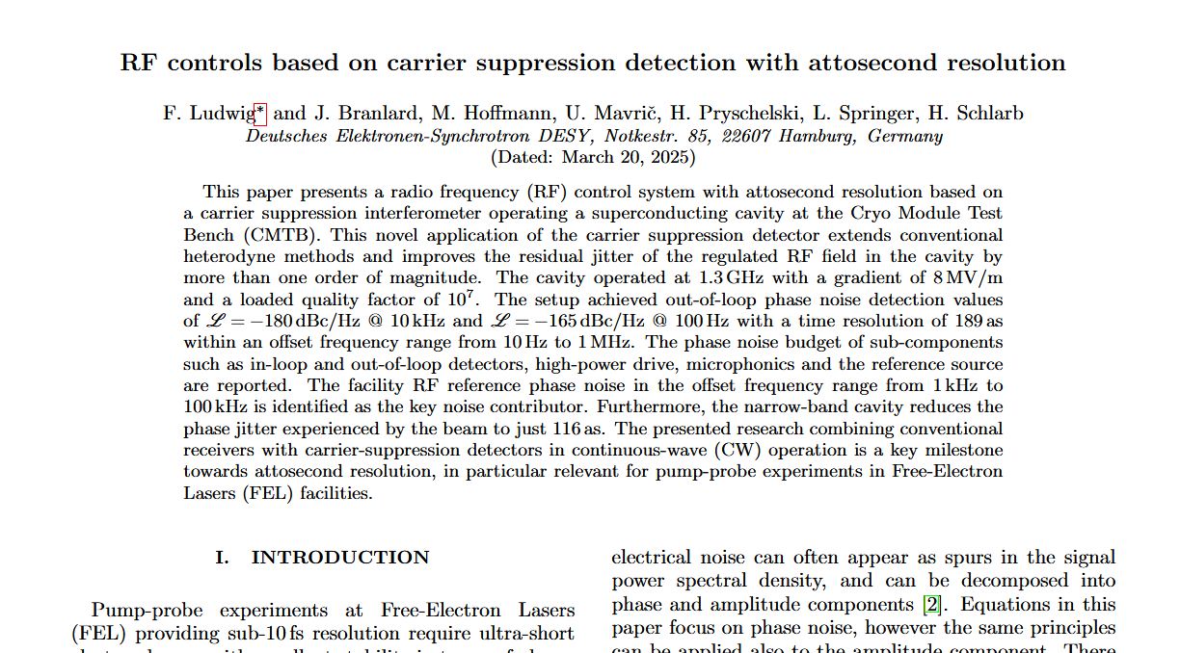
Thank you!
M. Hoffmann, A. Bellandi, F. Ludwig, U. Mavrič, H. Pryschelski, C. Schmidt, L. Springer, B. Szczepanski (DESY)
M. Kuntzsch, K. Zenker (HZDR)
Matthias Hoffmann
MSK
m.hoffmann@desy.de
+49 40 8998 1670

