Slide 1
Experience with cell experiments at ARES
Logistics, challenges, points for discussion.
Florian Burkart
on behalf of the ARES team:
Hannes Dinter, Frank Mayet, Sonja Jaster-Merz, Max Kellermeier, Willi Kuropka, Blae Stacey, Thomas Vinatier
with input from Elisabetta Gargioni, Nina Struve, Joel Senador (UKE)

Slide 2
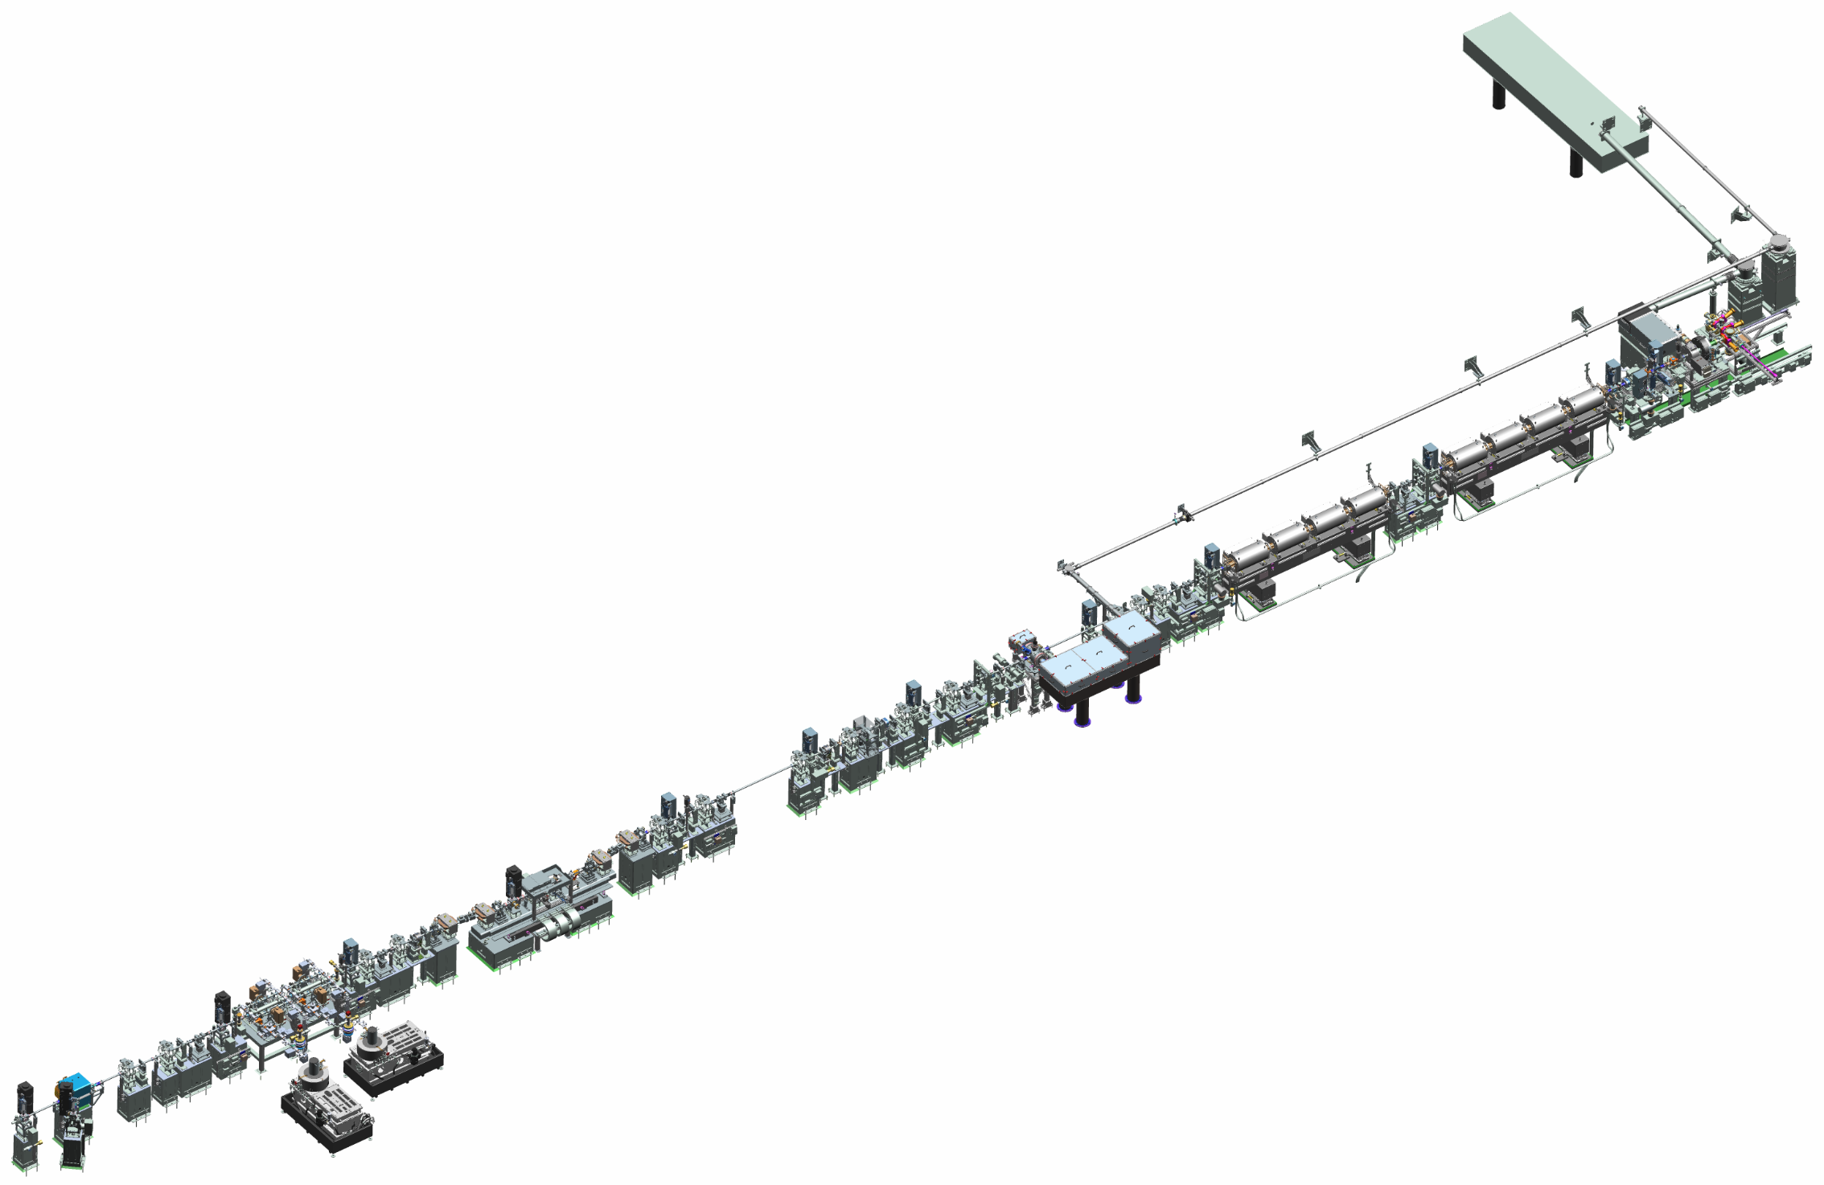

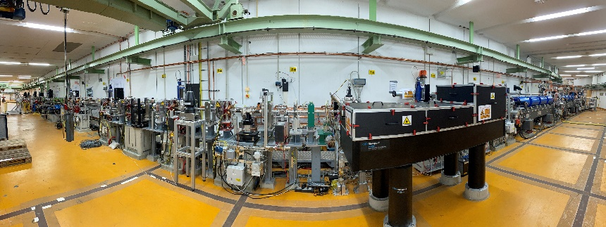
The ARES Linac at DESY
Design start (incl. removal of DORIS): 2014
Construction start: March 2018
First beam (gun section): October 2019
ARES fully installed: April 2023
Present – Final Layout and Status
ARES goal:
Generate and characterize ultrashort e- bunches (fs to sub-fs) with high stability for applications related to accelerator R&D and beam time for external R&D users.
Parameter | Target | Status
Charge | 0.05 - 200 pC | 0.003 - 200 pC
Momentum | 50 - 150 MeV/c | 20 - 160 MeV/c
Momentum Spread | 10⁻⁴ | 10⁻⁴ (res. limited)
Transv. Norm. Emittance | < 0.8 µm.rad | ≈ 0.07 µm.rad
Bunch Length (rms) | Sub-fs to ~10 fs | ≈ 2.9 fs (VB || BC)
S-Band
Gun
Gun Diagnostics
~45 m
S-Band
Traveling Wave Structures (TWS)
Experimental Area 1
Bunch Compressor
X-Band PolariX TDS (2 Cavities)
Experimental Areas 2&3
High Energy Spectrometer

Slide 3

Medical applications
In-vivo experiments
New challenges in 2021
FLASH RT
Medical imaging
The accelerator phycisist
VHEE

Slide 4
Logistics & Infrastructure

Slide 5
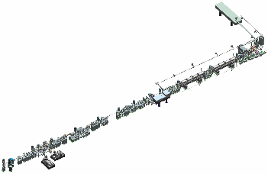
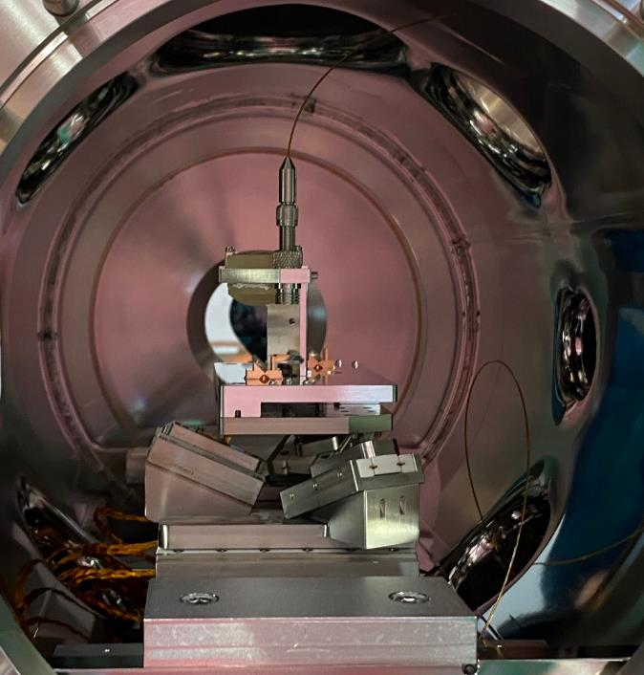
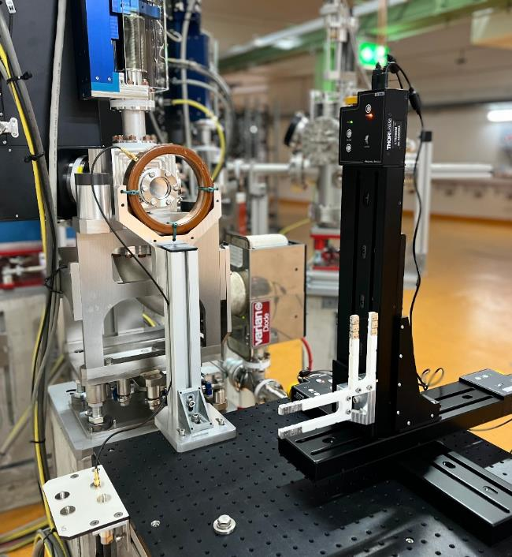
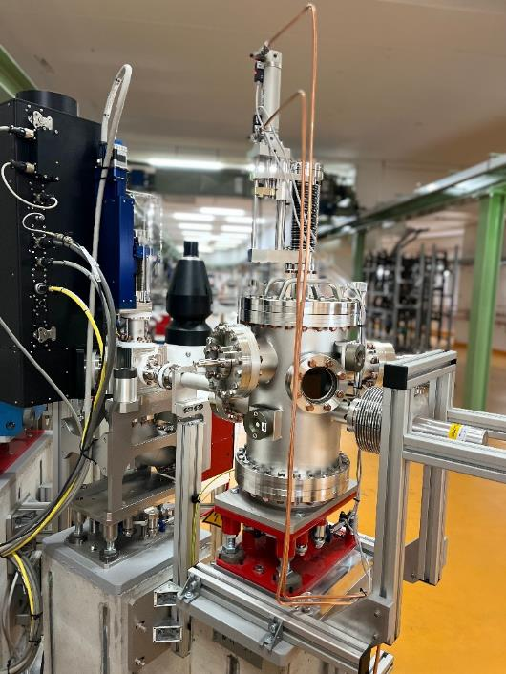
Three Experimental Areas for Users
Full Flexibility
In UHV (~7e-10 mbar), highest precision,
best beam control.
In air, highest flexibility.
In low pressure vacuum, detector test stand.

Slide 6
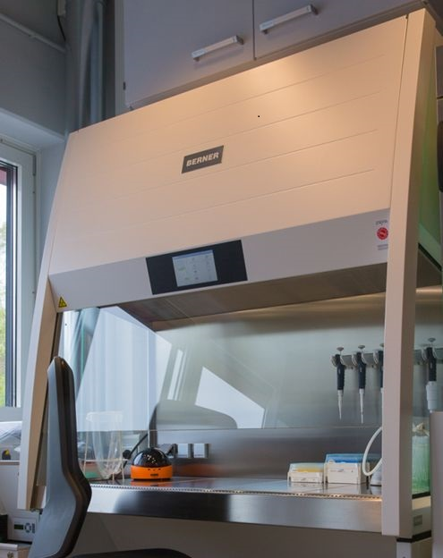
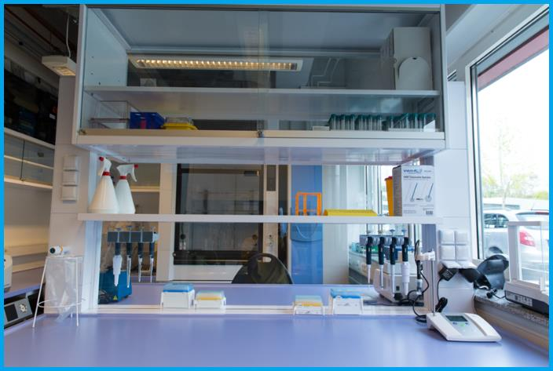
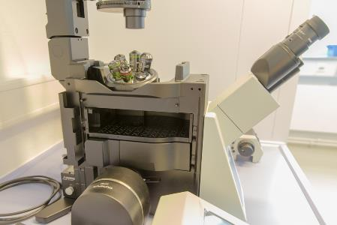
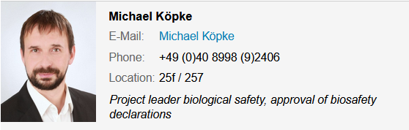
S2 Bio lab
photo by courtesy of M. Osterhoff
Now available for medical experiments at ARES.
inverse fluorescence microscope.
Work place in the Bio-Laboratory.
BSL2 safety workbench equipped with a mini centrifuge, vortexer, vacuum pump,…
provides all the necessary equipment to cultivate, store, manipulate and analyse biological agents
More info:
https://photon-science.desy.de/facilities/on_site_infrastructure/laboratories_technical_infrastructure_shift_service/biology_laboratory_bsl_2/equipment/%20index_eng.html

Slide 7
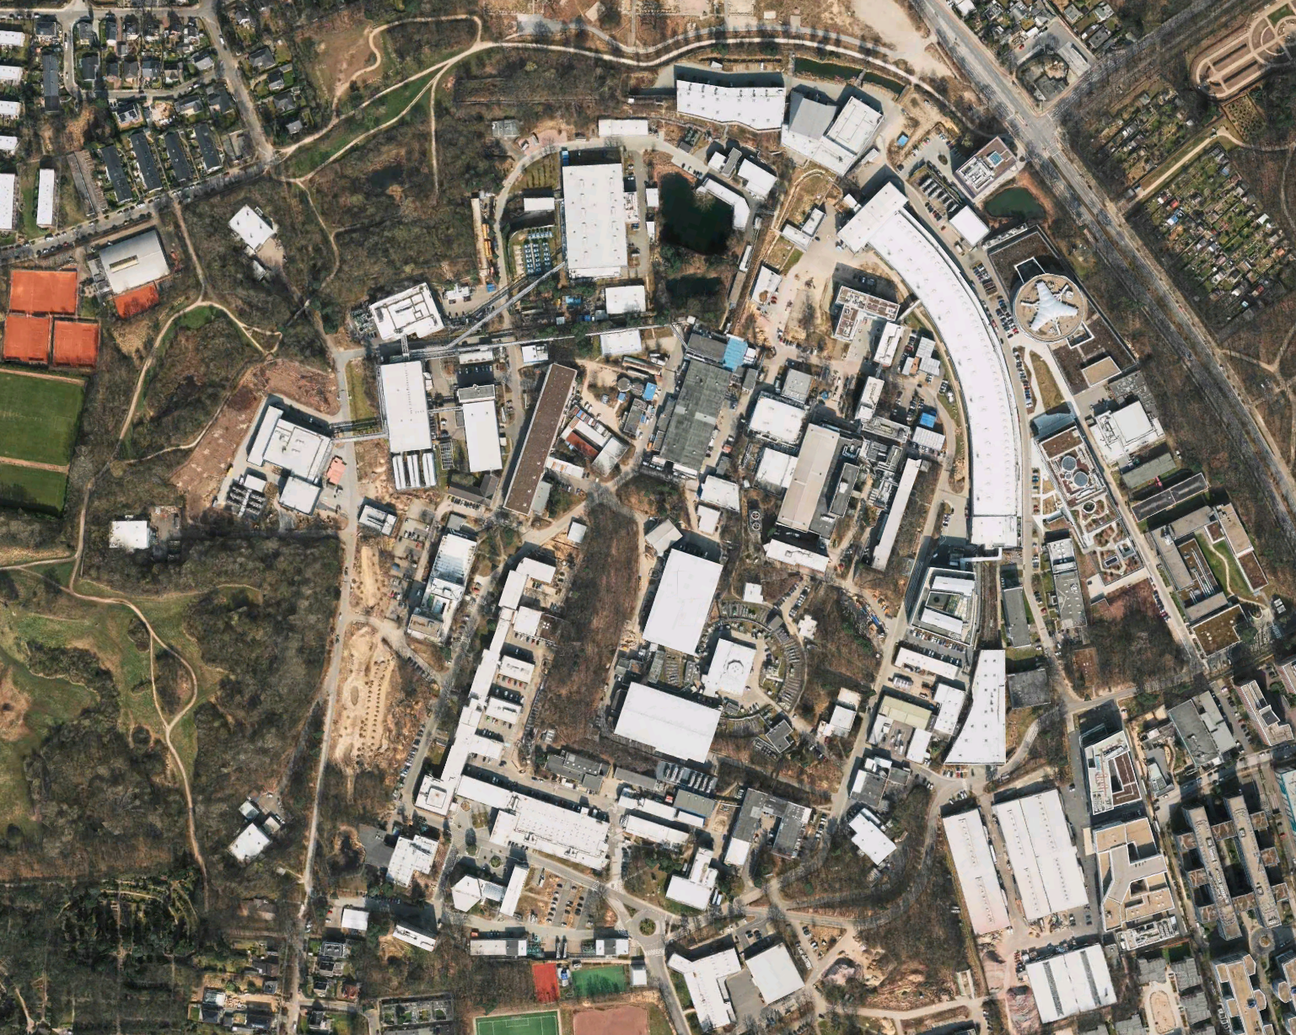
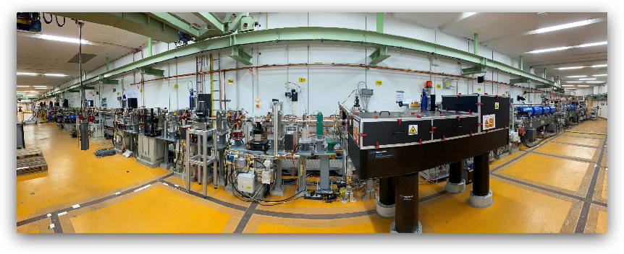
Locations on the DESY campus
5 min walking distance from Lab to ARES
ARES Linac
FLASH II
FLASH
PETRA III
SINBAD
EuXFEL
DESY II
KALDERA

Slide 8


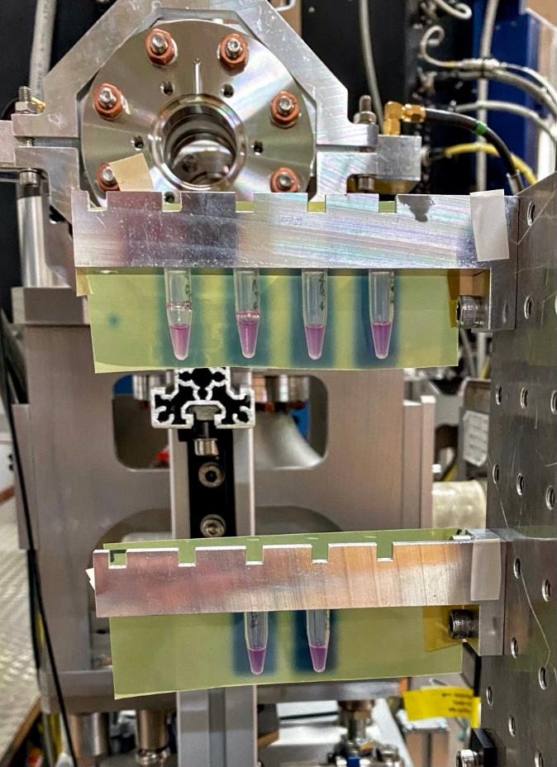
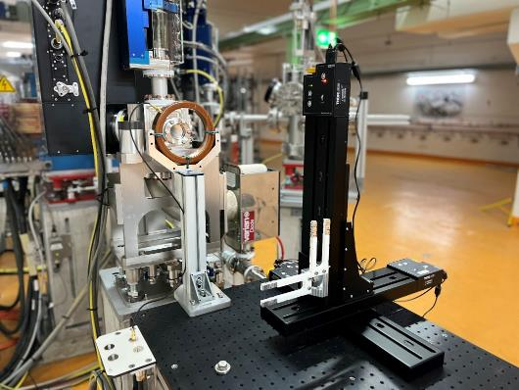
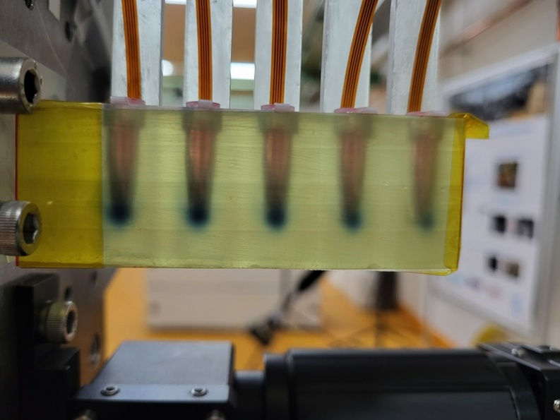
Research and Development at ARES
ARES, a worldwide unique facility for medical research
Up to 160 MeV high precision electron beams for research & development.
  Cutting-edge stability of the electron pulse energy
  Excellent beam control and highest flexibility in beam parameters
  In-vivo experiments possible
Ideally suited for VHEE & FLASH RT studies, dosimetry and medical imaging.
Collaborations started with UKE, Uni Manchester and Uni Wollongong
Experimental station designed for medical research
Online dosimetry and cell irradiation
First living cancer cells treated with VHEE.

Slide 9
Challenges

Slide 10
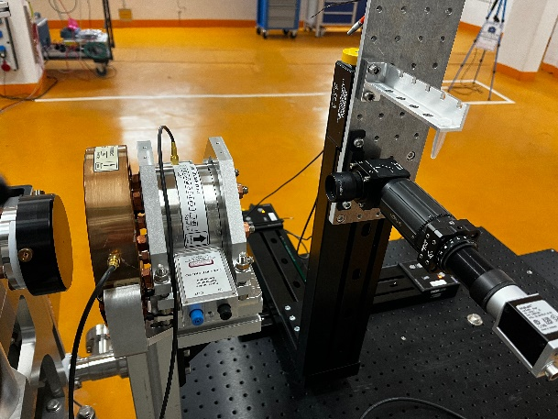
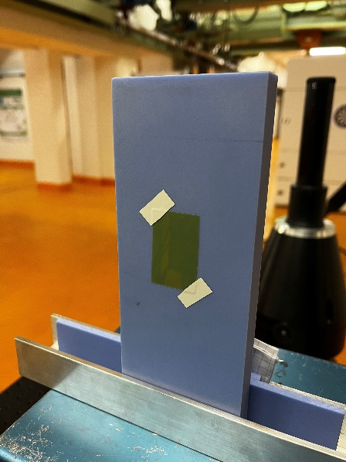

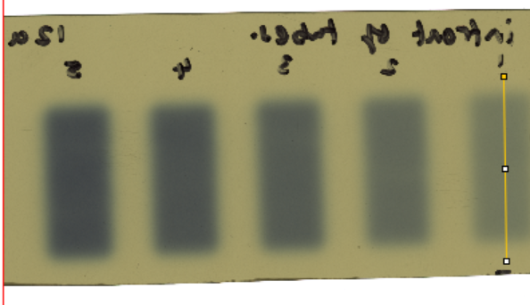
Completely new field for us
Medical side ~ translator ~ accelerator side
How to translate electrons to dose?
But:
What is the „right“ dose?
  Integrated dose
  Dose rate
  Dose rate/pulse
  How do we measure dose (fast!)

Slide 11
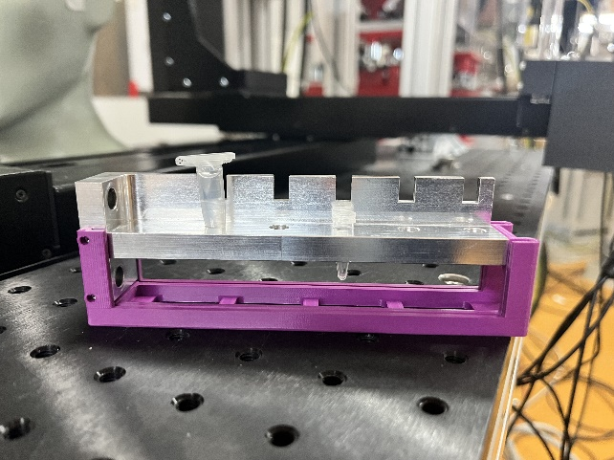

How to hit the cells?
Part 1
Eppendorf tubes are not Eppendorf tubes.
Different holder systems from DESY and UKE
Combination with online dosimetry.
Preparation in the lab and transport to ARES is not an issue.
Bringing the cells in the tunnel is also not a problem (special access mode to keep most of the accelerator parameters).

Slide 12
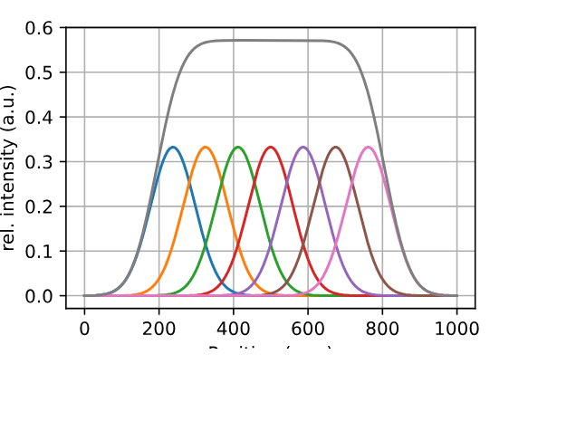
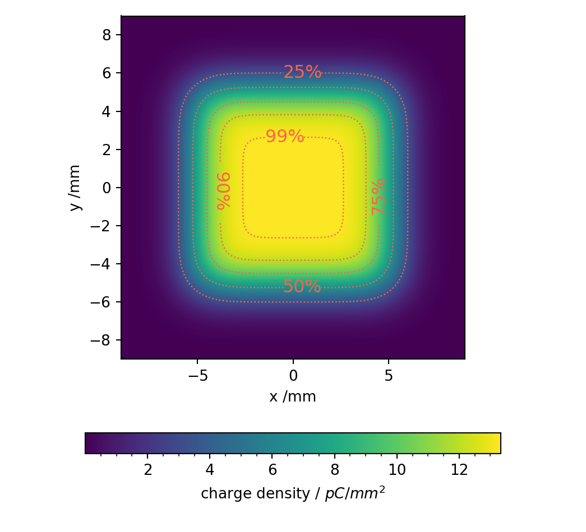
How to hit the cells?
Part 2
ARES is limited in the amount of charge we can produce / transport.
Small spot size, where we can achieve FLASH like beam parameters.
Cells need to be prepared very carefully.
We have to rely on dosimetry!
Still the issue remains: are we sure that we hit the cells with the right dose?
Different irradiation patterns: Spot (FLASH like parameter) vs. Snake pattern (uniform distribution) irradiation

Slide 13



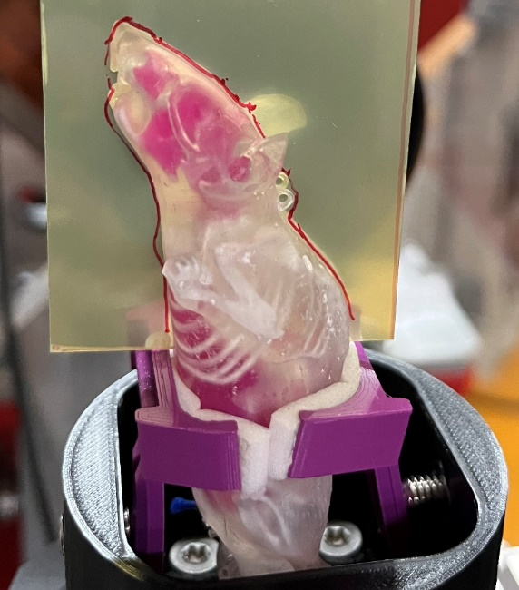
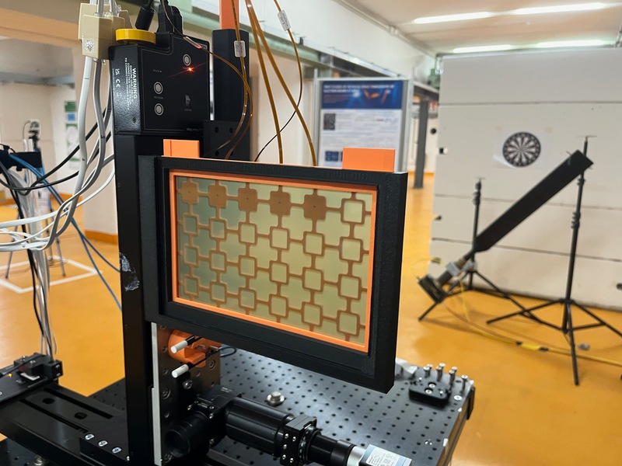
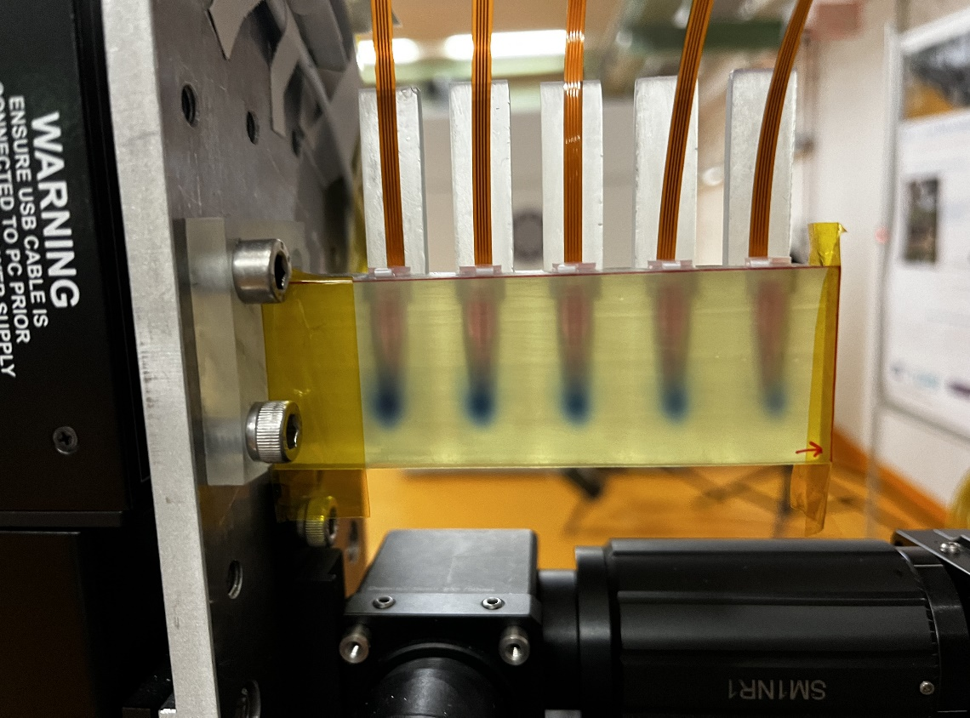
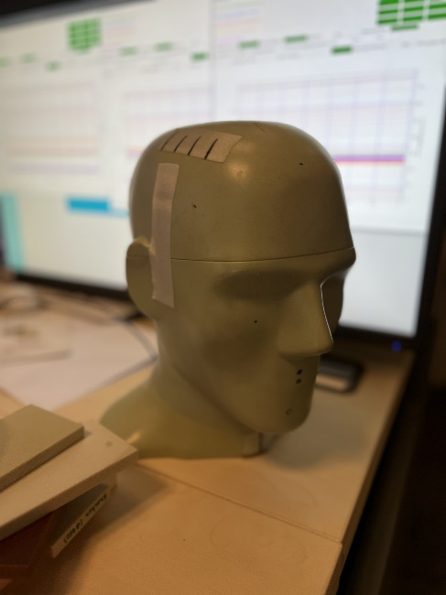
Studies with all types of samples
Studies for tumor treatment with high energetic electrons and FLASH parameters in collaboration with UKE and Uni Wollongong.
Mosfet detectors from Uni Wollongong as online dosimetry.
Animal and skull phantoms and living tumor cells.
Dosimetry development for medical applications with D3

Slide 14
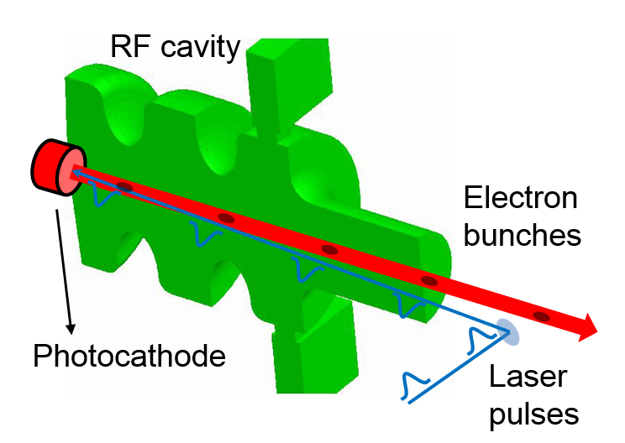

The solution for (almost) everything
ARES upgrade for more charge
Our RF structure
1.5 mu sec
10 – 50 Hz rep. rate
We want to place more bunches on our RF flat top

Slide 15
The solution for (almost) everything
ARES upgrade for more charge
Our RF structure
1.5 mu sec
10 – 50 Hz rep. rate
We want to place more bunches on our RF flat top.
Looking for funding possibilities.

Slide 16
Summary / Discussion
Fruitful collaboration with DESY and UKE.
  Many beam times
  Joel Master thesis
  Bringing together also radio protection and detector developers
  Successful project for novel online dosimetry.
Getting the dose right is a challenge.
Very tight budgets on DESY side → limits in availability in 2024/2025.
Looking for funding possibilities.
Looking for inspiring discussions also here at the workshop.

