Slide 1

S2E Simulation of THz FEL at PITZ with Bunch Compressor
13th MT ARD ST3 Meeting 2025 bei DESY in Zeuthen
Biaobin Li for THz group @ PITZ
ST3 meeting, 25.06.2025 to 27.06.2025

Slide 2
Content
Ming-Xie Parameterization for THz SASE FEL
Bunch compression for gaussian beam
Genesis simulation results
Summary

Slide 3
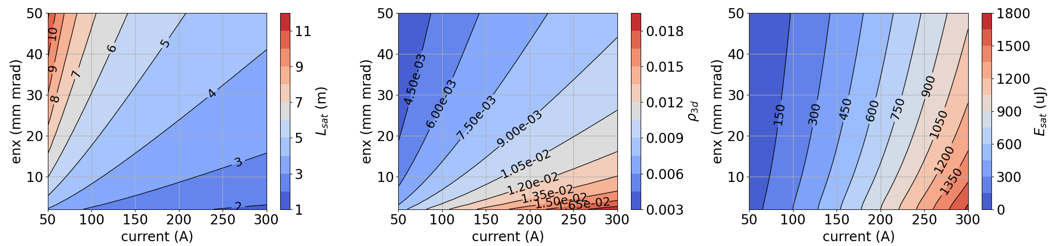
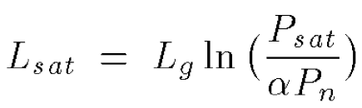
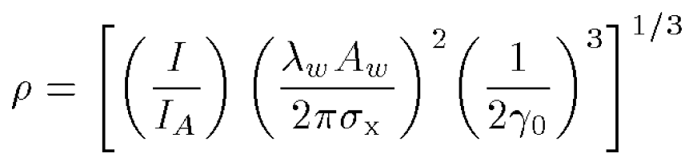
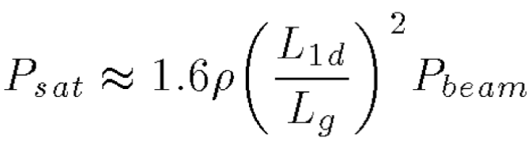
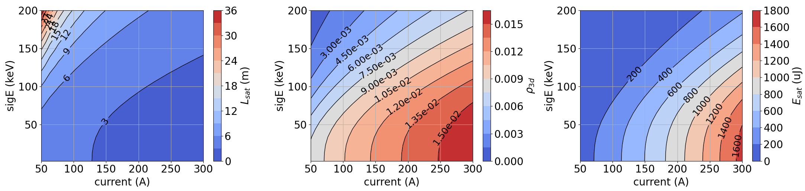
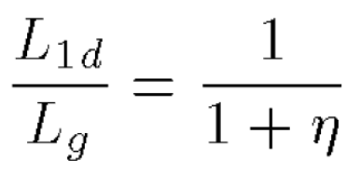
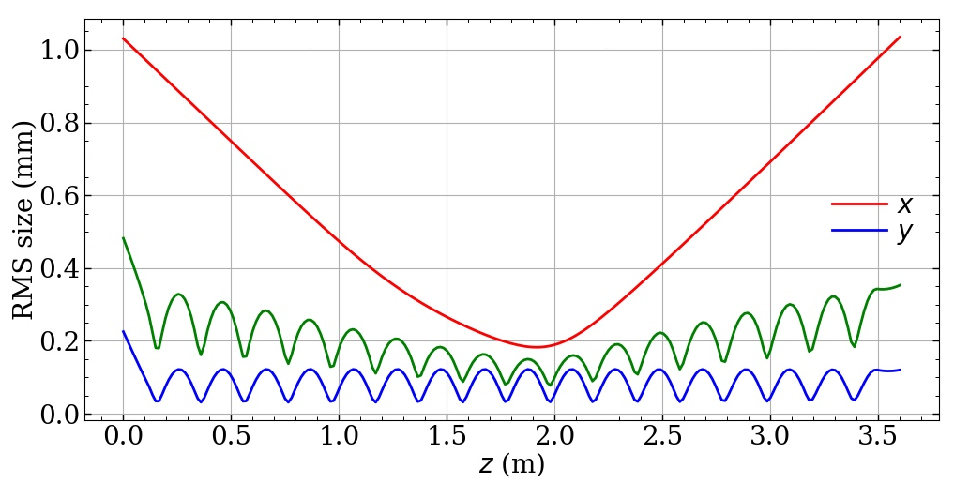
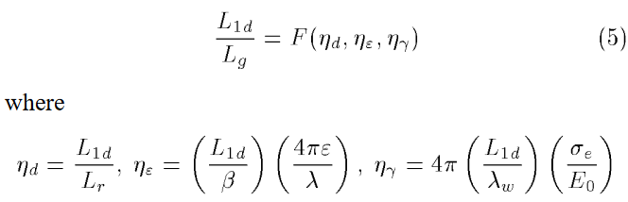
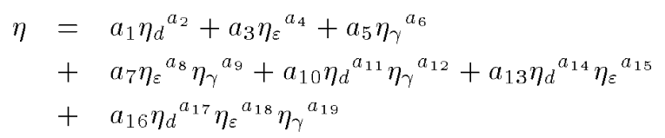



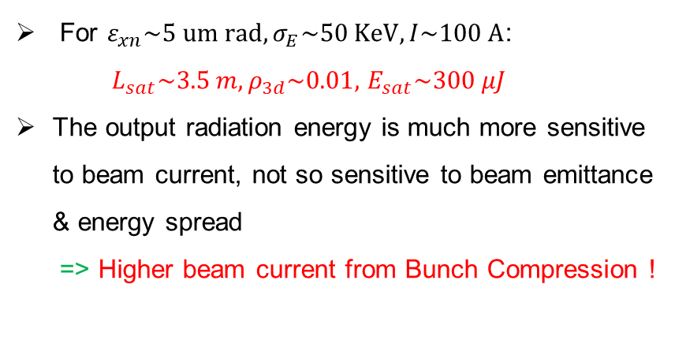

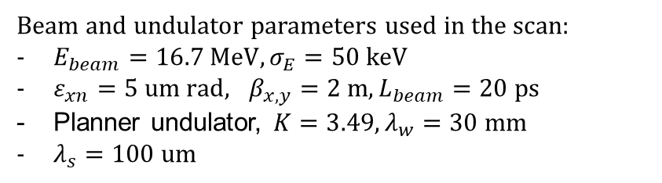


Ming-Xie Parameterization for THz SASE FEL
Electron beam for THz SASE FEL
Saturation length, pierce parameter and saturation power for SASE FEL can be given by Ming-Xie’s 1D equations:
$$L_{sat}$$
$$ρ_{3d}=ρ/\left(1+η\right)$$
$$E_{sat}$$
$$L_{sat}$$
$$ρ_{3d}=ρ/\left(1+η\right)$$
$$E_{sat}$$
Results from scanning beam current, emittance and energy spread show that
For $ε_{xn}\sim 5 um rad, σ_{E}\sim 50 KeV, I\sim 100 A$:
$L_{sat}\sim 3.5 m, ρ_{3d}\sim 0.01,$ $E_{sat}\sim 300 μJ$
The output radiation energy is much more sensitive to beam current, not so sensitive to beam emittance & energy spread
=> Higher beam current from Bunch Compression !
Beam and undulator parameters used in the scan:
$E_{beam}=16.7 MeV, σ_{E}=50 keV$
$ε_{xn}=5 um rad, β_{x,y}=2 m, L_{beam}=20 ps$
Planner undulator, $K=3.49, λ_{w}=30 mm$
$λ_{s}=100 um$
Xie, Ming, Proceedings Particle Accelerator Conference. Vol. 1. IEEE, 1995.
Beam size evo. Inside undulator

Slide 4
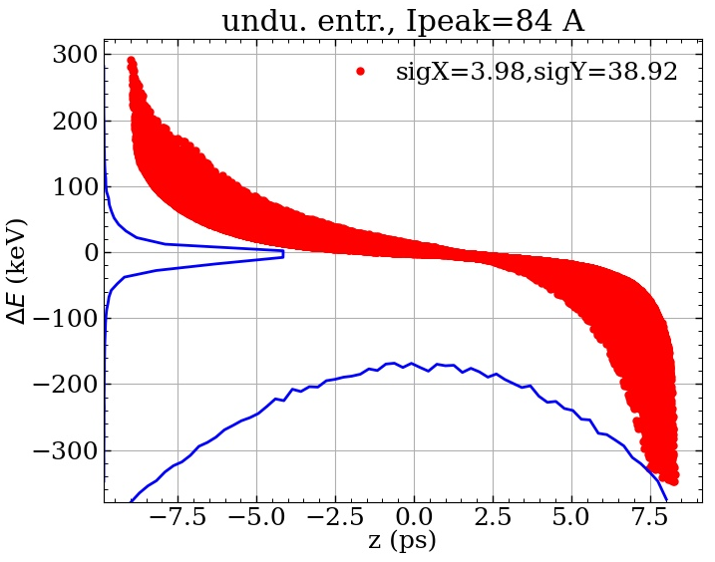
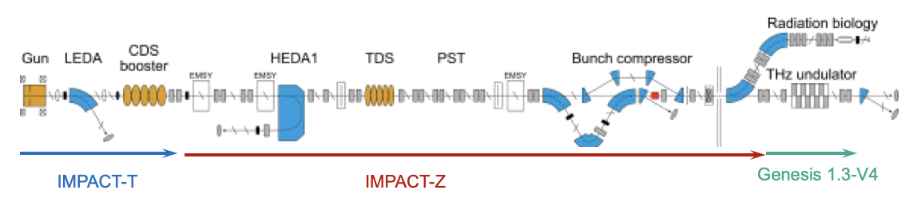
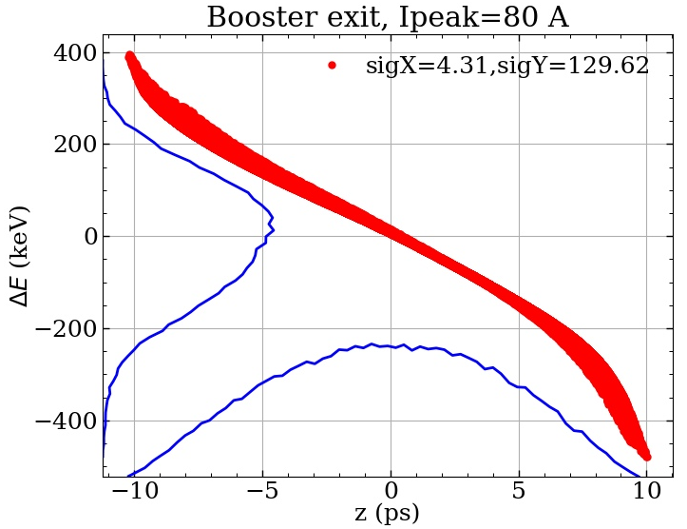
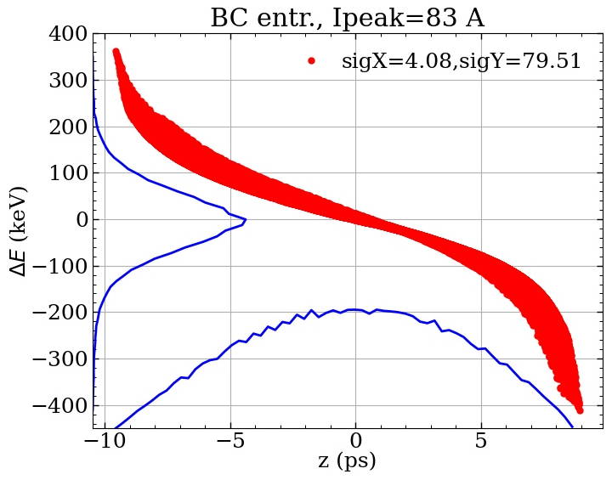
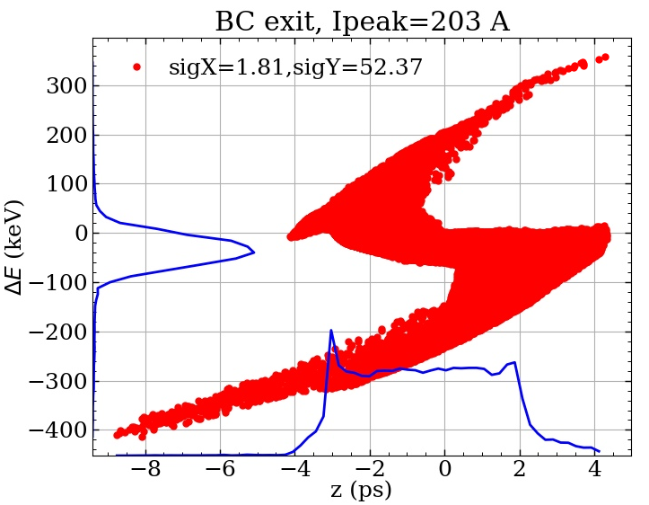
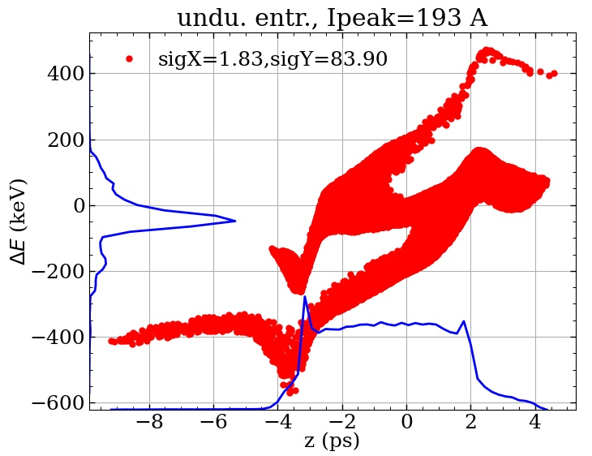
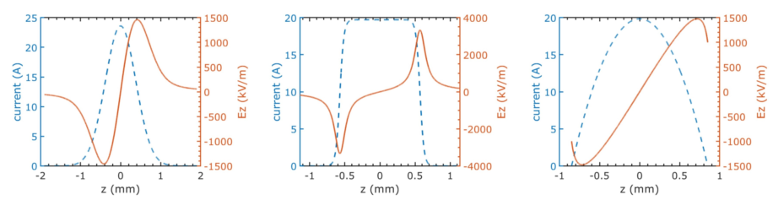
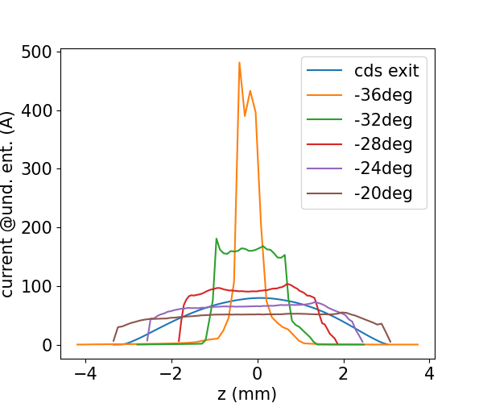

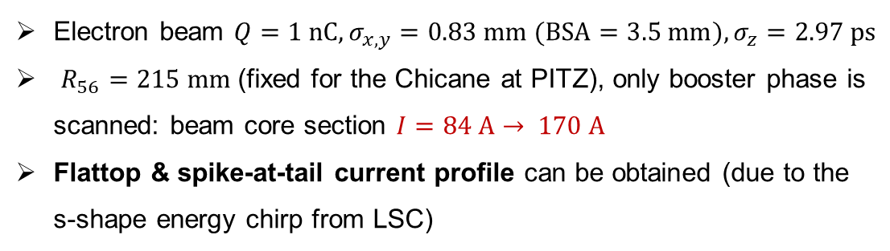
Bunch compression for gaussian beam
BC OFF
Longitudinal beam dynamics
84 A
BC ON
$$φ_{booster}=−32 deg$$
170 A
Electron beam $Q=1 nC, σ_{x,y}=0.83 mm (BSA=3.5 mm), σ_{z}=2.97 ps$
$R_{56}=215 mm$(fixed for the Chicane at PITZ), only booster phase is scanned: beam core section $I=84 A→ 170 A$
Flattop & spike-at-tail current profile can be obtained (due to the s-shape energy chirp from LSC)
LSC for different current profile
gauss, s-shape
flattop, z-shape
parabolic, s-shape
McNeil et al., Optics communications
165.1-3 (1999): 65-70.
Coherent radiation from the sharp edge & spike of the current profile => SACSE FEL !

Slide 5
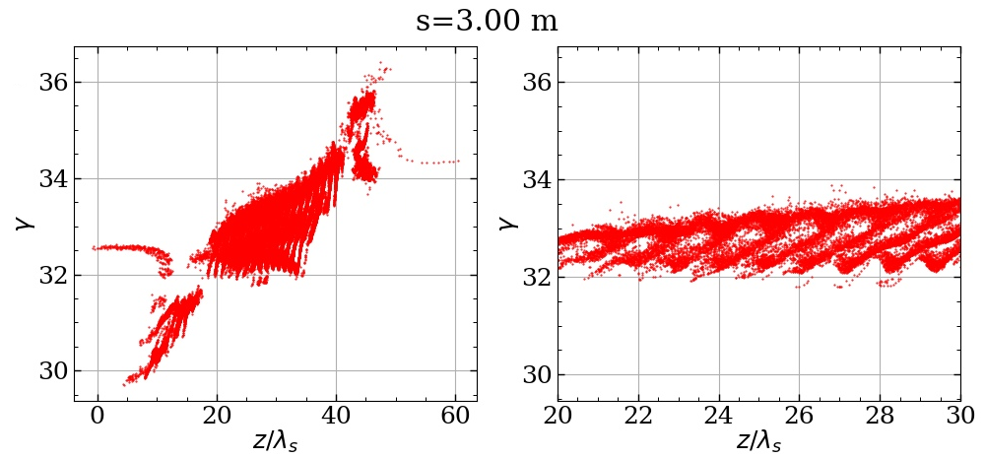
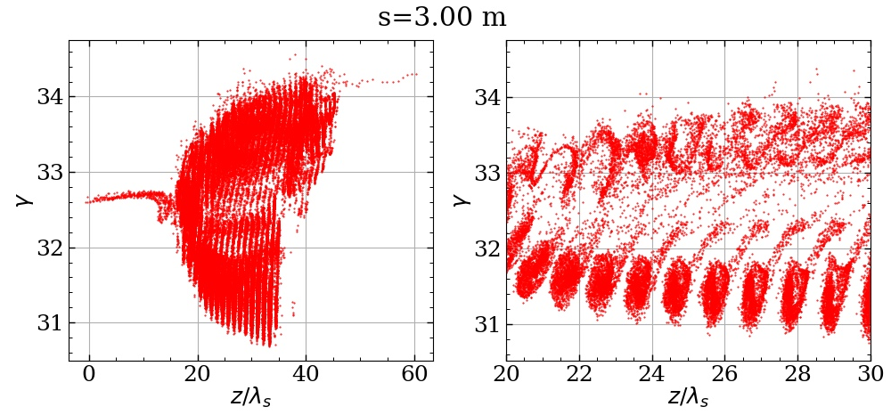
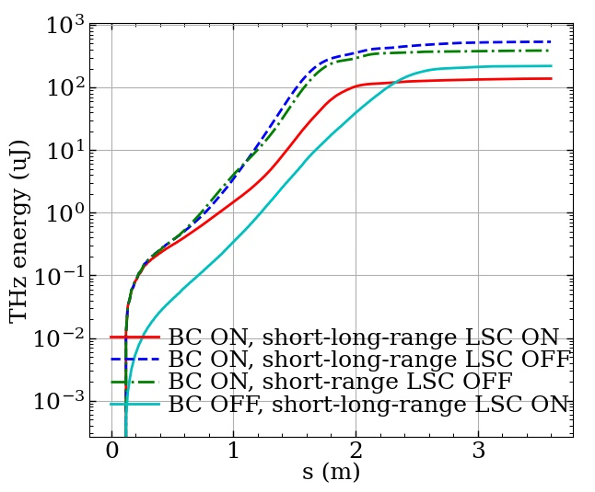
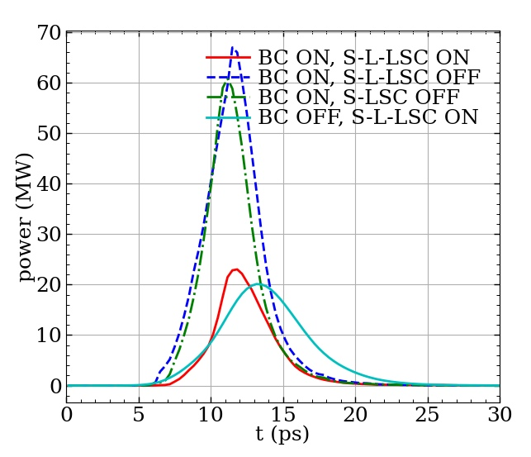
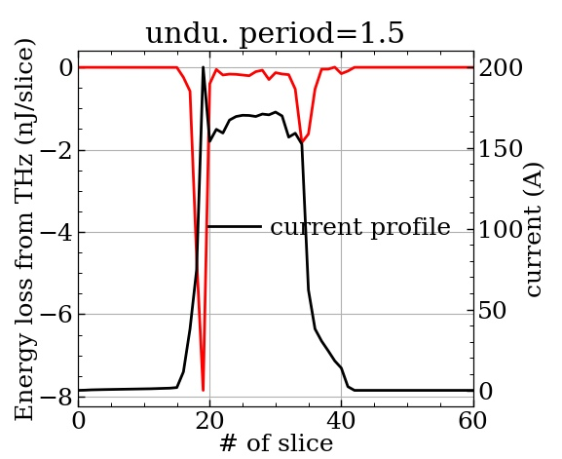
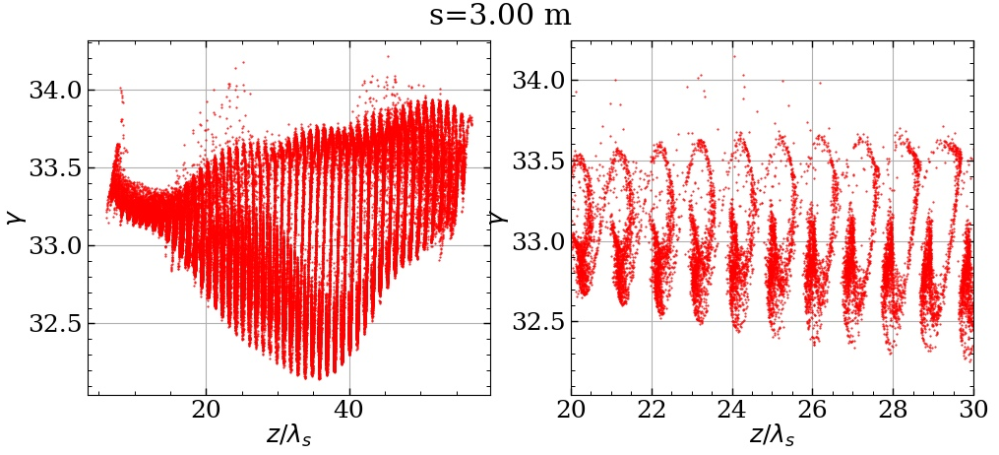
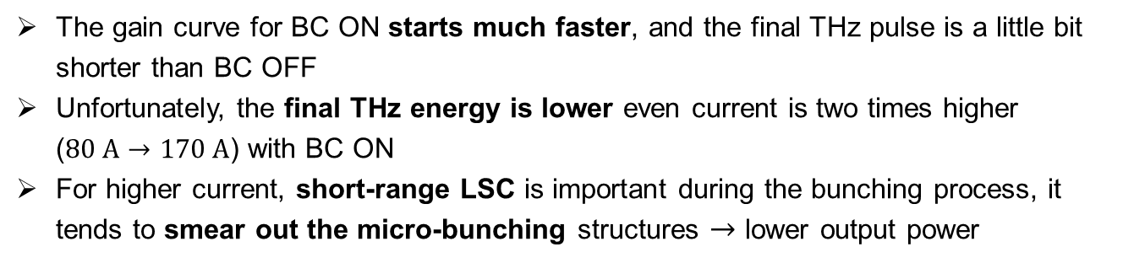
Genesis simulation results for gaussian beam
microbunching smeared
Short-range LSC effects in high-gain region
The gain curve for BC ON starts much faster, and the final THz pulse is a little bit shorter than BC OFF
Unfortunately, the final THz energy is lower even current is two times higher ($80 A→170 A$) with BC ON
For higher current, short-range LSC is important during the bunching process, it tends to smear out the micro-bunching structures $→$ lower output power
BC ON, S-L-LSC ON
BC ON, S-LSC OFF
BC OFF, S-L-LSC ON
short-range LSC effects in high-gain section
higher peak power with S-LSC OFF
Strong seeding from the bunch tail
The bunch compressor seems limited improvement to THz FEL here
For higher current, we need higher beam energy, or larger beam size inside the undulator to mitigate the S-LSC smearing effects!

Slide 6
Summary
For THz SASE FEL, the beam is much more sensitive to beam current, not so sensitive to beam emittance & energy spread => bunch compression for higher current
Flattop & spike-at-tail current profile can be obtained using BC for gaussian beam, strong seeding from the coherent radiation of the beam tail is observed in the Genesis simulation
For higher current, short-range LSC is important during the bunching process, it tends to smear out the micro-bunching structures => lower THz radiation energy
THANK YOU FOR YOUR ATTENTION !

Slide 7
Backup slides

Slide 8
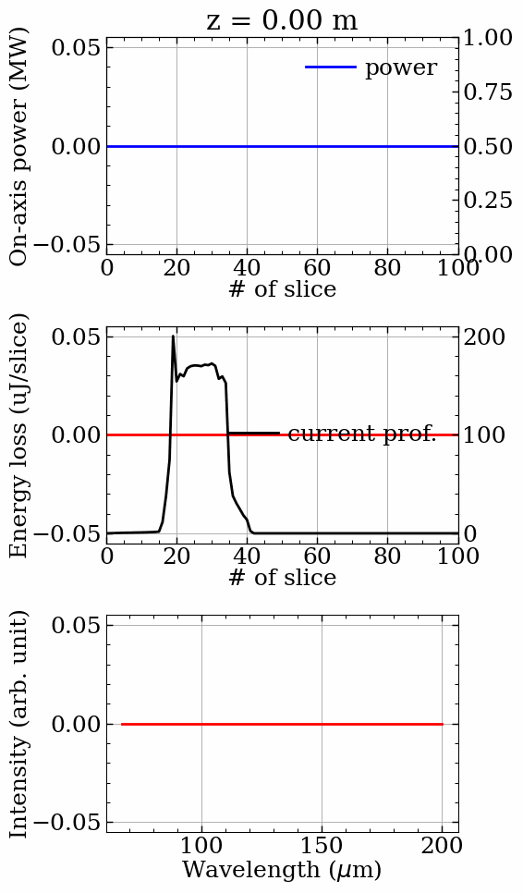
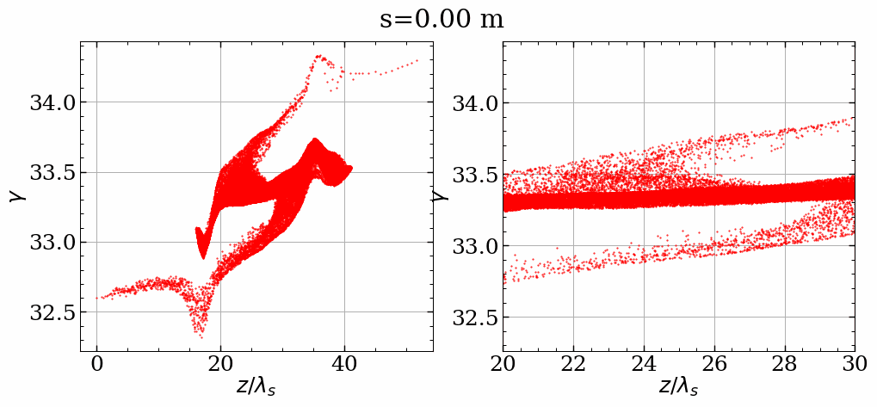
Genesis simulation results for gaussian beam
Short-range LSC effects in high-gain region
S-L-LSC ON
Energy loss of e-beam from THz radiation
Long. phase space evolution along the undulator

Slide 9
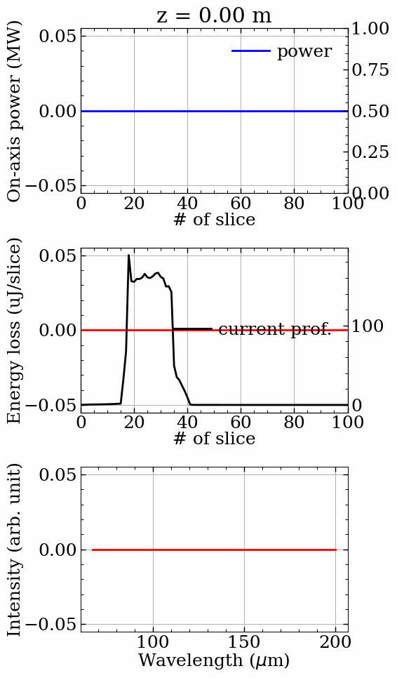
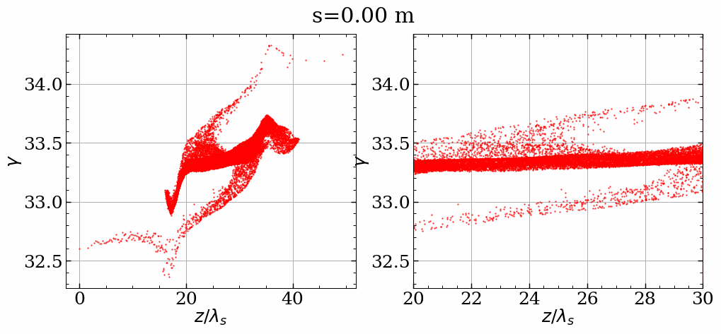
Genesis simulation results for gaussian beam
Short-range LSC effects in high-gain region
S-LSC OFF
Energy loss of e-beam from THz radiation
Long. phase space evolution along the undulator

Slide 10
Genesis simulation results for gaussian beam
Short-range LSC effects in high-gain region
S-L-LSC OFF
Energy loss of e-beam from THz radiation
Long. phase space evolution along the undulator

Slide 11
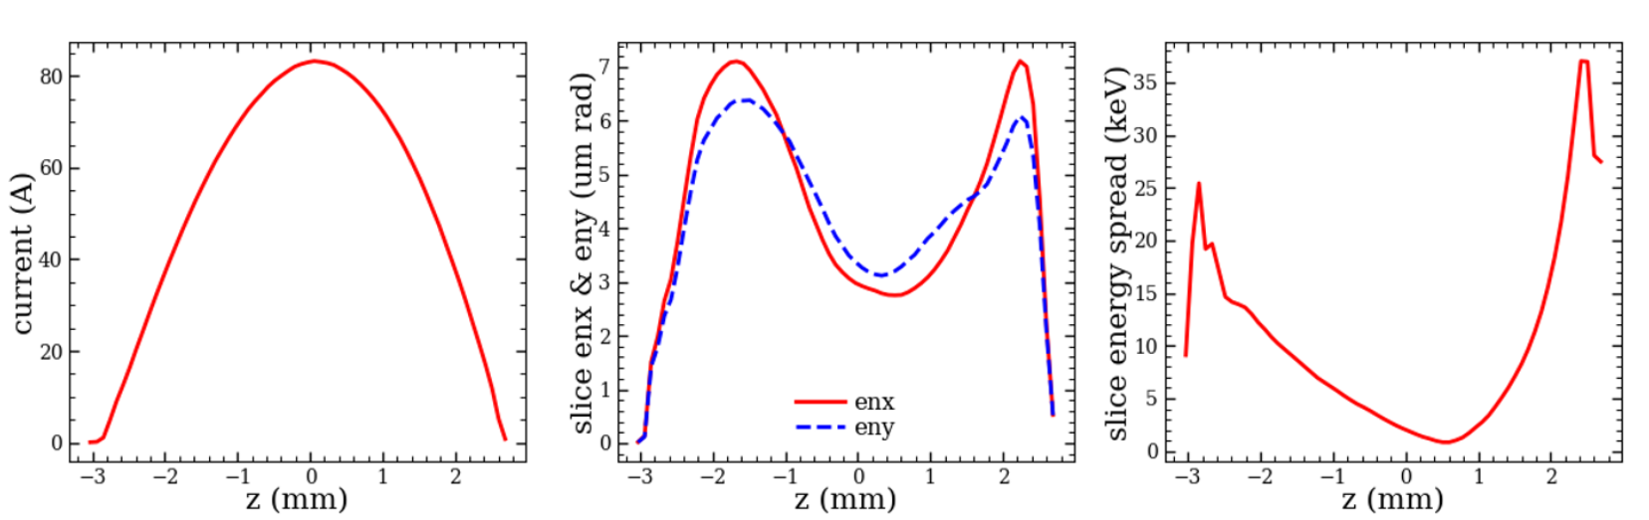
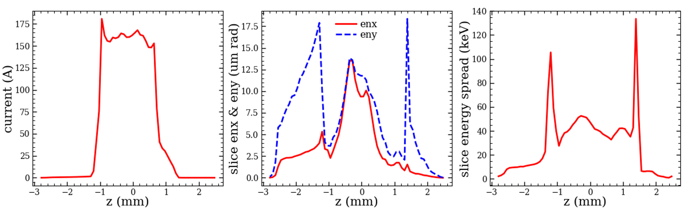
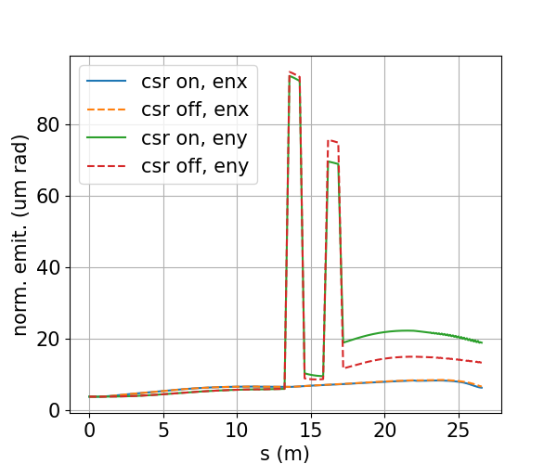
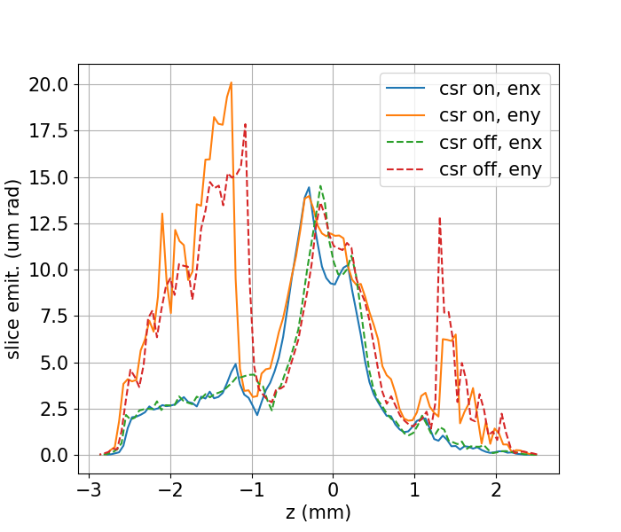
Bunch compression for gaussian beam
CSR effects in BC
Good enough for THz SASE FEL
The beam current is increased from $80 A→170 A$
The slice emittance & energy spread is getting worse after BC: $ε_{x,yn}=3 mm mrad→12 mm mrad, σ_{E}=2 keV→40 keV$
BC entr.
BC exit
CSR caused ~50% projected emittance growth in Y-plane: $ε_{xn}=8 mm mrad, ε_{yn}=22 mm mrad$
The slice emittance growth is not caused by CSR => mainly due to space charge (SC)
BC exit
CSR is strong inside the bunch compressor, however, beam quality is still good enough for THz SASE FEL.
eny, ~50% increase

Slide 12
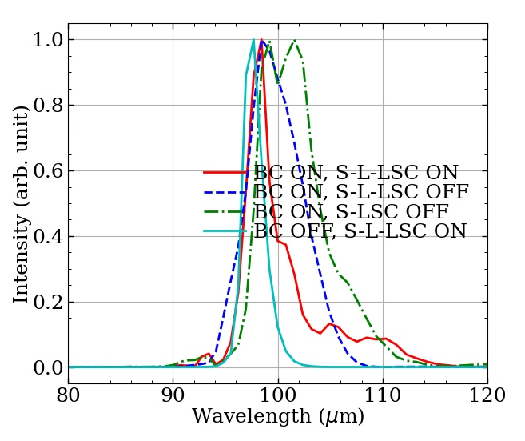
Genesis simulation results for gaussian beam
microbunching smeared
Short-range LSC effects in high-gain region
The gain curve for BC ON starts much faster, and the final THz pulse is a little bit shorter than BC OFF
Unfortunately, the final THz energy is lower even current is two times higher ($80 A→170 A$) with BC ON
For higher current, short-range LSC is important during the bunching process, it tends to smear out the micro-bunching structures $→$ lower output power
BC ON, S-L-LSC ON
BC ON, S-LSC OFF
BC OFF, S-L-LSC ON
short-range LSC effects in high-gain section
higher peak power with S-LSC OFF
broader spectrum when S-LSC OFF
The bunch compressor seems limited improvement to THz FEL here
For higher current, we need higher beam energy, or larger beam size inside the undulator to mitigate the S-LSC smearing effects!

