Slide 1
Beam dynamics Optimization for a High-brightness Photoinjector with various Photocathode Laser Pulse Shapes
S. Zeeshan, M. Krasilnikov, X.-K. Li, D. Bazyl and I. Zagorodnov
Speed Talk- 13th MT ARD ST3 Meeting 2025 Zeuthen
27.06.2025

Slide 2


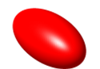

Beam Dynamics Optimization
EuXFEL CW SRF setup
Using Multi-objective Genetic Algorithm (MOGA) based beam dynamic optimization with projected emittance and electron rms bunch length as goal functions
A comparison of the performance of different photocathode laser profiles;
  Longitudinal Gaussian (G) with transverse Radial Uniform (RU)
  Longitudinal Flattop (FT) with transverse Truncated Gaussian (TG)
  3D ELlipsoidal (3D EL)
  Longitudinal Inverted Parabolic (IP) with transverse TG profiles
Initial optimization for injector section @ 20m
Best cases→ Prepared Monitors→ further tracked through S2E simulations
Parameters | Values
E_{cathode} | 55 MV/m
A1: E_{peak}(1st ½) | 32 MV/m
A1: E_{peak}(2nd ½) | 32 MV/m
Bunch Charge | 100 pC
Thermal emit | 1um/mm
Optimization at | 20 m

Slide 3
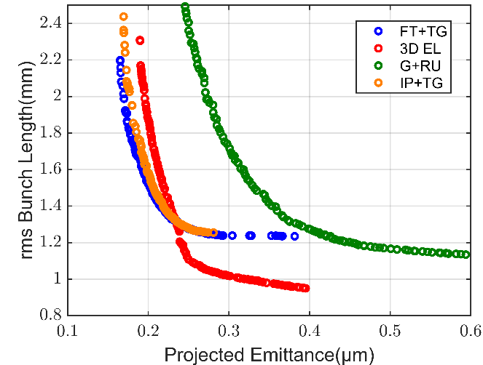
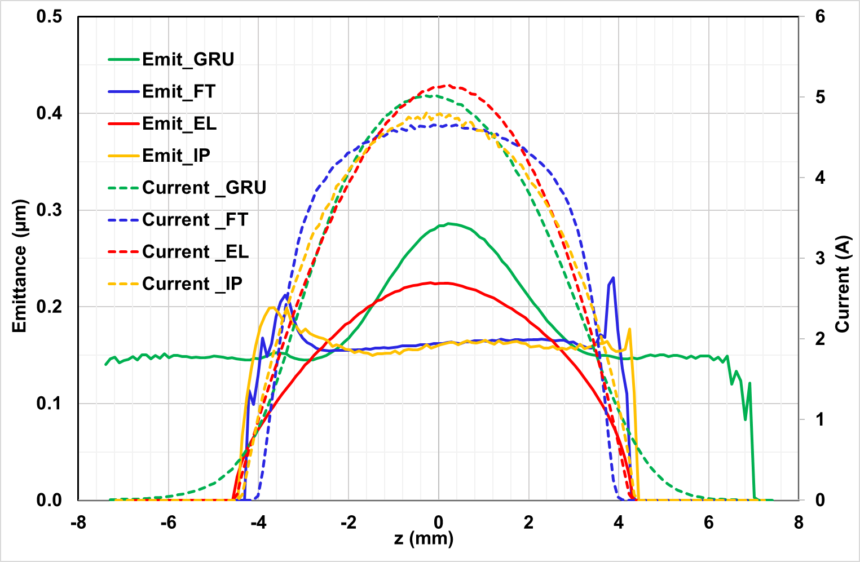
Optimization for Injector Section
Comparison of four Photoinjector Laser shapes
Best cases for 2mm rms electron bunch length are compared
This 2mm BL → corresponds to 5 kA peak current and it is sufficient to compress the beam at XFEL
Best Cases for 2mm rms electron bunch length
Parameters | G+RU | FT+TG | EL | IP+TG
Proj emit (mm mrad) | 0.26 | 0.17 | 0.19 | 0.18
Long emit (keV mm) | 610 | 395 | 506 | 471
Energy spread (MeV) | 0.56 | 0.36 | 0.27 | 0.76
Average 4D Bright (A/µm²) | 1231 | 1708 | 1983 | 2020
Slice emittance and slice current Optimized cases

Slide 4
Start to End Simulations
Highest brightness at the end of injector for the IP+TG → further tracking for final evaluation as compared to other photocathode laser shapes
S2E simulations to see the behaviour under compression under collective effects
Multistage bunch compression involves
  the mixing of longitudinal beam slices → local beam parameters as slice emittance & energy spread become critical
  The shape of the photocathode laser → distribution of the slice parameters within the bunch
The final estimation of 4D and 6D brightness at the end of S2E simulations reveal ?
Details on my poster

Slide 5
THANK YOU .
Sumaira Zeeshan
PITZ, DESY
sumaira.zeeshan@desy.de
Tel : +49 33762 77494

