Slide 1
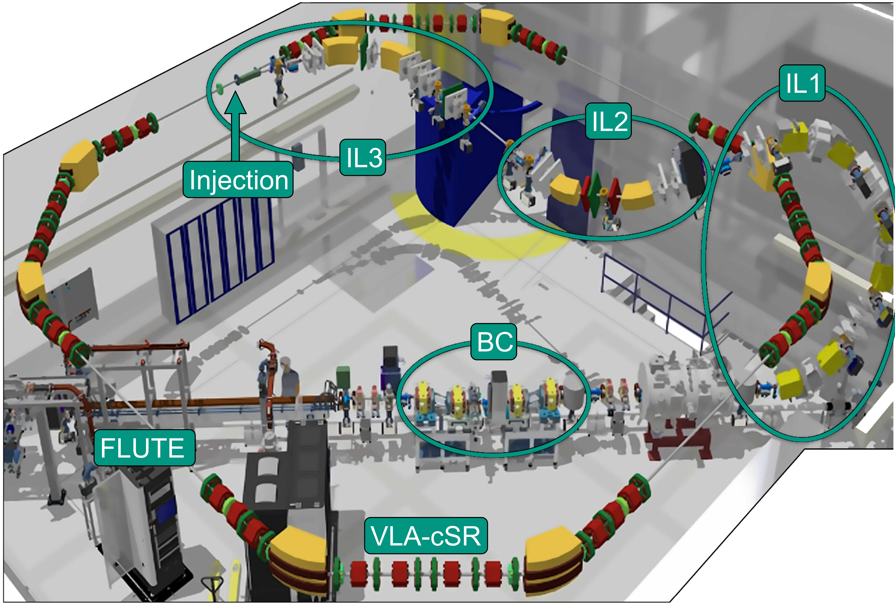

Simulation-based optimization of the injection of ultrashort non-Gaussian electron beams into a storage ring
Jens Schäfer,
M. Fuchs, B. Härer, R. Ruprecht, M. Schwarz, M. Schuh, C. Xu

Slide 2
Content
Motivation cSTART and Injection Line (IL)
Challenges and solving strategies
Longitudinal compression
Transverse Matching
Jens Schäfer (et al.) KIT – IBPT

Slide 3
cSTART motivation
cSTART:
  LPA‘s
  FLUTE
  Injection Line (IL)
  Storage ring (VLA-cSR)
  compact STorage ring for Accelerator Research and Technology
  Injection and storing of ultrashort LPA beams
  Opportunity to study non-equilibrium beam physics
  FLUTE as 2nd injector for comparison
  Development since initial IL design
  Conceptual initial design laid the foundation of IL
  cSTART advanced towards Final Design Report stage
  Advanced IL simulations required:
      Addressing technical constrains (space claims)
      Solutions for different beam parameter and optics
      Speed up simulation time from months to days

Slide 4
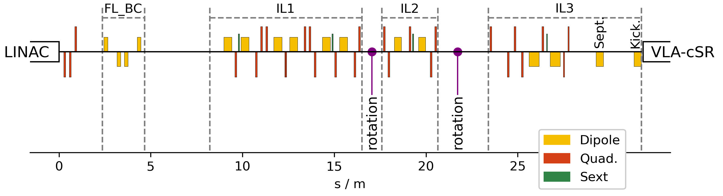
0verview
  FLUTE: bunch creation up to 90 MeV
  IL1: vertical arc around storage ring
  IL2: tilted DBA into the horizontal plane
  IL3: matching section and injection
  VLA-cSR: cSTART storage ring
# | Magnets
14 | Dipoles
32 | Quadrupoles
4 | Sextupoles
1 | Septum
1 | Kicker
          Injection Line Challenges
  Tight geometrical constrains
  Handling vertical, horizontal and tilted deflections
  Longitudinal bunch compression to femto-seconds!
  Transverse matching to storage ring
  Coping with non-linear effects and xy-coupling
  Adaptable for a parameter range (q, E, chirp …)

Slide 5
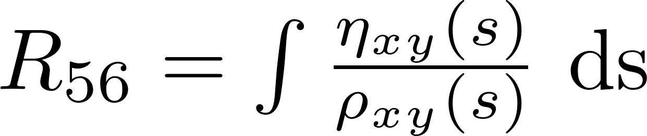
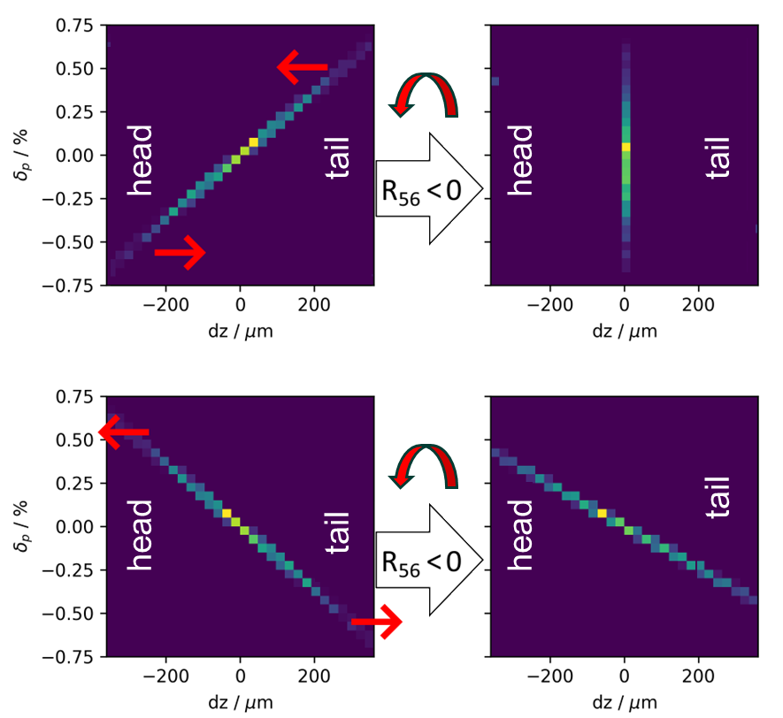
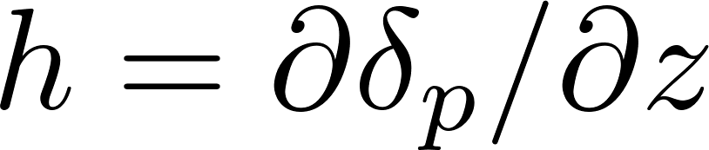

Bunch compressor
  FLUTE Bunch compressor (FL_BC)
  delayes low-energy electrons
  The BC “shears” the long. phase space
  counter-clockwise by R₅₆
  A bunch with a positive chirp h compresses
  Transporting ultrashort bunches leads to intense CSR bursts, energy loss and particle losses.
  A fs-bunch cannot be transported through the IL!
positive
chirp
h > 0

Slide 6
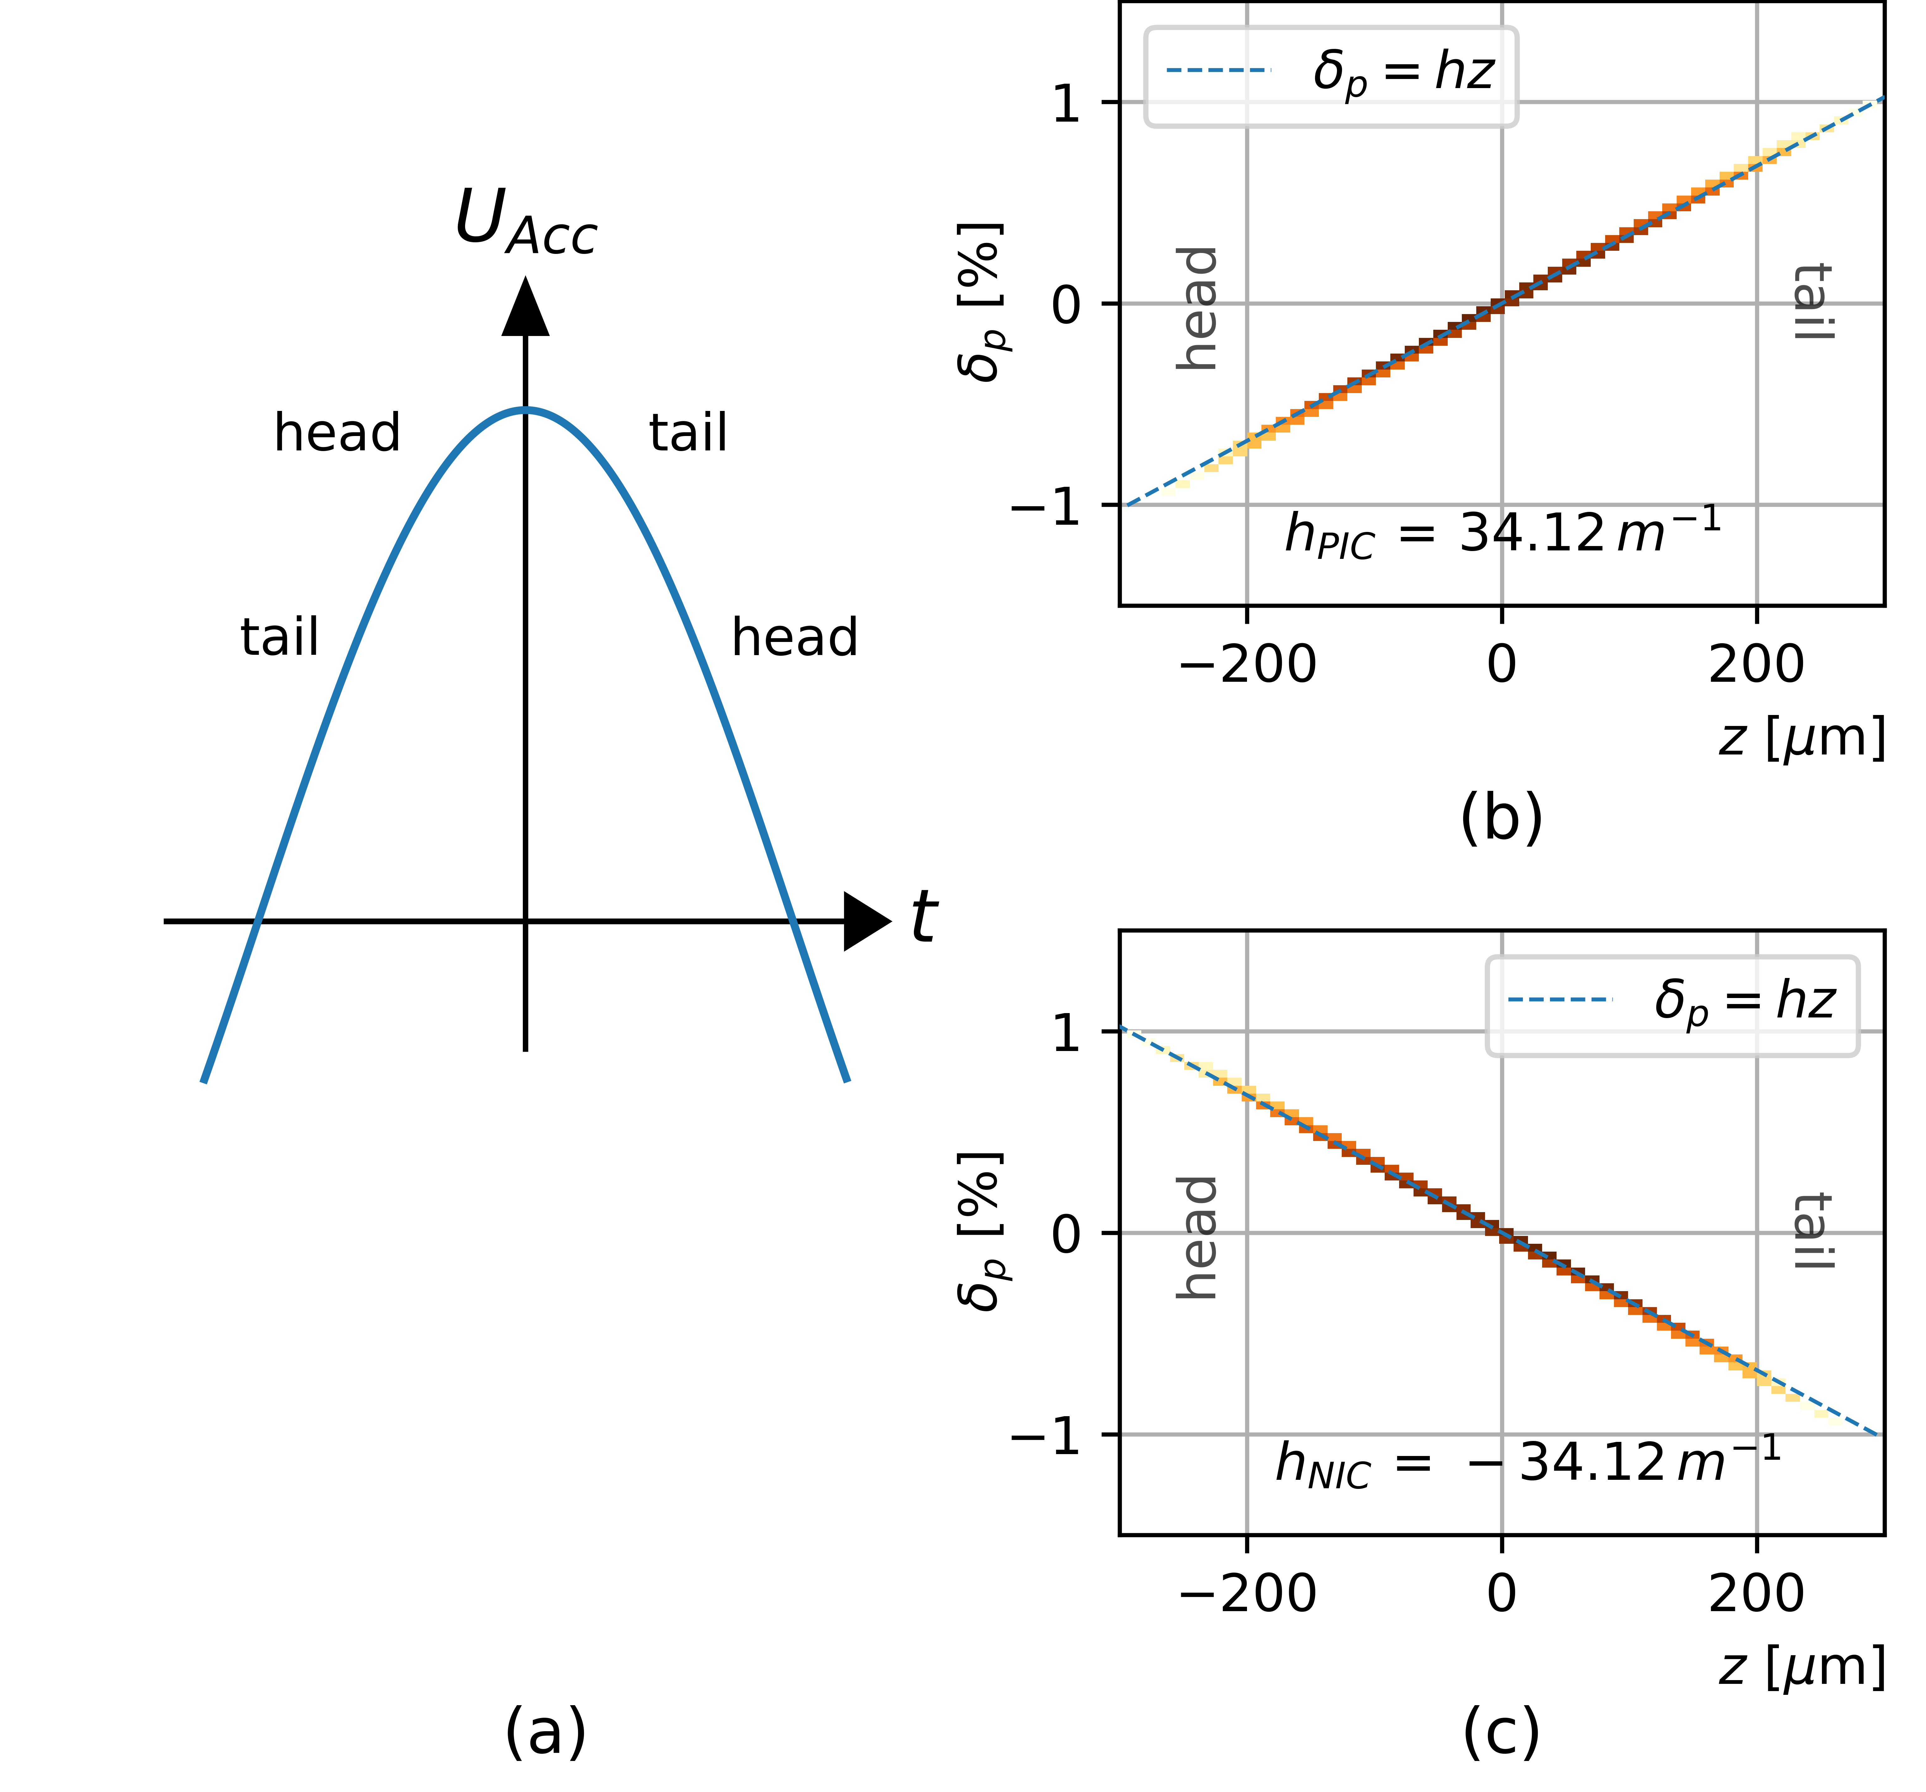
Initial chirp
  IL designed to compress the bunches
  just at the septum.
  FLUTE linac operation on
  “opposite flank” for a negative chirped bunch.
          IL phase space operation
  Starting with a negative chirp
  Bunch elongates first in BC & IL1 (R₅₆<0)
  and compresses in IL2 & IL3 (R₅₆>0)
      → No ultrashort bunches during transport.
positive
chirp
h > 0
Negative
chirp
h < 0
h < 0
h > 0

Slide 7
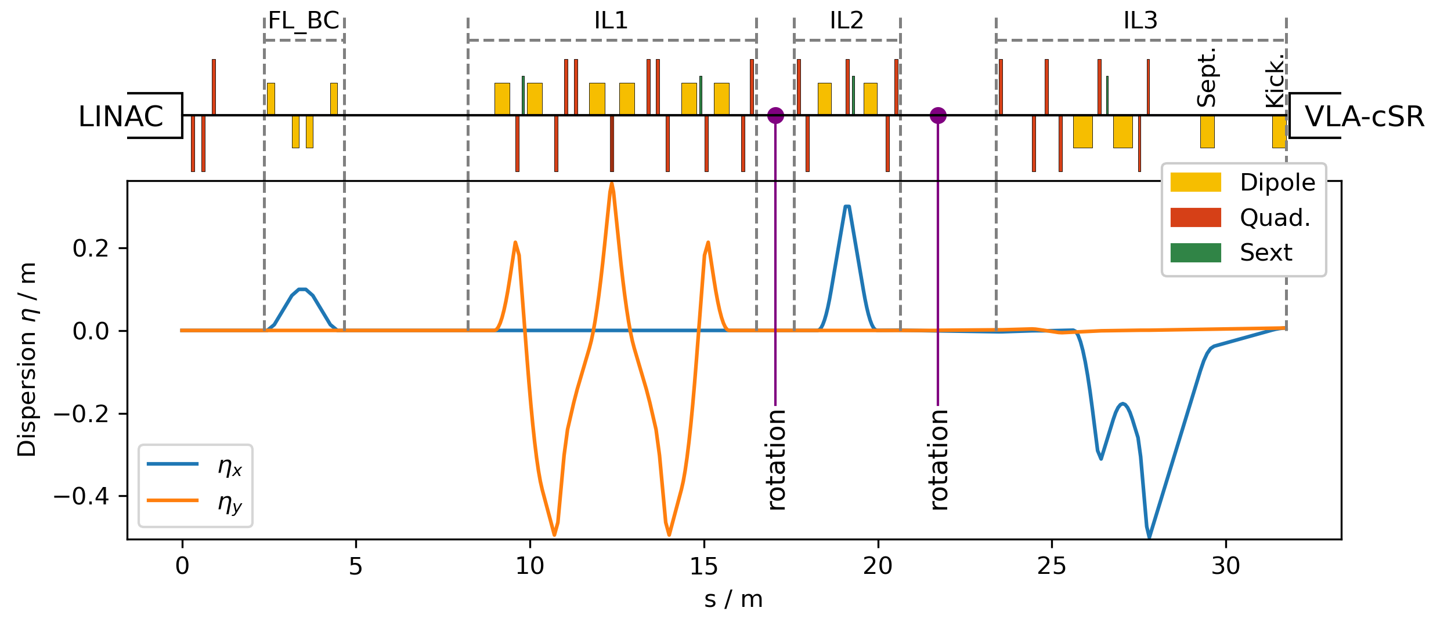
Strategy towards an optics solution
  Compose the TL out of achromatic sections: η=0 before/after section
  Only Quads at η≠0 influence long. Dynamics
  All Quads influence transverse dynamics
  Optics discussion:
  1. solve long. compression in
  η≠0 sections
  2. solve transverse matching in
  η=0 sections

Slide 8
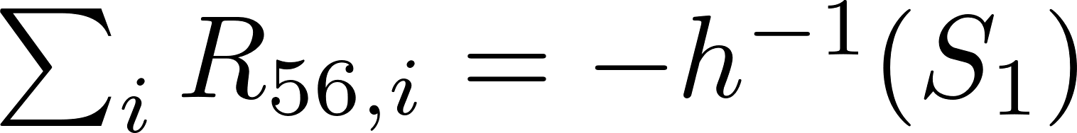
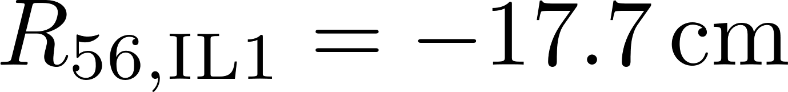
Full compression condition
  Bunch chirp transforms by R₅₆
  Initial chirp: h⁻¹(S₁) = -2.8 cm⁻¹
  Full compression: h⁻¹(S₂) = 0 cm⁻¹
  Full compression condition (FCC):
  The sum of all R₅₆ values have to counteract the initial chirp
  BC, IL2 & IL3 have limited margin in R₅₆
  IL1 designed for flexible R₅₆ value
Section | Structure | R56 / cm
BC | BC | -2.5
IL1 | HBA | [-420; +130]
IL2 | DBA | +3.4
IL3 | DBA | +20.1
ToF |  | -0.4

Slide 9
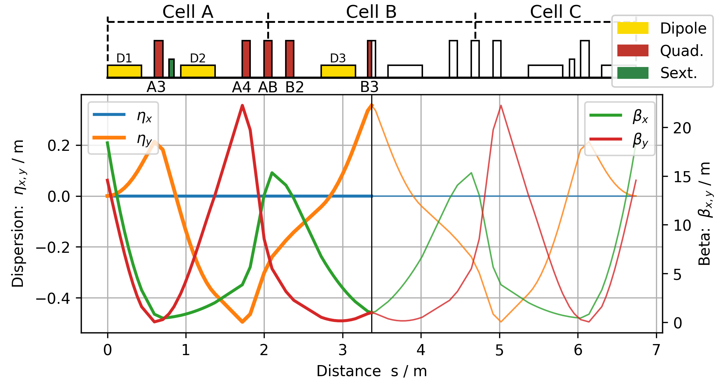
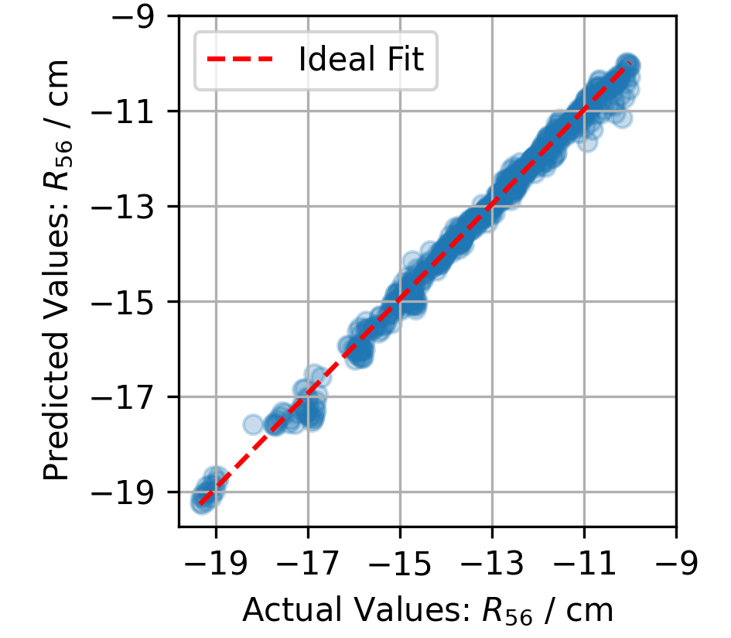
IL1 optics with NN
  Investigating the full parameter volume of possible optics
      IL1 optics serves 9 quadrupoles
      5 individual quadrupoles, considering mirror symmetry
      4 open DoF, considering achromaticity
  4 input parameter: K₁-values of quadrupoles: A3, A4, B2, B3
  For one set of inputs, several optic functions are calculated,
  e.g. R₅₆ and Twiss functions max values → 10 outputs
  Repeated for different input combinations
  → created ~ 16.000 different input/output pairs
  This data is used for training a NN* and constructing a surrogate model (SM).
  SM prediction has high accuracy:
  Pearson correlation coefficient > 0.99 for 6/10 outputs, e.g. R₅₆
  SM allows for an investigation of complete parameter volume with only 16.000 simulations, taking minutes instead of days!
*PyTorch: 6 layers, 32 neurons fully connected, feedforward, min-max-normalized,
rectified linear unit (ReLU) activation function, Adam optimizer, 9:1 training:evaluation

Slide 10
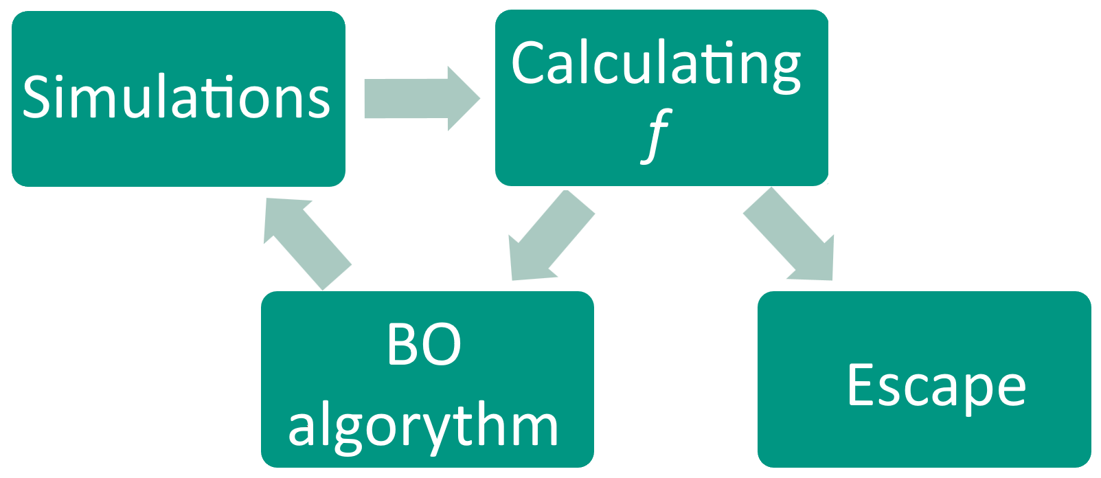
Transverse Optics
Transport Transport Matching
  Remaining quadrupoles utilized for
      Beam transport (FLUTE, IL1, IL2)
      Matching (IL2, IL3) with 6 quadrupoles
  6D tracking shows non-gaussian bunch shape at
  injection point due to IL2 rotation and higher order effects
      Matching optimization based on expensive 6D tracking,
      NN training not feasible
      Ideal for Bayesian Optimization (BO)
  BO implementation in python with xopt
  Fully customizable optimization function f
      Calculation of matching parameter : (𝛽_{x,y} , 𝛼_{x,y} , 𝜂_{x,y} )
      directly from 6D particle distribution
      trimming of long non-gaussian tails
          Work in progress…

Slide 11
Summary
No ultra-short bunches during transport
  Full compression condition (FCC)
NN & SM make IL1 optics for entire
parameter volume accesible
Allows fast investigation and finally
formulating for optimization criterions
BO implemented for Matching
Approach for coping with
non-linearities

Slide 12
Summary & Outlook
No ultra-short bunches during transport
  Full compression condition (FCC)
NN & SM make IL1 optics for entire
parameter volume accesible
Allows fast investigation and finally
formulating for optimization criterions
          Adding higher order dynamics to the SM
BO implemented for Matching
Approach for coping with
non-linearities
          Further ingeneering on optimization function f required

Slide 13
Backup Slides

Slide 14





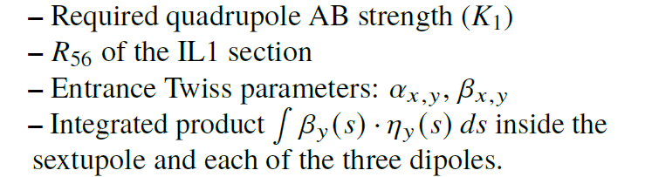
Backup: IL1 optics
  IL1 optics are calculated independent of surrounding IL.
  Considering Mirror symmetry, IL1 optics have 5 open DoF:
  K₁-strengh of quadrupoles: A3, A4, AB, B2 and B3.
  For a given set of K₁-values, the twiss parameter and
  dispersion are defined by:
  1 DoF (quadrupole AB) is set to met achromaticity:
  Remaining DoF are considered Input: A3, A4, B2, B3
  A set of output parameters is calculated:
  These instructions are used to create a dataset of ~16.400 input/output pairs.
  A data selection is applied:
  The remaining 6,400 input/output pairs are used to train a feedforward Neural Network*.
*PyTorch: 6 layers, 32 neurons fully connected, min-max-normalized,
rectified linear unit (ReLU) activation function, Adam optimizer

Slide 15


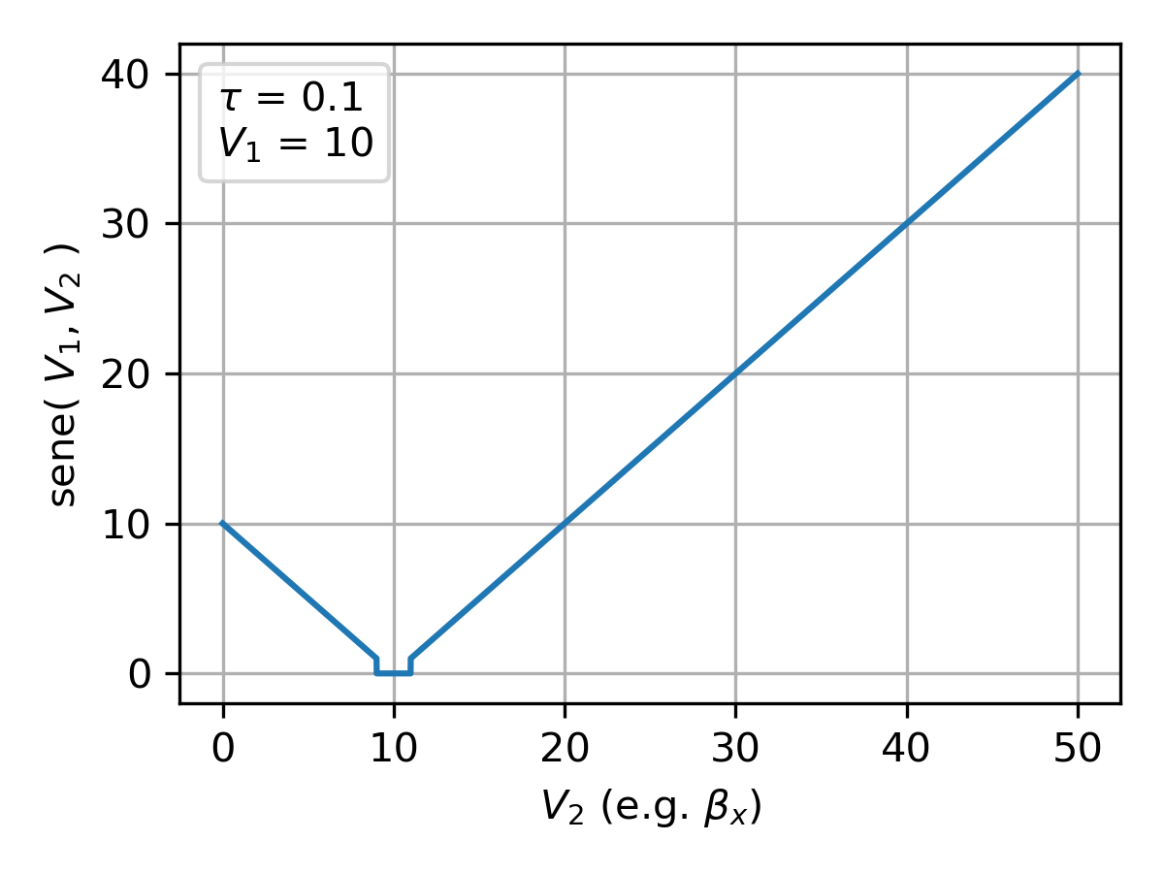
Backup: BO optimization function
  BO Implementation in python with xopt
  allows for a custom optimization function:
  minimization of
    L: beam losses in %
    m_{i}: Matching metric for each parameter V_{i}: (𝛽_{x,y} , 𝛼_{x,y} , 𝜂_{x,y} )
      m_{i} = sene(V_{1,} V₂ ) (soft-edge not equal), sensitivity function
      Distance between V₁ (desired value in VLA-cSR) and V₂ (injected)
      V₂ calculated directly from macro particle distribution
      Allows for advanced pre-processing, e.g. outlier handling

