Slide 1
Bunch shape and longitudinal measurements for non-relativistic beams at GSI LINAC
Nimue Schmidt

Slide 2
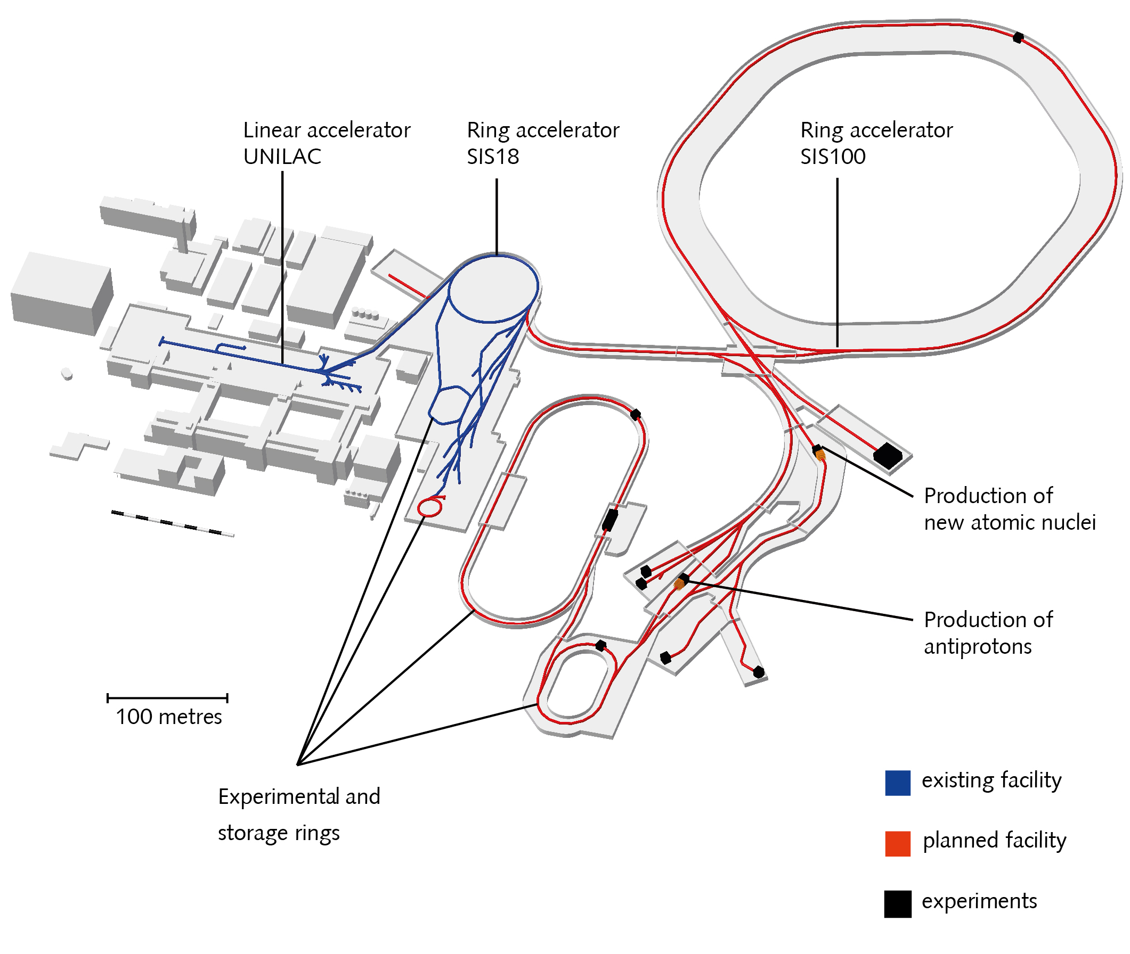
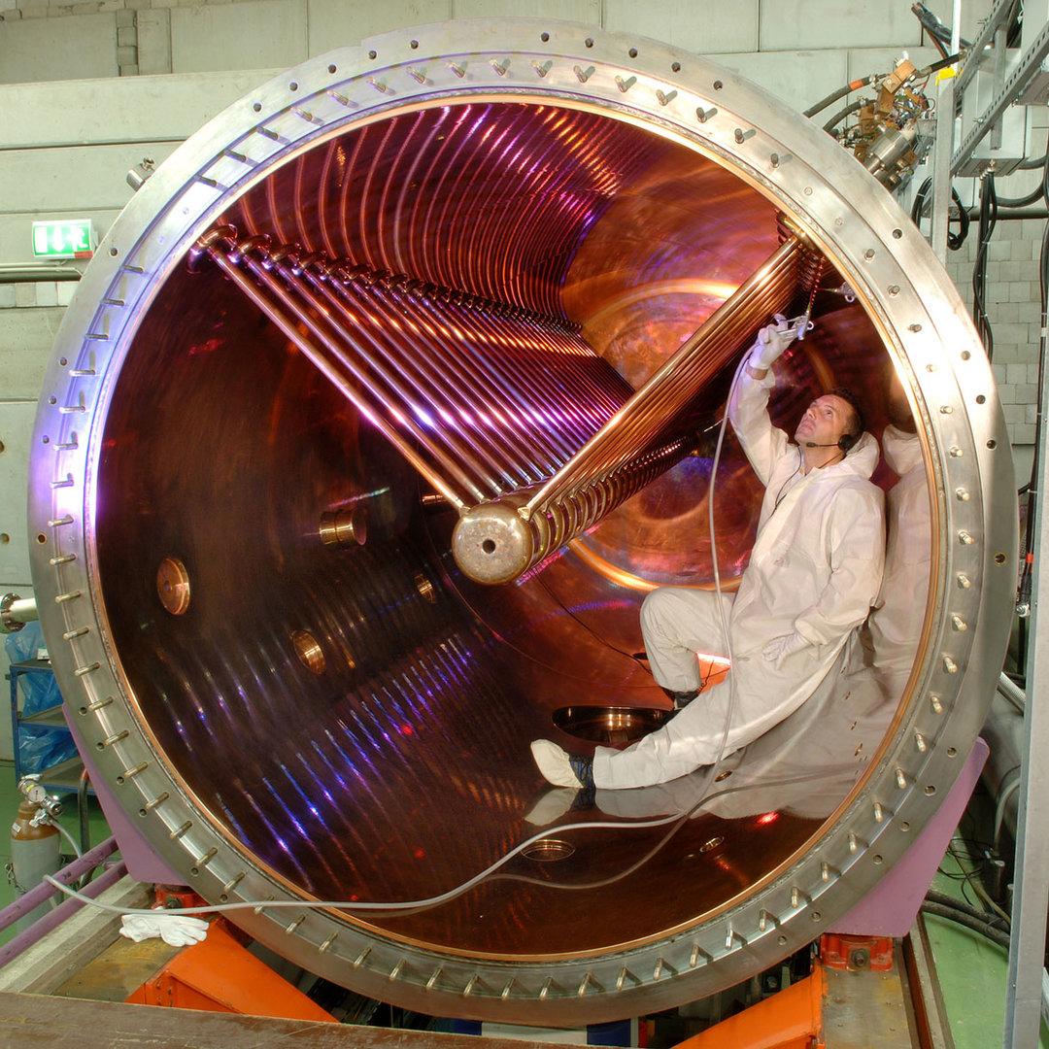
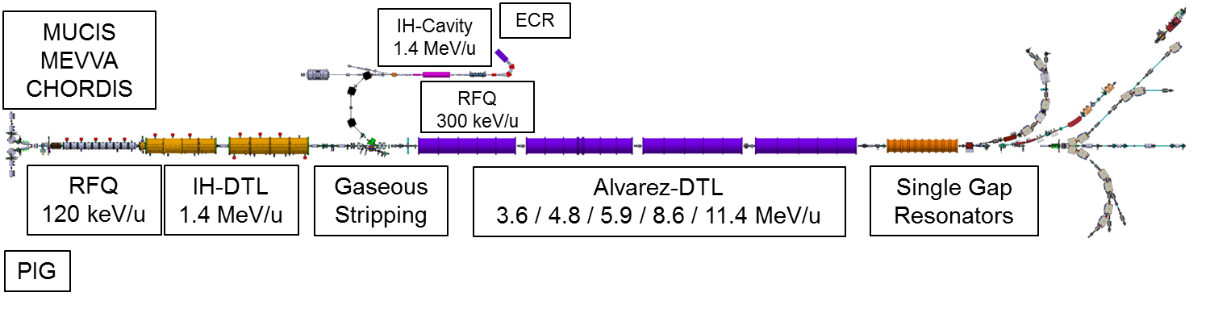
GSI/FAIR Overview
Helmholtz Centre for Heavy Ion Research
Founded 1969
Facility for Antiproton
and Ion Research
[1] https://www.gsi.de/forschungbeschleuniger/beschleunigeranlage/linearbeschleuniger
[2] https://www.gsi.de/en/researchaccelerators/fair/the_machine
Notes:
Alvarez

Slide 3
UNiversal Linear ACcelerator
Acceleration of Ions from Protons up to 92-fold ionised Uranium
Pulsed operation: 50 Hz
RFQ & IH: 36.136 MHz
Alvarez & ER: 108.41 MHz
Multi-Experiment Beam Sharing
[3] https://www.gsi.de/work/beschleunigerbetrieb/beschleuniger/unilac/unilac
Notes:
operated without acceleration: any arbitrary ion energy between 3.4 and 11.6 MeV/u = 16% speed of light,
Commissioning 1975
Sources Terminals can be equipped
Possible switching of beam parameters between two subsequent beam pulses
UNILAC experts

Slide 4
Motivation
Why do we need Longitudinal Diagnostics?
Matching to Acceptance of RF-Structures
Controlling Energy Spread
  Minimized at Injection to SIS-18
[3] https://www.gsi.de/work/beschleunigerbetrieb/beschleuniger/unilac/unilac
Notes:
Whole longitduinalt PS was not measured in a long time

Slide 5
Longitudinal Beam Diagnostic Devices
Measurement of Longitudinal Phase Space
Fast Faraday Cup (FFC)
Bunch Shape Monitor (BSM)
GHz Transition Radiation monitor (GTR) [4]
Phase Probe [4]
FFC
BSM
GTR
[4] Rahul Singh (Nov 2022). LONGITUDINAL BEAM DIAGNOSTICS R&D AT GSI-UNILAC, DOI:10.18429/JACoW-HIAT2022-TH2I2
[3] https://www.gsi.de/work/beschleunigerbetrieb/beschleuniger/unilac/unilac
Notes:
Link to GTR Paper Rahul

Slide 6
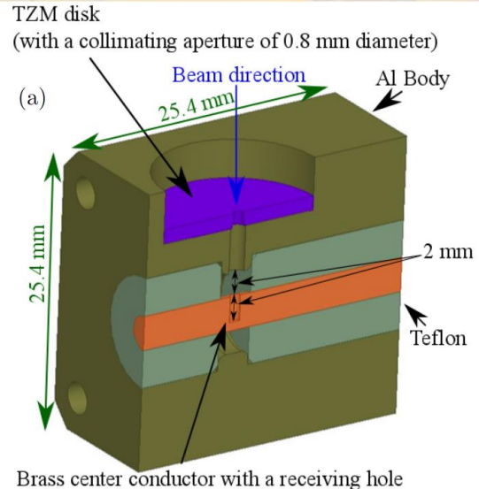
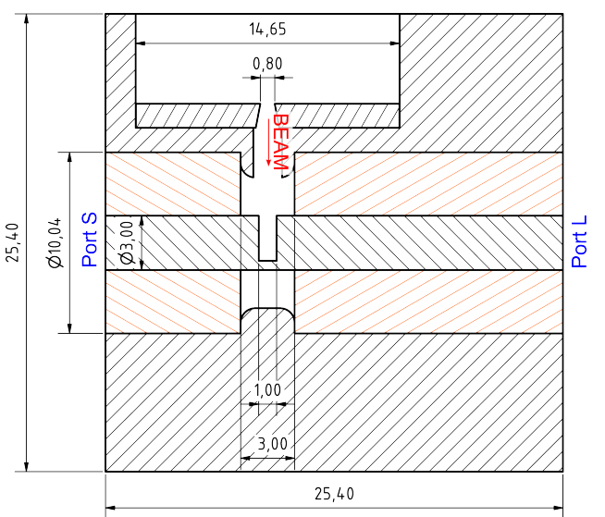
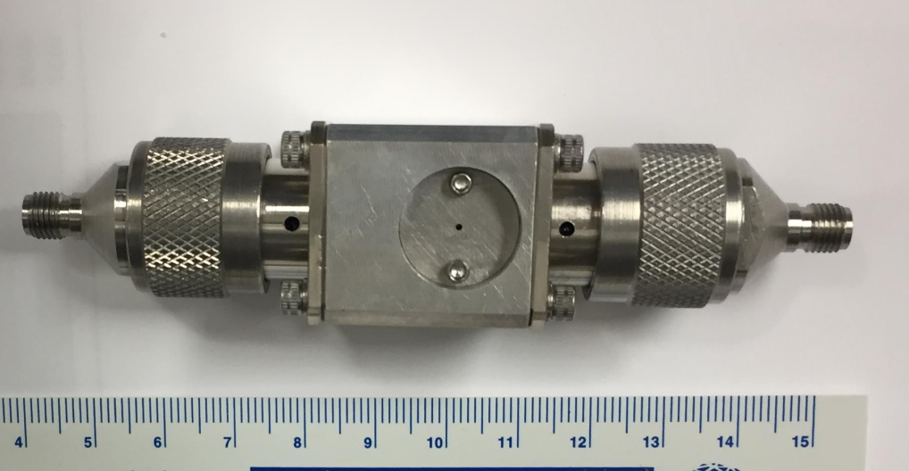
Fast Faraday Cup
Destructive Bunch-by-Bunch Method
  Longitudinal Bunch Shape
Radially Coupled Coaxial Fast Faraday Cup (RCFFC)
  30 ps Resolution
  5 GHz Bandwidth at β = 15%
[5] R. Singh et al. (2021). Comparison of Feschenko BSM and Fast Faraday Cup
with low energy ion beams, DOI: 10.18429/JACoW-IBIC2021-WEPP16
[6] R. Singh et al. (2022) Simulation and measurements of the Fast Faraday Cups at GSI UNILAC, doi:10.18429/JACoW-IBIC2022-TUP25
[7] R. Singh et al. (June 2022). Longitudinal beam diagnostics R&D at GSI UNILAC, HIAT 2022, Darmstadt
Notes:
Faraday Cup: current → same but whole lot quicker
Provide a small hole from the side of a co-axial into central conductor
Fermi 5 GHz at 15%c, around 30ps, 4 degrees at 108 MHz

Slide 7
Recent Measurements
FFC
BSM
GTR
IH2
[3] https://www.gsi.de/work/beschleunigerbetrieb/beschleuniger/unilac/unilac
IH1
β = 0.05473
β = 0.15591
β = 0.03995
Notes:
Gasstripper region,
IH1: beta 3.995 == 743keV/u
IH2: 5,473 == 11.4 MeV/u

Slide 8
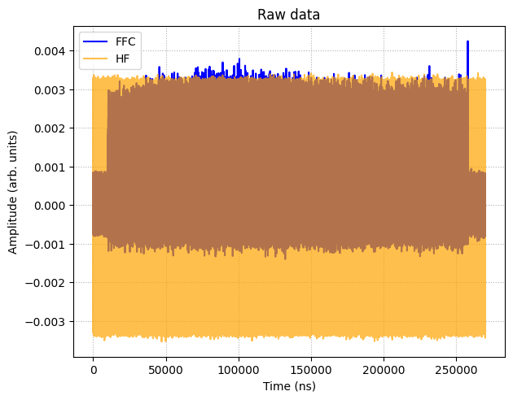

Recent Measurement
Measurement in X2
$Ar^{8+}$
Notes:
November
IH1: beta 3.995 == 743keV/u
IH2: 5,473 == 11.4 MeV/u

Slide 9
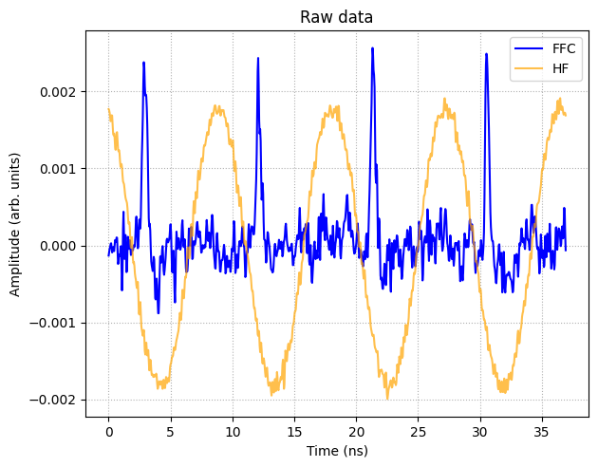
Recent Measurement
Measurement in X2
$Ar^{8+}$
Notes:
November
IH1: beta 3.995 == 743keV/u
IH2: 5,473 == 11.4 MeV/u
SE suppression (geometrical, apply Bias voltage )

Slide 10
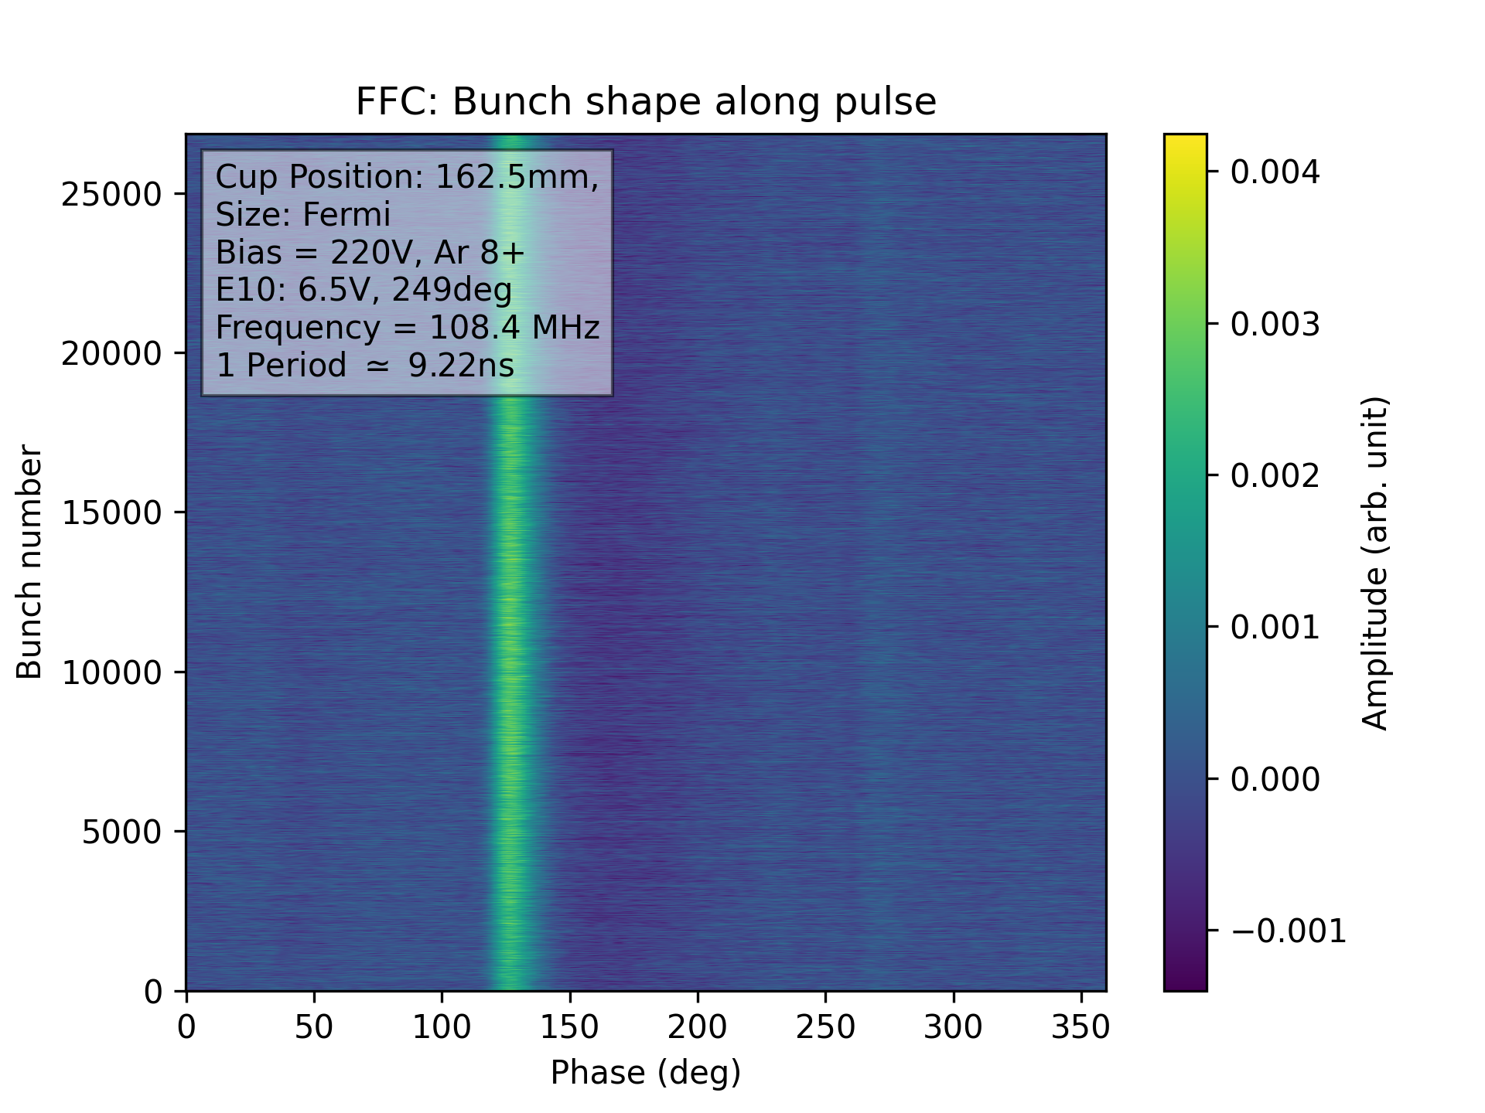
Recent Measurement
Measurement in X2
$Ar^{8+}$
Notes:
2025_04_02_CH1_HF_CH2_fFFC_CH3_current_CH4_PP_E10_6.5V_249deg_Ar8_Set1_Bias220V_fFFC_Pos162.5mm_001_ch2
SE suppression (geometrical, apply Bias voltage )

Slide 11
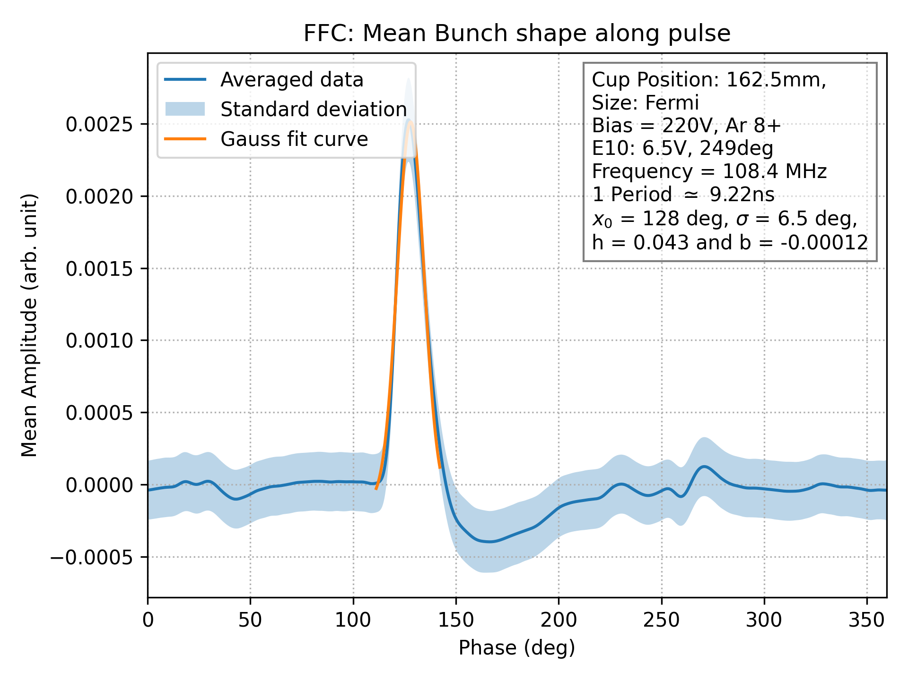

Recent Measurement
Measurement in X2
$Ar^{8+}$
$$A\left(φ\right)=b+\frac{h}{\sqrt{2πσ^{2}}}\exp\left(−\frac{{\left(x−x_{0}\right)}^{2}}{2σ^{2}}\right)$$
Notes:
2025_04_02_CH1_HF_CH2_fFFC_CH3_current_CH4_PP_E10_6.5V_249deg_Ar8_Set1_Bias220V_fFFC_Pos162.5mm_001_ch2
SE suppression (geometrical, apply Bias voltage )

Slide 12
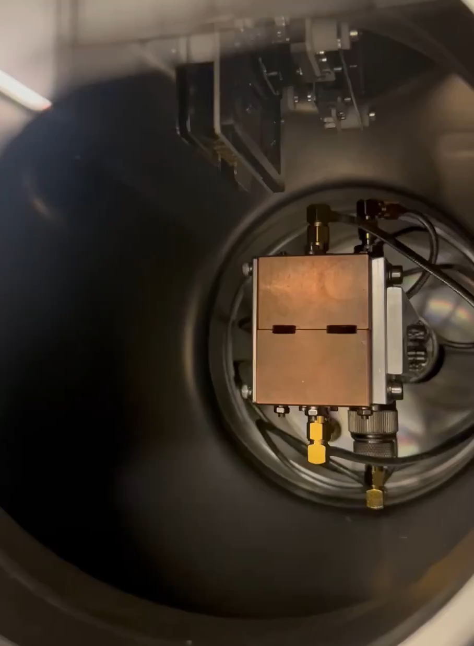
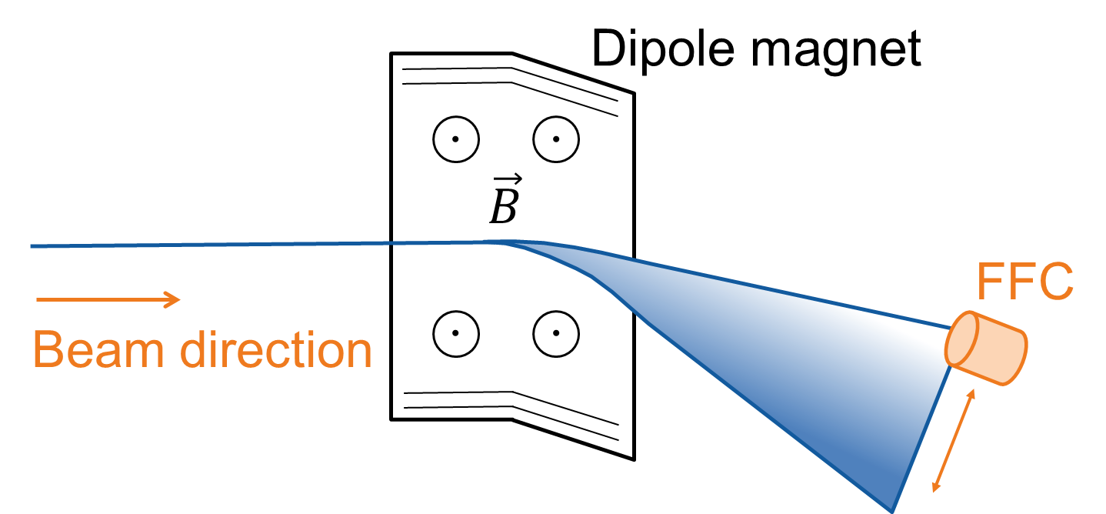
Emittance Measurement
Measurement of Dispersion-assisted Longitudinal Emittance
Notes:
1 dimension of long phase space, whole & emittance
Second axis == deviation in momentum/energy
Allocate x - p

Slide 13
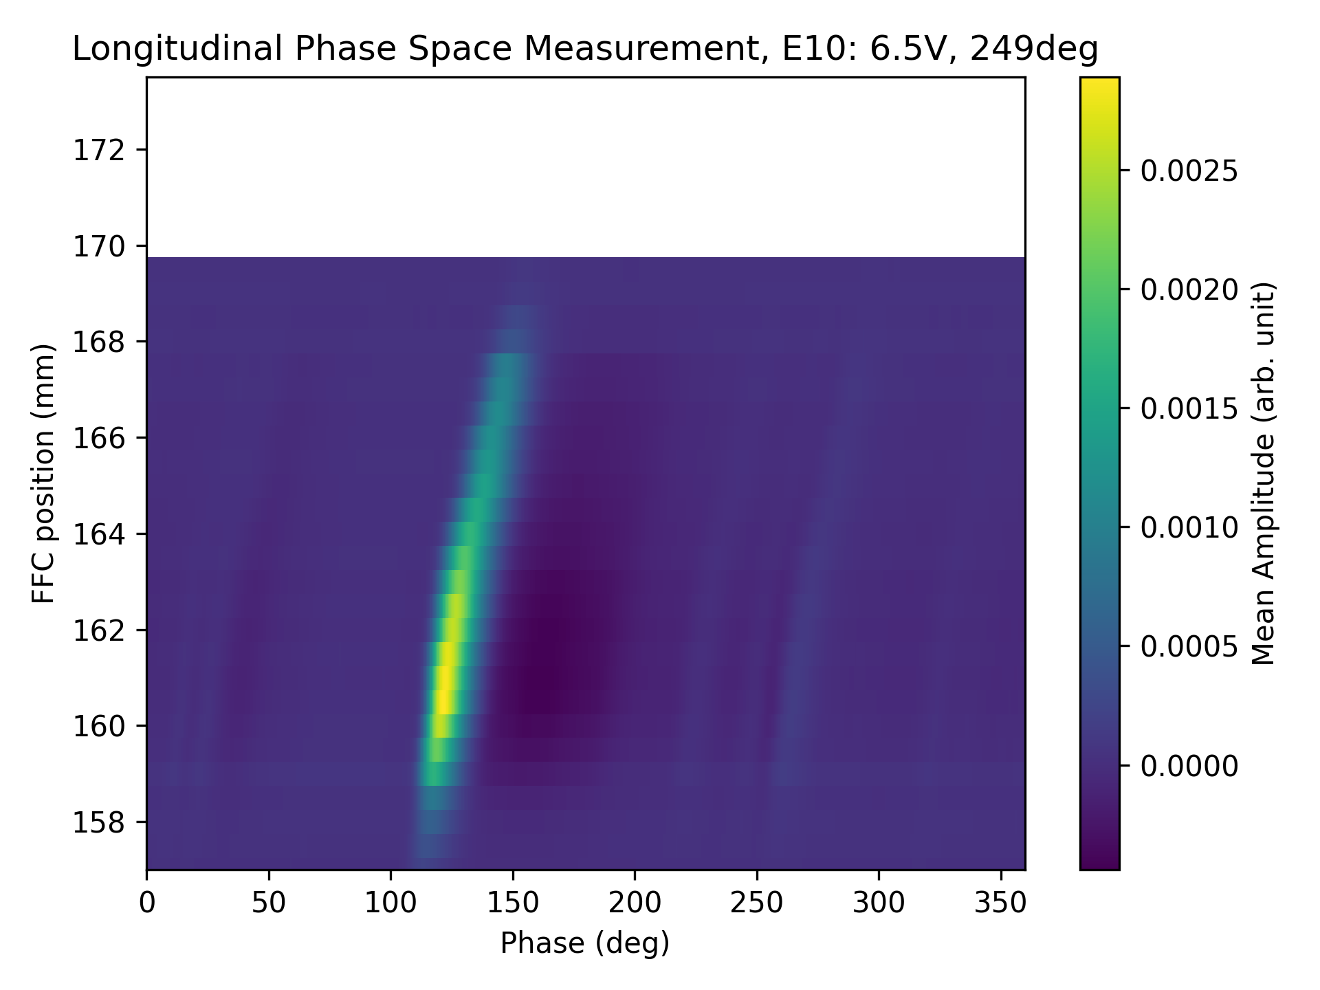
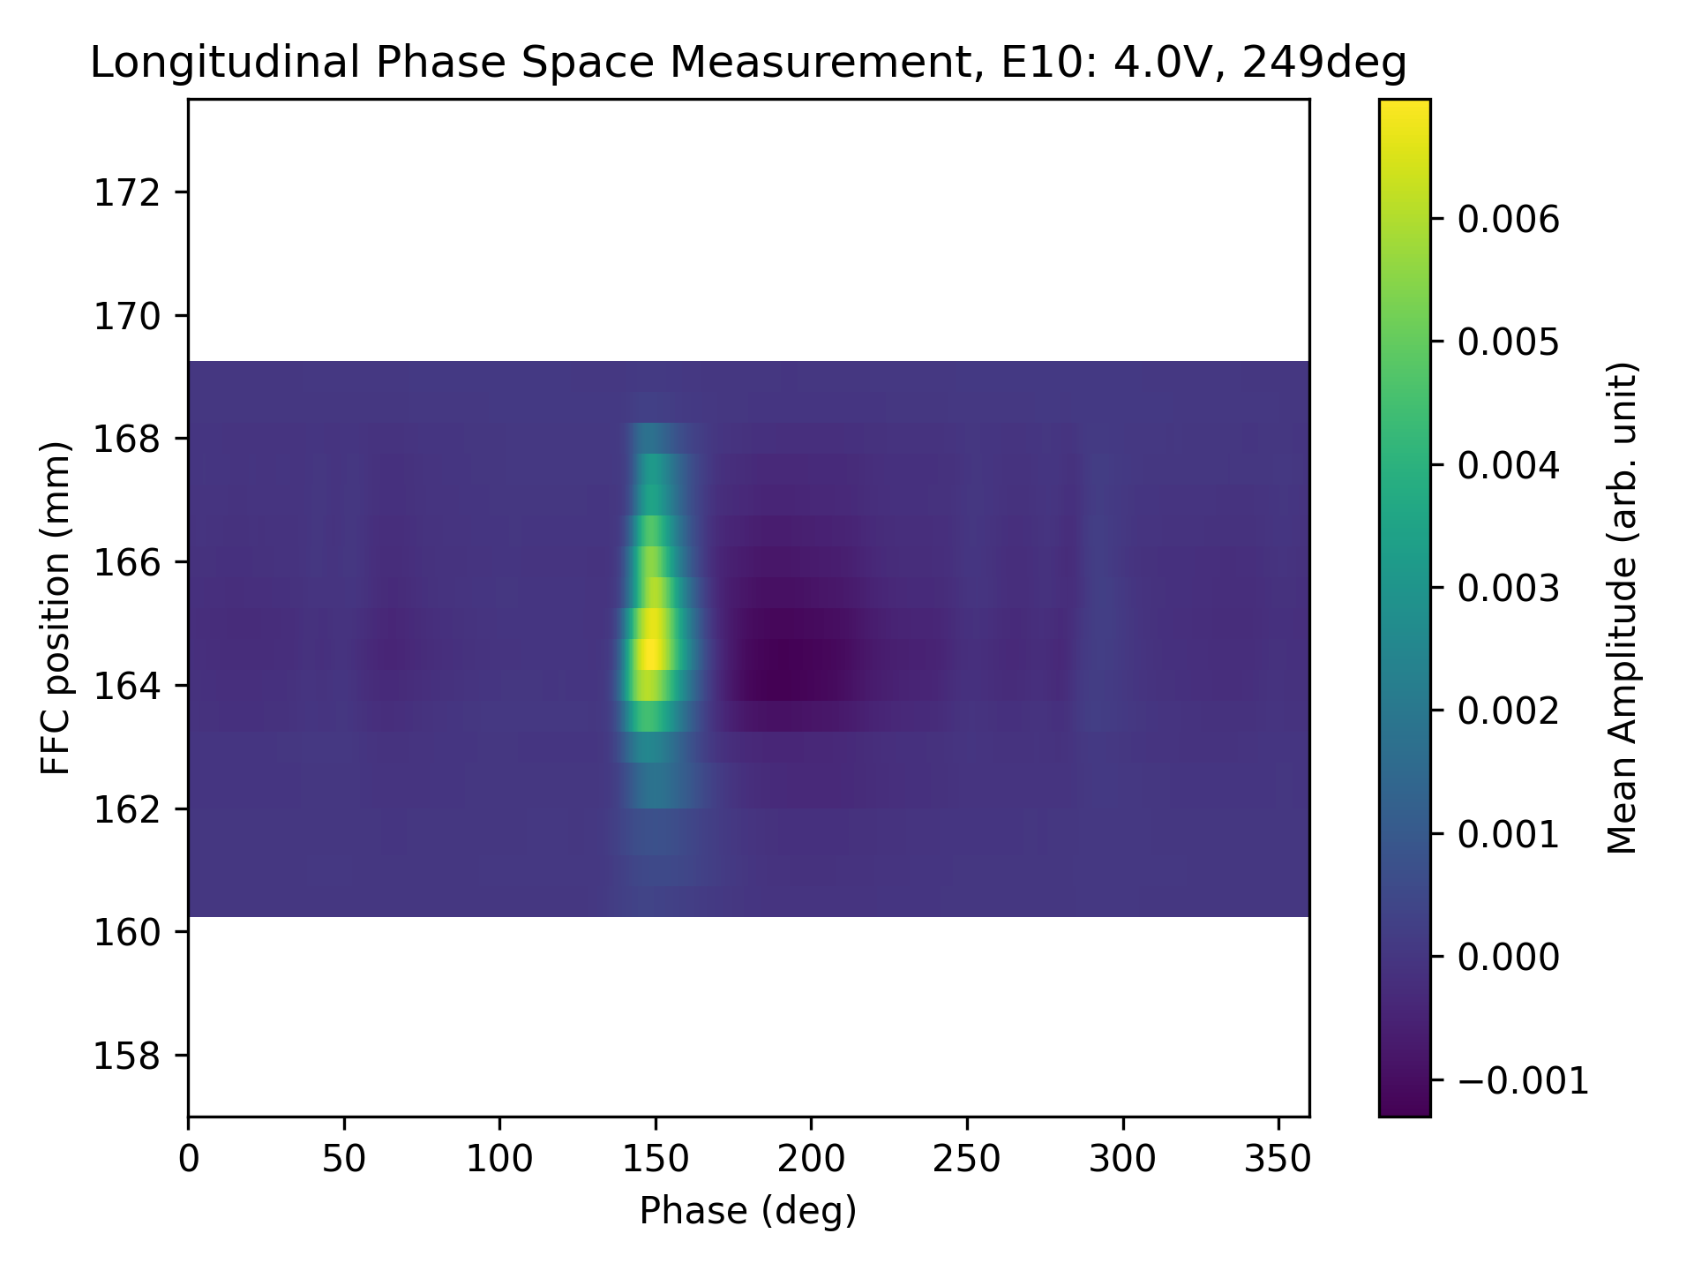

Emittance Measurement
Measurement in X2
$Ar^{8+}$

Slide 14
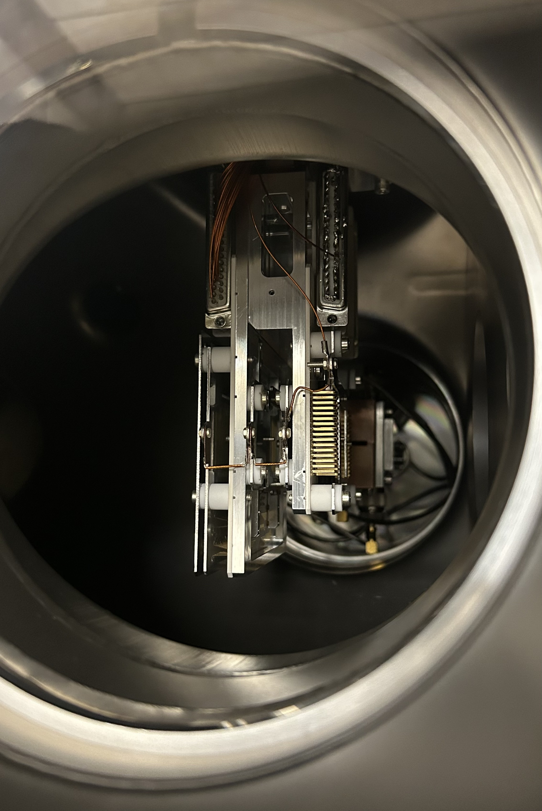
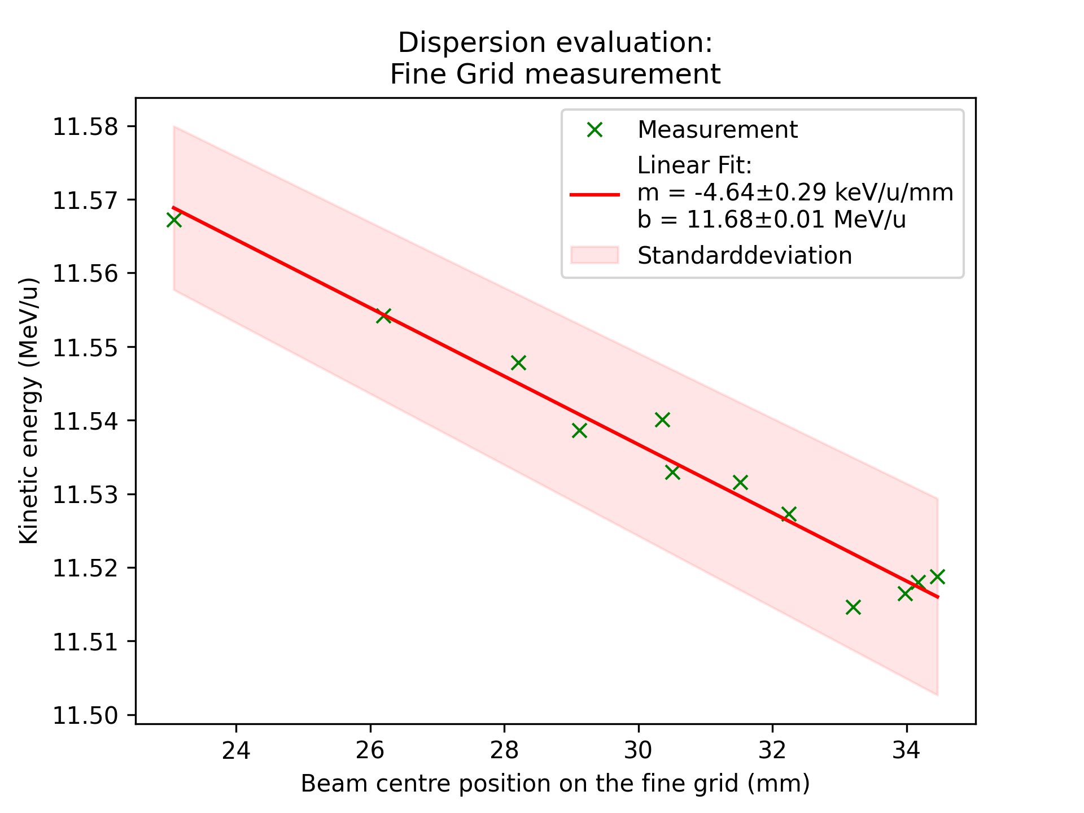

Emittance Measurement
Measurement in X2
$Ar^{8+}$
Dispersion Measurement
  5.03 m

Slide 15
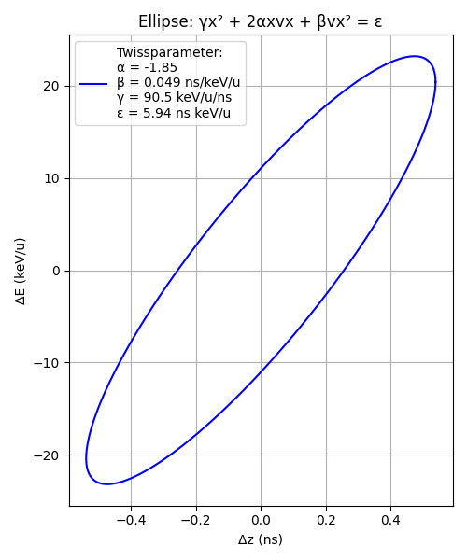
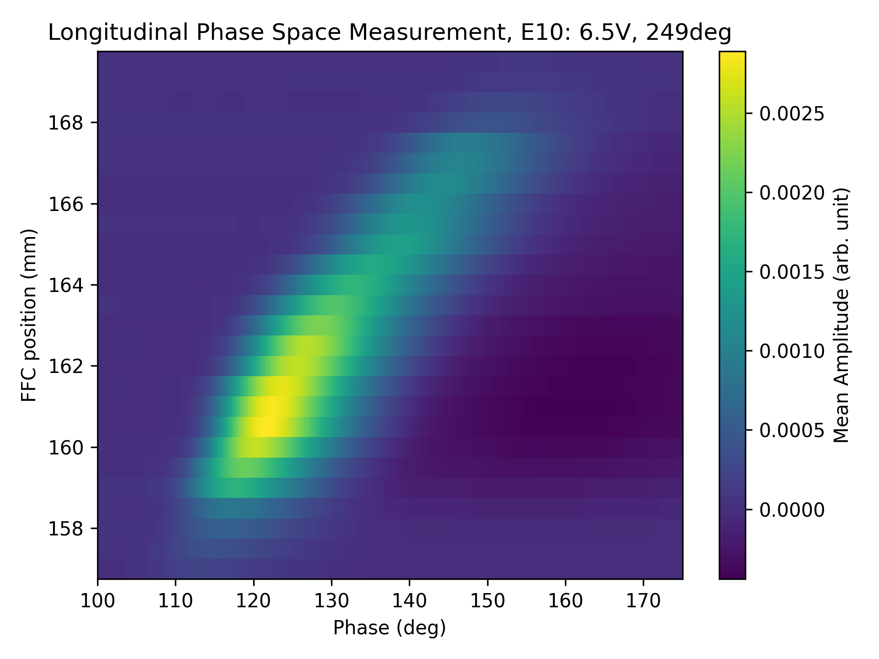
Emittance Measurement
Measurement in X2
$Ar^{8+}$

Slide 16
Longitudinal Beam Diagnostic Devices
Measurement of Longitudinal Phase Space
Fast Faraday Cup (FFC)
Bunch Shape Monitor (BSM)
GHz Transition Radiation monitor (GTR) [4]
Phase Probe [4]
FFC
BSM
GTR
[4] Rahul Singh (Nov 2022). LONGITUDINAL BEAM DIAGNOSTICS R&D AT GSI-UNILAC, DOI:10.18429/JACoW-HIAT2022-TH2I2
[3] https://www.gsi.de/work/beschleunigerbetrieb/beschleuniger/unilac/unilac

Slide 17
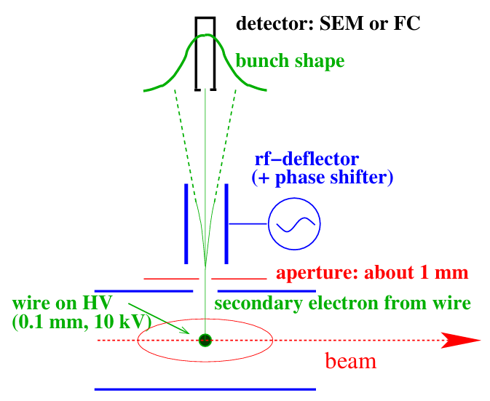
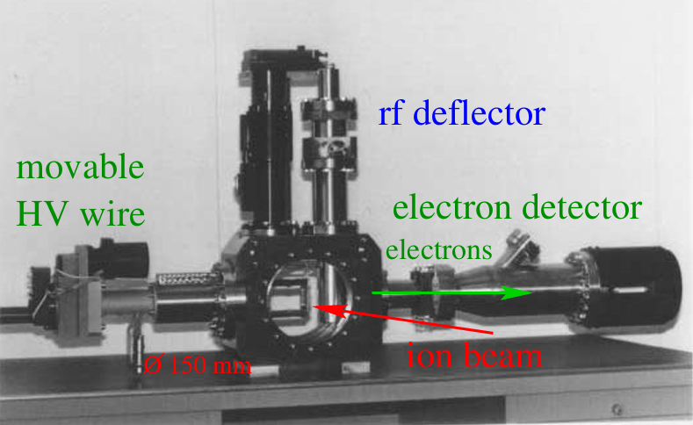
Bunch Shape Monitor (BSM)
Secondary electrons liberated from a wire (0.1mm, 10kV)
Accelerated towards rf-deflector
  Same Frequency as accelerating RF
  Time-to-space converter
Electron detection behind slit with
  SEM (Secondary electron multiplier)
  FC (Faraday Cup)
Change of phase of deflecting RF
  Scanning of whole bunch
Resolution of 1 degree, 26 ps
[8] P. Forck (2024). JUAS Lecture notes on beam instrumentation,
DOI: https://doi.org/10.23730/CYRSP-2024-003
Notes:
Difference to FFC: non destructive, average over multiple bunches

Slide 18
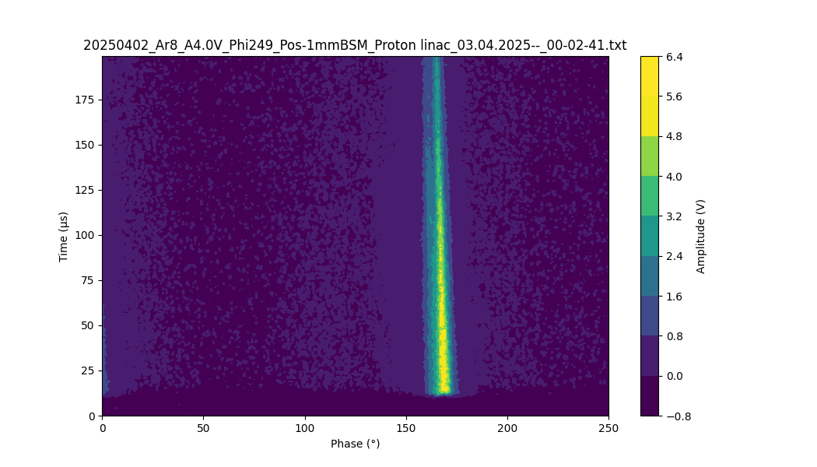
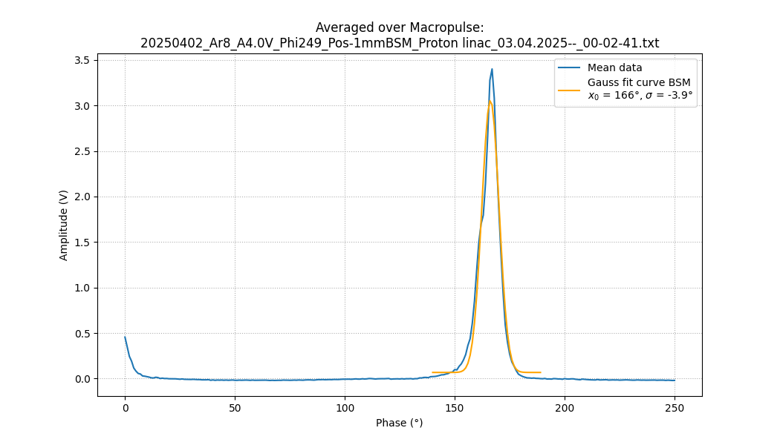
Bunch Shape Monitor (BSM)
Plots from X2 measurement

Slide 19
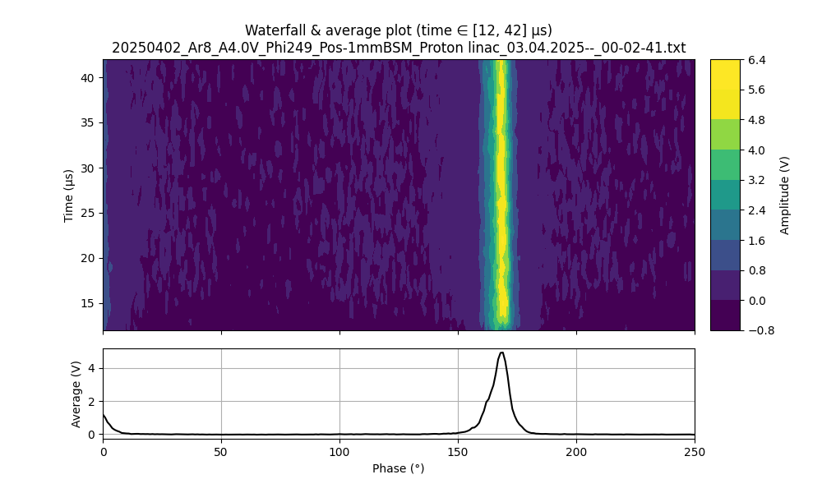
Bunch Shape Monitor (BSM)
Plots from X2 measurement

Slide 20
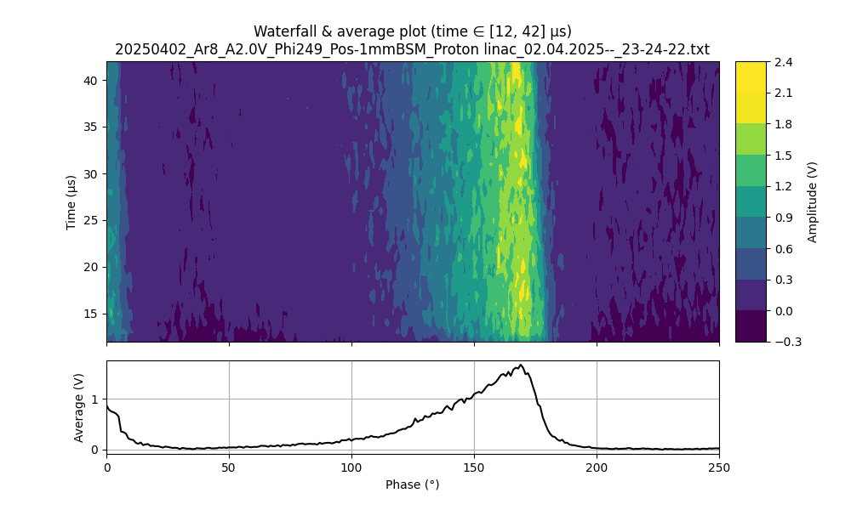

Bunch Shape Monitor (BSM)
X2 measurements, Buncher at 2.0 V
Different wire positions
Notes:
Bunch not gaussian like at some positions (other part of bunch)

Slide 21
Summary & Outlook
Fast Faraday Cup
  Destructive, Bunch-by-Bunch Method for Bunch Shape Measurement
  30 ps, 4 degrees Resolution @108 MHz with electronics + 40 mm cables
    Improvements planned to reach 2 degrees
Bunch Shape Monitor
  26ps, 1 degrees Resolution
Dispersion-assisted Longitudinal Emittance
  Dispersion is sufficiently high in X2
  Demonstration of the Method’s Functionality
  Calculation of the Emittance
Comparison measurement with BSM
  Moving wire to scan phase space
Notes:
Next FFC resolution 2 degree , smaller hole and moving osci closer to FFC → Improvement

Slide 22
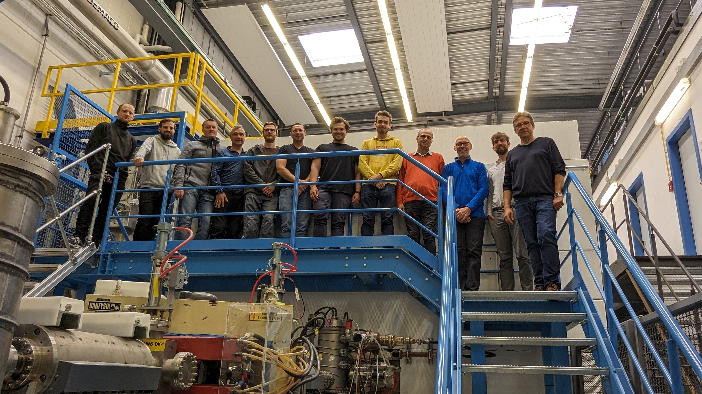
Many thanks to all the Physicists involved!
Prof. Dr. Winfried Barth
Dr. Maksym Miski-Oglu
Dr. Rahul Singh
Stephan Klaproth
Dr. Peter Forck
Uwe Scheeler
Dr. Simon Lauber
Dr. Thomas Sieber
Dr. Timo Milosic
…and many more

Slide 23
Backup slides

Slide 24
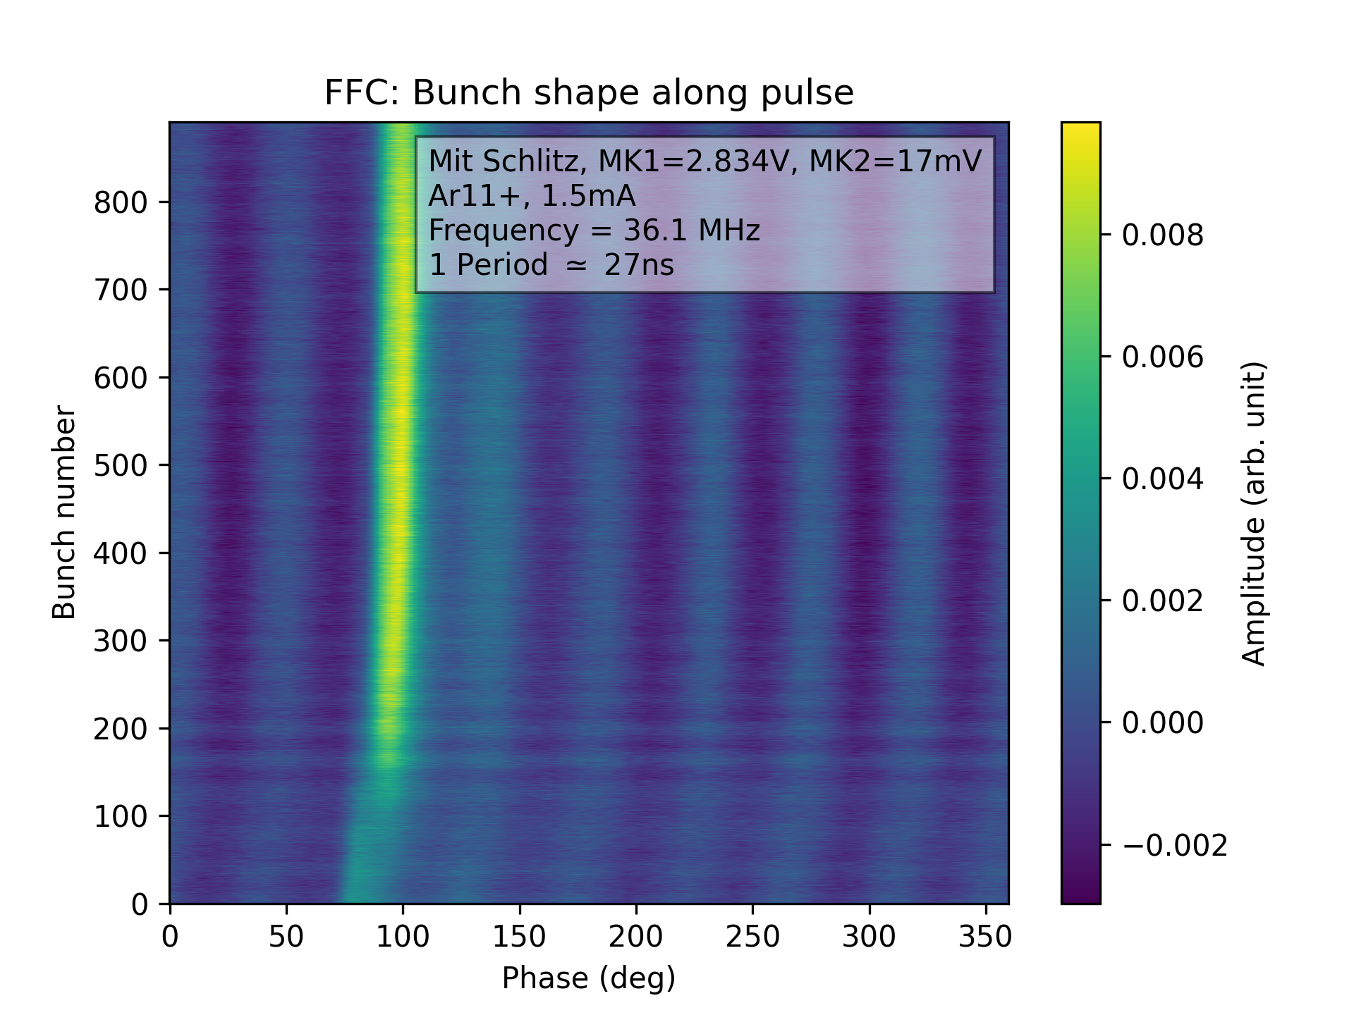
Difficulties
Hitting cable in Gasstripper FFC
Bunch movement
  In phase
  Amplitude change in Macropulse
Notes:
BACKUP

Slide 25
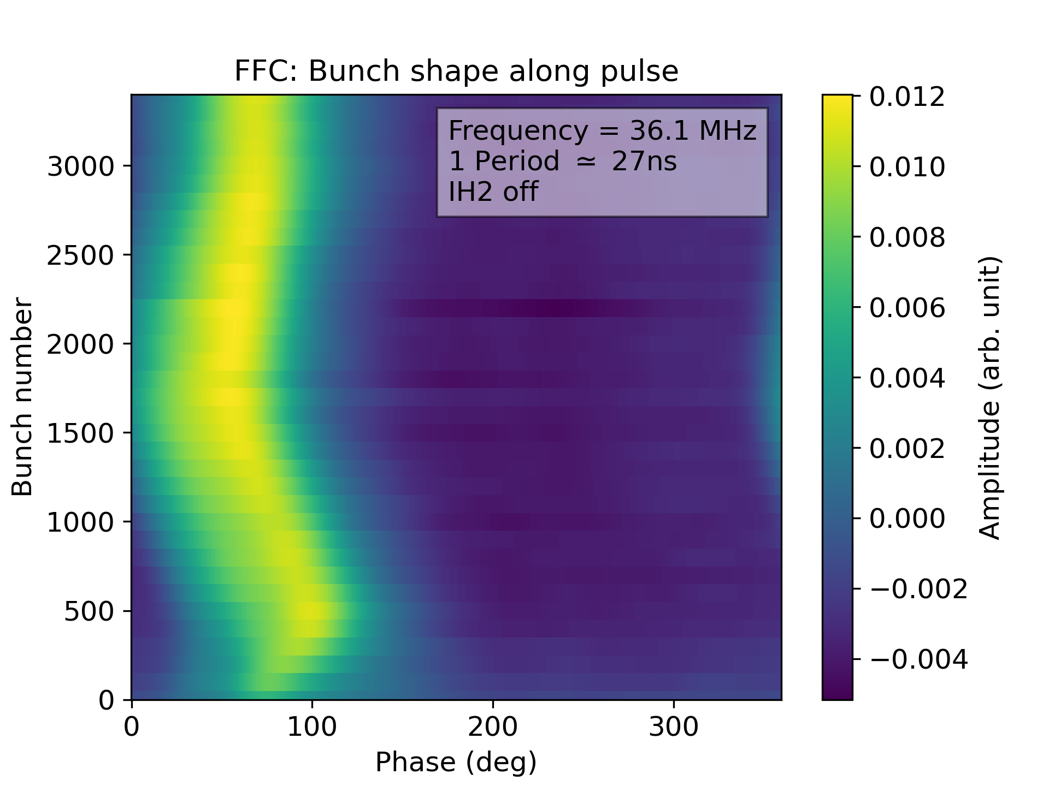
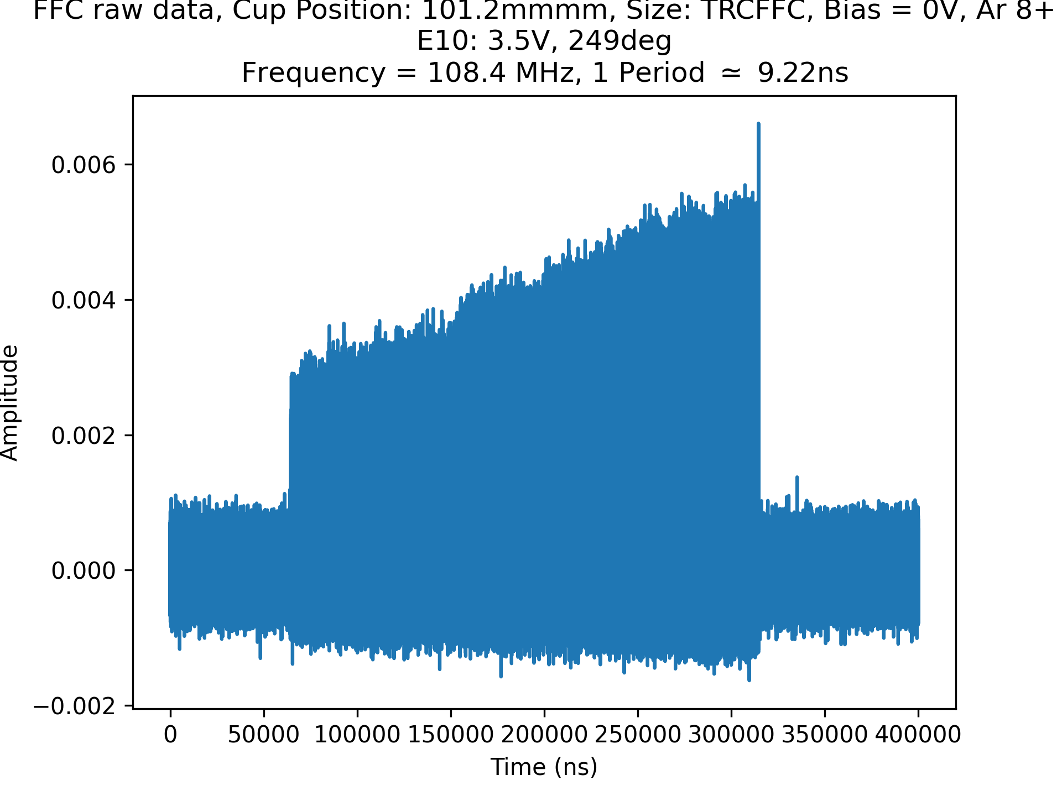
Difficulties
Hitting cable in Gasstripper FFC
Bunch movement
  In phase
  Amplitude change in Macropulse
Notes:
LATER/BACKUP

Slide 26
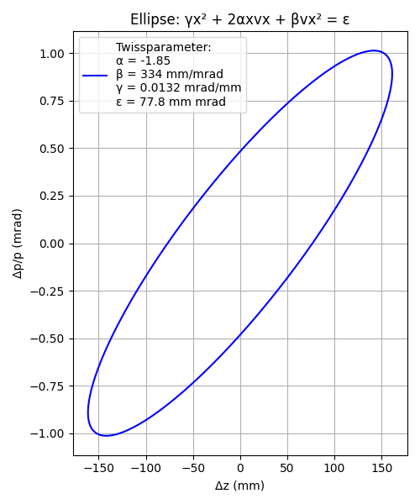
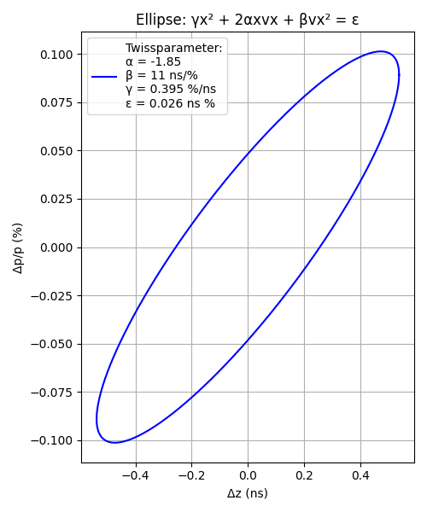
Emittance Measurement
Measurement in X2
$Ar^{8+}$

