Slide 1
ARES Operation Meeting
Summary of week 32 / 2023
Willi Kuropka, on behalf of the ARES crew

Slide 2
X-band conditioning and machine development
X-band RF station on load with 6MW peak power and ca. 2us LLRF pulse width…break down rate decreases steadily
AutoAcc shift with Jan and MDI intensity monitor shift on Tuesday
Tested orbit feedback and investigated orbit oscillations
Took data for quadrupole strength confirmation

Slide 3
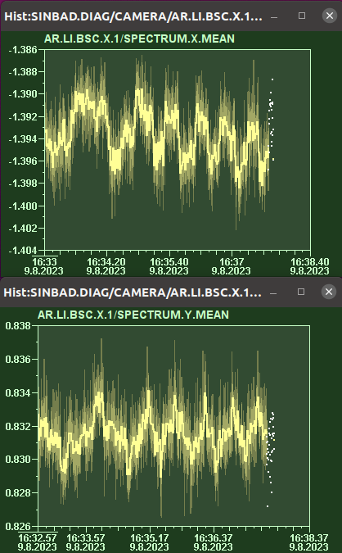
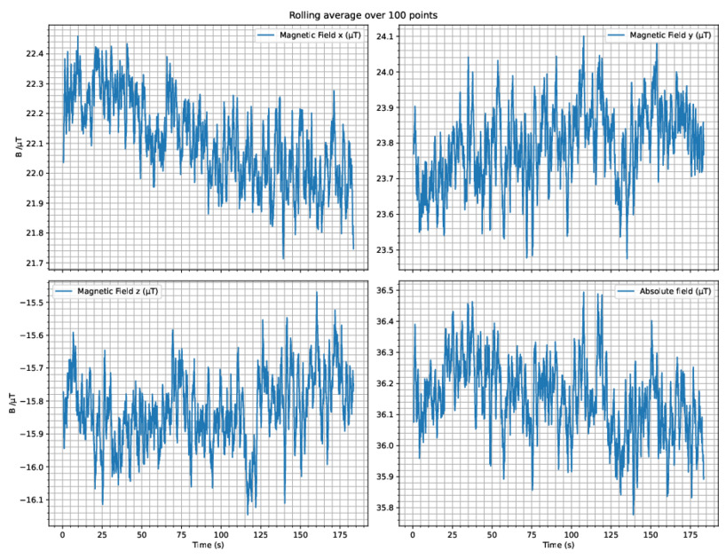
Dark charge on LIX1 w/o corrector magnets
Gun and solenoid only
Measured magnetic field next to gun using smart phone

Slide 4
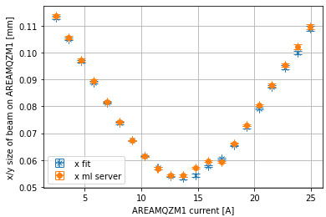
Quadrupole scan
Evaluate the quadrupole strengths as preparation for tomography measurements
Fit is with background subtraction
Dark charge has some influence

Slide 5
Schedule this week
Mon, Tue: X-band klystron connected to structure
This week and next week: ACHIP stage 1
Tasks:
  Re-establish ACIP stage 0
  Setup velocity bunching working point for stage 1
  Measure femtosecond rms bunch length using DLA
  → WIN

