Slide 1

The PUNCH4NFDI Project
TA4 WP1
Ivan Knežević 11th December 2023

Slide 2








Federated science data platform
Guarantee reproducibility
Compute4PUNCH
Results visualisation
Save workflow
Write and execute the code
Request computing resources
Storage4PUNCH
Information regarding resource and access rights within the institution
Home institute
Get dataset
PLATFORM
AAI request

Slide 3
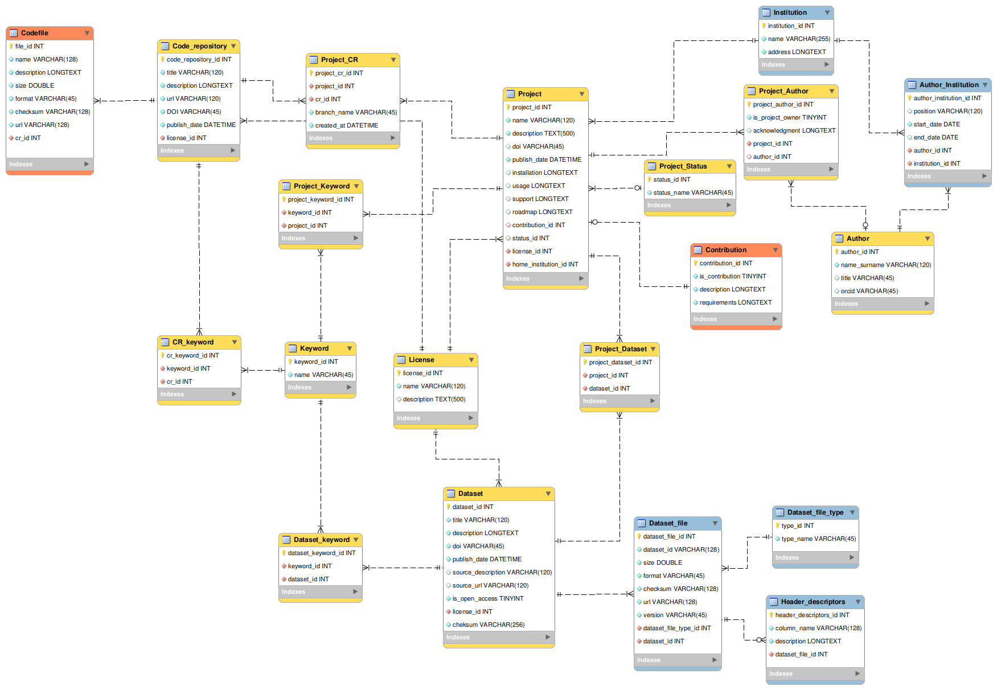
Digital Research Products
General project data
Code repository
Dataset
Minimal Viable Product

Slide 4
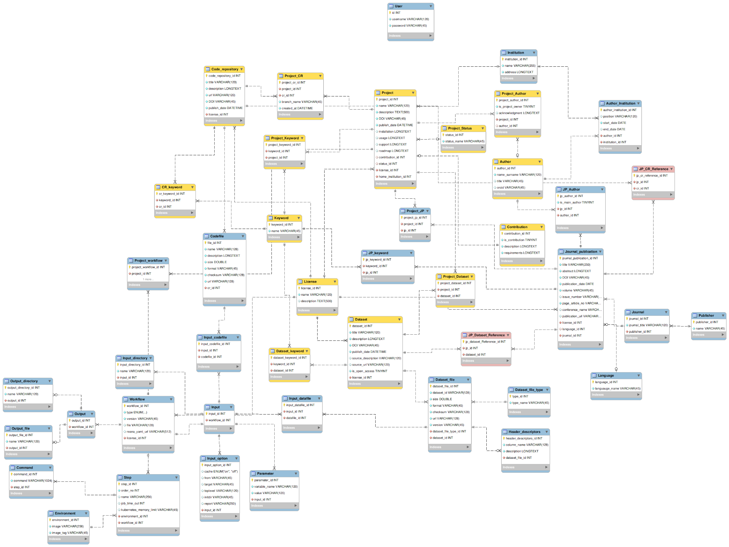
Digital Research Products
Code repository
General project data
Journal publication
Dataset
Workflow

Slide 5
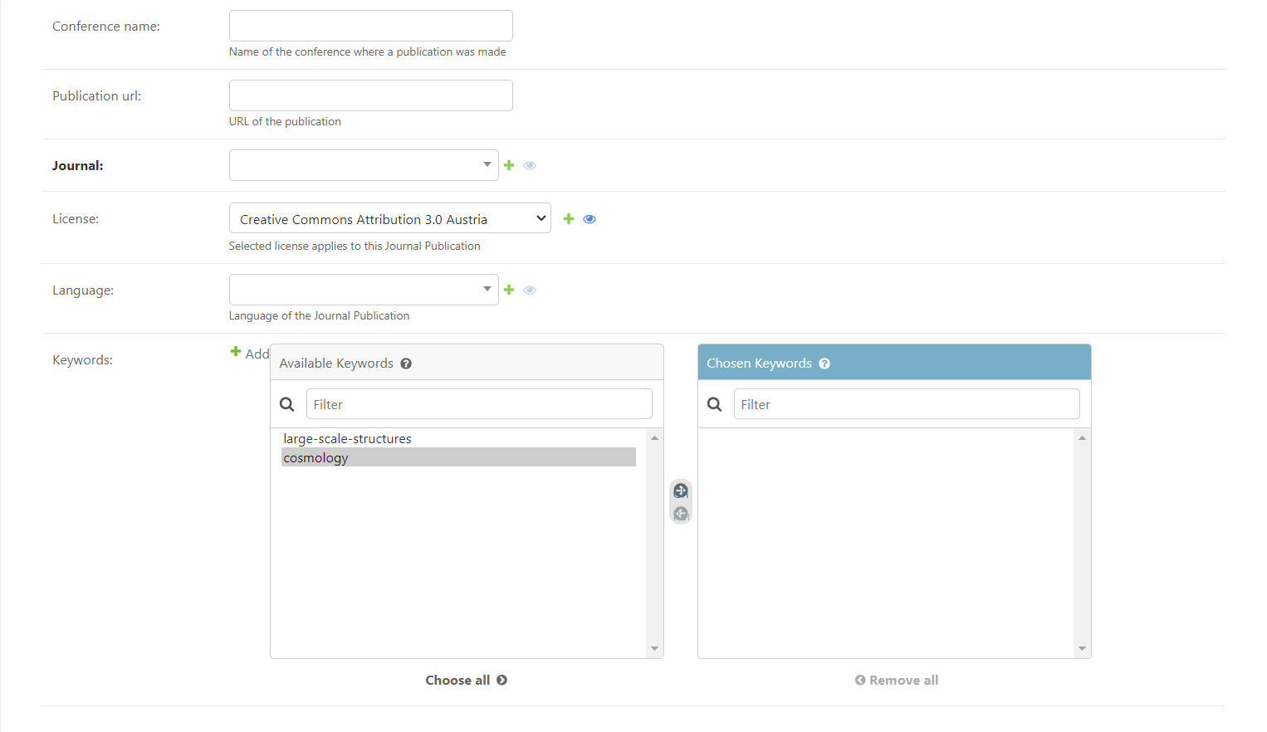
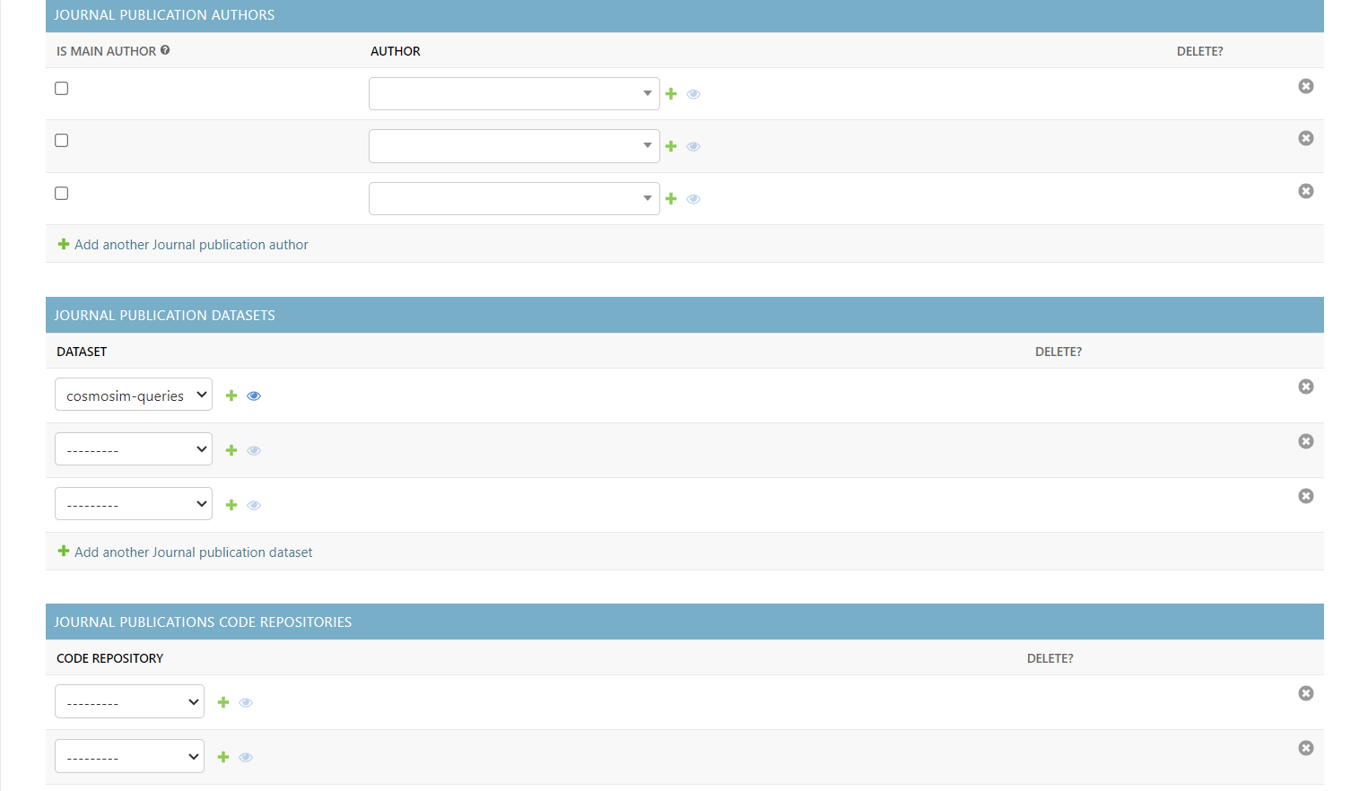
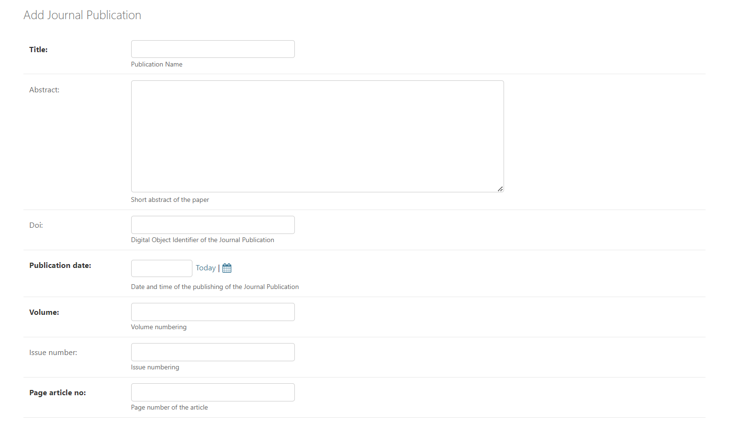
Journal Publication

Slide 6
Smaller adjustments to already existing entitites
Support for GitLab and GitHub automatic data entry for Code Repositories;
Search recommendations for Author selection for all entities.
Search recommendations for Language selection for Journal Publications.
Additional filtering for Datasets, Projects and Code Repositories (by Title, name, release date, keyword, open access status…)

