Slide 1
ARES Operation Meeting
Summary of week 33 / 2023
Frank Mayet, on behalf of the ARES crew

Slide 2
Summary
Week 33
 | Monday 14th August | Tuesday 15th August | Wednesday 16th August | Thursday 17th August | Friday 18th August
Achievements | POLARIX cavity 1 connection to the waveguides | POLARIX cavity 1 connection to the waveguides FINISHED SH.E2 screen+mirror add-on installed | Setup of the ACHIP Stage 0 WP (long bunch) for 64 MV/m gun setpoint (instead of 74MV/m, which we had before) Transmission through DLA achieved | ACHIP laser re-aligned on the laser table in the tunnel ACHIP observation camera re-focused | Work on ACHIP Stage 0 WP → Transmission achieved; spatial alignment done; first timing scans
Difficulties |  |  |  | Timing setup camera did not work → Reboot of acclxsisrv03 fixed the problem (Genicam caches?)
Notes

Slide 3
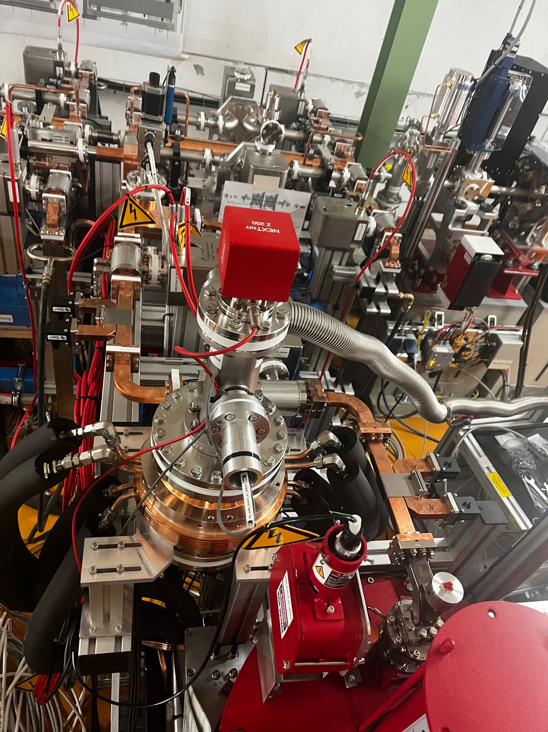
POLARIX Cavity 1 Connected

Slide 4
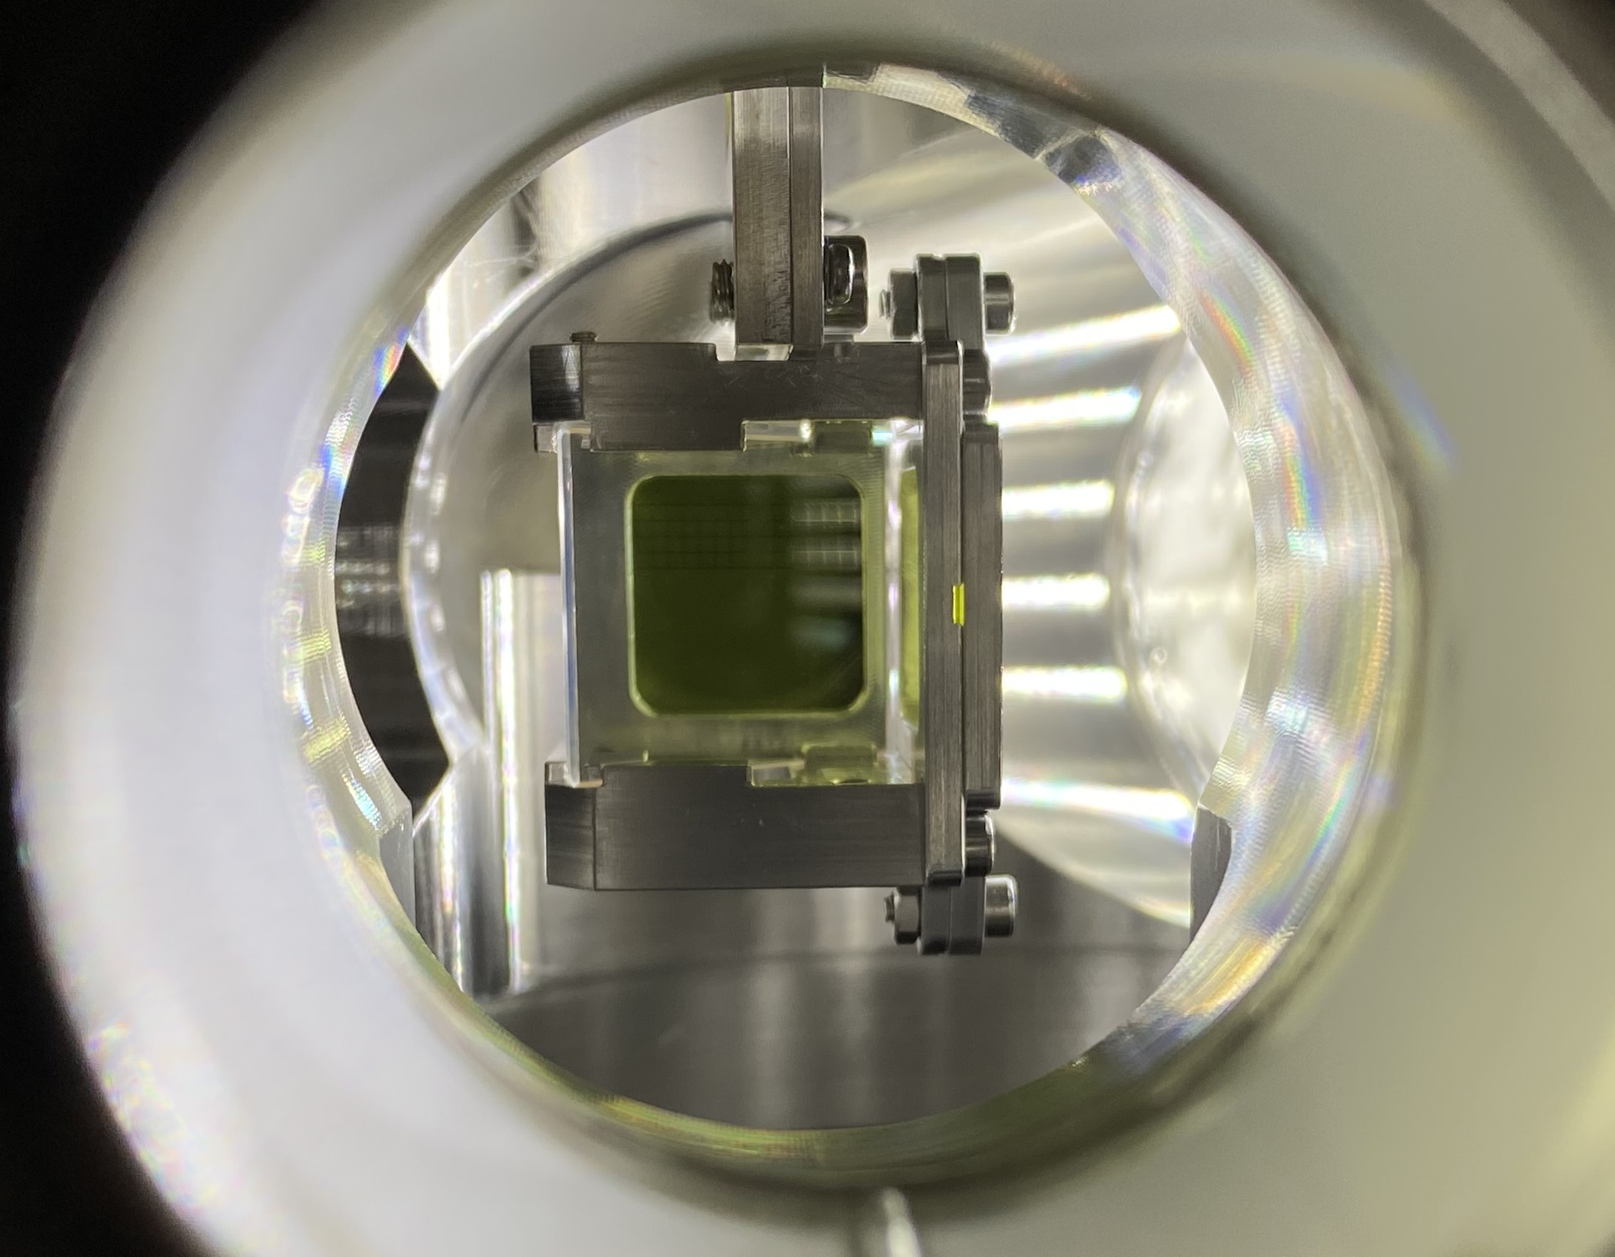
SH.E2 Screen Addon Installed

Slide 5
Schedule this week
Mon: Tunnel open
Rest of the week: ACHIP
Tasks:
  Re-establish ACIP stage 0
  Setup velocity bunching working point for stage 1
  Measure femtosecond rms bunch length using DLA
  → WIN

