Slide 1
ARES Operation Meeting
Summary of week 34 / 2023
Willi Kuropka, on behalf of the ARES crew

Slide 2
ACHIP
Monday: adjusting 2um laser setup on table in tunnel, MKK works
Rest of the week: Stage 0 experiment
  WP with moderate and stable electron transmission through DLA
  Laser alignment
  Time overlap
  NO modulation achieved

Slide 3
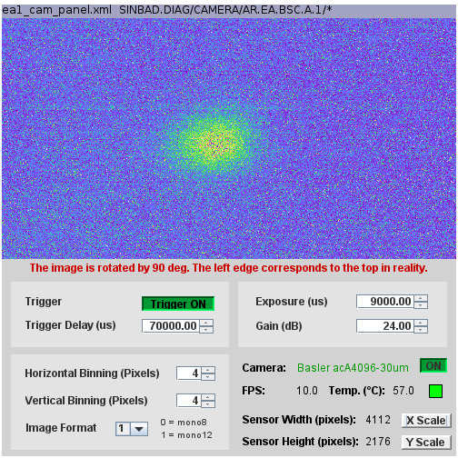
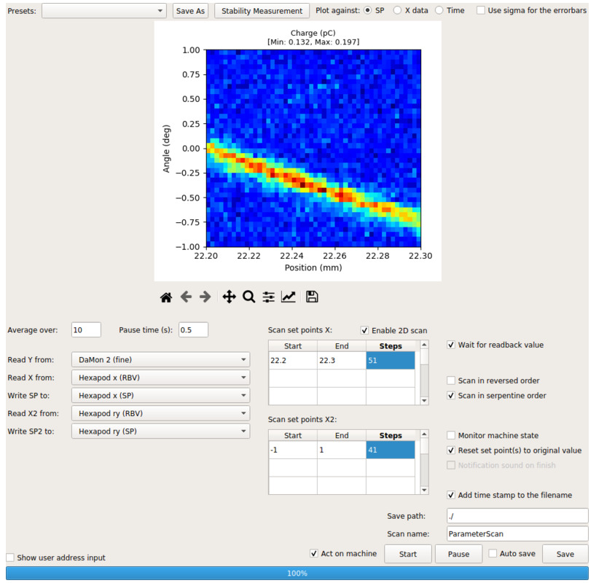
WP is different from last time
Due to 64MV/m gun gradient
Beam at EA YAG screen still looks nice
Optimized transmission

Slide 4
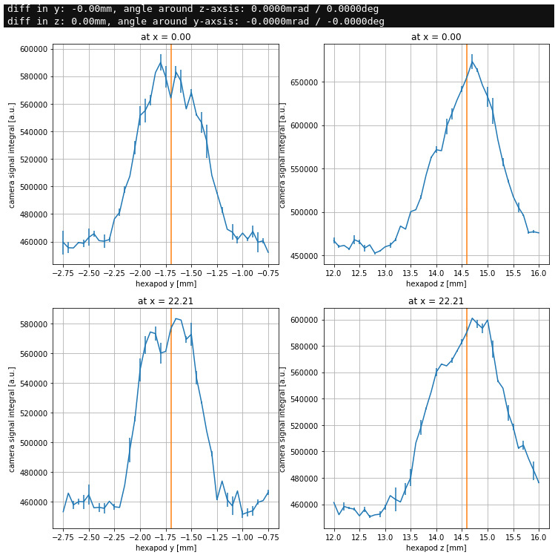
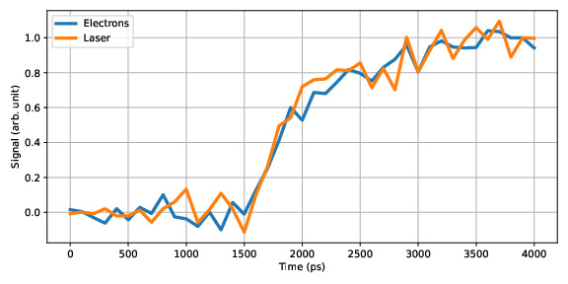
Started timing scans already on Tuesday
Gated intensified camera works reliably, but it appears laser alignment is tedious

Slide 5
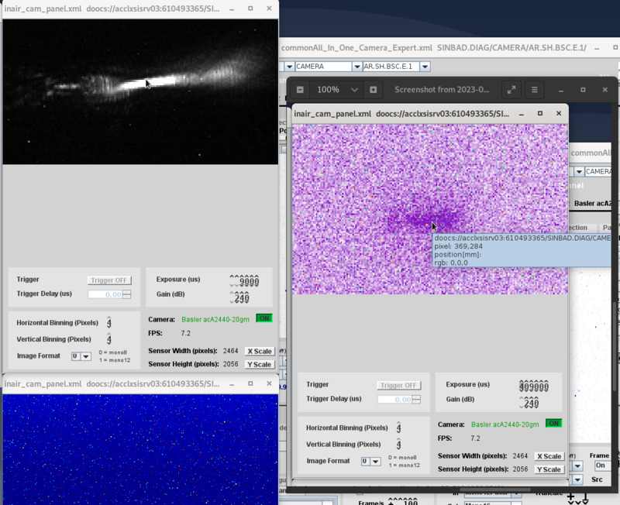
Spent significant amount of time on laser alignment and timing scans
Using the observation cam on the laser table in the tunnel and the cam on the transmitted beam on the small bread board after the IP

Slide 6
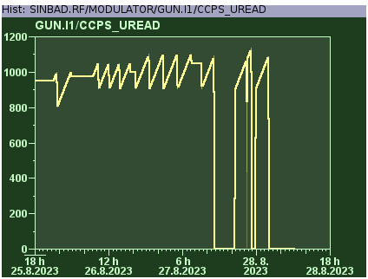
Gun RF station conditioning
Goal: Achieve 74MV/m gradient again
Since week 24 2023 we reduced the modulator pulse width and charge voltage

Slide 7
Schedule this week
Mon: MKK tests in the tunnel for X-band precision water cooling
Tue, Wen: ACHIP Stage 0/1
Thursday: D3 dosimetry
Friday: AutoAcc

Slide 8
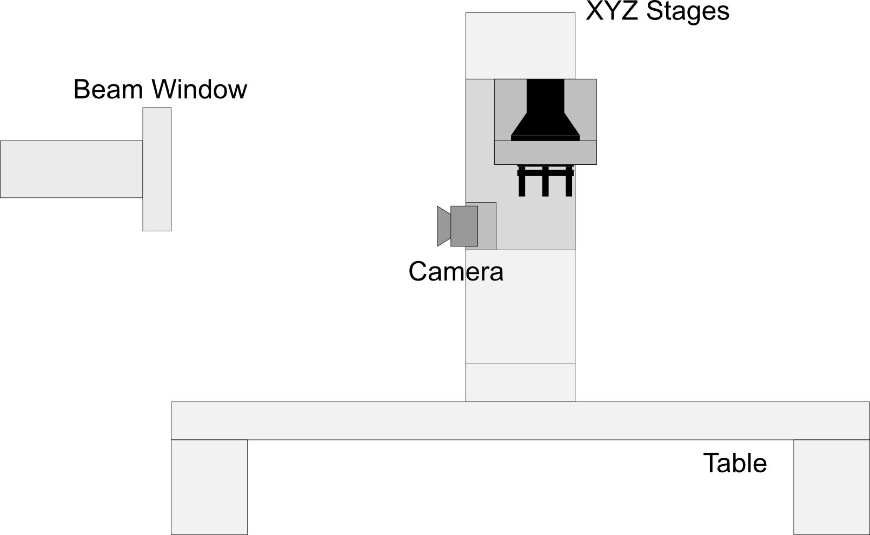
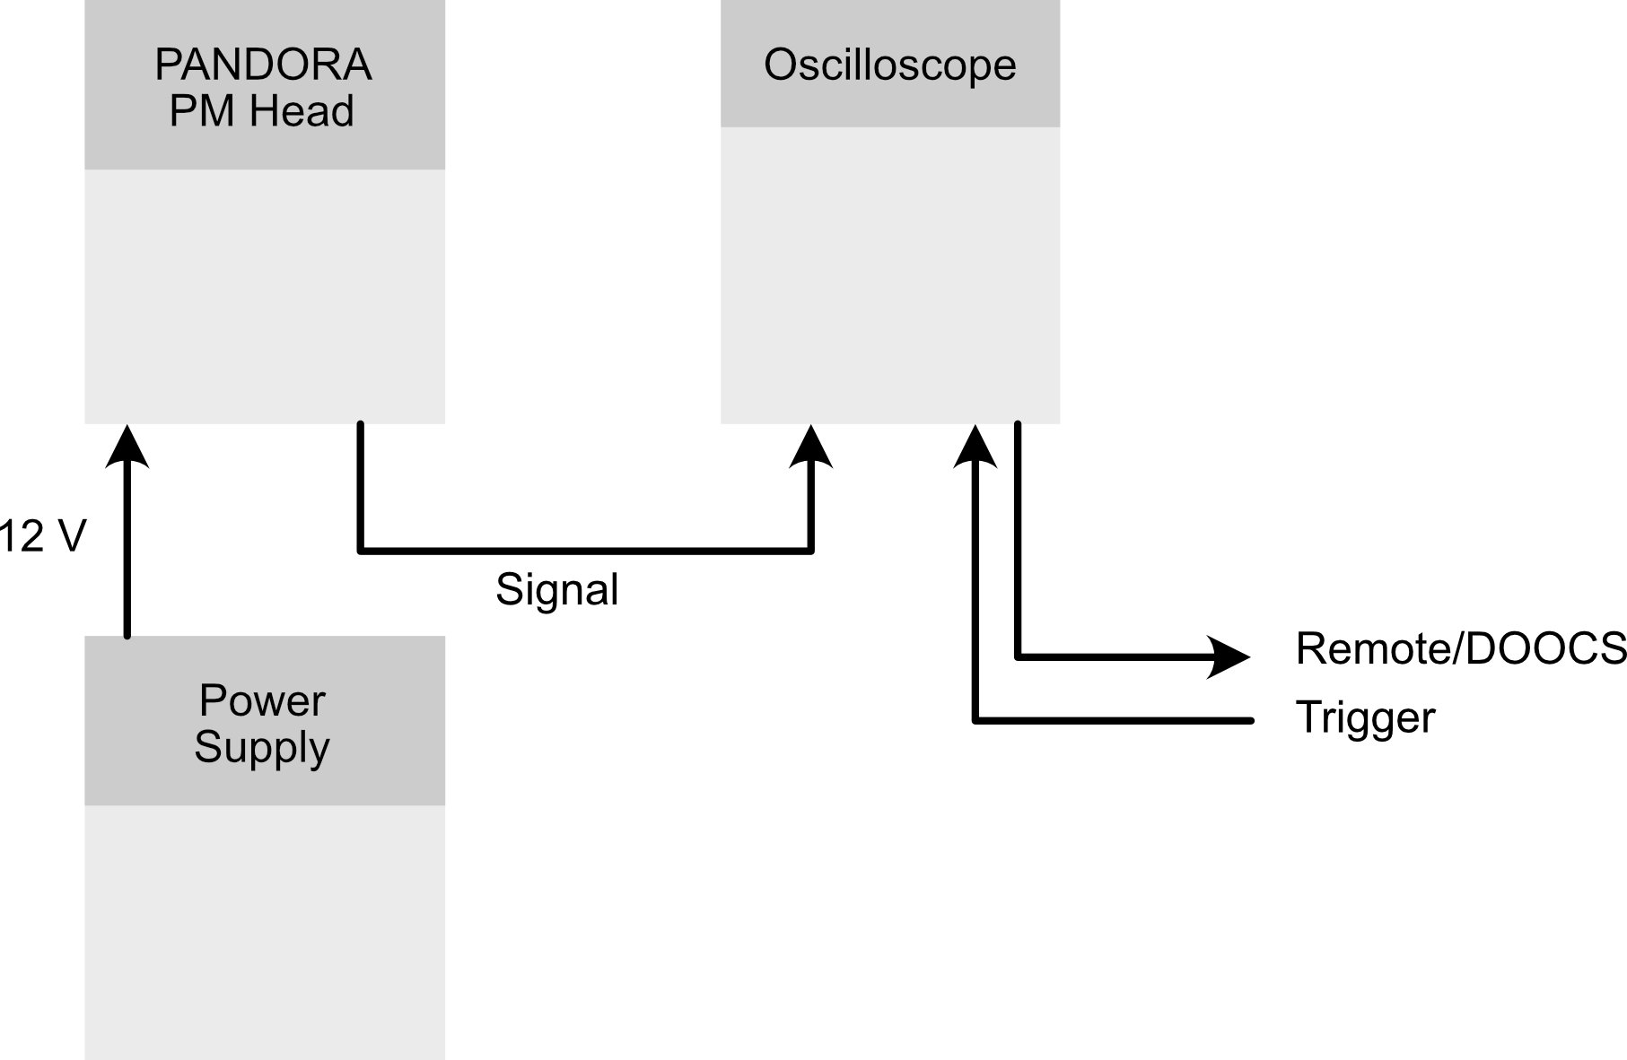
2023-08-31 D3@ARES
PANDORA PM response measurements
Goal:
Measurement of the PANDORA PM response for different beam intensities
at different positions.
Beam requirements:
0.5 - 10 pC per bunch
Beam size 1 mm x 1mm rms
Single bunch shots
(ZZ for changing the detector) Maybe
Requirements
Scope
Trigger signal
Procedure
Adjust detector position in respect to the beam
Record detector signal with the scope at different intensities
Setup
Cabling

