Slide 1
ARES Operation Meeting
Summary of week 35 / 2023
Willi Kuropka, on behalf of the ARES crew

Slide 2
ACHIP
Over the weekend: Gun RF station conditioning, stable charge voltage could be improved
Monday: MKK work, 74MV/m gun gradient restored
Tuesday: Check and readjust laser on table, transmission to IP improved!, On-crest WP established
Wednesday: Stage 0 modulation achieved!
Thursday: D3 NitroFlash detector with Oliver
Friday: AutoAcc shift, On-crest WP for ACHIP restored
Weekend: improved ACHIP modulation by aligning laser, established velocity bunching WP with relatively stable transmission, but no interaction achieved, yet

Slide 3
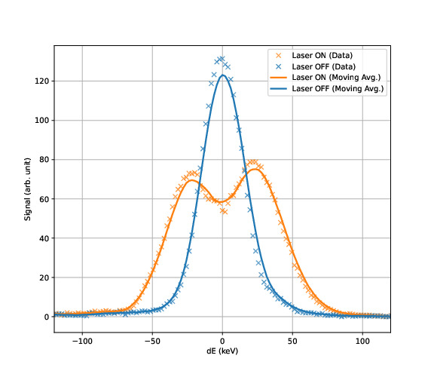
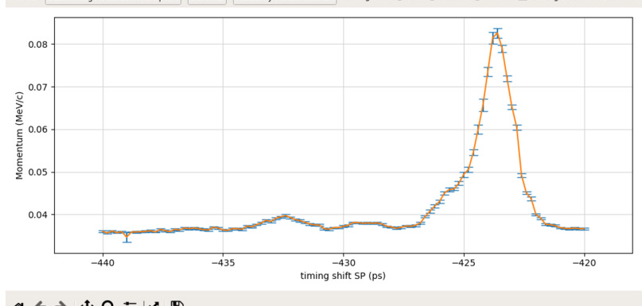
Modulation result wednesday
Again with 74MV/m gun gradient WP
Less modulation, but very clear signal
Aligning the laser with the Cherenkov light on the observation cam appears to work reasonably well

Slide 4
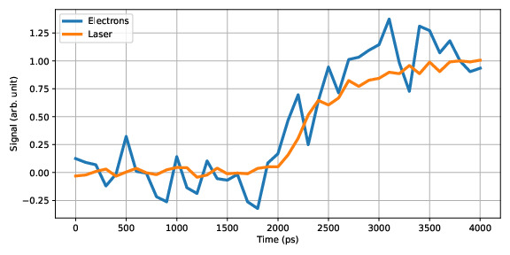
Gated camera timing works very well!

Slide 5
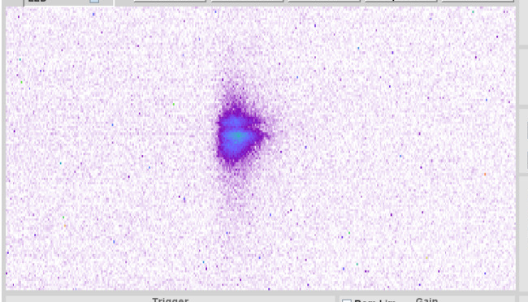
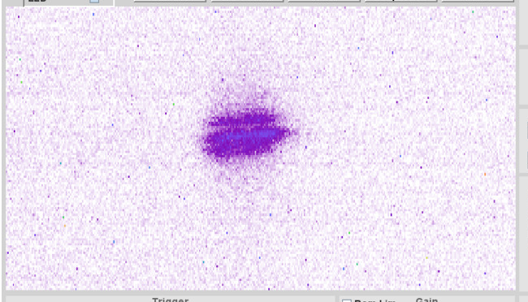
Very clear modulation signal
Improved modulation on weekend, ca 1mJ laser power on the last lens
Laser off
Laser on

Slide 6
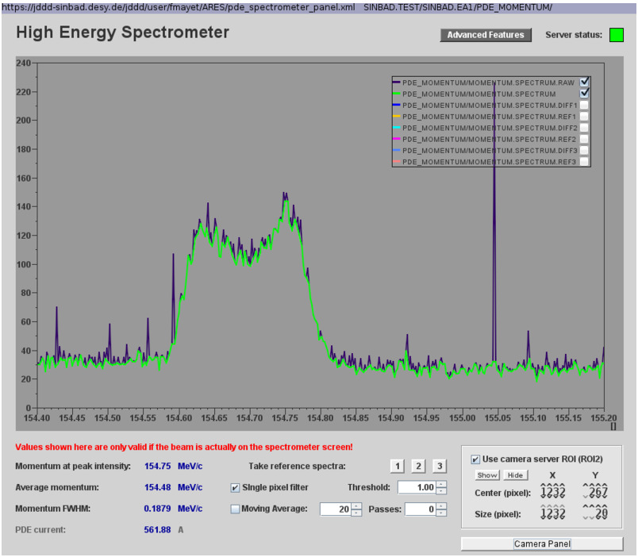
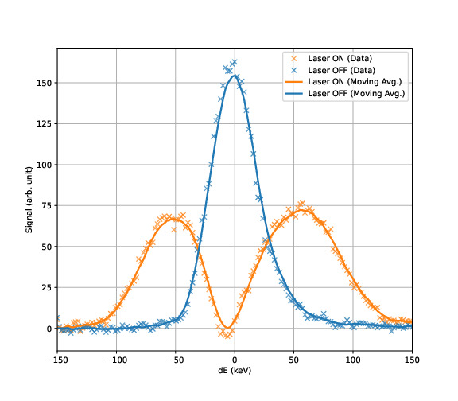
Very clear modulation signal
Improved modulation on weekend, ca 1mJ laser power on the last lens

Slide 7
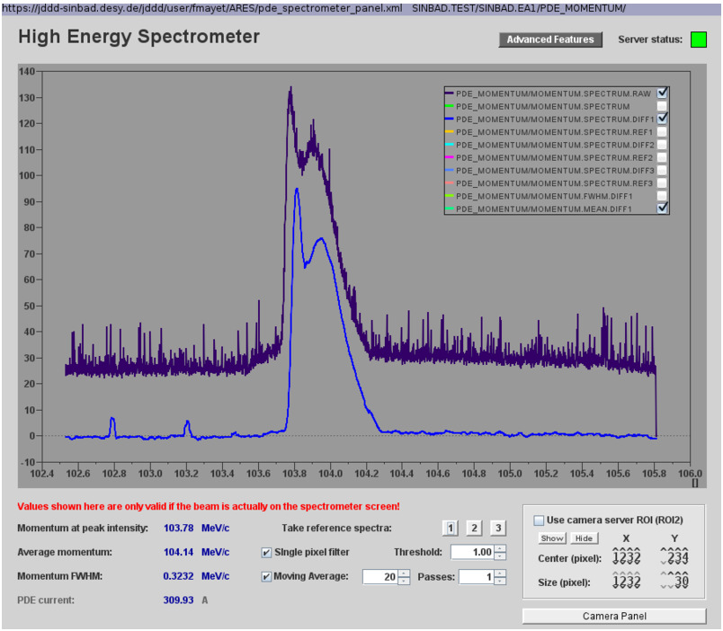
Spectrum of velocity bunching WP

Slide 8
Schedule this week
MCS server updates
MKK commissioning of the precision water cooling for the X-band system

