Slide 1
Non-Gaussianity in single field models without slow-roll
Johannes Noller, Imperial College London
Cosmology meets Particle Physics, DESY, Hamburg, 28/09/2011

Slide 2
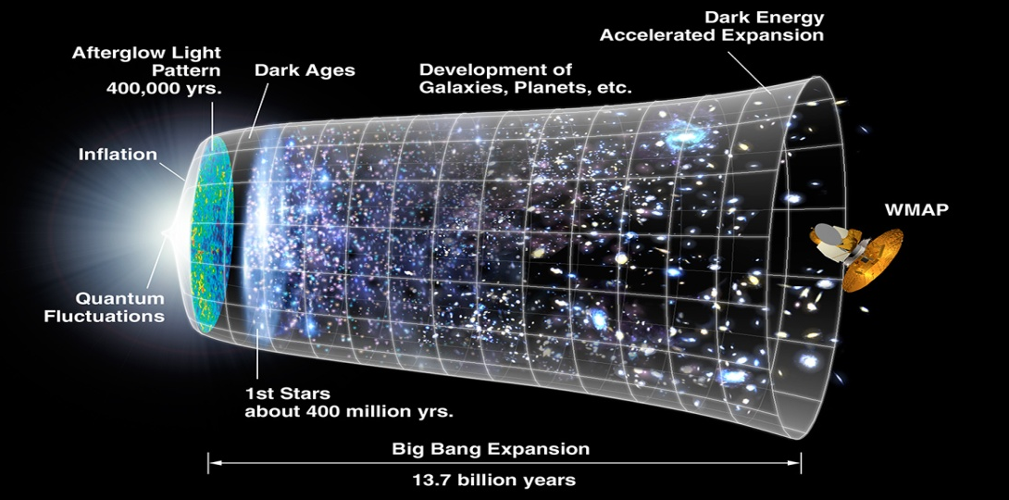
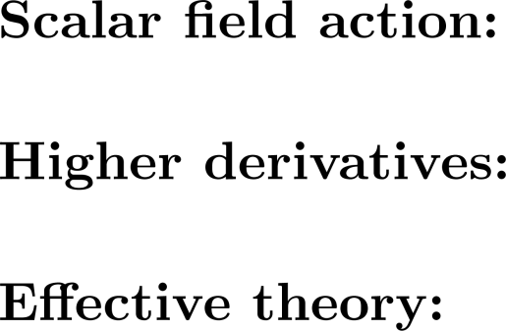
The most general Lorentz invariant action for a single scalar field minimally coupled to gravity that contains at most first derivatives of the field

Slide 4
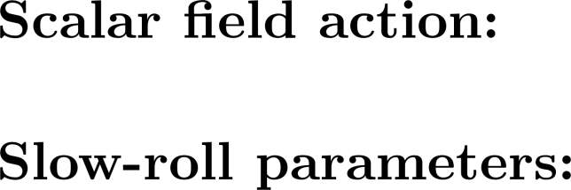
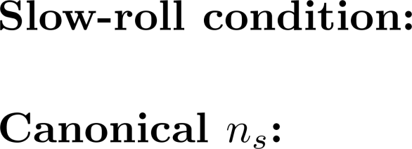
Notes:
Perhaps kill canonical n_s, no need to motivate slow-roll here really?????

Slide 5
cf. Chen ’10 , Khoury, Piazza ‘09 , Senatore et al. ‘09 , Seery, Lidsey ‘05
Plots by: Baumann; Renaux-Petel, Chen; JN

Slide 6
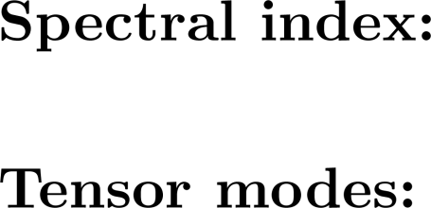
Agarwal & Bean ’09, Lorenz et al. ’08, Lidsey & Huston ’07, Stewart & Lyth ‘93

Slide 7
Running
Non-Gaussianity
cf. JN & Magueijo ‘11 , Byrnes et al. ’10, Khoury & Piazza ‘09, LoVerde et al. ‘08
Notes:
Strong coupling, show cutoff

Slide 8
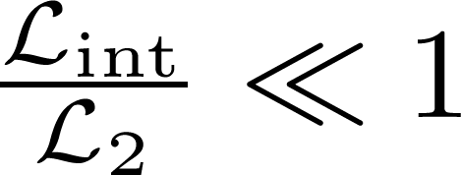
Running
Non-Gaussianity
cf. JN & Magueijo ‘11 , Byrnes et al. ’10, Khoury & Piazza ‘09, LoVerde et al. ‘08
Strong coupling
constraints
cf. Baumann et al. ‘11, Senatore et al. ‘09, Cheung et al. ‘07
Notes:
Strong coupling, show cutoff

Slide 9
LoVerde et al. ’08, Creminelli et al. ’06
Plots from LoVerde et al. ‘08
Notes:
Perhaps take out if time gets short….

Slide 10
JN & Magueijo ‘11, Magueijo, JN, Piazza ’10, Khoury & Piazza ‘09

Slide 11
JN & Magueijo ‘11, Magueijo, JN, Piazza ’10, Khoury & Piazza ‘09

Slide 12
Thank you!
JN & Magueijo, (PRD 83, 103511), arXiv:1102.0275

