Slide 1
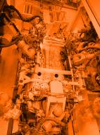
Tutorial
Debugging a MTCA system
12th DESY Workshop
powerBridge Computer Vertriebs GmbH
December, 2023

Slide 2
At a Glance
30 years in the market
Privately owned
30+ years VME experience
Own lab and integration facilities
powerBridge has delivered over 6.000 systems and 30.000 VME boards
PICMG member, actively working on MTCA Next Gen specification
ISO 9001:2015 and 14001:2015 approved

Slide 3
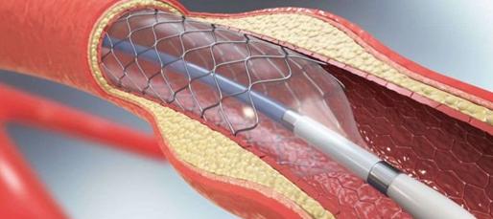
Defence
Industrial
Automation
Aerospace
Medical
Transportation
Telecommunication
Science

Slide 4
System debugging on a MTCA System
MTCA systems are not complicated at all!

Slide 5
System debugging on a MTCA System
MTCA systems are not complicated at all!
OS related debugging
OS system and OS tools
dmesg or lspci or else
MTCA user
Webinterface
NATView
MCH command line interface

Slide 6
System debugging on a MTCA System
Scope of the tutorial
This tutorial shall give you some tools to debug a MTCA system as
Normal user without system experience
Visual diagnose
Normal user with system experience
Webinterface
Experienced MTCA user
Webinterface
NATView
MCH command line interface

Slide 7
System debugging on a MTCA System
MTCA.0 Rev.3 has been released recently!

Slide 8
System debugging on a MTCA System
MTCA.0 Rev.3 has been released recently!
This tutorial do concentrate on the current available hardware only

Slide 9
System debugging on a MTCA System
MTCA.0 Rev.3 has been released recently!
This tutorial do concentrate on the current available hardware only
New products are underway with improved feature sets

Slide 10
System debugging on a MTCA System
MTCA.0 Rev.3 has been released recently!
This tutorial do concentrate on the current available hardware only
New products are underway with improved feature sets
Tutorial shows samples, there may other vendors/products on the market

Slide 11
System debugging on a MTCA System
Without further help
Watchout for LEDs on
AMC
MCH
Normal user with system experience
Linux internal commands
View of PCIe devices in the system
MCH Webinterface
GbE Link state
PCIe Link state
Systeminformation
Experienced MTCA user
MCH Webinterface
MCH configuration
PCIe setup
LAN setup
MCH command line
Useful commands, …

Slide 12
MTCA Debug visual
STAT
Shows the status of MCH
Primary (green) or Secondary (yellow)
Hot Swap LED
FLT
Red LED indicates error

Slide 13
MTCA Debug visual
FRU* Indicator
Indicates if a FRU is detected
Indicates presence of up to 4 PM
Indicates presence of up to 2 CU
Indicates presence of up to 12 AMC
Green LED indicates a valid FRU
No LED: no FRU
LED blinks: IPMI communikation, FRU data are queried
LED on: FRU is detected and ready for operation
FRU Indicator
* FRU stands for Field replaceable unit

Slide 14
MTCA Debug visual
PCIe Link Indicator
Indicates an existing PCIe Link
Slowly blinking (PCIe Gen.1)
Fast blinking (PCIe Gen.2)
Constant green light (PCIe Gen.3)
PCIe Link Indicator

Slide 15
MTCA Debug visual
OK LED
Shows the status of AMC
Hot Swap LED
S (SATA activity)
WD (Watchdog LED)
Red LED indicates error

Slide 16
MTCA Debug visual
Inspect the system front carefully for LED signs
Blue HS LED must be OFF on any FRU
Usually a green LED indicates proper functions
OK LED
Shows the status of AMC
Hot Swap LED

Slide 17
MTCA Debug visual
Inspect the system front carefully for LED signs
Red LED indicates a suspicious condition
Refer to user manual of AMC
Yellow or other colour LED may indicate activity signs
In case of doubt, refer to user manual of AMC
S (SATA activity)
WD (Watchdog LED)
Red LED indicates error

Slide 18
Software tools
Browserinterface
Access via LAN (192.168.1.41)
Password protected
General configuration incl. LAN and PCIe Switch
Debug Flags
NATView
JAVA based tool
LAN
Access of sensordata/ FRU Information, Power configuration
Command line interface
Terminalprogram
USB-to-Serial (19200, 8, N, 1)
LAN (192.168.1.41)

Slide 19
Browserinterface

Slide 20
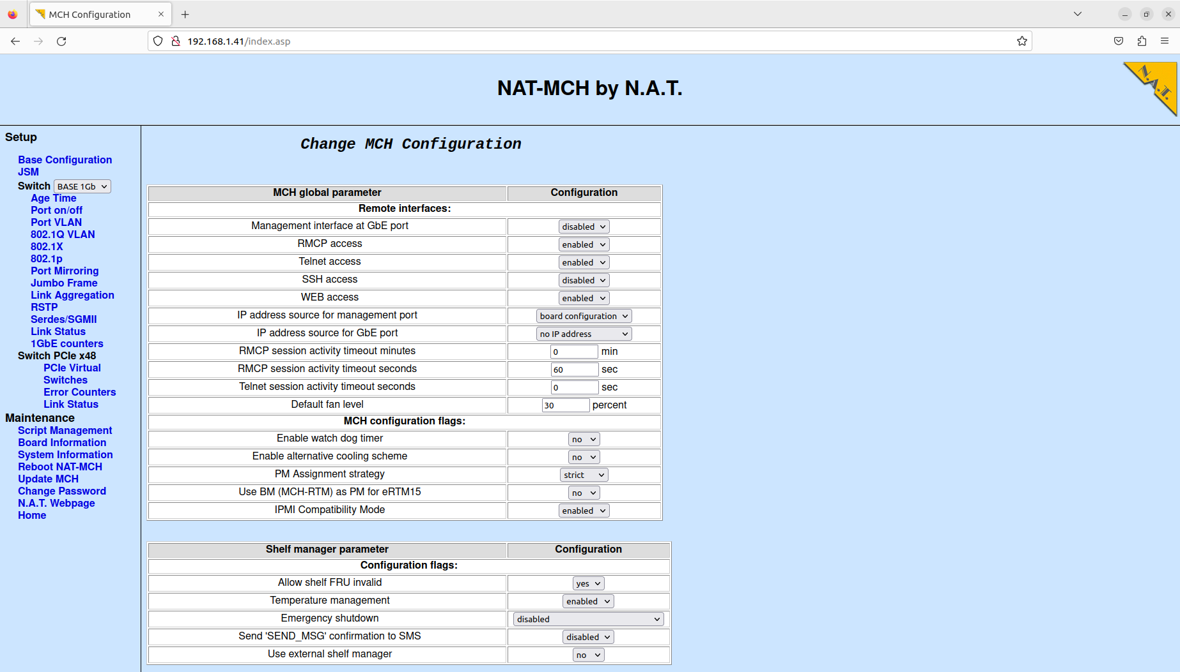
Browserinterface

Slide 21
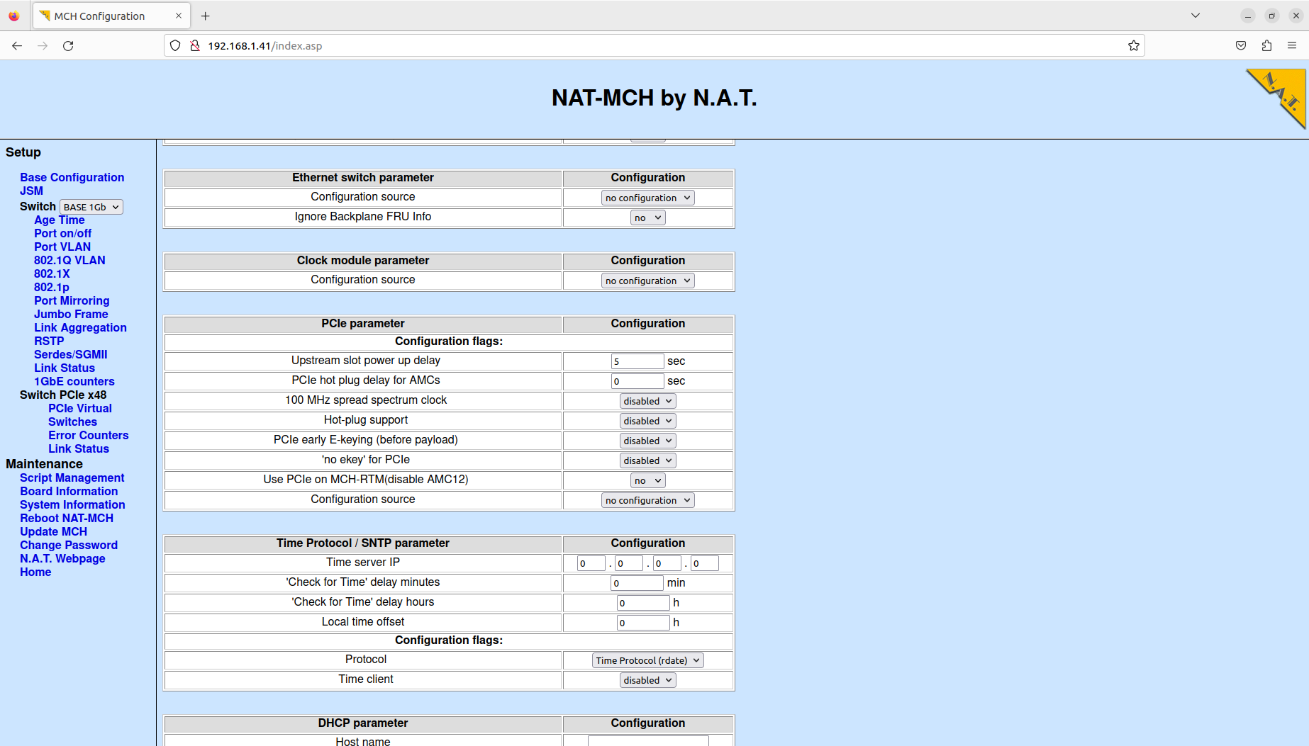
Browserinterface

Slide 22
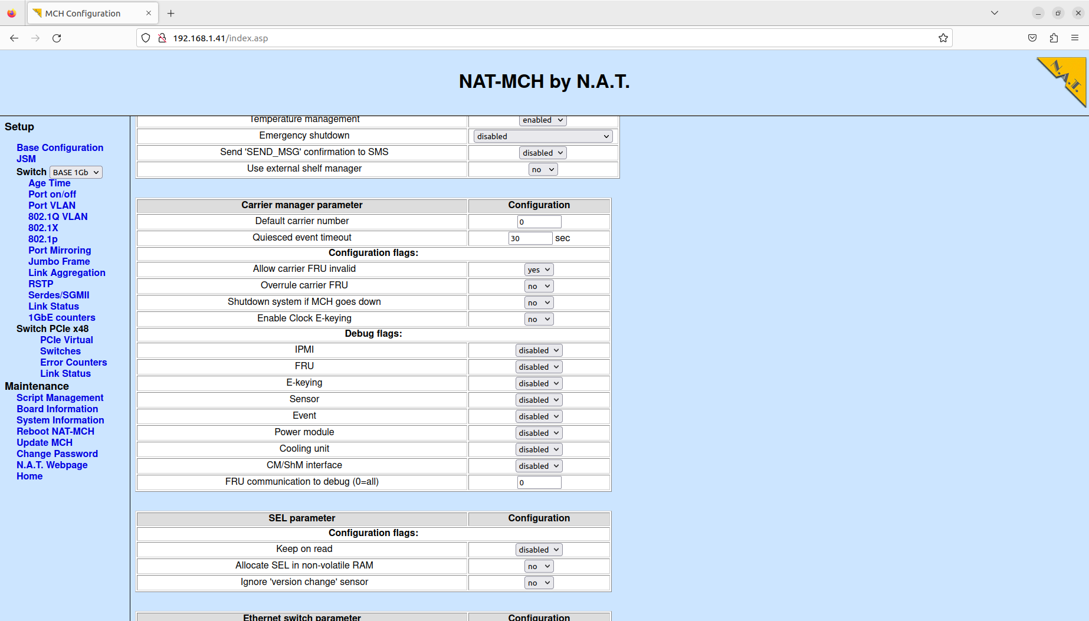
Browserinterface

Slide 23
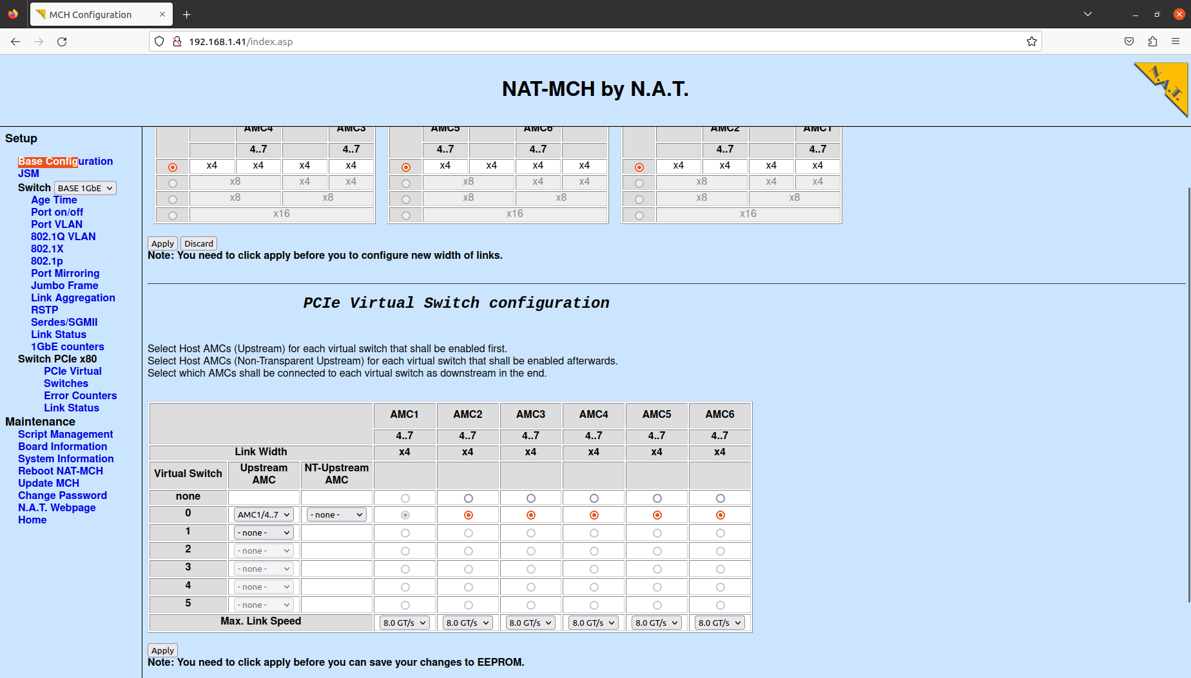
Browserinterface

Slide 24
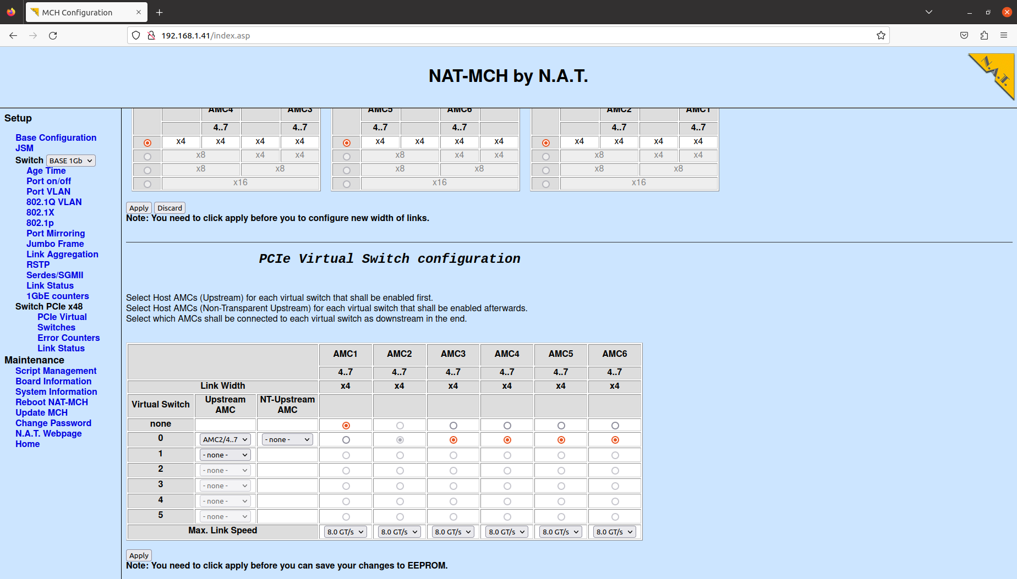
Browserinterface

Slide 25
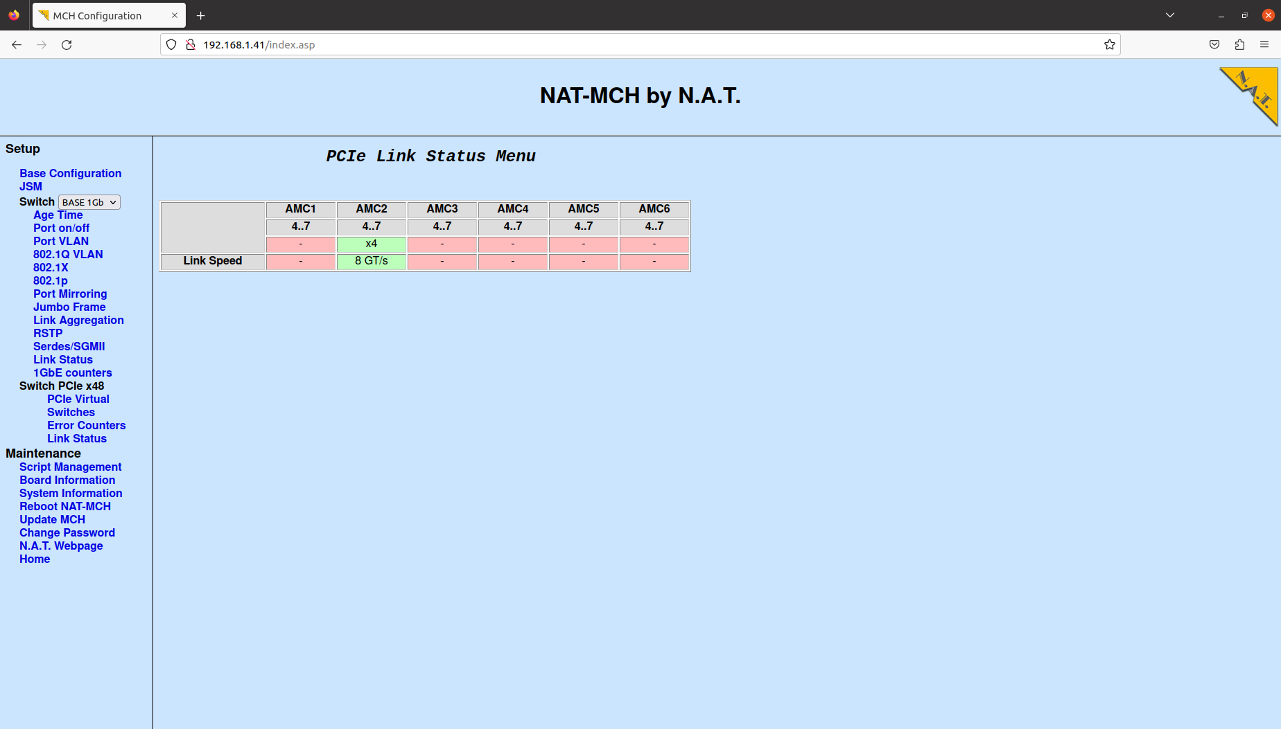
Browserinterface

Slide 26
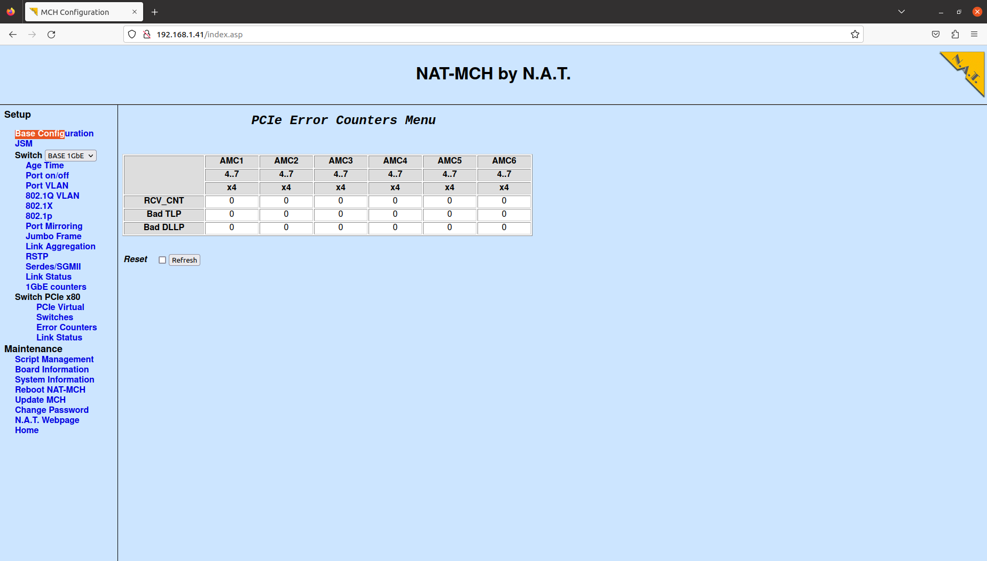
Browserinterface

Slide 27
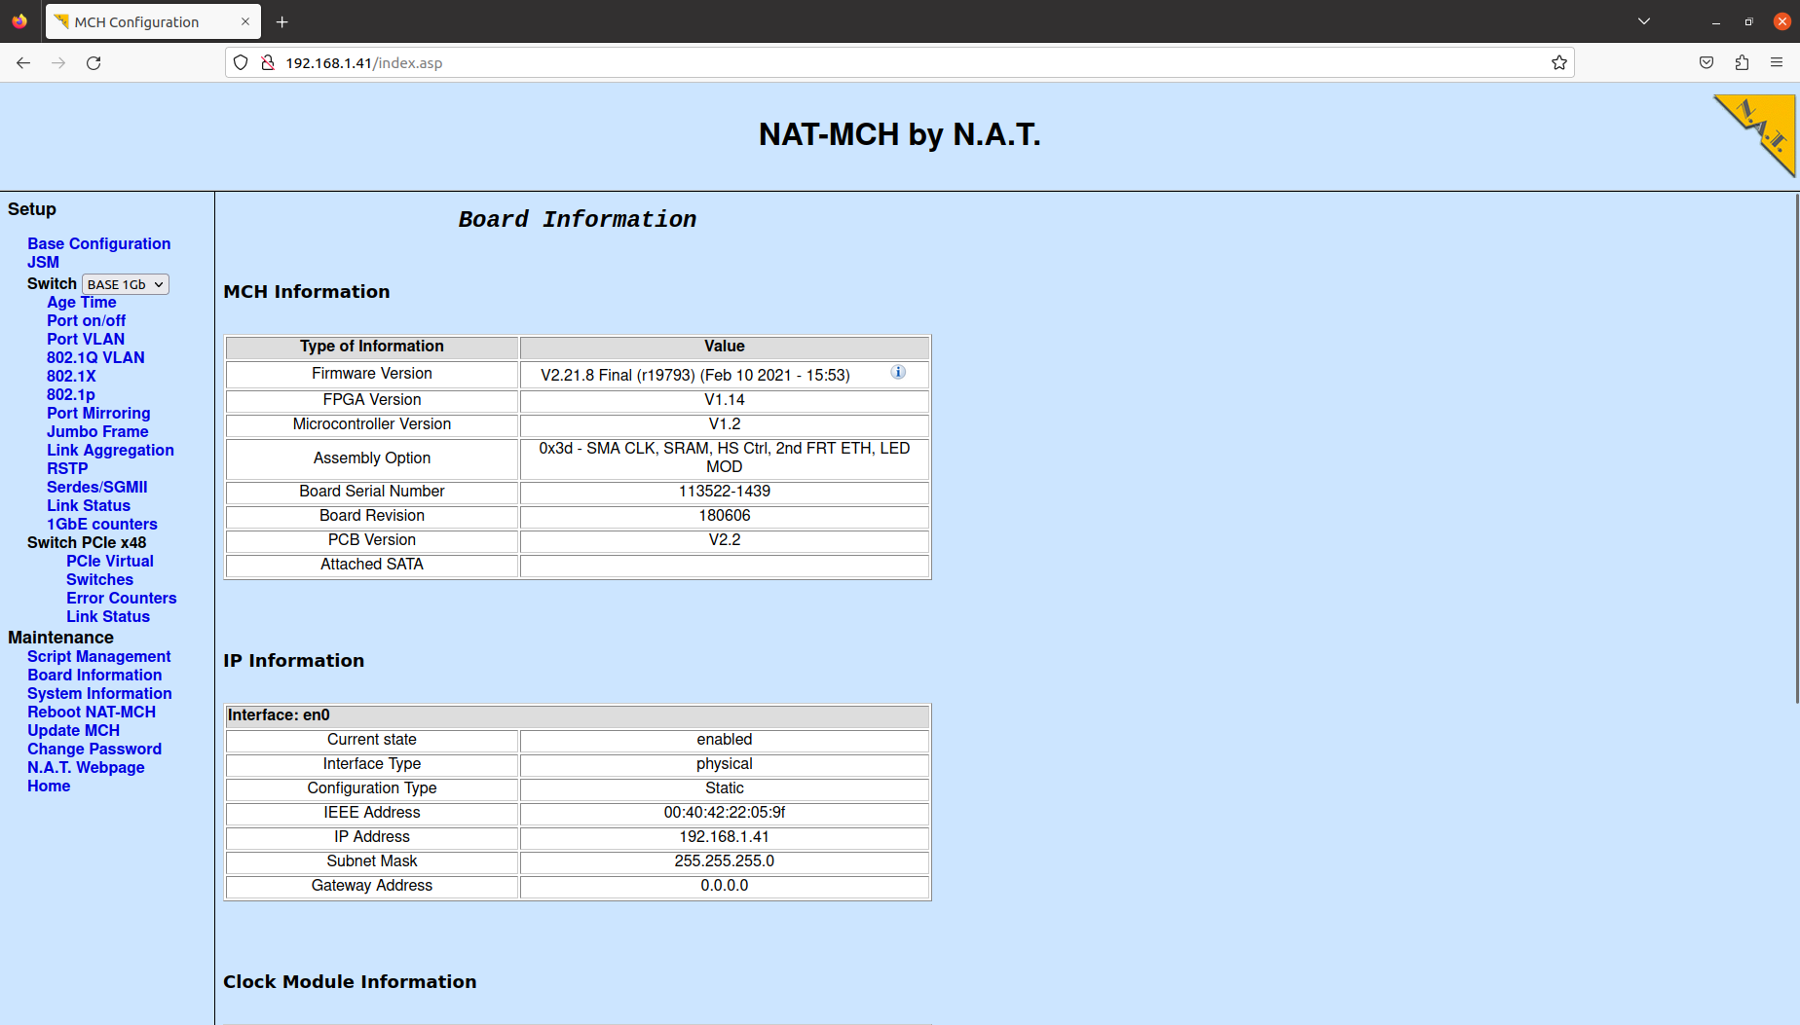
Browserinterface
Current version is 2.23.5
March 2023!

Slide 28
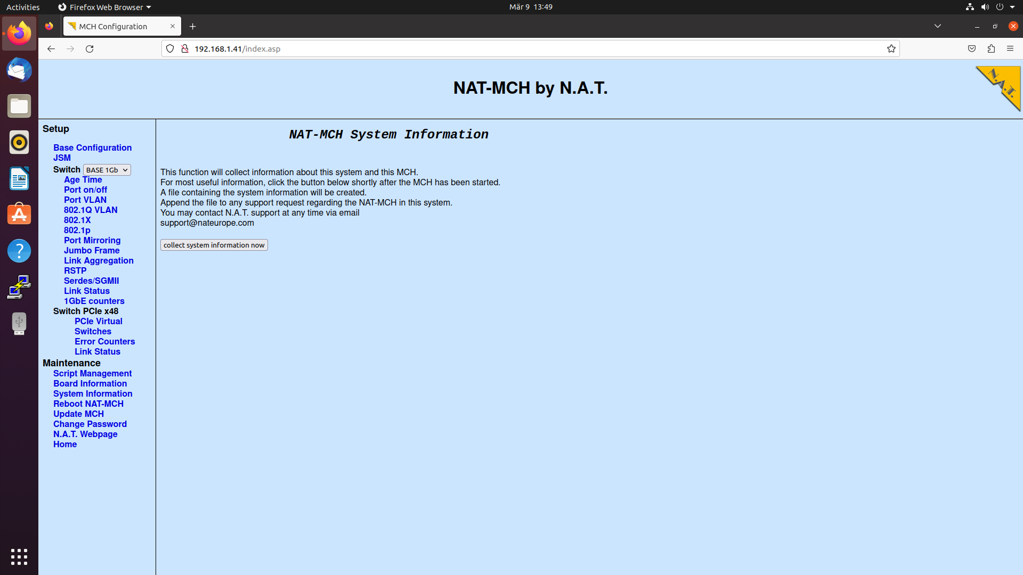
Browserinterface

Slide 29
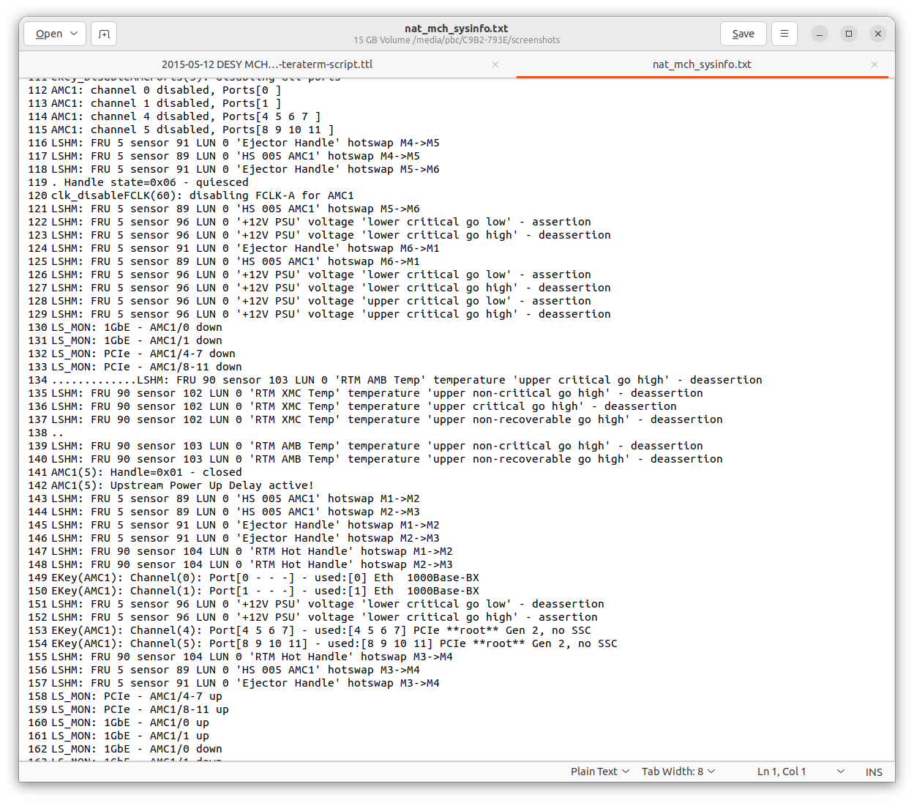
Systeminformation/ History

Slide 30
Tool NATView
Browserinterface
Access via LAN (192.168.1.41)
Password protected
General configuration incl. LAN and PCIe Switch
Debug Flags
NATView
JAVA based tool
LAN
Access of sensordata/ FRU Information, Power configuration
Command line interface
Terminalprogram
USB-to-Serial (19200, 8, N, 1)
LAN (192.168.1.41)

Slide 31
NATView
JAVA Tool
Platform independant, Windows, MacOS, Linux, etc.
JAVA 1.8 or better
Different licensing models
NATView Easy
Standardversion, no cost
Limited functions
NATView FE
Single User, FRU Editor
NATView HPM
Single User, HPM Update
NATView PRO
5 User, all functions
NATView PRO-C
Company edition, unlimited users, all functions
Current version (November 2023) Version 3.4

Slide 32
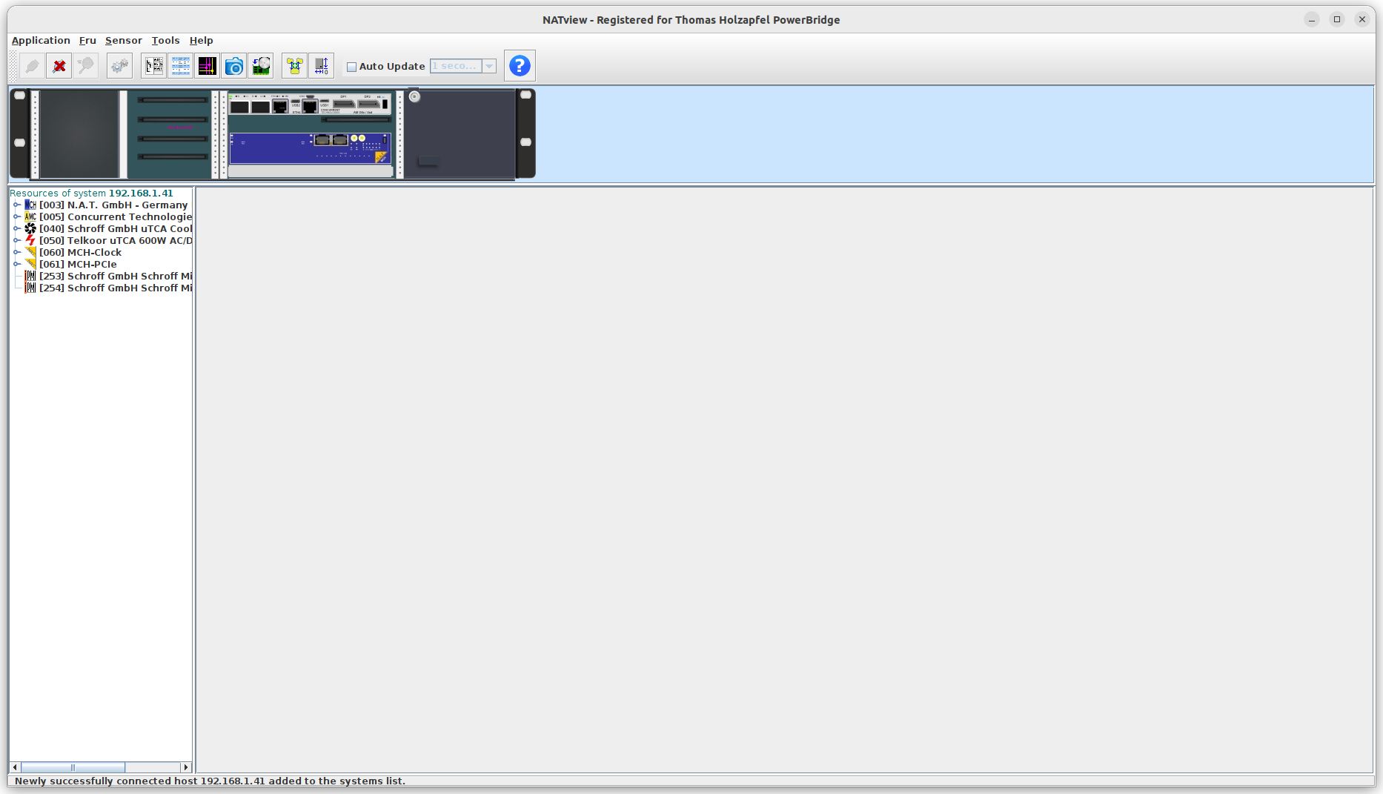
NATView
Graphical image of AMC modules and chassis (if image exists)
Display of modules with status

Slide 33
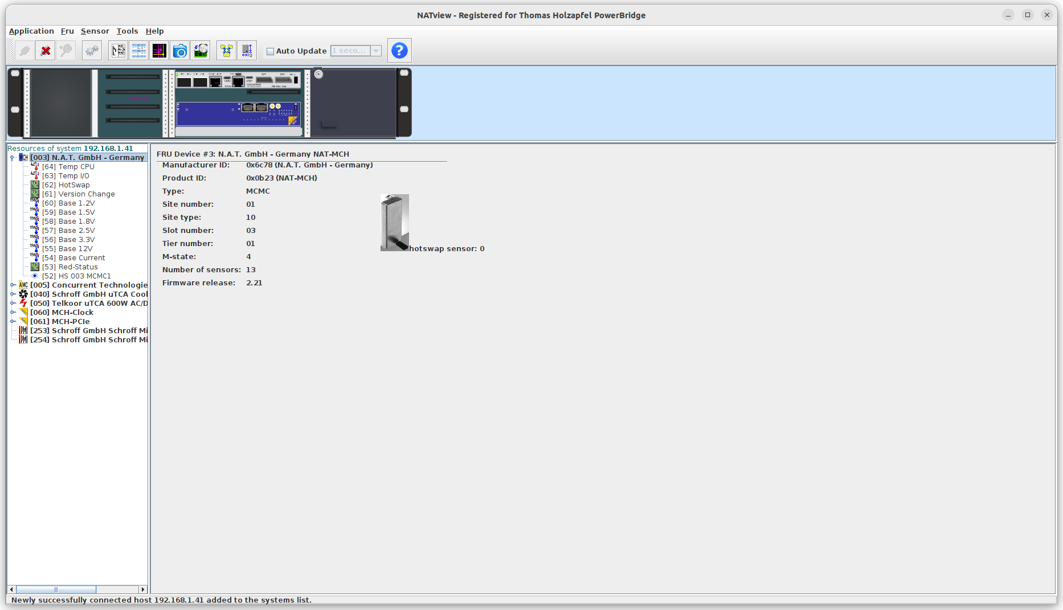
NATView
Display of sensor values for the modules

Slide 34
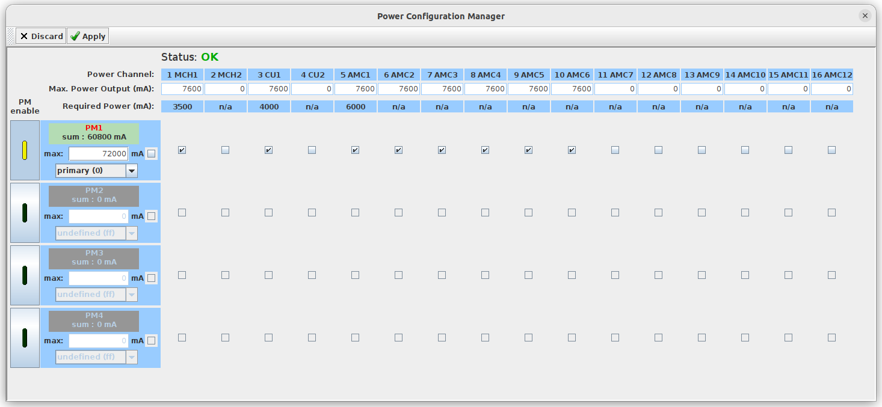
NATView
Power Backplane Editor

Slide 35
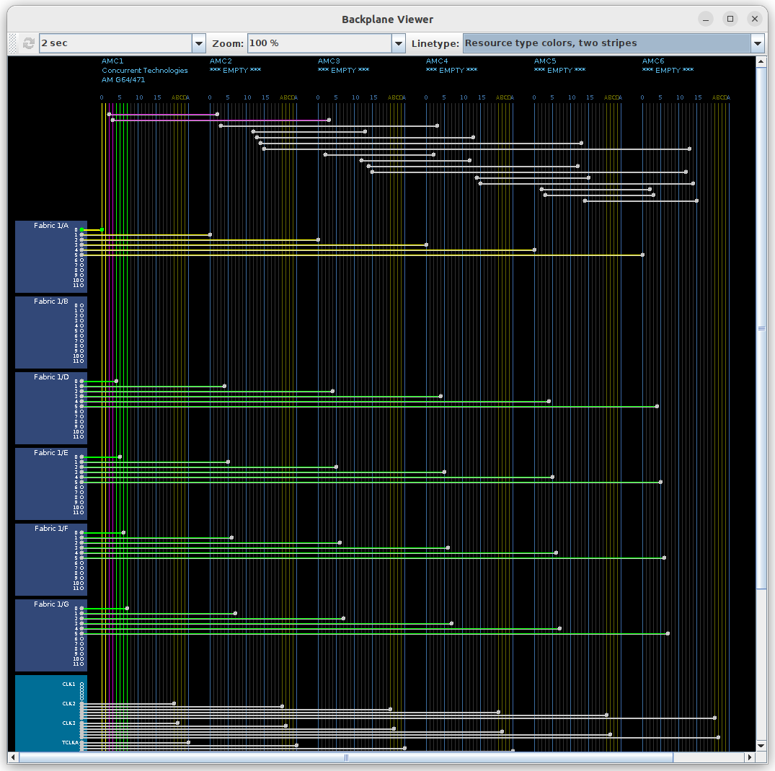
NATView
Backplane Viewer
Displays all active connections
graphical „show_link_state“ command

Slide 36
Command Line tool
Browserinterface
Access via LAN (192.168.1.41)
Password protected
General configuration incl. LAN and PCIe Switch
Debug Flags
NATView
JAVA based tool
LAN
Access of sensordata/ FRU Information, Power configuration
Command line interface
Terminalprogram
USB-to-Serial (19200, 8, N, 1)
LAN (192.168.1.41)

Slide 37
Command line
Terminalprogramm needed
Windows: „putty“, „Terraterm“, etc.
Linux: build in program „telnet“ or ext. terminal software

Slide 38
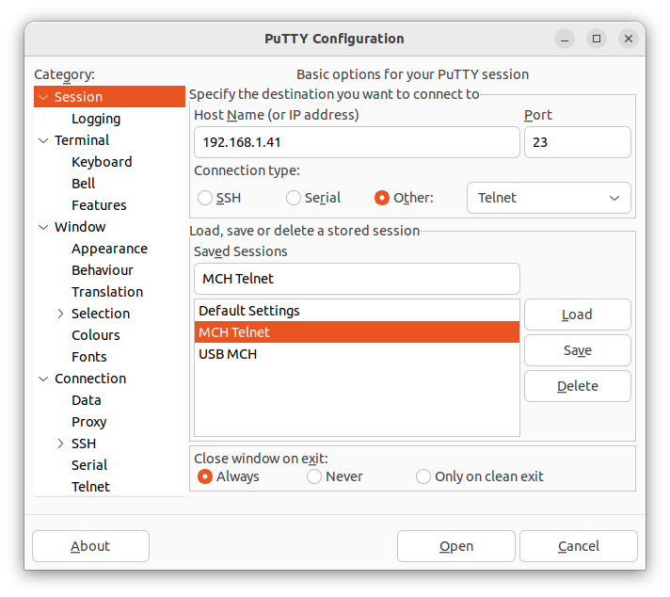
Command line
Windows
PuTTY
TerraTerm
…
Linux
telnet 192.168.1.41

Slide 39
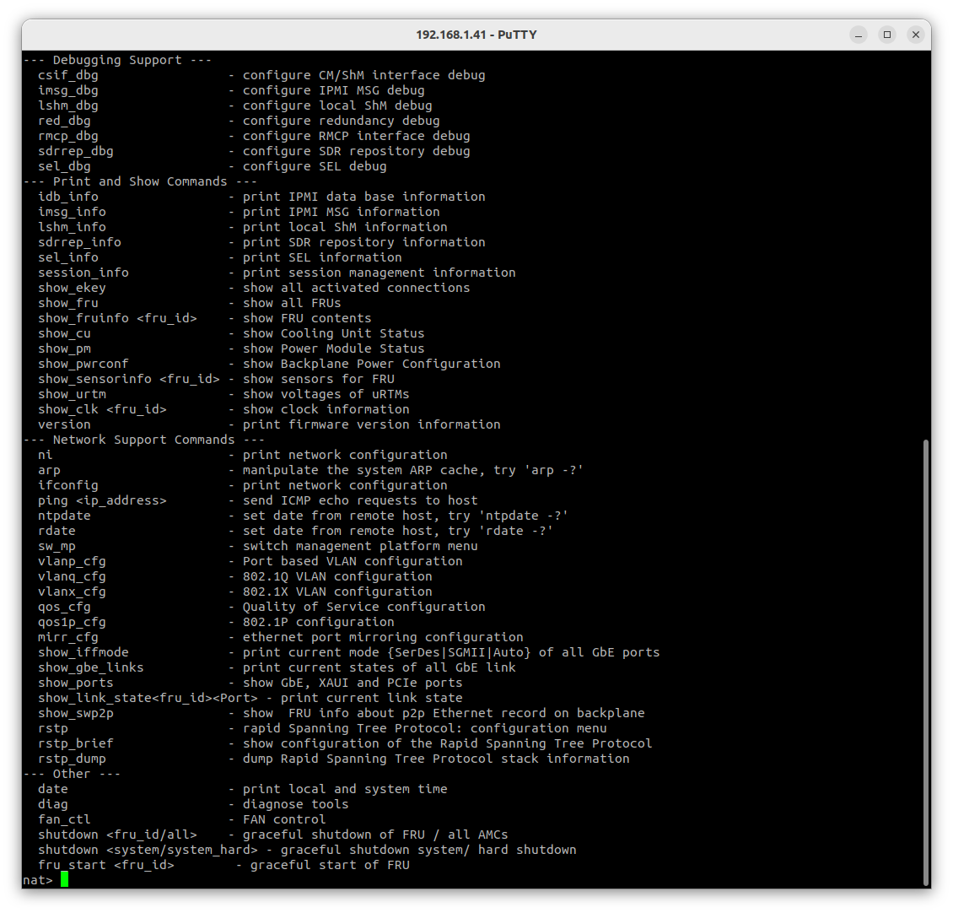
Command line
CLI for information and setup
Runtime information from system and MCH
„?“ Displays all commands

Slide 40
Command line
Help function available
„?“
Important commands
show_ekey
show_fru
show_fruinfo <fru_id>
show_cu
show_pm
show_powerconf
show_sensorinfo <fru_id>
show_urtm
show_clk <fru_id>
ni
ifconfig
version
Most important command
history

Slide 41
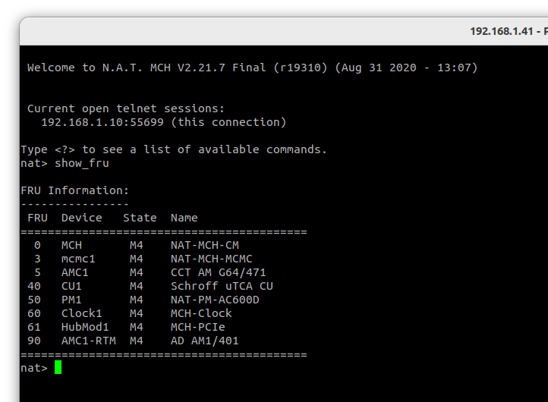
Command line
show_fru
Show all FRUs

Slide 42
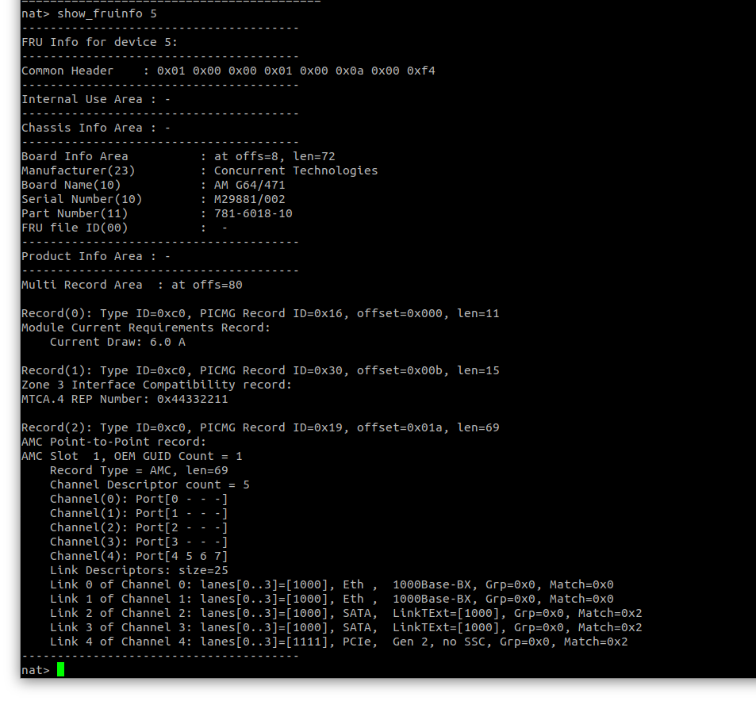
Command line
show_fruinfo <fru id>
Show FRU content
Sensor values
…

Slide 43
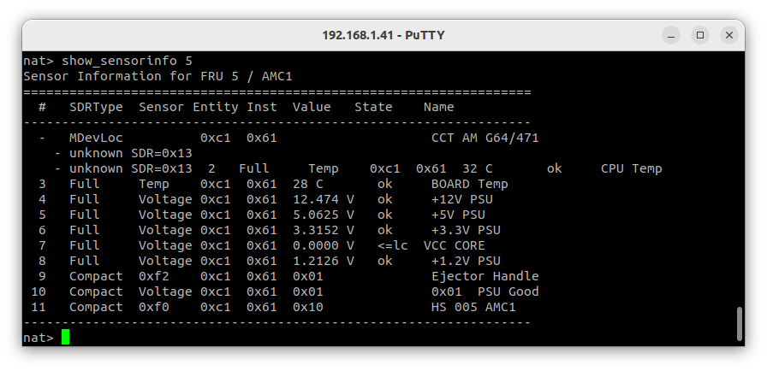
Command line
show_sensorinfo <fru id>
Show sensors of FRU
…

Slide 44
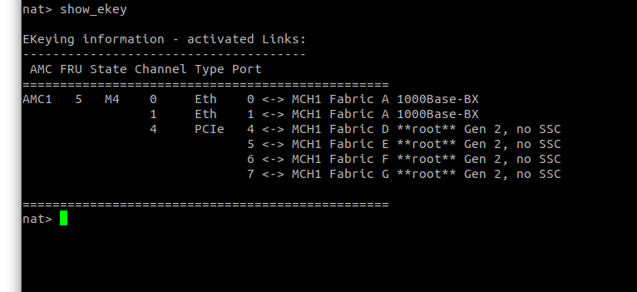
Command line
show_ekey
Show all activated connections

Slide 45
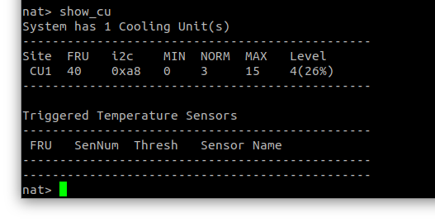
Command line
show_cu
Show cooling unit status
…

Slide 46
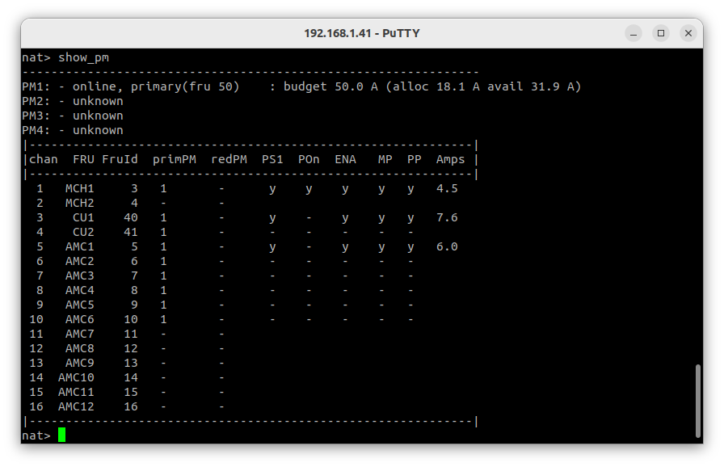
Command line
show_pm
Show power module status
…

Slide 47
Command line
show_powerconf
Show backplane power configuration

Slide 48
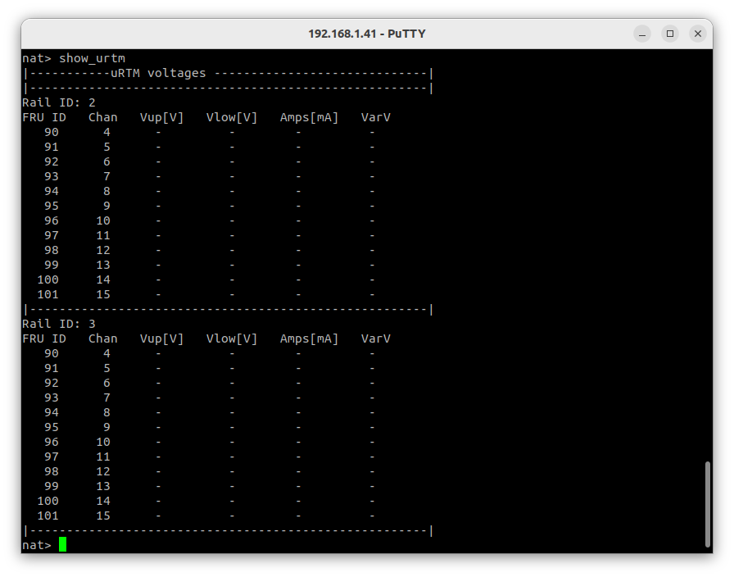
Command line
show_urtm
Show voltages of uRTMs
…

Slide 49
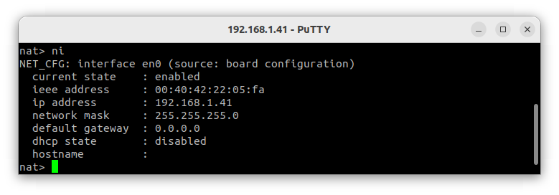
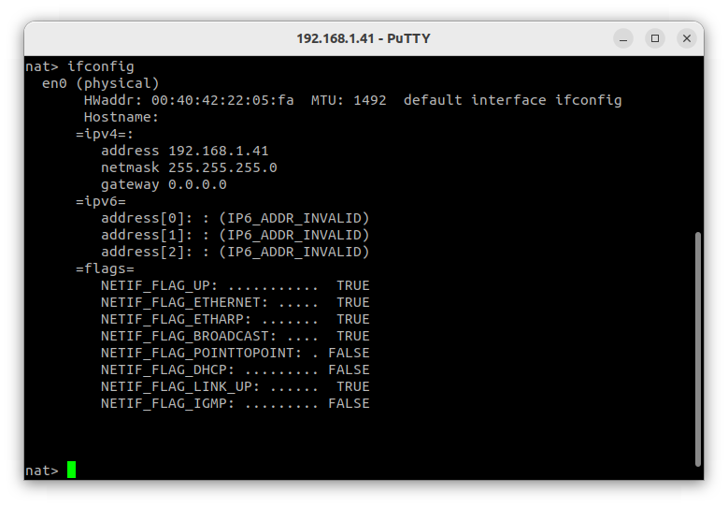
Command line
ni
ifconfig
Print network configuration
…

Slide 50
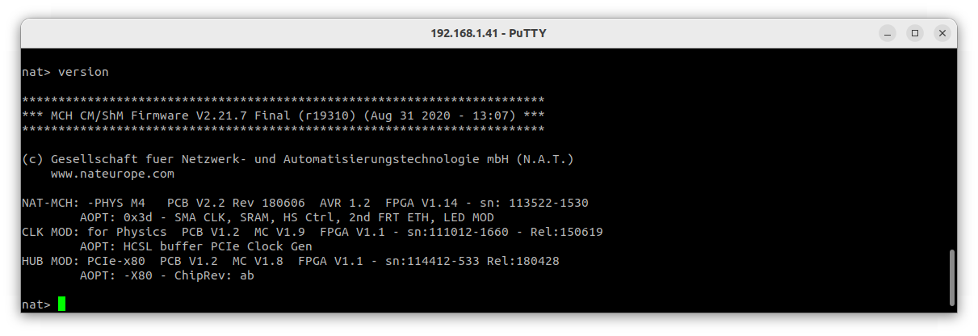
Command line
version
Print firmware version information
Latest version 2.23.5
…

Slide 51
Systeminformation/ History

Slide 52
The End
Questions?
Thanks for listening 😁

Slide 53
Contact Information
Thomas Holzapfel
Email: thomas.holzapfel@powerbridge.de
Tel: +49-5139-9980-21
Friedrich Fix
Email: friedrich.fix@powerbridge.de
Tel: +49-5139-9980-15
Daniel Redmann
Email: daniel.redmann@powerbridge.de
Tel: +49-5139-9980-23
Tobias Naber
Email: tobias.naber@powerbridge.de
Tel: +49-5139-9980-37
powerBridge Computer Vertriebs GmbH,
Ehlbeek 15a, 30938 Burgwedel, Germany
http://www.powerbridge.de

