Slide 1
ARES Operation Meeting
Summary of week 37 / 2023
Max Kellermeier, on behalf of the ARES crew

Slide 2
Summary of week 37
Mon. 11th Sep | Tue. 12th Sep | Wed. 13th Sep | Thu. 14th Sep | Fri. 15th Sep
 | Beam setup for eCT beamtime Initial eCT measurements Investigations of Gun issues | Gun water temperature and flow rate investigations → finally solved eCT studies continued with stable beam, 2D scans | Manual rotational scans with automated 2D scan for full 3D reconstruction Long 2D high res. scan in the evening | 3D scans continued High res 2D slice scan, i.e. rotational and horizontal scan
Gun modulator unstable (operational for ~1h) | Gun modulator interlock overnight TWS2 in fault state | TWS2 in fault state | Beam jump by 0.5mm on Timepix detector
Tunnel open Tunnel closed in the late afternoon |  |  |  | Gun conditioning over the weekend
Achievements
Difficulties
Notes

Slide 3
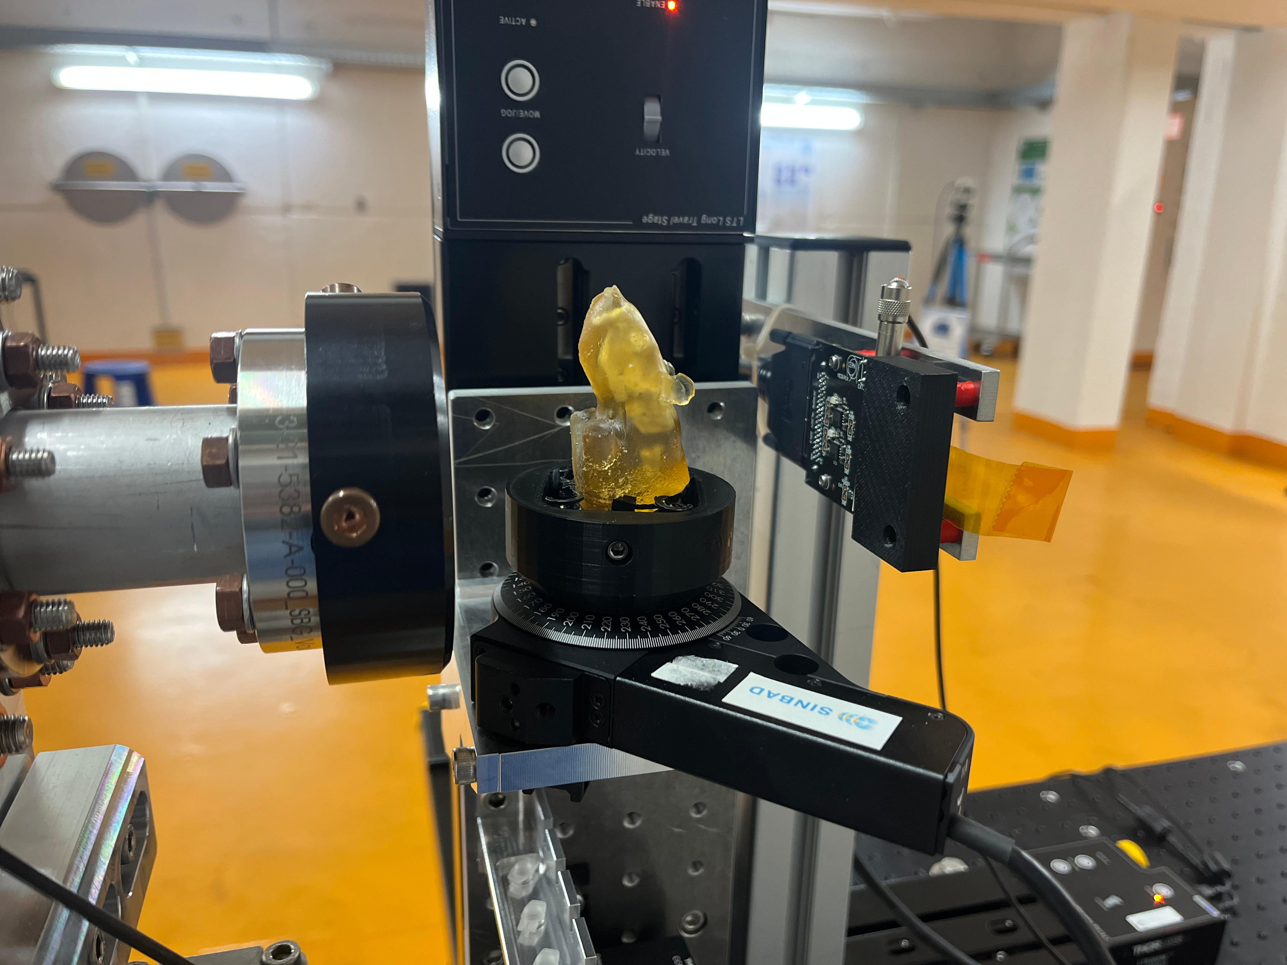
Electron CT
Recap from last week
Mouse phantom scanned with low charge
(< 10 fC) beam
Scattering detected with TimePix3 detector
2D scans: translational stages in x and y
3D scans: additional rotational stage
Synchronization procedure:
Scan always start at aluminum base plate
→ onset when moving into the gap between aluminum and mouse

Slide 4
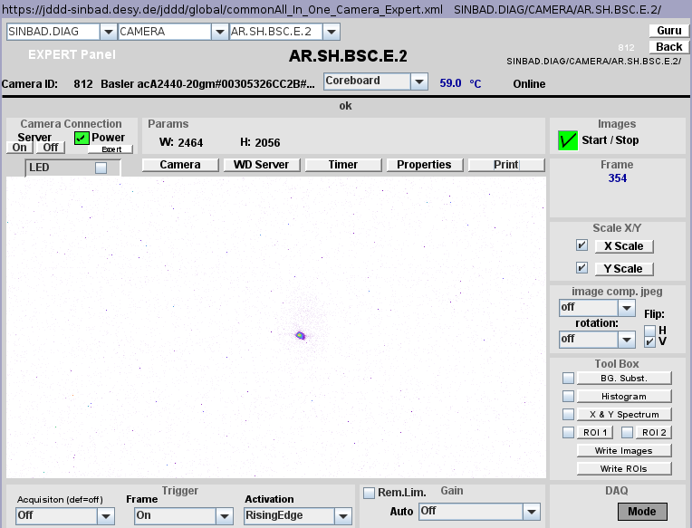
Beam setup for eCT
Tuesday
Low charge beam (0.4 pC) transported to FL section, imaged on FL.A1
Charge decreased by laser attenuator, beam position and size monitored with TimePix
All our diagnostics blind:
  T-ICT lower limit is 12 fC
  Photobeam on FL.A1 hardly distinguishable from dark current

Slide 5
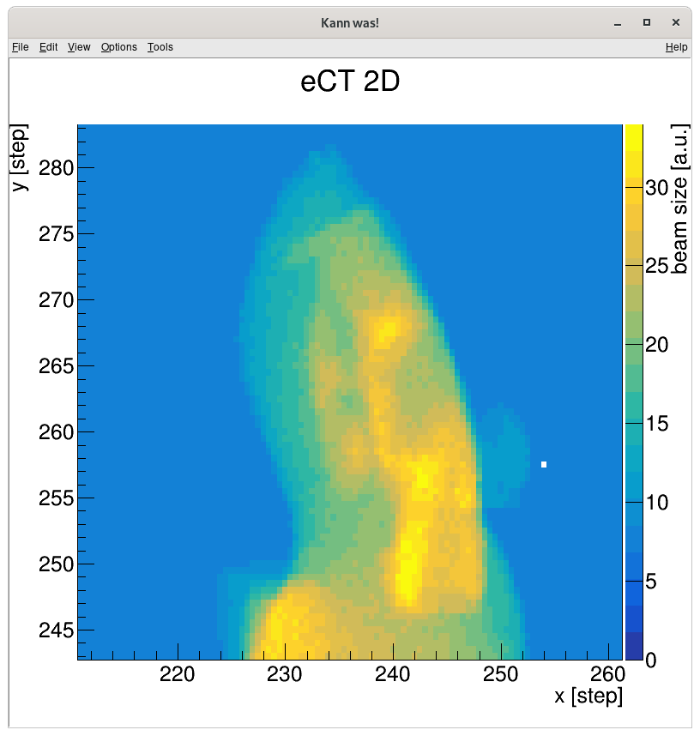
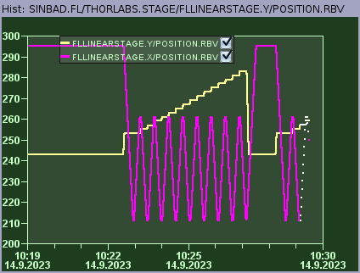
Wednesday: 2D scans
Issues with data interpretation delivered by Timepix detector
“Workaround necessary to analyse data”

Slide 6
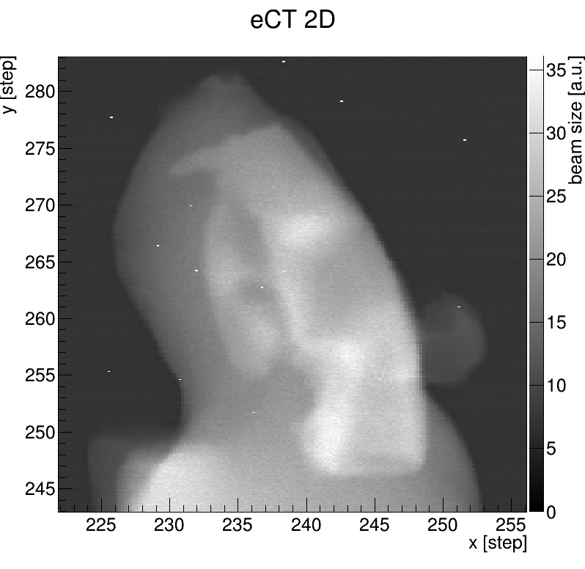
Thursday: Manual 3D Scans
2D scans with manual rotations in between
→ Time consuming
Issue with beam jump (0.5mm) after about 75% of the measurement
  Continued measurement
  Beam jump corrected
  All 2D scans repeated which where conducted after the jump
Automated 3D scans prepared; to be tested in future
High resolution scan in the evening

Slide 7
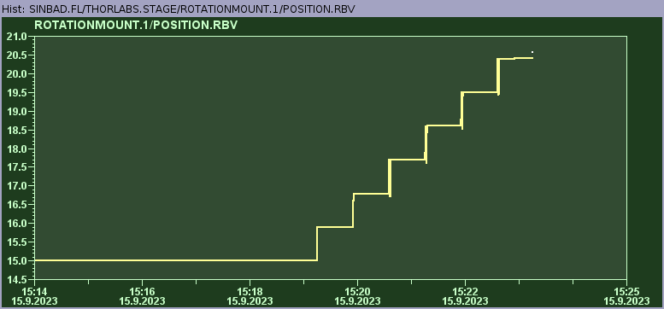
Friday: 3D scans
Resolution from Thursday’s 3D scans not sufficient → repeated with smaller ROI (same number of data points)
High resolution slice scan: 1D scans along x-axis at slow stage velocity, repeated at more angular positions (automated with scan tool)

Slide 8
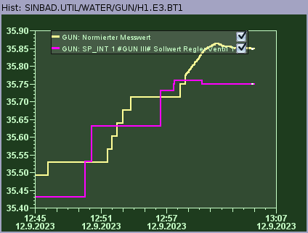
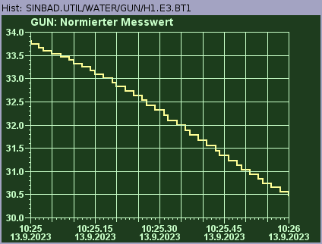
Gun Modulator Interlocks
Event logs: ”Interlock TI\DoorSts\Input missing” → Event log messages are outdated (old settings from Pitz modulator) and have no meaning for our modulator
Tested gun water temperature:
  (TUE) first due to detuning of gun operating at lower gradient
  (WED) Later to trigger water temperature interlocks on purpose → works, interlock threshold at 32 deg C
→ Gun modulator could not be reset

Slide 9
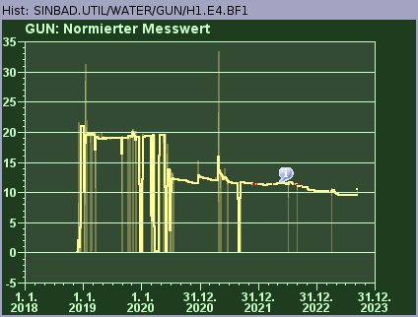
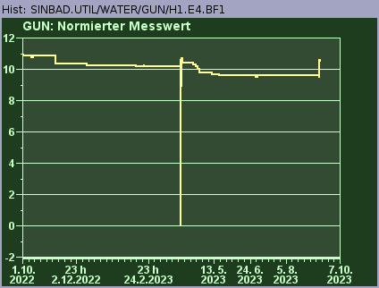
Gun Water Flow Rate
Investigations by MIN and MKK2
Final interlock reason found: Water flow rate too low, threshold at 9.5 l/min
Same Error Bit set due to Gun water temperature, water flow rate and water pressure (not monitored regularly)
Fixed on Wed around noon
Stable operation for rest of week

Slide 10
Plan for the week
TWAC beam time
Optimize WP3 (increase gun gradient and optimize transverse focusing) + characterize trtansmission through alignment channel
Generate WP4 (WP3 with compression in time via velocity bunching).
Measure emittance at experimental location (wire scanner) to ease comparison with simulations.
Continue tests of longitudinal wakefield effect (going off-axis in the alignment channel).
Try to go down to 10 MeV/c to be closer to the beam available at PHIL.
Try to improve transverse quality by starting with more charge and then collimate to 10 pC.
(Sorted by priority)
On Thursday evening: partial AA shift, i.e. preparing autonomous agents for overnight runs

Slide 11
Schedule
Week 38
Date | Shift Crew
18.09. | --
19.09. | Thomas, Max
20.09. | Thomas, Max
21.09. | Thomas, Max
22.09. | Thomas, Max
Week dedicated to TWAC
If you want to learn or join the shift: please give the shift leader a call (BKR 2840 / SINBAD Box 2454)

