Slide 1


Studies on Longevity of RPCs
G. Aielli Roma Tor Vergata
Terascale Detectors Workshop
Mainz, 22 February 2024

Slide 2
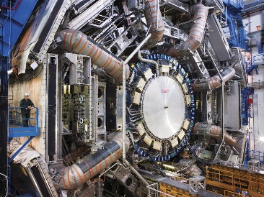
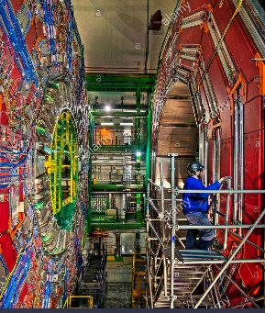
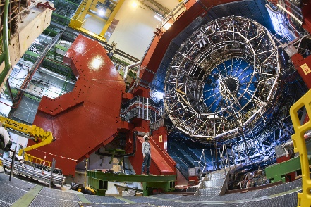
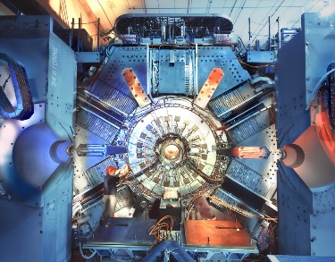
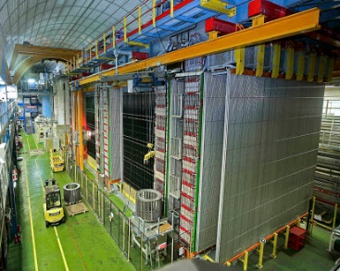
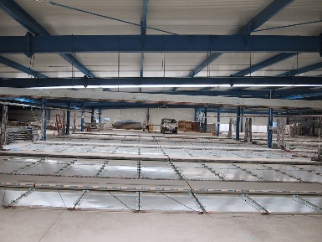
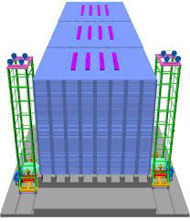
Past and present application of classic rpcs
(some of)Present and recent past Application at colliders
Present and recent past Cosmic rays and underground
ATLAS
LHC 7000 m²
HL-LHC1400 m²
Tracking trigger
CMS
LHC 4000 m²
HL-LHC1000 m²
Tracking trigger
ALICE
LHC 144 m²
HL-LHC new RPCs
Tracking trigger
BaBar
SLAC 2000 m²
Instrum. iron
μ identifier
OPERA
CERN ν beam
Instrum. iron
μ spectrometer
ARGO Ybj
CR exp. 7000 m²
4600 m altitude
3D reconstruct.
INO (staged)
ν observatory
150000 m²
Instrum. Iron
RPCs of the present generation have been largely employed for the LHC experiments
The streamer to avalanche mode transition enabled them for the LHC program rate, by reducing the charge per count by 2 orders of magnitude preserving the performance for the expected duration of the experiments
Long and detailed studies have been carried out to understand in deep the potential ageing mechanisms
Further reduction of the charge per count allowed to qualify them for HL-LHC upgrades

Slide 3


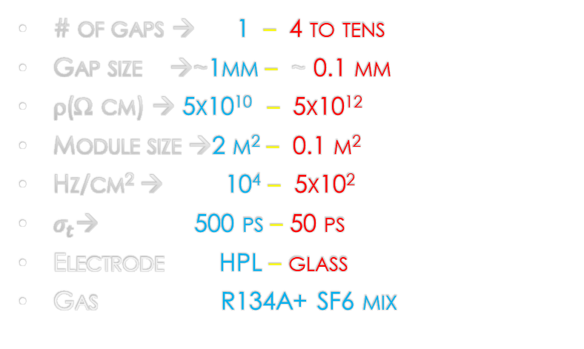
Resistive Plate chambers at a glance
Common features
high r electrodes → Spark less
Uniform electrode → simple
uniform field → prompt signal
Working at atm. Pressure
0.1mm 2D localization
Gas mixture
Feature RPC vs MRPC
# of gaps → 1 – 4 to tens
Gap size →~1mm – ~ 0.1 mm
ρ(Ω cm) → 5x10¹⁰ – 5x10¹²
Module size →2 m² – 0.1 m²
Hz/cm² → 10⁴ – 5x10²
$σ_{t}$→ 500 ps – 50 ps
Electrode HPL – glass
Gas R134A+ SF6 mix
$$Q\left(V\right)=\ln\left(1+e^{a\left(V−V_{0}\right)}\right)$$
$$Q\left(x\right)=\ln\left(1+e^{αx}\right)$$
Integral logistic growth
G. Aielli et al NIM A 508 (2003) 6–13

Slide 4
RPC Strength vs. weakness diagram
Continuous resistive electrode structure
Gaseous target and multiplication coincide
Simple and robust construction
prompt avalanche → high time resolution and efficiency
Very variable avalanche dynamic range
Inefficient charge collection (Ramo)
Spark free
High average <Q> → limitation in rate capability
No micro-structures helping to define the avalanche growth space
Low cost
Classic design recipe: “low” resistivity electrodes + electronegative gases+ sensitive electronics
Easy to scale single module dimension to a few m^2 at constant unit cost and complexity

Slide 5
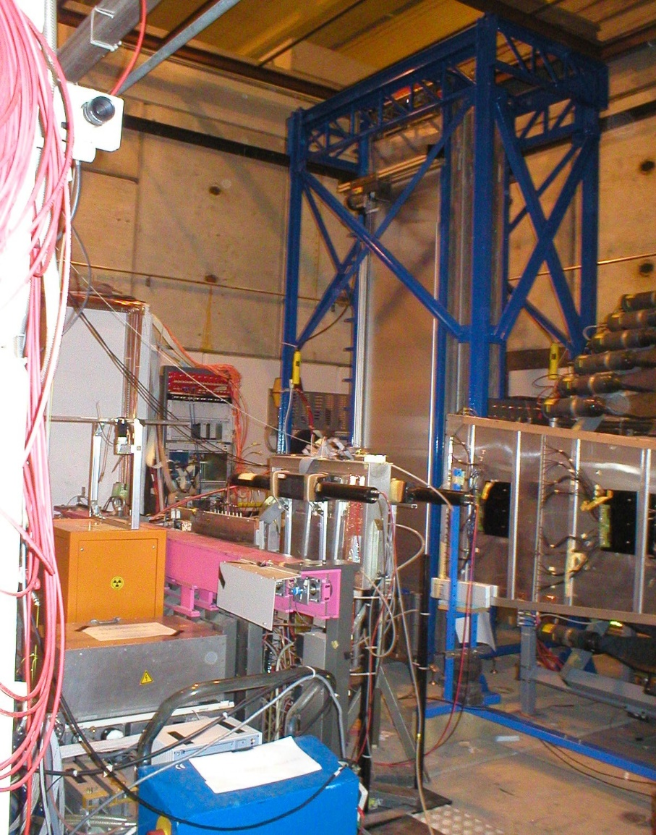
LHC experiments Ageing test on rpcs
RPC is a very resilient detector but is forced to work in very harsh condition, so detailed ageing studies were always important
The RPC of Alice, Atlas and Cms share almost all the construction procedures and material features as well as the production site.
Common ageing studies from 1998 to 2005 (Alice, Atlas, Cms)
Carried out at the GIF within a coordinated rpc ageing studies taskforce
Long term irradiation of prototypes, module-0 and production chambers
Each experiment tried to accumulate the hits expected in 10 years of LHC operation at nominal luminosity with a given safety factor
  Alice: 50 mC/cm²
  Atlas: 400 mC/cm² → 10 years of HL-LHC (150 Hz/cm^2)
  CMS: barrel (100 mC/cm2) EC 400 mC/cm²

Slide 6
Test summary
General procedure:
  Total charge integral
  climatization
  Monitoring of the efficiency and rate capability
  Monitoring of the electrode resistivity
  Monitoring of the dark current
A given an amount of integrated charge produces different effect depending on:
  Working point: the lower the better → many small avalanches are better than few big ones
  Source intensity: acceleration factor may bias the result
  Temperature: the lower the better
  Relative humidity: best value 40-45% for stable resistivity around 5*10¹⁰ Ω cm
  Resistivity: too low values may lead to detector instabilities
  Gas change rate: the higher the better, but with same RH of environment

Slide 7
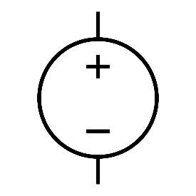
Explanation of the effects
HPL is hygroscopic
It behaves as porous water container setting surrounding environment to an equilibrium point around 40% RH
HPL electrical conduction is mediated by water ions
A constant availability of water molecules at the electrode anodic face, guarantees a stable conductivity
To expose the anode side of each RPC electrode, both environment and gas must be kept at constant RH (around 40%)
RH=40%
RH=40%

Slide 8
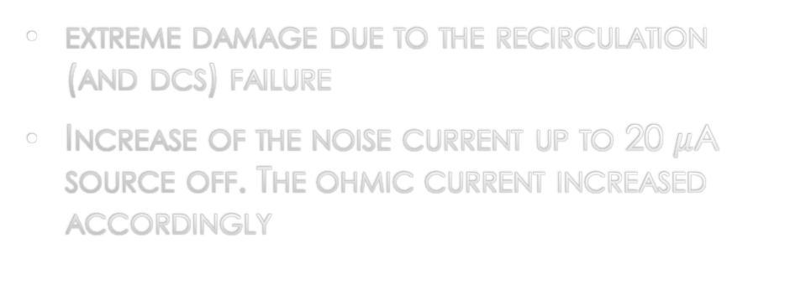
A case of surface damaging
extreme damage due to the recirculation (and dcs) failure
Increase of the noise current up to 20 $μ$A source off. The ohmic current increased accordingly
Recovery monitored at constant temperature
  Deep cleaning with pure argon discharge
  Operation at reduced voltage (7000V)
  15% C4H10
  2 change/h
Extra current disappeared completely and the detector performance was as before

Slide 9
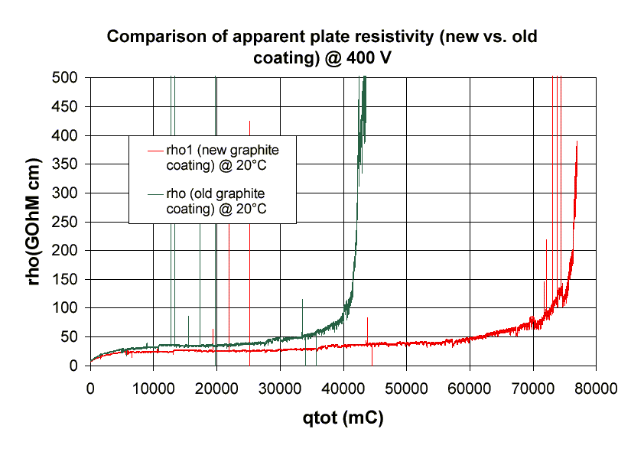
The graphite contact ageing
A test was performed on the stability of the graphite-HPL ohmic contact
10X10 cm^2 bachelite plates 2 mm thick, coated on both sides, by applying a voltage across the electrode in order to simulate an ageing test
Test repeated at different applied voltages (speed)
Two types of coatings with the same surface resistivity but different graphite density: “light” and “heavy”
Interpretation: The cathions (namely OH⁻) reach the anodic graphite and reacts. If they are supplied too fast with respect to the reaction speed, a fraction of them doesn’t take part in it resulting in a lower damage
HV
Readout
Readout resistor
“Heavy” gains over “light” a factor 2 in longevity
Asymptotic values for slow ageing equivalent to 20 HL-LHC years
Worst case scenario

Slide 10

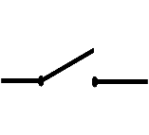
Modelling Ageing effects on rpcs
Detector lifetime from the electric point of view depends on the stability of the electrode conduction properties and surface integrity
  three potential problems have been pointed out:
    Chemical damage leading to a sudden increase of the contact resistance
    Increase of the electrode resistivity due to depletion of carriers.
      Affecting rate capability
    Damaging of the inner surface by means of HF deposit
      Increases of spurious counts affecting detector performance
  Risk factors are driven by
    Total charge per count
    Local counting rate
    Local gas change rate and composition
    Gas and environment humidification
    High temperature operation
    Gas volume construction defects
R graphite
Vdrop
I
V
R electrode
f
R gas
Vgas
Vgas = V – Vdrop
Vdrop = V – I (Rgraph + Relec)
I = f <Qcount>

Slide 11
Analysis of the risk factors - Graph
Main control nodes
Local discharge
Local HF production
Working point
Gas composition
temperature
Surface damage
Total current
Global HF production
Low resistivity
HF accumulation
Graphite damage
Surface quality
Counting Rate
Gas change rate
initial resistivity
background
Gas RH supply
Resistivity increase
Voltage drop
Resistivity increase can be controlled through the RH and has a negative feedback
Noise induced by HF can be controlled by lowering the current. It has a positive feedback

Slide 12
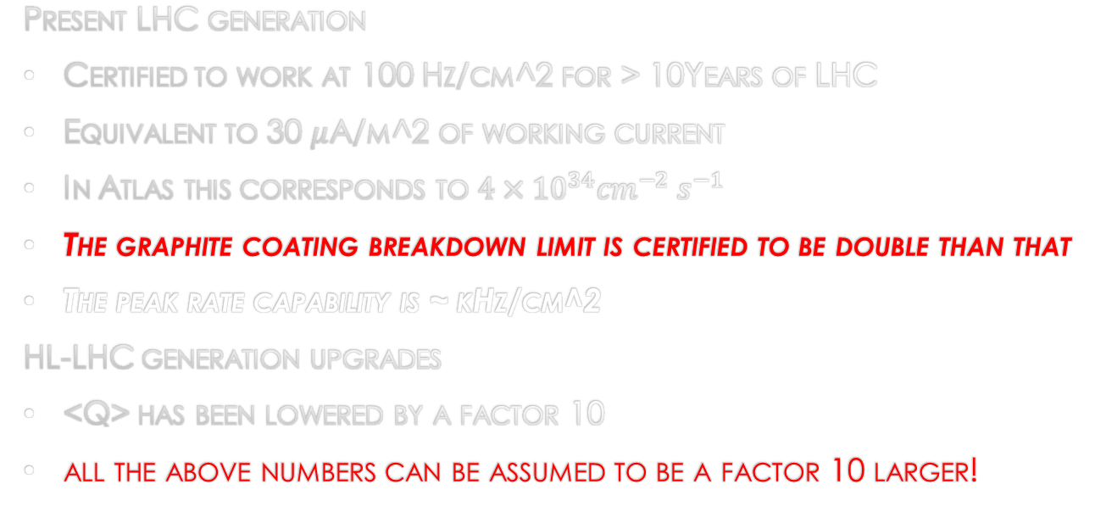
Present limits – rate and longevity
State of the art
Present LHC generation
Certified to work at 100 Hz/cm^2 for > 10Years of LHC
Equivalent to 30 $μ$A/m^2 of working current
In Atlas this corresponds to $4×{10}^{34}{cm}^{−2} s^{−1}$
The graphite coating breakdown limit is certified to be double than that
The peak rate capability is ~ kHz/cm^2
HL-LHC generation upgrades
<Q> has been lowered by a factor 10
all the above numbers can be assumed to be a factor 10 larger!
1mm gap ATLAS upgrade
Resistivity → 5*10¹⁰
Noise → 4000 e-
ABS3.3 at GIF++ → ~10 kHz/cm²
Reduction of <Q> improves rate capability and longevity at the same time
  by gaining x10 S/N on the FE electronics
  The 10 years operation longevity is extended “for free” at 1.5 kHz/cm^2 (same current)
Lowering R improves rate capability only
  Lower resistivity materials
  Thinner electrodes
Achieving high rate by brute force reduction of R (without reducing at the same time the E field) may lead to instable detectors
One rule: lower the electrode resistance and <Q> at the same time

Slide 13
INCREASING RATE CAPABILITY AND LONGEVITY
limited by Ramo theorem and electron attachment (~1/10 of <Q> is usable)
low resistivity electrodes made of HPL (~10¹⁰ Ω cm)
SiGe FE tech. with 4k e- noise to reduce <Q>
Reaching up to 10 kHz/cm² in production chambers
Suitable for operation with eco-gas mixture
HL-LHC upgrade
Moving the amplification from the gas to the transistor paves the way to seamlessly extend the rate and longevity of RPCs more than proportionally
FFC TARGET → improve by a further order of magnitude by increasing S/N
Last generation SiGe etero-junction technologies (fT 0.7 THz) announce a further x 10 leap in the FE → 500 e- noise reduction
For further exploiting the electronics:
Faster avalanche
Very efficient grounding
Pointing out a bi-gap of 0.5 mm as ultimate classic RPC…
1mm gas gap
LHC → 30pC (50 fC)
HL-LHC P1 → 5pC (4fC)
HL-LHC → 1-2 pC (1-2 fC)
Thinner gap → better Q/q (https://doi.org/10.1088/1748-0221/11/07/P07014)

Slide 14
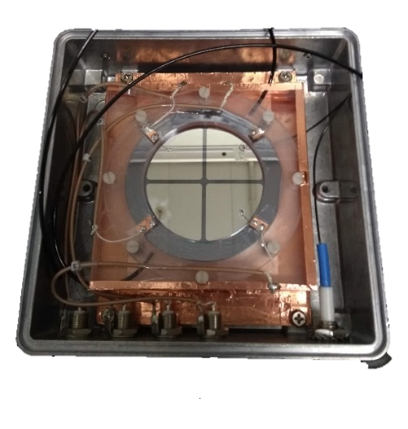
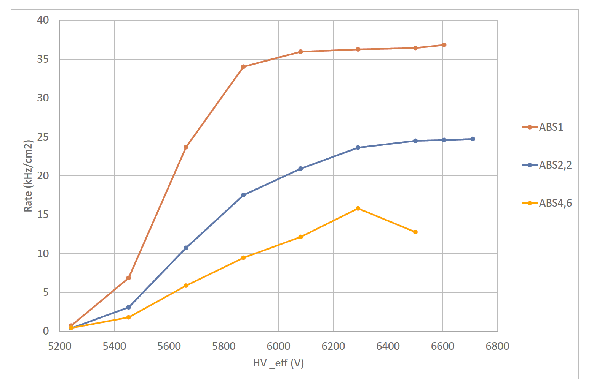
Lower resistivity for higher rate (all RPCs)
MRPC →extreme exploitation of the detector structure to extract the most of <Q>
  E.g. ALICE: 10 gas gaps of 0.25mm with 0.4 mm electrodes
Main limitation → thin float glass limited to < 1 kHz/cm² due to ρ~10¹² Ω/cm.
New materials with low resistivity (down to 10⁹⁻¹⁰ Ω/cm) →(ceramics, plastics, glass,…) (10.1016/j.nima.2006.12.027, 10.1016/j.nima.2010.08.076, 10.1016/j.nima.2020.163483, 10.1088/1748-0221/14/09/C09007, http://cds.cern.ch/record/2319919
A new device: single gap semi-conductor RPC
[electronic carriers can not be depleted]
  Counting rate > 40 kHz/cm²
  0.6 mm GaAs electrodes
  Resistivity 1.4×10^8 Ωcm
  1 MHz/cm² seems possible
  Active area 6.25 cm²
  10.1088/1748-0221/15/12/C12004
  Carrier depletion effects observed → R&D needed
  material non-homogeneities for large sizes
  Thinning electrodes still possible.
  Forced (no diffusion) gas distribution
Large margin achievable by lowering < Q >
Seamlessly achieved 40 kHz
FFC TARGET → improve by a further order of magnitude by lowering R

Slide 15
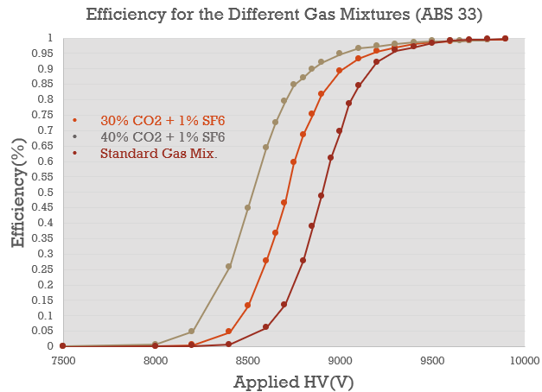
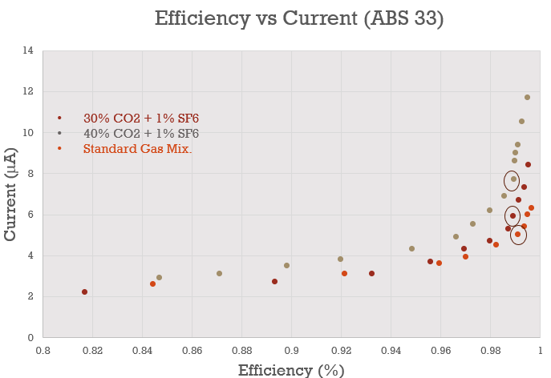
Validation of lower GWP gas mixtures
HFO (hydro-fluor-olefine) based mixtures are under deep study since a few years
Very low pollution of air (GWP)
Very high pollution of the RPC…
HFO degrades easily → free radicals
Standard Gas Mixture: 0% CO2, 5% C4H10, 0.3% SF6 and 94.7% C2H2F4
30% Co2 Mixture: 30% CO2, 5% C4H10, 1% SF6 and 64% C2H2F4
40% Co2 Mixture: 40% CO2, 5% C4H10, 1% SF6 and 54% C2H2F4
0.5% SF6 Gas Mixture: 30% CO2, 5% C4H10, 0.5% SF6 and 64.5% C2H2F4
We can see the working point anticipation of 200-250V for 30% and 40% CO2 gas mixtures wrt. Standard gas mixture @ the same ABS (photon shielding) factor (ABS 33).
For 30% and 40% CO2 gas mixtures @ same ABS factor, we observed that the current is increasing by ~20% wrt. Standard gas mixture.

Slide 16
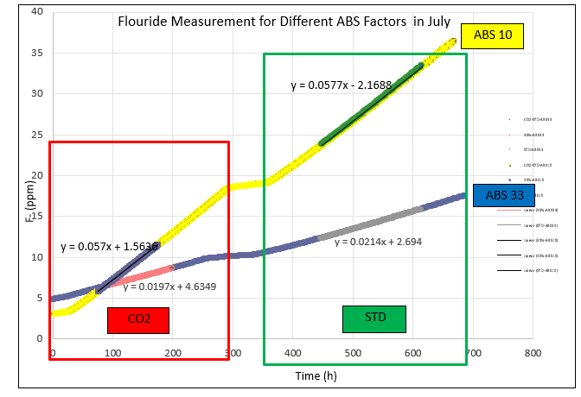
Progress of the ageing test and the Flouride Measurement
Ohmic current very good! It increased slightly due probably the accelerated ageing at the beginning
Electrode resistance started very high and is not changing much.
Target →10 ATLAS years which corresponds to ~ 300 mC/cm^2
We are in ~2 ATLAS years
This mixture has been introduced in ATLAS in June 2023 (since then no luminosity in the LHC…
Method: Starting with 30% CO2 gas mixture for 2.5h
Switching the gas and waiting for the gas flush for 1h
Continuing with Standard Gas Mixture for 2.5h
To eliminate the systematic and environmental effects!
Conclusion: We have the similar amount (or slightly less) of fluoride production in each test for CO2 gas mixture!

Slide 17
Something new
All RPC features have been stretched in all direction except two apparently fundamental ones
The atmospheric pressure operation
The electric field uniformity
The target for extending the longevity:
Find a structure as fast as the RPC but using inexpensive gas mixtures (e.g. Ar-CO2)
What if one tries to combine RPCs and Pestov chamber wrapping an RPC on a cylinder?

Slide 18
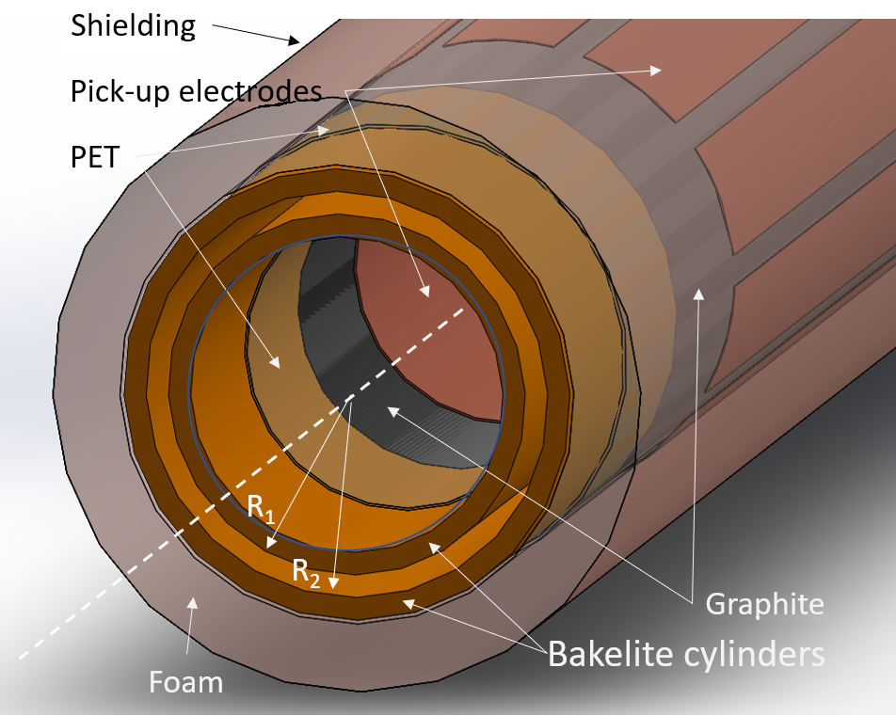
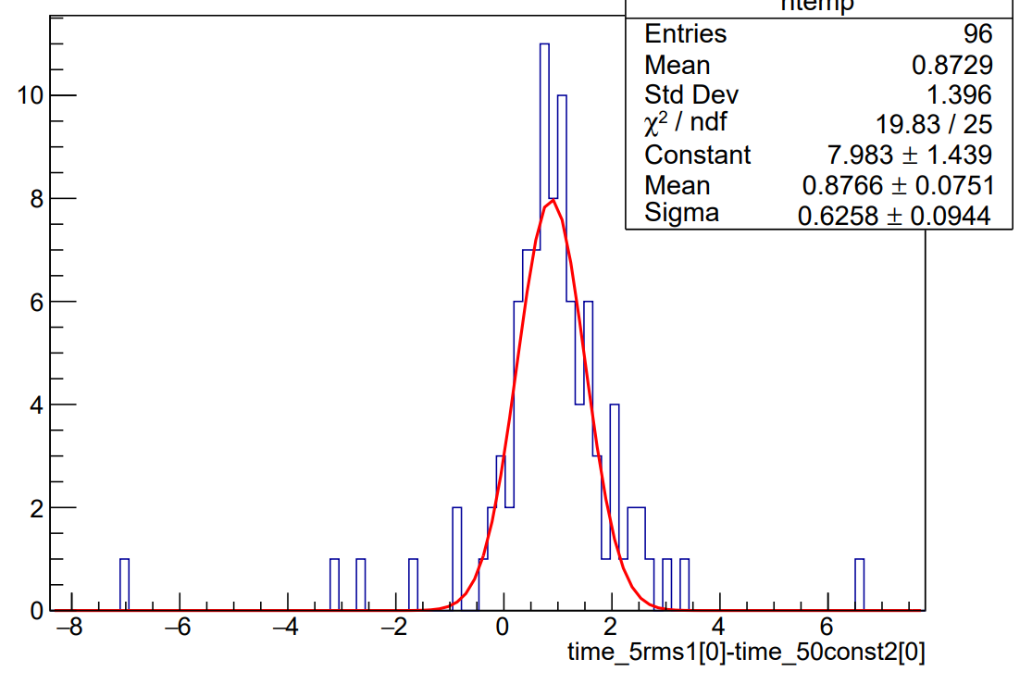
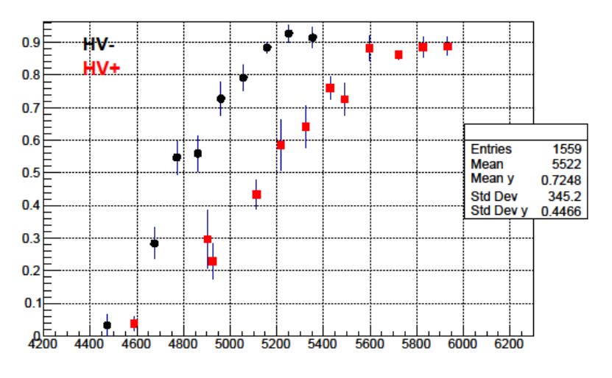

The Resistive Cylindrical Chamber (RCC)
R. Cardarelli “Future RPC developments”, RPC2020 Roma 10-14 /02/2020 proceeding on JINST
Geometry defined by two concentric pipes spaced by a gas gap
The radial field introduce the concept of geometrical quenching, can be tuned by playing with R1 and R2
No need of expensive and high GWP electronegative gases to keep the avalanche stable → preliminary test with pure CO2
No chemical driven ageing effects
Cylindrical geometry supports high pressure operation implying:
  Full efficiency in a single micro gap even with light gases
  Time resolution proportional to pressure
Aiming to a fully efficient spark-less ~20 ps resolution detector…
First test in Roma2 lab
$$E\left(r\right)=−\frac{V}{rlog\frac{R_{1}}{R_{2}}}$$

Slide 19
conclusions
All versions of RPC technology has proven in the last 30 years to be a fundamental building block of modern experiments.
The most important ageing mechanisms have been understood
There are challenges which must be faced to fulfil future experiments needs
Inexpensive gas challenge
Consolidating the several kHz rate with 10 years guaranteed longevity
Approaching MHz/cm^2 rate
New materials, construction process and detector layout are the ingredients to project RPC technology in the future

