Slide 1
Summary of KW 38
 | Monday 18th September | Tuesday 19th September | Wednesday 20th September | Thursday 21st September | Friday 22nd September
Achievements | * Tunnel open for maintenance day * Machine restart, debugging | * Establish 20 MeV/c WP again (TWS1 only with reduced amp. + 800 µm ap.) * Reaching 20 (10) MeV/c with deceleration in TWS2 | * Try to use TWS sol. for 20 MeV/c → Misalignment prevents sym. focus * Achieve half-way good focus on EA.A1 (200 µm ap.) * Overnight AA run | * Transport 20 MeV/c (200 µm ap.) WP to MR.R1 (stripe) and MR.R2 (round) * 2D scan of DLA alignment channel | * Trying to obtain a cycled WP * 1D scans of the alignment channel with 200 µm WP and misalignment correction * Switch to 320 µm ap. Scan of alignment channel not good (large faint halo suspected) * Overnight AA run
Perturbating events | * Cycling procedure from MLS not working for EA and MR quads | - | * AA run not successful (gun sol. crashed at 5 pm) * EA quads stuck at polarity change | * MR.R1 & MR.R2 panels swept → fixed by Artem * Strong beam shape instability (EA.A1) | * Coupling of EA quads and TCA steerers strong at 20 MeV * DIO1 crashed and TWS1 modulator crashed (waterflow problem)
Notes | - | - | - | - | * Bug in scan tool fixed by Frank

Slide 2
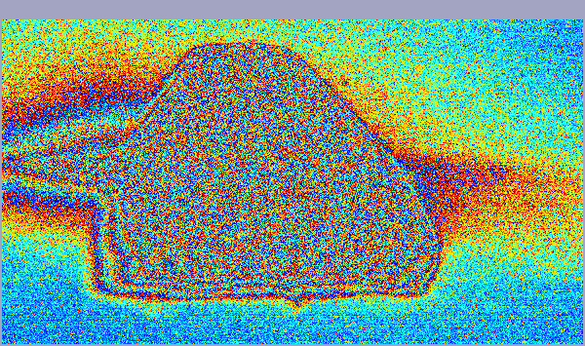
Towards a TWAC-suitable 20 MeV/c WP
Requirements: At least 10 pC charge and a bunch duration around 1 ps rms or below (monotonic wakefield) → Large laser aperture and low gun solenoid focusing helps
2 acceleration options tested: Just TWS1 on at reduced amplitude (17.5 vs 76) & TWS1 on-crest at nominal amplitude + On-crest deceleration in TWS2 at slightly reduced amplitude (63 vs 76)
  Option 2 comes with nicer beam shape (less transverse feature) and better transport, but larger transverse size when using low gun solenoid focusing → retained but leads to some limitations.
Study to use TWS sol. to catch the beam while using low gun solenoid focusing was performed → TWS1 sol not effective (too high momentum). TWS2 last sol. effective but too misaligned → Bad final focusing (transverse rotation visible).
Using too low gun solenoid focusing not possible because beam is clipped by the undulator beam pipe for the EA quads settings allowing focusing on EA.A1 → Trade-off has to be found.

Slide 3
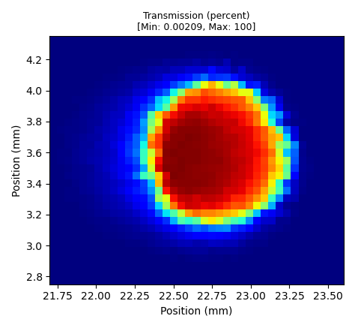
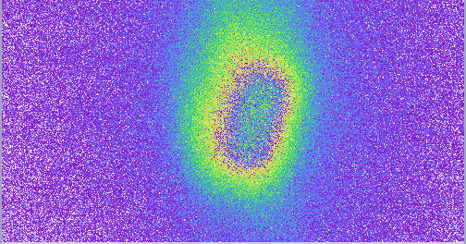
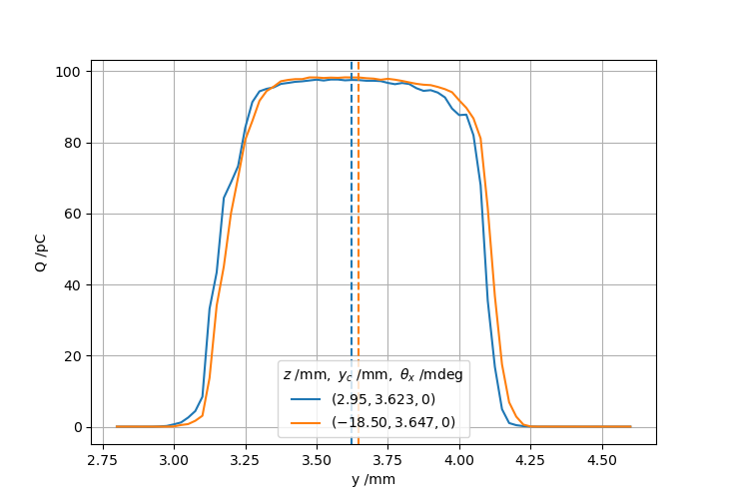
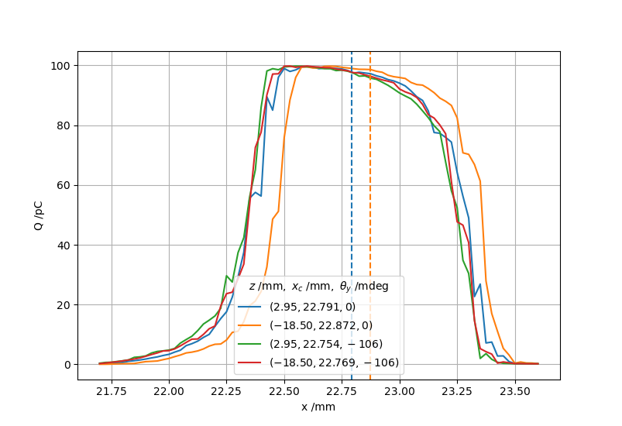
Cathode laser aperture at 200 µm
Using the 200 µm aperture leads to a beam which could be used for passive streaker tests (significant offset of around 200-250 µm reachable, but not in both planes simultaneously)
The asymmetry in the X profile is due to a tail in the beam transverse profile (not visible at the top of the image)

Slide 4
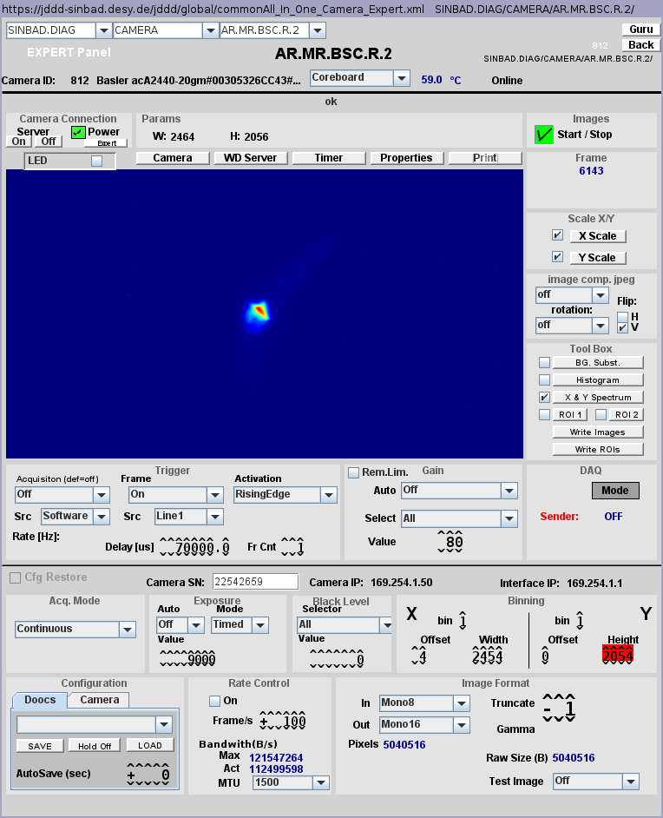
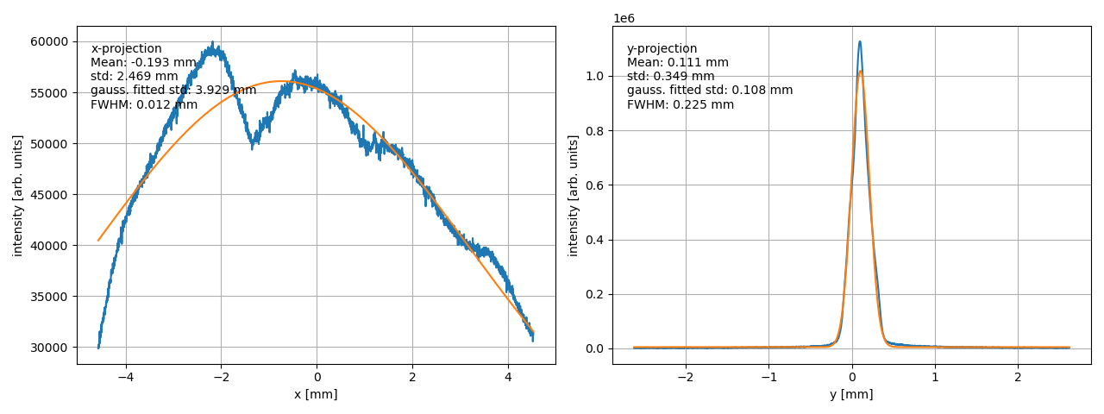
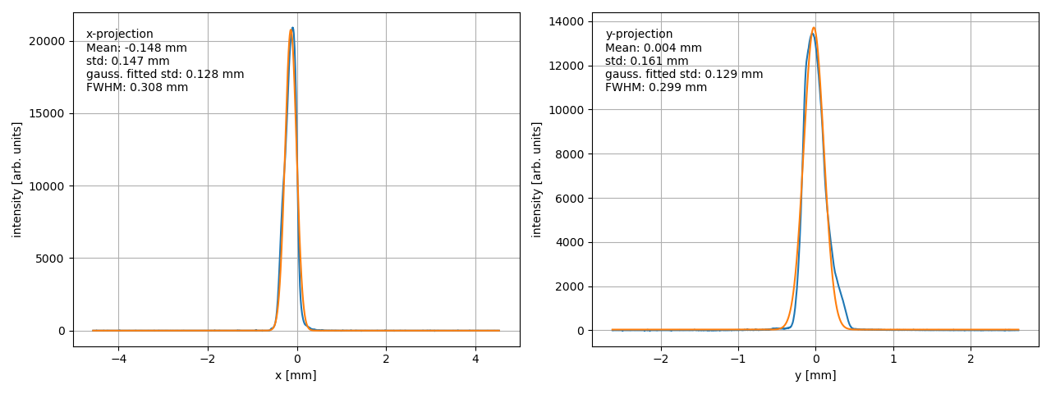
Cathode laser aperture at 320 µm
The beam can easily be catch after the EA chamber to image the streaking on either MR.R1 with a „stripe“ beam (only one quad between chamber and screen) or MR.R2 with a round beam.
Problem: According to ASTRA the bunch duration is around 1.2 ps rms → Slightly too long → Going to 320 µm aperture to reduce bunch duration further or try to increase
gun gradient (now around 75.3 MV/m peak field)

Slide 5
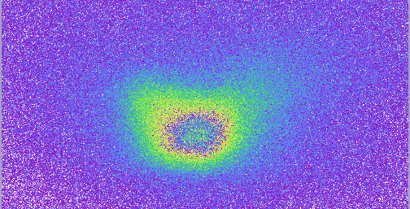
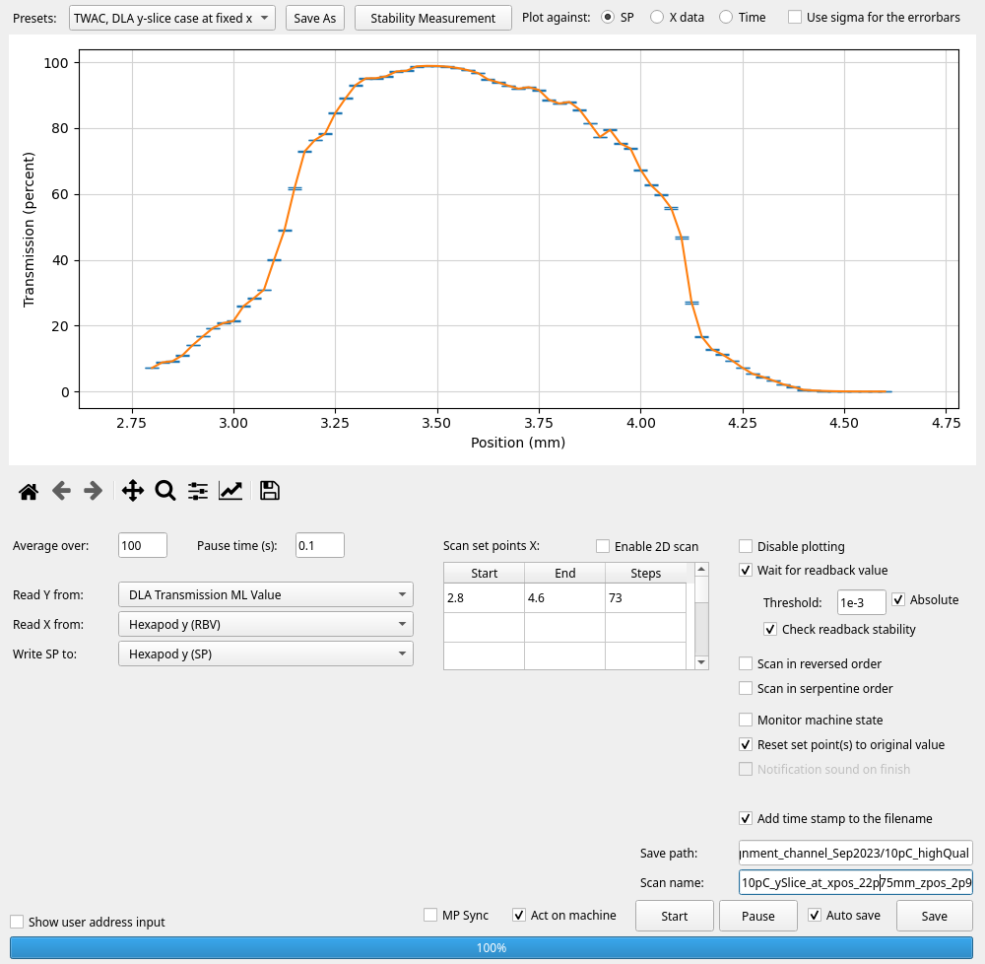
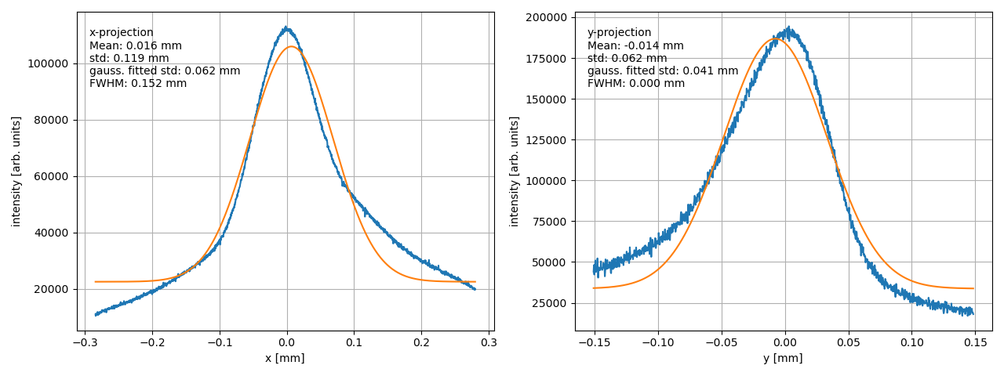
Cathode laser aperture at 320 µm
Focusing on EA.A1 looked good at first sight. but when scanning the DLA alignment channel, the result is worse compared to 200 µm aperture. Assumption: a large faint halo (below camera noise) could be present.

Slide 6
Summary of TWAC run
WP3 (20 MeV/c and 10 pC with ≤ 1 ps rms bunch duration) study
Limitations were identified: TWS solenoids not useable because of misalignment, clipping on undulator beam pipe, features in beam transverse profile which increases with aperture diameter.
A useable working point using the laser 200 µm aperture has been established: 200-250 µm offset achievable in the 1 mm diameter channel, transport after EA chamber is possible
However, transverse profile still asymmetric and bunch duration likely too long
Transverse focusing looks to deteriorate too much at larger laser aperture to enable a significant offset (to be clarified)
A third preparation run is needed to finalize the 20 MeV/c WP
Potential preparation work: Check UV laser transverse (and time) profile, Check UV laser alignment in the gun, Increase gun gradient, Simulations to better identify the conditions optimizing the 20 MeV/c WP

Slide 7
Plan for KW29
User run for UKE

Slide 8
Schedule
Week 29
Date | Shift leader
17.7. | Florian (Tunnel open)
18.7. | Frank
19.7. | Max, Willi
20.7. | Frank, Florian
21.7. | Willi, Thomas
If you want to learn or join the shift: please give the shift leader a call (BKR 2840 / SINBAD Box 2454)

