Slide 1
Status of the DESY Grid Centre
Volker Guelzow & the Grid Crew
DESY IT
Hamburg, April 28th

Slide 2
Outline
The 2011 DESY Grid centre status
The NAF@DESY
Requests and Pledges for WLCG
dCache
The LHCone project
The German Tier 2 situation
Conclusion

Slide 3
GridCentre Resources as of 26.4.2011
 | DESY-HH | DESY-ZN | NAF
CPU (#Slots) | 4224 | 784 | 1620
CPU (HS06) | 33.9 kHS06 | 8.6 kHS06 | 22 kHS06
Disk (ATLAS) | 890 TB (525 TB) | 750 TB (525 TB) | 135 TB
Disk (CMS) | 1057 TB (640 TB) | - | 58 TB
Disk (LHCb) | - | 180 TB | 47 TB
Disk (other Grid, like Hera, ILC, Astro,…) | 348 TB | 500 TB | 33 TB
Difference to WLCG T2 Pledges in ():
Local and NAF resources in dCache
Dedicated
Lustre space

Slide 4
DESY-Grid Centre Usage

Slide 5
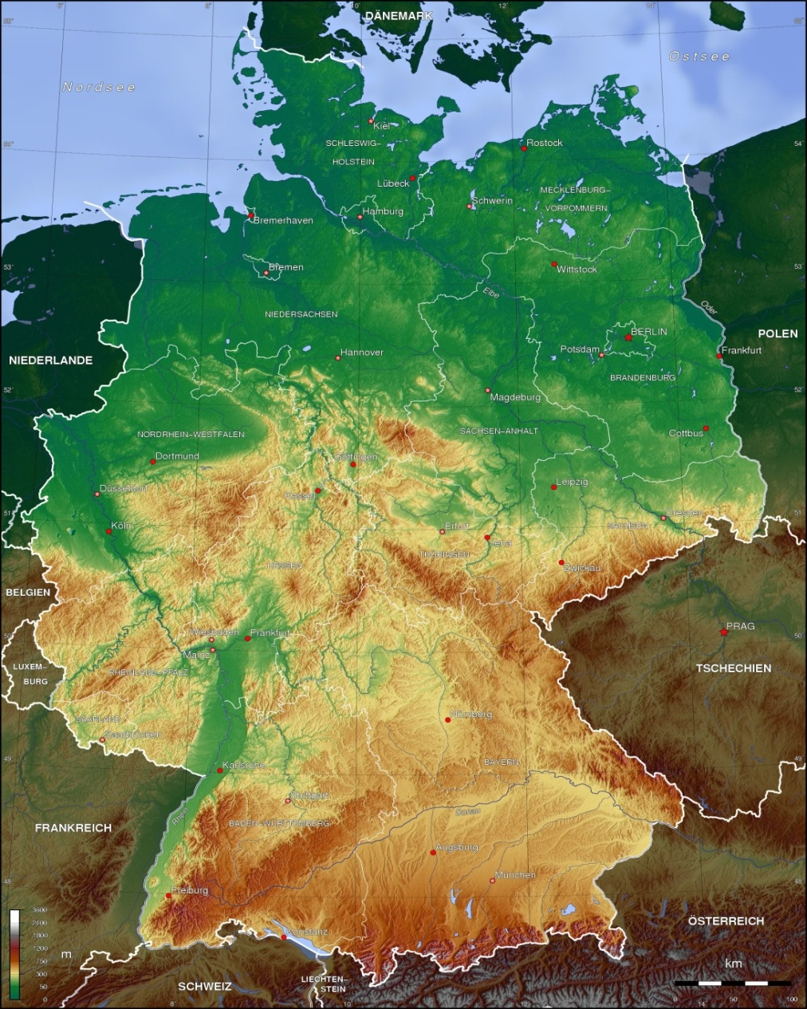
The German T2‘s (Atlas, CMS, LHCb)
HGF Alliance funding for Universities:
Pledges for Germany
http://lcg.web.cern.ch/LCG/Resources/WLCGResources-2010-2012_15DEC2010.pdf
 | CPU 2011 [HS] | CPU 2012 [HS] | Disk 2011 [TB] | Disk 2012 [TB]
A DESY | 6200 | 6600 | 1050 | 1350
C DESY | 11800 | 12900 | 640 | 900
A Goettingen | 3800 | 4000 | 400 | 590
C Aachen | 6600 | 8700 | 330 | 435
A Munich | 9220 | 11560 | 1040 | 1340
A FR/Wupp | 4633 | 4917 | 633 | 733
A FR/W Freiburg | 4610 | 5780 | 518 | 668
Summe CMS | 18400 | 21600 | 970 | 1335
Summe Atlas | 28463 | 32857 | 3641 | 4701
SumDESY | 18000 | 19500 | 1690 | 2250
SumNonDESY | 28863 | 34957 | 2921 | 3786
GrandTotAllT2WW | 725324 | 776203 | 60454 | 71998

Slide 6
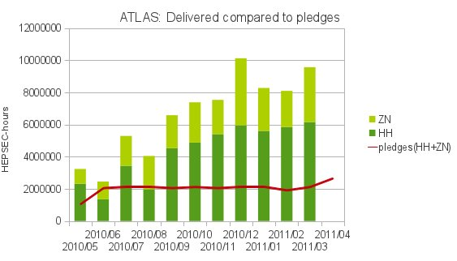
Atlas delivered vs. pledged CPU resources@DESY

Slide 7
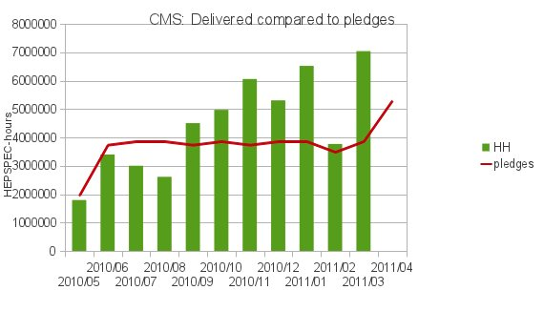
CMS delivered vs pledged computing

Slide 8
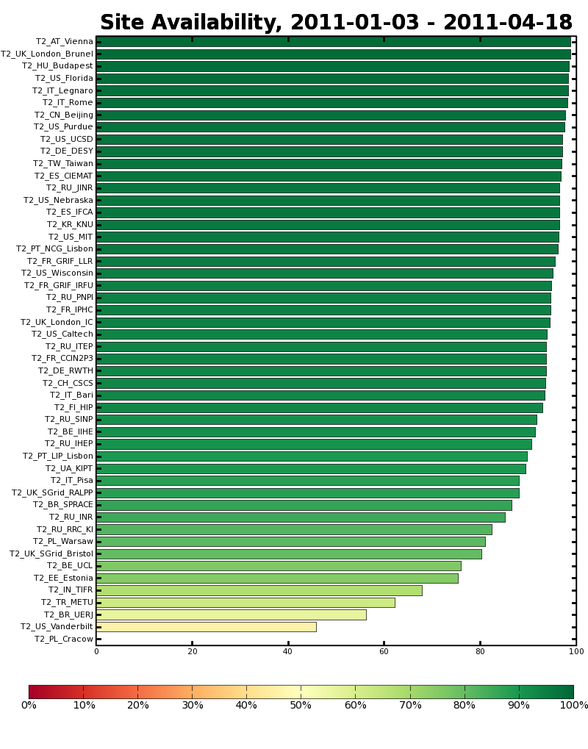
CMS Tier2 availability based on SAM tests

Slide 9
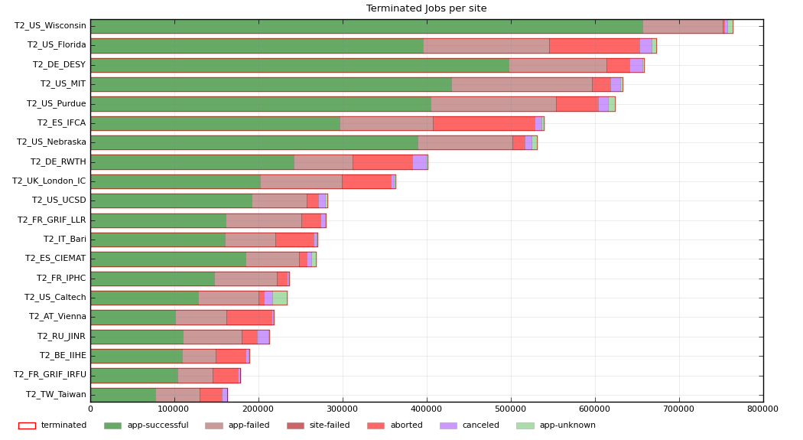
CMS Analysis Jobs since beginning of 2011

Slide 10
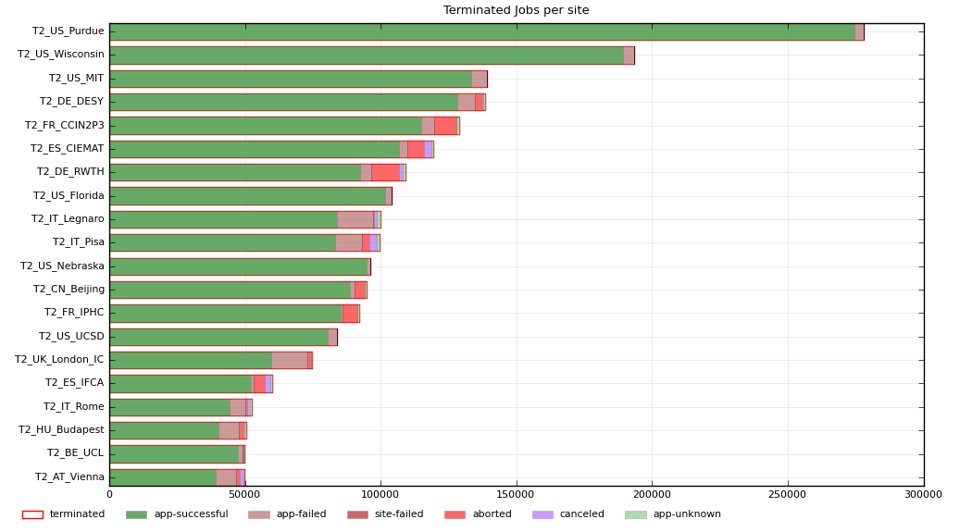
CMS MC production jobs since January 2011

Slide 11
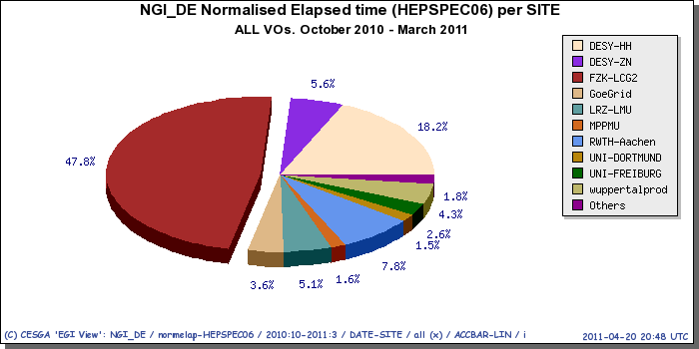
Contribution of German Grid sites to EGI
Wall-Time spend on the different German Grid sites for all VOs last 6 month: Clear domination by FZK and the two DESY sites
DESY
HH+ZN
FZK

Slide 12
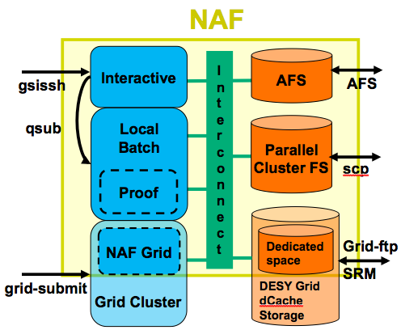
NAF services
Access to experiment data on the Grid Storage Element
CPU cycles for analysis: interactive and local batch
Complement the Grid resources
New techniques like PROOF
Additional storage: Lustre parallel file system
Home directories on AFS, accessible from everywhere
Size: ~ 1 T2 site + extra services (e.g. TAG DB, afs UI, …)

Slide 13
NAF usage shares 2011
Wall Clock circle
Lustre Space circle

Slide 14
NAF usage by VO
Uni-HH (CMS) group has strongly contributed to the NAF, thus usage of CMS larger than weight in Germany
Check also previous slide

Slide 15
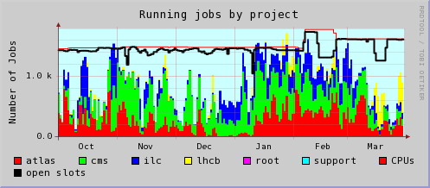
NAF CPU occupancy
Clearly more activity before conferences (Moriond, DPG,…)
Periods of lower usage, different reasons

Slide 16
NAF: Current open questions and discussions
Some requests from the user community
Increase stability and reliability of NAF AFS
Lustre management tools (group quotas, old-file-deletion, synchronization with dCache)
Interactive and graphical software stack on the NAF
Faster X-access (other protocols like NX)
Install CernVM-FS for experiment software (NAF&Grid)
NAF provider view:
Many of these requests make sense, and we think could be useful
Some requests are very difficult: e.g. Lustre product has deficiencies and lacks features
Other requests have to be discussed because of lack of manpower and difficulties to integrate into current NAF setup as targeted to a national community
Further development as a joint effort between User (NAF User Committee) and provider

Slide 17
The DESY GridLab:
Idea:
DESY Grid more than just a production site
Have dedicated machines to develop and test new products and components … representative for and integrated into production environment
Reusing old WNs from Grid, temporarily borrowing WNs from production Grid
Purchasing some dedicated HW (storage)
Contacts: D. Ozerov, Y. Kemp
Activities:
Taking part in the WLCG storage technology demonstrators:
NFS v4.1 (pNFS) with dCache.org
Benchmarking LHC applications on a dedicated setup: HEPIX, CHEP, EMI conference contributions
Together with external physicists
Platform for Cloud & virtualization testing in Grid context
Platform for DPHEP prototype
Platform for external students work
…

Slide 18
dCache, The Deployment
94 PB in total WLCG
8 Tier I’s
60 Tier II’s
WLCG Storage per SE type
dCache
Other
Storage
Systems
Dresden
Freiburg
Mainz
Göttingen
Wuppertal
Aachen
Munich
FERMIlab
Florida
DESY
KIT
Germany
16 PB
BNL
Purdue
USA
28 PB
Madison
Wisconsin
Barcelona
Cambridge, MA
Europe
44 PB
East : 1 PB
Lyon
Athens
Sweden
Pisa
Roma
Madrid
NDGF
Amsterdam
London
Contact : Patrick Fuhrmann @ DESY

Slide 19
dCache, Status
dCache : a world wide recognized storage technology
DESY provides the project infrastructure (headquarter)
Development :
Web Pages, Wikis and Documentation.
Central Code Repositories
Organization of developers meetings and workshops
Services activities:
Test infrastructure & performance (Grid-Lab)
Quality Management
Release Management
Customer support : Tier I conferences, support@dcache.org
Network Activities :
DESY : dCache operations (DOT) and Grid-Lab
Germany : HGF, DGI, German Support
Europe : EMI, NDGF, Swedish National Infrastructure
Worldwide : WLCG, Open Science Grid, Open Grid Forum
Main communities
WLCG
HERA
Photon Science (@ DESY)
LOFAR (LOw Frequency ARray) : Amsterdam & Jülich
Swedish academic storage e-infrastructure (SNIC)
dCache.org dCache.org
Contact : Patrick Fuhrmann @ DESY

Slide 20
dCache, People and Funding
Partners
DESY (Headquarters)
DESY (lab) : 2
HGF & DGI : 3
European Middleware Initiative : 2
(DESY Grid-Lab : 1)
Nordics
Nordic Data Grid Facility : 1
Swedish National Infrastructure : 1
FERMIlab
FERMI (lab) plus USCMS : 2
Kopenhagen
Stockholm
DESY
Chicago
The European Middleware Initiative (EMI, 2010 – 2013 )
12 Million € total EU funding plus 12 € by 22 partners.
DESY gets 500.000 € over 3 years = 2 FTE plus a lot of traveling
dCache is one of the 4 middle-wares (gLite, ARC, UNICORE, dCache)
dCache.org provides the EMI data area leader (Patrick)
EMI provides access to new communities
EMI provides efforts for standards in dCache (more non HEP customers)
dCache provides a stable collaboration, important for HEP and strategically interesting for DESY. dCache success attracted 3. party money.
Contact : Patrick Fuhrmann @ DESY

Slide 21
LHCone: proposed architecture
Dedicated network to connect T1‘s & T2‘s (&T3‘s)
EU-US capacity:
Several 10G links - demand oriented
RENATER
GARR
ESNET/
USLHCNet
GEANT
Capacity reserved for LHC and according to demand
T1 centre
DFN
Other NRENs
T2 (or T3)

Slide 22
T2 requirements for Germany
 | 2011 CPU [HS06] | 2012 CPU[HS06] SRC | 2013 CPU [HS06] SRC | 2011 Disk[TB] | 2012 Disk [TB] SRC | 2013 Disk [TB] SRC
Atlas Total T2 | 278000 | 295000 | 315000 | 34200 | 47000 | 53000
CMS Total T2 | 319500 | 350000 | 350000 | 19900 | 26000 | 26000
Worldwide requested by the experiments
(source: CRRB April 2011)
 | CPU2011 | CPU 2012 | CPU 2013 | Disk 2011 | Disk 2012 | Disk 2013
Atlas | 27800 HS | 29500 HS | 31500 HS | 3420 TB | 4700 TB | 5300 TB
CMS | 23960 HS | 26300 HS | 26300 HS | 1490 TB | 1950 TB | 1950 TB
Per centre:
Av. Atlas | 9300 HS | 10000 HS | 10500 HS | 1240 TB | 1560 TB | 1800 TB
Av. CMS | 12780 HS | 17600 HS | 17600 HS | 1000 TB | 1300 TB | 1300 TB
Resulting requirements for Germany (Atlas 10%, CMS 7,5%)

Slide 23
The German T2‘s: critical funding situation for T2‘s
HGF Alliance funding for Universities ends 2012:
About 160k/year until mid 2012
Uni contribution: Energy, space, personnel, education
After 2012 financing of T2 is open
What are the possible consequences for German T2 strategy?

Slide 24
Summary
The DESY-Grid-Centre is one of the top centres in WLCG
The NAF is very helpful and used nationwide
Lessons learned and new requirements for the NAF
dCache is the major working horse for LHC datamanagement and DESY has the lead
LHCone is a great chance for changing computing models
DESY has taken the leading role for LHCone in Germany
There is an open financing issue for the Universities Tier 2 after end 2012

