Slide 1
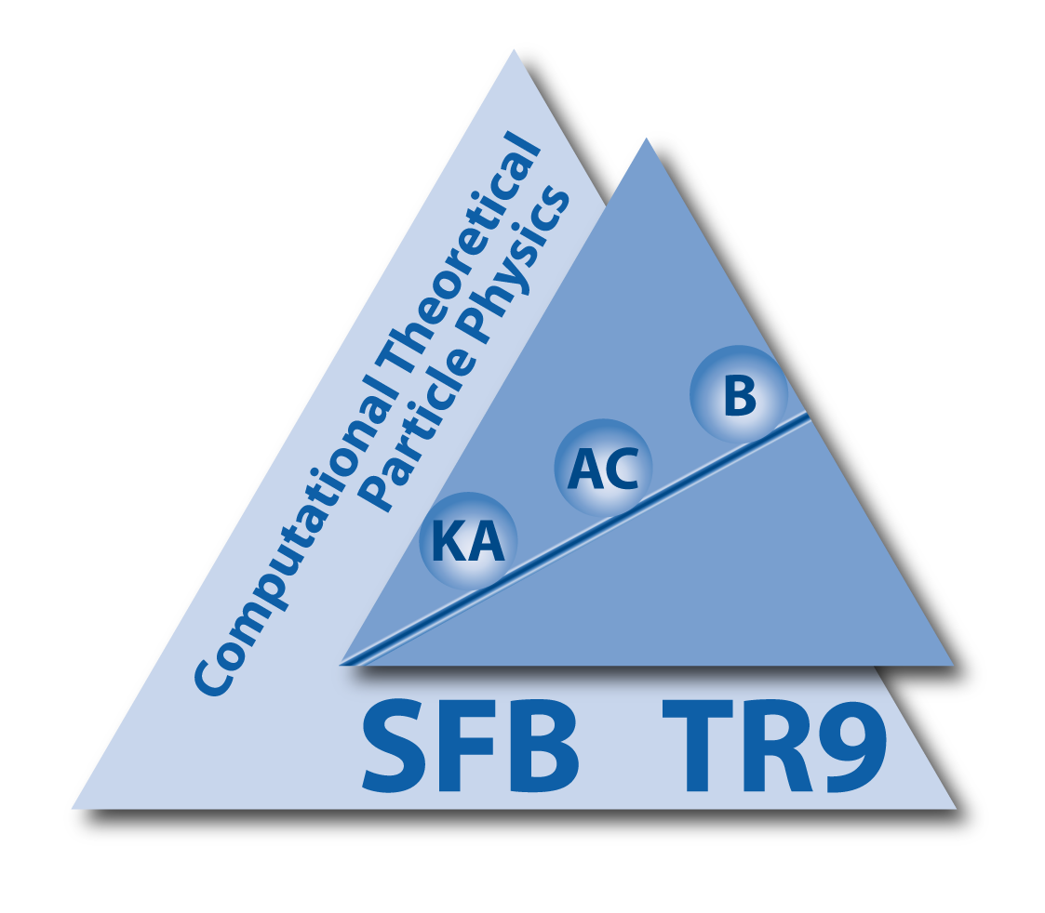
Double Parton Scattering with Leptonic Final States at the LHC
Anna Kulesza
C.-H. Kom, AK, W. J. Stirling, Phys.Rev.Lett. 107 (2011) 082002, arXiv:1105.4186 [hep-ph]
C.-H. Kom, AK, W. J. Stirling, arXiv:1109.0309 [hep-ph], to appear in EPJC
MPI@LHC 2011, DESY Hamburg, 21-25.11.2011

Slide 2
Multiple Parton Scattering
Flux of incoming partons grows with collision energy
⇒ increased probability of having more than one parton-pair scattering
Many events with Multiple Parton Interactions (MPI) expected at the LHC
Theoretical description unsatisfactory (though a lot of recent progress!)

Slide 3
Multiple Parton Scattering
Flux of incoming partons grows with collision energy
⇒ increased probability of having more than one parton-pair scattering
Many events with Multiple Parton Interactions (MPI) expected at the LHC
Theoretical description unsatisfactory (though a lot of recent progress!)
Testground: Double Parton Scattering (DPS)
Multiplicity
legitimate to use perturbative methods for description of multiparton scattering at high p_{T}
information on correlations, multi-parton distribution functions, validation of the MPI models in MC generators
p_{T}
Soft
Hard

Slide 4
Leptonic Final States
“Standard candles” at the LHC
clean experimental signatures in the hadronic environment
Single Parton Scattering (SPS) processes well-known theoretically
Complementary information to other processes: different scales and initial state partons
DPS processes characterized by small p_{T}, small Q² : challenge for jet physics

Slide 5
Leptonic Final States
“Standard candles” at the LHC
clean experimental signatures in the hadronic environment
Single Parton Scattering (SPS) processes well-known theoretically
Complementary information to other processes: different scales and initial state partons
Considered in the literature for
Double Drell-Yan (DDY) [Goebel, Halzen, Scott’80][Halzen,Hoyer, Stirling’87]
Same-sign W production [AK, Stirling’00] [Cattaruzza, Del Fabro, Treleani’05] [Maina’09] [Gaunt, Kom, AK, Stirling’10]
DPS processes characterized by small p_{T}, small Q² : challenge for jet physics
Here:
four muon final states : μ⁺ μ⁻ μ⁺μ⁻ , either though double Drell-Yan or double J/ψ resonance

Slide 6
DPS Framework
Assuming longitudinal-transverse separation
Assuming factorized double distributions
A
B

Slide 7
DPS vs SPS
At LO, both DPS and SPS processes of O(α⁴) → cf. same-sign W production where SPS suppressed by α² or α_{s}² [AK, Stirling’00] [Gaunt, Kom, AK, Stirling’10]
Need to enhance DPS rate by
including regimes where DPS gives large contributions
good muon identification
in the low mass region
excellent low p_{T} acceptance, down to 1 GeV

Slide 8
DPS vs SPS
At LO, both DPS and SPS DDY processes of O(α⁴) → cf. same-sign W production where SPS suppressed by α² or α_{s}² [AK, Stirling’00] [Gaunt, Kom, AK, Stirling’10]
Need to enhance DPS rate by
including regimes where DPS gives large contributions
studying kinematical properties
good muon identification
in the low mass region
excellent low p_{T} acceptance, down to 1 GeV
Pair-wise balancing
in the transverse plane

Slide 9
DDY event simulation
DPS
SPS
Herwig++
two hard events generated using the built-in multi-parton scattering model
ISR included
intrinsic p_{T} smearing for both hard processes implemented
Parton level events generated with Madgraph, then interfaced to Herwig++
ISR included
intrinsic p_{T} smearing applied

Slide 10
DDY selection
What is needed?
LHCb acceptance
1.9 < η < 4.9
p_{T} > 1 GeV
Muon-pairs from (and not from decays of hadrons, resonances, or Z bosons)
Exactly two opposite-sign muon pairs
m(μ⁺μ⁻) > 4 GeV for all four μ⁺μ⁻ combinations
9.2 GeV < m(μ⁺μ⁻) < 10.5 GeV
m_{4μ} < 40 GeV
“basic cuts”
Assumption: 100% detector and reconstruction efficiency

Slide 11
DDY rates at the LHCb
After basic cuts:
 | DPS | SPS
7 TeV | 0.08 fb | 0.43 fb
14 TeV | 0.16 fb | 0.68 fb
Challenging!
➭ Study kinematical distributions for 14 TeV collision energy
Parameters: , intrinsic p_{T} r.m.s. σ=2 GeV, MSTW2008 NLO pdfs

Slide 12
Pair-wise balancing
Pairing of 2μ⁺ and 2μ⁻
S=0 at LO in DPS for right pairing (i.e. muon-pairs from )
Choosing combinations with smaller S leads to 75% of all DPS events correctly paired ☑
Radiation and intrinsic p_{T} effects flattens and spreads the DPS distribution in S ➞ cannot use S to discriminate between SPS an DPS ☒
cf. [Berger, Jackson, Shaughnessy’09]

Slide 13
DDY kinematical distributions
Other distribution also studied: p_{T}(μ) , η(μ), Δφ (μ⁺μ⁻), Δφ (μ⁺μ⁺), y(μ⁺μ⁺), Δφ (μ⁺μ⁻ , μ⁺μ⁻ ),
|Δy(μ⁺μ⁻ , μ⁺μ⁻ )|, p_{T}(4μ)
⇒ No striking kinematical differences observed allowing for efficient DPS selection
Combination of various kinematic quantities?

Slide 14
Double J/ψ production
Large cross sections for the production of single resonances ⇒ expect large DPS rates
Exactly two opposite-sign muons pairs in the final state: out of the two combinatoric ways to form pairs, combination with invariant masses closest to J/ψ masses is chosen
[Baranov, Snigirev, Zotov’11] [Novoselov’11]
LHCb acceptance
1.9 < η < 4.9
p_{T} > 1 GeV

Slide 15
Double J/ψ event simulation
SPS
LO colour-singlet result for
[Qiao’02] [Li,Zhang,Chao’09][Ko,Yu,Lee’11]
implemented in Herwig++ and an in-house Monte Carlo code
ISR and intrinsic p_{T} included

Slide 16
Double J/ψ event simulation
SPS
DPS
p_{T} distribution modelled in the small p_{T} regime
Crystal Ball function fit
to LHCb, ATLAS, CMS and CDF data
LO colour-singlet result for
[Qiao’02] [Li,Zhang,Chao’09][Ko,Yu,Lee’11]
implemented in Herwig++ and an in-house Monte Carlo code
ISR and intrinsic p_{T} included

Slide 17
Double J/ψ rates at LHCb
After basic cuts:
 | DPS | SPS
7 TeV | 3.16 pb | 1.70 pb
14 TeV | 7.69 pb | 2.62 pb
Very promising!

Slide 18
Has DPS been already seen at LHCb?
[C.-H. Kom, AK, W. J. Stirling’11]
Data on double J/ψ production published in
[LHCb-CONF-2011-09]
[LHCb-PAPER-2011-03, arXiv:1109.0963 [hep-ex]]
2 < y_{J/ψ} < 4.5
p_{T J/ψ} < 10 GeV

Slide 19
Kinematical distributions for double J/ψ production
Cross section as a function of minimum p_{T} of the reconstructed J/ψ..
..or as a function of the azimuthal angle between the two reconstructed J/ψ’s
Distributions for transverse quantities strongly dependent on radiation effects

Slide 20
Kinematical distributions for double J/ψ production ctd.
Correlations in the longitudinal direction
SPS events: the two reconstructed J/ψ’s
should on average have small rapidity
separation Δy
in a frame where the p_{T} of the J/ψ-pair is zero
Lab-frame
Stable results wrt. radiation and intrinsic p_{T} effects

Slide 21
Rapidity separation for double J/ψ
|Δy(μ⁺μ⁻ , μ⁺μ⁻ )|>|Δy(μ⁺μ⁻ , μ⁺μ⁻ )|_{min}
LHCb total rates at @ 7 TeV
 | DPS | SPS
basic cuts | 2.18 pb | 1.27 pb
basic cuts + |Δy|>1.0 | 0.48 pb | 0.07pb
basic cuts + |Δy|>1.5 | 0.11 pb | 0.005 pb
basic cuts + |Δy|>2.0 | 7 fb | < 1 fb
2 < η_{μ} < 4.5, p_{Tμ} > 1 GeV
Good prospects for extracting DPS signal in the 7 TeV run using rapidity separation!

Slide 22
Summary
Double Parton Scattering processes offer testing ground for many aspects of Multi Parton Interactions
Leptonic final states provide clean environment for DPS measurements
Due to excellent muon acceptance at low p_{T}, advantageous to study potential for DPS measurements of the LHCb detector
Observation of DPS through double Drell-Yan process proves challenging at the LHC
Double J/ψ production process, with J/ψ decaying into muons offering a very promising way of measuring DPS
new variable: rapidity separation between the J/ψ’s

Slide 23
BACK-UP

Slide 24
Rapidity separation for DDY

Slide 25
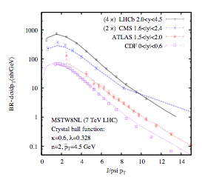
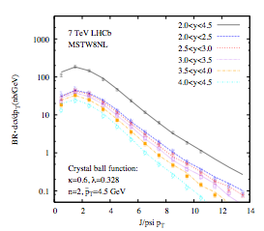
Fit to Single J/ψ Production

Slide 26
Parameters
Double Drell-Yan
Double J/ψ
Parameters: , intrinsic p_{T} r.m.s. σ=2 GeV, MSTW2008 NLO pdfs
Parameters: , m_{J/ψ}=3.096 GeV, BR(J/ψ-> μ⁺ μ⁻)= 0.05935, intrinsic p_{T} r.m.s. σ=2 GeV, σ_{eff}=14.5 mb , K=0.064 s/m²_{J/ψ,} κ=0.6, n=2, <p_{T}>=4.5 GeV, MSTW2008 NLO pdfs
Assumption: 100% detector and reconstruction efficiency

