Slide 1

Scicat new backend
And what to expect?
Noel Barth
Hamburg, 16.10.23

Slide 2

New backend status
New instances with new backend
New backend functionalities
Old backend migration
Current instances
Reachable from the internal network
scicat.service@desy.de
Notes:
- we can deploy the new backend and it is operational
- from now on we will no longer deploy instances with the old backend
- simply because we want and need to gain experience with the new backend.
- for the moment the new backend has the same functions as the old one, so it is possible to ingest proposal and create datasets.
- we will also be working on getting more features up and running
- from the point where we have implemented new features and they are working, we will inform you
- we will also try to migrate data from the old backend to the new one, but more about that on a later slide.
- to give you an overview of the instances
- currently we have 4 user instances including 3 with the old backend for example those of flash and p08
- and now we have added new instances with the new backend for p08 and flash
- All instances are accessible only from the internal network, will not change in the near future
- if you have heard this now and don't have an instance yet, but we have caught your interest, feel free to write an email to scicat.service@desy.de.
- and if you already have an instance and want to tell us something, please write to this email as well

Slide 3

Login new backend
Functional accounts
  Future plan: New approach
Keycloak with DESY account
Helmholtz AAI
Current Keycloak problems
Notes:
- the first question is probably what has changed in the login and the answer is quite simple: actually nothing
- the login still works with the functional accounts
-- and in the future there is a plan of the developers of scicat to abandon the functional accounts and to hand over the role assignment to the institutes, so that we can assign the necessary permissions to every individual account
-- but when exactly this change will come is not known yet
- then another way to log in would be via keycloak with the desy account
- and the third way would be via the helmholtz aai
- so far everything sounds fine, but at the moment we have a problem when it comes to login via keycloak
- it can happen that when you try to log in, you get an error with the message "unauthorized" or "internal error".
- then the current procedure for the user is to simply try the login again
- it is also possible that you have to try the login two or three times until you are logged in.
- we know that this is not user friendly, but we have not found a solution for the problem yet.

Slide 4
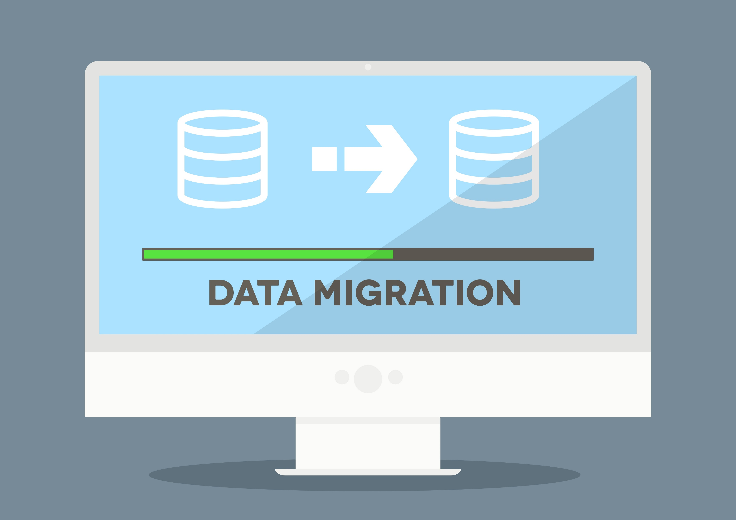
Migration
Procedure
  Find a suitable date
  Backup Data
  Running migration Scripts
  If successful
    Switch to new backend
  If failed migration
    Revoke migration
NO guarantee of migration!
Notes:
- since we have instances that were initially tested with the old backend, we have to do a migration of the database, before we can switch these instances to the new backend
- because the database structure has changed
- and that's why when we want to switch from the old to the new backend, we have to run scripts on the database to adjust the database structure
- this only applies to instances that previously used the old backend
- the migration procedure would look like this:
1. we would find a suitable date with the responsible persons of the instance
1. and then we would announce the migration
1. Note here! migration will not be addressed before december
2. then we would make a backup of the database
3. after that we would run the migration
4. if the migration worked, we would switch the instance to the new backend
5. if the migration did not work, we would load the backup and not switch the instance to the new backend
6. in the case that the migration did not work, we would collect information about why the migration did not work and pass this information on to the developers
- probably now the question came up why don't we fix the migration ourselves
- the answer is simply because we don't have the resources for it
- and also that is why we cannot guarantee that the data will be migrated

