Slide 1
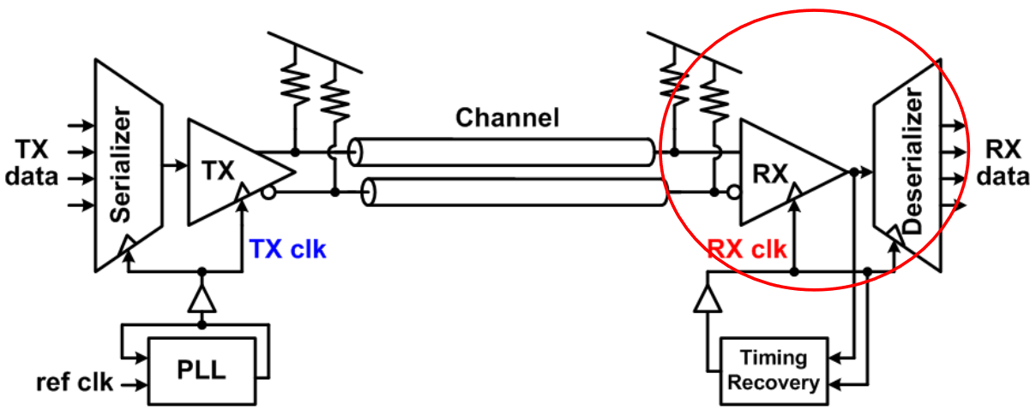
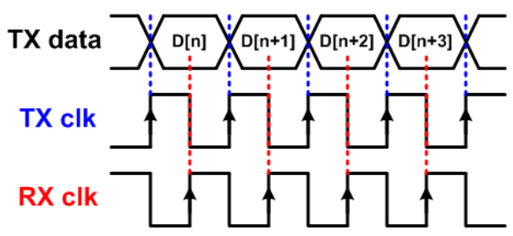
High-speed electrical link
RX block diagram
Sampler/
Comparator
V_{in}
Pre-
Amp
clk
RX must sample the signal with high timing precision and resolve input data to logic levels with high sensitivity
Input pre-amp improves signal gain and input referred noise
also be used for equalization and offset correction
provides gain at high-bandwidth corresponding to full data rate
Comparator is implemented with clocked regenerative amplifier

Slide 2
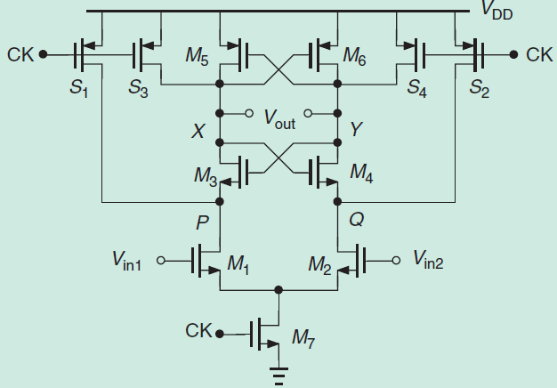
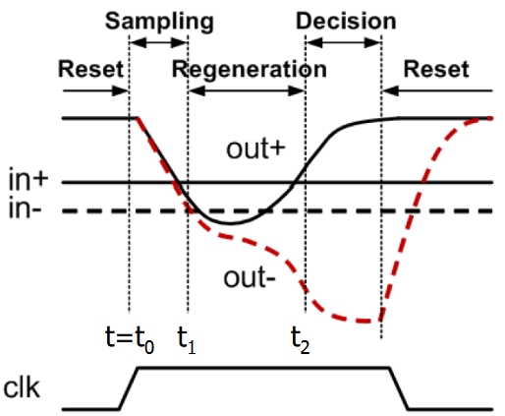
StrongARM latch
Sense amplifier, comparator, robust latch in digital signaling
Advantages:
zero static power → low power
high sensitivity → CMOS output level
precharge switches
Amplification /
Precharge /
cross-coupled pairs
VDD
GND
clocked diff. pair
four phases

