Slide 1
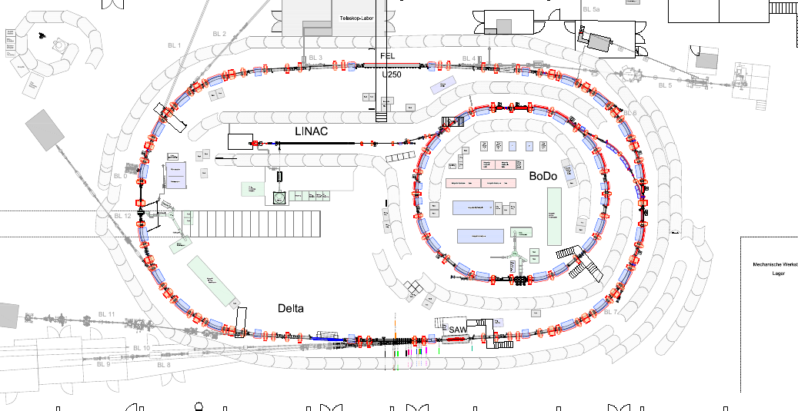
FLARE Project Status

Slide 2
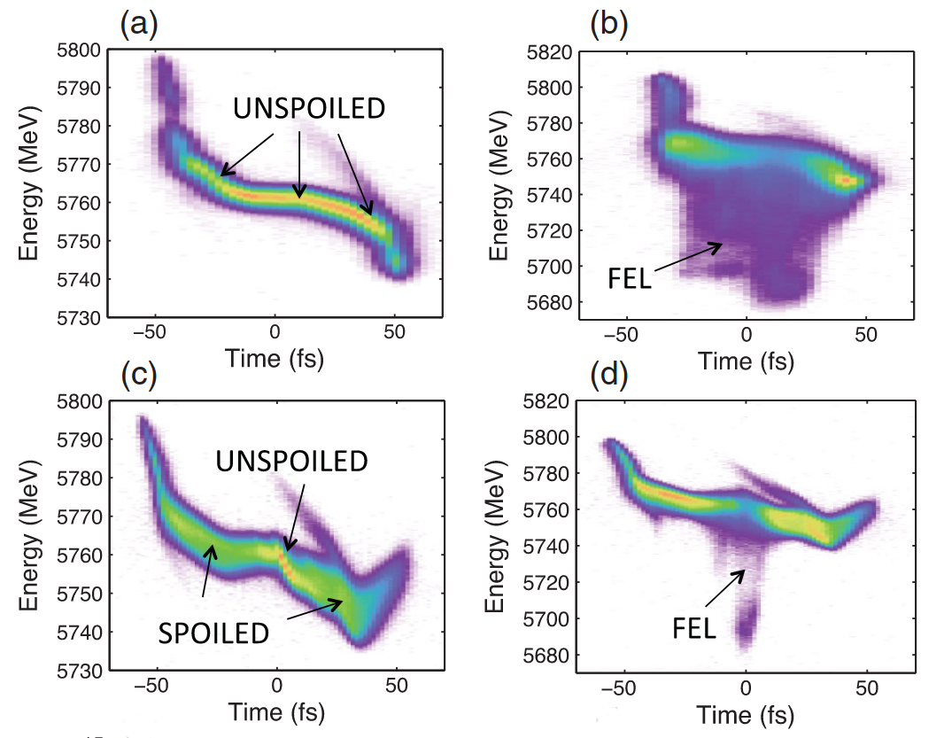
2
FLARE: project goals
- support commissioning of laser heater
- establish short-pulse techniques based on laser heater:
- partial overheating of the bunch
A. Marinelli et al., PRL 116, 254801 (2016)

Slide 3
3
FLARE: project goals
- support commissioning of laser heater
- establish short-pulse techniques based on laser heater:
- partial overheating of the bunch
- proof of conecpt of new scheme:
[1] T. Tanaka, Phys. Rev. Accel. Beams 22 (2019) 110704.

Slide 4
4
Status after the last project meeting ( Feb 2023 ) …
- successful laser heater studies in Nov 2022 & Jan 2023
- so far no acquisition of PolariX images for FLARE
- FLARE interferometer: delivery issues with optical components
- beam times scheduled in March & June

Slide 5
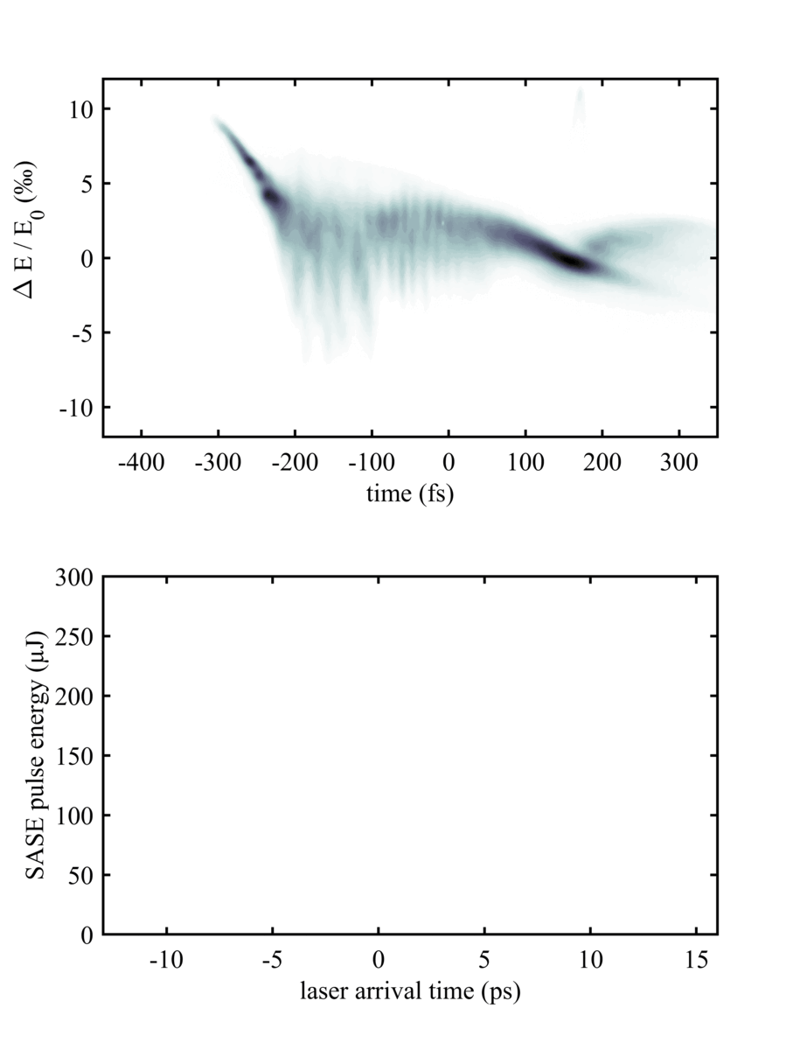
5
March 23: Heating the bunch
- acquisition of PolariX images
- change of arrival time
- idea: variation of pulse duration ?
- not observed
- SASE suppression visible very well

Slide 6
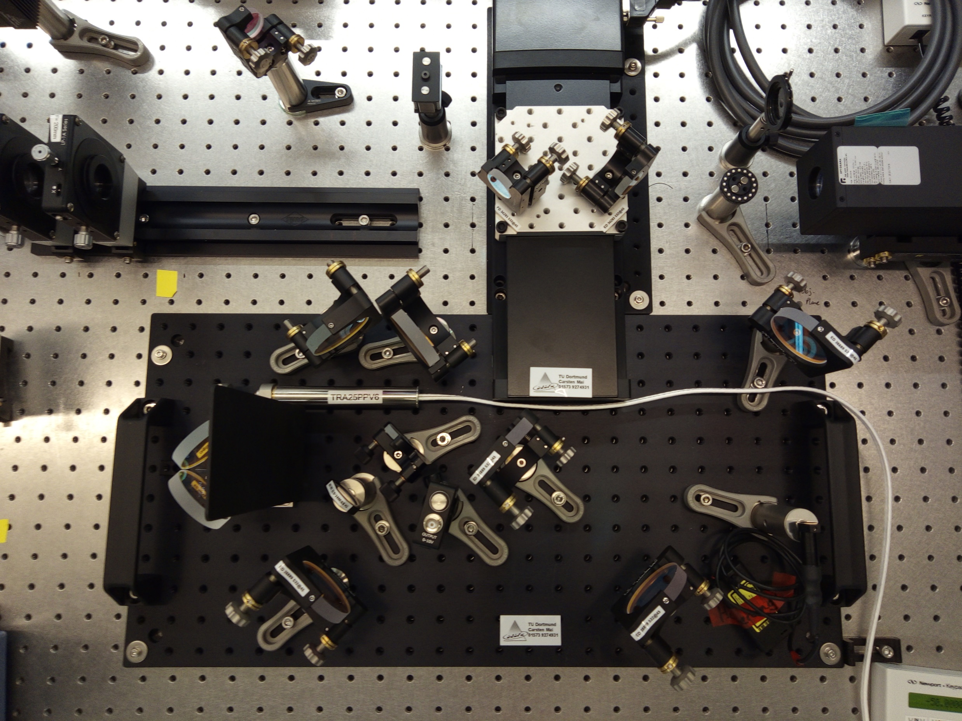
6
FLARE interferometer setup
from laser
to machine

Slide 7
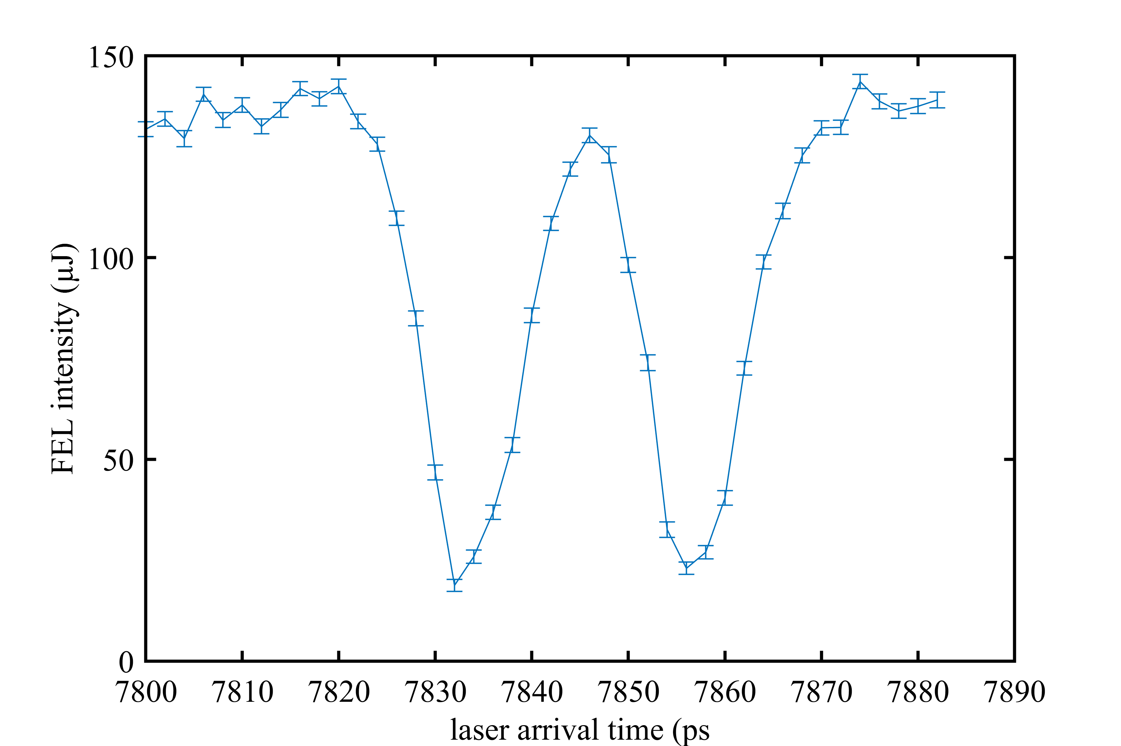
7
June 2023: finding two-fold overlap

Slide 8
8
August 2023: influence of interferometer
FEL not
saturated
two pulses
one pulse
continuous moving
of interferometer
in 128-nm steps

Slide 9
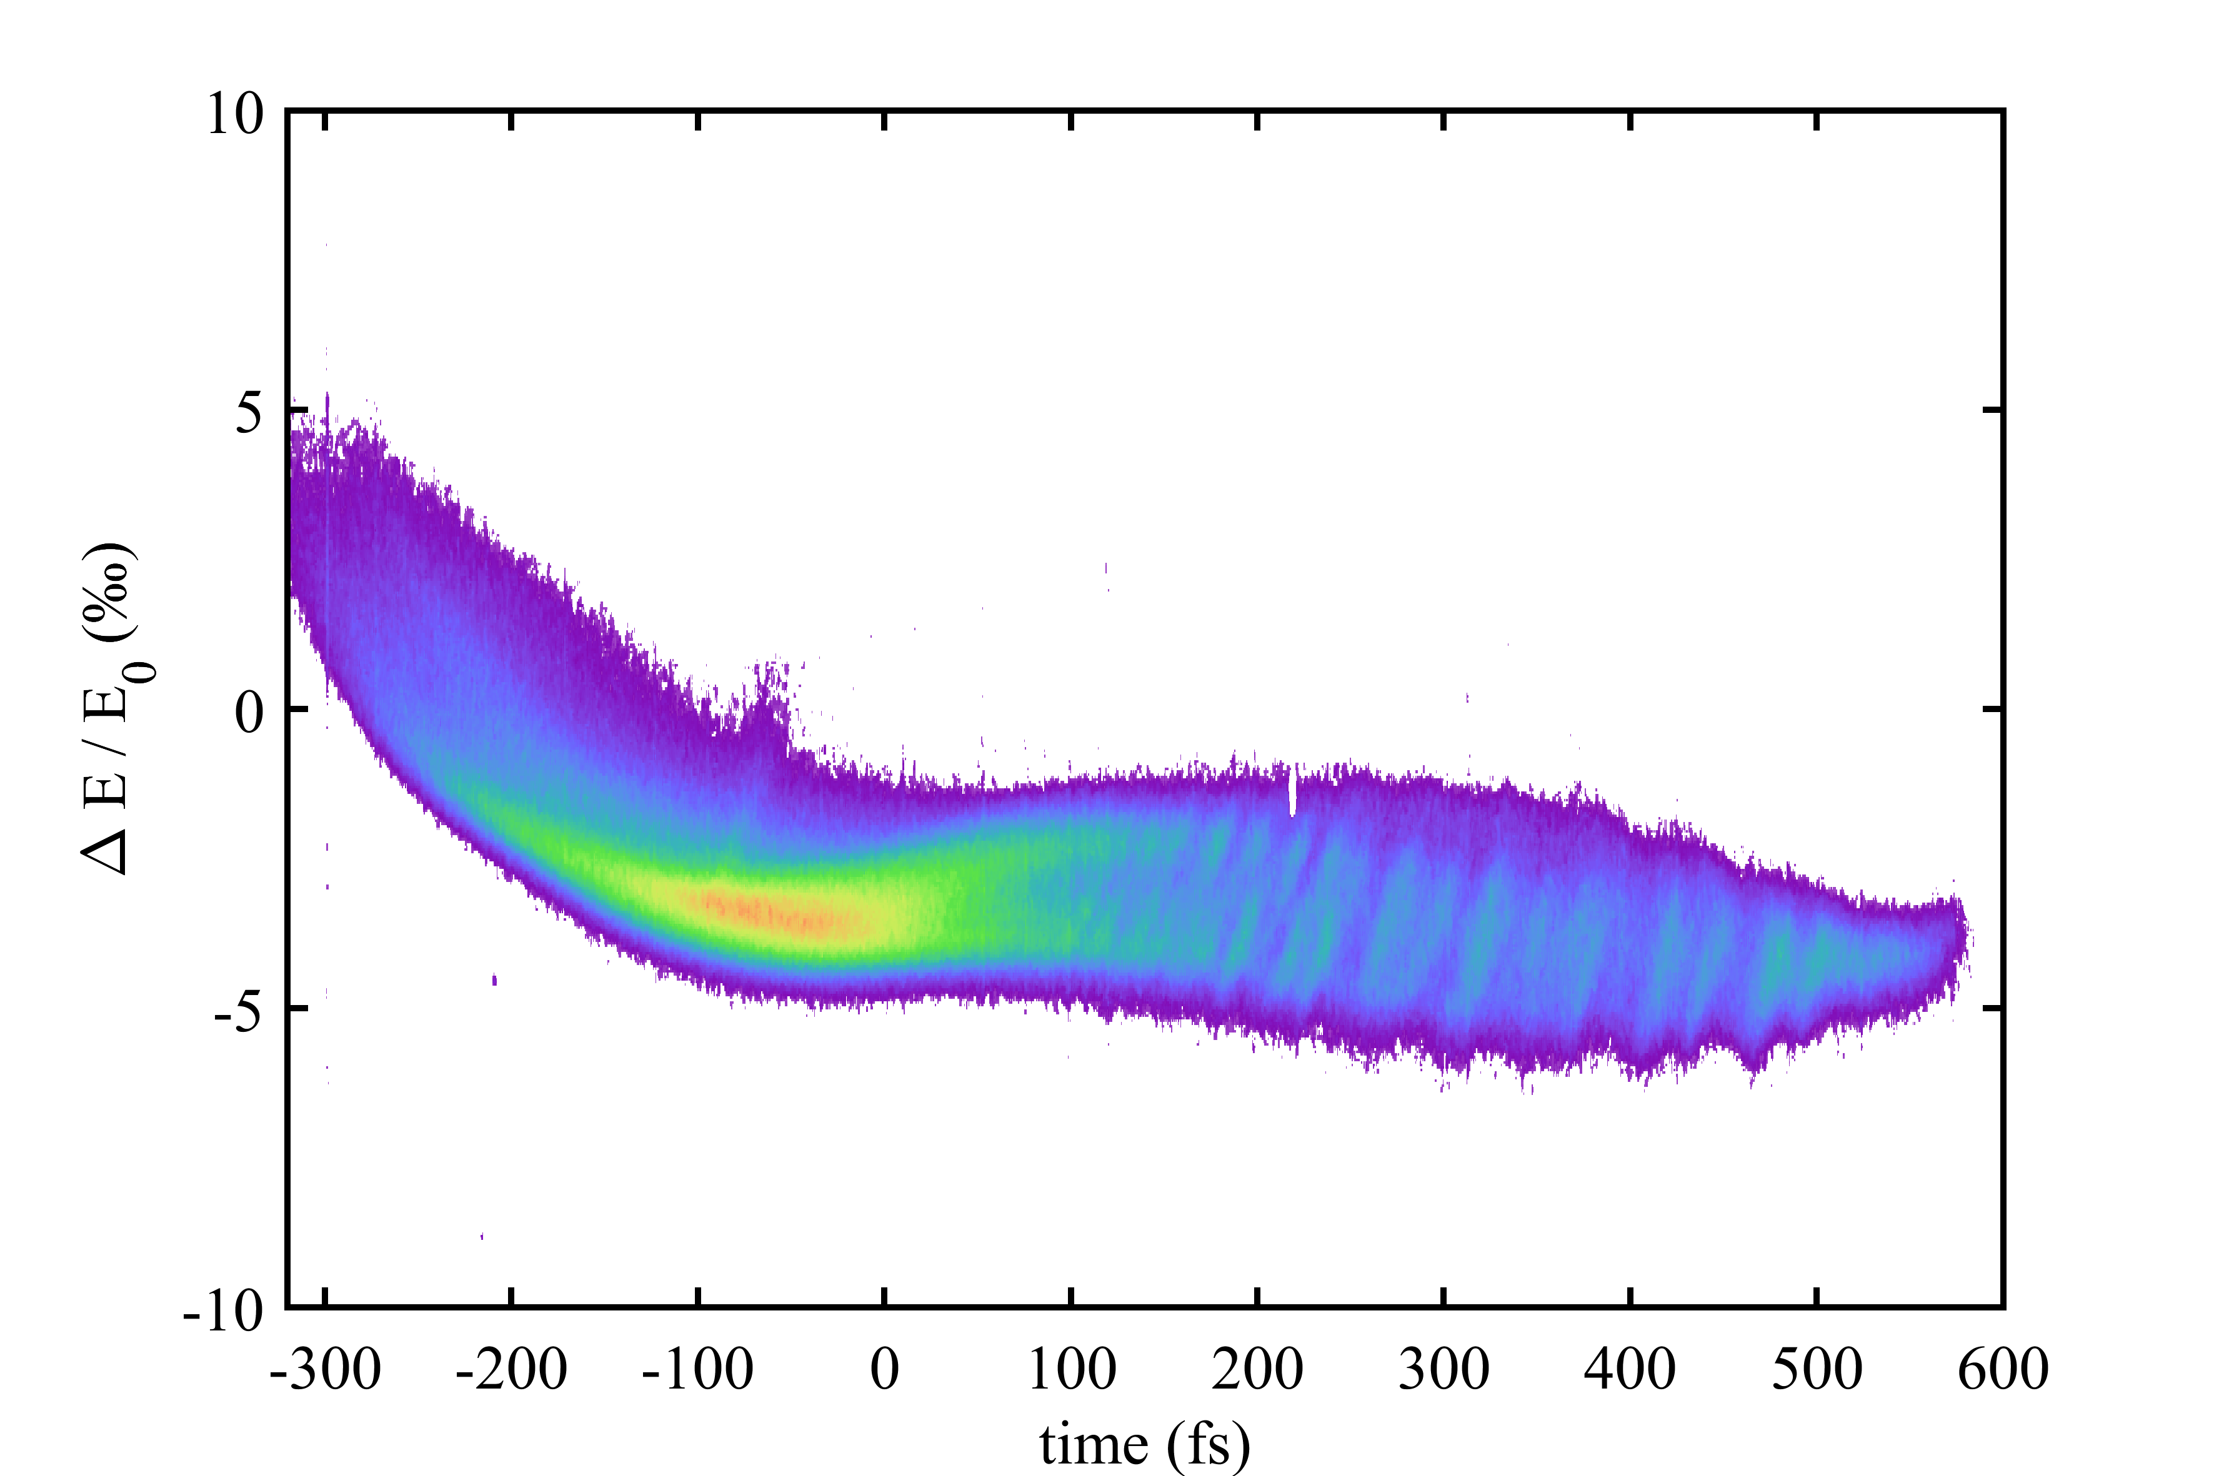
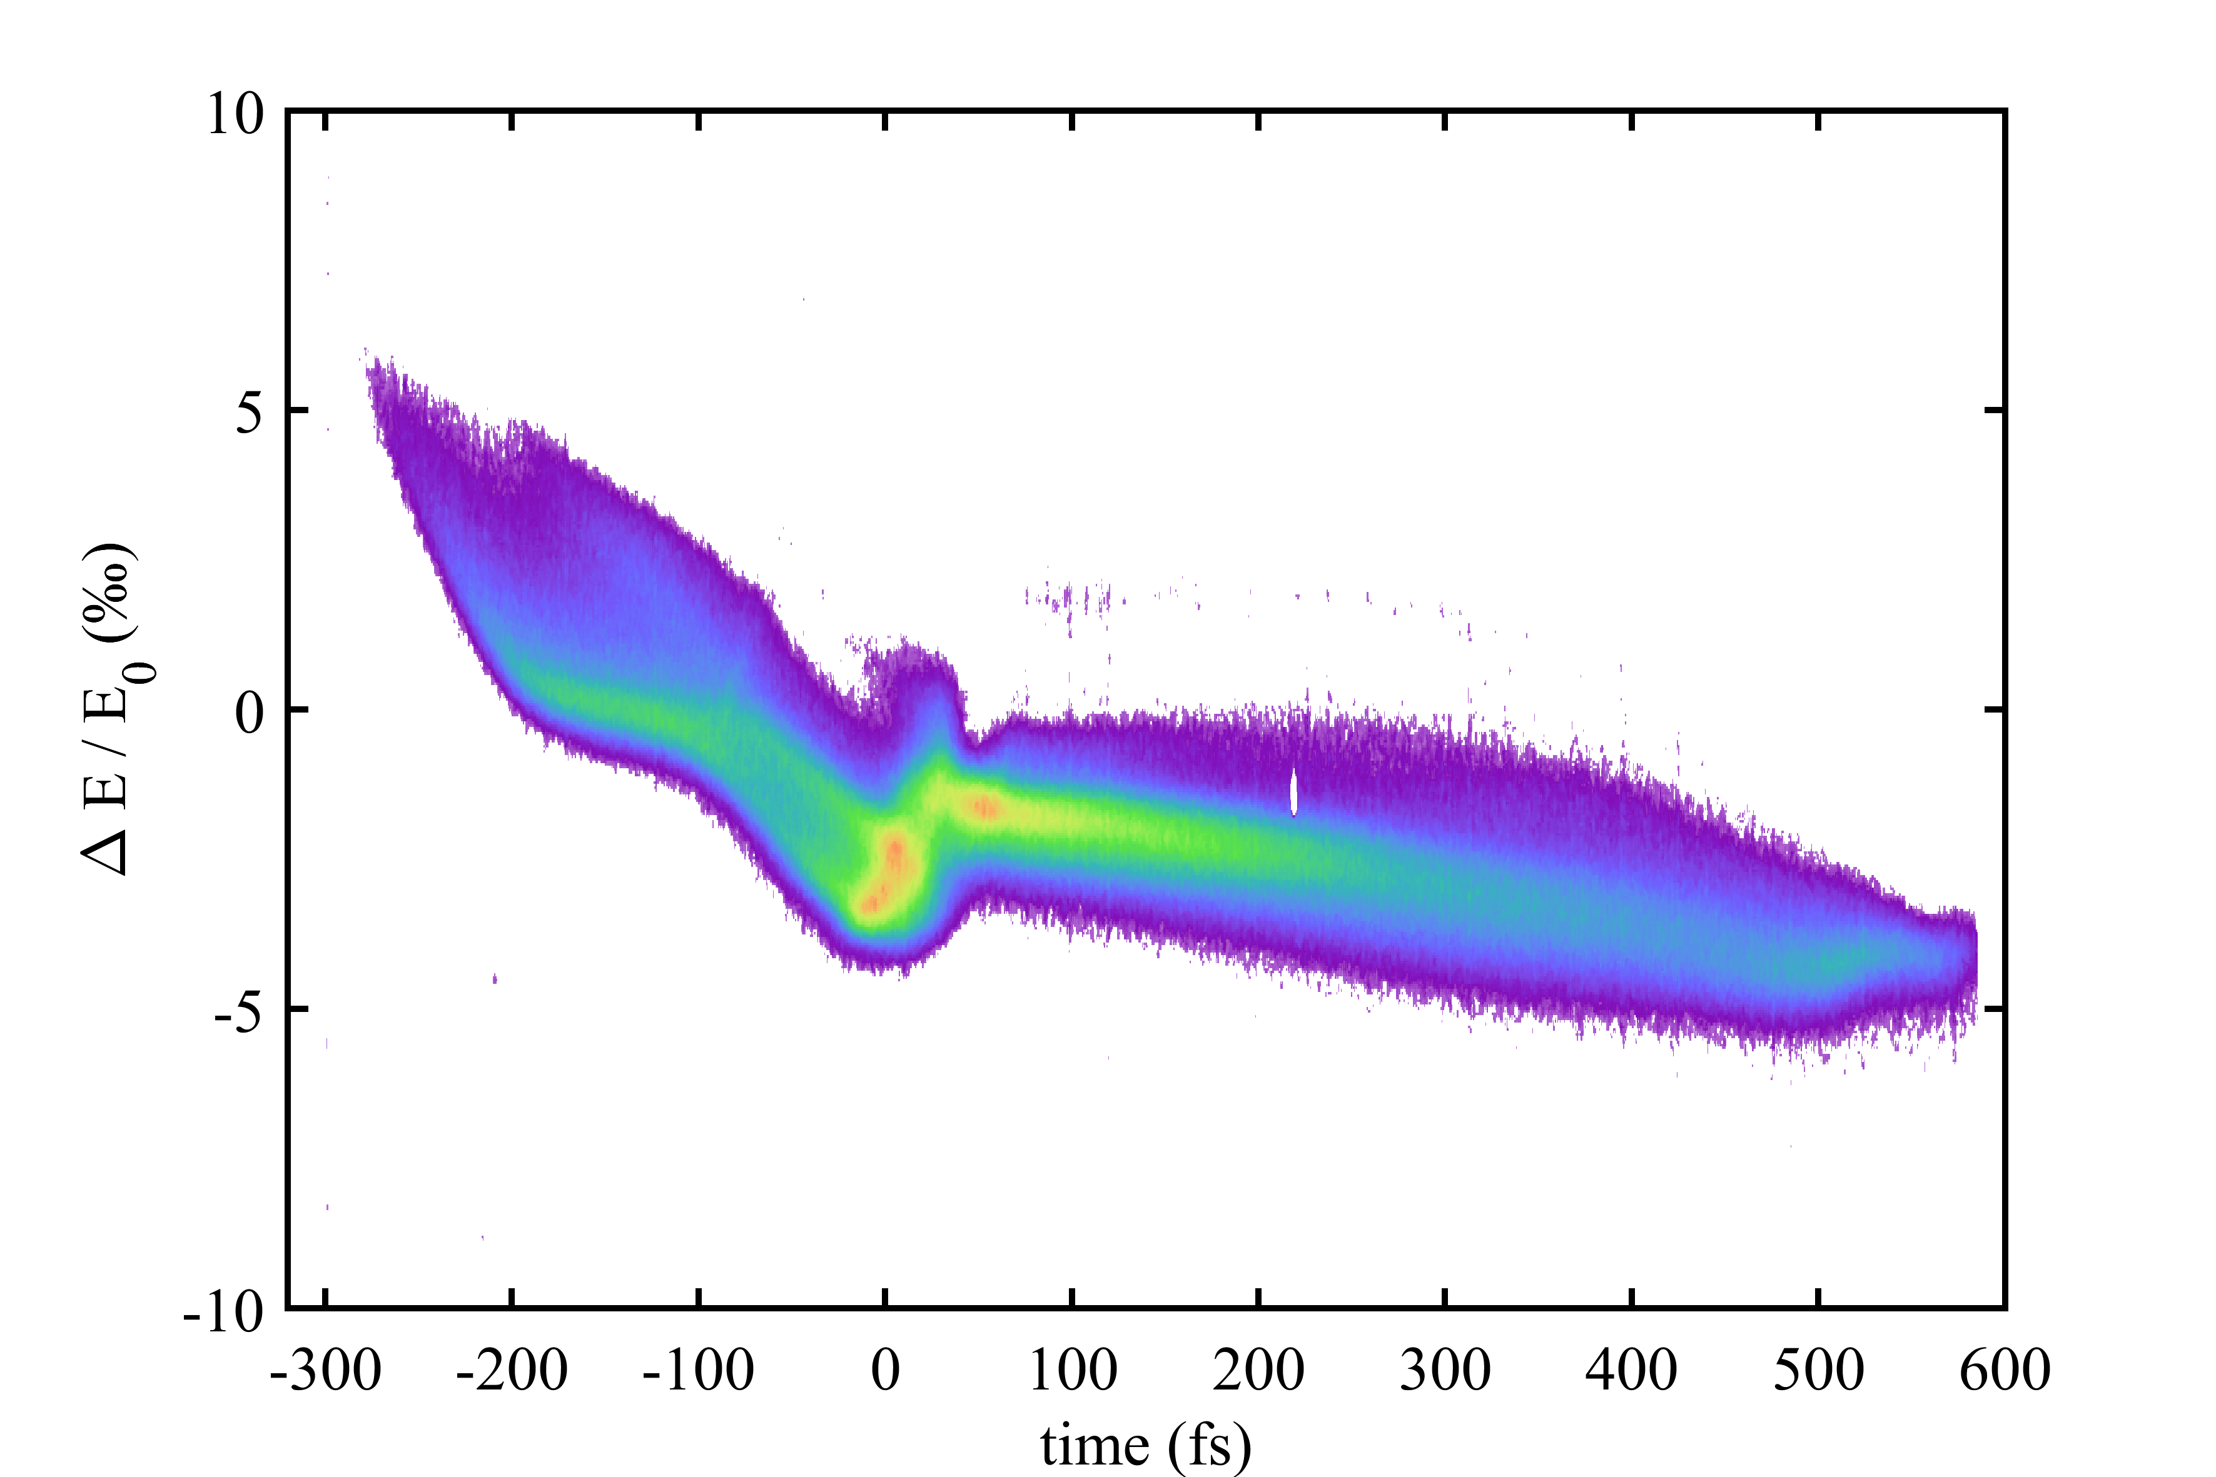
9
September 2023: no SASE, but interesting phase space
one pulse
two pulses, delay: 14.9 ps
(linear stage: 8.52 mm)

Slide 10
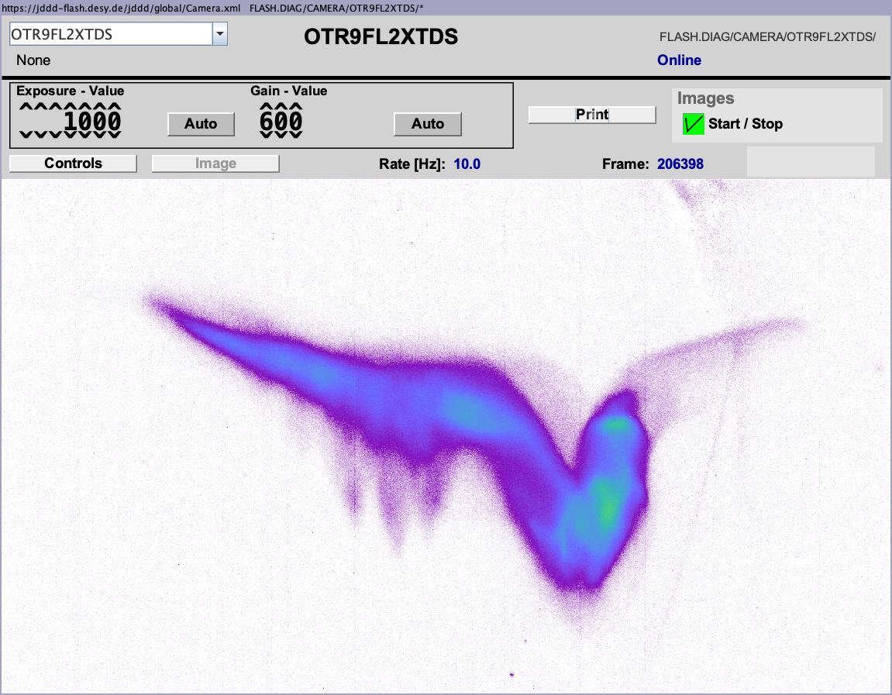
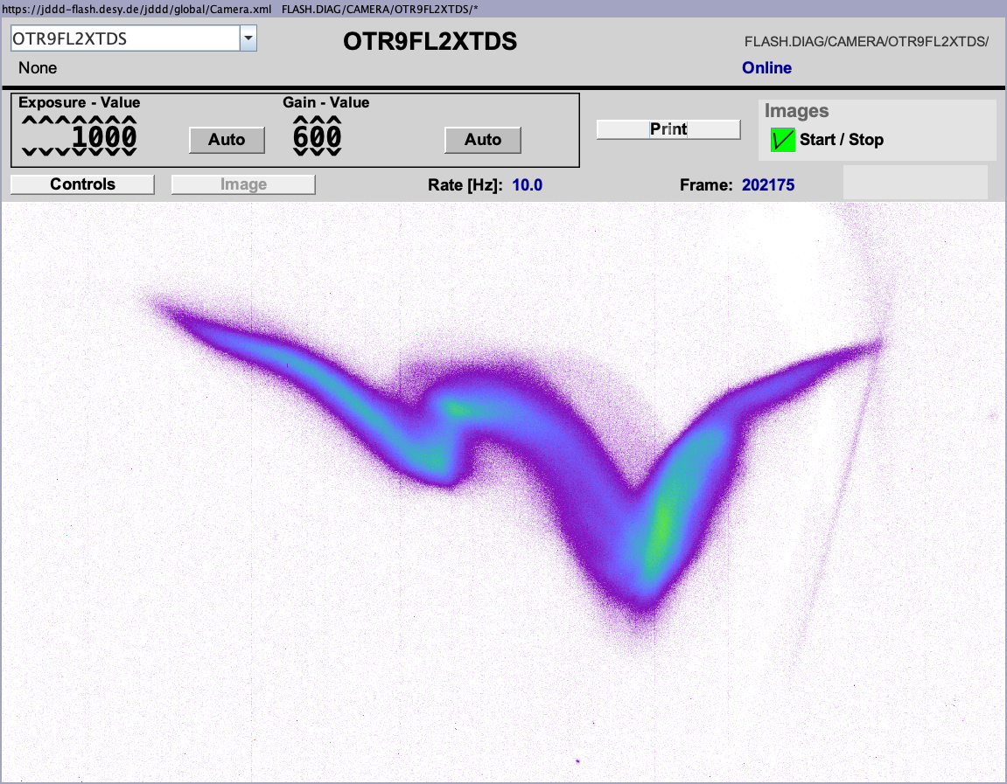
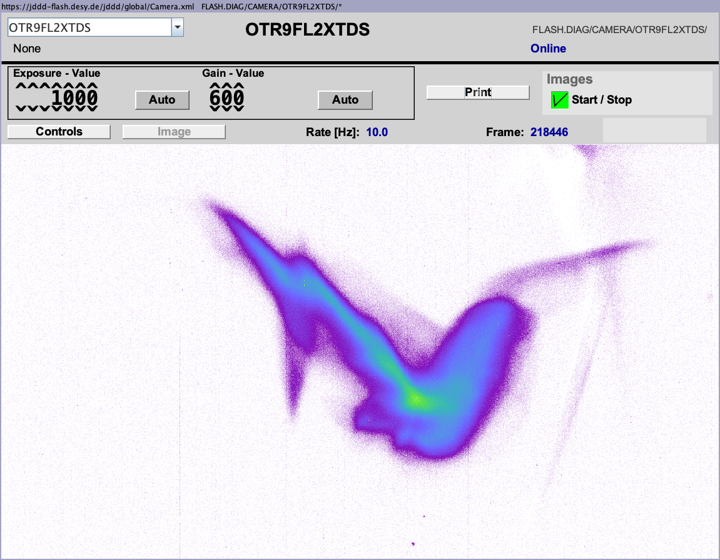
10
November 2023: same configuration with lasing
NO LASER
ONE LASER PULSE
(too much heating)
TWO LASER PULSES
(FLARE interferometer)

Slide 11
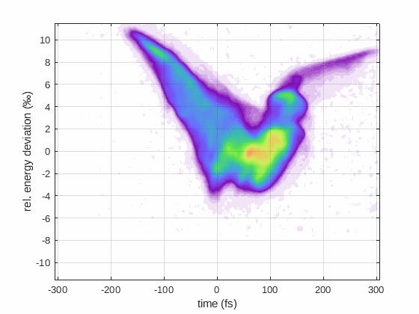
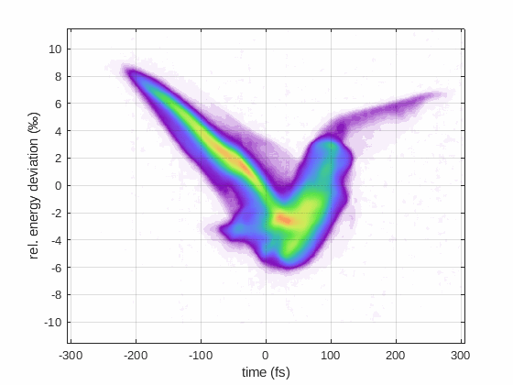
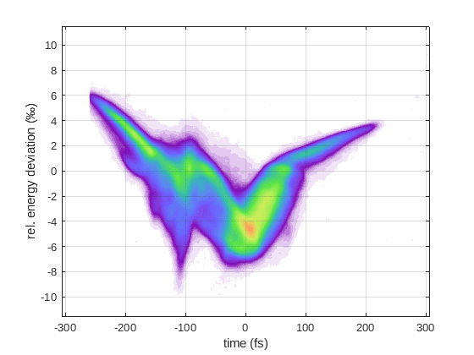
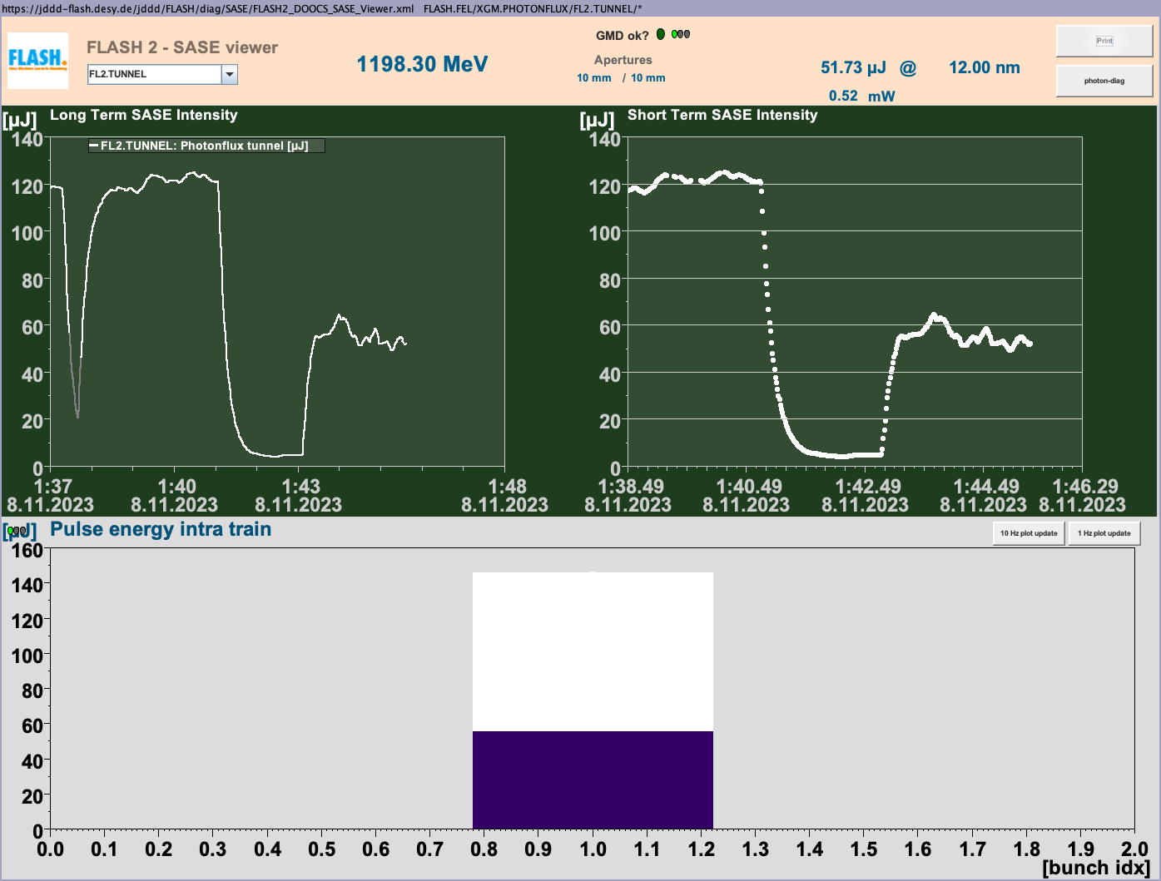
November 2023: same configuration with lasing
one laser pulse:
overheating
two laser pulses:
partial overheating
SASE

Slide 12
Initial schedule (October 2021)
3/2022 end of FLASH Shutdown
laser heater installation
4/2022 Laser heater commissioning
theory/simulation towards fs pulses
1/2023 flexible laser pulse shaping
theory/simulation towards fs pulses
2/2023 first modulation with unspoiled region
3/2023 optimization and fs diagnostics
4/2023 fs pulses with users
first tests towards linearly increasing amplitude
1/2024 Shutdown
theory/simulation towards sub-fs compression
2/2024 Shutdown
theory/simulation towards sub-fs lasing
3/2024 Shutdown
tests at DELTA, laser studies at FLASH
4/2024 Shutdown
tests at DELTA, laser studies at FLASH
1/2025 first modulation with sub-fs compression
2/2025 sub-fs lasing and diagnostics

Slide 13
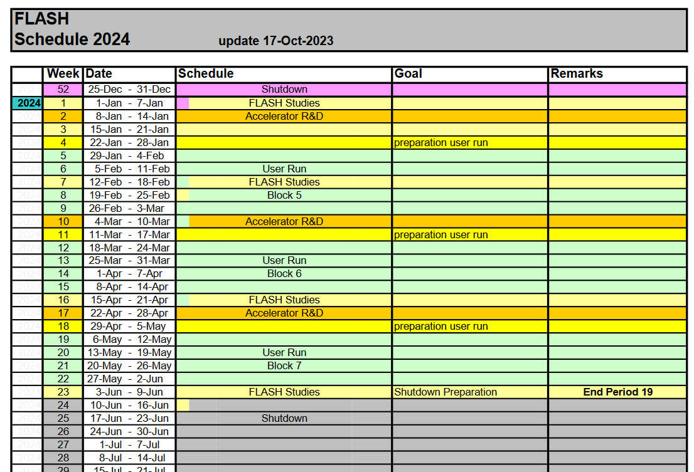

Slide 14
Next steps
until shutdown:
leave interferometer setup as it is?
further measurements with THz streaking?
dedidacted shift for comparison of different PolariX analysis methods?
during shutdown:
improve laser setup
laser autocorrelation
feedback to stabilize interferometer
general realignment
simulation studies
consider follow-up project? (next BMBF call expected by May 2024)
after shutdown:
shifts with short-pulse diagnostics

Slide 15
Thank you for your attention!

