Slide 1
ARES Operation Meeting
Summary of week 42 / 2023
Hannes Dinter, on behalf of the ARES crew

Slide 2
Summary of week 42
 | Mon. 16th October | Tue. 17th October | Wed. 18th October | Thu. 19th October | Fri. 20th October
Achievements | Tunnel open for maintenance day X-band klystron check (MIN) USV yearly check Work on grounding net ICT cable installation (MDI) SH.D1 trigger | AutoAcc shift Repeat measurements from last shift Added BO implementation Add newly trained (geometry-agnostic) agent Also over night Cavity BPM tests | Debugging magnet problems with MPC and MCS PolariX RF conditioning in parallel (off-beam) PolariX power readbacks calibrated (MSK) Magnet server updated, found exception fixed Over night: AutoAcc, PolariX conditioning | ICT measurements with charges between 0.6pC and 40pC (MDI) Several ZZ to test different setups (ferrite cores, attenuator) PolariX: RF conditioning in parallel (off-beam) Power balanced (MIN) Trying to bring timing on-beam (no effect observed) Testing laser auto-alignment (successful) Over night: AutoAcc, PolariX conditioning | PolariX RF conditioning UV laser beamline checks (FS-LA)
Difficulties |  | Magnet power supplies stuck Several workarounds implemented in AutoAcc script Strange beam shape observed | AutoAcc script crashed due to stuck EA quad After refining / adding more workarounds, it ran smoothly over night
Notes |  |  |  | Enabled "en Regler" for AR.LI.BPM.G1 (signal was clipping)

Slide 3
Magnet power supply freezing issue
The power supply server does not allow interruption of a current ramp in the opposite direction. The server will just stop and the new SP will never be reached. An easy workaround is to just issue the new SP again. Also: When the switch OFF command is given, the server ramps the PS to zero current. If a new SP is given during this ramp, a DOOCSException is thrown. Right now all of this has to be handled by the client application, but M. Walla will implement a server-side fix.
Workaround / reanimation procedure implemented in AutoAcc measurement script
Server-side fix implemented → Operation now much more reliable

Slide 4
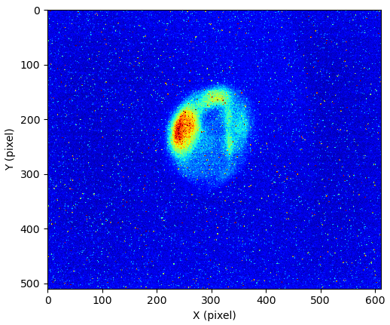
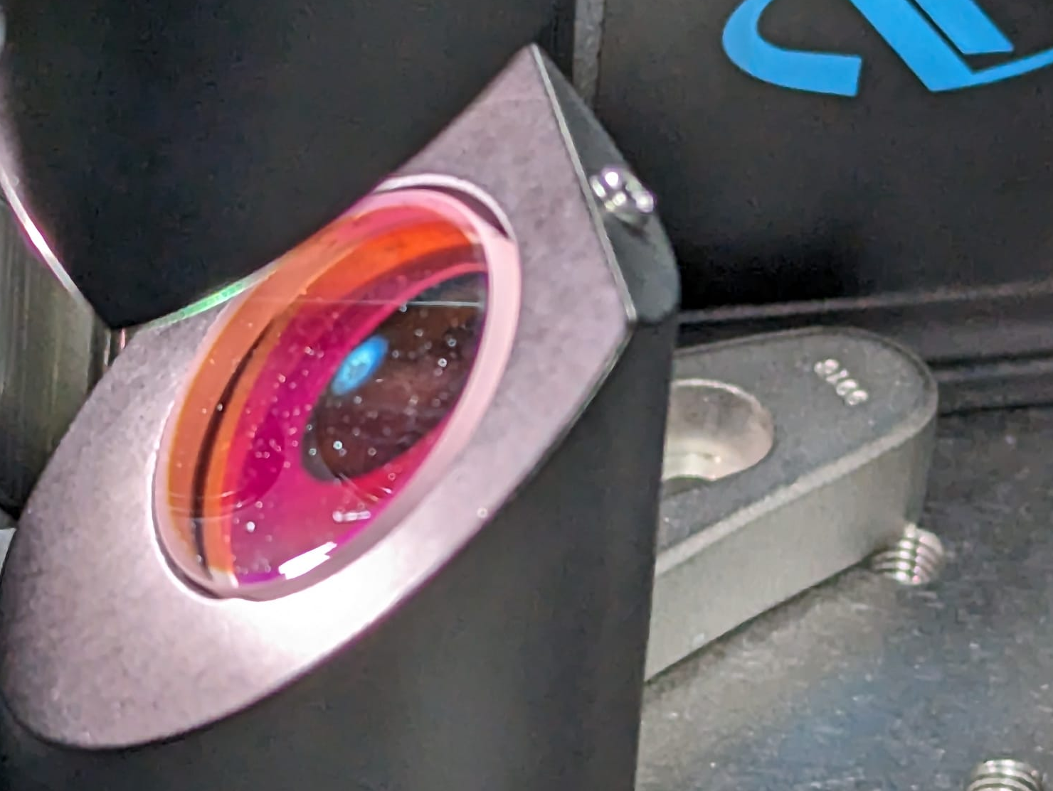
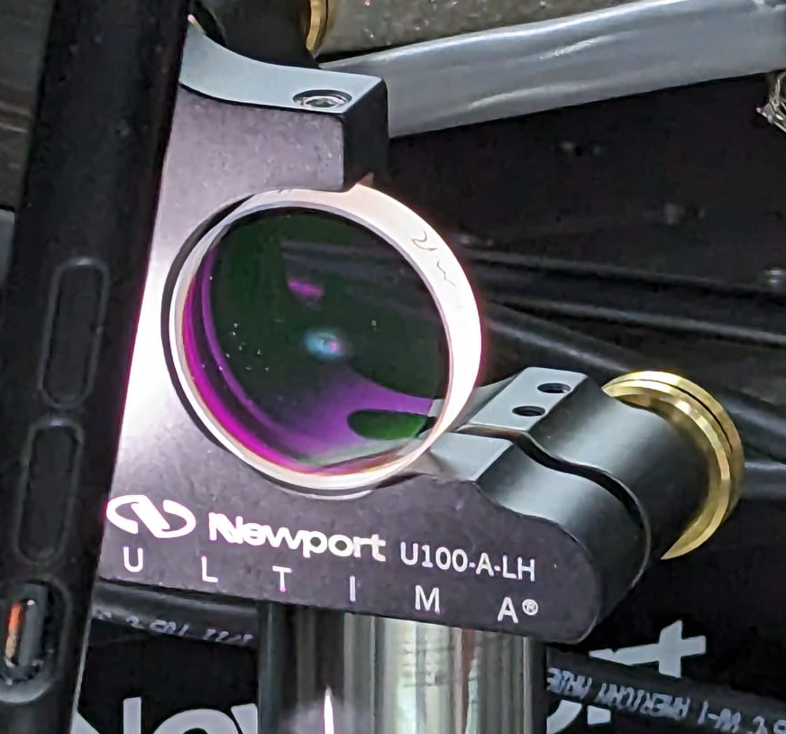
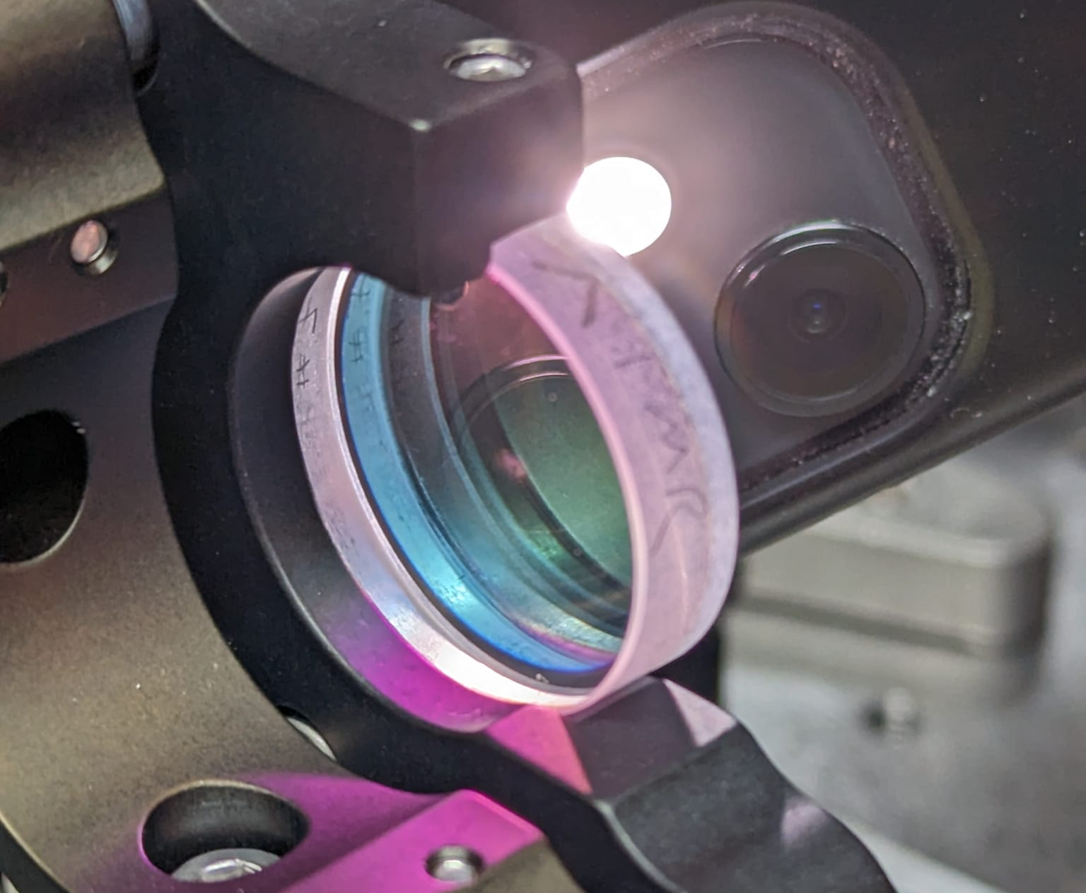
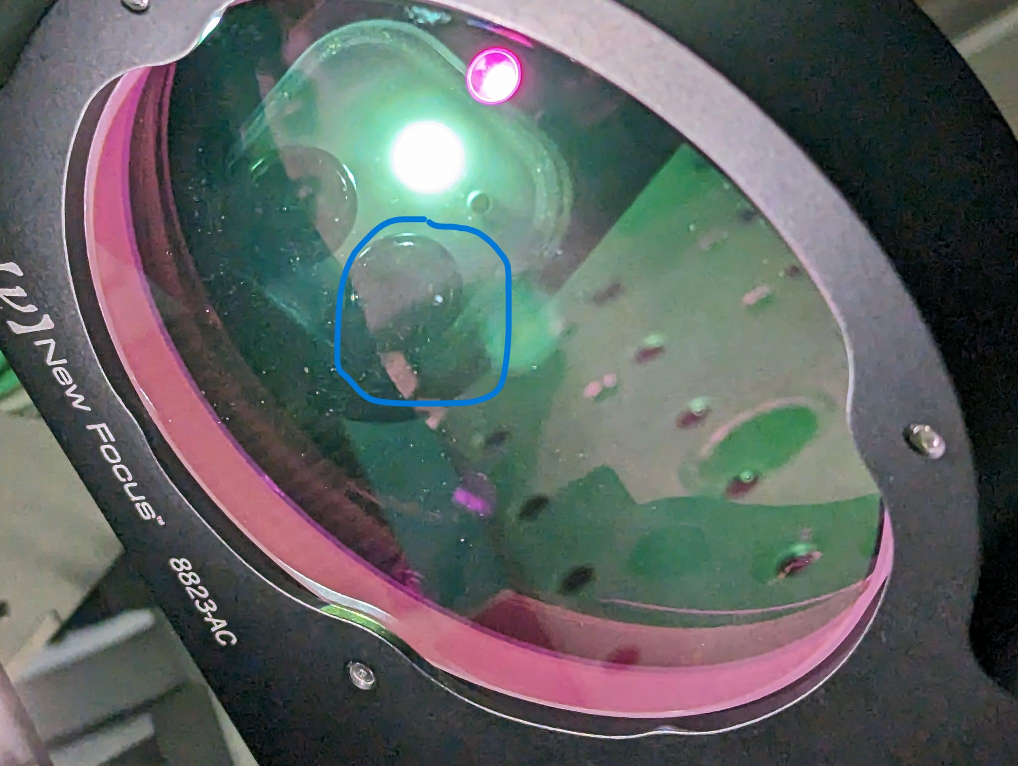
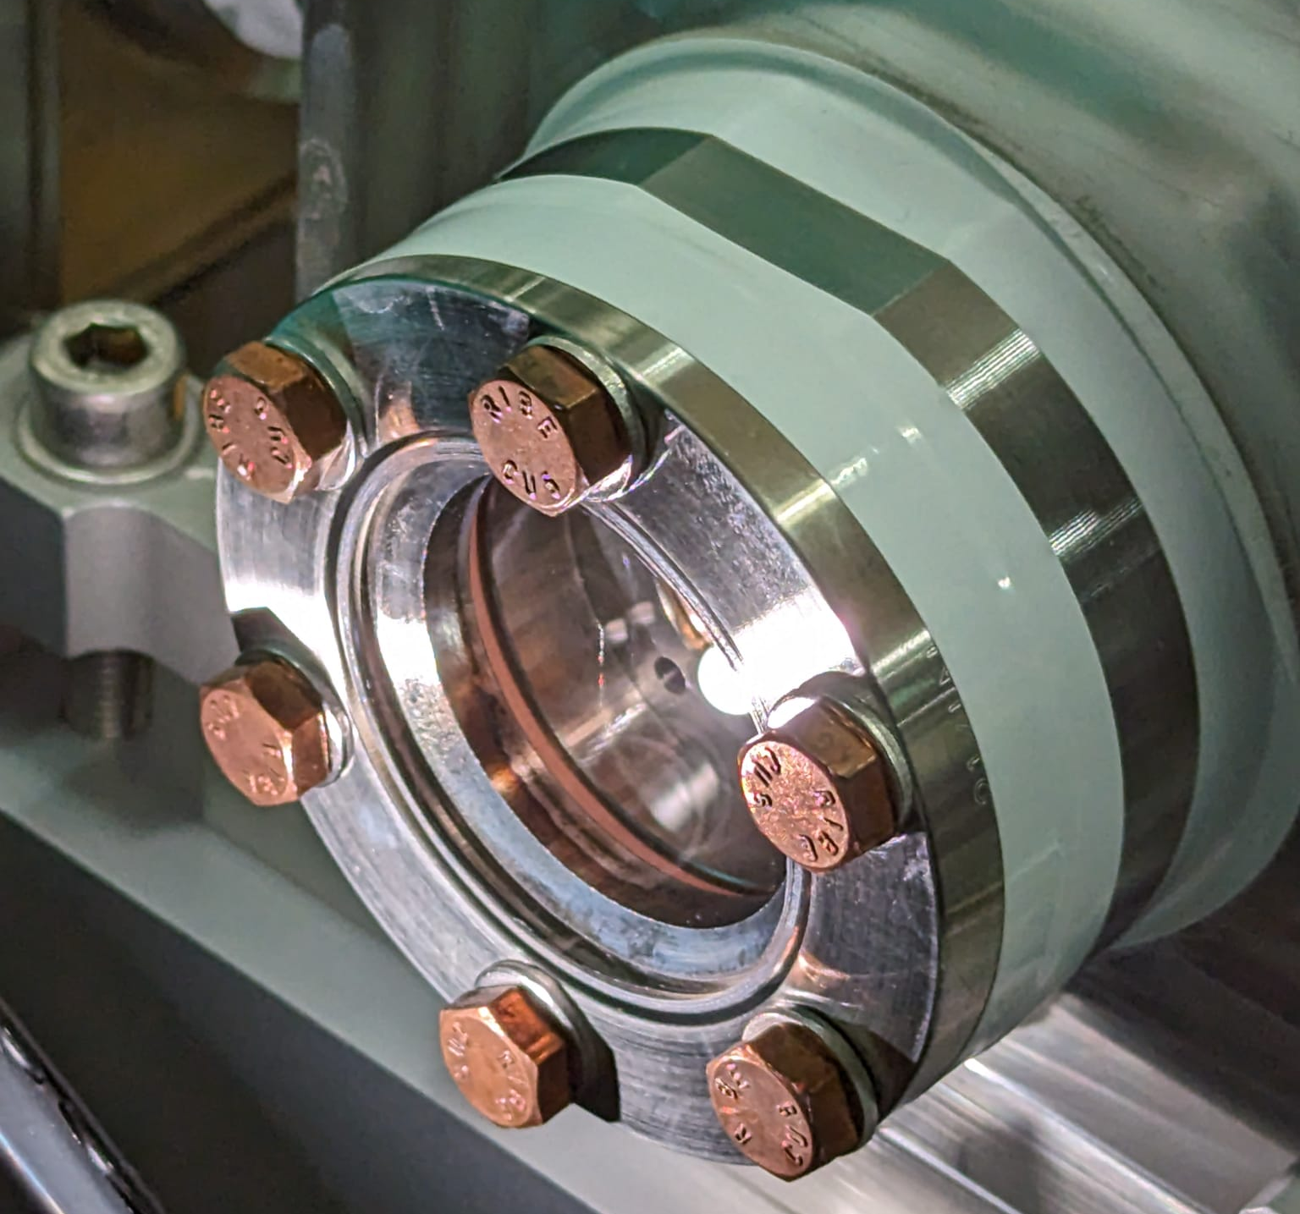
UV laser optics damages
Found some damaged mirrors, maybe scratch on vacuum in-coupling window
e⁻ beam on SH.D1

Slide 5
Plan for this week
MON:
  D3 setup
  Wille grounding net
  ZM works on the controls for the TDS mover system
TUE – FRI:
  D3 detector measurements
  PolariX conditioning in parallel (off-beam)

Slide 6
Schedule
Week 43
Date | Shift Leader
23.10. | Florian, Hannes, Max
24.10. | Hannes
25.10. | Max, Hannes
26.10. | Max
27.10. | Thomas
If you want to learn or join the shift: please give the shift leader a call (BKR 2840)

