Slide 1
Search for vector dark matter in microwave cavities with Rydberg atoms
Jordan Gué
In collaboration with A. Hees, J. Lodewyck, R. Le Targat and P. Wolf
Based on JG et al. Phys. Rev. D 108 035042 (2023)
COSMIC WISPers, DESY
February 1st 2024

Slide 2
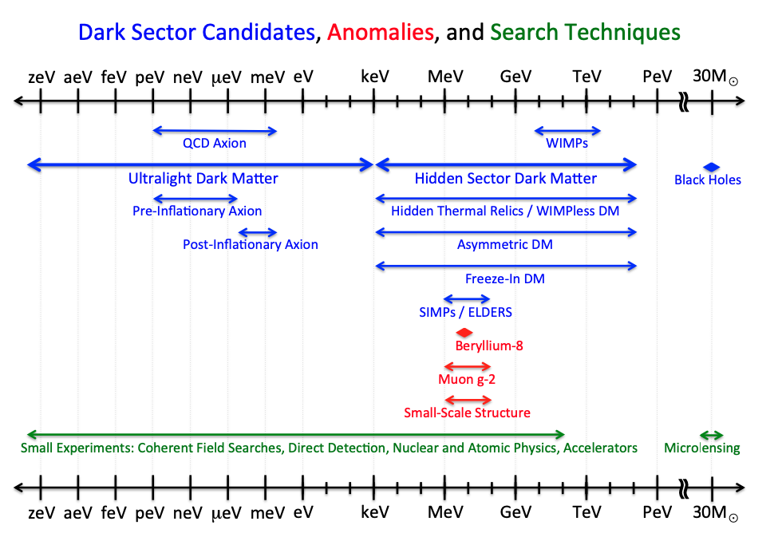
Classes of Dark Matter
ULDM mass interval
From US cosmic vision : new idea for Dark Matter 2017, Arxiv:1707:04951
2

Slide 3
Ultra Light Dark Matter (ULDM) models
$$\sim 0.4 GeV/{cm}^{3}$$
$$\frac{n}{n_{k}}\sim \frac{ρ_{DM}}{{(mc^{2})}^{4}v_{max}^{3}}>1$$
ULDM with $mc^{2}<10 eV$ must be bosonic (Pauli exclusion principle)
Various bosonic ULDM candidates
When $mc^{2}≪eV →n/n_{k}≫1→$ a generic vector field $\vec{φ}$ can be treated classically, i.e as oscillating solution of the Klein Gordon equation in FRLW expanding universe,
Occupation number
in phase space
$$\sim {10}^{−3}c$$
$$<10 eV$$
Inspired from P. Tourrenc et al, Arxiv:quantum-ph/0407187, 2004
Scalar fields (Dilatons,...)
Pseudo-scalar fields (Axions,…)
Vector fields (Dark photons,...)
$$\vec{φ}={\vec{φ}}_{0}\cos\left(ω_{DM}t\right)$$
$ℏω_{DM}=m_{DM}c^{2}$ in DM rest frame
$∝\sqrt{ρ_{DM}}$, local DM energy density
3

Slide 4
Dark Photon (DP) phenomenology
DP can couple to matter through B-L current → leads to violation of UFF
Here, we are interested in its coupling with electromagnetism
$$ℒ=−\frac{1}{4}F^{μν}F_{μν}+j^{μ}A_{μ}−\frac{1}{4}φ^{μν}φ_{μν}−\frac{1}{2}m^{2}φ_{μ}φ^{μ}−\frac{χ}{2}F^{μν}φ_{μν}$$
The photon-DP mixing generates a standard electric field filling the whole space
$${\vec{E}}_{DP}≈−χω{\vec{φ}}_{0}\cos\left(ω_{DM}t\right)$$
which is the observable we aim at detecting!
P. Fayet, Phys. Rev. D 99 (2019)
Kinetic mixing coupling
DP strength tensor
DP field
B. Holdom, Phys. Lett. 166B, 196 (1986)
$$≡\vec{φ}$$
4

Slide 5
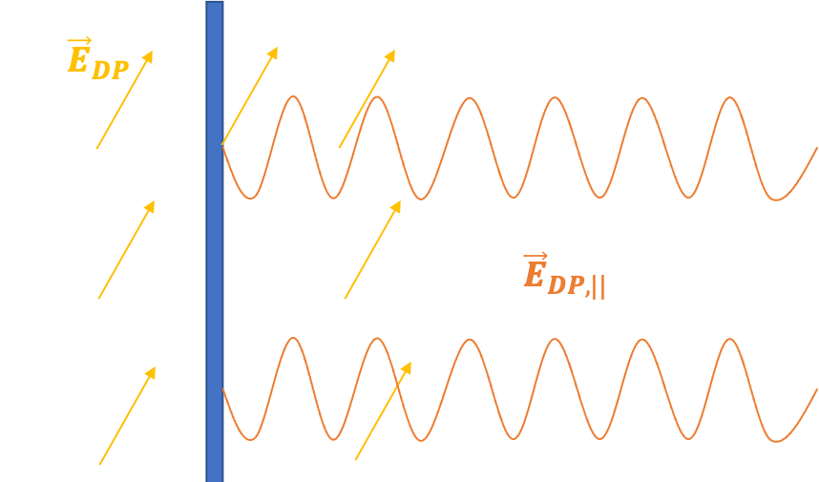
Resonant cavity to amplify ${\vec{E}}_{DP}$
Use of metallic plate to create classical propagating EM field by boundary conditions
In , we propose a new way of detecting ${\vec{E}}_{DP}$ using microwave cavity and atoms whose signal is $∝χ$
At GHz freq., mainly 2 types experiments to detect ${\vec{E}}_{DP}$
1) Cavities (haloscopes)
Detection of EM power inside the cavity $∝χ^{2}$
2) Dish antennas
→ Detection of EM power focused by curvature of dish $∝χ^{2}$
P. Arias et al., JCAP 06 (2012)
D. Horns et al., JCAP 04 (2013)
JG et al. PRD (2023)
5

Slide 6
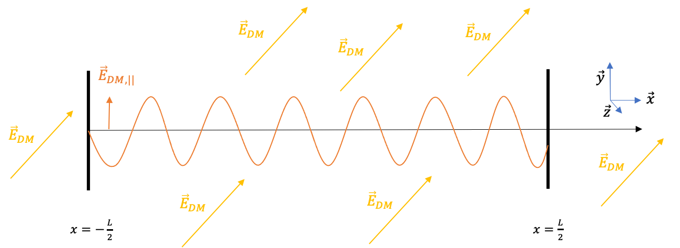
The experiment : Setup using microwave signal
We work in 1D with a microwave cavity.
$$X_{DM,||}∝χ\sqrt{ρ_{DM}}\cos\left(ω_{DM}t\right)$$
6

Slide 7
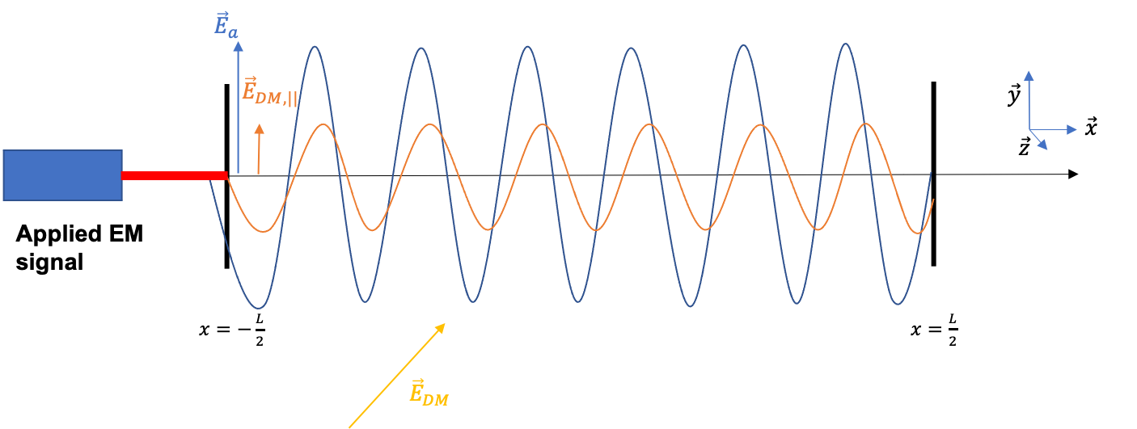
The experiment : Setup using microwave signal
We work in 1D with a microwave cavity.
$$X_{DM,||}∝χ\sqrt{ρ_{DM}}\cos\left(ω_{DM}t\right)$$
→ Apply an external field ${\vec{E}}_{a}∝{\vec{X}}_{a}\cos{(ω_{a}t +φ_{a})}$…
…and look at the total E field squared
$$ω_{a}−ω_{DM}$$
✓
$${|\vec{E}}_{T}|^{2}∝ X_{a}X_{DM}[cos\left(∆ωt+φ_{a}\right)+\cos\left(Σωt+φ_{a}\right)]$$
$$+X_{DM}^{2}\cos{(2ω_{DM}t)}+X_{a}^{2}\cos{(2ω_{a}t+φ_{a})}$$
JG et al. PRD 108 035042 (2023)
Oscillating too fast and/or amplitude too small
6

Slide 8
The experiment : Setup using microwave signal
We work in 1D with a microwave cavity.
$$X_{DM,||}∝χ\sqrt{ρ_{DM}}\cos\left(ω_{DM}t\right)$$
→ Apply an external field ${\vec{E}}_{a}∝{\vec{X}}_{a}\cos{(ω_{a}t +φ_{a})}$…
…and look at the total E field squared
$$ω_{a}−ω_{DM}$$
✓
$${|\vec{E}}_{T}|^{2}∝ X_{a}X_{DM}[cos\left(∆ωt+φ_{a}\right)+\cos\left(Σωt+φ_{a}\right)]$$
$$+X_{DM}^{2}\cos{(2ω_{DM}t)}+X_{a}^{2}\cos{(2ω_{a}t+φ_{a})}$$
JG et al. PRD 108 035042 (2023)
Oscillating too fast and/or amplitude too small
→ Slowly oscillating signal $∝χ$ → We are sensitive to $ω_{DM}$ such that $∆ω<{πf}_{s}$
We use the applied field to amplify the weak DM field (through ${\vec{X}}_{a}$)
6

Slide 9
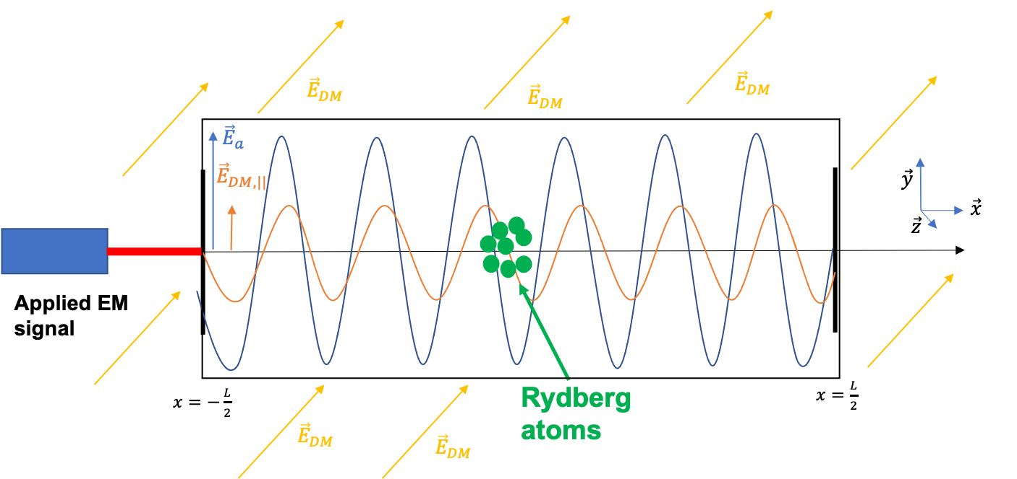
The experiment : Detection using Rydberg atoms
Best way of measuring the square of the electric field strength is through quadratic Stark effect
$$Δν=\frac{1}{2h}∆α{\left\langle E\right\rangle }^{2}$$
Measurement of transition frequency of an atom and look for $ν\left(t\right)=ν_{0}+Δν\cos{(Δωt+φ_{a})}$
With Rydberg atoms :
High accuracy on $Δν$ from ${\left\langle E\right\rangle }^{2}$
Large polarizability $∆α$
Good resolution on${ \left\langle E\right\rangle }^{2}$
→ Better sensitivity on ${\left\langle E\right\rangle }^{2}$
Short lifetime ($\sim μ$s)
Non-destructive measurement
→ High sampling frequency possible
7

Slide 10
Experimental methodology
Apply electric field with frequency $ω_{a}$ for $T_{obs}$ → scan DM signals with $\frac{2π}{T_{obs}}<|Δω|<\frac{{πf}_{s}}{2}$
2) Shift applied frequency by $πf_{s}$for $T_{obs}$
→ scan new DM signals with $\frac{2π}{T_{obs}}<|Δω|<\frac{{πf}_{s}}{2}$
Allowed interval for $ω_{DM}$
New allowed interval for $ω_{DM}$
Shift of $ω_{a}$
$$ω (Hz)$$
$$ω (Hz)$$
$$Δω=πf_{s}/2$$
$$Δω=πf_{s}/2$$
$$Δω=πf_{s}/2$$
$$Δω=πf_{s}/2$$
$$ω_{a}^{(1)}$$
$$ω_{a}^{(1)}$$
$$ω_{a}^{(2)}$$
N times
→ Large window of DM frequencies scanable $(=Nf_{s})$
8

Slide 11
Rough estimation of the experiment sensitivity
1st source of noise : Statistical noise
Measurement uncertainty on the frequency shift of atoms…
$$σ_{∆ν}^{2}=\frac{S_{∆ν}f_{s}}{2}$$
…induces a measurement uncertainty on the electric field squared
$$S_{∆ν}={\left(\frac{∆α}{2h}\right)}^{2}S_{E^{2}}$$
Frequency shift noise PSD
Frequency shift variance
Electric field squared noise PSD
9

Slide 12
Rough estimation of the experiment sensitivity
2nd source of noise : Systematic effect
Amplitude fluctuation of the applied field, characterized by the RIN of the signal generator
$$X_{a}→X_{a}\left(1+\int{dω_{0}\frac{ΔX_{a}{(ω}_{0})}{X_{a}}\cos{{(ω}_{0}t+φ_{0})}}\right)$$
The RIN PSD $S_{RIN}{(ω}_{0})$ is given by
$$\frac{ΔX_{a}{(ω}_{0})}{X_{a}}=\sqrt{\frac{S_{RIN}{(ω}_{0})}{2T_{obs}}}$$
The main amplitude fluctuation (mimicking a signal at $Δω$) is at frequency $ω_{0}=Δω$. Then
$$X_{a}→X_{a}+{ΔX}_{a}(Δω)\cos{(Δωt+φ_{0})}$$
$$S_{RIN}\left(ω\right)=\frac{P_{RIN}}{ω}$$
(Flicker type noise)
10

Slide 13
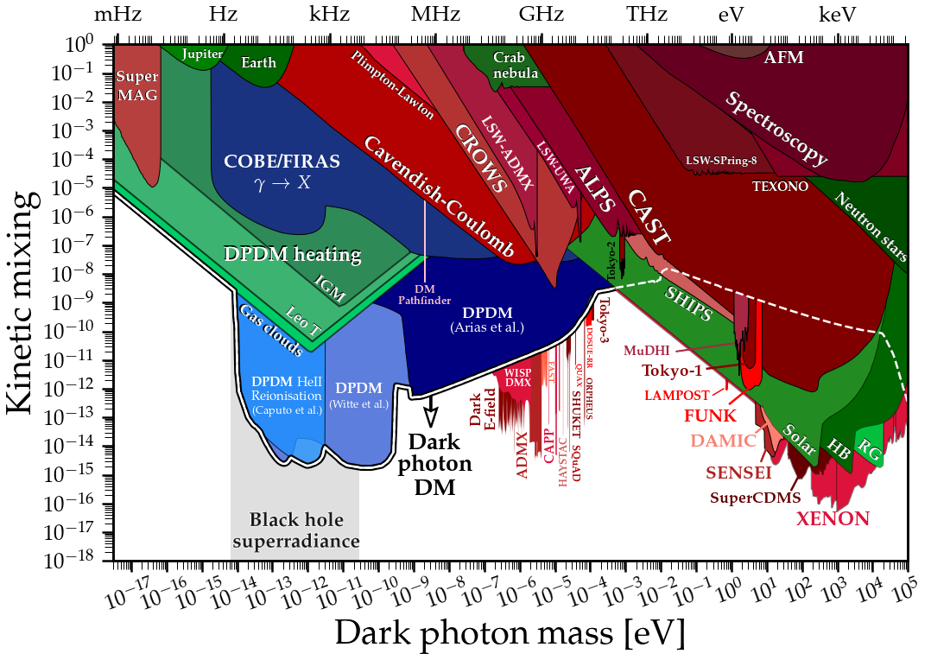
Rough estimation of the experiment sensitivity
(From cajohare.github.io/AxionLimits/)
11

Slide 14
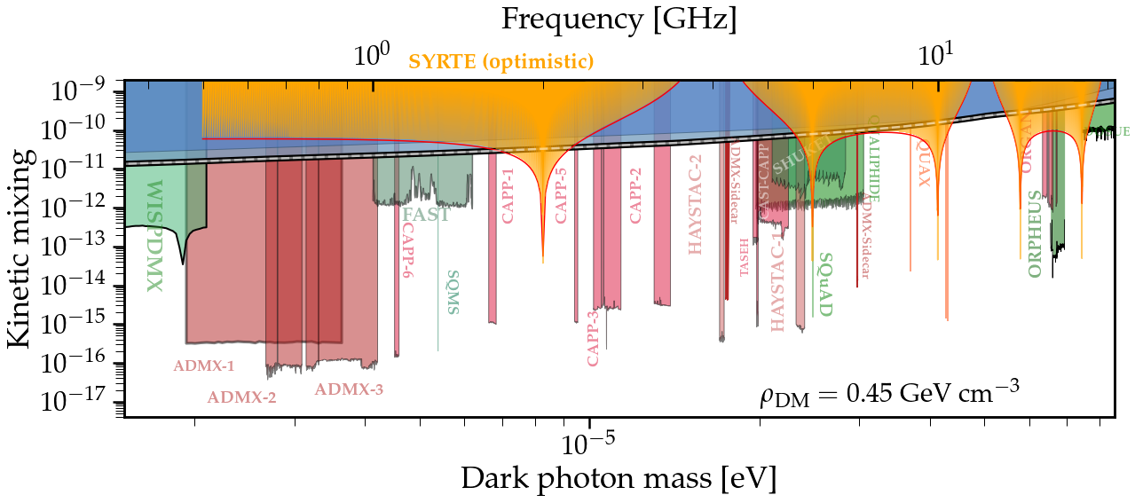
Rough estimation of the experiment sensitivity
(From cajohare.github.io/AxionLimits/)
JG et al. PRD 108 035042 (2023)
With realistic experimental parameters, $\sim 5$ days of data-taking could constrain the black region
12

Slide 15
Conclusion
DP is a serious DM candidate → numerous lab experiments trying to detect it.
Proposal of a new kind of experiment looking for DP using atoms inside a microwave cavity. As a resonant device, it acts as a narrow band DM detector.
With the current technology in quantum optics, competitive constraints on the coupling constant $χ$compared to other experiments.
Experiment could be feasible in the near future using Sr or Hg clocks e.g @SYRTE
JG et al. PRD 108 035042 (2023)
13

Slide 16
Thank you for your attention !
JG et al. Phys. Rev. D 108 035042 (2023)
I am looking for postdoctoral position starting next year in COSMIC WISPers working group related areas (direct dark matter detection with quantum sensors)
so please, let me know if you propose opportunities !
This work was supported by the Programme National GRAM of CNRS/INSU
with INP and IN2P3 co-funded by CNES.

Slide 17
Back-up : propagation of DP field in lab
Free Klein-Gordon equation of each DP space component $A^{i}$
$${\ddot{φ}}^{i}+3H{\dot{φ}}^{i}+ω^{2}φ^{i}≈0$$
whose solution is oscillatory when $ω≫H$
Treating DP field as a classical massive field, we have (in its rest frame)
$$\vec{φ}={\vec{φ}}_{0}\cos{(ωt)}$$
Now, considering the DP field makes the whole DM local density, it passes through lab with ${\vec{v}}_{DM}$
$\vec{k}= \frac{m{\vec{v}}_{DM}}{ℏ}→λ≫L$, size of cavity experiment considered
→ propagation neglected in the lab frame
$$ω=\frac{mc^{2}}{ℏ}$$
$𝒪({10}^{−3}$c)
$𝒪({10}^{−6}$ eV)
$$𝒪(300 m)$$

Slide 18
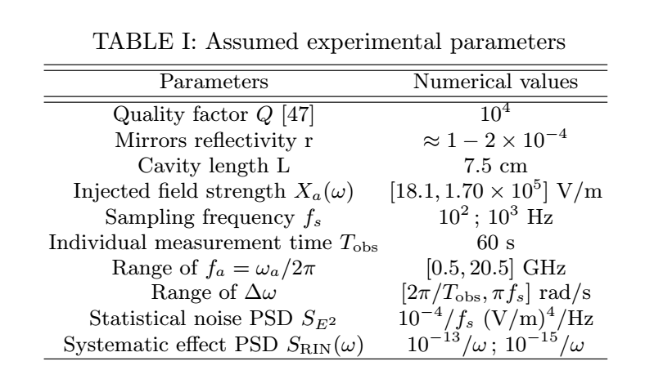
Back-up : Experimental parameters
J. Guena et al., IEEE TUFFC 59, 391 (2012)
Bridge et al. Opt. Express 24, 2281 (2016)
Millen et al. Journal of Physics 44, 184001 (2011)
Rubiola, Arxiv:physics/0512082 (2005)

Slide 19
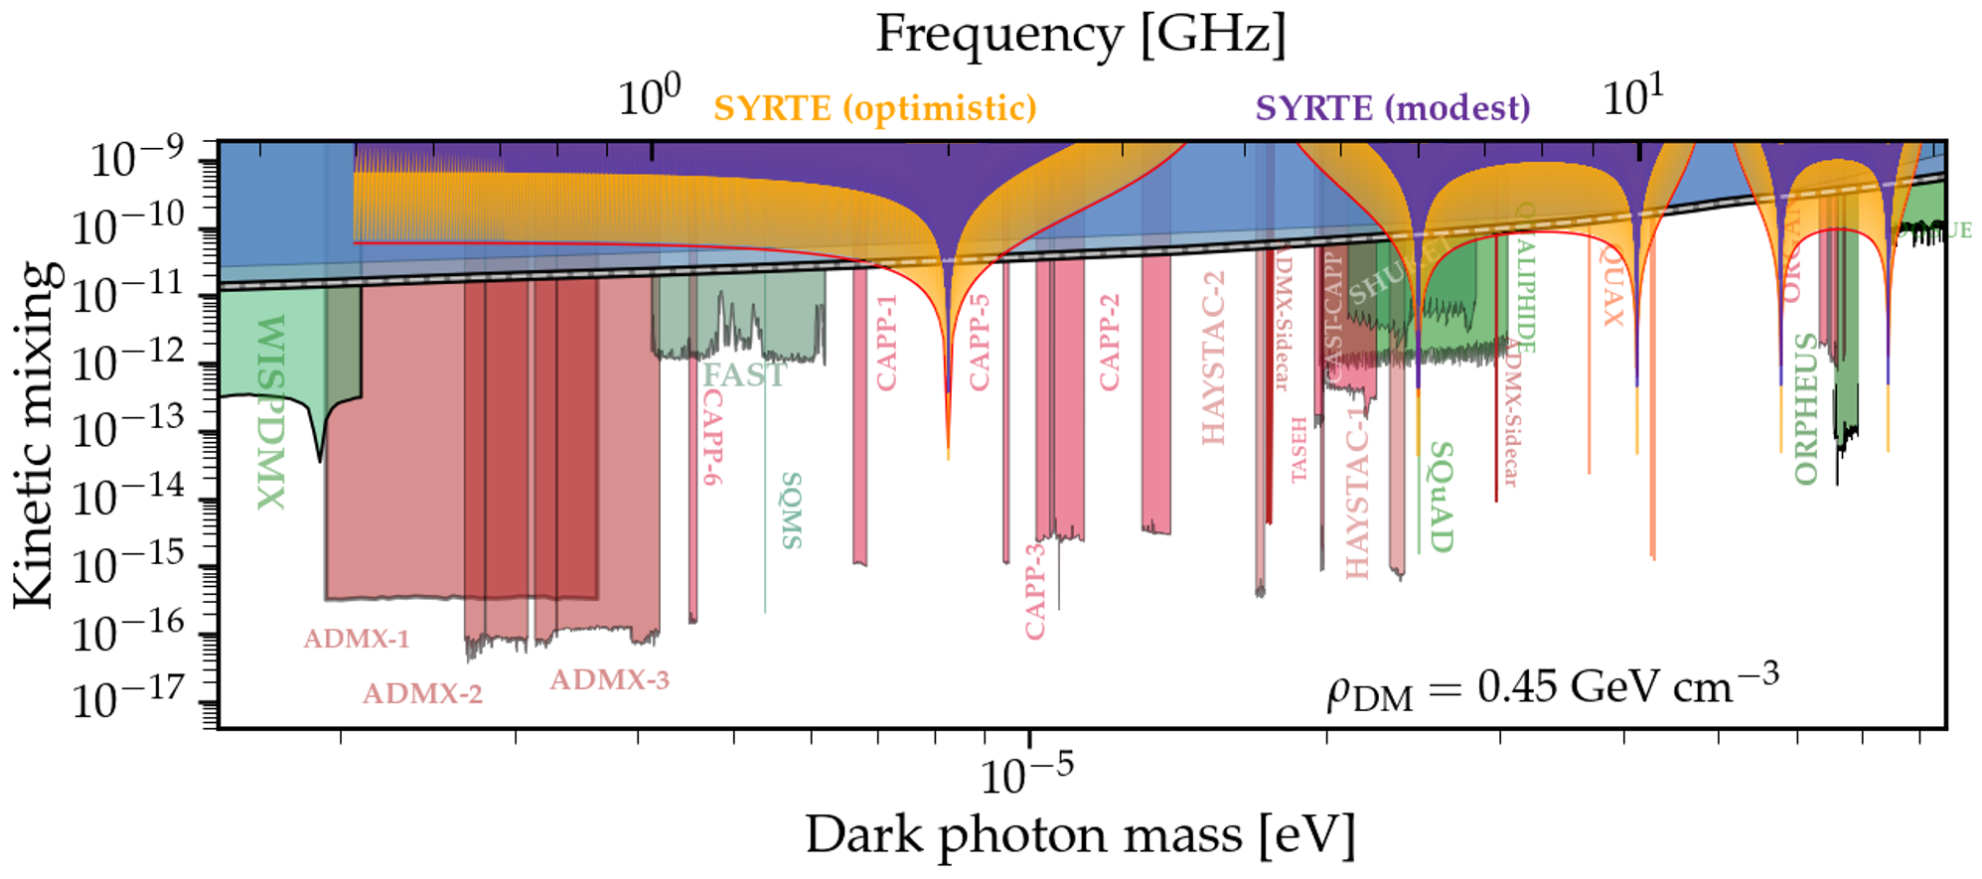
Back-up : modest/optimistic sensitivities

