Slide 1
WG4 – Direct WISP Searches
C Gatti - M Karuza

Slide 2
Tasks
T4.1: Review of present and future WISPs experiments (including DM ones) in order to assess their discovery potential.
Subtask 4.1.1: Perform an update of summary plots of present limits for various WISPs models (axion, hidden photons, chameleons etc.). For the axion constraints on the coupling with photons, electrons, nucleons. For HP, bounds on the kinetic mixing angle. Reinterpretation of existing experimental limits with new WISPs models.
Subtask 4.1.2: Combination of experimental results with astrophysical and cosmological limits to extract summary plots.
Subtask 4.1.3: Highlight regions of the parameter space not yet covered by experiments and discuss feasibility of the experimental searches in these regions. Discuss the feasibility of testing all the couplings (to leptons, photons, baryons etc.) in all the parameter space.
T4.2: Identify progress need in the key technologies and techniques (data analysis, signal filtering) for present and future experiments needed to cover the theoretically motivated region in the parameter space.
Subtask 4.2.1: perform a survey of technology (materials, detection, sources, cryogenics, magnets, high resolution detectors) needed in WISP experiments.
Subtask 4.2.2: perform a survey of solutions available (in SME or academic research) and of the competences available.

Slide 3
Activities [WG1-4]:
Organization of workshops on specific topics of the WGs.
Organization of Short Term Scientific Missions (STSM).
Organization of Technology Forums (WG4).
Publication of report on the scientific results in the webpage (in cooperation with WG5). Participation in outreach activities (in cooperation with WG5).
Preparation of the final White Paper and of the Training School Lecture Notes.
Milestones [WG1-4]:
WG meetings to track the progress of each WG and to take corrective measures in case of problems.
Deliverables:
D4.1 Draft Report on direct detection (month 12)
D4.2 Interim Report on direct detection (month 24)
D4.3 Final Report on direct detection
D4.4 Report on Technologies Forums

Slide 4
WG4 - General organization
WG4 meetings one per month
Report on direct detection and Tech. Forums: Overleaf LATEX
WG4 documents on Drive/Dropbox
Mailing List cosmicwisperwg4@lists.infn.it
INDICO meetings https://agenda.infn.it/category/1831/

Slide 5
Contact Persons
WG contact persons:
WG1 Mario Reig
WG2 Jose Cembranos
WG3 Maurizio Giannotti, Federico Urban
WG5 Loredana Gastaldo, Serkant Ali Cetin
Contact person with CERN-PBC Technology working group: Giovanni Cantatore, Pierre Pugnat
Contact person with ECFA Quantum Sensing WG (tbd)

Slide 6
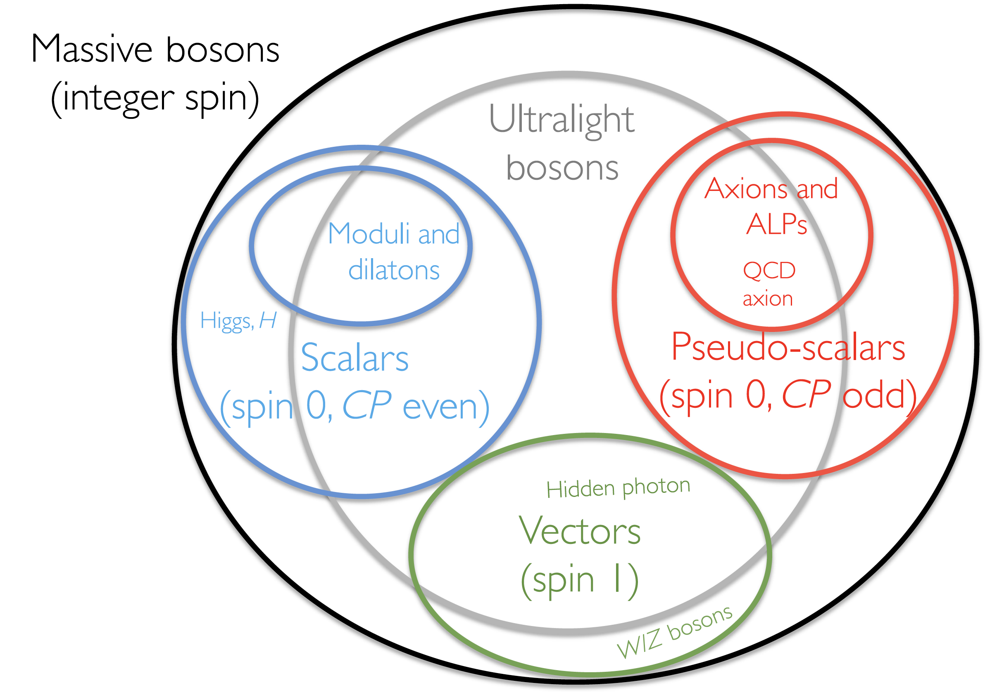
Inputs from WG1
Models

Slide 7
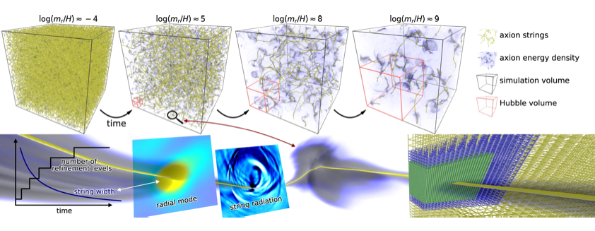
Inputs from WG2
Preferred parameter space for WISP dark matter candidates

Slide 8
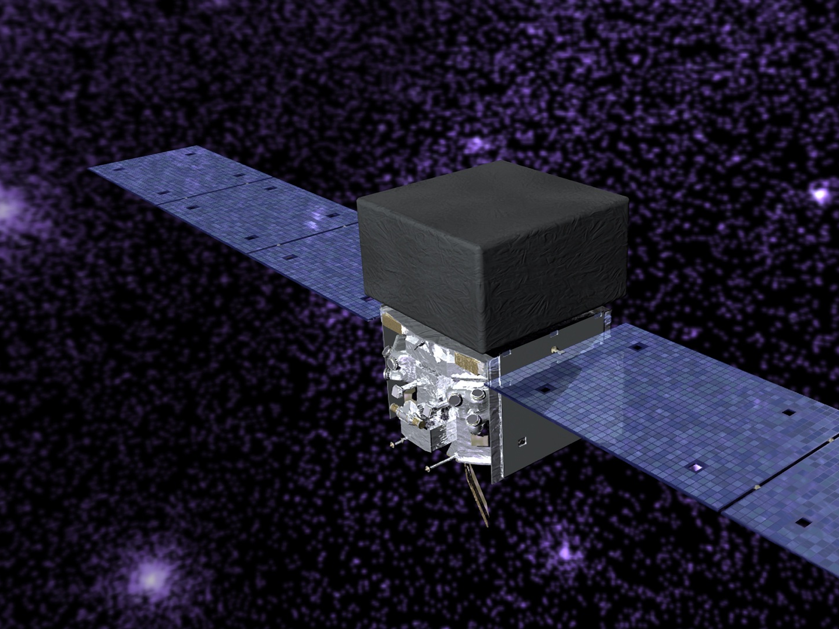
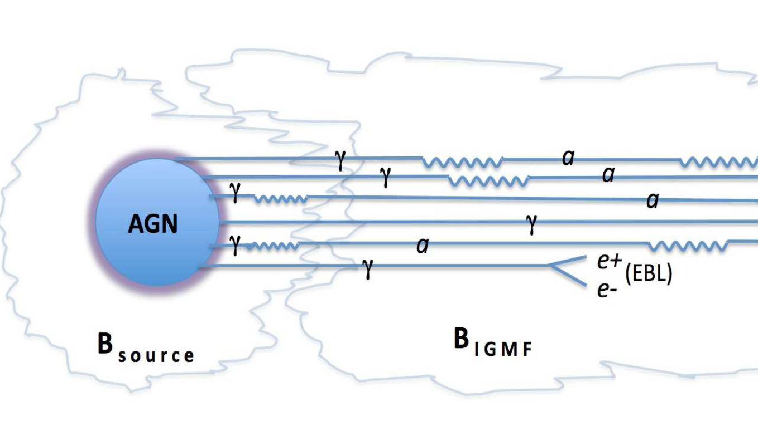
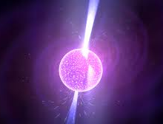
Inputs from WG3
Astrophysical experimental results (hints or limits)

Slide 9
First year plan
Make a list of WISPs models
Make a list of WISPs experiments
Preliminary Summary Plots
Contact experts in specific experiments and techniques within and outside the COST. Invite them to join the COST.
Make a list of technology needed by WISP experiments
Draft of Direct Search Report

Slide 10
Talks in 2023
Link to agenda: https://agenda.infn.it/category/1835/
Experimental techniques
Microcalorimeters at Heidelberg - L Gastaldo
Chameleons detection – M Karuza
Xray detector Iaxo– L Gastaldo
Theory Models
Spin 2 ULDM - F Urban
Chameleons – C Burrage
Experimental Schemes
Axions in plasma - H Tercas
Directly Deflecting Particle Dark Matter - S Ellis
Searching for axion forces with spin precession in atoms and molecules – M Reig
Experiments
Axion limits package and data combination - C Ohare
BRASS Experiment - LH Nguyen
WISPFI Experiment - M Maroudas
Haloscopes - A Rettaroli
Helioscopes - J Vogel
Gnome - G Zoran
Searches at DESY – T Kozlowsky
CAST – S Cetin
PADME – V Kozhuharov
VMB – S Kunc
NA64 – L Marsicano
WISPS at GW detectors – L Pierini
X17 – A Krasznahorkay
ALP at LHC – M Gallinaro
Topological Defects - DG Martin

Slide 11
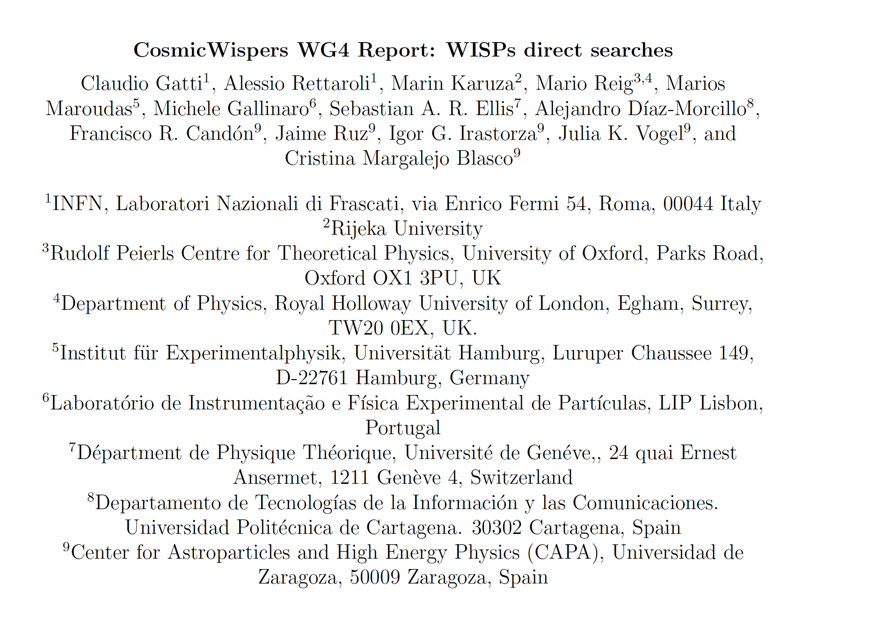
WG4 report draft
Link to Report: https://www.overleaf.com/4678842289cfhfndnmvtyr

Slide 12
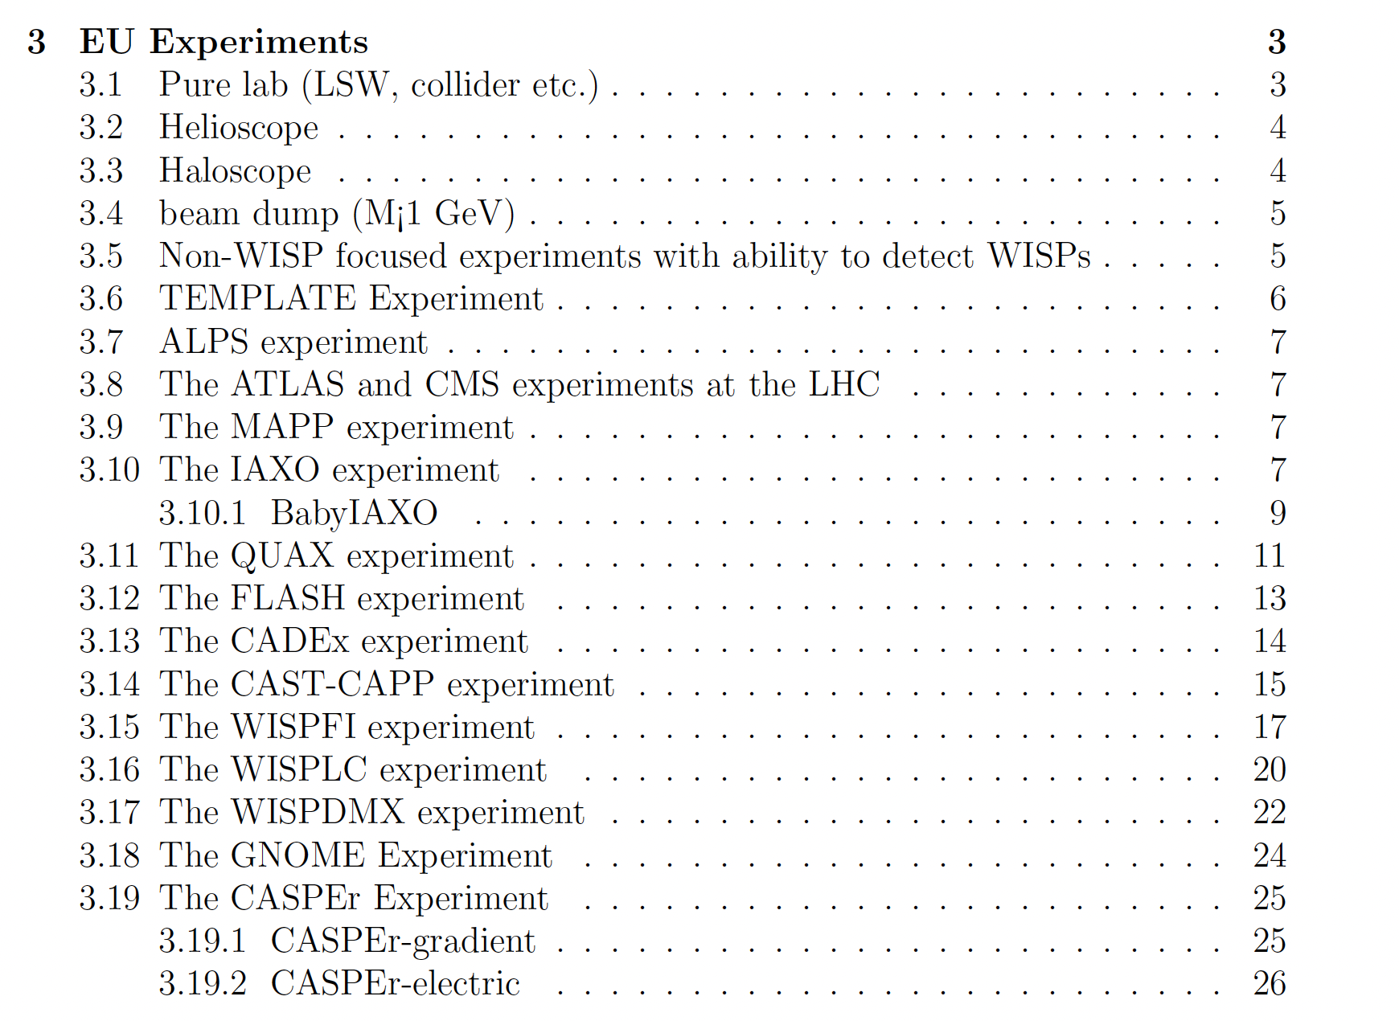
Report Content
Many EU experiments already described in the report

Slide 13
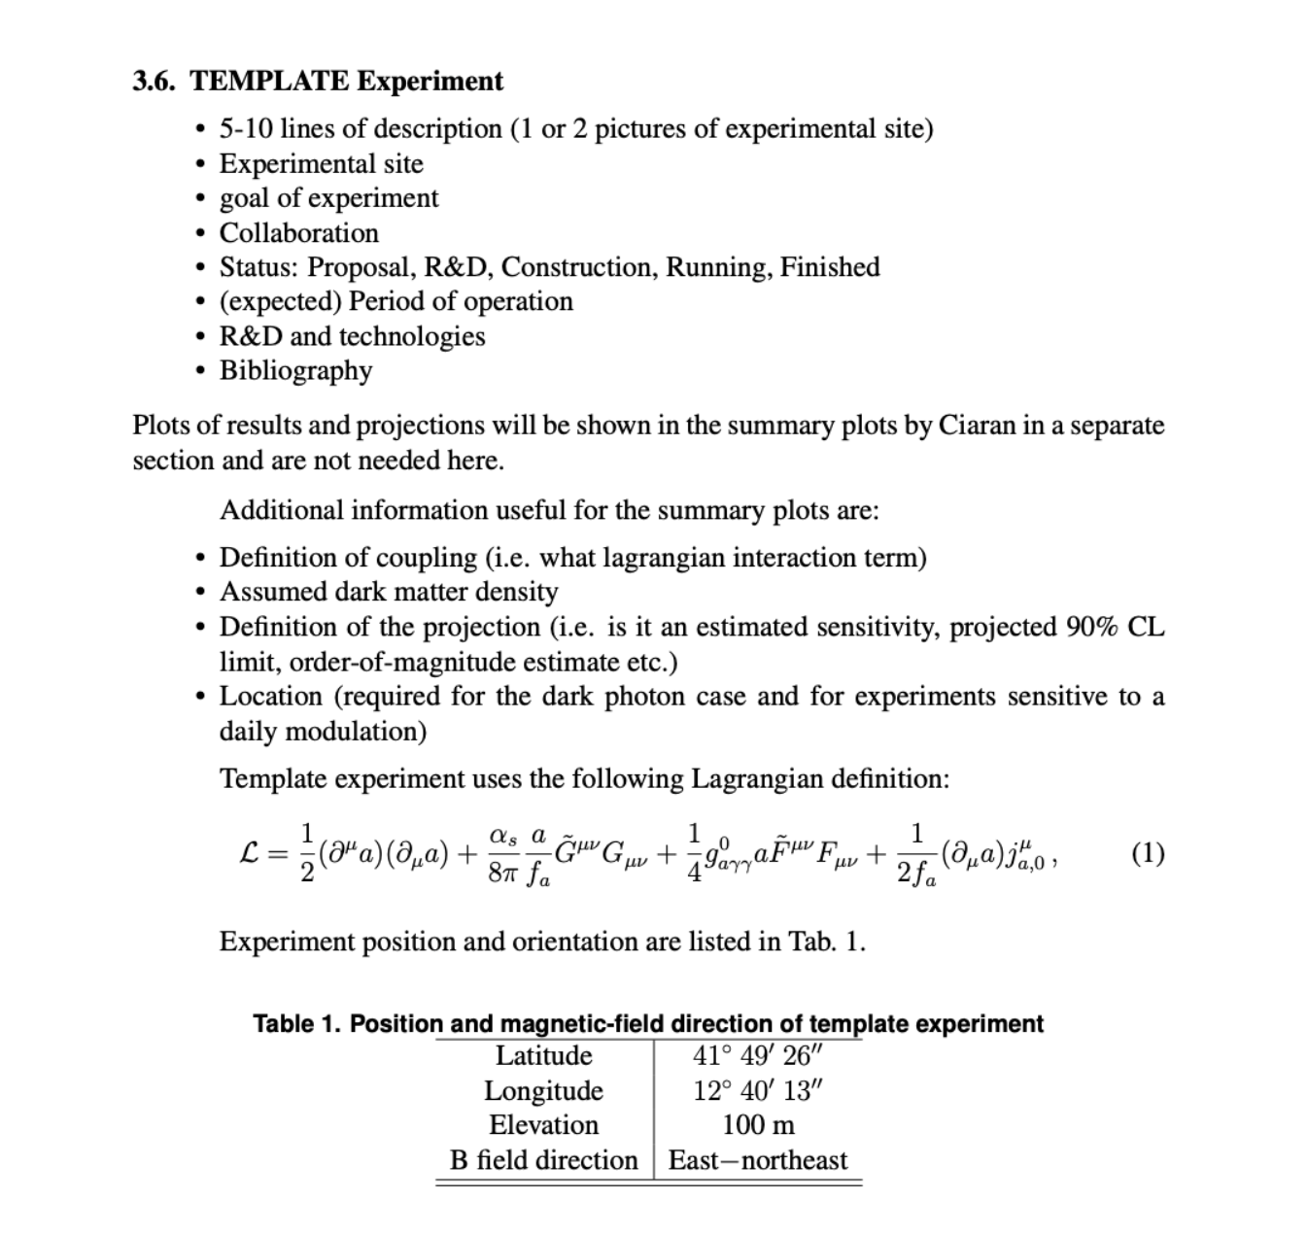
Latex template for experiments

Slide 14
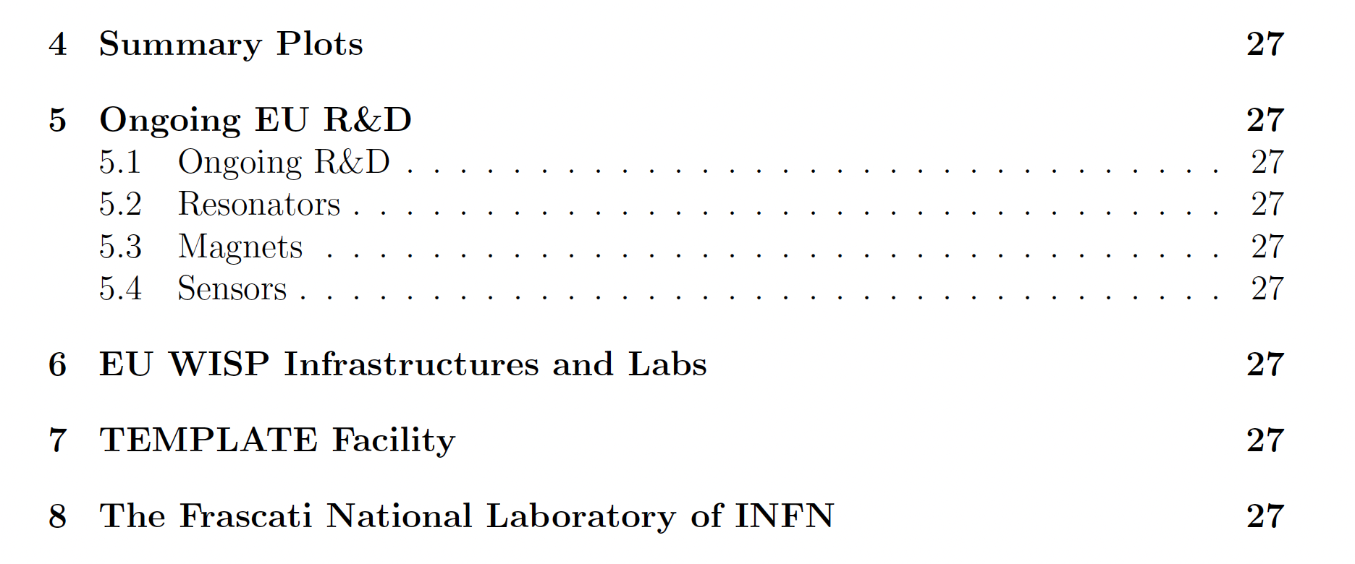
Report content
NbTi, ReBCO, Nb3Sn, geometries tuning etc.
First Tech forum
Microcalorimeters, qubits, bolometers, membranes, … and 2nd Tech forum
In 2024 add contributions from: DESY, Grenoble, Canfranc, Mainz …

Slide 15
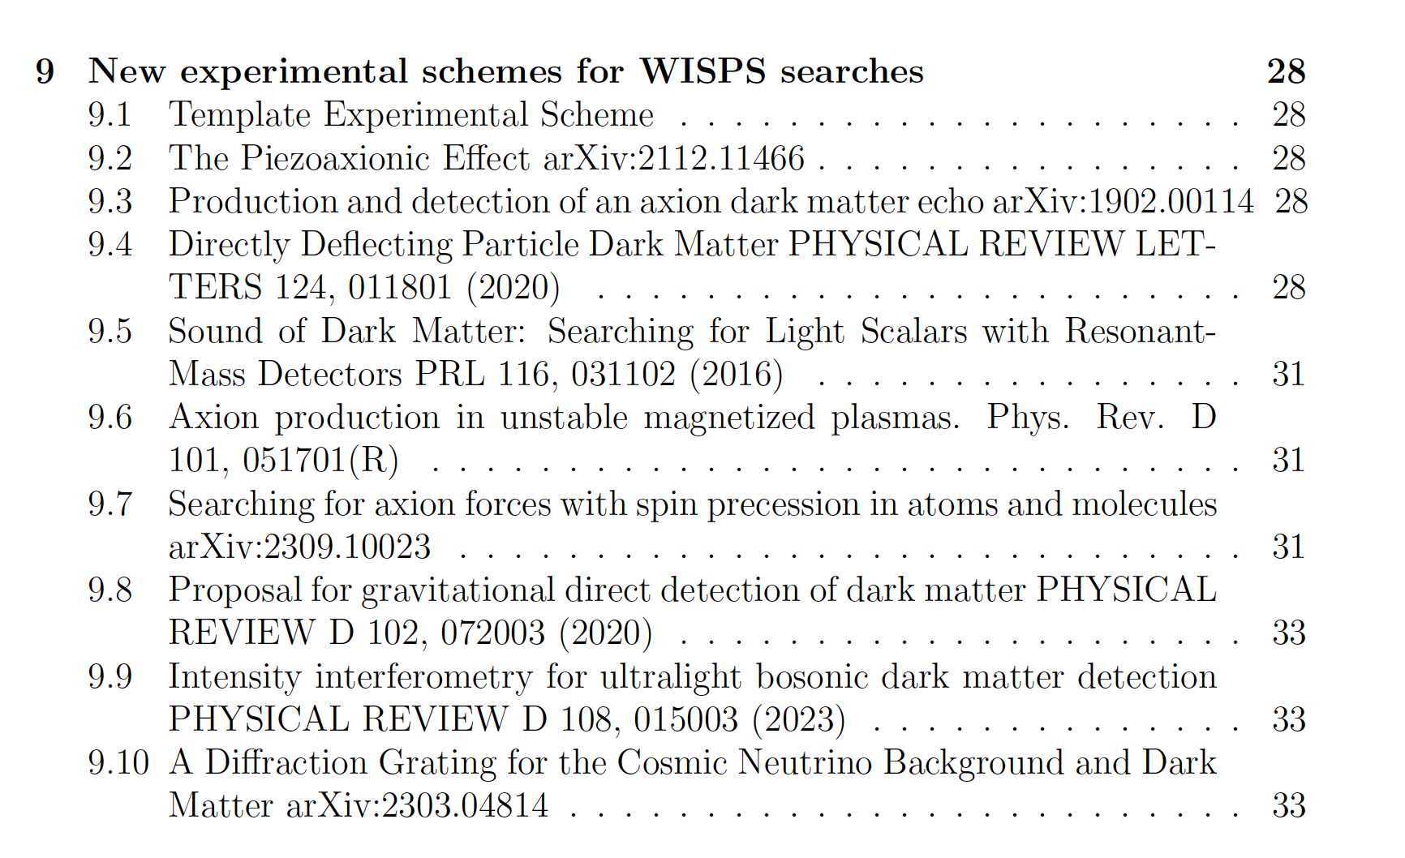
WG4 Report

Slide 16
Material for the Round Table Discussion
Common R&D:
magnets
quantum technologies
quality optics, mirrors, cavities
actuators
detectors (radio,THz, IR, optics, xray, gamma)
Data taking and analysis (cloud computing)
Data preservation and access
Data combination
Axion astrophysics:
EU Networks for astrophysical objects (GNOME-like)
Supernova axions
Link neutrino and axions
HFGW
Collaborations
“EU Funding Agency” problem
Connection with PBC@CERN and DRDC
Closer collaboration within WGs:
Modelling for HFGW with wisps detectors
Cross sections calculations
Sensitivity/exclusion plots prescriptions
List of models/signals/etc to widen physics reach of experiments or modification to experiments
Outreach: wich are the tools, how to contribute? How to give new suggestions, social media etc.

