Slide 1
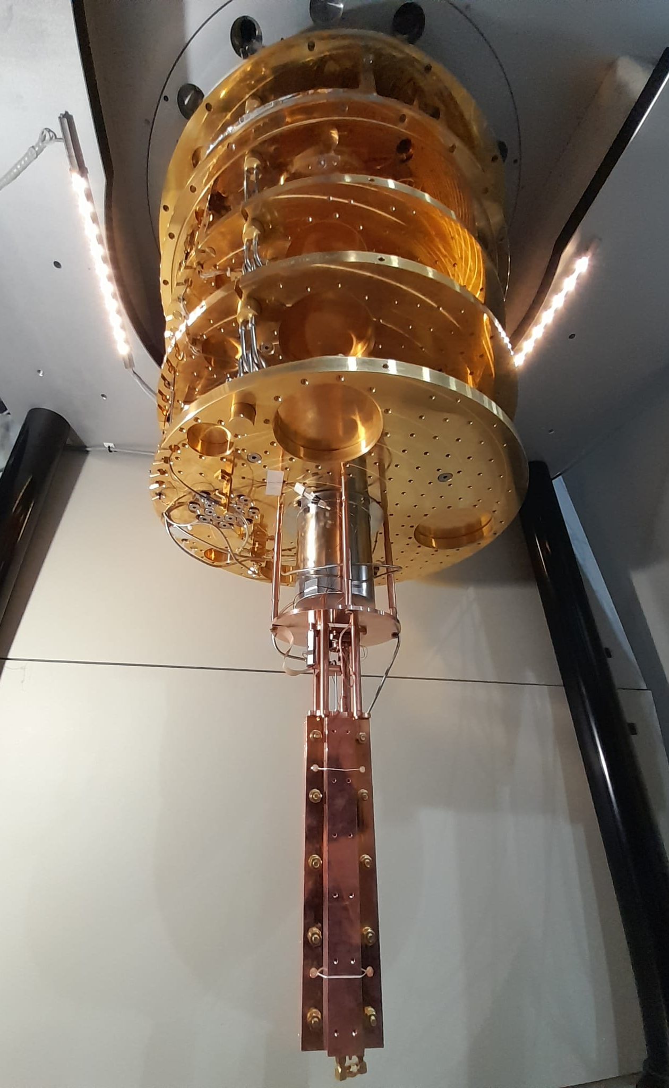




Recent results of QUAX @ LNF
Alessio Rettaroli
alessio.rettaroli@lnf.infn.it
COST Action COSMIC WISPers (CA21106) $−$ Working Group Meeting
1 - 2 Feb 2024 $−$ DESY, Hamburg

Slide 2





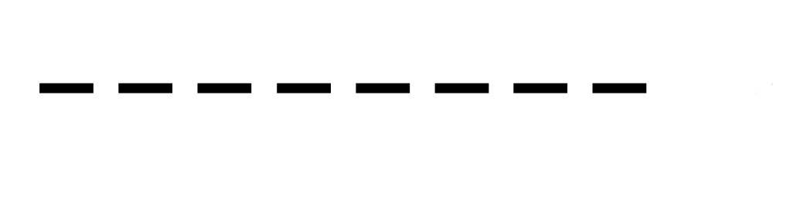

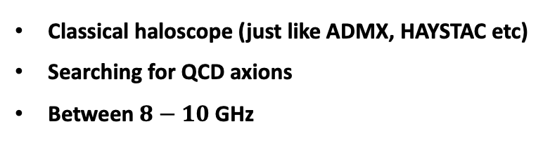

The QUAX experiment is a light DM hunt experiment
Classical haloscope (just like ADMX, HAYSTAC etc)
Searching for QCD axions
Between $8−10$ GHz
LNL (Legnaro)
a
γ
LNF (Frascati)
Axions from DM halo
$$\vec{B}$$
Photon detector

Slide 3
$$2017$$
2017
$$2018−2019$$
2018−2019
$$2022$$
2022
$$2020−2021$$
2020−2021
$$2023$$
2023
2024
→2025
QUAX timeline
Proposal
First
measurements
QCD band
Almost KSVZ with TWJPA
QCD band
with Photonic cavity
First scan with tuning rod
2 GHz Scan experim.

Slide 4
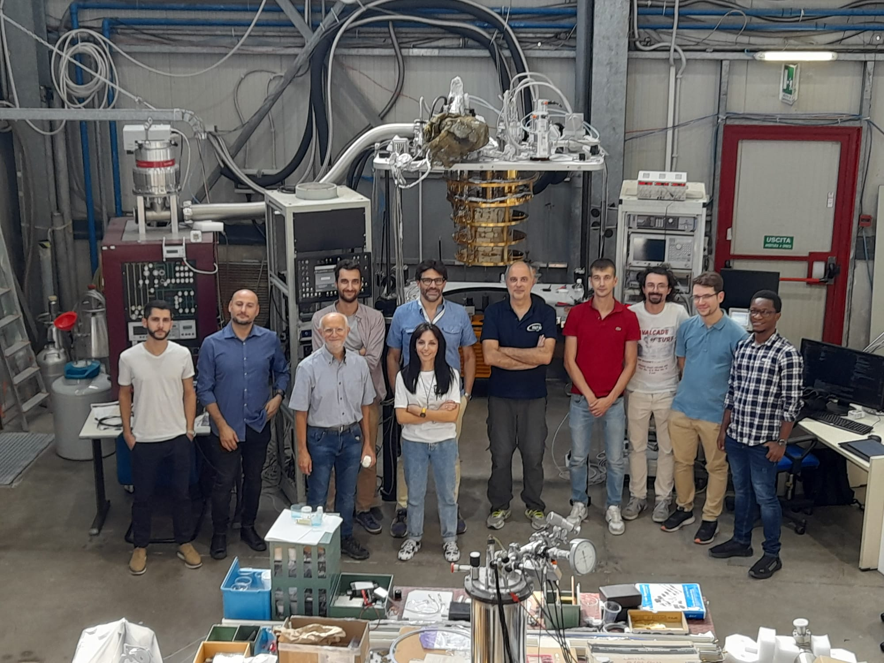
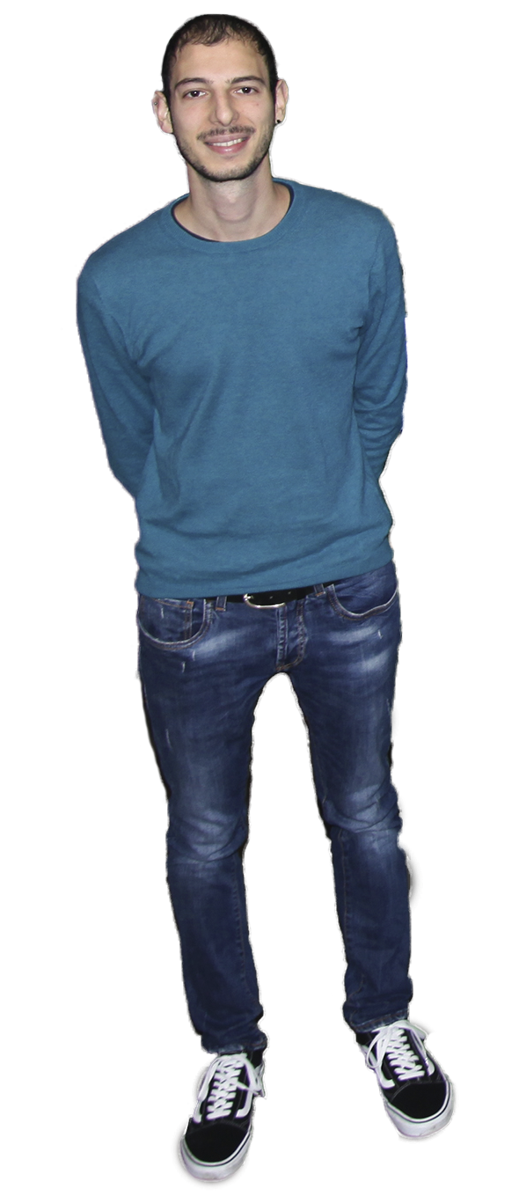
Group and lab are enlarging

Slide 5
Haloscope ingredients
Dilution refrigerator
Low noise receiver
Microwave resonant cavity
SC magnet
Tunable frequency
Already
purchased
Ongoing
Recent Achievements
Recent Achievements

Slide 6
QUAX@LNF first axion search with tuning rod mechanism

Slide 7
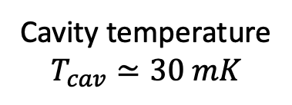
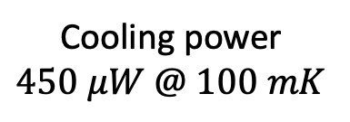
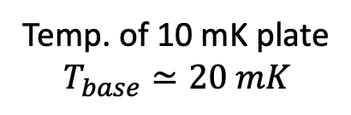
Dilution refrigerator
Leiden Cryogenics
Cooling power
$$450 μW @ 100 mK$$
Temp. of 10 mK plate
$$T_{base}≃20 mK$$
Cavity temperature
$$T_{cav}≃30 mK$$

Slide 8
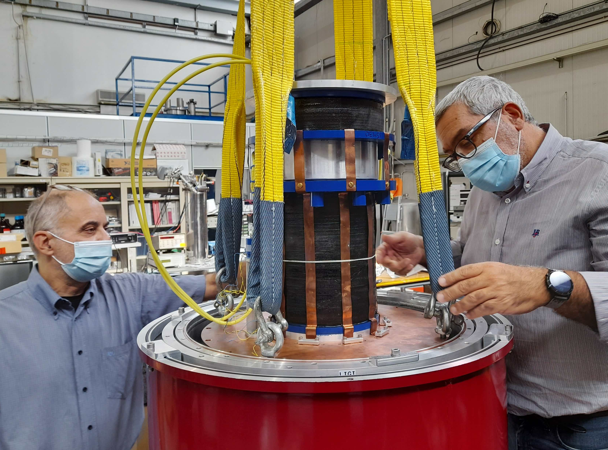
9 T magnet
Anchored to 4 K stage
Reached 9 T
Took data at one freq with 9 T
Quench
Ramp to 8 T ok
Took data with 8 T stably for 2 weeks

Slide 9
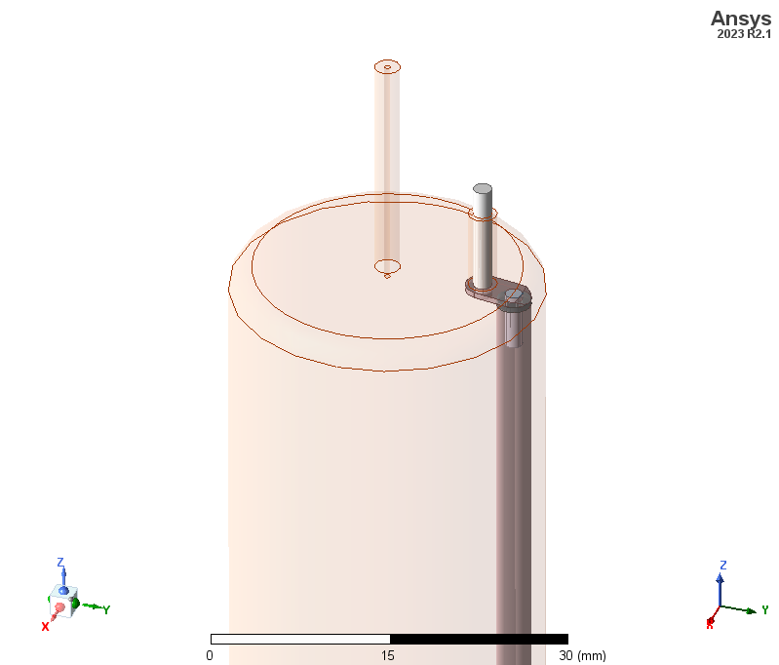
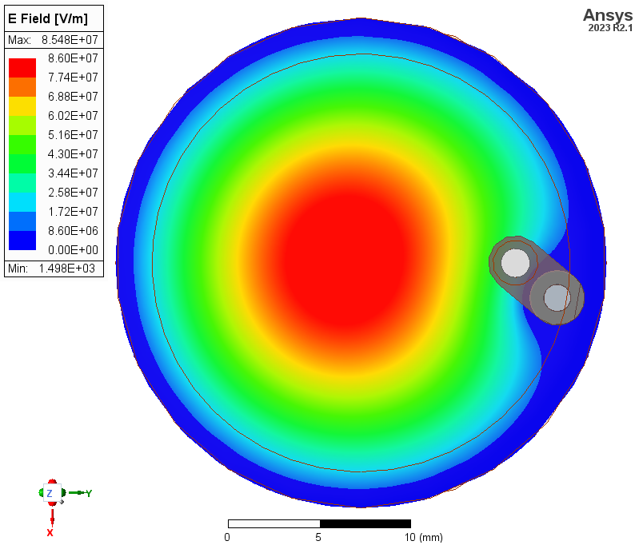
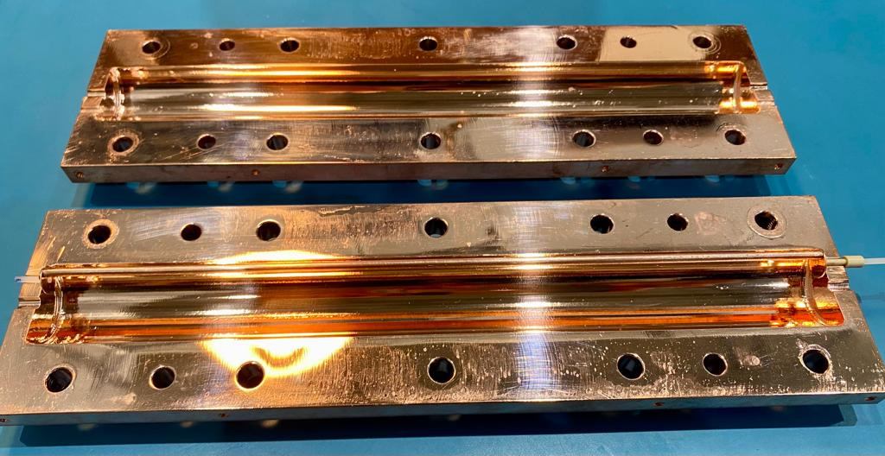
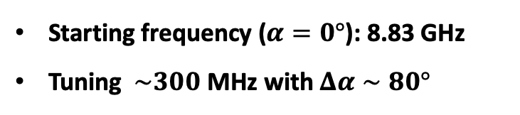
Microwave cavity + tuning
HFSS simulations by Simone Tocci
OFHC Copper
Radius = 13.5 mm, height = 246 mm
TM010 mode
Starting frequency ($α=0°$): 8.83 GHz
Tuning $\sim 300$ MHz with $Δα∼80°$

Slide 10
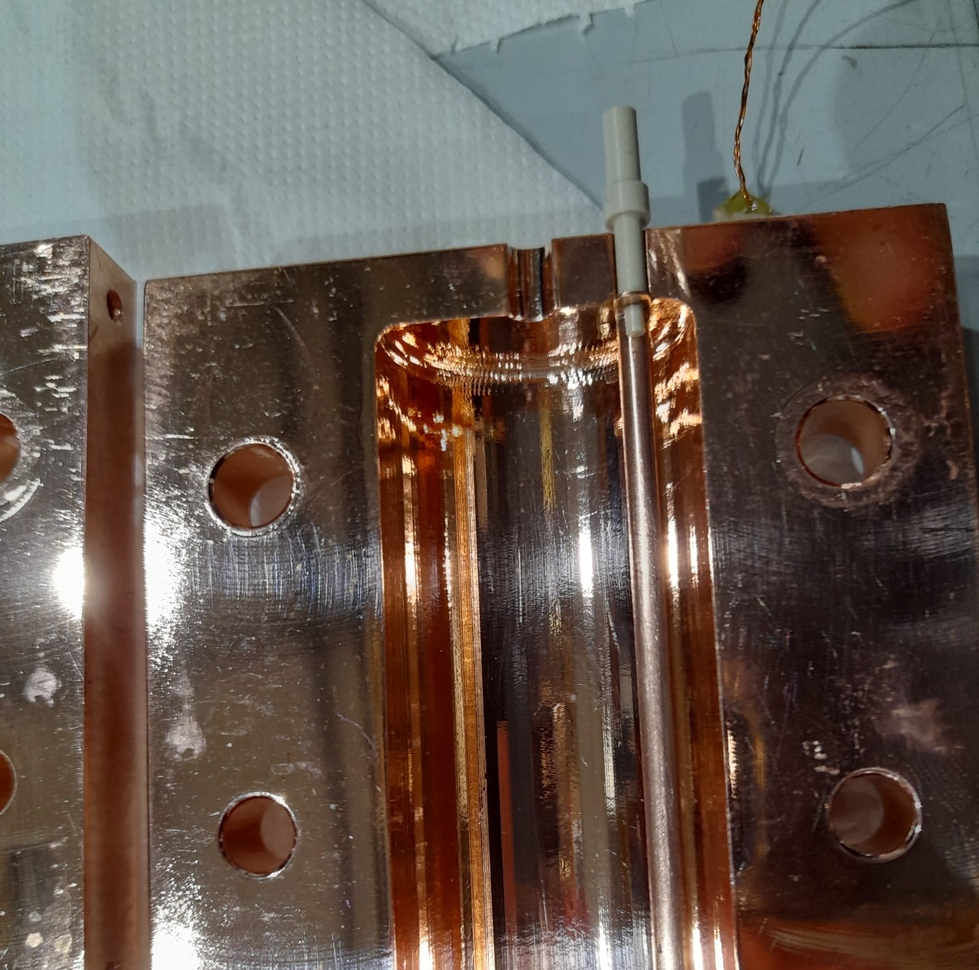
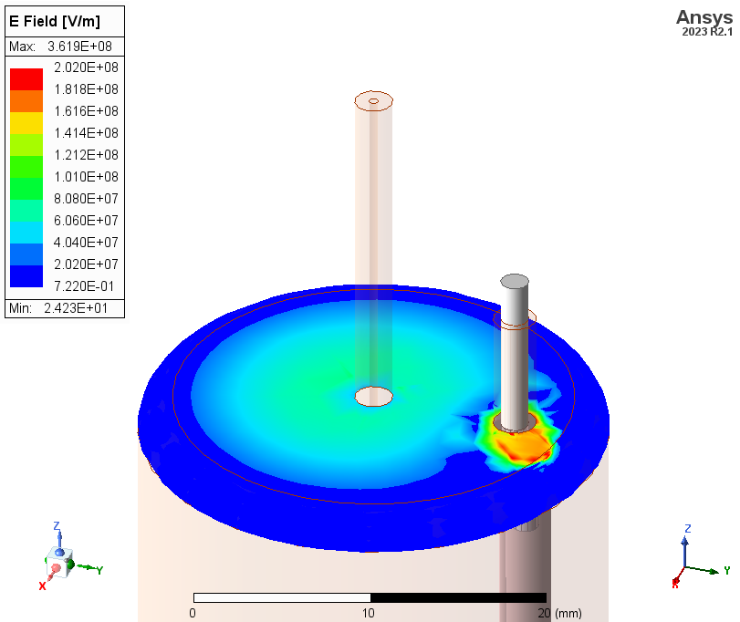
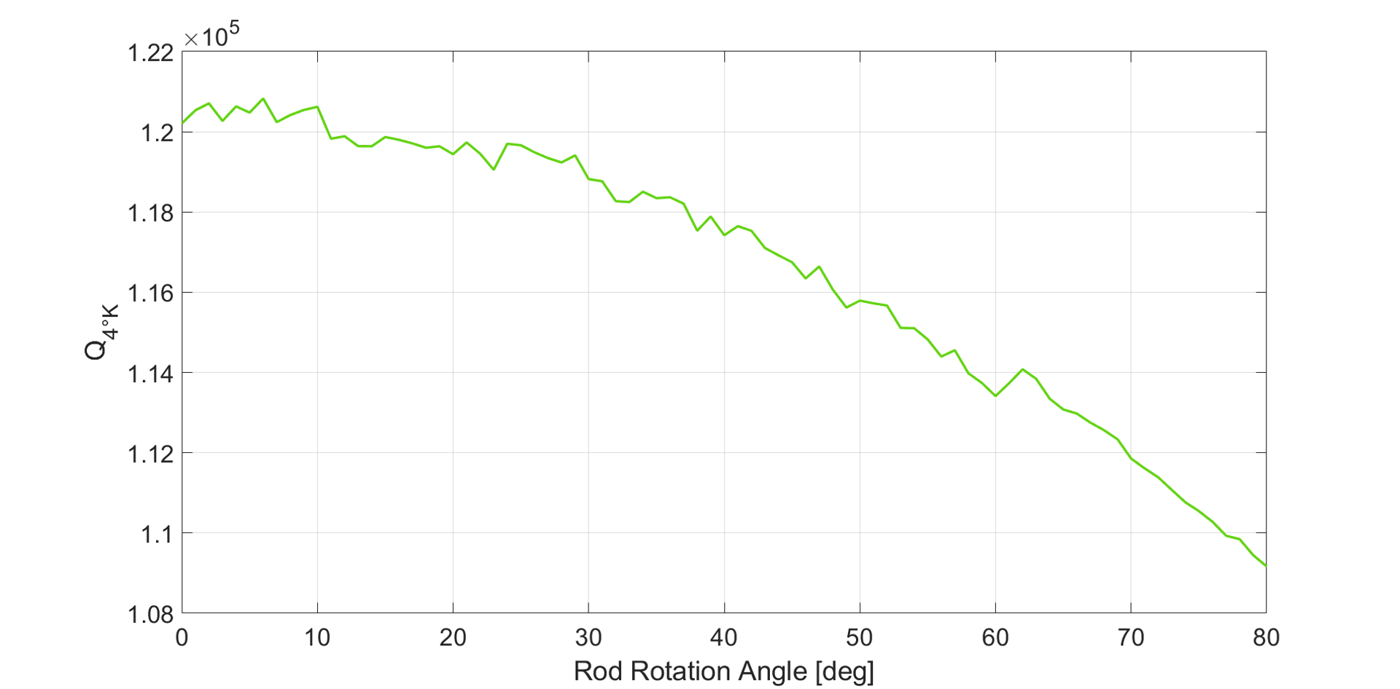

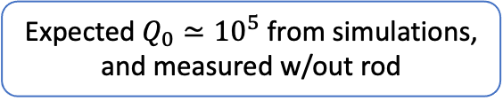
Microwave cavity + tuning
Trapped field between metallic disk and cavity endcap
Expected $Q_{0}≃{10}^{5}$ from simulations, and measured w/out rod
Measured $Q_{0}≃{5×10}^{4}$ w/ rod
This is likely due to losses caused by the rod configuration and PEEK

Slide 11

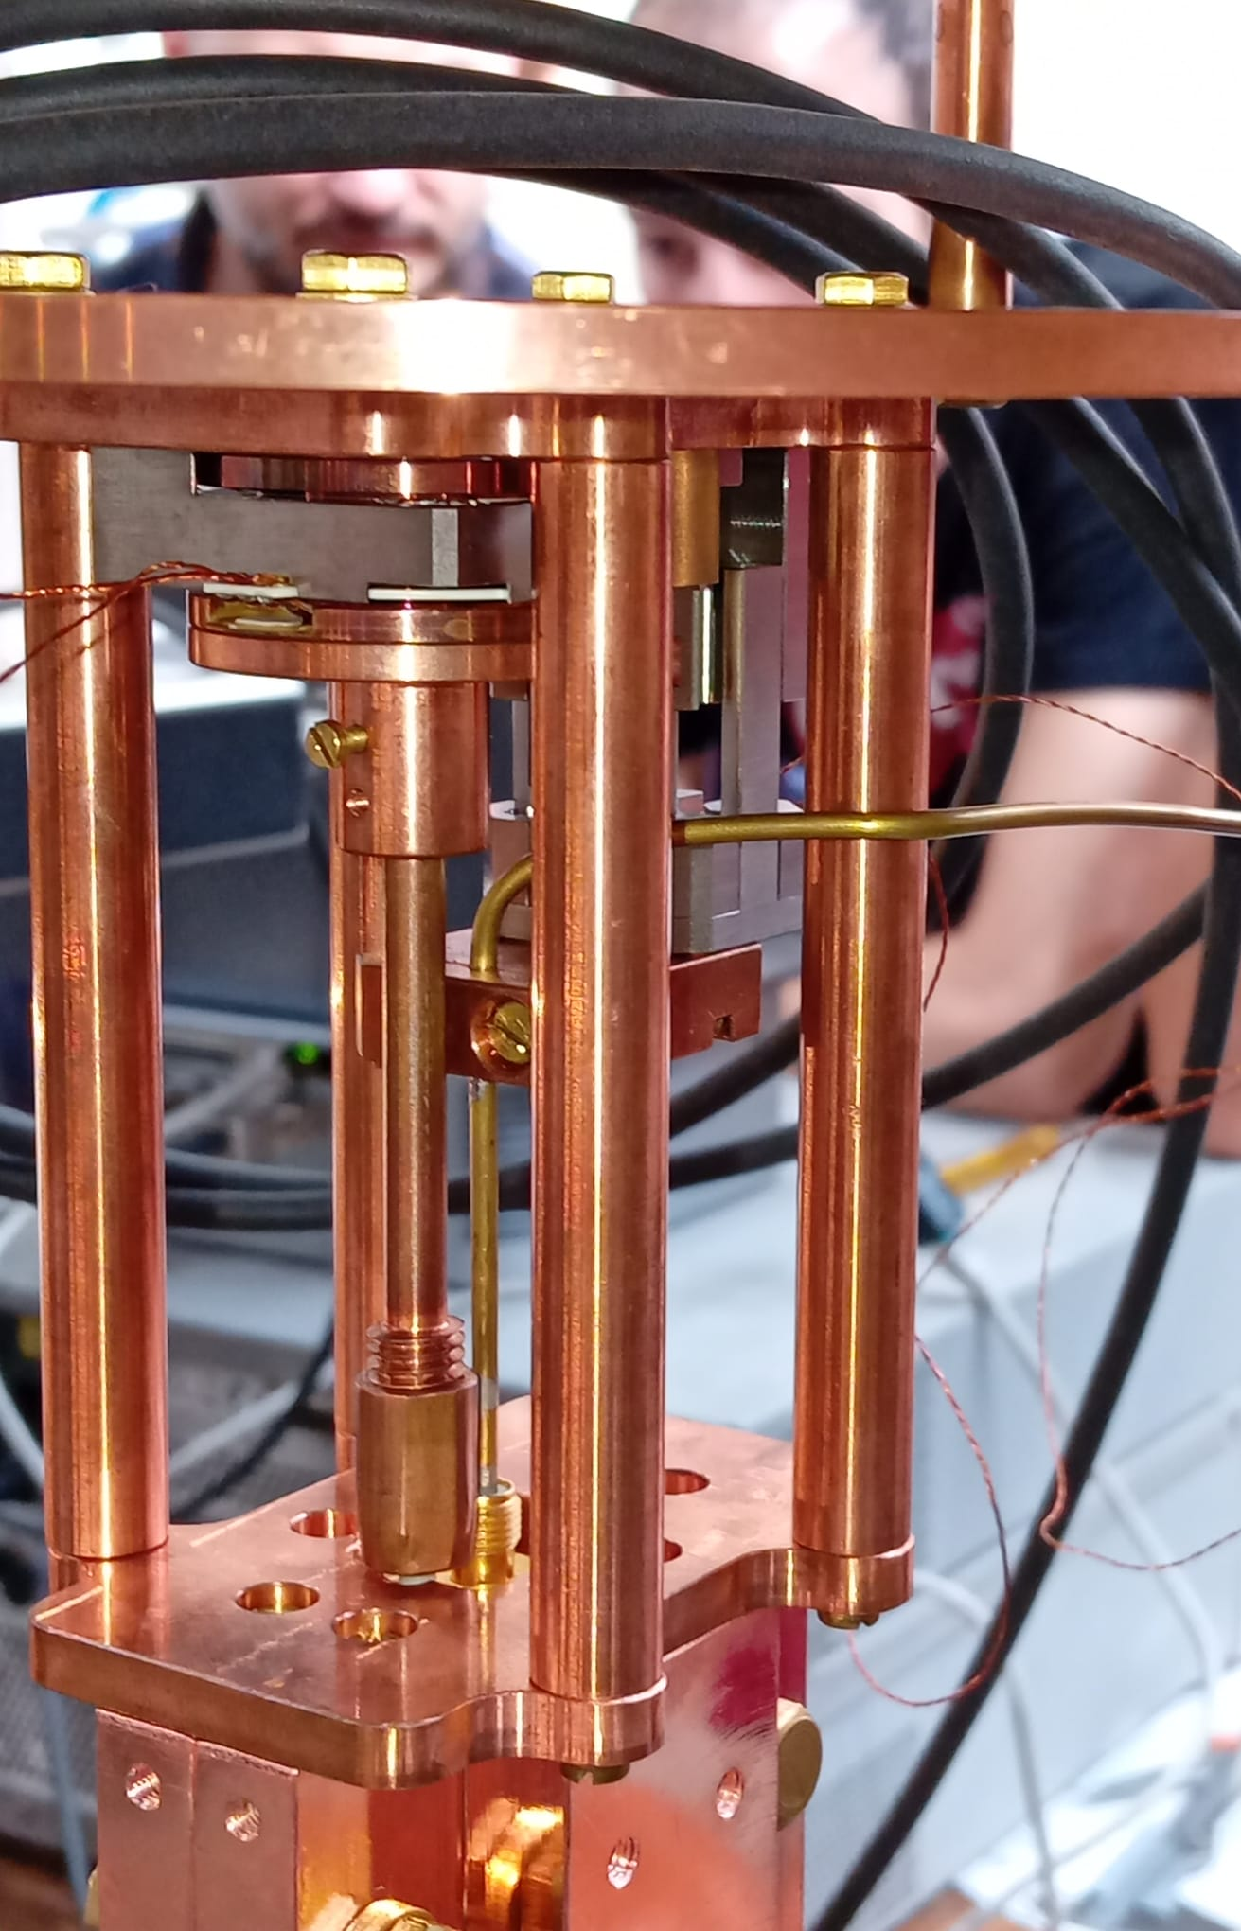
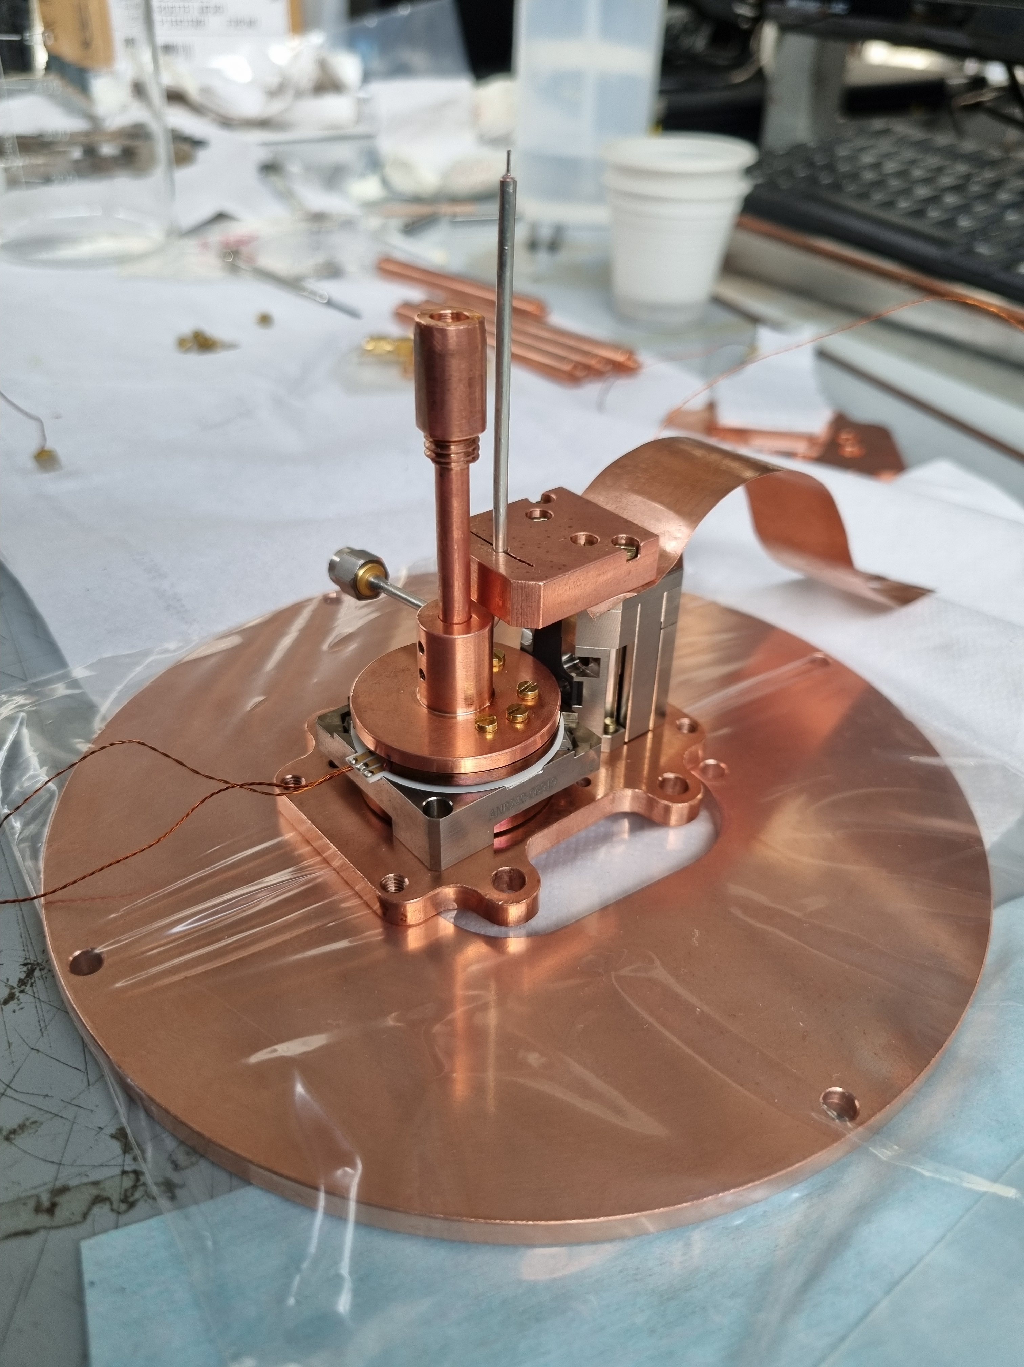
Rod and antenna movimentations
Frequency vs rod position
6 MHz for this run
1 linear motor for Antenna
1 rotative motor for Rod

Slide 12






Amplification chain
LO
low-noise cryogenic
HEMT
FET
low-freq
Voltage ampli
I-Q mixer
LO
RF
I
2 MHz
ADC
Q
Coming soon:
JPA
16 bit
Coming soon:
FPGA
4 K
300 K
$$G^{HEMT}≃37 dB$$
$$G^{FET}≃36 dB$$
$$G^{V}≃ ×1000$$
$$T_{n}^{HEMT}≃3 K$$
$$T_{n}^{FET}≃80 K$$
$$V_{n}=2.3 nV/\sqrt{Hz}$$
Tot eff. Gain = 116 dB
Noise Temp = 4.5 K

Slide 13
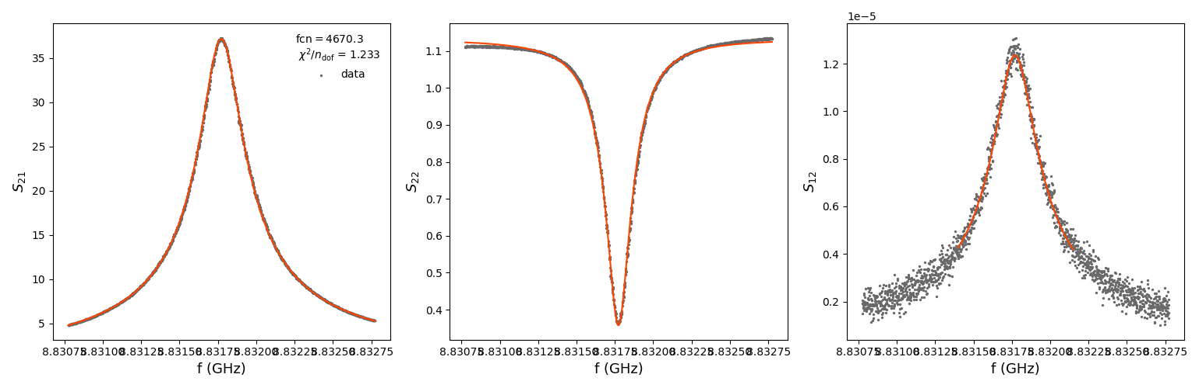
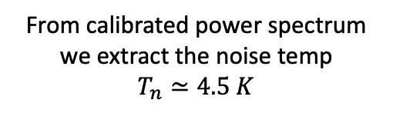
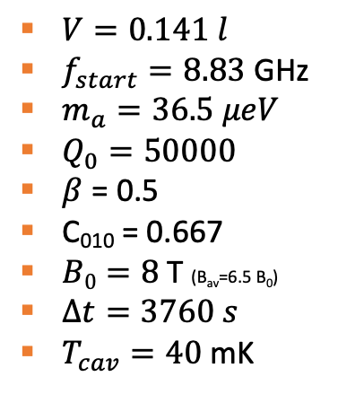
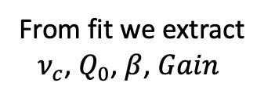
Calibration + spectrum
Fit procedure
Raw power spectrum
LO
cavity
Fits by Gianluca Vidali (student)
$V=0.141 l$
$f_{start}=8.83$ GHz
$m_{a}=36.5 μeV$
$Q_{0}=50000$
$β$ = 0.5
C₀₁₀ = 0.667
$B0=8$ T (B_{av}=6.5 B₀)
$Δt=3760 s$
$T_{cav}=40$ mK
From fit we extract
$ν_{c}$, $Q_{0}$, $β$, $Gain$
From calibrated power spectrum we extract the noise temp
$$T_{n}≃4.5 K$$

Slide 14
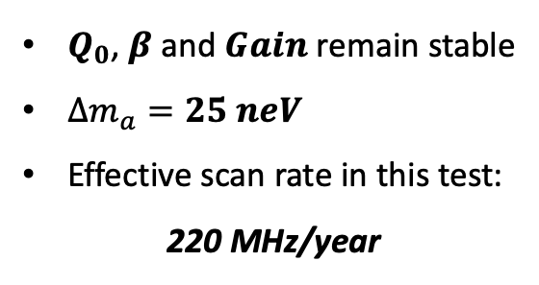
6 MHz tuning
6 MHz scan
Performed the same procedure on each run
$Q_{0}$, $β$ and $Gain$ remain stable
$Δm_{a}=25 neV$
Effective scan rate in this test:
220 MHz/year

Slide 15
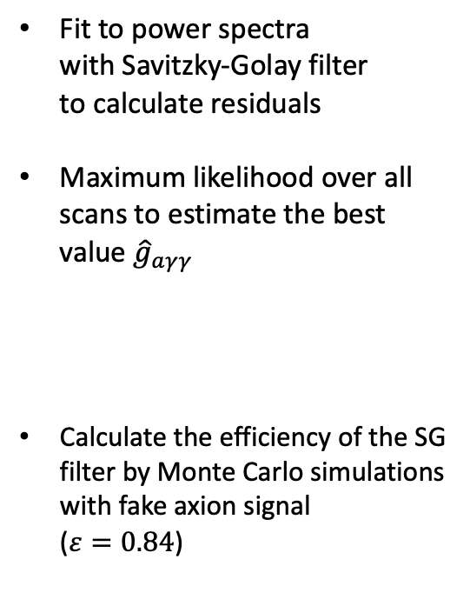
Analysis
Analysis procedure by Alessandro D’Elia
Fit to power spectra
with Savitzky-Golay filter
to calculate residuals
Maximum likelihood over all scans to estimate the best value ${\hat{g}}_{aγγ}$
Calculate the efficiency of the SG filter by Monte Carlo simulations with fake axion signal
($ε=0.84$)
Example of power spectrum with SG fit
Cumulative normalized residuals over all scans

Slide 16

PRELIMINARY
Final plot - $g_{aγγ}$
Touched the QCD line
Avg value $g_{aγγ}=2×{10}^{−13} GeV^{−1}$
QUAX@LNF this run

Slide 17

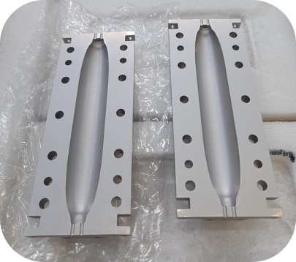
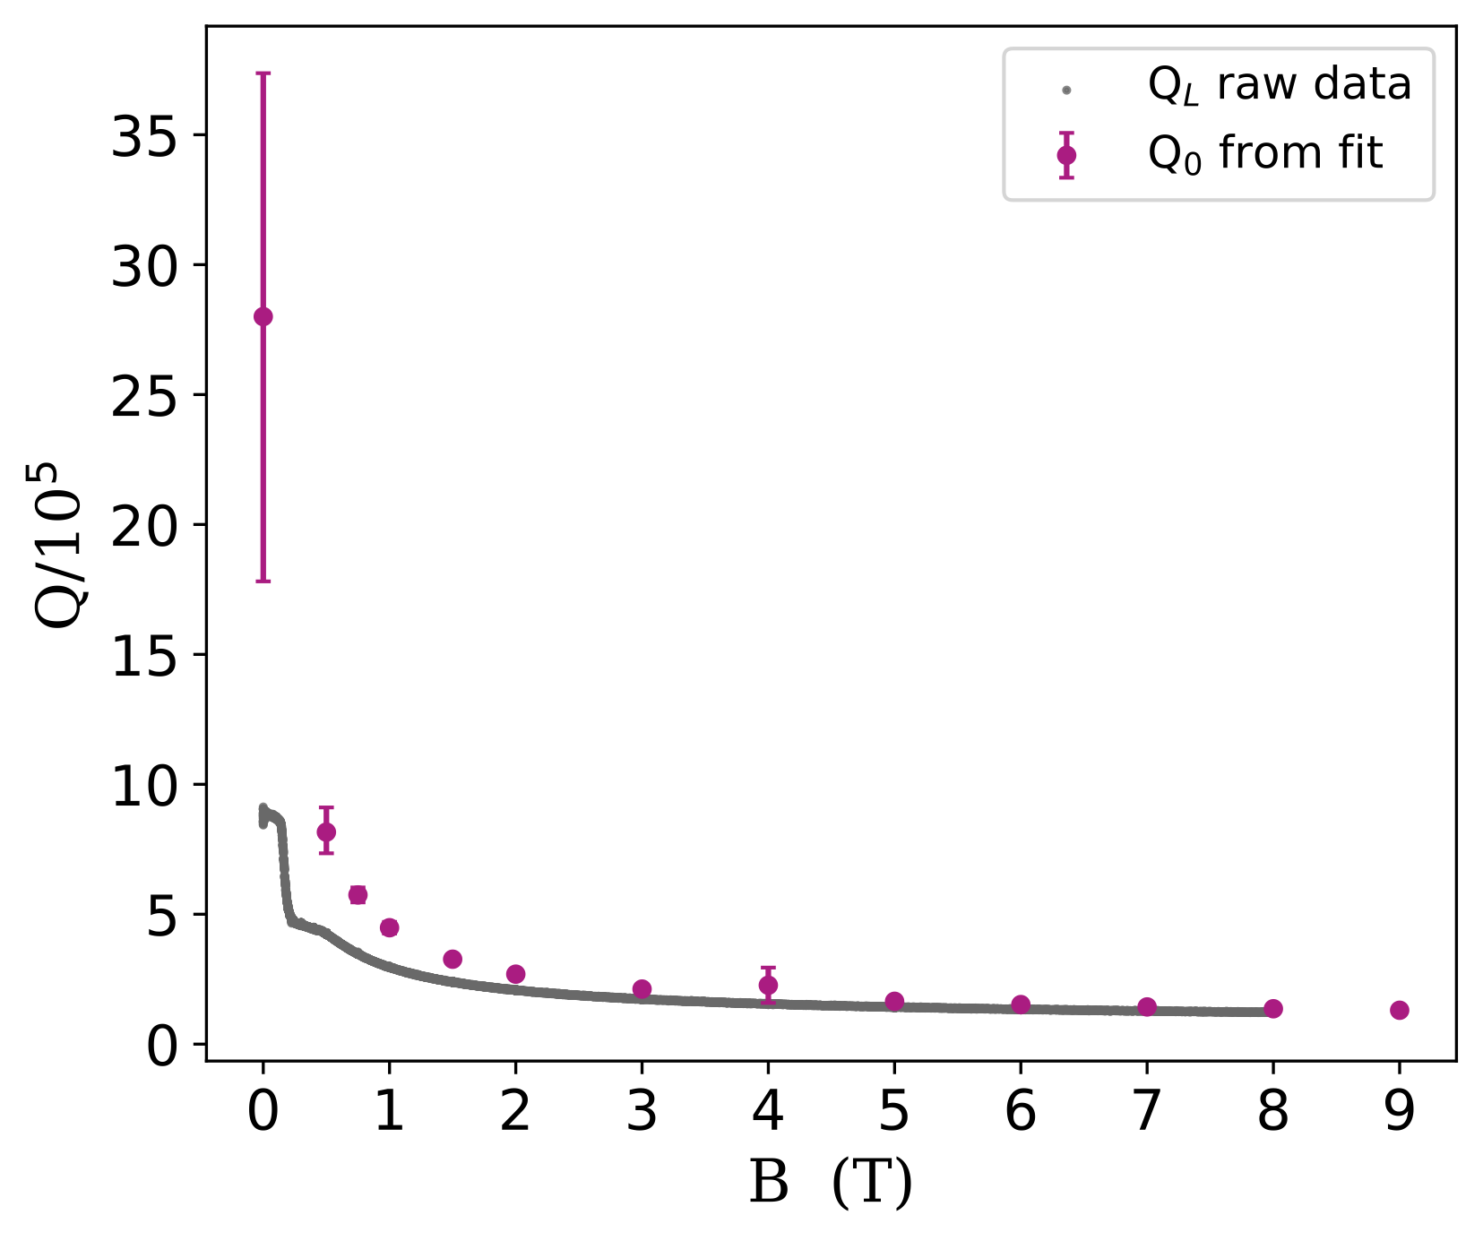


Bonus: superconducting cavities
ReBCO-tapes cavity
$Nb_{3}Sn$ cavity by FNAL
Q_loaded
$Q_{0}≃1.3×{10}^{5}$ at 9T

Slide 18
Next
Qubit photon detector*
JPA, fabrication by FBK
Optimization of tuning rod
Superconducting cavities
FPGA for acquisition
*S. Kono et al; Nature Phys 14, 546–549 (2018)

Slide 19
Conclusions
First QUAX@LNF run with complete haloscope
  2 weeks of data taking.
  9 T magnet. Operated at 8 T.
  Tuning rod to scan frequencies.
Savitzky-Golay + Maximum Likelihood analysis.
Still much room for improvements.
QUAX competitive in the panorama.

Slide 20
backup

Slide 21
Figures of merit in a haloscope
The signal power is very faint
The scan rate depends critically on noise temperature

Slide 22
L1
L2
L3
L5

Slide 23
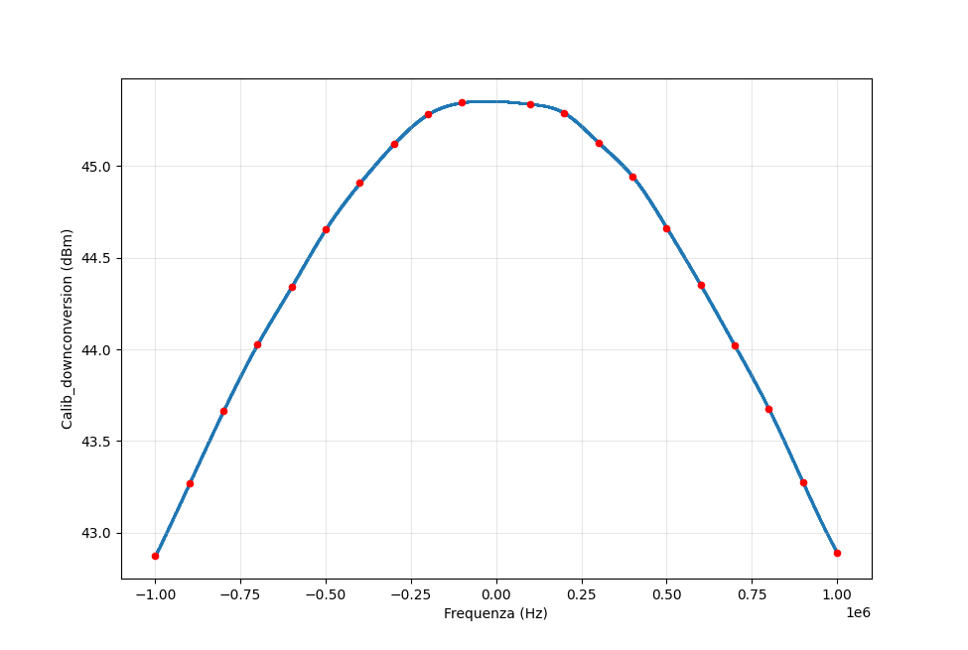
All calibrated scans
Calibration of downconversion hardware

