Slide 1
ARES Operation Meeting
Summary of week 43 / 2023
Max Kellermeier, on behalf of the ARES crew

Slide 2
Summary of week 43
Mon. 23rd Oct | Tue. 24th Oct | Wed. 25th Oct | Thu. 26th Oct | Fri. 27th Oct
Tunnel open for maintenance: Experimental setup by D3 Grounding net installation by Wille ZM working on TDS mover system (controls) | Beam size on FL screen established for D3 tests Vert. and Hor. Scans on NitroFlash detector → center defined Fine 2D scan set up for overnight run PolariX conditioning (off-beam) | Intensity scans on NitroFlash detector | Beam size scans on NitroFlash detector Pulse shot measurements with dosimetry films TLD sample holder installed 2D scan started | Machine state recovery 2D scan repeated
 |  | Overnight: Valves closed due to vacuum event in PolariX Tektronix scope died | TWSs modulators in fault state again Water flow rate warning on Gun modulator (Power supply) | Overnight: Valves closed due to vacuum event in PolariX Power glitch → DIO.1 couldn’t be restarted BC dipole turned on
 |  | Scan tool tool take way longer than expected PolariX conditioning | PolariX conditioning | PolariX conditioning
Achievements
Difficulties
Notes

Slide 3
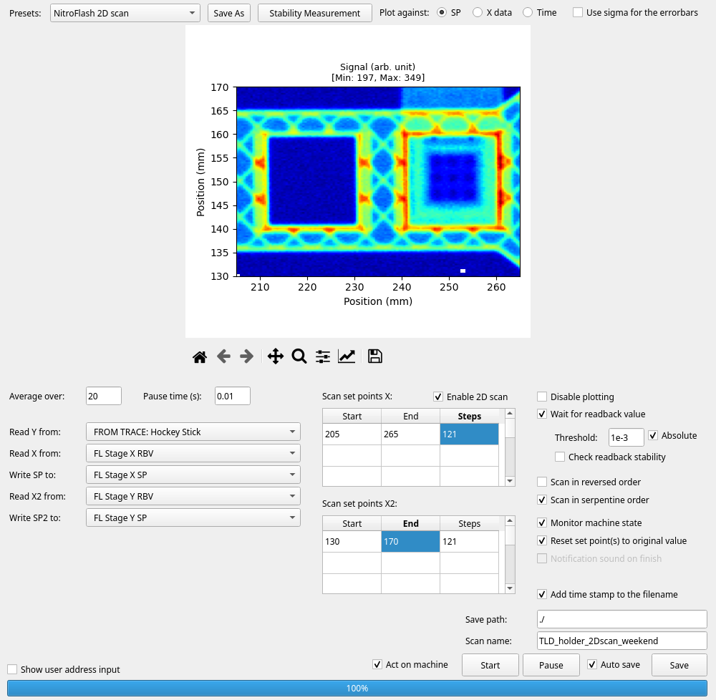
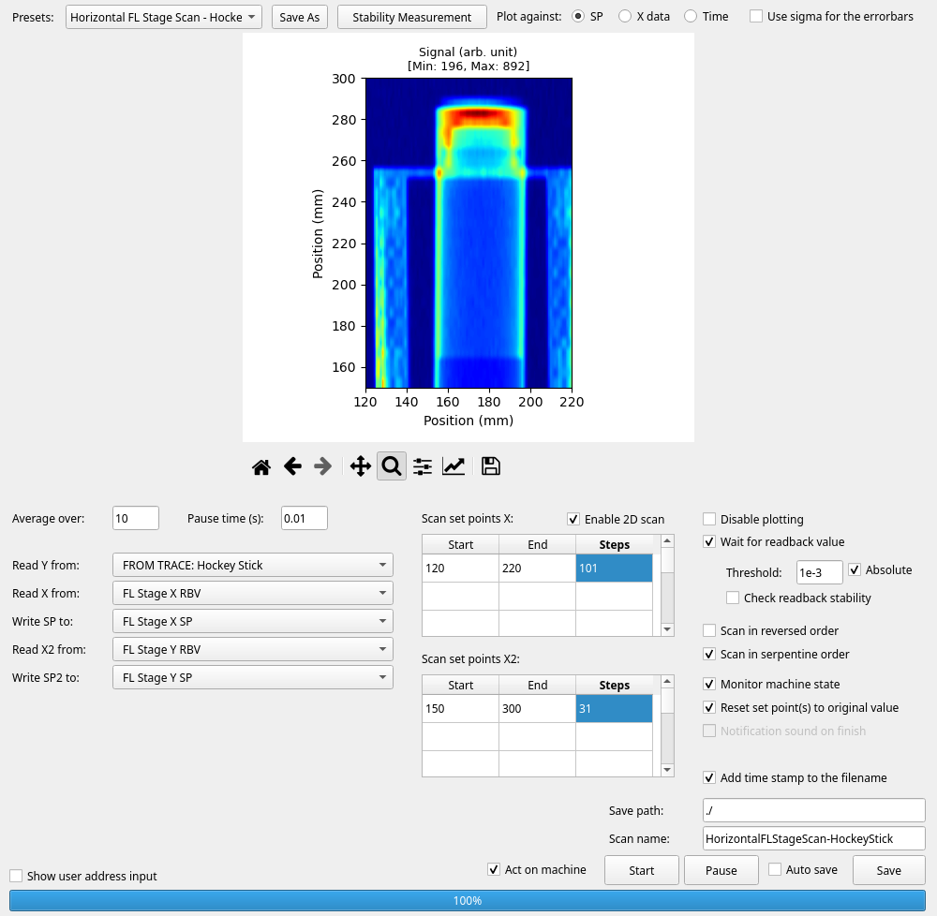
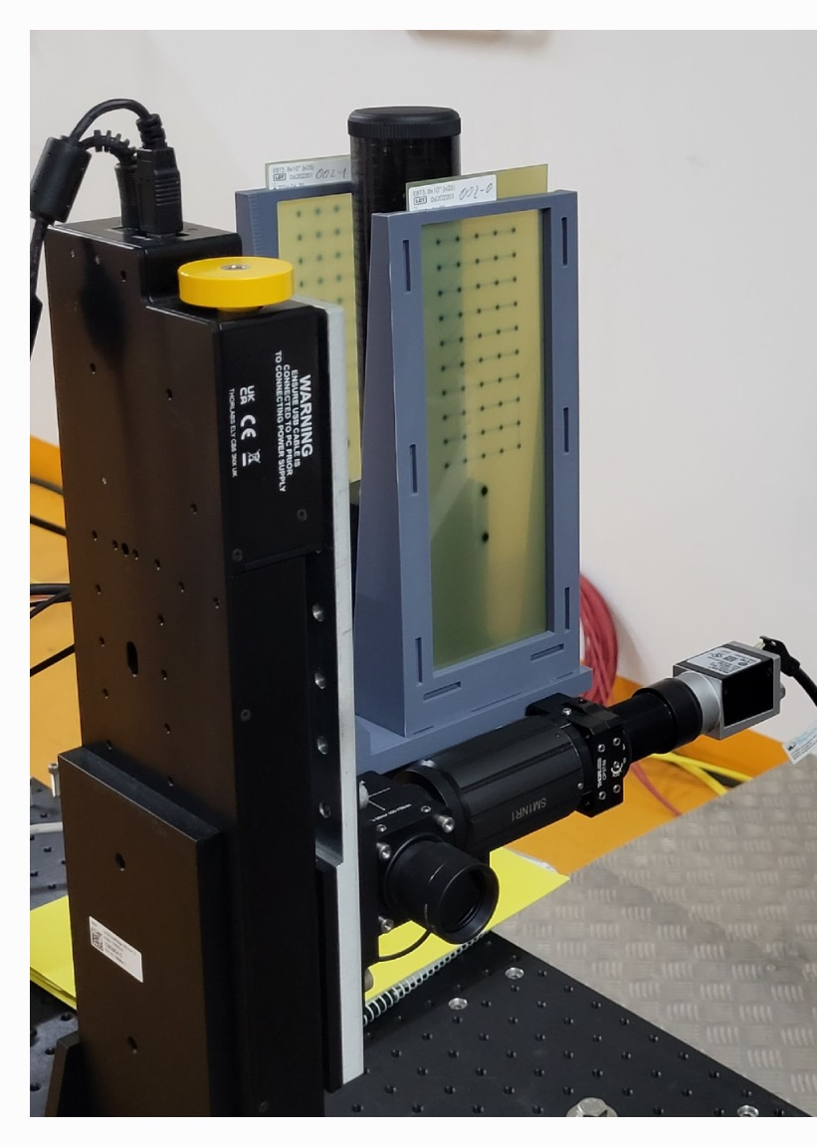
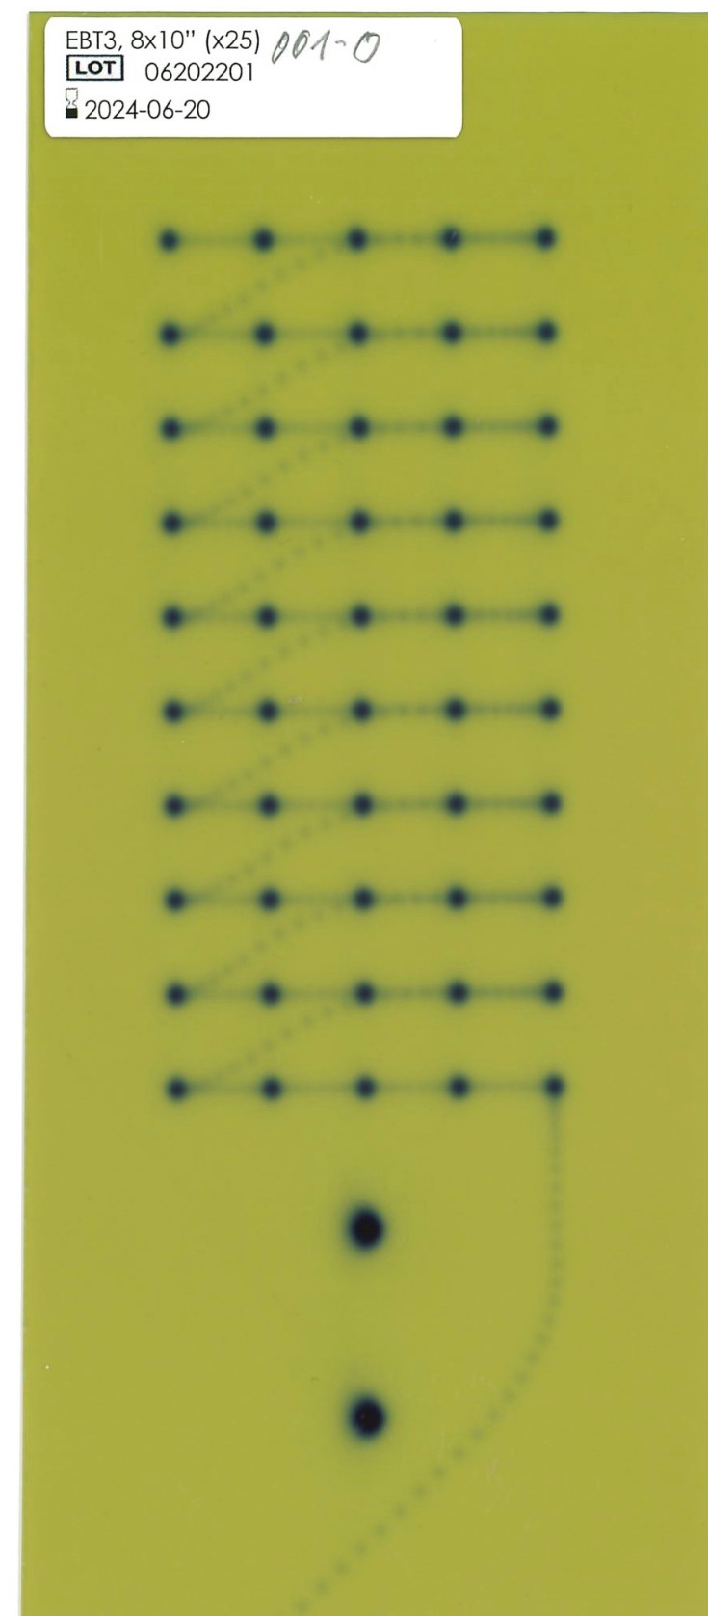
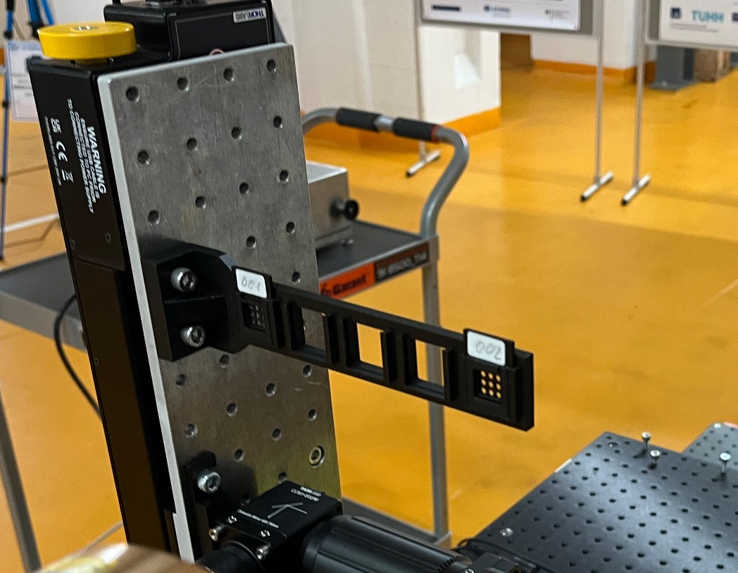
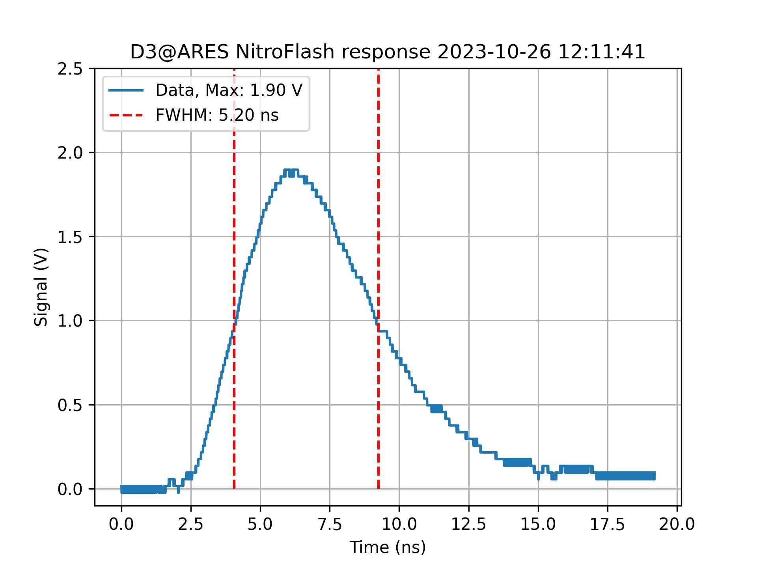
D3@ARES 23.10. - 27.10.2023 NitroFlash Measurements
Detector response measurements and dosimetry film irradiation
Goals:
Measure the NitroFlash0 detector response at different positions and beam intensities
Irradiate dosimetry films and TLDs for dose references
Most of the measurements were performed. Accelerator and data acquisition worked most of the time.
In some cases measurements had to be repeated due to minor issues during the runs.
TLDs were not irradiated due to the lack of time.
Setup for film and TLD irradiation.
Response signal.
2D Scan for position determination.
X-Y Scans with detector response measurements.
Now: Data analysis…
Setup with irradiated films.
Scanned film.
Thanks to the ARES OP Team!
Notes:
RL overview at ARES EA, RL loop @ ARES EA, optimisation problem formulation, transformation to RL problem, action, observation ,description of the problem in general (maybe 2 slides)

Slide 4
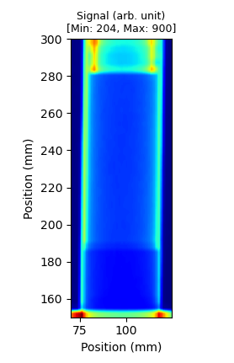
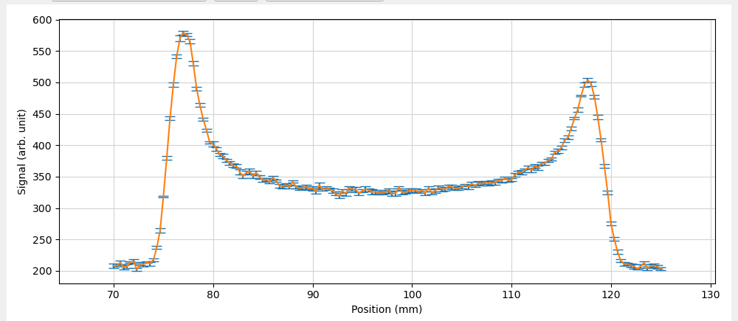
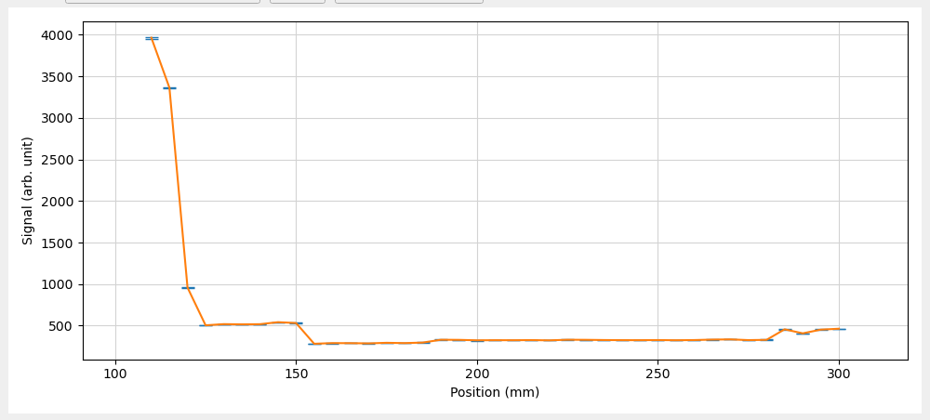
Alignment Scan on NitroFlash Detector
Tuesday
One of the UKE WP loaded with 74 MV/m gun gradient, 3 pC
last DL quads tuned for beam size
Alignment scans using Hockey Stick BLM → (97.4, 220) defined as center
Overnight 2D scan failed: Tektronix scope stopped working around 8 p.m.
→ ZZ to restart
→ overnight scan repeated from Wed to Thu
Wed morning: Valves closed around Polarix, but scan already finished
Holder
photomultiplier
scintillator
cap

Slide 5
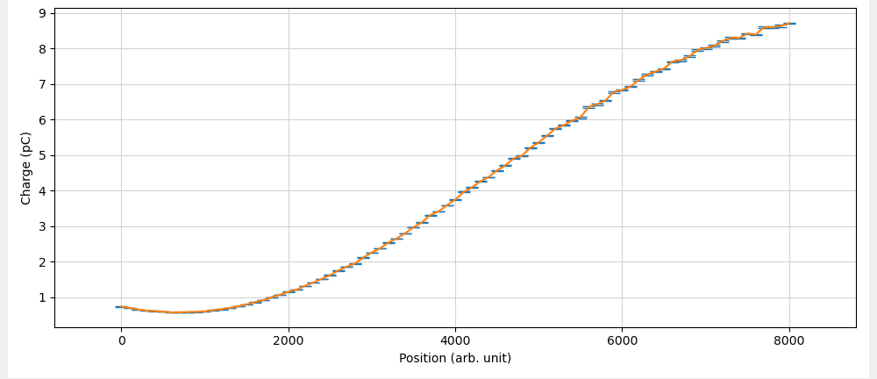
Intensity scans
Wednesday
2D scans at different Pharos settings (25%, 15%, 45%)
  laser attenuator: 1800 to 7500 (roughly linear regime)
  FL y stage: 210mm to 280mm
  Beam size checked before each scan at low and high charge
Mid charge range: 0.98 pC to 8.8 pC
Low charge range: 0.18 pC to 1.6 pC
High charge range: 5.7 pC to 27.5 pC
  Might have had beam clipping, but not critical (final measurement at T-ICT)
Overnight: repeated 2D scan

Slide 6
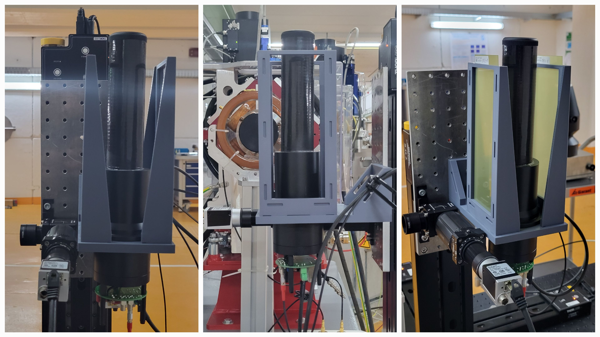
Beam size scans and new holder installation
Thursday
Changed beam size by moving along z → scattering from TI vacuum window more severe (to be repeated with adjusting quads)
  Detector Data aqusition for 1min
New holder installed → screen + cam moved by
z /mm | σ_{x} (gaussian fit) /mm | σ_{y} (gaussian fit) /mm
213 | 0.56 | 0.58
153 | 0.71 | 0.72
93 | 0.85 | 0.87
33 | 1.00 | 1.01
(Z-pos. for screen, detector is always +87mm)

Slide 7
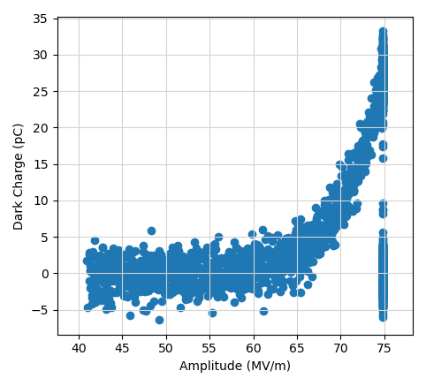

Measurements with film holder
Thursday
Alignment scans w/out film
Pulse shot mode: 3 pulses per spot
Dark current severe
→ Dark current spots each 1 min. (via valve)
Done twice (3 ZZs)
→ 64 MV/m working point next time

Slide 8
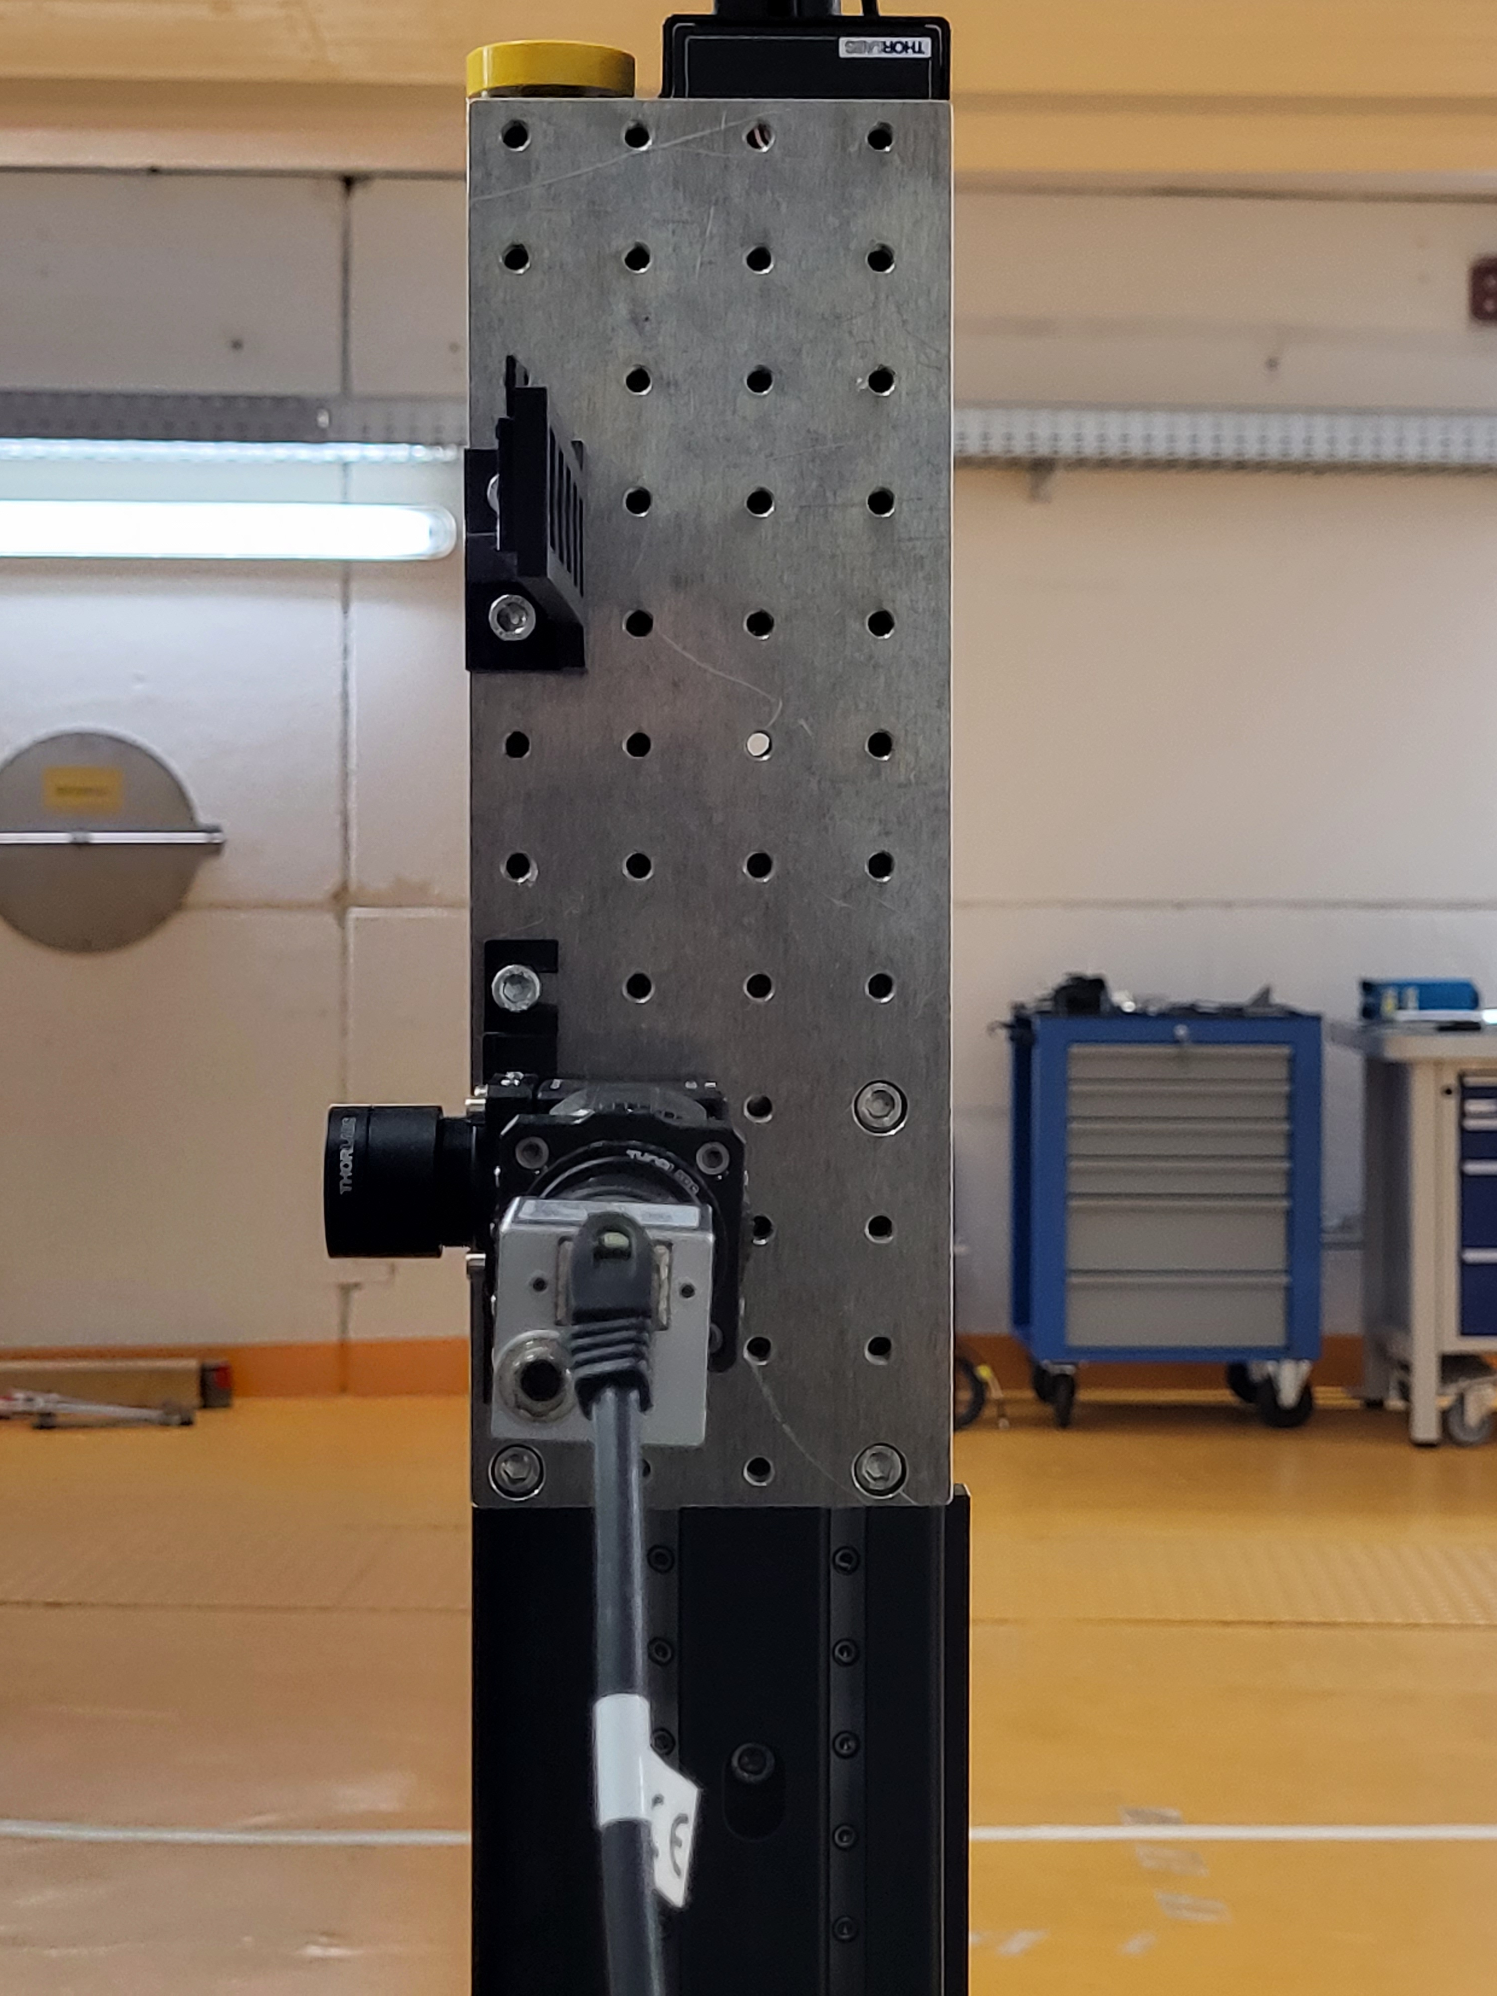
TLD holder installation
Thursday/ Friday
TLD holder installed
1D Positions scanned to define reference points
2D overnight scan (failed and repeated on friday)
Left most slot (from beam perspective): alignment grid; Second slot empty
→ No TLD irradiation

Slide 9
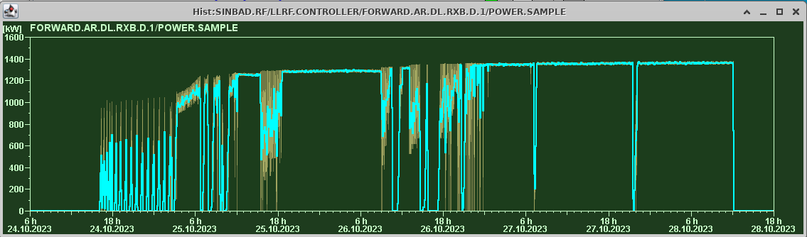
PolariX conditioning
At 1.35 MW
Two vacuum interlocks during overnight runs interrupted measurements due to closing valves

Slide 10
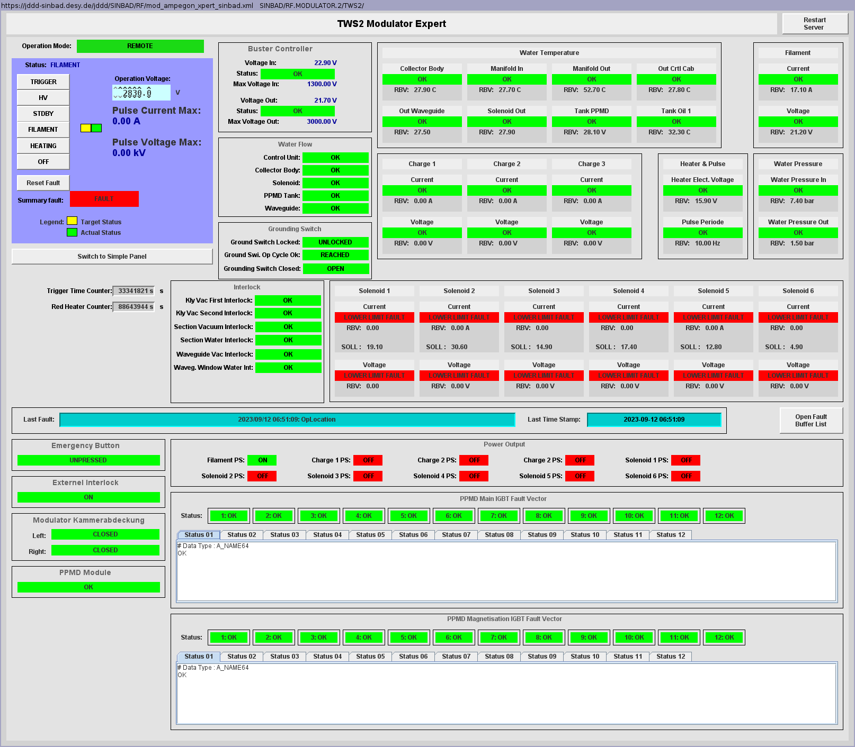
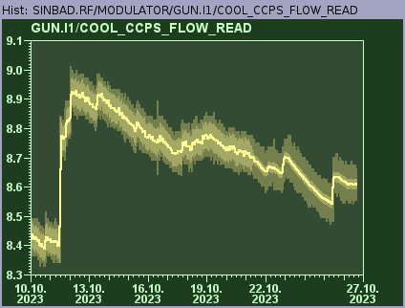
Issues with S-Band structures
Thu: After 1st ZZ both TWSs couldn’t be set back to TRIGGER with known fault state → after repeated filament mode it worked again
Thu: After 2nd ZZ warning on Gun modulator about low water flow rate
Fri: TWS2 fault state again → MIN contacted
(Old panel screenshot from two month ago)

Slide 11
Schedule and Plan for the Week
Week 44
Date | Shift Crew
30.10. | --
31.10. | -- (public holiday)
01.11. | Willi, Max
02.11. | Frank, Hannes
03.11. | Frank, Willi, Thomas (?)
Mon: Tunnel to be closed in the afternoon for PolariX conditioning over the public holiday
Wed to Fri: UKE beam time
PolariX Conditioning (off-beam)
If you want to learn or join the shift: please give the shift leader a call (BKR 2840 / SINBAD Box 2454)

