Slide 1
Gravitational wave vertical cryostat

Slide 2
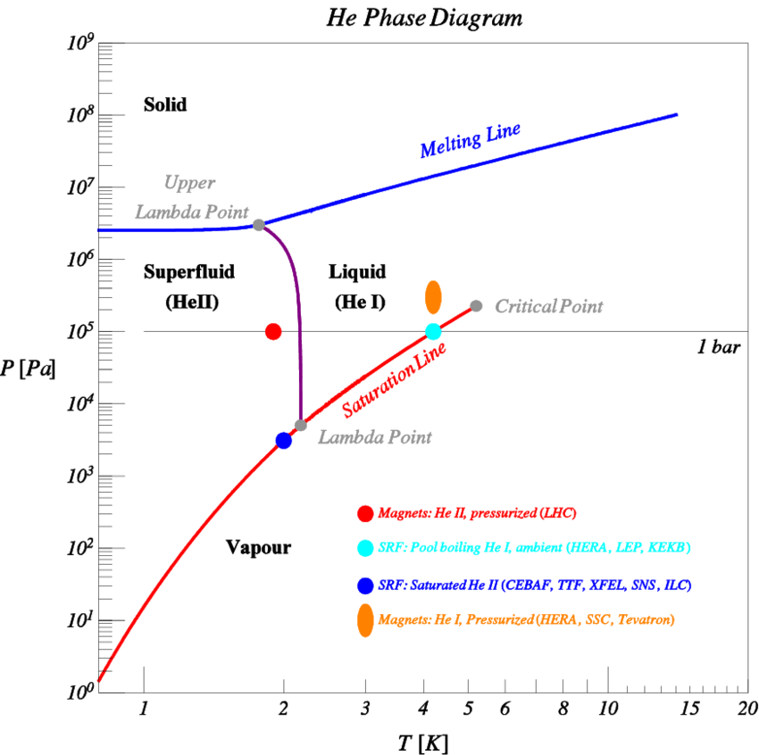
Pressure–temperature phase diagram of helium 4
Several phases are possible in the heat transfer to helium: superfluid He II, Solid, liquid, and vapor
arXiv:1307.8286 (2013)

Slide 3
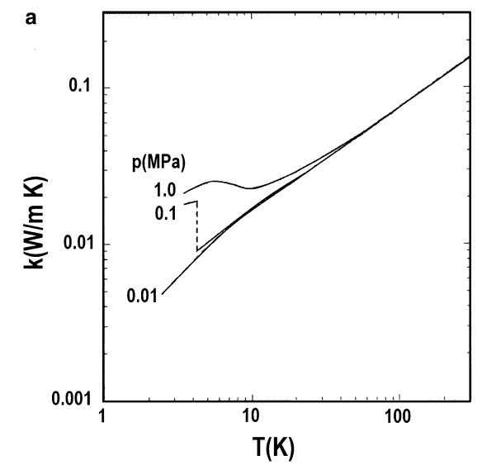
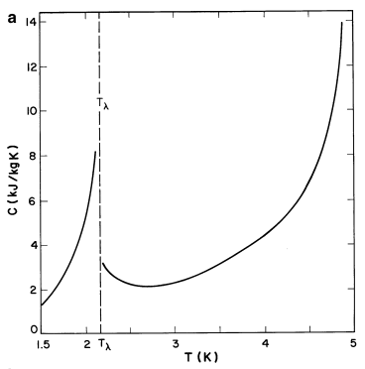
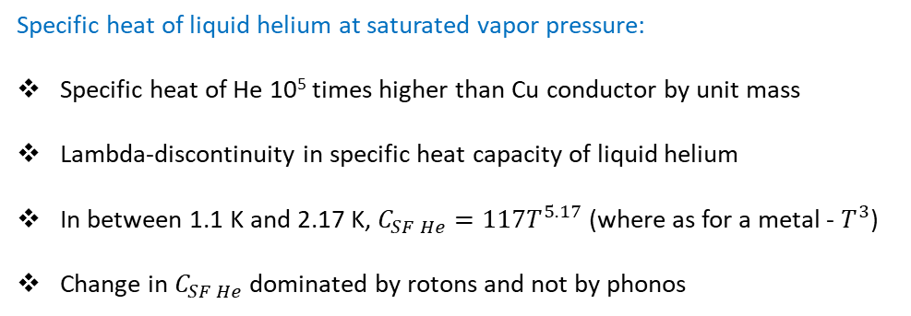
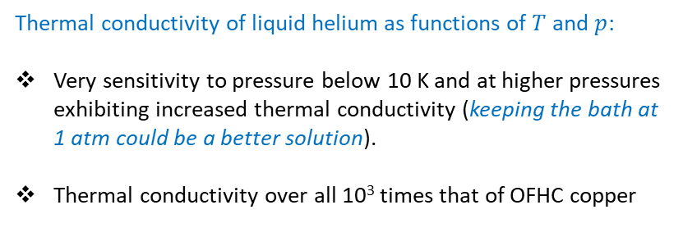
Properties of superfluid helium 4
SF He
LHe
Cu
Cu
Thermal conductivity of liquid helium as functions of $T$ and $p$:
Very sensitivity to pressure below 10 K and at higher pressures exhibiting increased thermal conductivity (keeping the bath at 1 atm could be a better solution).
Thermal conductivity over all 10³ times that of OFHC copper
Specific heat of liquid helium at saturated vapor pressure:
Specific heat of He 10⁵ times higher than Cu conductor by unit mass
Lambda-discontinuity in specific heat capacity of liquid helium
In between 1.1 K and 2.17 K, $C_{SF He}=117T^{5.17}$ (where as for a metal - $T^{3}$)
Change in $C_{SF He}$dominated by rotons and not by phonos
Steven W. Van Sciver, Helium Cryogenics (2012)

Slide 4
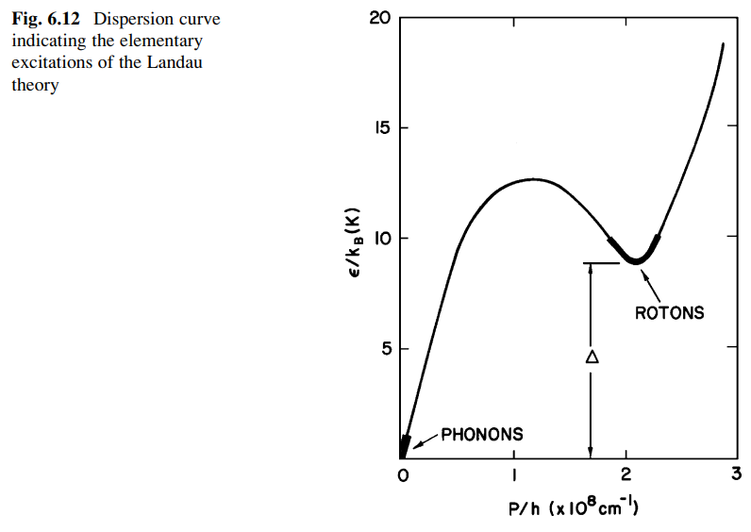
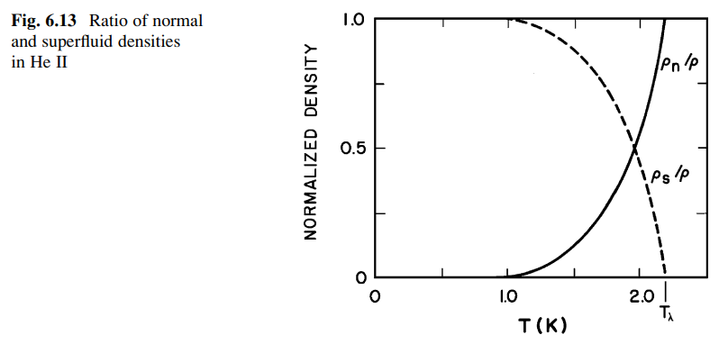

Properties of superfluid helium 4
Due to strong temperature dependence, the superfluid component composes about 99% of He II at 1 K.
Specific heat dominated by rotons between 1.1 and 2.1 K and not by phonons
Steven W. Van Sciver, Helium Cryogenics (2012)

Slide 5
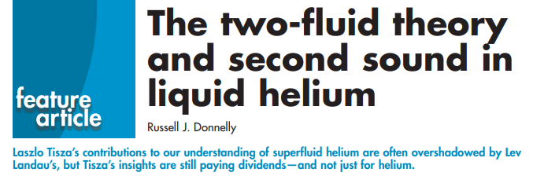
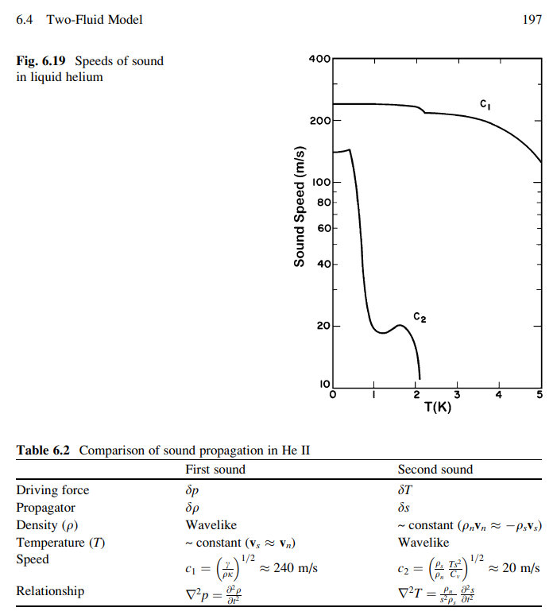
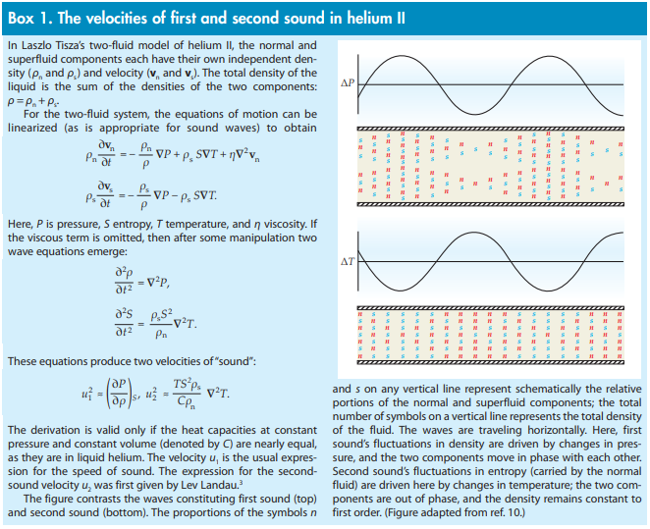
Russell J. Donnelly, Physics Today 62, 10, 34 (2009)
Steven W. Van Sciver, Helium Cryogenics (2012)

Slide 6

General superfluid (SF) helium properties
First sound wave: SF helium has an exceptionally low sound wave speed of 238 m/s.
Excitations: It also shows unique kinds of excitations, such as quantized vortices, and second and third sound waves.
Density: The low density (ρHe = 145 kg/m3) and effective mass of SF helium contribute to a high zero-point fluctuation (ZPF) amplitude, resulting in significant optomechanical/electromechanical coupling.
Dielectric constant: The dielectric constant of SF Helium is 1.057, indicating that it is a low-loss dielectric medium. This characteristic results in minimal light absorption or scattering, which leads to low optical loss.
Viscosity: The absence of viscosity in SF helium results in a very low sound attenuation (acoustic loss proportional to T⁴ ), which contributes to high mechanical quality factor.
Thermal conductivity: The high thermal conductivity of SF helium prevents any heating issues from RF/optical powers.
Band gap: Helium II does not exhibit linear absorption visible of infrared light, due to its large bandgap (19.9 eV), and the lack of chemical impurities which freeze to the walls of the container.
Tuning tool: SF helium can be employed as a tuning tool for resonators, allowing adjustments to the effective mass and resonance frequency.
In conclusion, the combination of low intrinsic absorption and the large thermal conductivity of superfluid helium contributes to improved RF/optical power handling.

Slide 7
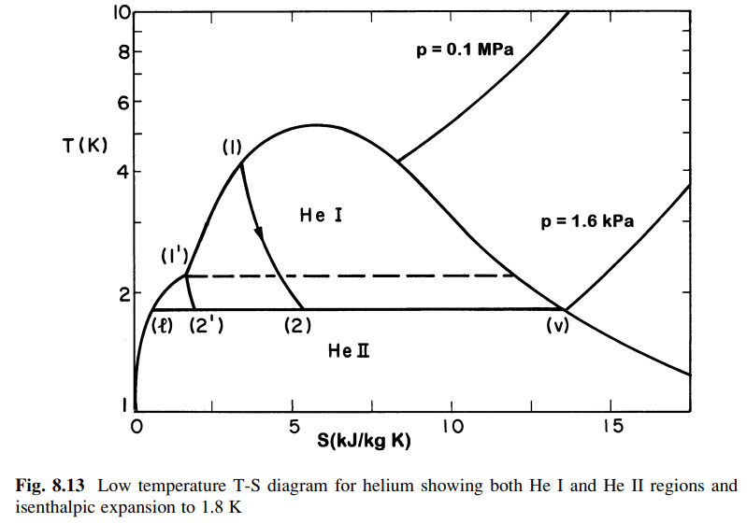
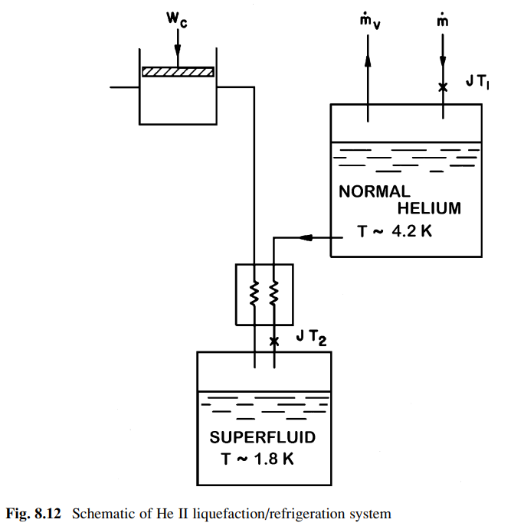
Production of 2 K superfluid helium via isenthalpic expansion
liq.
gas
Considering an isenthalpic expansion of helium from 0.1 MPa, 4.2 K to 1.6 kPa corresponding to the saturated vapor pressure at 1.8 K
Steven W. Van Sciver, Helium Cryogenics (2012)

Slide 8
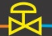
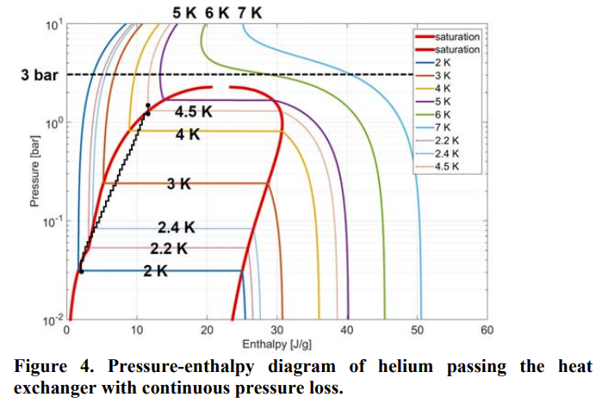

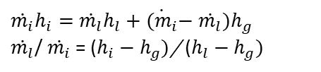
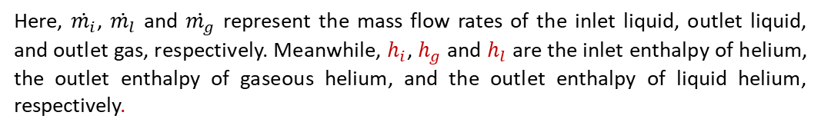



Joule-Thomson valve
$\dot{m_{i}}h_{i}$ ((liq. He )
$\dot{m_{l}}h_{l}+\dot{m_{g}}h_{g}$ (liq. He + gas He)
After the expansion of liquid helium (LHe) from high pressure to low pressure through the JT valve, the resulting helium exists in both liquid and gaseous phases, while conserving enthalpy across the valve:
$H_{i}$ = $H_{0}$
$\dot{m_{i}}h_{i}=$ $\dot{m_{l}}h_{l}+\dot{m_{g}}h_{g}$
Here, $\dot{m_{i}}$, $\dot{m_{l}}$ and $\dot{m_{g}}$ represent the mass flow rates of the inlet liquid, outlet liquid, and outlet gas, respectively. Meanwhile, $h_{i}$, $h_{g}$ and $h_{l}$ are the inlet enthalpy of helium, the outlet enthalpy of gaseous helium, and the outlet enthalpy of liquid helium, respectively.
Furthermore, the mass flow rate through the JT valve is determined by
$\dot{m_{i}}$= $\dot{m_{l}}+\dot{m_{g}}$. Consequently,
$\dot{m_{i}}h_{i}=$ $\dot{m_{l}}h_{l}+{\dot{{(m}_{i}}−\dot{m_{l}})h}_{g}$
$\dot{m_{l}}$/ $\dot{m_{i}}$ = ($h_{i}−$ $h_{g})$/ ($h_{l}−$ $h_{g})$
In addition, the fraction of mass flow liquefied or yield is defined,
$x= \dot{m_{l}}$/ $\dot{m_{i}}$
J. Phys.: Conf. Ser. 969 012084 (2008)

Slide 9
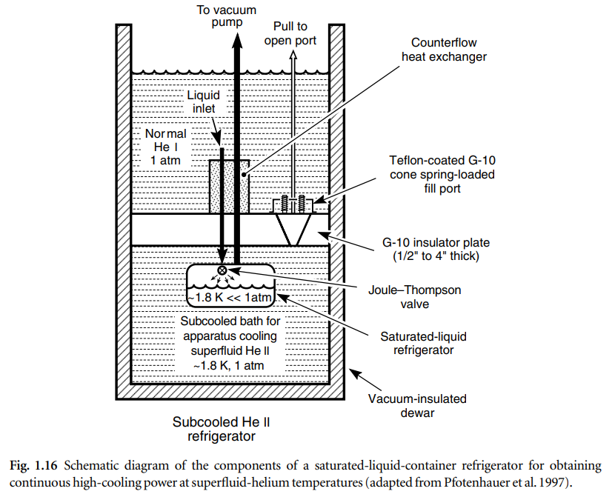
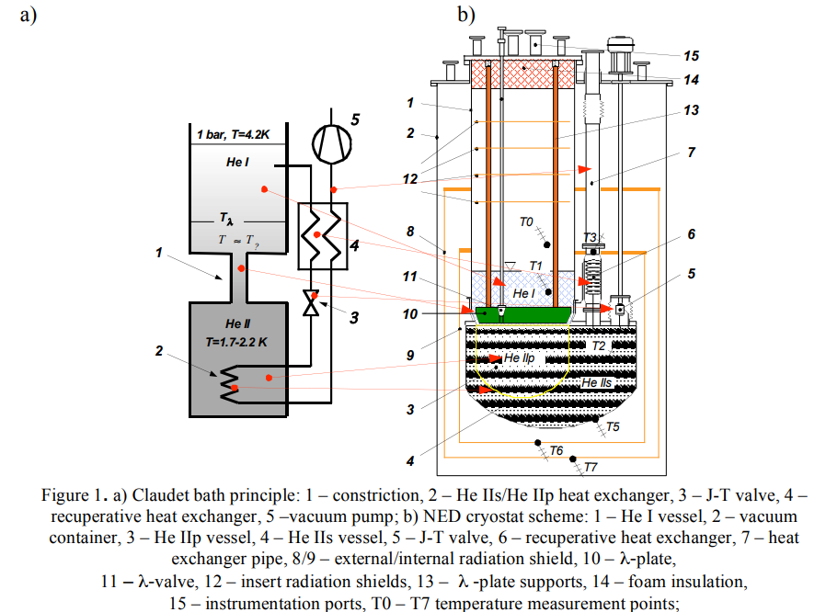
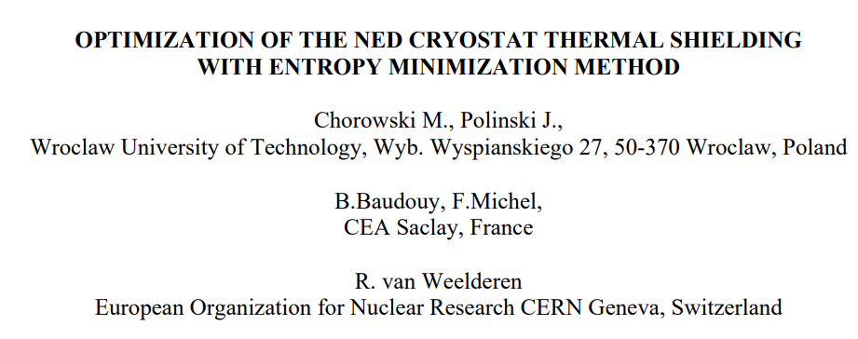

Lambda plate in the Claudet bath

Slide 10
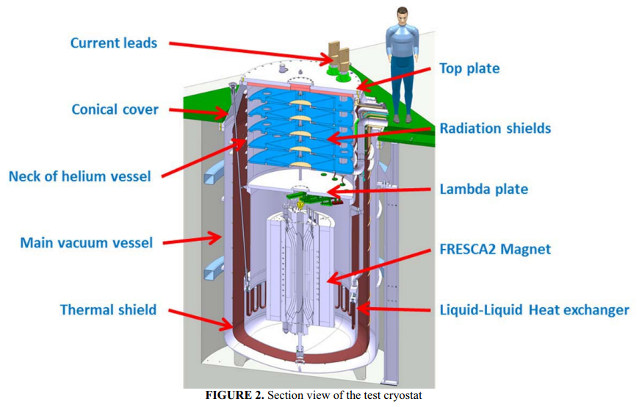
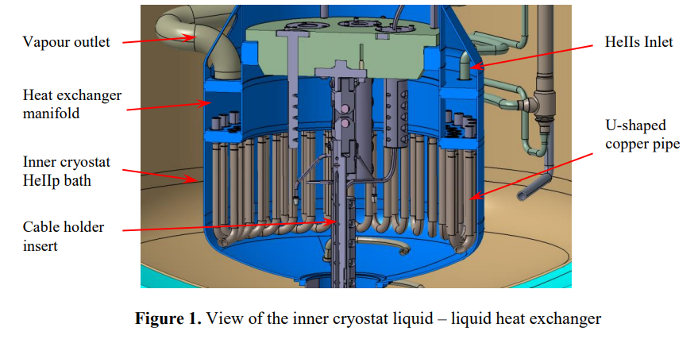
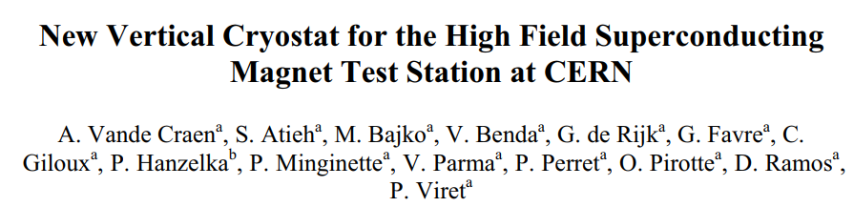
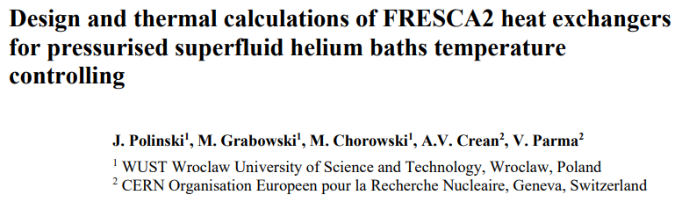
FRESCA2 cryostat at CERN

Slide 11
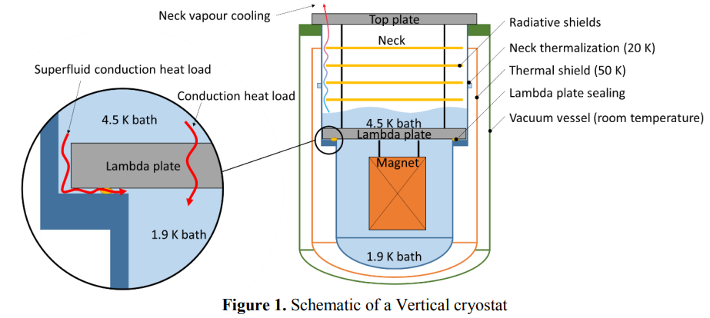
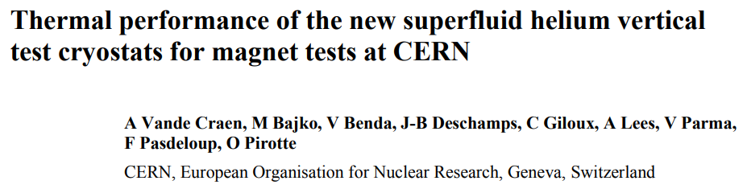
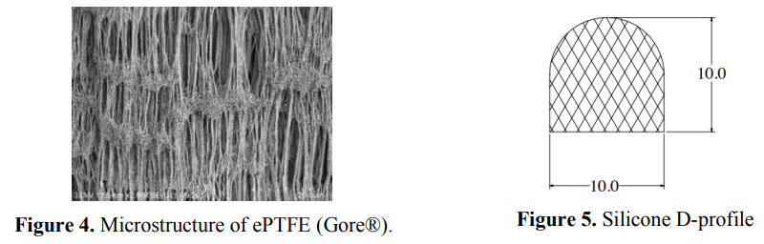
FRESCA2 cryostat at CERN

Slide 12
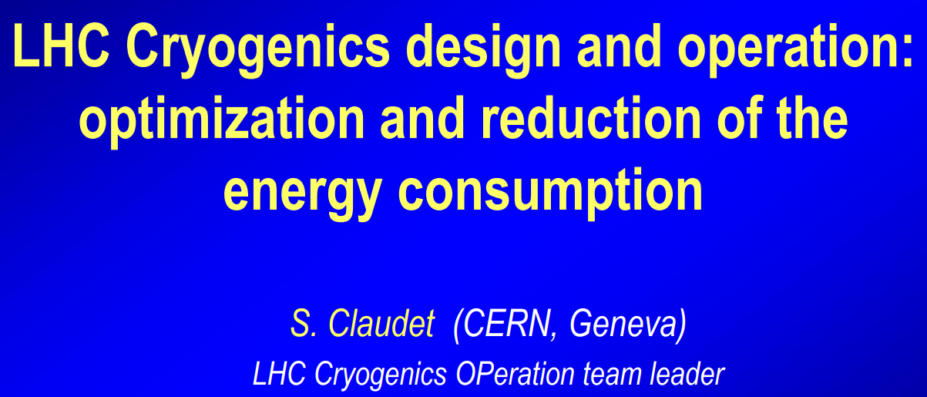
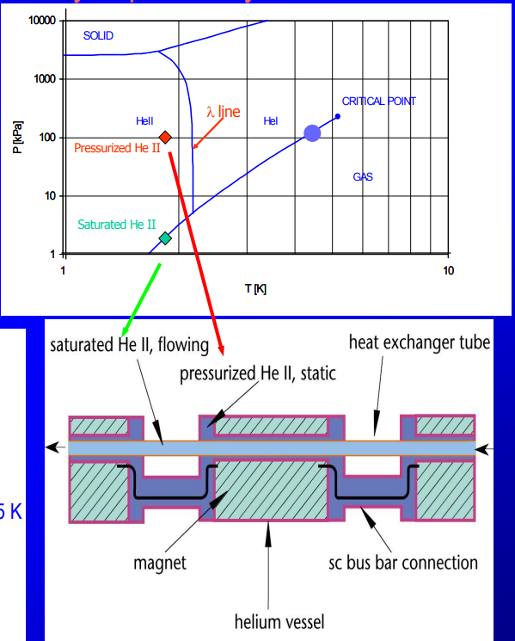
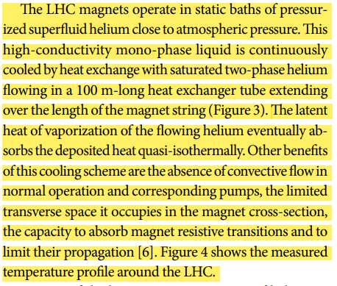
3-LHC-Cryogenics-design-and-operation-optimization

Slide 13
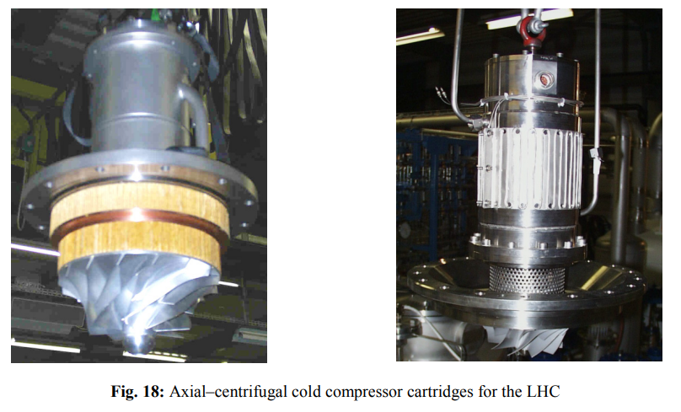
Cold hydrodynamic helium compressors
four-stage LHC cold compressors

Slide 14
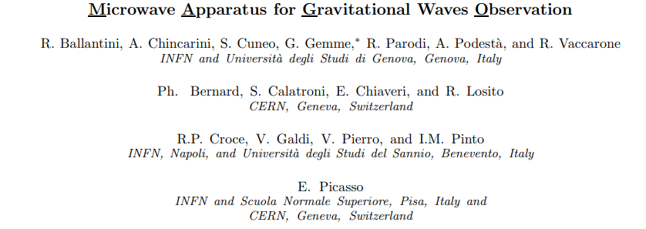
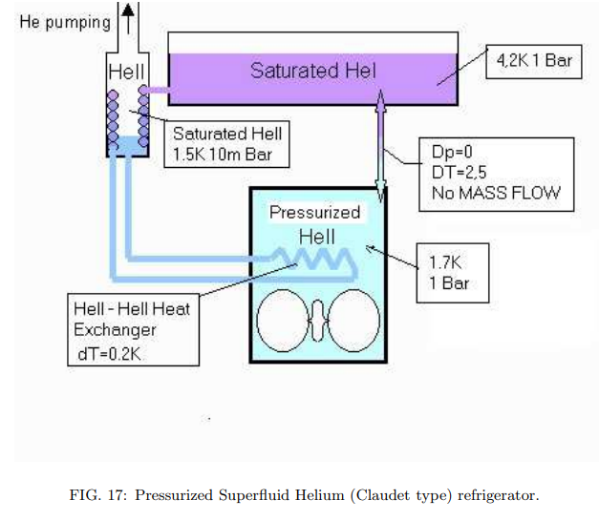
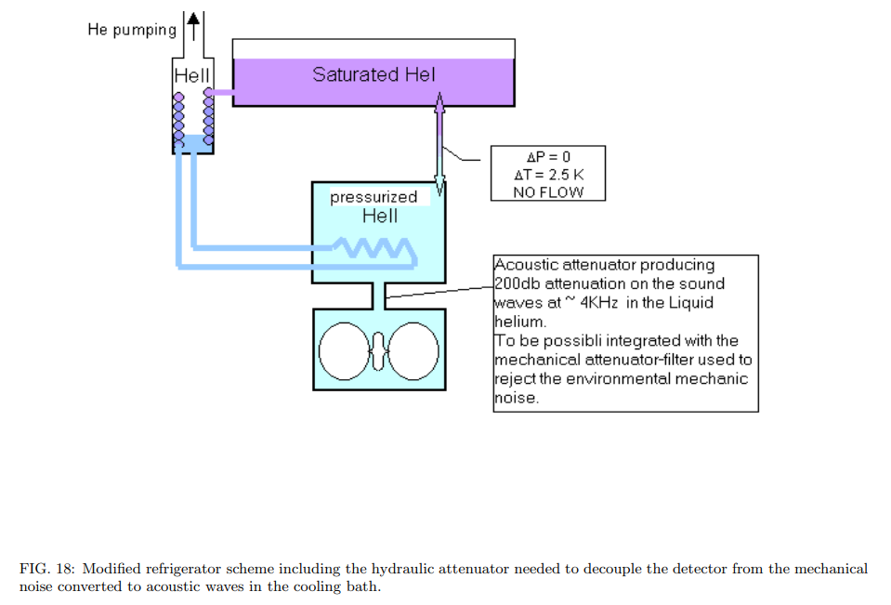
http://arxiv.org/abs/gr-qc/0502054v1

Slide 15
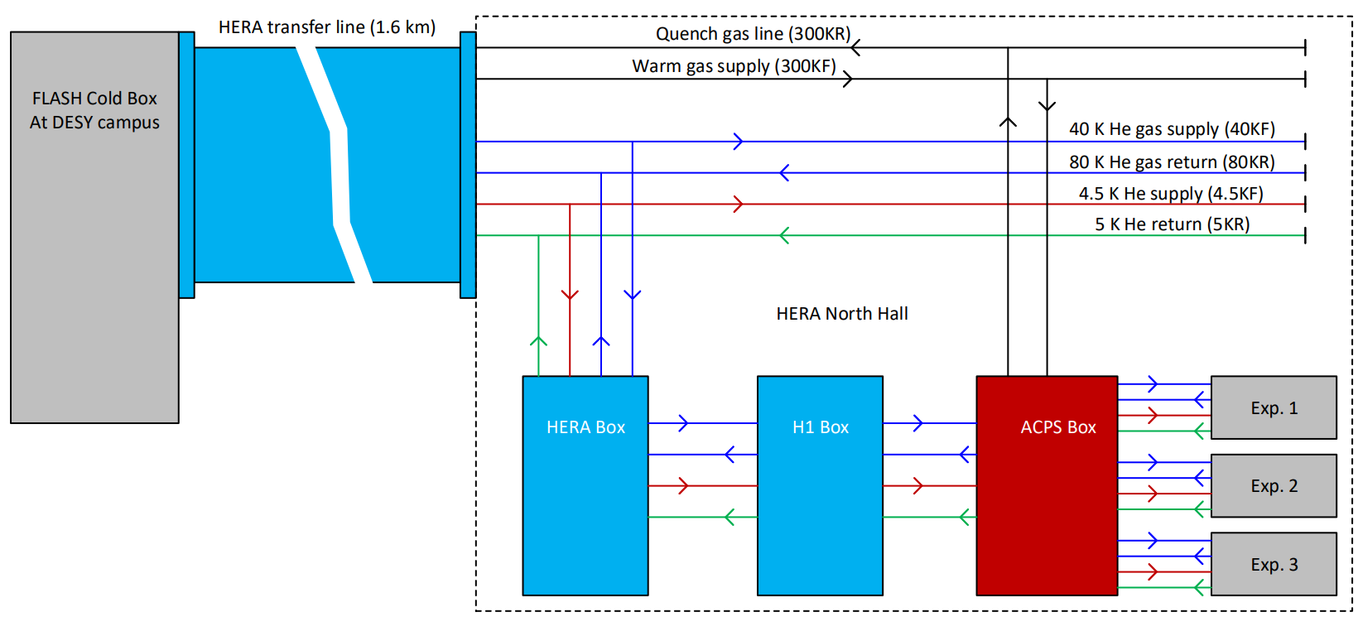
General description of HB Box, H1 Box and ACPS in HERA North Hall
1

Slide 16
Cold valves in ACPS Transfer line 3
4K/5K cold valves:
Valve | Function | Type | DN | Kvs – for vendors | Kvs – max. valve lift (calculated) | Services | Tmin, K | PN, bar | Ps, bar | Tin, K | m, g/s | Pin, bar | DP, bar
ACPSVC2140 | ACPS TL3 4K supply | Control, NC | 15 | 3.24 – 4.33 | 2.88 – 63 % | Liq. serv. | 4.5 | 25 | 20 | 6.13 | 10 | 3.5 | 0.050
ACPSVC2240 | ACPS TL4 4K return | Control, NC | 20 | 6.9 – 7.8 | 6.12 – 63 % | Liq. serv. | 4.5 | 25 | 20 | 6.13 | 10 | 1.3 | 0.050
ACPSVC2240 | ACPS TL4 4K return | Control, NC | 20 | 7.8 – 9.5 | 7.02 – 63 % | Gas serv. | 4.5 | 25 | 20 | 6.13 | 10 | 1.3 | 0.050
ACPSVC2245 | ACPS TL4 4K cooldown | Control, NC | 25 | 14.7 – 15.6 | 13.66 – 84 % | Gas serv. | 4.5 | 25 | 20 | 300 | 20 | 1.8 | 0.50
40K/80K cold valves:
Valve | Function | Type | DN | Kvs – for vendors | Kvs – max. valve lift (calculated) | Services | Tmin, K | PN, bar | Ps, bar | Tin, K | m, g/s | Pin, bar | DP, bar
ACPSVC3140 | ACPS TL4 40K supply | Control, NC | 10 | 1.73 – 2.16 | 1.40 – 76 % | Gas serv | 40 | 25 | 20 | 55 | 10 | 14 | 0.40
ACPSVC3240 | ACPS TL4 40K return | Control, NC | 15 | 2.60 – 3.24 | 2.37 – 76 % | Gas serv. | 40 | 25 | 20 | 80 | 10 | 14 | 0.20
ACPSVC3245 | ACPS TL4 40K cooldown | Control, NC | 20 | 6.9 – 7.8 | 5.26 - 63 % | Gas serv. | 300 | 25 | 20 | 300 | 15 | 7 | 5.7

Slide 17
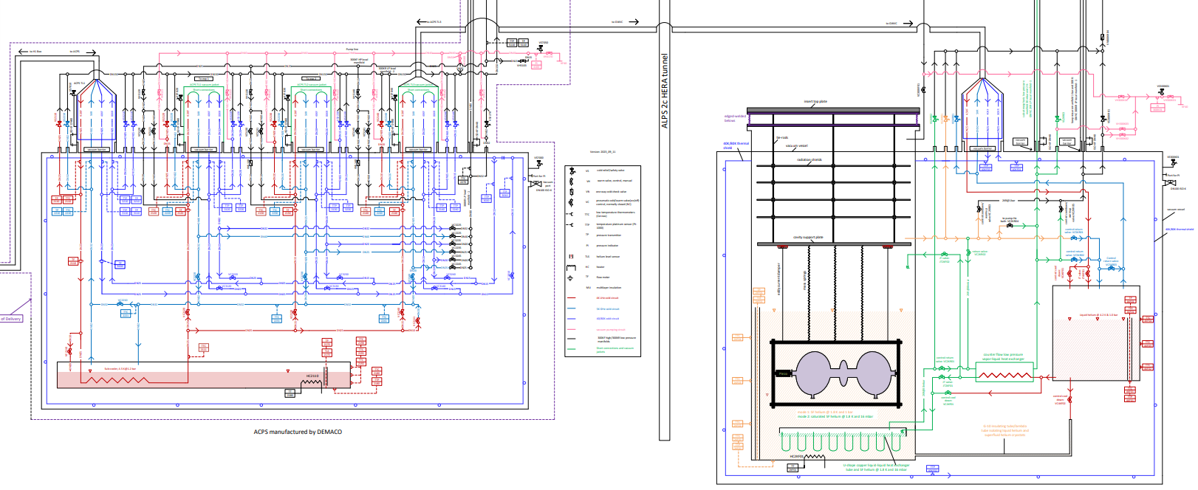
Flow scheme of GW vertical cryostat (GWVC)
ACPS
GWVC

Slide 18
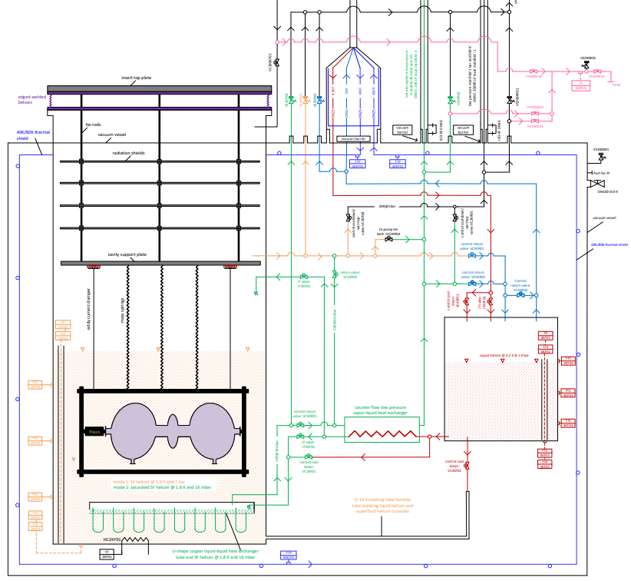
Flow scheme of GW vertical cryostat
high pressure manifold line (300K, 12 – 16bar)
helium transfer lines (4.5KF, 5KR, 40KF and 80KR)
Vacuum pump line
sub-atmospheric low pressure manifold 30 mbar and 2 K
low pressure manifold (cooldown/warm-up)
radiation shields
vacuum vessel
40K/80K thermal shield
cavity support plate
JT valve 3 for producing SF He @ 1.8 K and 16 bar
JT valve 1 for producing LHe @ 4.2 K and 1 bar
vibration isolation
liquid He bath @ 4.2 K and 1 bar
2K low pressure heat exchanger
JT valve 2 for producing SF helium @ 1.8 K and 16 mbar
SRF cavity
PZT actuator
G-10 insulating tube/lambda tube
U-shape copper liquid-liquid heat exchanger tube
SF He bath @ 1.8 K and 16 mbar

Slide 19
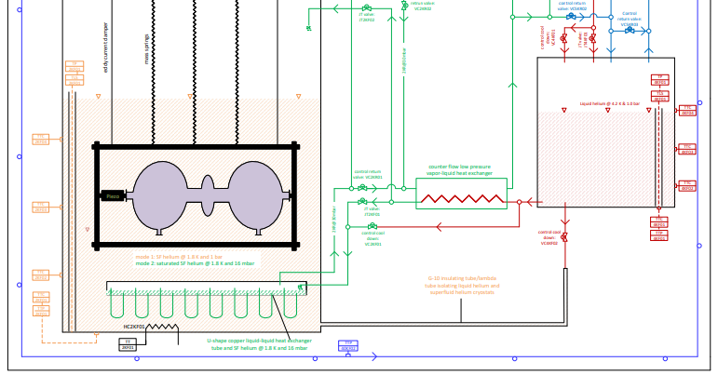
Heat exchangers and JT valves
JT valve 3 for producing SF He @ 1.8 K and 16 bar
JT valve 1 for producing LHe @ 4.2 K and 1 bar
2K low pressure heat exchanger
JT valve 2 for producing SF He @ 1.8 K and 16 mbar
U-shape copper HeII - HeII heat exchanger tube

Slide 20
Two phase SF (flowing) and one phase helium (static) in GWVC
With one phase helium, it‘s easy to avoid bubble formation and other instabilities like TCOs, TFs, etc.
one phase SF He@1 bar & 1.8 K
two phase He@ 1 bar & 4.2 K
two phase SF He@ 16 mbar & 1.8 K

Slide 21
Design and thermal calculations for GWVC heat exchangers
U-shape copper HeII - HeII heat exchanger tube
counter flow low pressure liquid HeI- vapor HeII heat exchanger

Slide 22
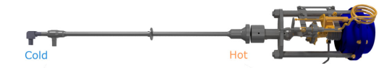
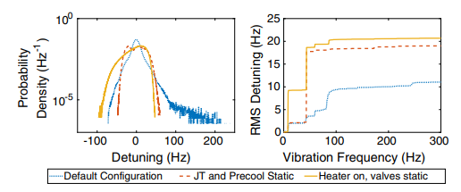
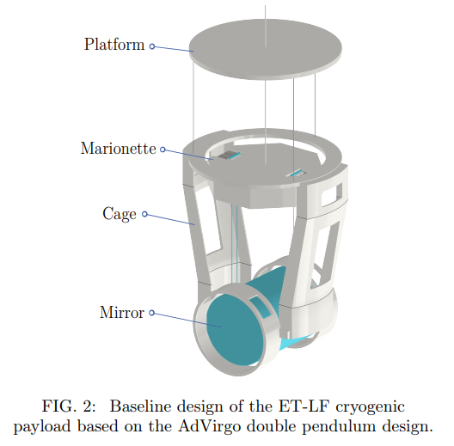
Vibration isolation
PHYSICAL REVIEW ACCELERATORS AND BEAMS 22, 052002 (2019)
arXiv:2305.01419

Slide 23
Operation modes
"Warm-up and cool-down of experiments between 300 K and 1.8 K with certain temperature gradients.
Controlled production of both single-phase (at 1 bar) and two-phase (at 16 mbar) superfluid helium at 1.8 K using JT valves and heat exchangers.
The thermal shield is cooled down using helium supplied at 40 K and under 14 bar.
Pressure regulation inside the cryostat is achieved through the opening and closing of control valves.
In the event of a vacuum breakdown, helium is collected via a safety device.
The cold mass can be in direct contact with both single-phase and two-phase superfluid helium.

Slide 24
Heat load budget and helium mass flow rate for the GWVC

Slide 25
Heat load budgets for the GWVC
support structures
vacuum vessel@300 K
thermal shield@40 K
LHe @ 4.2 K & 1.0 bara
thermal radiation
penetration, convection, electric connections, etc.
SF He @1.8 K and 1 bar
RF power dissipation
MAGO cavity

Slide 26



Static RF heat load to SRF cavities in the GWVC
Power dissipation in the SRF cavity: At a finite temperature, the unpaired electrons in a superconductor experience the effect of the RF field, resulting in power dissipation on the metallic cavity walls based on their surface resistance and the surface magnetic field intensity.
Surface resistance: The Bardeen, Cooper and Schrieffer (BCS) theory of superconductivity can be used to develop expressions for the surface impedance of superconductors on the base of several fundamental material properties (as the mean free path, coherence length, etc.)
where is expressed in Kelvin and is expressed in gigahertz [H. Padamsee, RF Superconductivity (2009)].
SCRF Cavity fabrication technology:
The first term represents the BCS contribution, the second term accounts for increased losses resulting from trapped DC magnetic fields, such as Earth's magnetic field. The third term encompasses various sources, including chemical residues on surfaces, foreign material inclusions, condensed gases, and the presence of hydrides and oxide layers.

Slide 27
Dynamic RF heat load to SRF cavities in the GWVC

Slide 28
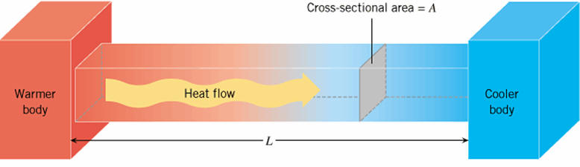
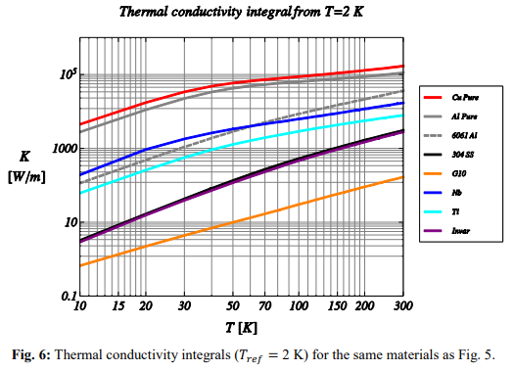
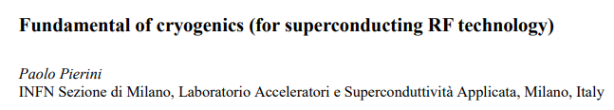
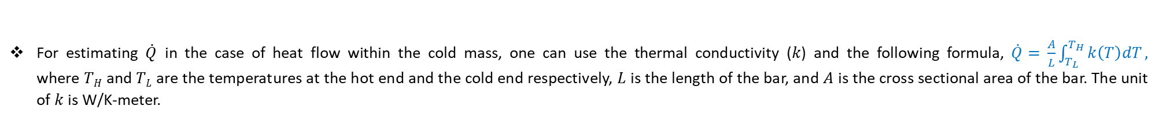
Conduction heat load duo to support structures, RF components and cabling etc.
For estimating $\dot{Q}$ in the case of heat flow within the cold mass, one can use the thermal conductivity (𝑘) and the following formula, $\dot{Q}=$ $\frac{A}{L}\int_{T_{L}}^{T_{H}}{k\left(T\right)dT},$ where $TH$ and $TL$are the temperatures at the hot end and the cold end respectively, $L$ is the length of the bar, and $A$ is the cross sectional area of the bar. The unit of $k$ is W/K-meter.
Thermal conductivity (and its integral) varies greatly with temperature and with material. Proper choice of materials and thermal intercept strategies for the conduction paths to the cold environment is therefore necessary in the design of the SCRF components.

Slide 29




Convection heat load
convection heat transfer between a surface at temperature with a bulk fluid at temperature is the Newton law of cooling
Analysis of convection exchanges are therefore important to make proper provision for the cooldown and warmup procedure
An insufficient heat transfer coefficient in the presence of high heat loads would drive the pipe surface temperatures to higher values to sustain the transfer

Slide 30


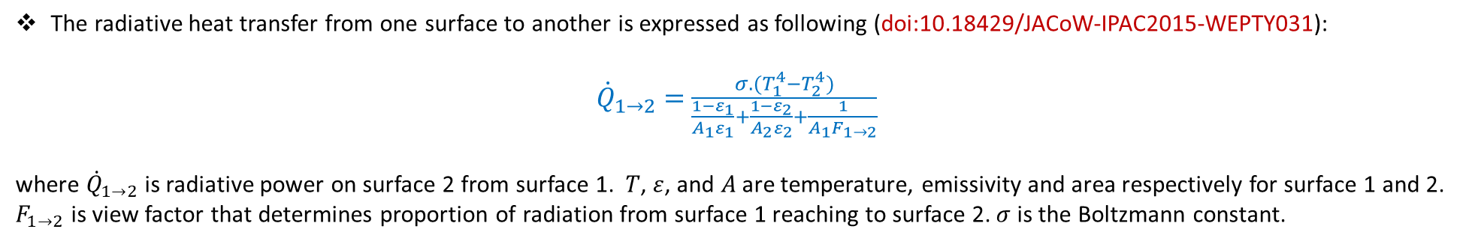
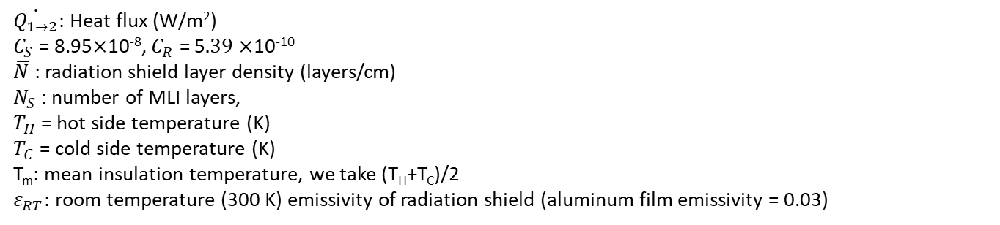
Radiation heat load
The radiative heat transfer from one surface to another is expressed as following (doi:10.18429/JACoW-IPAC2015-WEPTY031):
${\dot{Q}}_{1→2}=$ $\frac{σ.(T_{1}^{4}−T_{2}^{4})}{\frac{1−ε_{1}}{A_{1}ε_{1}}+\frac{1−ε_{2}}{A_{2}ε_{2}}+\frac{1}{A_{1}F_{1→2}}}$
where ${\dot{Q}}_{1→2}$is radiative power on surface 2 from surface 1. $T$, $ε$, and $A$ are temperature, emissivity and area respectively for surface 1 and 2. $F_{1→2}$ is view factor that determines proportion of radiation from surface 1 reaching to surface 2. $σ$ is the Boltzmann constant.
The empirical formula for calculating the heat flux through the MLI layers sufficiently verified in practice:
$\dot{ { Q}_{1→2}}=$ $\frac{C_{S}{\overline{N}}^{2.56}T_{m}}{N_{S}+1}\left(T_{H}−T_{C}\right)+\frac{C_{R}ε_{RT}}{N_{S}}\left(T_{H}^{4.67}−T_{C}^{4.67}\right)$
$\dot{Q_{1→2}}:$ Heat flux (W/m²)
$C_{S}$ = 8.95$×$10⁻⁸, $C_{R}$ = 5$.39×$10⁻¹⁰
$\overline{N}$ : radiation shield layer density (layers/cm)
$N_{S}$: number of MLI layers,
$T_{H}$= hot side temperature (K)
$T_{C}$= cold side temperature (K)
T_{m}: mean insulation temperature, we take (T_{H}+T_{C})/2
$ε_{RT}:$ room temperature (300 K) emissivity of radiation shield (aluminum film emissivity = 0.03)
Nuclear Instruments and Methods in Physics Research A 763 (2014) 701–710 703
With MLI insulation, the radiative load can be brought to the following levels:
0.5 W/m2 to 1.5 W/m2 from the room temperature environment to the intermediate shield temperatures (~40–80 K),
0.05 W/m2 to 0.1 W/m2 from the thermal shields to negligible temperatures.

Slide 31
Radiation heat load to GWVC
T_{outer vessel} = 300 K
T_{shield} = 50 K
We need to calculate the area of the 40, 4K, and 2K cold surface regions that are covered by MLI.
Radiation heat load of 1.55 W/m2 from 300 K to the shield temperature of 40 K with 30 MLI
0.1 W/m2 from the thermal shield at 40 K to 4K and 2K cold masses with 10 MLI.

Slide 32
Heat load duo to RF losses/Ohmic losses

Slide 33

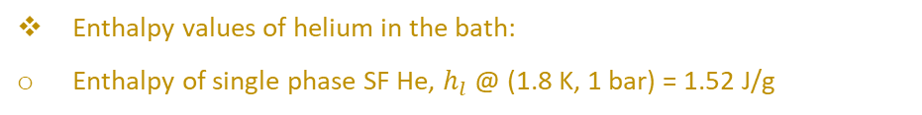


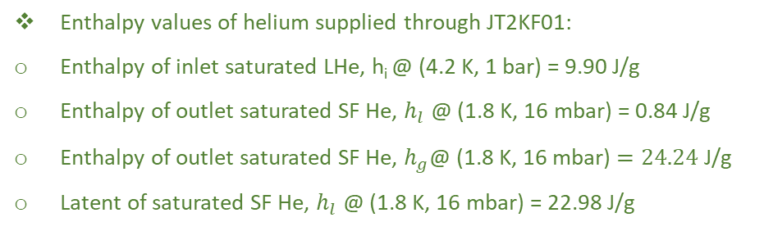
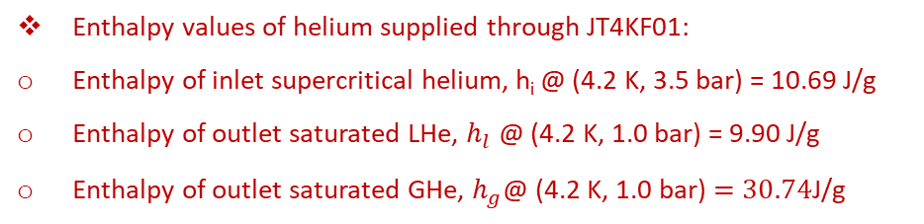
Mass flow rates required for cooling down the SRF cavity
ACPS TL3
$m_{i}$= 10 g/s, 4.5 K & 3.5 bar
${\dot{m}}_{l}$ = 9.62 g/s
${\dot{m}}_{g}$ = 0.38 g/s
JT valve: JT4KF01
LHe @ 4.2 K & 1.0 bara
SFHe @1.8 K and 16 mbar to warm compressor
Enthalpy values of helium supplied through JT4KF01:
Enthalpy of inlet supercritical helium, h_{i} @ (4.2 K, 3.5 bar) = 10.69 J/g
Enthalpy of outlet saturated LHe, $h_{l}$ @ (4.2 K, 1.0 bar) = 9.90 J/g
Enthalpy of outlet saturated GHe, $h_{g}$@ (4.2 K, 1.0 bar)$=30.74$J/g
JT valve: JT2KF01
LP CFHEX
${\dot{m}}_{l}$ of SF He = 5.89 g/s
${\dot{m}}_{g}$ of SF He = 3.72 g/s
HeII – HeII heat exchanger
Heat absorption = 5.89*22.98 = 135.5 W
Enthalpy values of helium supplied through JT2KF01:
Enthalpy of inlet saturated LHe, h_{i} @ (4.2 K, 1 bar) = 9.90 J/g
Enthalpy of outlet saturated SF He, $h_{l}$ @ (1.8 K, 16 mbar) = 0.84 J/g
Enthalpy of outlet saturated SF He, $h_{g}$@ (1.8 K, 16 mbar)$=24.24$J/g
Latent of saturated SF He, $h_{l}$ @ (1.8 K, 16 mbar) = 22.98 J/g
SF He @1.8 K and 1 bar
Enthalpy values of helium in the bath:
Enthalpy of single phase SF He, $h_{l}$ @ (1.8 K, 1 bar) = 1.52 J/g
MAGO cavity (heat load = 30 W)

Slide 34
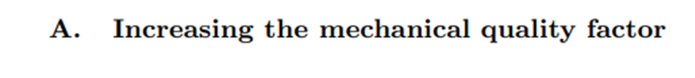


Slide 35



Slide 36



Slide 37


THE GERSEMI VERTICAL CRYOSTAT AT FREIA
arXiv:2103.05265v1

Slide 38
Cryostat in two parts
Elevating this part to a greater height can help maintain hydraulic pressure during cryostat filling.
Additionally, it can assist in reducing vibrations and minimizing noise.
But it will strongly depend on the fund of the project.

Slide 39
Specific questions related to the project
In which orientation will the cavity be mounted on the cryogenic insert?
Will the MAGO cavity be submerged in SF helium or remain in a vacuum?
What quality factor and resonance frequency would be aimed for?
How do we plan to address the issues of microphonic noise, vibration isolation, flux pinning (very slow cooldown and magnetic shield) and electronic noise?
How can we estimate all potential sources of different heat loads?
Simulation and calculation of various physical parameters for the set-up, such as stress analysis, thermal analysis, etc.
Complete understanding of the flow scheme and translation into a 3D drawing.
Preparation of specifications for the insert, cold compressors, and cryostat.
How many different applications would you like to configure for the cryostat? For instance, applications involving an applied magnetic field or filling the cavity with SF helium.

Slide 40
Thank you for your attention!!!

