Slide 1
ARES Operation Meeting
Summary of week 44 / 2023
Willi Kuropka, on behalf of the ARES crew

Slide 2
Summary of week 43
Mon. 30.10. | Tue. 31.10. | Wed. 01.11. | Thu. 02.11. | Fri. 03.11.
X-band conditioning | Public holiday | UKE shift Cell irradiation in Eppendorf tubes and chamber slides Mainly prep work for the next two days | More cell irradiation | More cell irradiation Fiber beam loss monitor test in EA section Screen image data taking for Sonjas defense
Water pressure for the X-band system (or maybe our entire section?) appears to be too low, MIN/MKK are investigating |  | Slow start due to unclear experimental conditions and modified sample holders | Interlock broken during ZZ (probably the time delay between sound and video is the problem?) Pharos synchronization failed due to piezo actuator at limit…probably chiller exchange is the culprit?
 |  | Let’s make a more detailed schedule for the experiment next time | Difficulties may need further investigation | After setup on wed. experimental protocol sailed smoothly, except for pharos sync. issue
Achievements
Difficulties
Notes

Slide 3
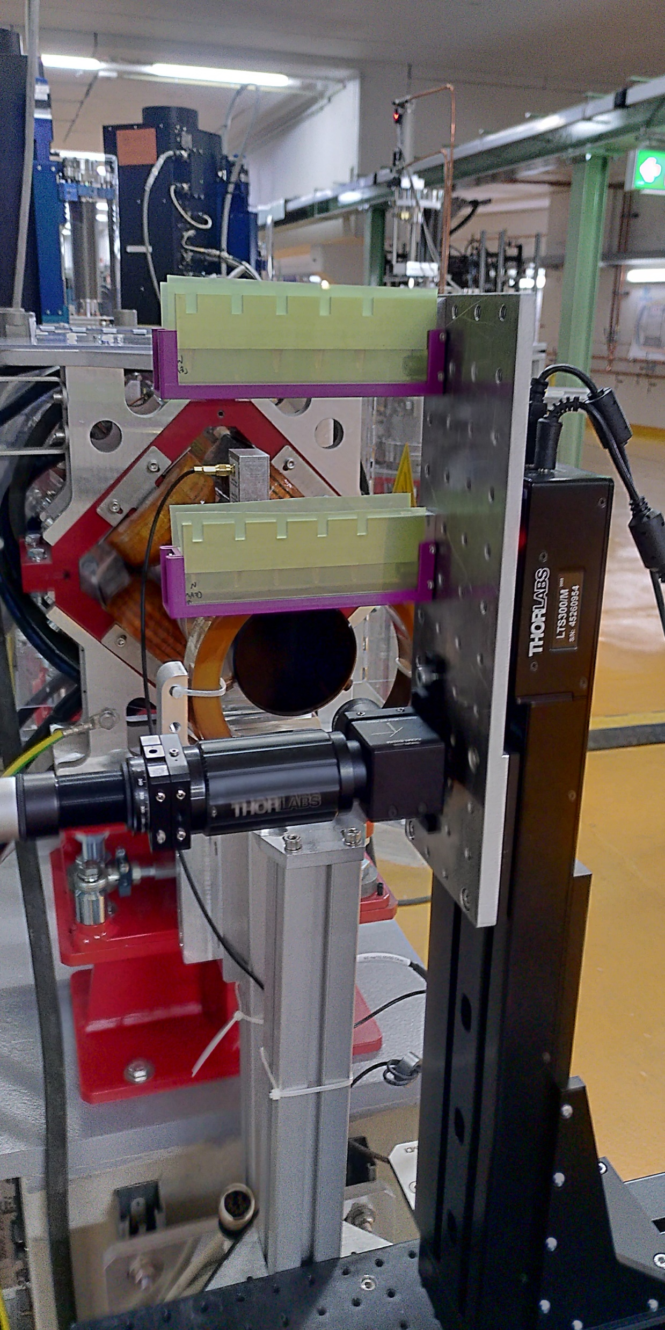
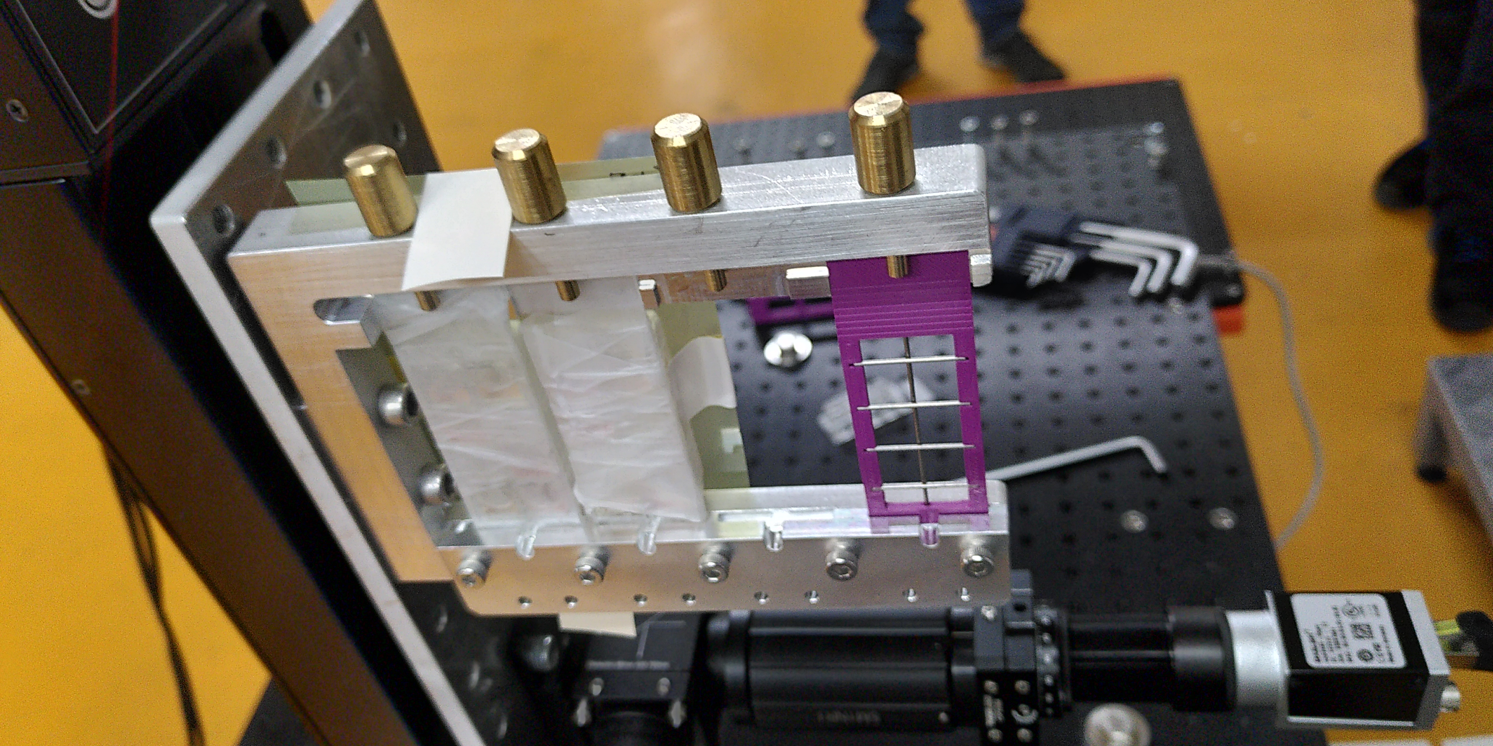
Cell irradiation

Slide 4
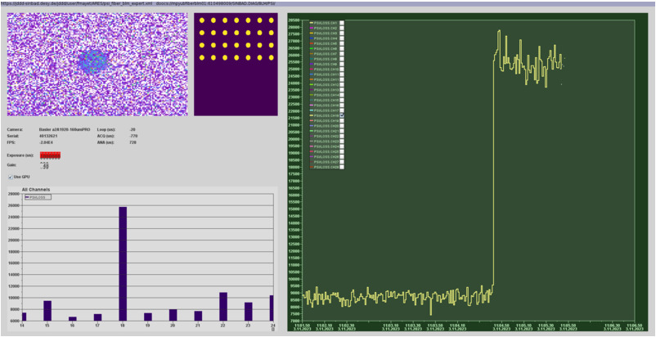
Fiber BLM test

Slide 5
Schedule and Plan for the Week
Week 45
Date | Shift Crew
06.11. | --
07.11. | Blae, Willi
08.11. | Blae, Willi
09.11. | Blae, Frank
10.11. | Blae, Frank
Mon: MIN/MKK cooling water investigation
Spacechip/ACHIP dark run
  Velocity bunching WP
  Undulator test
  (prpobably) Poalrix timing setup
PolariX Conditioning (off-beam)
If you want to learn or join the shift: please give the shift leader a call (BKR 2840 / SINBAD Box 2454)

