Slide 1
Uncertainty-awareness and energy-efficency in Deep Learning
Martin Burger
Helmholtz Imaging, FS-CI, DESY
Deep Learning Summit Hamburg, 08.12.2023

Slide 2
Deep Learning – A Math Perspective
Why Deep Learning ?
Deep learning is ubiquituos, some people even think it is AI*
Why are we using deep learning, deep neural networks ?
What are the theoretical foundations ?
*Remember the I is for intelligence

Slide 3
Deep Learning Architectures: High Dimensional Function Approximation
Universal approximation property
Famous results due to Cybenko 1989 / Hornik, Stinchcombe / White 1989:
Every continuous function can be approximated arbitrarily well with deep (even with shallow) networks*
Even better: dimension-independence
Barron 1992 / 1995 shows that functions in arbitrary dimension can be approximated with rate n^{-1/2}, where n is the number of parameters**
*The proof is actually a quite simple application of the Stone-Weierstrass Theorem **Ok, this was cheated, there was a hidden assumption that implies the admissible class depends on dimension

Slide 4
Deep Learning Architectures: High Dimensional Function Approximation
Universal approximation property
Famous results due to Cybenko 1989 / Hornik, Stinchcombe / White 1989:
Every continuous function can be approximated arbitrarily well with deep (even with shallow) networks*
Even better: dimension-independence
Barron 1992 / 1995 shows that functions in arbitrary dimension can be approximated with rate n^{-1/2}, where n is the number of parameters**
*The proof is actually a quite simple application of the Stone-Weierstrass Theorem **Ok, this was cheated, there was a hidden assumption that implies the admissible class depends on dimension

Slide 5
Deep Learning Architectures: High Dimensional Function Approximation
What nobody tells you
Universal approximation by many systems
Even dimension-independent bound generic for nonlinear approximation
So why do we really use deep neural networks ?

Slide 6
Deep Learning on GPUs
Why do we use deep neural networks ?
Because they fit to NVIDIA GPU architectures
Because Google and Facebook implemented them* and had the amount of data to
Should we be concerned ?**
*TensorFlow / Pytorch **If Google would optimize everything for diffusion equations, would we simulate waves with diffusion equations ?

Slide 7
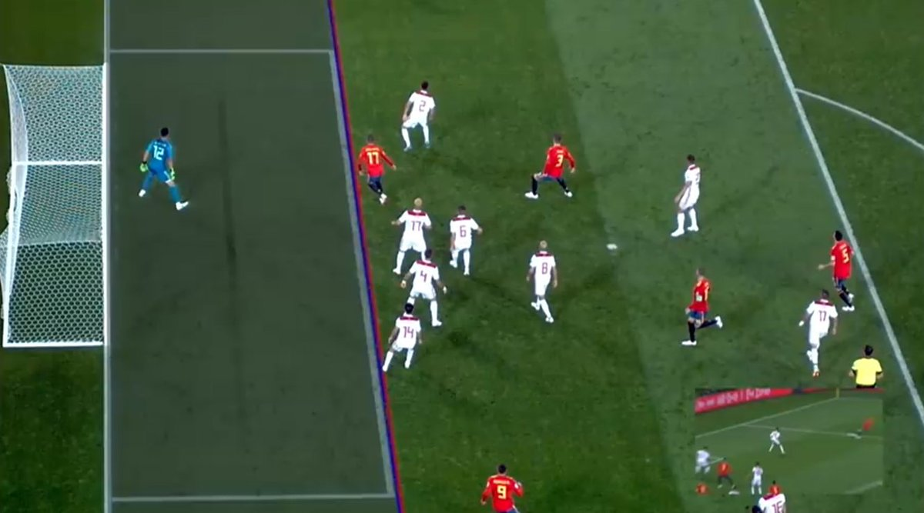
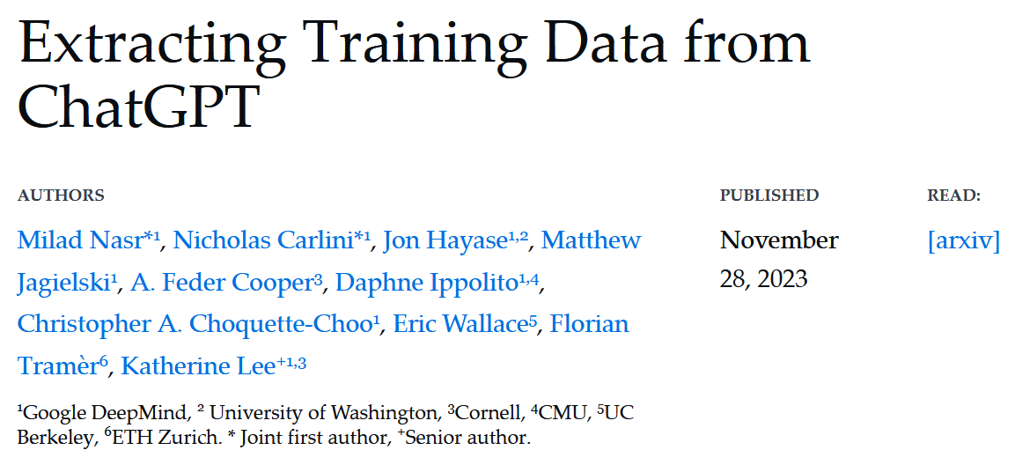
Deep Learning
What else to be concerned
Uncertainties: deep learning performs statistical computations without error bars
Deep learning can be fooled easily
Deep learning often based on brute-force computing, horrible carbon and water footprint

Slide 8
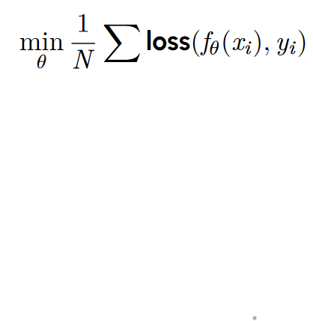
Uncertainties in Deep Learning
Supervised learning
Standard formulation: empirical risk minimization
Train parameters to obtain a network f that approximates output y given input x

Slide 9
Uncertainties in Deep Learning
Training Data Uncertainty
Standard question: generalization (from finite number of training data to full population)
Standard results: statistical estimates on generalization error / population loss
Under assumption that training data are i.i.d. sampled
Note: even exact knowledge of expected loss does not tell you much about single data point

Slide 10
Uncertainties in Deep Learning
Training Data Uncertainty
Further issues: distribution shifts
Training data not sampled from μ
Typical example: simulated data, e.g. in inverse problems Model errors, wrong noise statistics, missing ground truth data
Even if sampled from μ, not i.i.d. or not from whole population

Slide 11
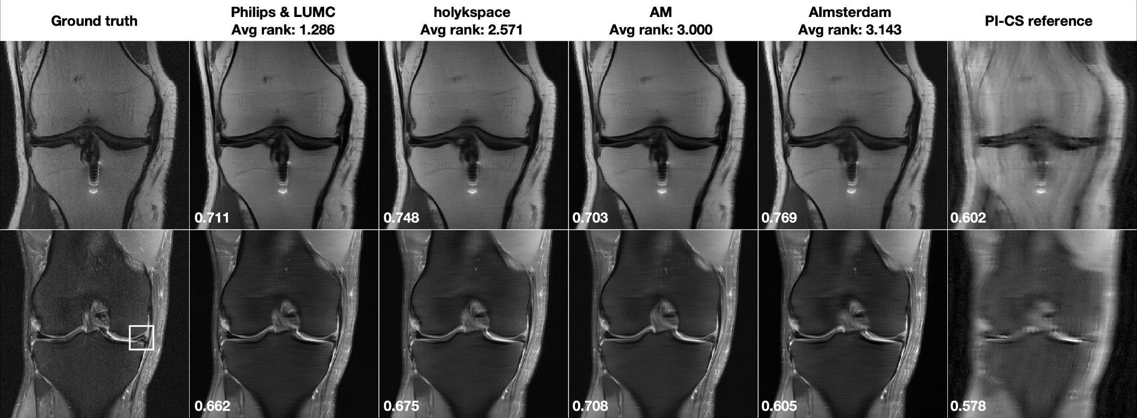
Learning in Image Reconstruction
Undersampled MRI
Undersampling in MRI is attractive since it does not
Lower complexity, since forward operator just Fourier transform, low noise
Isometry property of Fourier transform leads to low Lipschitz constant of inverse
Data pairs from existing fully sampled measurements and reconstructions
Radmanesh Radiology AI 2022 Knoll MRM 2019 / 2020 (fast MRI challenge)

Slide 12
Learning in Image Reconstruction
Undersampled MRI
Majority of results convincing
But possible hallucinations on few data sets
Not recognizable by experienced radiologists
(courtesy Florian Knoll, Erlangen)
Ground truth
Reconstruction
Muckley TMI 2021

Slide 13
Uncertainties in Deep Learning
Single Data Uncertainty
Even for a well trained model, there may be inputs x (our outputs y)
Basic smoothness assumption
may be violated

Slide 14
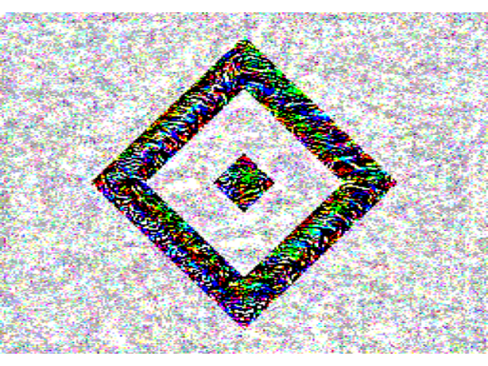
Adversarial Attacks
Even the worst can happen
+
=
HSV
δ = 0.02
St. Pauli

Slide 15
Adversarial Attacks
Carefully manipulate the input data
Ideal attack around a given point
Difficult to compute, approximate to first order
Thus, for small perturbations we can maximize

Slide 16
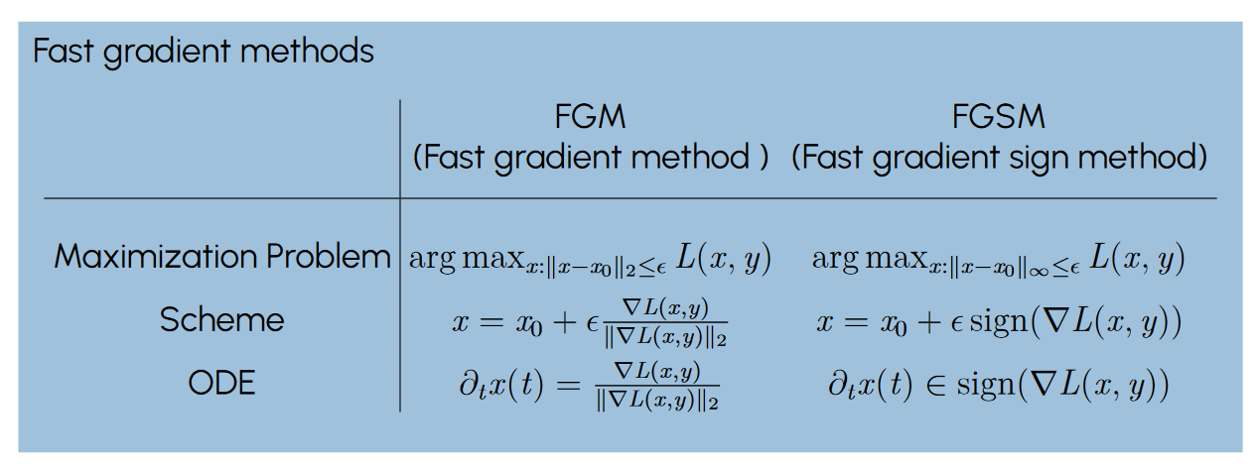
Adversarial Attacks
Different ways to compute attacks

Slide 17
Adversarial Attacks
Fooling AI by noise

Slide 18
Robust training
Adversarial defense
Incorporate possible changes already in the training loss
Alternatives: stochastic formulations, expectation over local perturbations instead of minimization

Slide 19
Robust training
Total variation regularization

Slide 20
Robust training
Distributional adversaries
Generalize from changes of inputs to full distribution
G suitable distance on distributions, e.g. Wasserstein metric
For certain Wasserstein metrics equivalence to pointwise formulation

Slide 21
Uncertainties in Deep Learning
Generative models
Diffusion models, normalizing flows, GANs …
Basic structure: map an empirical data distribution into a distribution that can be sampled (neural network parametrizes the map / transport)
Similar issues: generalization, distribution shifts
Further issue: reconstruction of training data (privacy etc)

Slide 22
Uncertainties in Deep Learning
Scientific data / questions
Importance of adversarial attacks / robustness demonstrated in many data sets
Unclear: use in scientific cases
Can measurement noise / errors act like adversaries ? Which robustness to enforce ?
Open to your Input !!

Slide 23
Efficiency in Deep Learning
Options
Avoid overuse of deep learning (remember old knowledge / marry with model-based approaches)
New methods that can deal with less training data
More efficient / sparse network structures
Novel computing architectures (quantum / neural …)

Slide 24
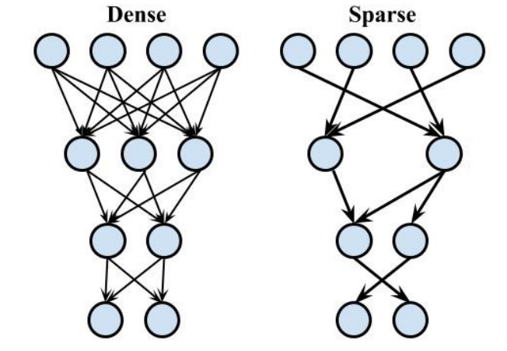
Sparse Neural Networks
Lottery ticket hypothesis*
Each dense neural network contains an equally performing sparse subnetwork
How to find sparse neural networks ?
dense-to-sparse training (pruning)
sparse-to-sparse training
sparse training with a possibly hidden dense structure
*Frankle et al 2018

Slide 25
Inverse Scale Space / Bregman Iterations
Idea from Image Reconstruction and Analysis
Use variational regularization to define scale
Perform an iteration / flow that iteratively adds finer and finer scales
Image reconstruction: scale related to geometric objects
Regularization = total variation
Interpretation as length of edge sets
Scale: boundary length vs. volume
MB-Gilboa-Osher-Xu-Yin 2005, Benning-MB 2018

Slide 26
Inverse Scale Space / Bregman Iterations
Idea from Image Reconstruction and Analysis
Use variational regularization to define scale
Perform an iteration / flow that iteratively adds finer and finer scales
Image reconstruction: scale related to geometric objects
Regularization = total variation
Interpretation as length of edge sets
Scale: boundary length vs. volume

Slide 27
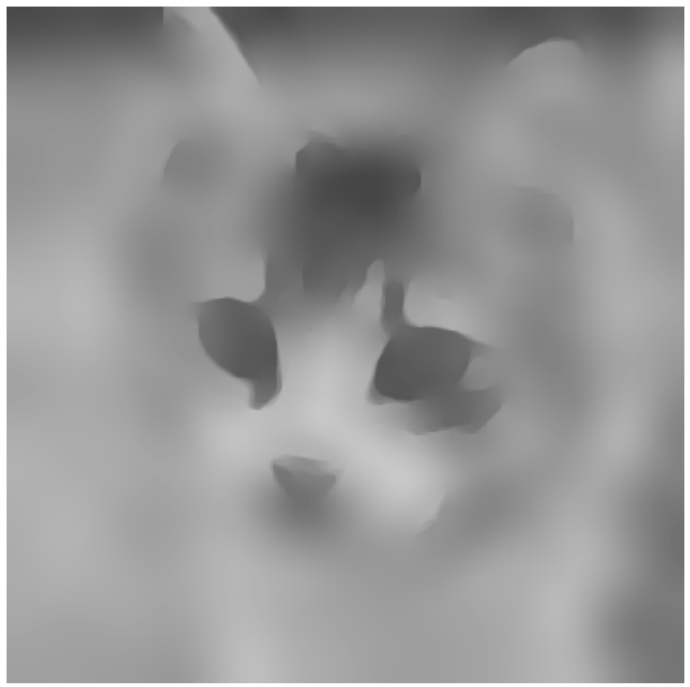
Inverse Scale Space / Bregman Iterations
Idea from Image Reconstruction and Analysis
Use variational regularization to define scale
Perform an iteration / flow that iteratively adds finer and finer scales
Image reconstruction: scale related to geometric objects
Regularization = total variation
Interpretation as length of edge sets
Scale: boundary length vs. volume

Slide 28
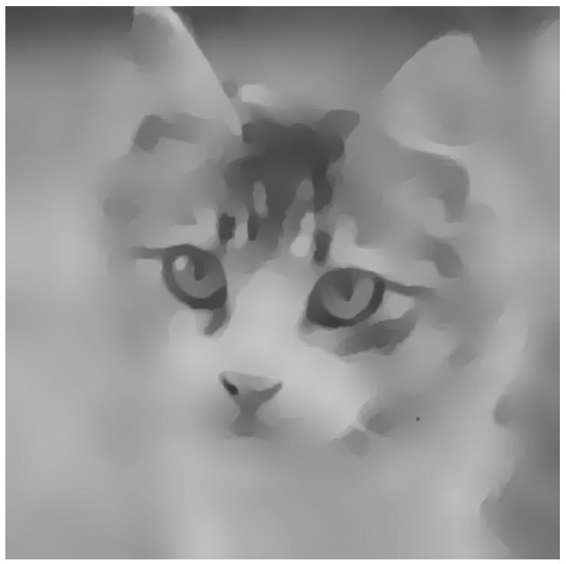
Inverse Scale Space / Bregman Iterations
Idea from Image Reconstruction and Analysis
Use variational regularization to define scale
Perform an iteration / flow that iteratively adds finer and finer scales
Image reconstruction: scale related to geometric objects
Regularization = total variation
Interpretation as length of edge sets
Scale: boundary length vs. volume

Slide 29
Inverse Scale Space / Bregman Iterations
Idea from Image Reconstruction and Analysis
Use variational regularization to define scale
Perform an iteration / flow that iteratively adds finer and finer scales
Image reconstruction: scale related to geometric objects
Regularization = total variation
Interpretation as length of edge sets
Scale: boundary length vs. volume

Slide 30
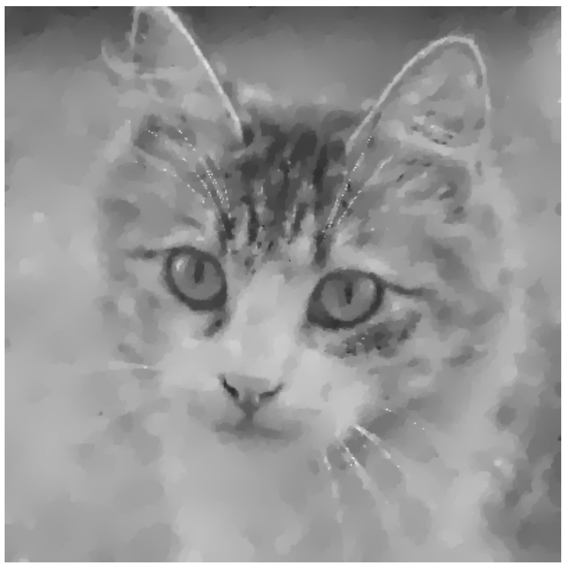
Inverse Scale Space / Bregman Iterations
Idea from Image Reconstruction and Analysis
Use variational regularization to define scale
Perform an iteration / flow that iteratively adds finer and finer scales
Image reconstruction: scale related to geometric objects
Regularization = total variation
Interpretation as length of edge sets
Scale: boundary length vs. volume

Slide 31
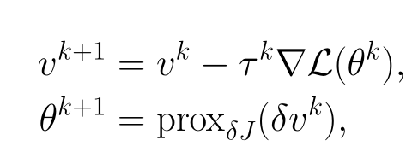
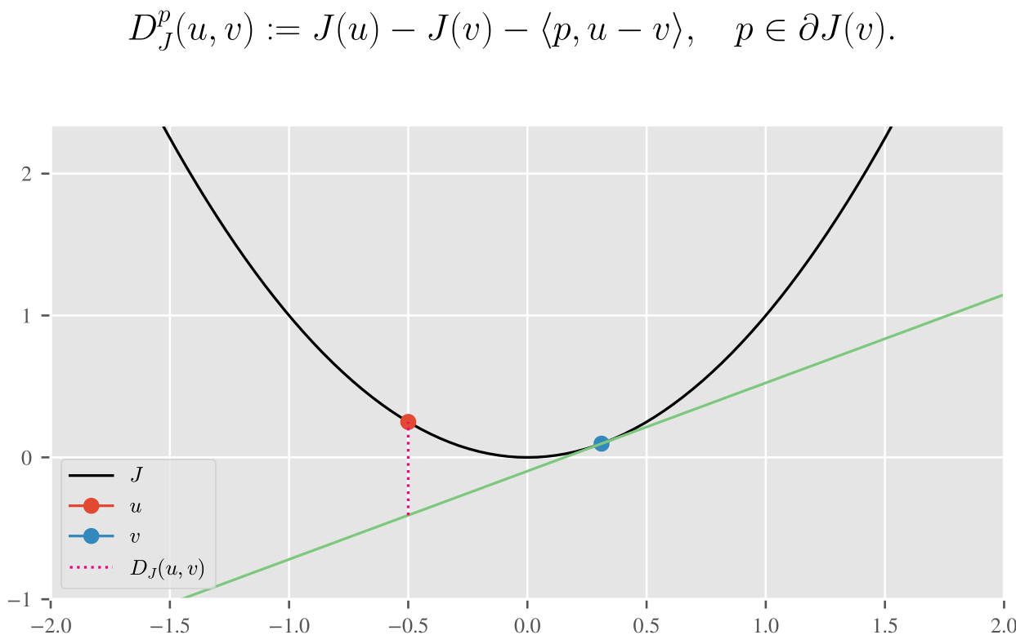
Inverse Scale Space / Bregman Iterations
Enforcing Sparsity: 1- norm
Basic iteration scheme for loss (gradient descent when Euclidean distance is replaced by Bregman distance)
Bungert-Roith-Tenbrinck-MB 2022

Slide 32
LinBreg Algorithm

Slide 33
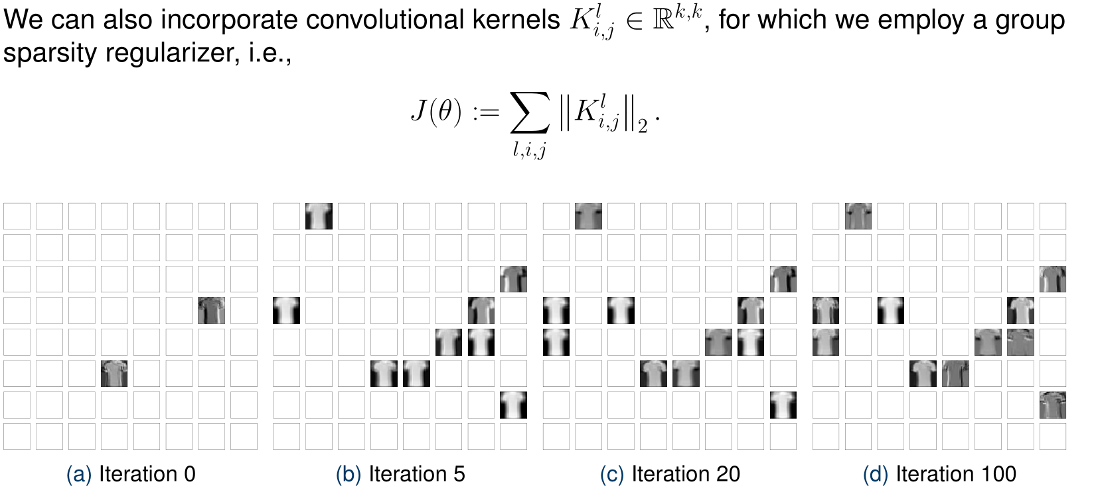
Sparse Convnet
Platzhalter Sternchentext oder Quellenangabe

Slide 34
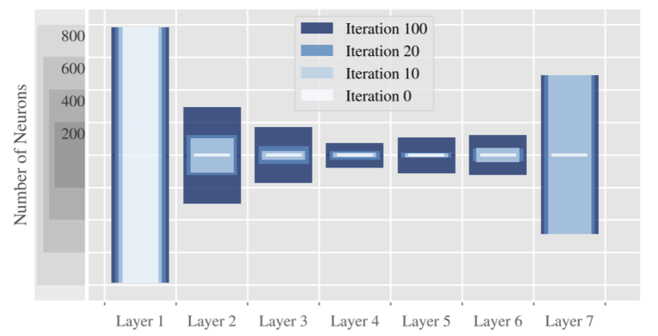
Neural Architecture search
Use group sparsity for different groups
few neurons: group weights corresponding to one neuron
few skip connections
few layers (only for residual network)

Slide 35
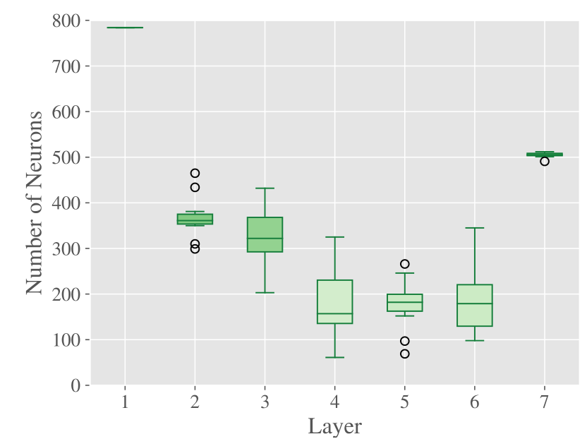
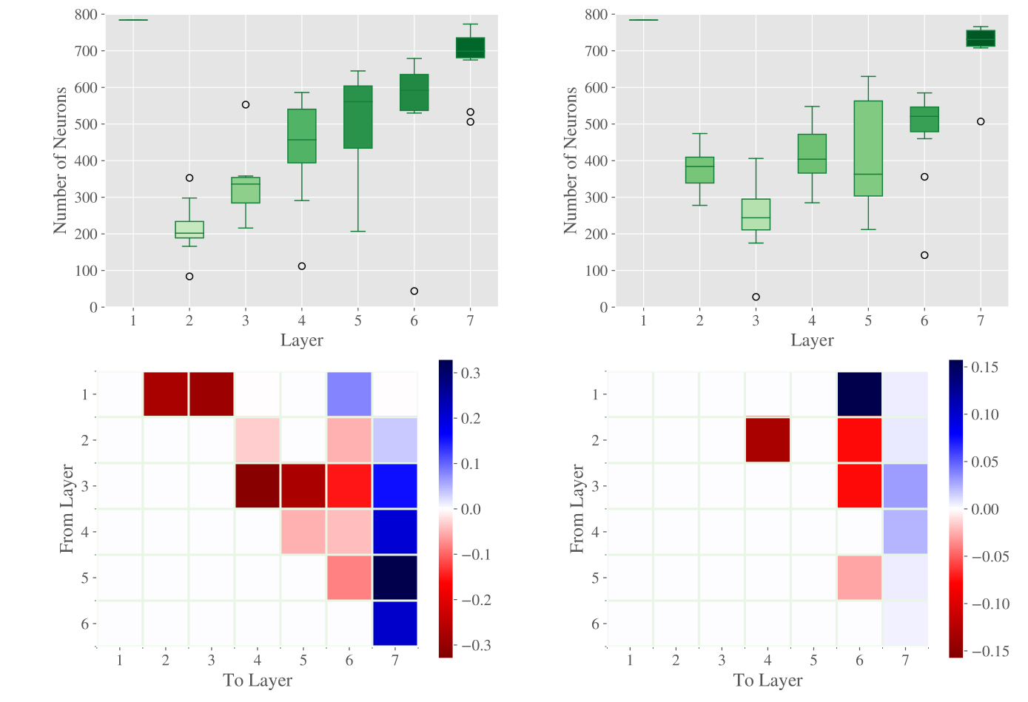
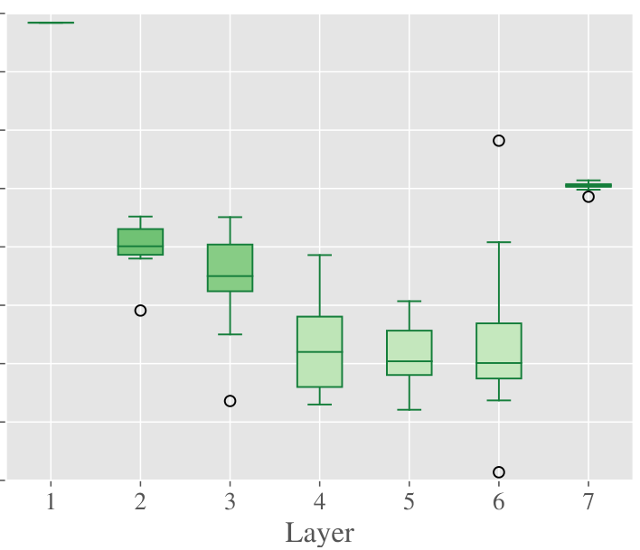
Sparsity for Different Tasks
Denoising Deblurring
Without skip With skip connections With skip connections Without skip
Platzhalter Sternchentext oder Quellenangabe

Slide 36
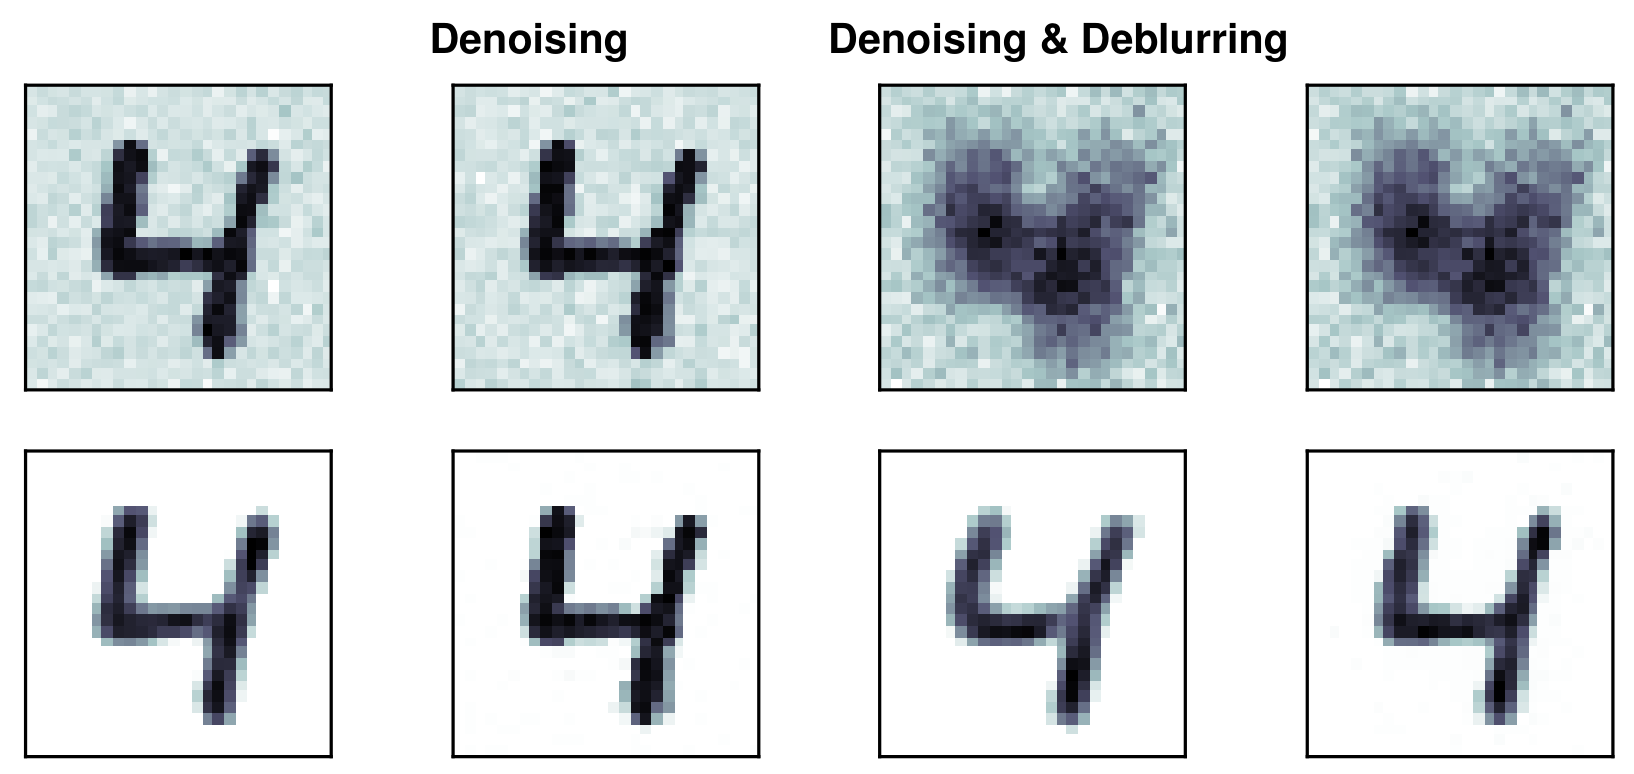
Outlook: Lossless Data Compression
Neural architecture search for image reconstruction
Train an autoencoder structure with low complexity in the middle layer (encoder)
Save encoded data and parameters of decoder network
Platzhalter Sternchentext oder Quellenangabe

Slide 37
Outlook: Robustness and Sparsity
Do we gain robustness for sparse networks ?
Do we loose robustness for sparse networks ? (larger Lipschitz constant ?)
Platzhalter Sternchentext oder Quellenangabe

