Slide 1
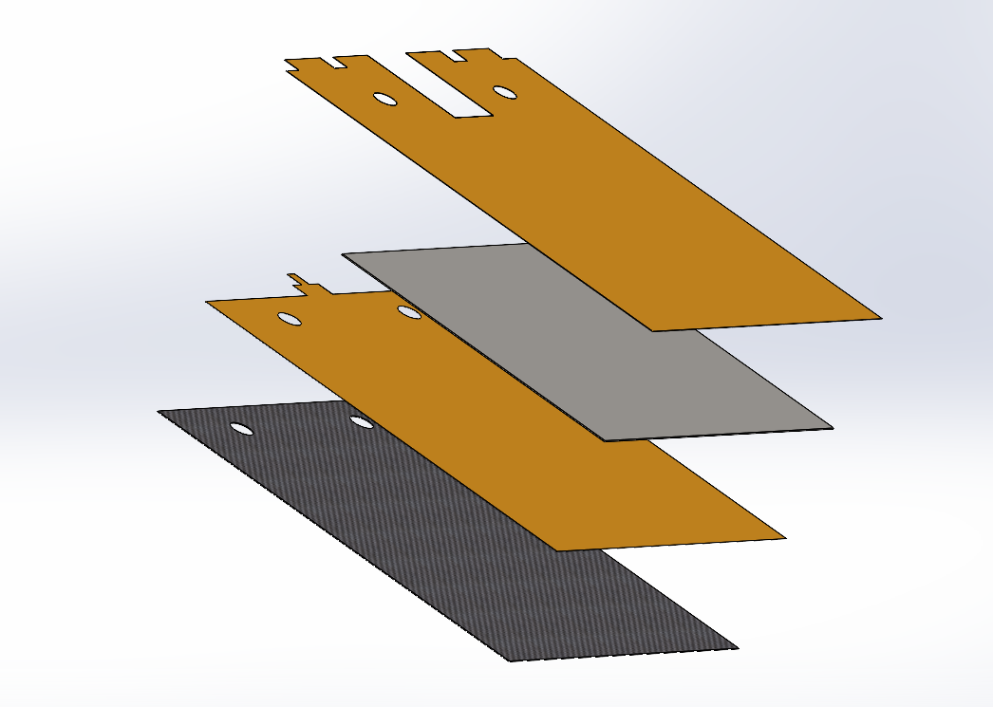
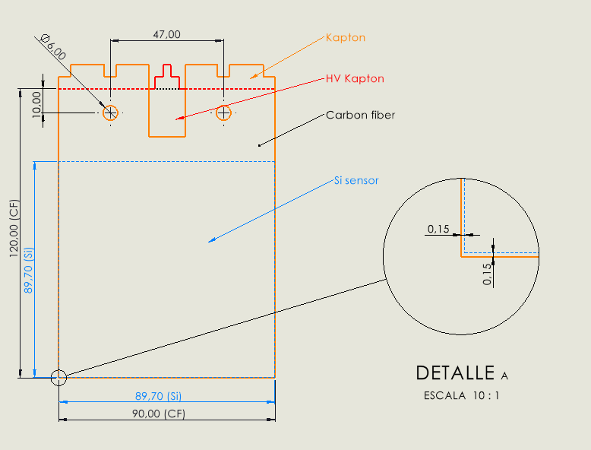
SANDWICH STRUCTURE

Slide 2
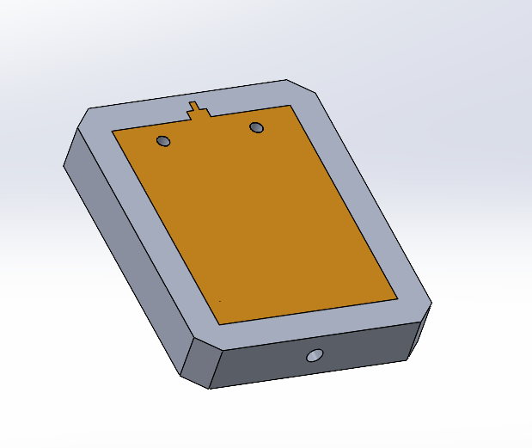
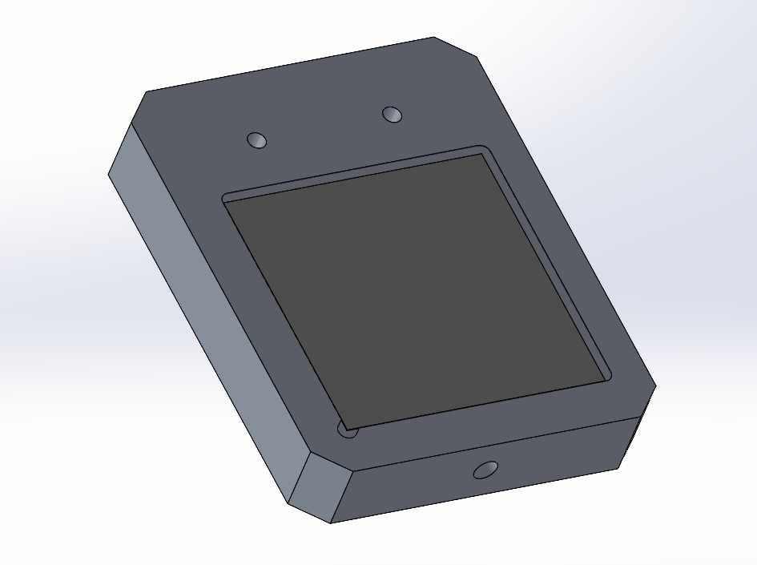
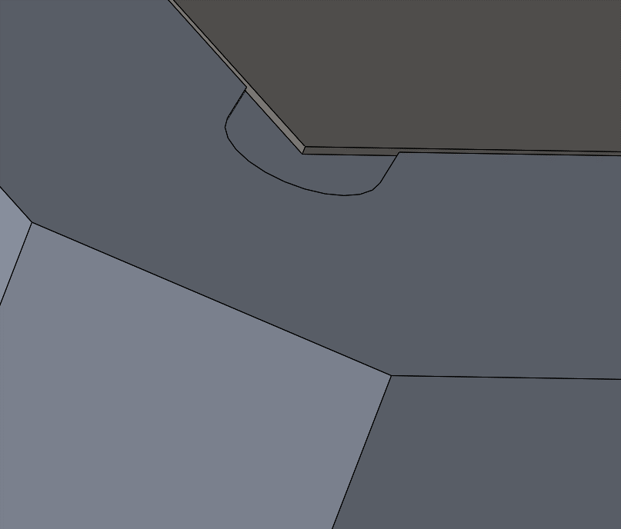
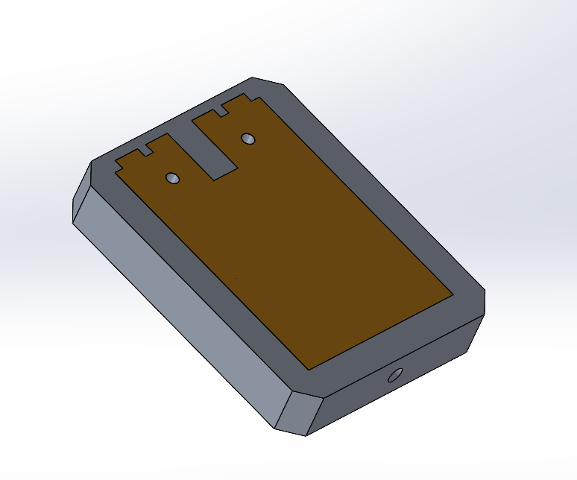
ASPIRATION PLATES
Positioning pins
Aspiration plate
Aspiration plate
HV Kapton
Si sensor
Si alignment/positioning edges
Aspiration plate
Kapton
Surface depth: 0,15mm
Si thickness: 0,32mm

Slide 3
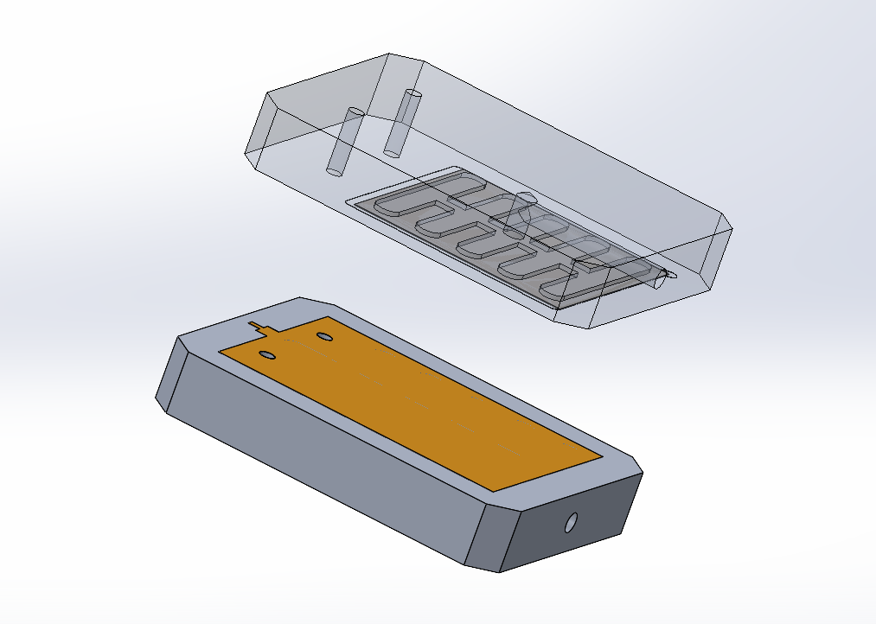
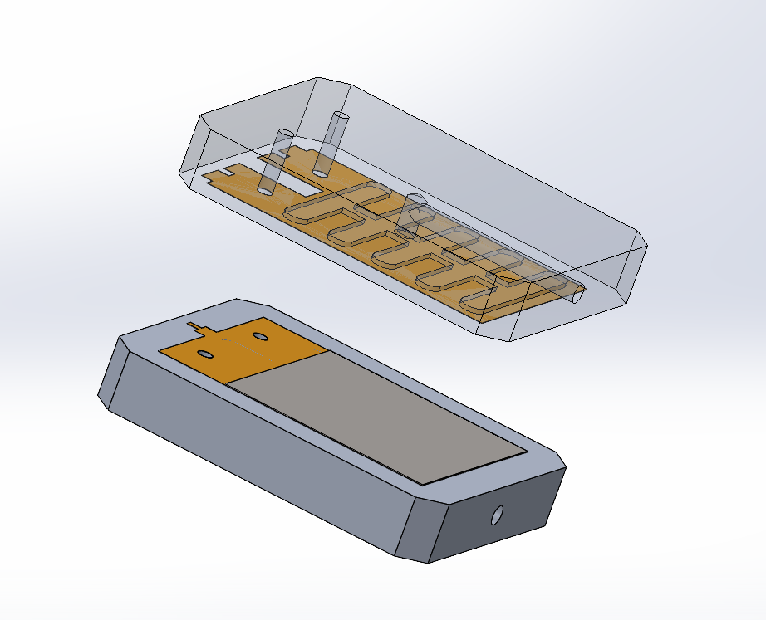
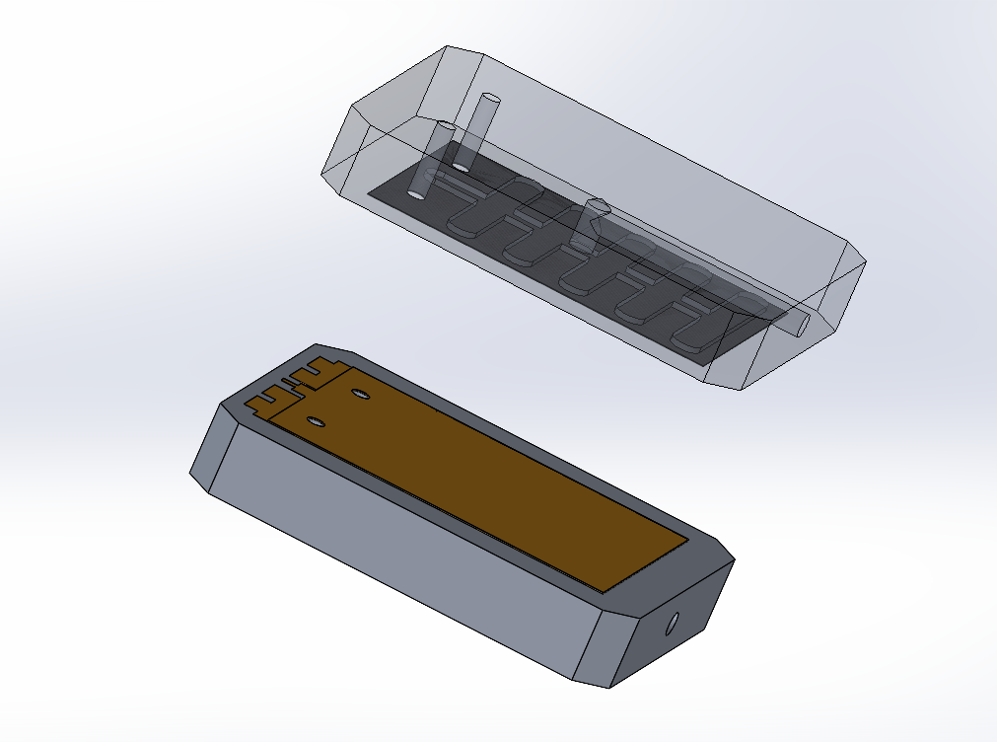
GLUEING
1st glueing step: HV kapton + Si
2nd glueing step: (HV kapton + Si)+Kapton
3rd glueing step: (HV kapton + Si+Kapton)+CF

Slide 4
Tentative to-do list:
- Decide the mechanical geometry of the kaptons
- Finalize design of jigs according to the previous point.
- Get mechanical prototypes of: CF, kaptons, jigs (wafers? I have few glass wafers… but not many)
- jig first prototypes: to be done at IFIC. Can we meet the required tolerances? To be seen. If not, we will ontact external companies.

