Slide 1
What can Rostock do for us?
and what do they need from us to succeed?
Preparation for 20.11.

Slide 2
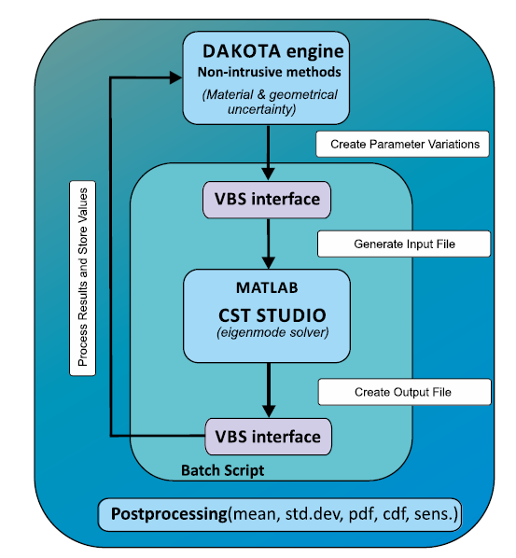
To find the „best“ cavity geometry
We tell them what values of properties or „figures of merit“ we want to achieve or optimize (maximize/minimize values)
and
give them the geometry and let them tune it to achieve a local or global optimum for all/most of properties
How do they do this: The skills they have (and we don‘t) is
  to define a smart way to create a multidimensional phase space,…
  scan it efficiently,…
  and a metric to assess the solutions to optimize the geometry

Slide 3
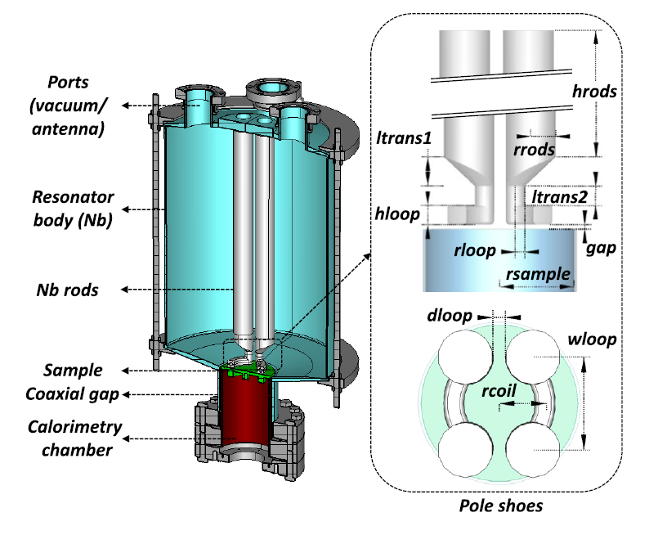
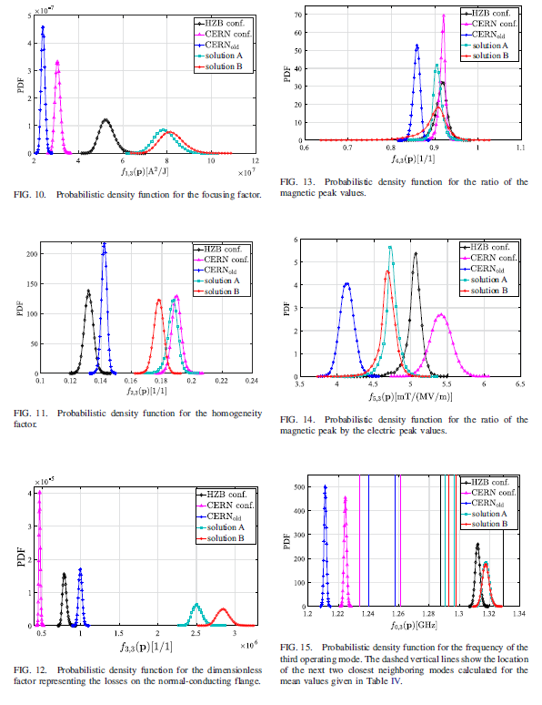
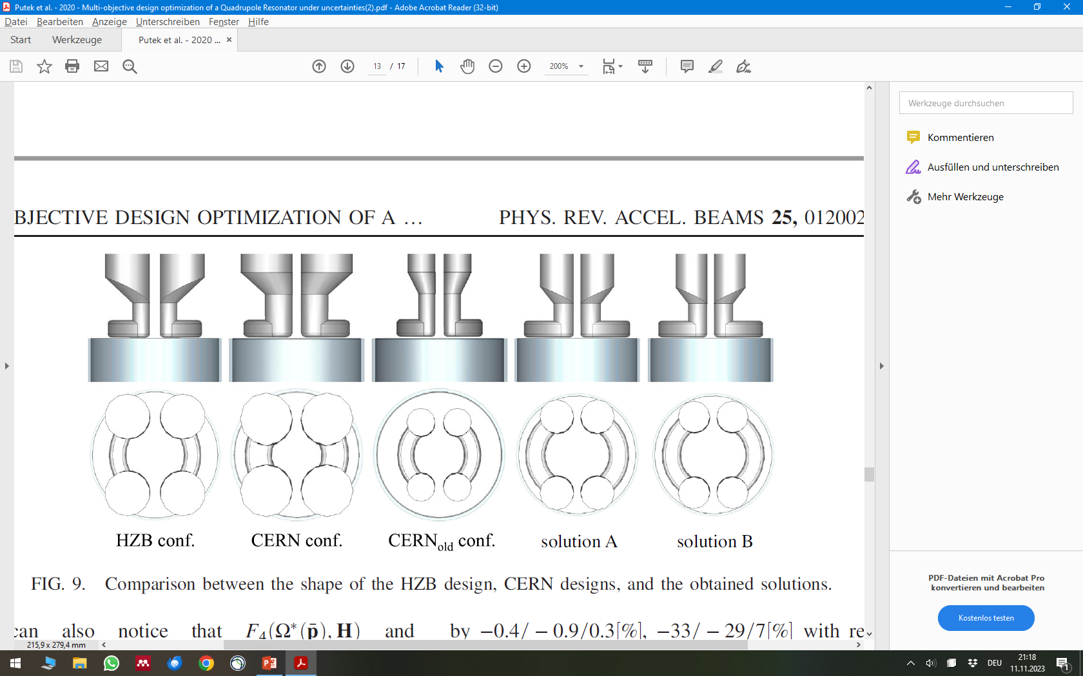
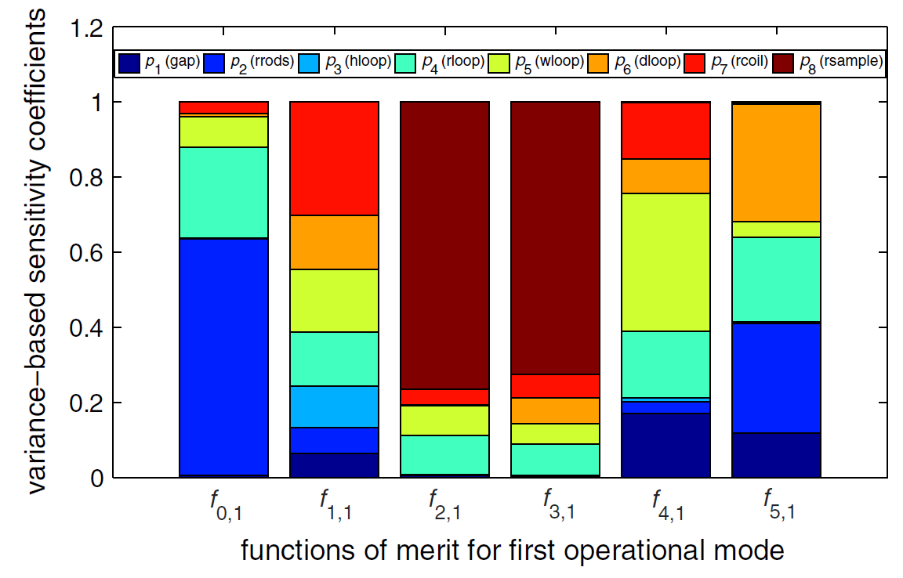
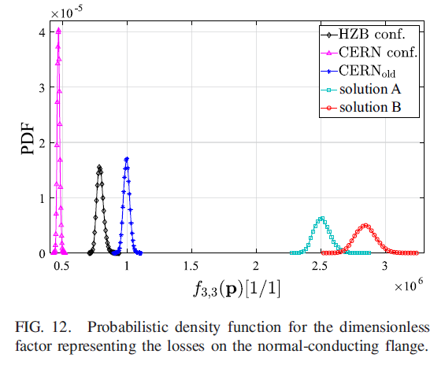
What is the outcome of their work?
Putek, Piotr, et al. "Multiobjective design optimization of a quadrupole resonator under uncertainties." Physical Review Accelerators and Beams 25.1 (2022): 012002.
Which geometrical properties matter for which target function?
What is the local or global optimum aka the best geometry?

Slide 4
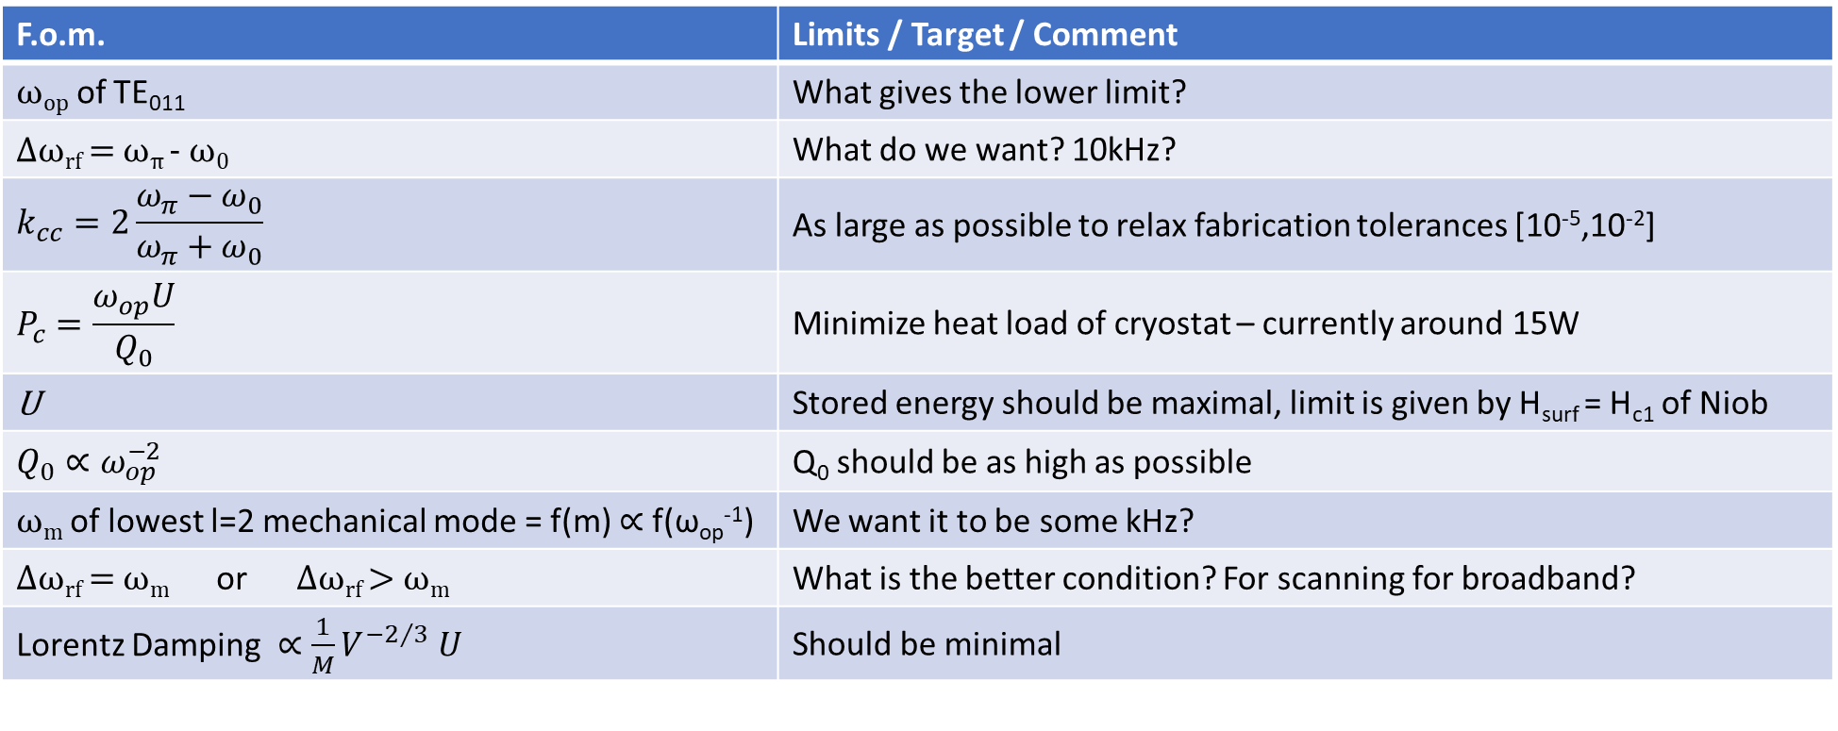
What are our figures of merit?
Incomplete or imprecise list? Target values to be discussed.
F.o.m. | Limits / Target / Comment
ω_{op} of TE₀₁₁ | What gives the lower limit?
Δω_{rf} = ω_{π} - ω₀ | What do we want? 10kHz?
$$k_{cc}=2\frac{ω_{π}−ω_{0}}{ω_{π}+ω_{0}}$$ | As large as possible to relax fabrication tolerances [10⁻⁵,10⁻²]
$$P_{c}=\frac{ω_{op}U}{Q_{0}}$$ | Minimize heat load of cryostat – currently around 15W
U | Stored energy should be maximal, limit is given by H_{surf} = H_{c1} of Niob
$$Q_{0}∝ω_{op}^{−2}$$ | Q₀ should be as high as possible
ω_{m} of lowest l=2 mechanical mode = f(m) $∝$ f(ω_{op}⁻¹) | We want it to be some kHz?
Δω_{rf} = ω_{m} or Δω_{rf} > ω_{m} | What is the better condition? For scanning for broadband?
Lorentz Damping $∝{\frac{1}{M}V}^{−2/3} U$ | Should be minimal
Everything points to a lower $ω$_{op} – what are mechanisms giving a limit on that?
Mechanical Resonances? Minimal distance to $ω$_{GW}? Mass? Cryostat size? Practical Reasons?

