Slide 1
Discussion on Suspension System
O. Gerberding
K. Peters
M. Wenskat
10.11.2023

Slide 2
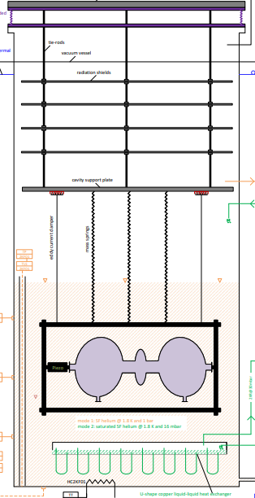





Physics to be considered…
We have a lot of advantages:
Our system would have a resonance around 1 Hz
We don‘t care about a relative alignment
Our intended resonance is in the kHz range, so a strong damping expected
Things to discuss:
We probably want two pendulums beneath the support plate to get a 1/f⁴ or 1/f² suppression
Alignment of wires can be optimized to minimize excitation of modes
Mechanical resonance of a pendulum
A
$$Q≈{10}^{6}$$
$$\frac{1}{f^{2}}$$
$$∆ω= \frac{1}{2}ωQ$$
$$\frac{1}{f}$$
$$f_{0}= \frac{1}{2π}\sqrt{\frac{g}{l}}$$
f

Slide 3
To be discussed
The principle layout:
Blattfedern for vertical damping
Connections (Vacuum, RF) as soft as possible or in spiral to act as spring (otherwise mechanical shortcut). But if mass is high, those connections do not matter that much.
1 or 2 levels for pendulum
High mass of cavity/box is ok, second mass needs to be similar
Lenght of pendulum should be similar for both levels

Slide 4
Homework
What is the mechanical damping of superfluid helium?
Estimate required attenuation or max amplitude to be below thermal noise (or amplifier noise)
Spectra for a start-discussion
Groundmotion in AMTF
Vibration on top of insert (low and high frequency range)
Groundmotion in HERA Nord (Cryoplattform) → ask ALPS

