Slide 1
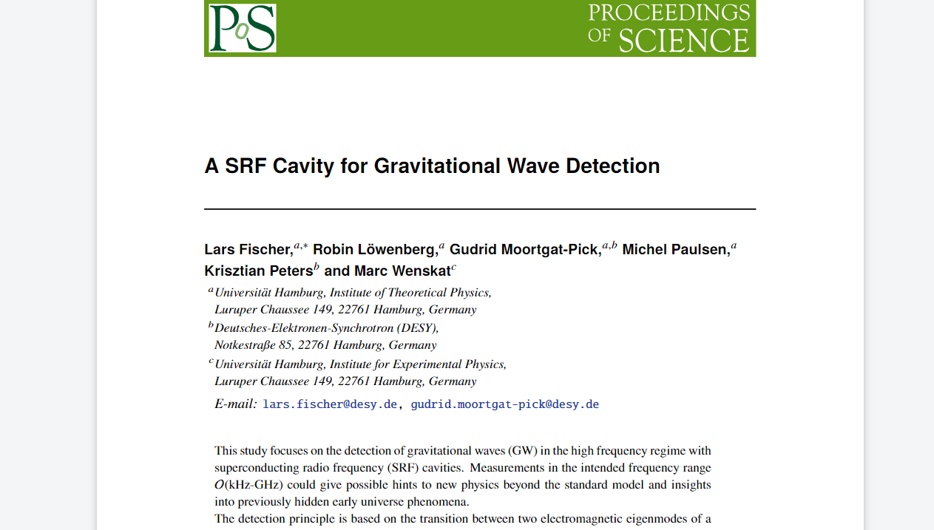
Finished EPS proceeding

Slide 2
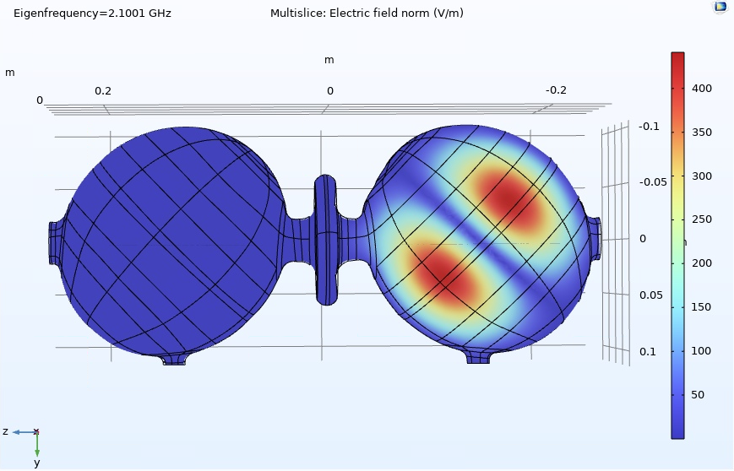
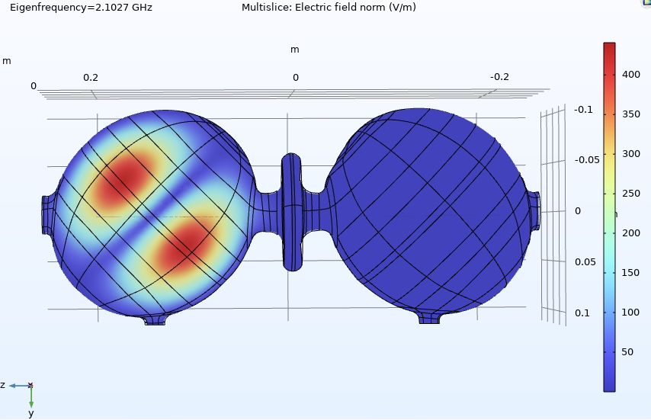
Eigenfrequency of the Scanned Cavity
For normal conducting copper
For perfect electric conductor
W_0 = 2.100 053 648 GHz
W_0 = 2.100 068 410 GHz
Q_0 = 71 150
W_pi = 2.102 747 453 GHz
W_pi = 2.102 762 239 GHz
Q_pi = 71 102
Mesh: MaxEl 0.015m, MinEl: 0.001m, MaxElgrow: 5, Curvf: 1, ResNRs: 0.1

Slide 3
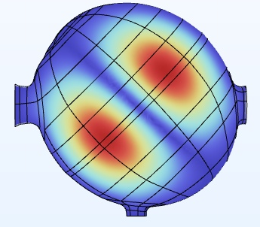
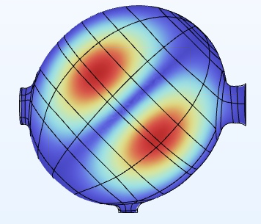
Single Cell frequency
Dented Cell (DC)
W_DC = 2.100 108 389 GHz
Undented Cell (UDC)
w_UDC = 2.102 800 022 GHz

Slide 4
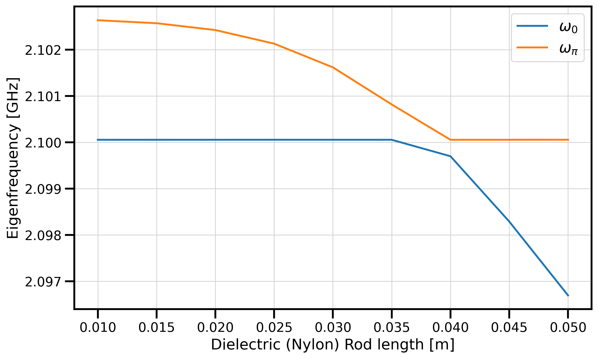
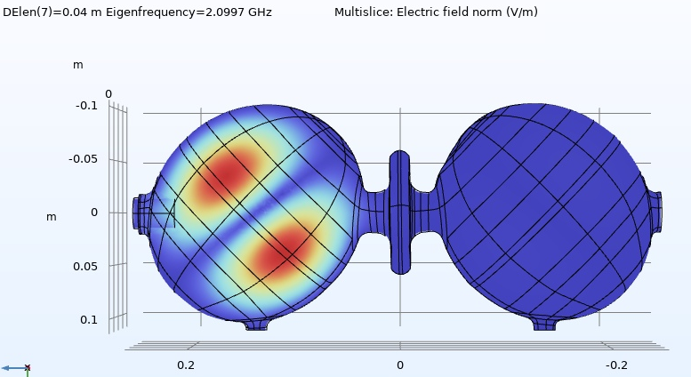
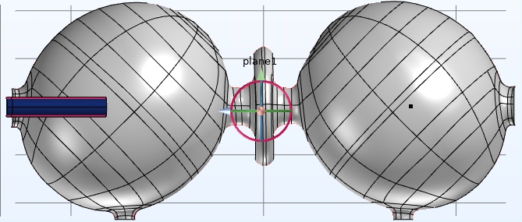
Dielectric Rod in UDC
Eigenfrequency of the pi-mode is shifted as expected
When pi and 0 mode are close in value the 0-mode falls off
UDC
DC

Slide 5
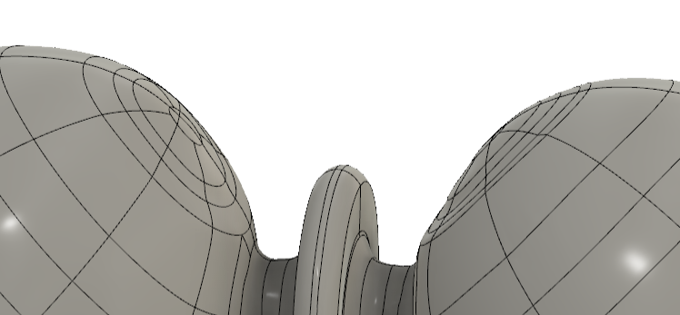
Both Cells dented (Eigenfrequency)
PEC: w_0 = 2.100 070 155 GHz w_pi = 2.102 971 508 GHz dw = 2.9 MHz
NC copper: w_0 = 2.100 055 396 GHz w_pi = 2.102 956 719 GHz dw = 2.9 MHz
Maybe the dent is not the problem but the different surface thicknesses, the TC or the short flanges are?

