Slide 1




Dielectric laser accelerators for electron compression and quantum sensing
Zhexin Zhao, PhD
Postdoctoral Researcher at FAU Erlangen-Nürnberg
zhexin.zhao@fau.de
March 19, 2024

Slide 2

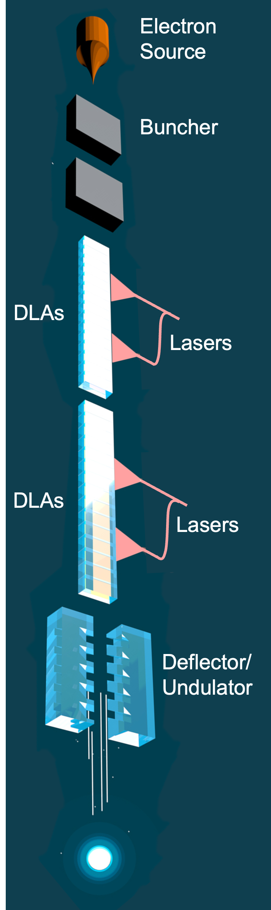
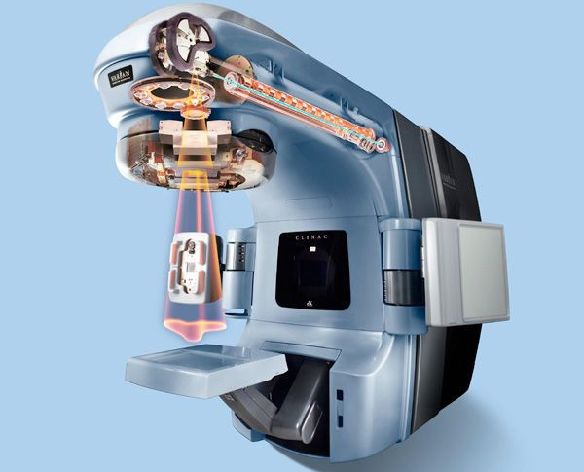
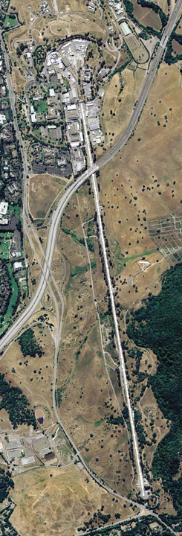


Introduction: On-chip particle accelerators
Conventional accelerators
Dielectric Laser Accelerators (DLAs)
SLAC
Table-top
(On-chip)
2-mile long
Miniturization
news.fnal.gov/2022/05/
Varian medical systems
Chlouba, T., et al. "Coherent nanophotonic electron accelerator." Nature 622.7983 (2023): 476-480.
m.indiamart.com
https://www6.slac.stanford.edu/about/contact-slac
Notes:
Particle accelerators: Science. 2-mile linac, particle physics. Coherent X-ray; Medical Equipments, Industrial processing. Useful but bulky.
If miniaturized, it will be much accessible and enable new applications. Therefore, scientists study dielectric laser accelerators to build a particle accelerator on a chip. Since the main acceleration stage is dielectric structure, powered by laser, DLA. Picture: silicon chip.
are important for science. Here is a picture of the 2-mile long linear accelerator at stanford linear accelerator center. It has been the driver of fundamental physical discovery for decades. And it powered the free-electron laser to generate the brightest coherent x-ray radiation. Accelerators are also widely used in radiotherapy and industrial processing. However, accelerators are big. Here is a picture of the magnets and the radio frequency cavity for the control and acceleration of electrons. With laser technology and integrated photonics, researchers studied how to build a particle accelerator on a chip.
Conventional accelerators and applications
Useful but bulky

Slide 3
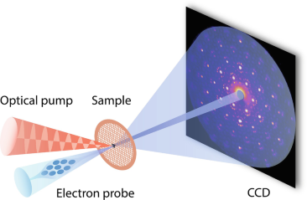
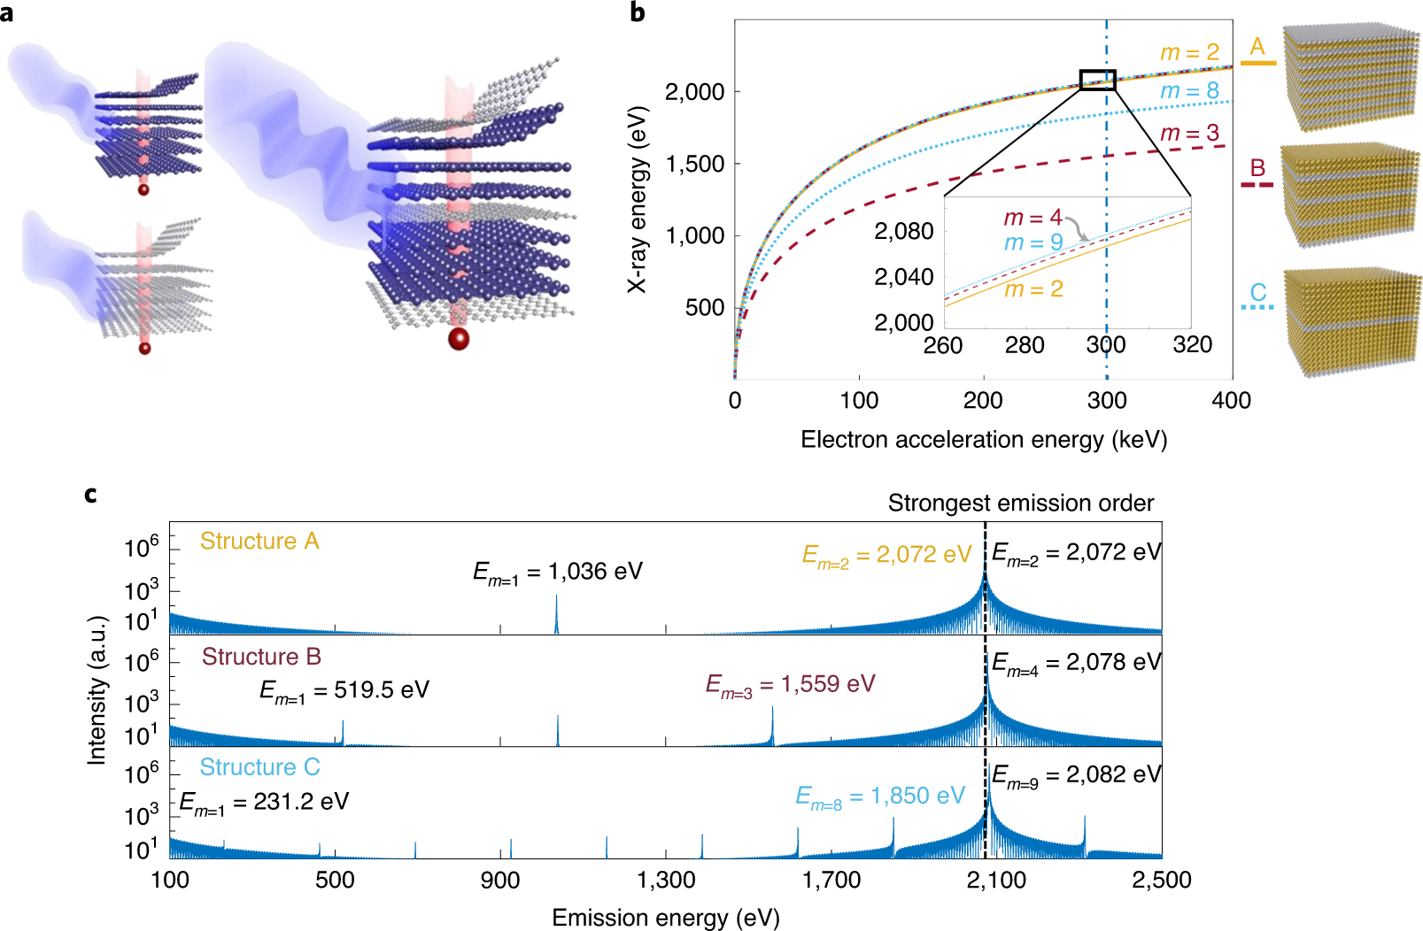
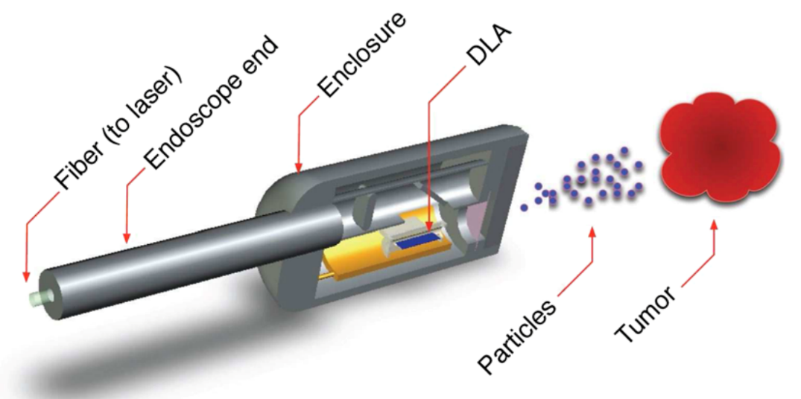
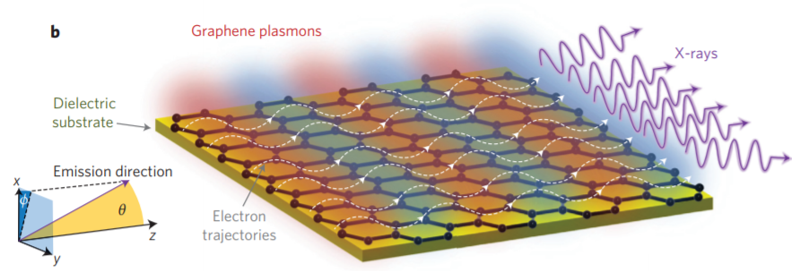

Potential applications of DLAs
Free-electron (X-ray) light sources
Ultrafast electron diffraction and microscopy
X-rays
van der Waals materials
Zong, A. (2021). Ultrafast Electron Diffraction. Springer, Cham.
$$e$$
Medical devices
Shentcis, Michael, et al." Nature Photonics 14.11 (2020): 686-692.
Wong, Liang Jie, et al. Nature Photonics 10.1 (2016): 46.
England, et al. Reviews of Modern Physics 86.4 (2014): 1337.
Notes:
DLAs can open up many applications. The accelerated free electrons can generate tunable radiation, including x-ray.
References: Nilsson, Daniel. "Zone plates for hard x-ray free-electron lasers." PhD diss., KTH Royal Institute of Technology, 2013.
Zong, A. (2021). Ultrafast Electron Diffraction. In: Emergent States in Photoinduced Charge-Density-Wave Transitions. Springer Theses. Springer, Cham. https://doi.org/10.1007/978-3-030-81751-0_3

Slide 4


Outline
Electron compression
$$ω_{1} ω_{2}$$
Electron pulse
Optical resonator, e.g., DLA
Quantum sensing
$$e$$

Slide 5
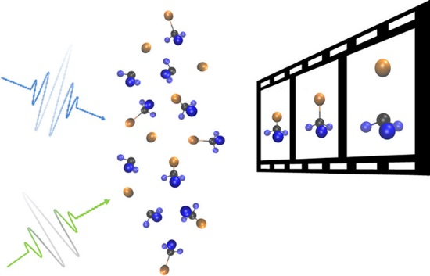
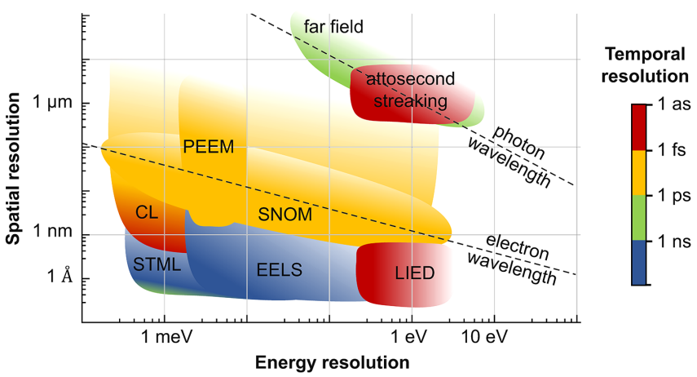
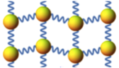
Electron microscopy
Molecular dynamics
High spatial resolution
High temporal resolution
Zhang, Ming, et al. The Journal of Physical Chemistry Letters 13.7 (2022): 1668-1680.
Lattice dynamics
Zhou, Fei, et al. Physical Review B 100.18 (2019): 184308.
Garcia de Abajo, F. Javier, and Valerio Di Giulio. "Optical excitations with electron beams: Challenges and opportunities." ACS photonics 8.4 (2021): 945-974.

Slide 6
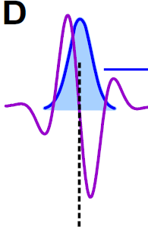
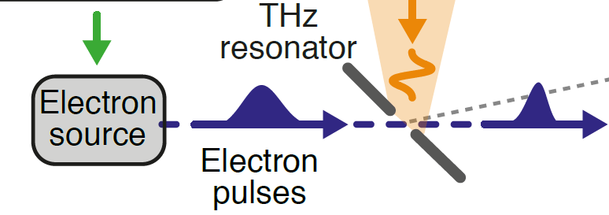
Electron pulse compression
Objective: To achieve high temporal resolution in electron microscopy
To measure fs dynamics requires fs probes.
THz electron compressor:
☺ Electron pulse compression: ps → fs.
☹ THz generation efficiency is typically low.
Electron pulse
THz energy modulation
Science 352.6284 (2016): 429-433.

Slide 7
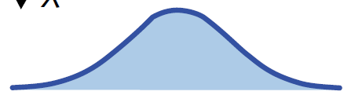
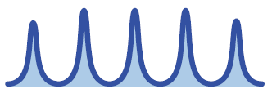
Electron pulse compression
Optical modulation can generate attosecond electron pulse trains
Electron pulse
Electron source
Electron pulses
Attosecond electron pulse trains
Optical energy modulation

Slide 8
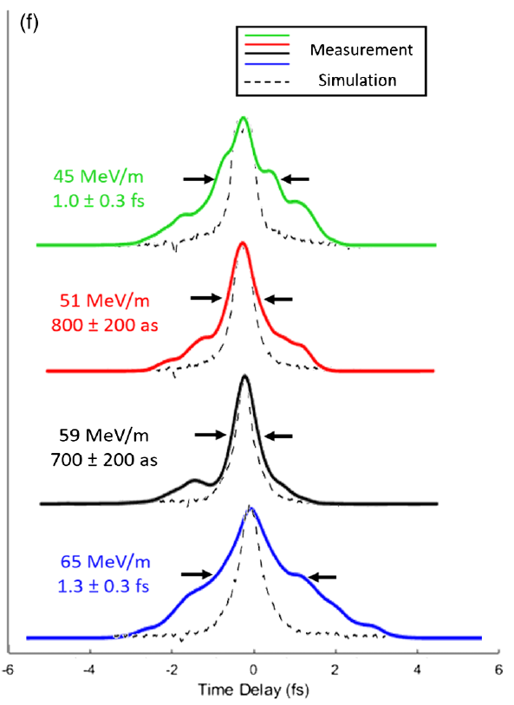
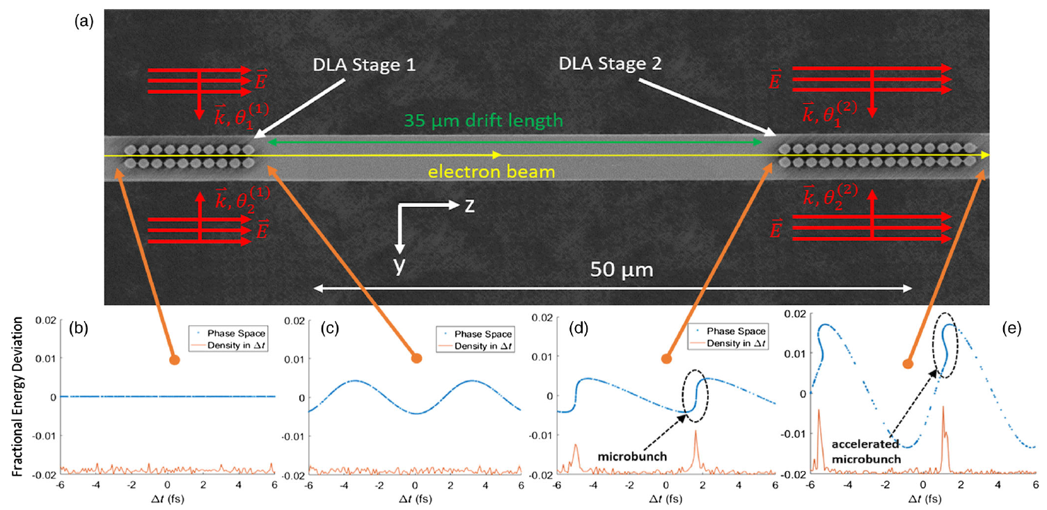
Attosecond electron pulse trains with optical modulation
Black, Dylan S., Uwe Niedermayer, Yu Miao, Zhexin Zhao, Olav Solgaard, Robert L. Byer, and Kenneth J. Leedle. Physical review letters 123, no. 26 (2019): 264802.

Slide 9
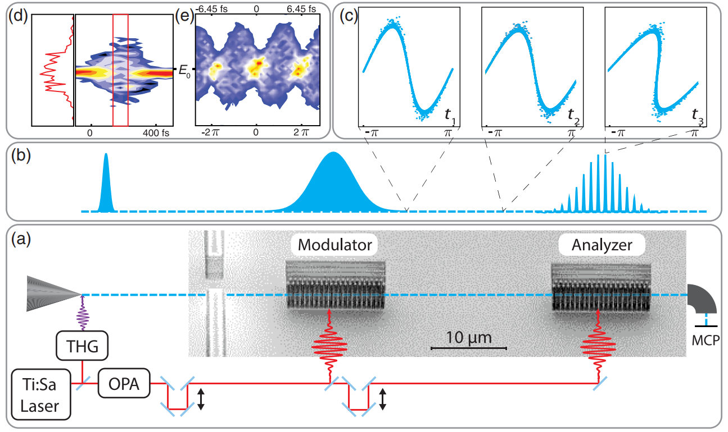
Attosecond electron pulse trains with optical modulation
Schönenberger, Norbert, Anna Mittelbach, Peyman Yousefi, Joshua McNeur, Uwe Niedermayer, and Peter Hommelhoff. Physical review letters 123, no. 26 (2019): 264803.
Notes:
Pay attension of the transverse dim of the electron.
The beam may diverges after the first interaction stage!

Slide 10



Electron pulse compression with optical beat note
How to use optical modulation to compress the whole (sub-relativistic) electron pulse from ps to fs?
$$ω_{1} ω_{2}$$
Electron pulse
Optical resonator, e.g., DLA
Electron pulse
$$ΔE$$
Optical modulation
$$τ$$
Zhao, Zhexin, Kenneth J. Leedle, Dylan S. Black, Olav Solgaard, Robert L. Byer, and Shanhui Fan. "Electron pulse compression with optical beat note." Physical Review Letters 127, no. 16 (2021): 164802.

Slide 11





Working principle
$$ω_{1}, { ω}_{2}$$
Electron pulse
Drift length
$$1$$
$$0.1$$
$$ρ (A.U.)$$
Optical beat node
$$0.01$$
Zhao, Zhexin, Kenneth J. Leedle, Dylan S. Black, Olav Solgaard, Robert L. Byer, and Shanhui Fan. "Electron pulse compression with optical beat note." Physical Review Letters 127, no. 16 (2021): 164802.

Slide 12




Improvement with high harmonics
Challenge: Only a small portion of the electrons can be captured in the central density peak after compression.
With high harmonics, larger portion of the total energy modulation $ΔE\left(τ\right)$ is aligned with a linear slow-varying energy modulation.
$$ω_{1}, { ω}_{2}, 2ω_{1}, 2ω_{2}, …, Nω_{1}, Nω_{2}$$
Electron pulse
Enlarged view near $τ=0$
$$N=4$$

Slide 13
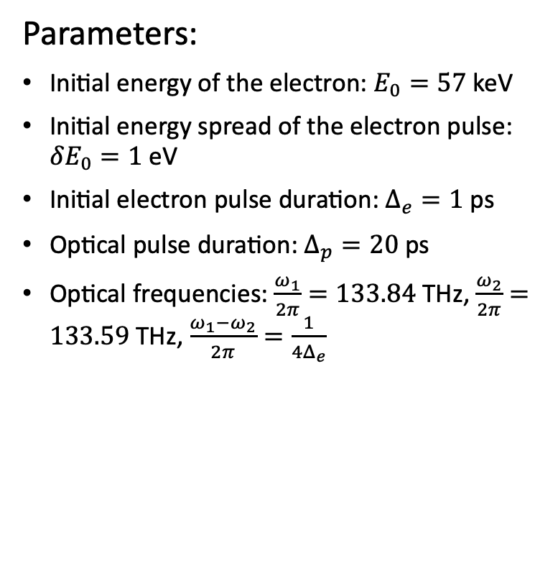
Numerical compression results
Parameters:
Initial energy of the electron: $E_{0}=57$ keV
Initial energy spread of the electron pulse: $δE_{0}=1$ eV
Initial electron pulse duration: $Δ_{e}=1$ps
Optical pulse duration: $Δ_{p}=20$ps
Optical frequencies: $\frac{ω_{1}}{2π}=133.84$ THz, $\frac{ω_{2}}{2π}=133.59$ THz, $\frac{ω_{1}−ω_{2}}{2π}=\frac{1}{4Δ_{e}}$
N (# of harmonics) | FWHM | Peak ratio (% captured within FWHM)
1 | 2.3 fs | 3%
4 | 2.9 fs | 21%

Slide 14
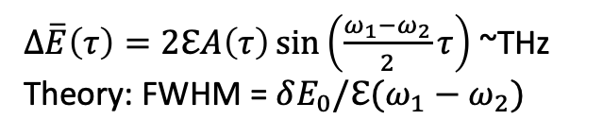
Peak ratio
Compressed pulse duration
FWHM decreases with increasing modulation amplitude.
With more harmonics, the FWHM remains almost unchanged.
With more harmonics, the peak ratio increases significantly.
$Δ\overline{E}\left(τ\right)=2ℇA\left(τ\right)\sin\left(\frac{ω_{1}−ω_{2}}{2}τ\right)$ ~THz
Theory: FWHM = $δE_{0}/ℇ(ω_{1}−ω_{2})$
Notes:
$Δ\overline{E}\left(τ\right)=2ℇA\left(τ\right)\sin\left(\frac{ω_{1}−ω_{2}}{2}τ\right)$ ~THz
Theory: FWHM = $δE_{0}/ℇ(ω_{1}−ω_{2})$

Slide 15
Electron pulse compression with optical beat note
$$ω_{1} ω_{2}$$
Electron pulse
Optical resonator, e.g., DLA
Electron pulse
All-optical electron pulse compression with optical beat note
Compression comparable to THz, without THz generation
Compress electrons with a wide range of initial durations by tuning the optical beat frequency.
Numerical demonstration: 1 ps → 3 fs
$$ΔE$$
Optical modulation
$$τ$$
Zhao, Zhexin, Kenneth J. Leedle, Dylan S. Black, Olav Solgaard, Robert L. Byer, and Shanhui Fan. "Electron pulse compression with optical beat note." Physical Review Letters 127, no. 16 (2021): 164802.

Slide 16
Outline
Electron compression
$$ω_{1} ω_{2}$$
Electron pulse
Optical resonator, e.g., DLA
Quantum sensing
$$e$$

Slide 17
Quantum description
Classical description
A density distribution description is suitable for electrons.
An electron is a point particle.
The state of the electron can be described by a wave function.
Temporal extension of the electron wave packet can be longer than light periodicity.
Notes:
When the classical description is suitable?
Single electron region: quantum?
Remove the figure
Electron in a DC field: Airy
Bloch oscillation
State the obvious

Slide 18
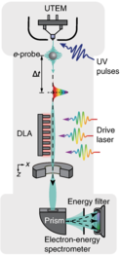
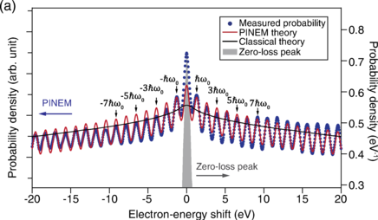








Engineer the free-electron wave function with a DLA
The quantum nature of electron-laser acceleration observed in a DLA
$$+3ℏω$$
$$+2ℏω$$
$$+ℏω$$
$$E_{0}$$
$$0$$
$$−ℏω$$
$$−2ℏω$$
$$−3ℏω$$
Adiv, Yuval, et al. "Quantum nature of dielectric laser accelerators." Physical Review X 11.4 (2021): 041042.
With the wavefunction engineered free electrons, what is new in the electron-matter interaction?
Notes:
State the completely uncontroversal.

Slide 19
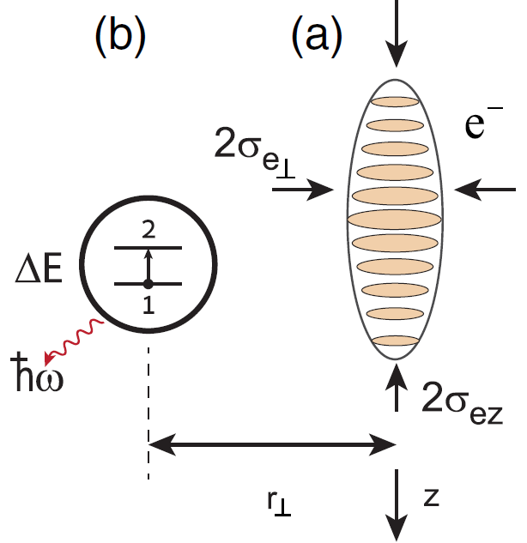

Free-electron—atom interaction
Objective: Investigate free electrons as the probe for quantum systems
Previous work: Semi-classical approach
Limitations of the semi-classical model:
  The back-action on the free electron is missing.
  Entanglement arising from the interaction cannot be revealed.
$${ℏω}_{a}$$
Gover, Avraham, and Amnon Yariv. Physical Review Letters 124.6 (2020): 064801.

Slide 20






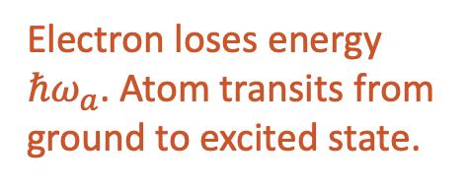





Quantum free-electron—atom interaction: Theory
Scattering matrix:
S
Electron measurements
Measurement results depend on the initial free-electron wave function.
$\left|Atom\right\rangle$
$\left|Atom′\right\rangle$
$b=b_{q=\frac{ω_{a}}{v_{0}}}$
$$\frac{ω_{a}}{v_{0}}$$
$$ω_{a}$$
$$ω$$
$$(k+q,ω+v_{0}q)$$
Electron and atom state are unchanged
Electron loses energy $ℏω_{a}$. Atom transits from ground to excited state.
$$(k,ω)$$
$$k$$
Coupling coefficient
Linearized electron dispersion relation
Zhao, Zhexin, Xiao-Qi Sun, and Shanhui Fan. "Quantum entanglement and modulation enhancement of free-electron-bound-electron interaction." Physical Review Letters 126, no. 23 (2021): 233402
Notes:
Ref

Slide 21
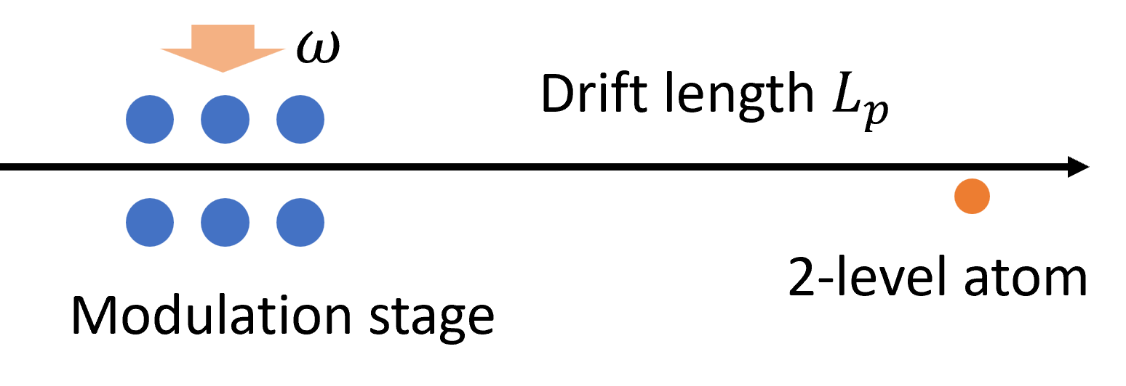
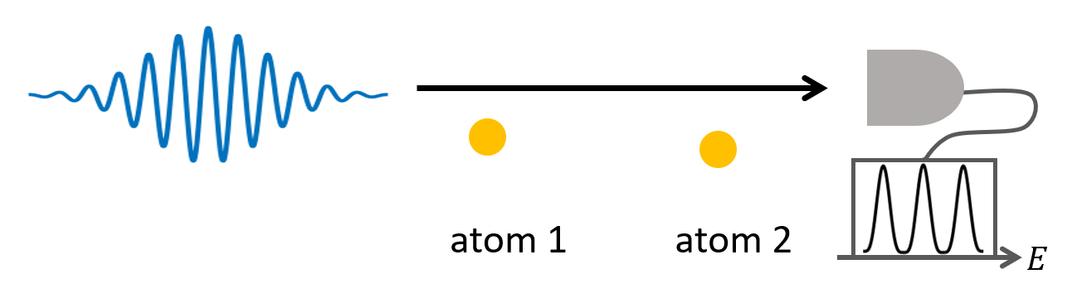




Probe the atomic coherence with modulated free electrons
Electron energy loss spectrum example: $g=1×{10}^{−3}$
$$e$$
$$ρ_{a}=\left[\begin{matrix}0.5 & 0.5 \\ 0.5 & 0.5\end{matrix}\right]$$
$$ρ_{a}=\left[\begin{matrix}0.5 & 0 \\ 0 & 0.5\end{matrix}\right]$$
Plane-wave like electron
Resonant modulated electron
This anti-symmetric EELS signal can probe the atomic coherence.
Zhao, Zhexin, Xiao-Qi Sun, and Shanhui Fan. "Quantum entanglement and modulation enhancement of free-electron-bound-electron interaction." Physical Review Letters 126, no. 23 (2021): 233402
Notes:
Change on the free-electron due to the interaction: $Δρ_{e}=Tr_{a}\left[Sρ_{ea}^{i}S^{†}−ρ_{ea}^{i}\right]$

Slide 22
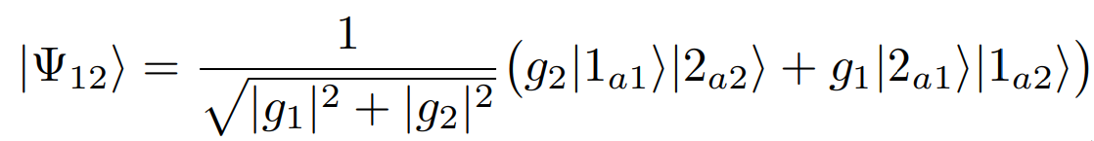
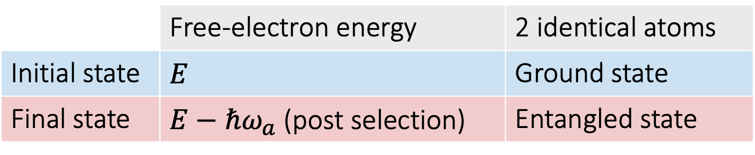
Create entanglement
 | Free-electron energy | 2 identical atoms
Initial state | $E$ | Ground state
Final state | $E−ℏω_{a}$ (post selection) | Entangled state
Zhao, Zhexin, Xiao-Qi Sun, and Shanhui Fan. "Quantum entanglement and modulation enhancement of free-electron-bound-electron interaction." Physical Review Letters 126, no. 23 (2021): 233402

Slide 23
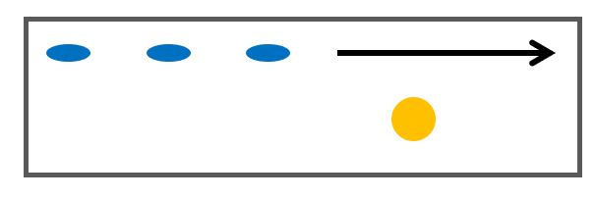
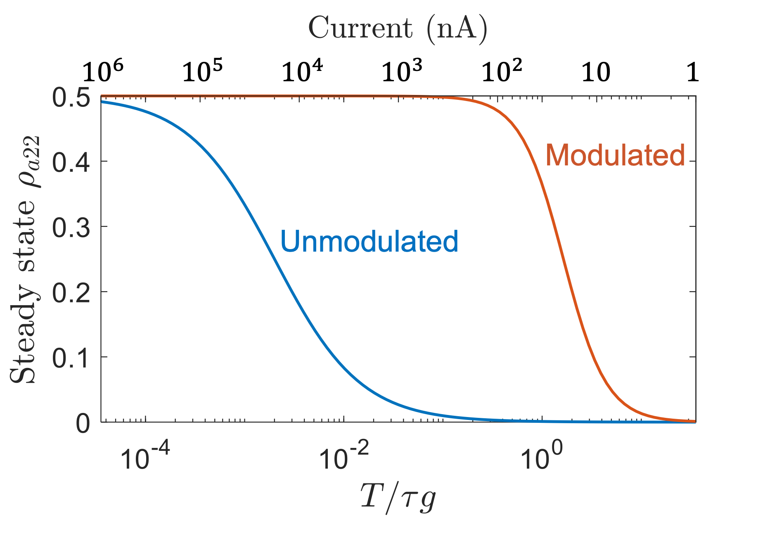
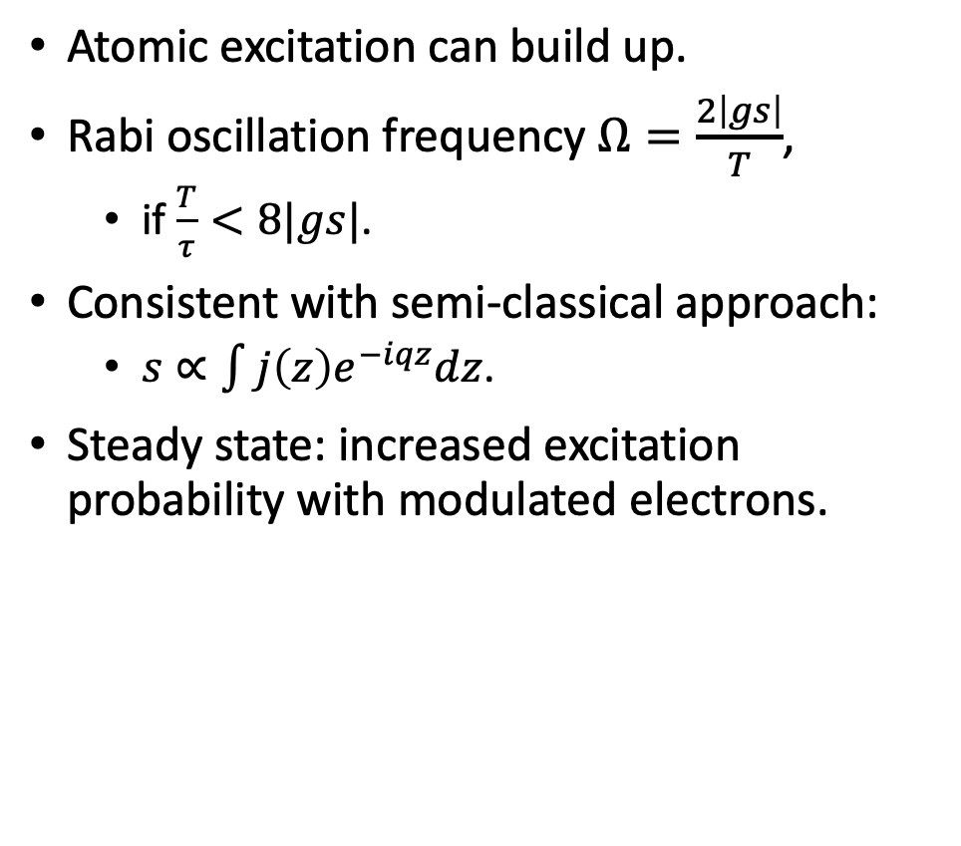

Interaction between the two-level system and a dilute electron beam
Atomic excitation can build up.
Rabi oscillation frequency $Ω=\frac{2\left|gs\right|}{T}$,
  if $\frac{T}{τ}<8|gs|$.
Consistent with semi-classical approach:
  $s∝\int{j\left(z\right)e^{−iqz}dz}$.
Steady state: increased excitation probability with modulated electrons.
$$T$$

Slide 24
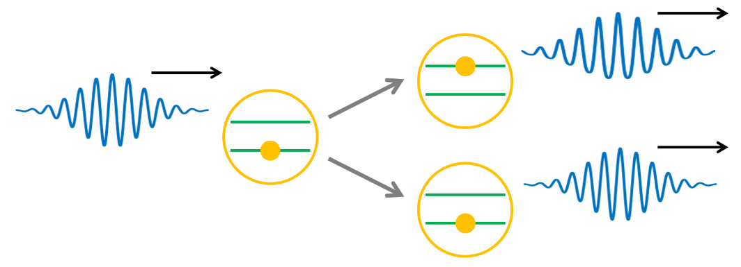

Quantum free-electron—atom interaction: Summary
Modulated free electrons can probe the quantum coherence.
Enhanced interaction due to free-electron wave function modulation
Enhanced electron energy loss spectrum to probe atomic coherence
Interaction between the two-level atom and a modulated dilute electron beam: Consistent with semi-classical theory
Creating entanglement
Zhao, Zhexin, Xiao-Qi Sun, and Shanhui Fan. "Quantum entanglement and modulation enhancement of free-electron-bound-electron interaction." Physical Review Letters 126, no. 23 (2021): 233402
Notes:
Driving the 2-level atom
Electron energy loss/gain spectrum (EELS)
Creating entanglement
Interaction between the two-level system and a dilute electron beam

Slide 25




Summary
Electron compression
$$ω_{1} ω_{2}$$
Electron pulse
Optical resonator, e.g., DLA
Quantum sensing
$$ω$$
$$E$$
$$e$$
$$E$$
2-level atom
Modulation stage

Slide 26















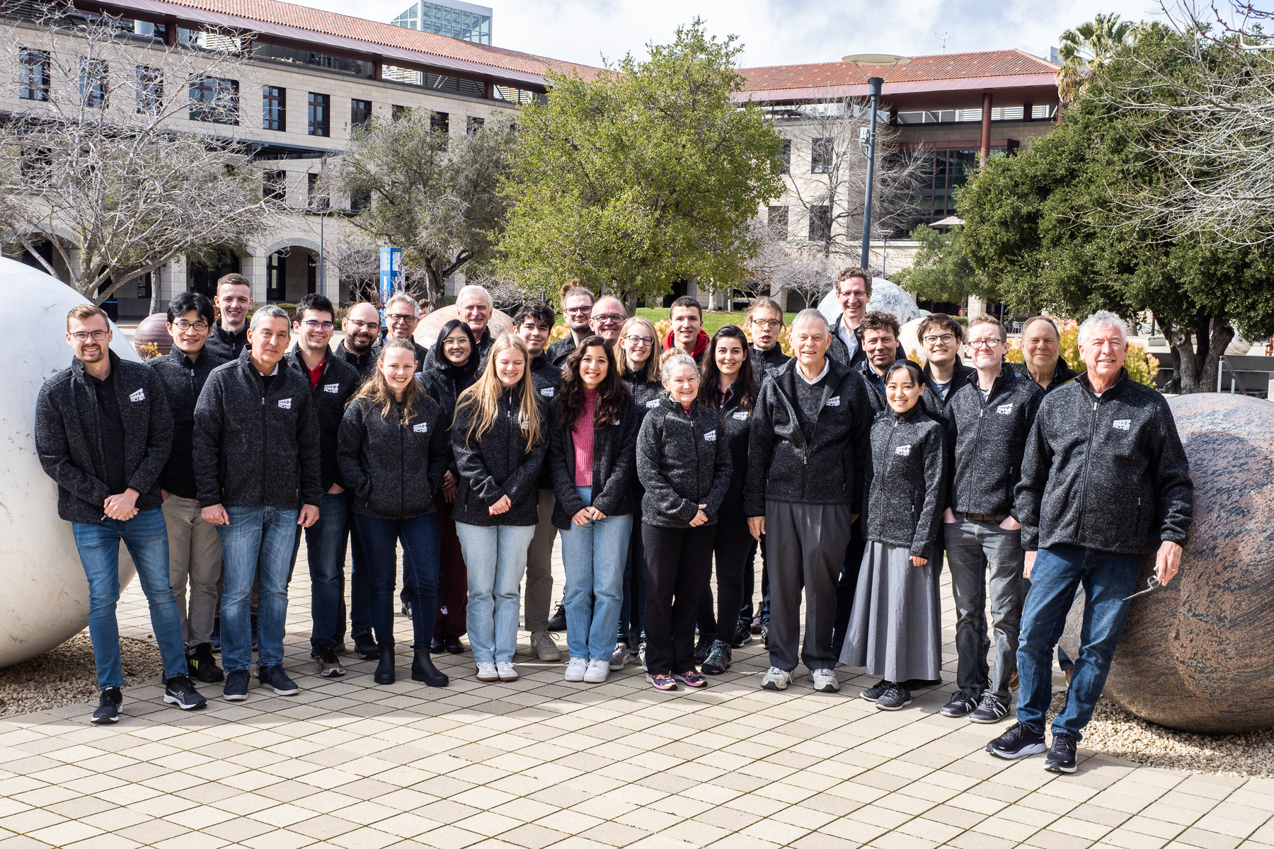
Acknowledgement
Stanford Graduate Fellowship
Siemann Graduate Fellowship
Collaborators:
Prof. Shanhui Fan
Prof. Robert L. Byer
Prof. Olav Solgaard
Dr. Dylan S. Black
Dr. Kenneth J. Leedle
Dr. Xiao-Qi Sun
Notes:
Dylan S. Black,2 Xiao-Qi Sun,3 Tyler W. Hughes,2 Kenneth J. Leedle,2 Si Tan,2 R. Joel England,4 Olav Solgaard,2 Robert L. Byer,2 Shanhui Fan,2 and Peter Hommelhoff

Slide 27
Thank you!

