Slide 1
ARES Operation Meeting
Summary of week 45 / 2023
Blae Stacey, on behalf of the ARES crew

Slide 2
Summary of week 45
Mon. 06.11. | Tue. 07.11. | Wed. 08.11. | Thu. 09.11. | Fri. 10.11.
MIN/MKK investigated water pressure for X-band system – within normal range. | Spot size on cathode looks good after exchange of Pharos mirrors; Manual attenuator in lab adjusted to reduce charge; Ballistic on-crest WP used to zero phases; TWS1 moved off crest; Transmission optimised with DLA in; Scan TWS1 phases using JAI camera, PDE FWHM, and PDE momentum at peak intensity. | Transmission recovered with yesterday’s DLA position; Removed filter on bread board camera and repositioned diode behind cylindrical lens; Scanning bread board cam stage positions. | Transition radiation observed on silver mirror using JAI camera (incoherent); TWS1 phase scans using transition radiation; Detailed bread board camera scans. | TWS1 phase scans with refocusing on YAG screen; ACHIP undulator in – expected variations in beam; PolariX conditioning over weekend.
 | TWS2 error – fixed by MIN. | No signal observed on diode. | Vacuum event in PolariX overnight; Transition radiation too weak for spectrometer.
 |  | Fire Brigade visit (tunnel open). | Group laptop in tunnel running spectrometer software. | Polarstern visit (tunnel open); Group laptop removed from tunnel; Undulator still in beamline.
Achievements
Difficulties
Notes

Slide 3
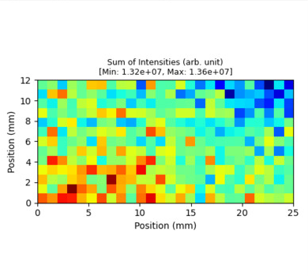
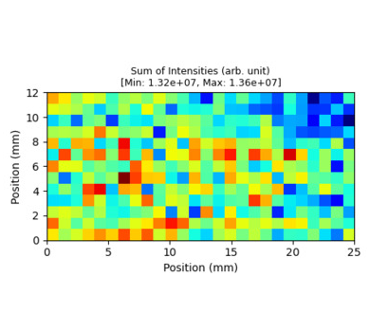
Bread Board Cam 2D Position Scans
PHAROS OFF
PHAROS ON

Slide 4
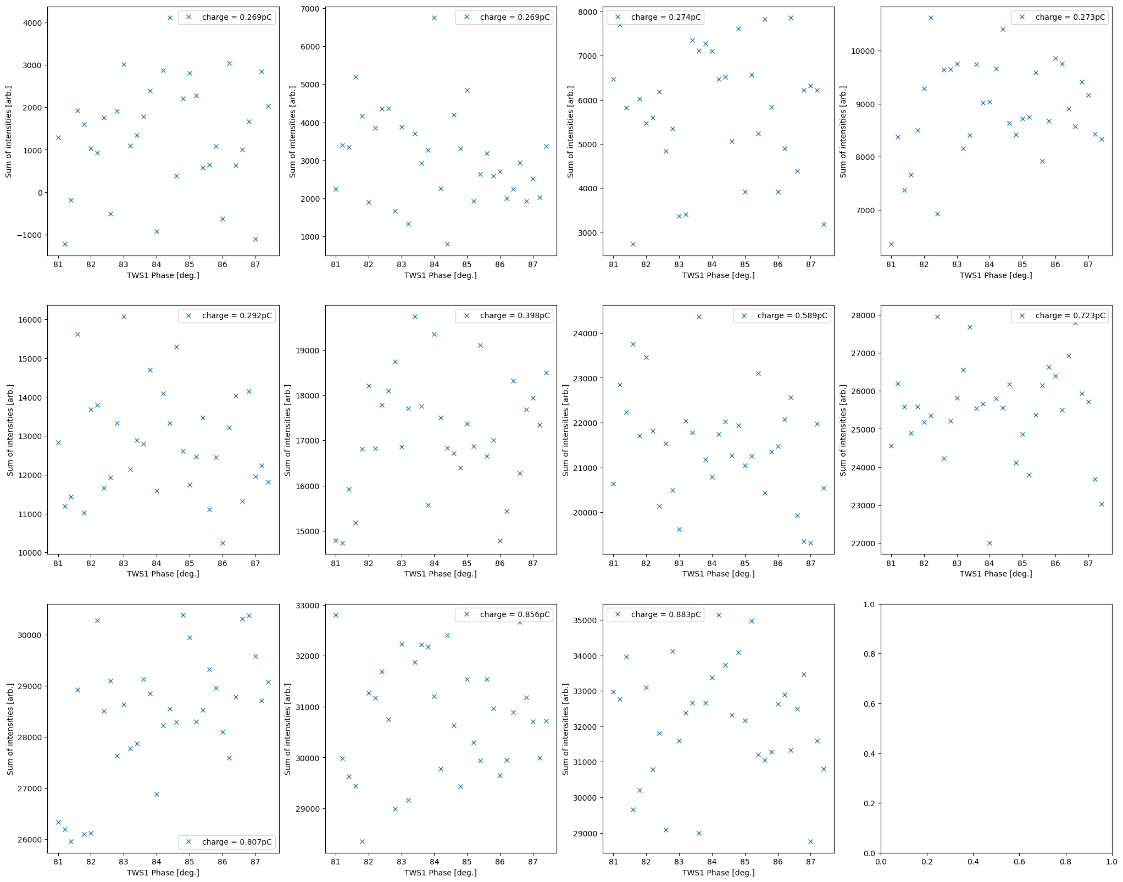
TWS1 Phase Scans

Slide 5
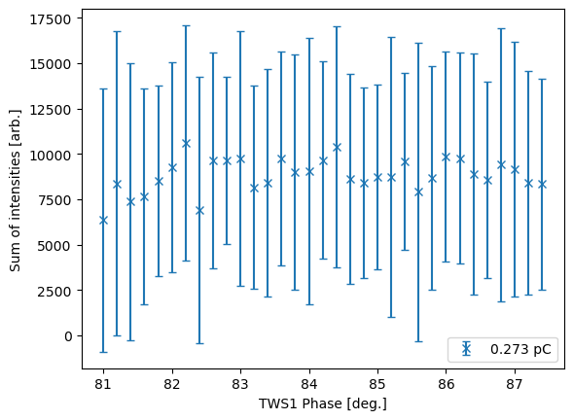
TWS1 Phase Scan with errors

Slide 6
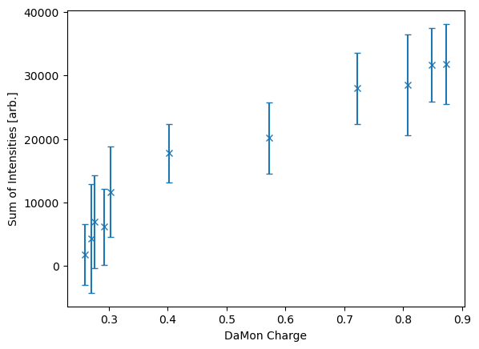
Charge Scan for TWS1 @ 82.4

Slide 7
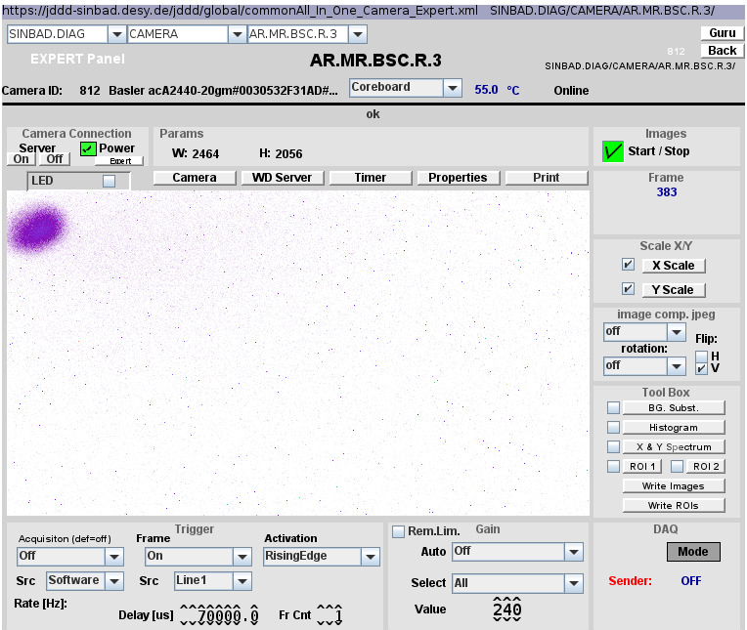
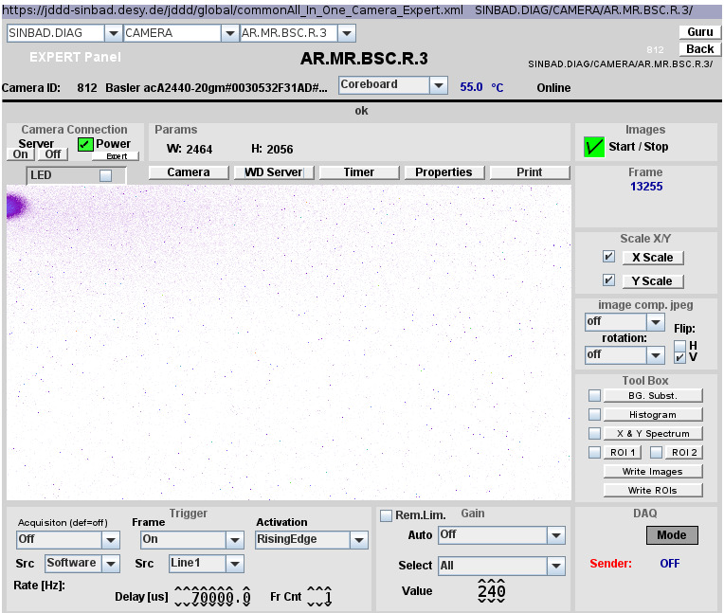
ACHIP Undulator 1
WITHOUT UNDULATOR
WITH UNDULATOR

Slide 8
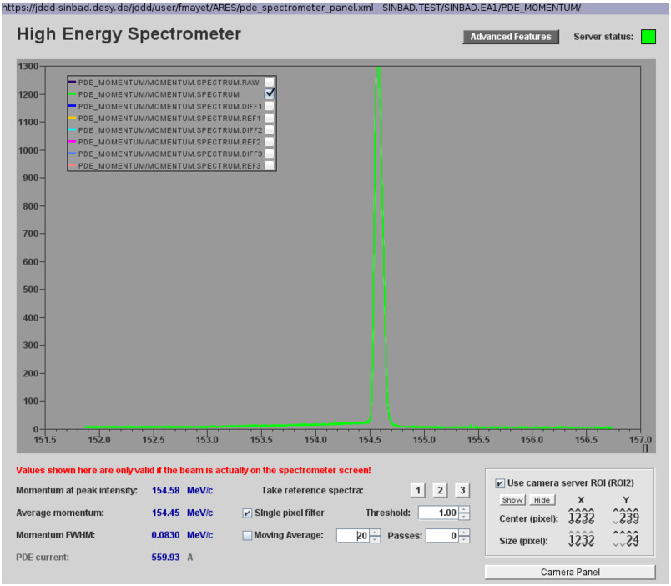
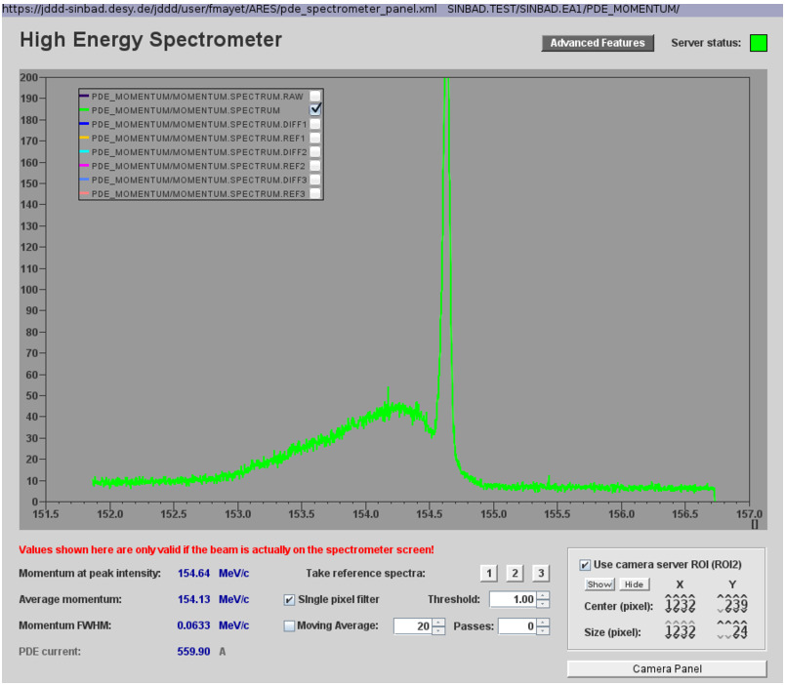
ACHIP Undulator 2
WITHOUT UNDULATOR
WITH UNDULATOR

Slide 9
Schedule and Plan for the Week
Week 46
Date | Shift Crew
13.11. | --
14.11. | Thomas, Max
15.11. | Thomas, Max
16.11. | Thomas, Max
17.11. | Thomas, Max
Mon: MIN/MKK cooling water investigation
TWAC
If you want to learn or join the shift: please give the shift leader a call (BKR 2840 / SINBAD Box 2454)

