Slide 1
Recent results from the MINOS experiment
Jenny Thomas
UCL

Slide 2

Preview
Whirlwind tour of where we are
  Introduction to Neutrinos, Oscillations and what the experiments tell us
Properties of neutrino oscillations
  Results from MINOS are world’s best
Future plans for MINOS
  Analysis of new anti-neutrino running
  MINOS+?
Summary
  Lots still to do, picture still missing pieces

Slide 3
introduction
What you all know about neutrinos already

Slide 4
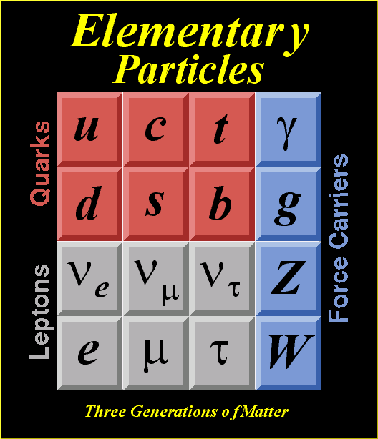

The Standard Model
Quarks, Leptons and Gauge Bosons make up the elementary particles
Three generations of leptons with ΔQ=1
Three generations of quarks with ΔQ=1
Three interactions, weak, EM and strong
Neutrinos are the only neutral fermion

Slide 5
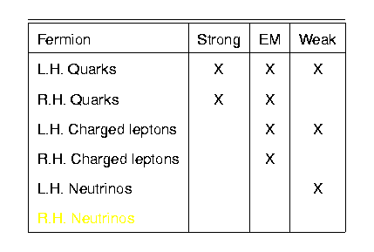
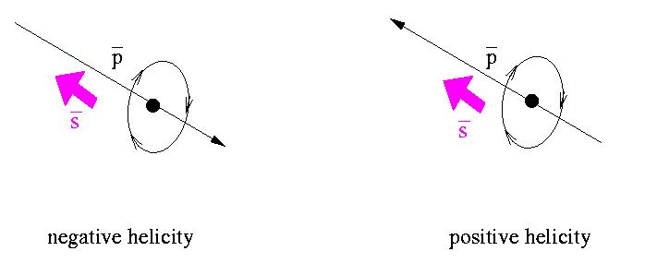
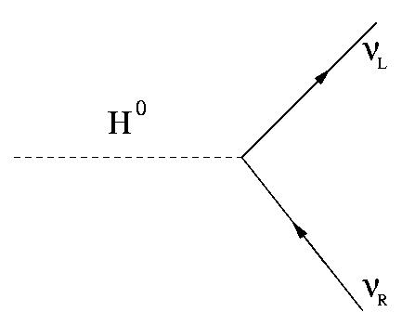
neutrino properties
Weak interaction violates parity
Neutrinos were thought to be exactly massless : SM reproduced the parity violation by making them so. Not any more!
Spin = ½, but left handed only. Not any more!
It is the mass term which would allow a RH neutrino to exist (coupling to the Higgs in today’s parlance)

Slide 6
Neutrino sector status
Solar&Reactor
Atmospheric
Reactor/LBL
Double Beta
Normal hierarchy
Inverted hierarchy
3 light neutrino flavours: e, μ, τ
Δm²₂₁ : (7.0 - 9.1) × 10⁻⁵ eV²
TAN²θ₁₂ : 0.34 – 0.62
Δm²₃₂ : (2.23^{+0.11}_{-0.08}) × 10⁻³ eV²
sin²θ₂₃ : >0.91 (@90% C.L.)
SIN²θ₁₃ ≤ 0.045
: unknown
Hierarchy : unknown
m_{lightest} < 2.2 eV
Dirac or Majorana: unknown
(m₃)²
(m₂)²
Δm²₂₁
(m₁)²
ν_{e}
Δm²₃₂
ν_{μ}
ν_{τ}
Δm²₃₁
(m₂)²
Δm²₂₁
(m₁)²
(m₃)²
m²_{lightest}
m²_{lightest}

Slide 7
Simple 2-flavour expression
(Average L/E is about 500 km/GeV for MINOS)

Slide 8
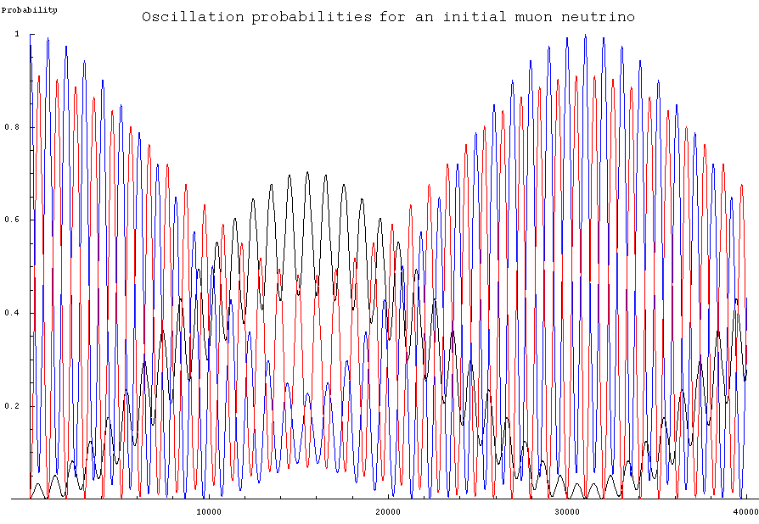
In a snapshot: what its like to be a muon neutrino
ν_{e} ν_{μ} ν_{τ}
L/E (km/GeV)
MINOS

Slide 9
THE MINOS EXPERIMENT
Given the confusing nature of the neutrino
  choose a place where you have a big probability of seeing a ν_{μ} become one of its chums
  L/E ~ 500 GeV is maximum probability of ν_{μ} disappearance without too much interference from ν_{e} (!!!)
  use a very very massive detector because the neutrino cross section is very very small
then you can…
  measure atmospheric oscillation parameters with precision (neutrinos and anti-neutrinos)
  search for sub-dominant oscillation of ν_{μ}->ν_{e}
  Search for sterile neutrino flavours
  And still look at atmospheric neutrinos…..

Slide 10
The minos detector
How 5kT of steel can measure the lightest particles

Slide 11
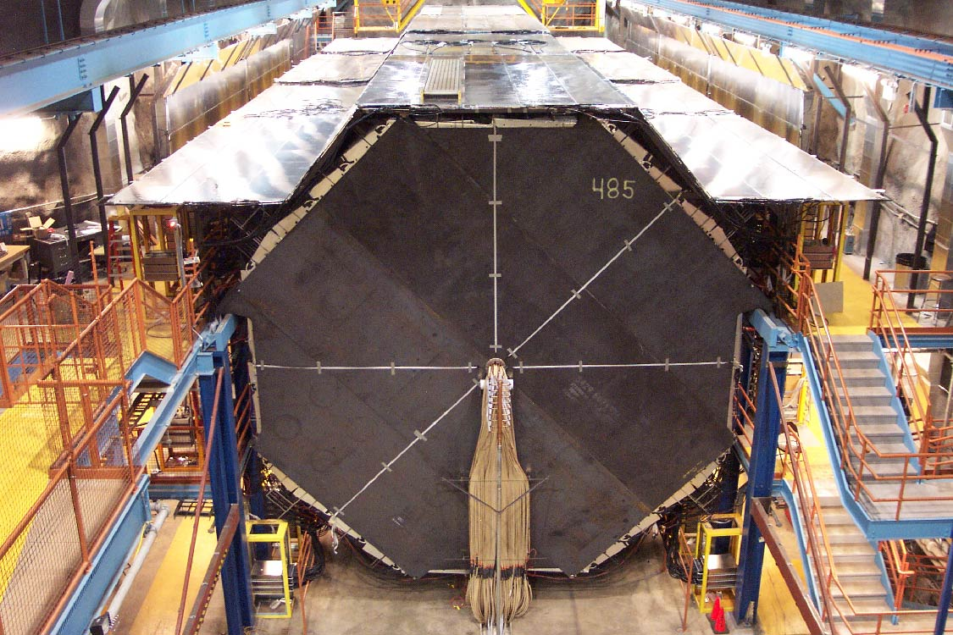
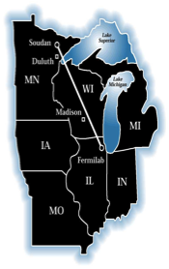
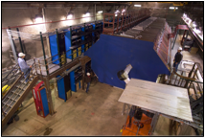
The MINOS Experiment
Long baseline neutrino oscillation experiment
    Neutrinos from NuMI
    L=732km, E~1-5GeV
    L/E ~500 km/GeV
    Atmospheric neutrino L/E
5 kT
Two detectors mitigate systematic effects
    beam flux mis-modeling
    neutrino interaction uncertainties
  Magnetic field measures charge
~1 kT

Slide 12
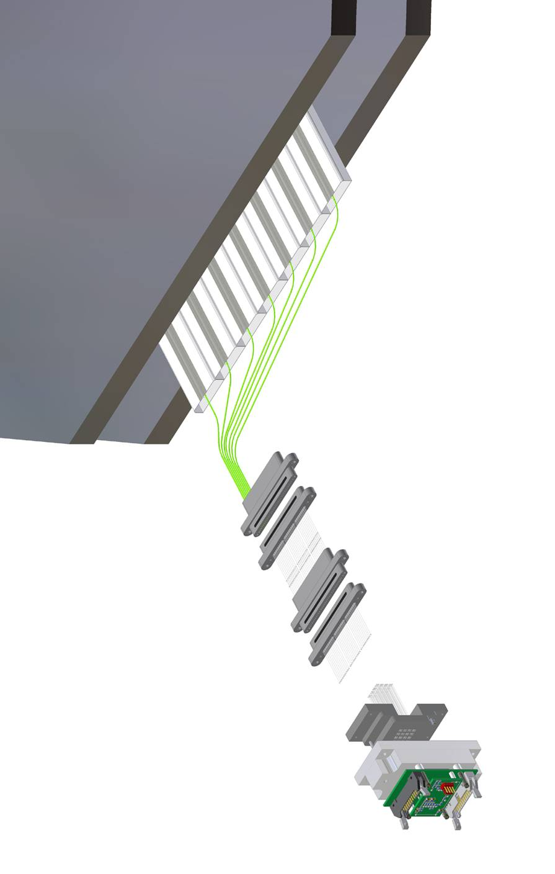
Detector Technology
2.54 cm Fe
Tracking sampling calorimeters
  steel absorber 2.54 cm thick (1.4 X₀)
  scintillator strips 4.1 cm wide (1.1 Moliere radii)
  1 GeV muons penetrate 28 layers
Magnetized
  muon energy from range/curvature
  distinguish μ⁺ from μ⁻
Functionally equivalent
  same segmentation
  same materials
  same mean B field (1.3 T)
Extruded
PS scint.
4.1 x 1 cm²
U V planes
+/- 45⁰
WLS fiber
Clear
Fiber cables
Multi-anode PMT

Slide 13
The neutrino beam
And how you make it

Slide 14
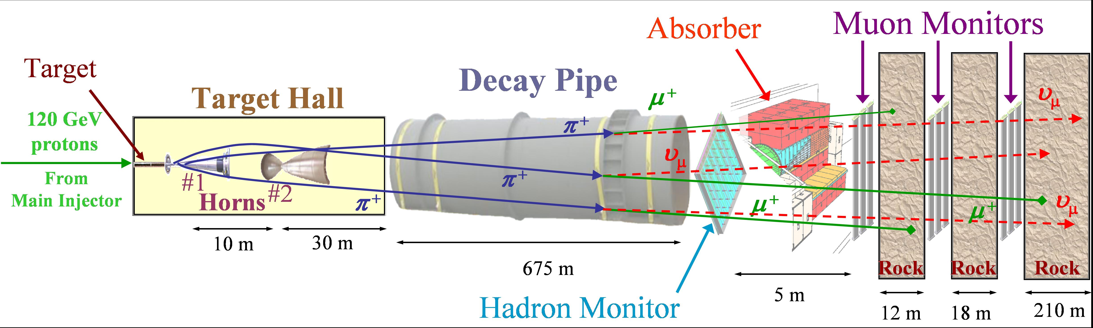
Making a neutrino beam

Slide 15
Making a neutrino beam
Hadron Production
  bombard graphite target with 120 GeV p⁺ from Main Injector
    2 interaction lengths
    310 kW typical power
  produce hadrons, mostly π and K

Slide 16
Making a neutrino beam
Focusing
  hadrons focused by 2 magnetic focusing horns
  sign selected hadrons
    forward current, (+) for standard neutrino beam runs
    reverse current, (–) for anti-neutrino beam

Slide 17
Making a neutrino beam
Decay
  2 m diameter decay pipe, 660m length
  result: wide band beam, peak determined by target/horn separation
  secondary beam monitored

Slide 18
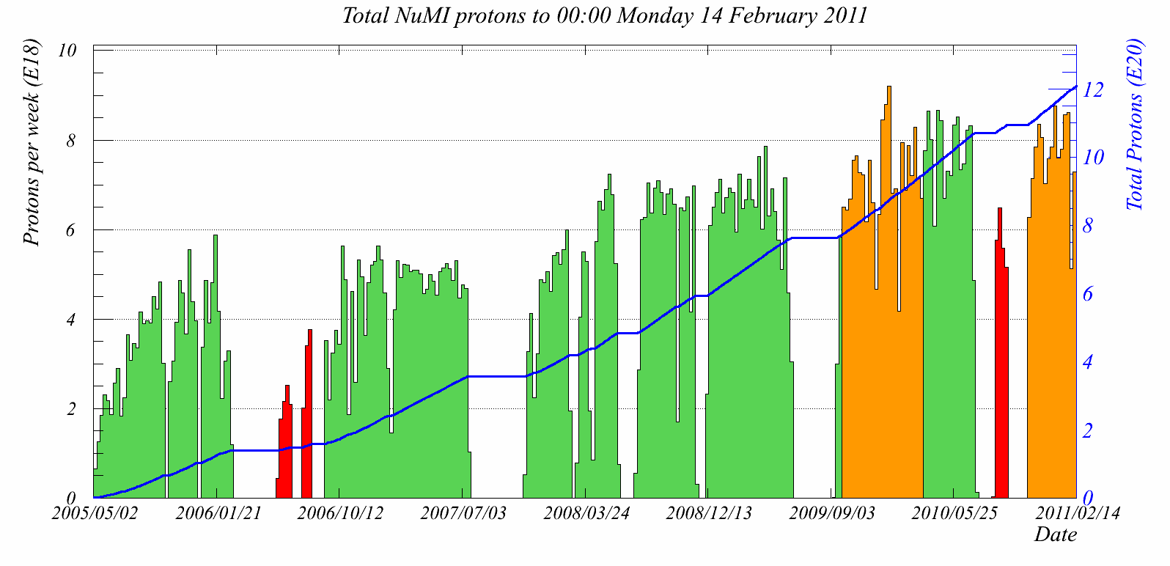
Beam Performance
3.0e20 P.O.T ν_{μ} today!
10²¹ POT!
Total Protons (x10²⁰)
Date

Slide 19
Near to Far
Far spectrum without oscillations is similar, but not identical to the Near spectrum!
π⁺
p
Target
FD
Decay Pipe
ND
Neutrino energy depends on angle wrt original pion direction and parent energy
  higher energy pions decay further along decay pipe
  angular distributions different between Near and Far

Slide 20

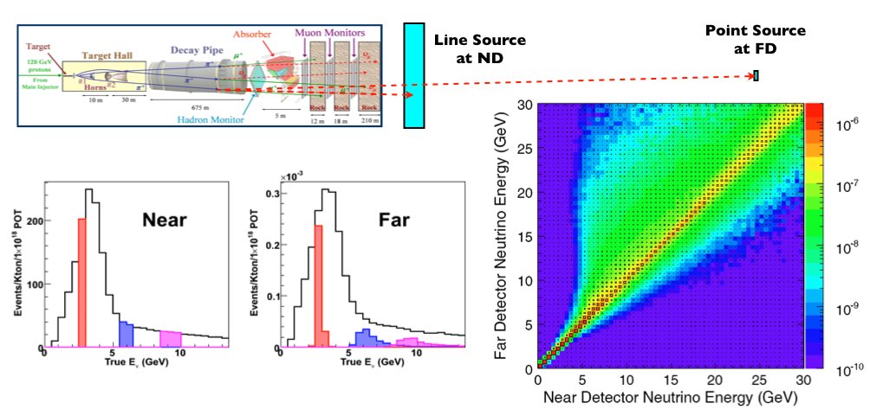
Extrapolation
Near Detector energy spectrum extrapolated to Far Detector, using MC to provide energy smearing and correct for detector acceptance
Notes:
FD energy spectrum w/o oscillations is not the same as ND spectrum
(includes pion decay kinematics, beam line geometry)

Slide 21
Neutrino events in minos
How easy they are to find and how hard some of them can be to identify

Slide 22
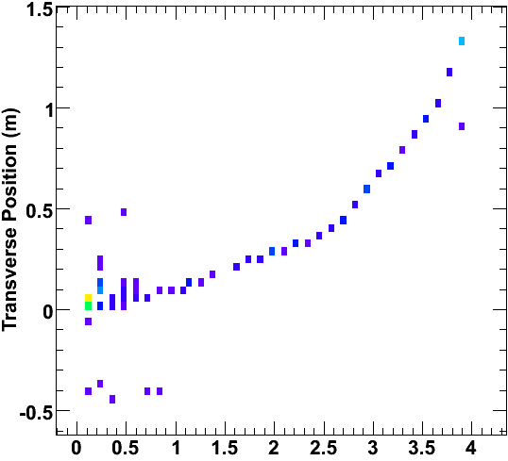
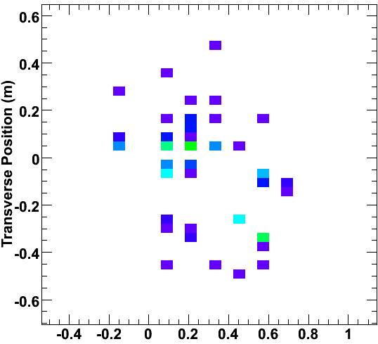
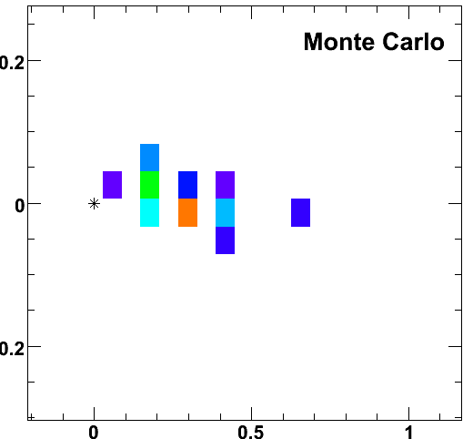
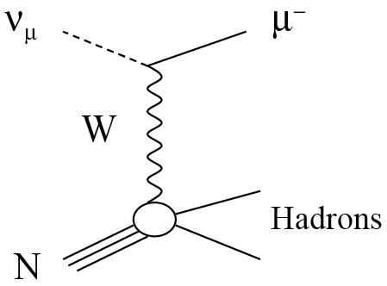
Neutrino Events in MINOS
Simulated Events
CC ν_{μ} Event
NC Event
CC ν_{e} Event
ν
e⁻
Transverse position (m)
μ⁻
Depth (m)
ν_{μ} Charged Current events:
  long μ track, with hadronic activity at vertex
  neutrino energy from sum of muon energy (range or curvature) and shower energy

Slide 23
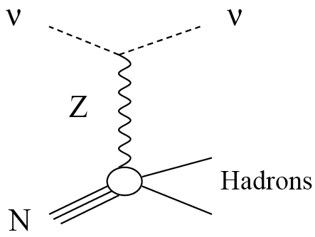
Events in MINOS
Simulated Events
CC ν_{μ} Event
NC Event
CC ν_{e} Event
ν
e⁻
μ⁻
Transverse position (m)
Depth (m)
Neutral Current events:
  short, diffuse shower event
  shower energy from calorimetric response

Slide 24
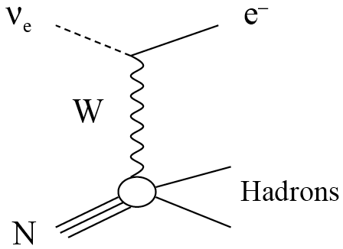
Events in MINOS
Simulated Events
CC ν_{μ} Event
NC Event
CC ν_{e} Event
ν
e⁻
μ⁻
Transverse position (m)
Depth (m)
ν_{e} Charged Current events:
  compact shower event with an EM core
  neutrino energy from calorimetric response

Slide 25
Neutrino oscillation measurement
A simple idea

Slide 26
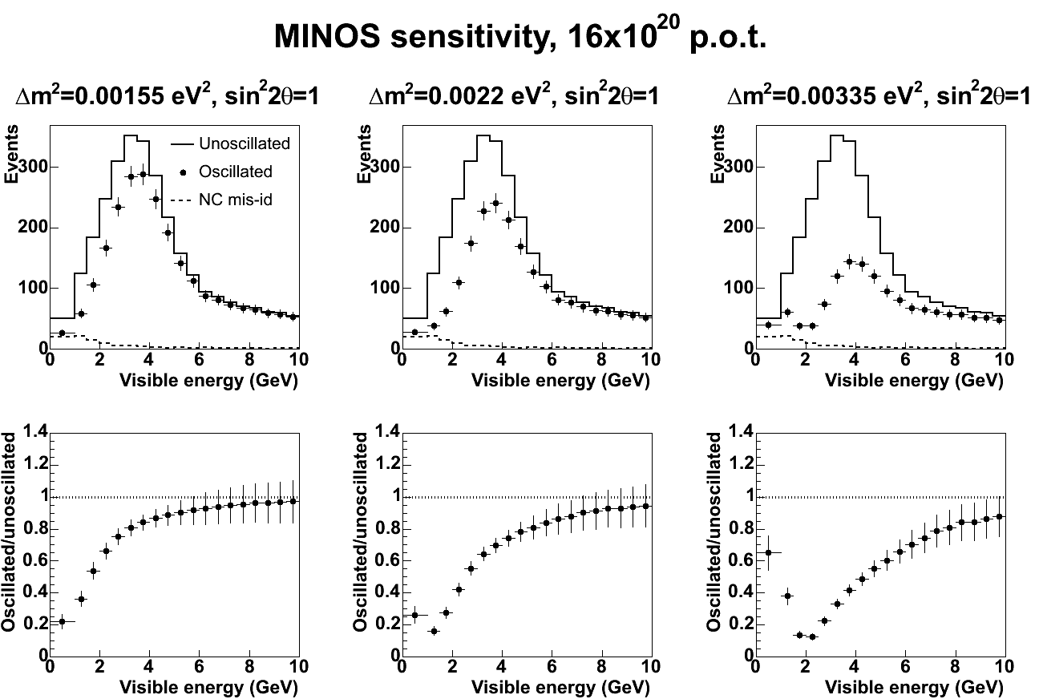
ν _{μ} Disappearance
Look for ν _{μ} disappearance as a function of neutrino energy
Use ND to predict unoscillated spectrum at Far Detector
Compare with measured spectrum to extract oscillation parameters
ν_{μ} spectrum
spectrum ratio
Unoscillated
Characteristic Shape
Oscillated
Monte Carlo
Monte Carlo
( Input parameters: sin²2θ = 1.0, Δm² = 3.35x10⁻³ eV² )

Slide 27
ν _{μ} Disappearance
Look for ν _{μ} disappearance as a function of neutrino energy
Use ND to predict unoscillated spectrum at Far Detector
Compare with measured spectrum to extract oscillation parameters
ν_{μ} spectrum
spectrum ratio
Unoscillated
Oscillated
sin²(2θ)
Monte Carlo
Monte Carlo
( Input parameters: sin²2θ = 1.0, Δm² = 3.35x10⁻³ eV² )

Slide 28
ν _{μ} Disappearance
Long baseline ν_{μ} disappearance experiment
Predict unoscillated CC spectrum at Far Detector
Compare with measured spectrum to extract oscillation parameters
ν_{μ} spectrum
spectrum ratio
Unoscillated
Oscillated
Δm²
Monte Carlo
Monte Carlo
( Input parameters: sin²2θ = 1.0, Δm² = 3.35x10⁻³ eV² )

Slide 29
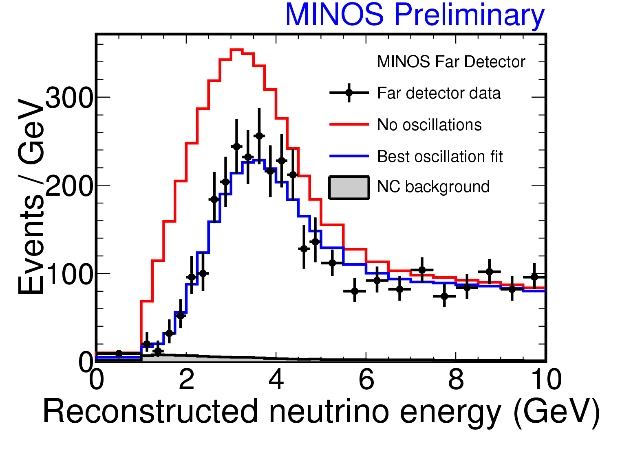
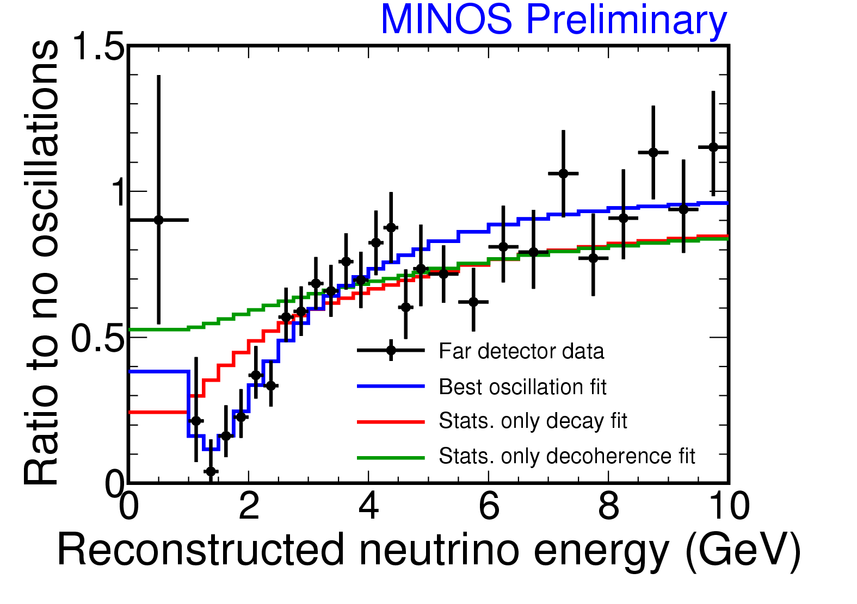
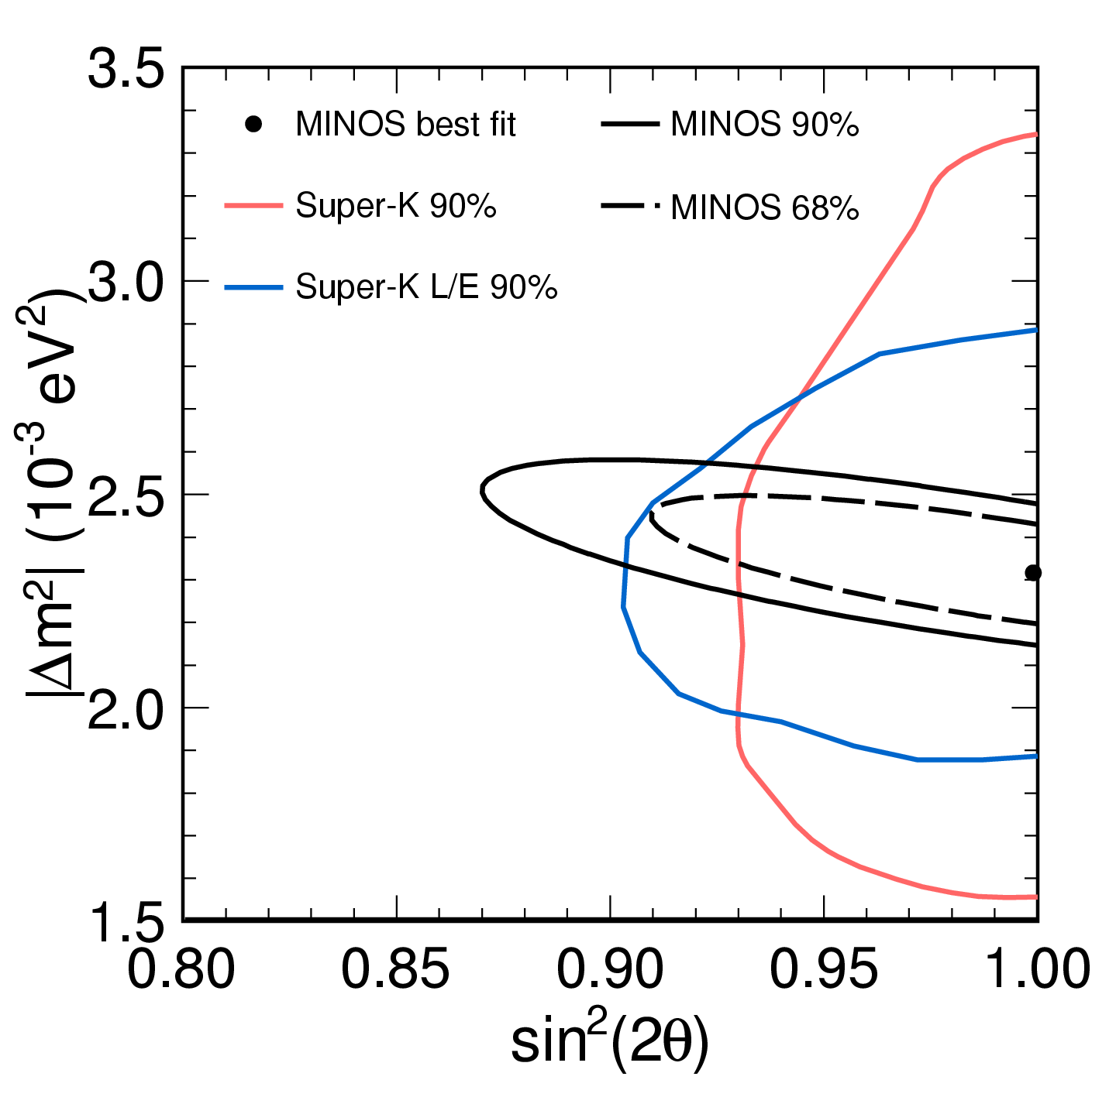
ν_{μ} Disappearance Result
No Oscillations: | 2451
Observation: | 1986
|Δm²|=2.32^{+0.12}_{-0.08} x 10⁻³ eV²
Sin²(2θ) > 0.90 (90% C.L.)
Super-K latest contour, uses full 3 flavour mixing
Notes:
This is the 2008 e320 result. 7e20 due next summer.

Slide 30
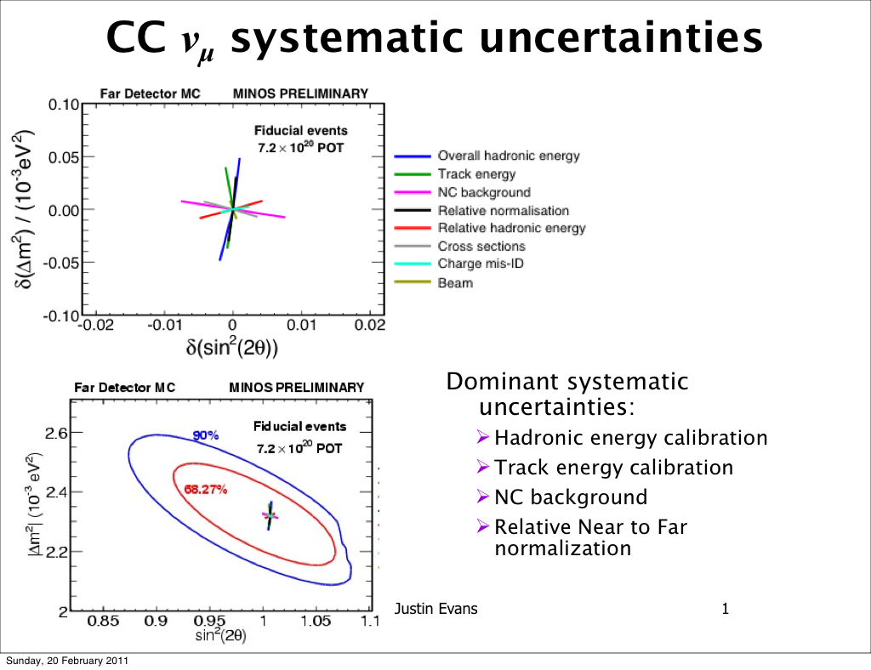

Slide 31

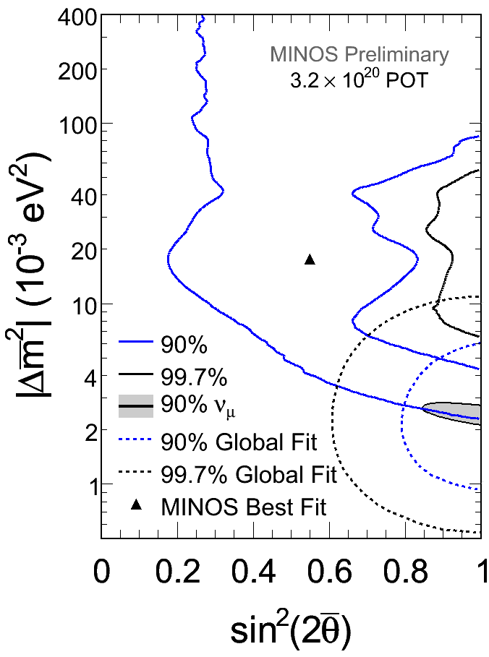
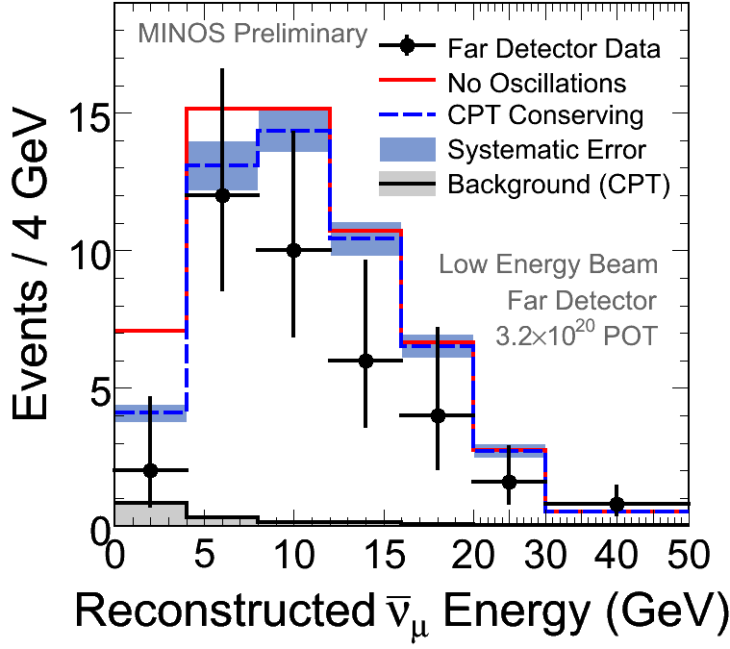
Antineutrino Results
42 events observed
  No oscillations
    64.6 ± 8.0_{stat} ± 3.9_{syst}
  conserving
    58.3 ± 7.6_{stat} ± 3.6_{syst}
Deficit is 1.9σ
Consistent with the ν_{μ} parameters at 90% c.l.
Global fit from Gonzalez-Garcia & Maltoni,
Phys. Rept. 460 (2008), SK data dominates

Slide 32
The anti-neutrino beam
How you make it and why it isn’t really

Slide 33
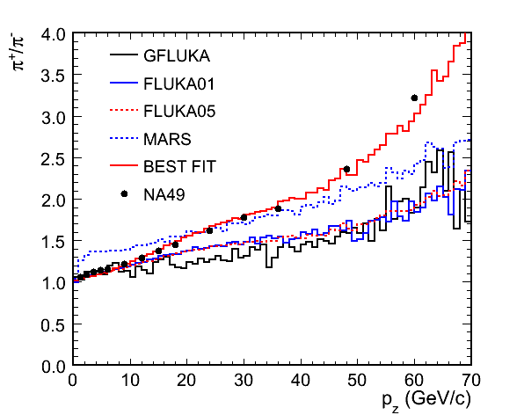
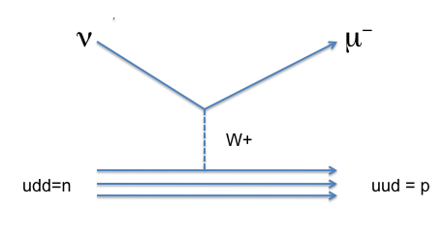
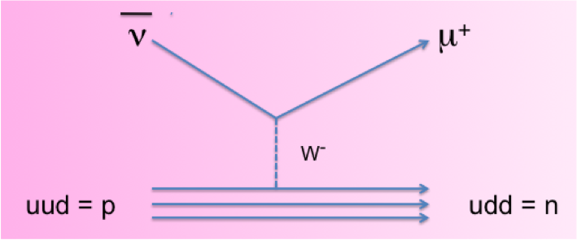
Making an anti-neutrino beam
Several issues contribute to lower anti-neutrino rate
  π+π- production ratio at target favours π- at level of ~1.3-1.5 (approx 30%)
  Ratio of n to p in iron gives ~30% in cross section
  Vector boson exchange has a sign (~30%)
  ν x-section larger at low energies by 30-50%
All results in about a factor 3 lower yield of anti-neutrinos

Slide 34
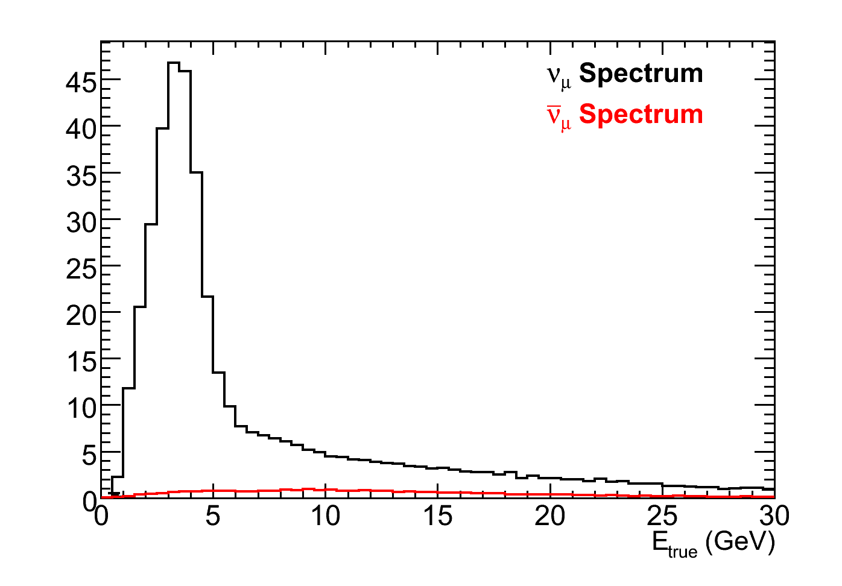
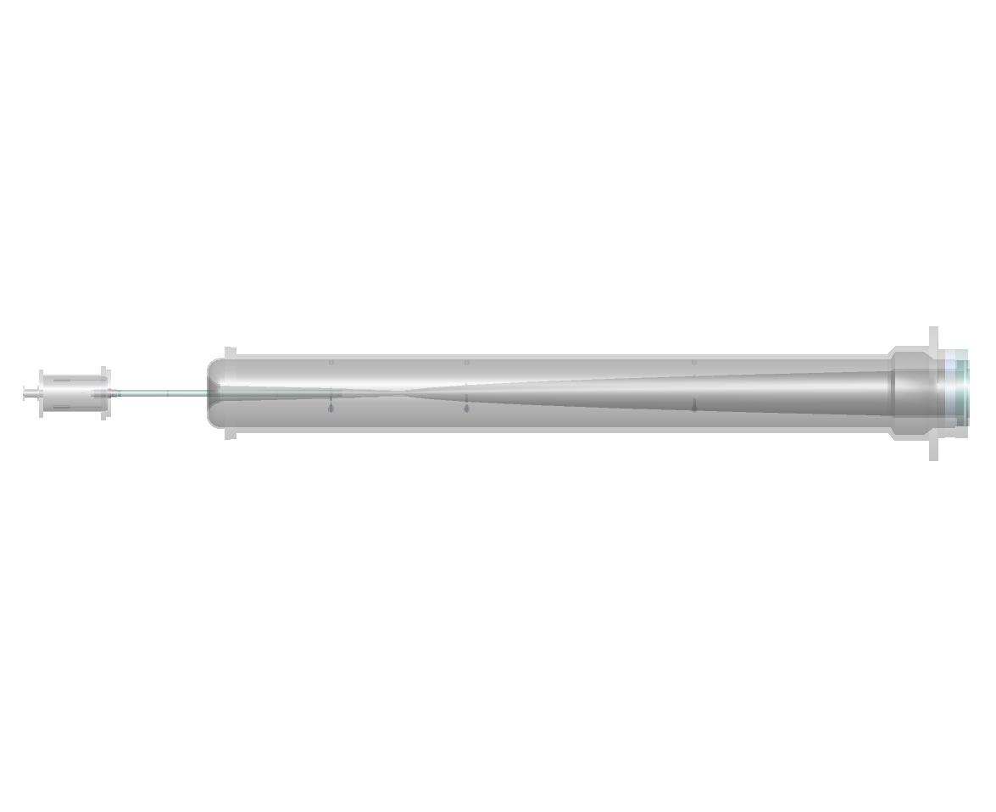
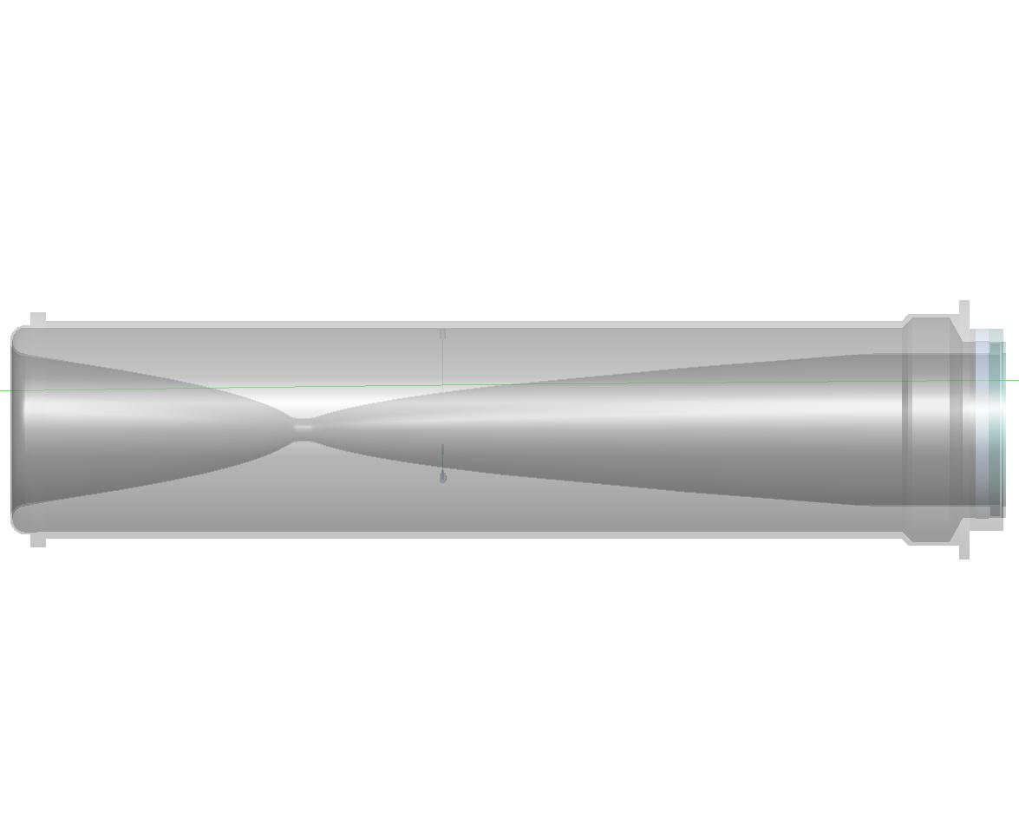
Making an anti-neutrino beam
Neutrino mode
Horns focus π⁺, K⁺
Events
ν_{μ}: 91.7%
ν_{μ}: 7.0%
ν_{e}+ν_{e} : 1.3%
Target
Focusing Horns
π⁻
2 m
ν_{μ}
120 GeV p’s from MI
π⁺
ν_{μ}
15 m
30 m
675 m

Slide 35
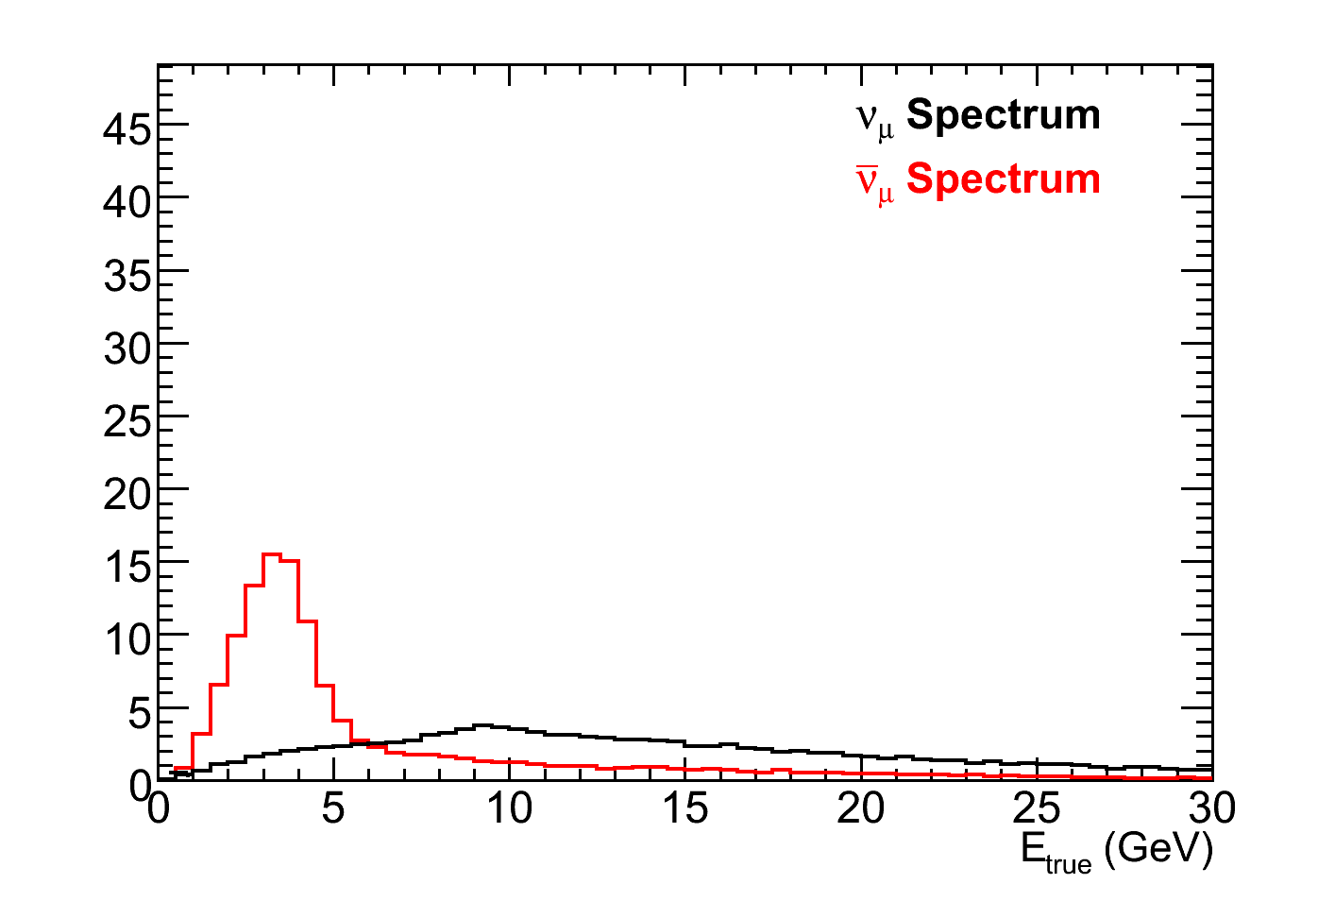
Making an anti-neutrino beam
Neutrino mode
Horns focus π⁺, K⁺
Anti-neutrino Mode
Horns focus π⁻, K⁻ enhancing the ν_{μ} flux
Events
Events
ν_{μ}: 91.7%
ν_{μ}: 7.0%
ν_{e}+ν_{e} : 1.3%
ν_{μ}: 39.9%
ν_{μ}: 58.1%
ν_{e}+ν_{e} : 2.0%
Target
Focusing Horns
π⁺
2 m
ν_{μ}
120 GeV p’s from MI
π⁻
ν_{μ}
15 m
30 m
675 m

Slide 36
Anti-neutrino oscillations
Measured in the same way, comparison of ND with FD

Slide 37
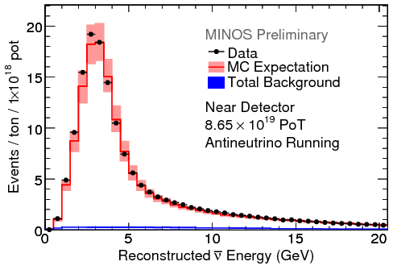
ND Anti-neutrino selection
Focus and select positive muons
  purity 94.3% after charge sign cut
  purity 98% < 6GeV
Data/MC agreement comparable to neutrino running
  different average kinematic distributions
  More low y events (more hard muons)

Slide 38
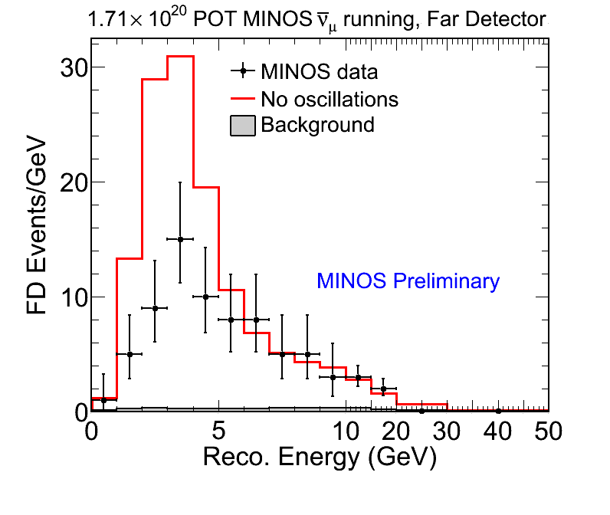
Far Detector Data
No oscillation Prediction: 155
Observe: 97
No oscillations disfavored at 6.3σ

Slide 39
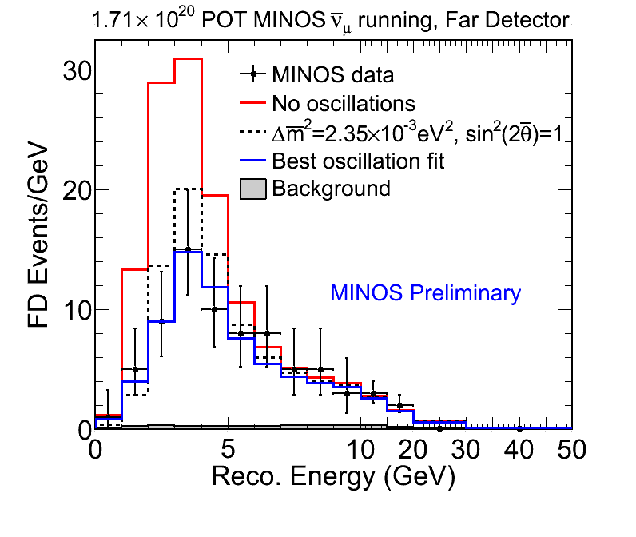
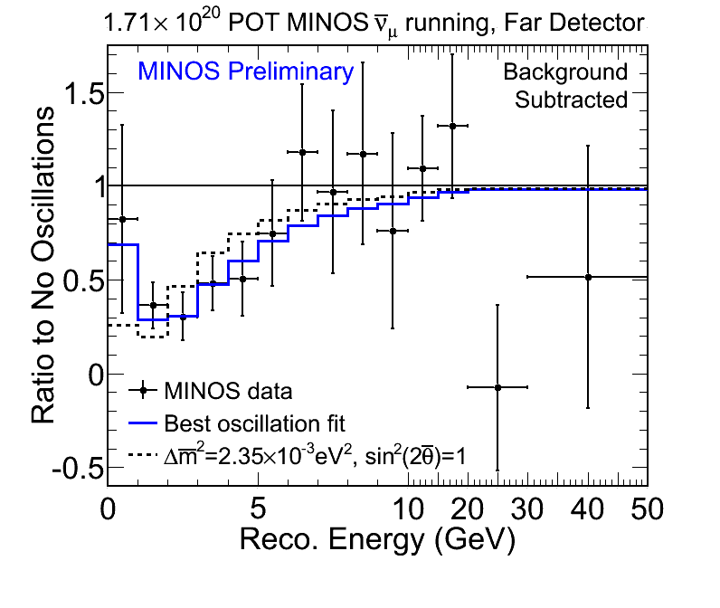
Comparison to Neutrino oscillation parameters

Slide 40
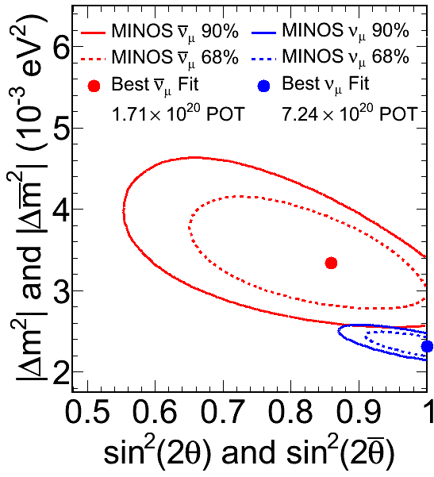
Comparison to Neutrinos
More anti-neutrino running expected soon
Contour includes effects of dominant systematic uncertainties
  normalization
  NC background
  shower energy
  track energy
< 2% probability of same parameters

Slide 41
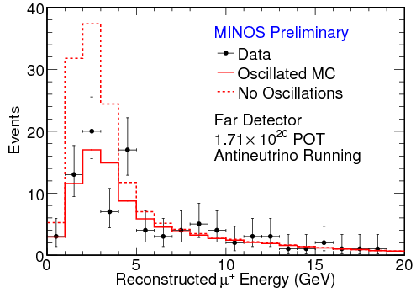
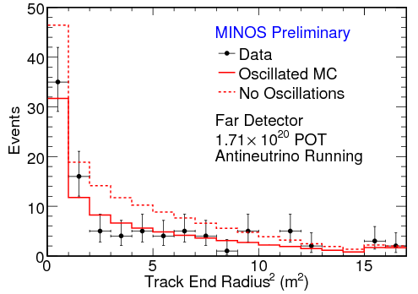
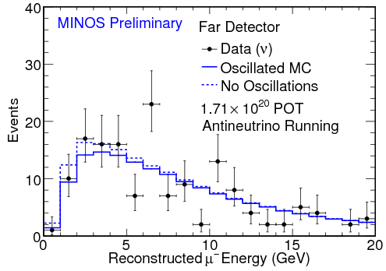
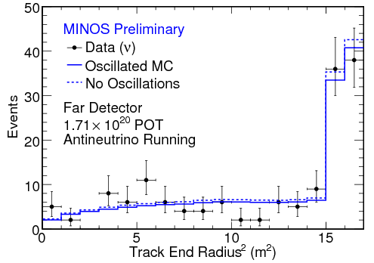
FD Data

Slide 42
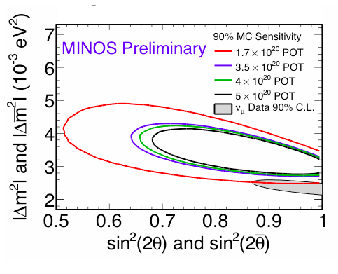
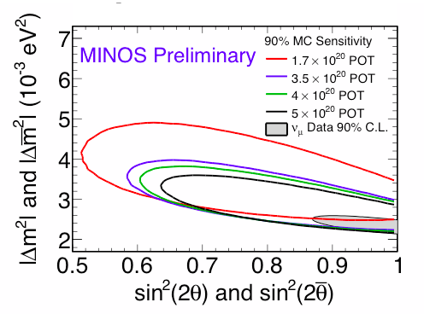
Future sensitivity
Predicted sensitivity
1.7e20 existing anti-ν data +
Additional data with same anti-ν parameters
1.7e20 existing anti-ν data +
additional data with CC-ν_{μ} parameters

Slide 43
Search for ν_{e}
Brief overview of the world status and the MINOS present limits

Slide 44

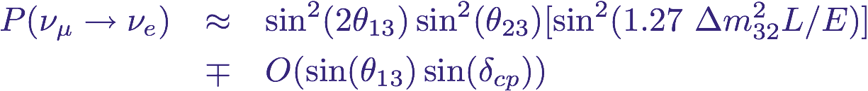
MINOS: Searching for θ₁₃
The probability of ν_{e} appearance in a ν_{μ} beam:
Searching for ν_{e} events in MINOS, we can access sin²(2θ₁₃).
Probability depends not only on θ₁₃ but also on δCP .
  A non-zero θ₁₃ would open the door to a CP violation measurement in the neutrino sector which could reveal the origin of the matter/anti-matter asymmetry of the universe.

Slide 45

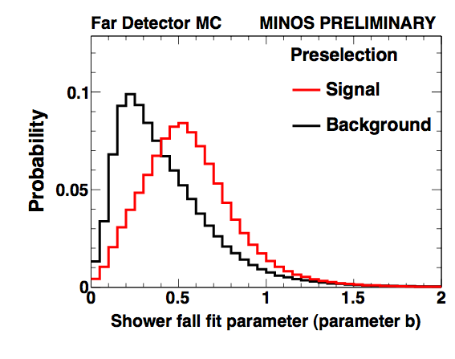
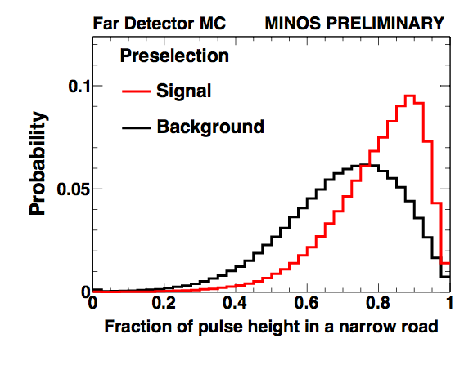
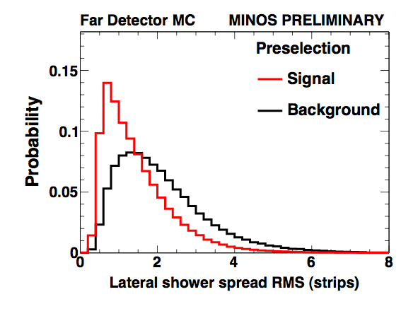
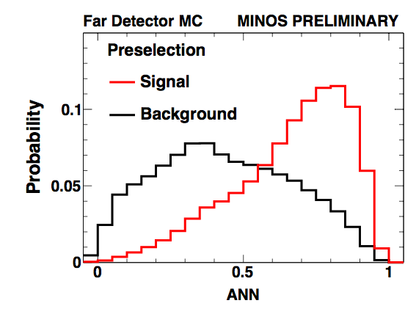
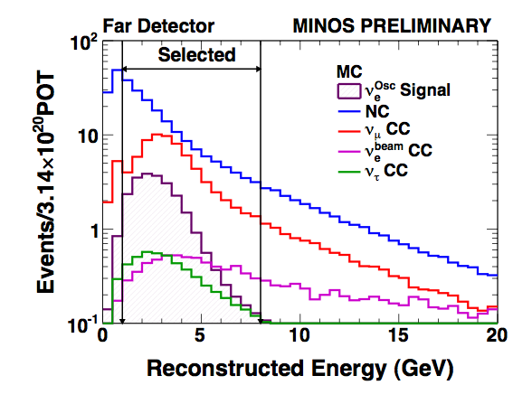
Selecting νe events with ANN
event characterization in length, width and shower shape
Example
...
...
11 variables chosen describing length, width and shower shape.
ANN algorithm achieves:
  signal efficiency 41%
  NC rejection >92.3%
  CC rejection >99.4%
  signal/background 1:4
Area Normalized
Δm²32=0.0024 eV², sin²θ23=1.0

Slide 46
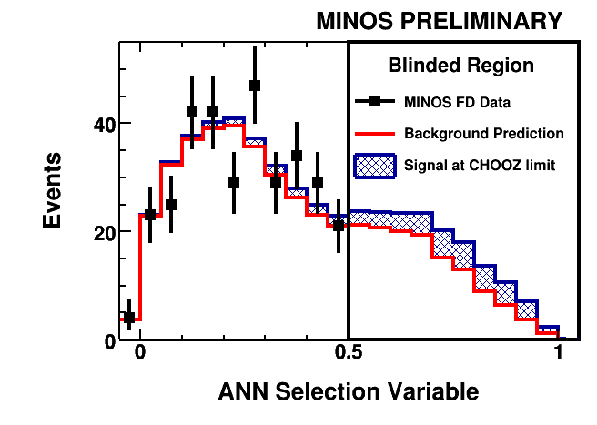

fD data
sideband
selected
observe a total of 54 events
expect 49.1±7(stat)±2.7(sys) background events
Difference of 4.9 events
0.7sigma excess
observe a total of 327 events.
Expect 314±18(stat)
Difference of 13 events also consistent with chooz limit
0.75 sigma excess

Slide 47


MINOS 90% C.L. for sin²2θ13
Anti-neutrino reach

Slide 48

Sensitivity
T2K
MINOS
Double Chooz
MINOS?
this summer
2.0 years
Results available ➔
1 month from now
1.0 year

Slide 49
Search for sterile neutrinos

Slide 51

Neutral Current Near Event Rates
Neutral Current event rate should not change in standard 3 flavor oscillations
A deficit in the Far event rate could indicate mixing to sterile neutrinos
  ν_{e} CC events would be included in NC sample, results depend on the possibility of ν_{e} appearance

Slide 52


Neutral Currents in the Far Detector
Expect: 757 events
Observe: 802 events
No deficit of NC events
Rules out sterile neutrinos between about 0.4eV² and 5eV², and with probability >~ 0.04
Anti-neutrinos???

Slide 53

Last but not least
MINOS has the biggest collection of neutrino data in the world
ND is the first neutrino experiment not to be statistics limited!!
In the ND, cross sections have been measured
Most precise data in the world across a large energy region

Slide 54
Minos+
What can MINOS contribute to the neutrino knowledge in the future

Slide 55
What do we know
Neutrino Oscillations have been discovered?
  Non conservation of CC event rate over distance
Precision measurement of oscillation parameters has been made by MINOS/SK?
  5-10% errors on parameters of the MODEL!
This has convinced everyone that the first matrix to be written down is correct
  Throw away all the rest of the information to focus on one parameter of this matrix, θ₁₃

Slide 56

Precision Measurement?
Z line-shape from ALEPH

Slide 57

Precision Measurement
In fact this precision measurement is so convincing that we have decided (world wide) to throw away all the other information: area under the black points will be lost!
~4000 events/year between 4-10GeV

Slide 58

Precision Measurement?
Initial estimates give ~3000 events in this region in one year of Nova running (about 2x what we have in the LE peak region after ~5 years running)
In 4-10 GeV region error bars go from 25%/GeV to ~5%/0.5GeV after 2 years

Slide 59

Ratio of oscillated to non-oscillated
All estimates, no responsibility

Slide 60


MINOS, MINOS+ and NOνA
All estimates, no responsibility
One year of MINOS+
MINOS continues to dominate Δm² measurement
NOνA 50% complete
Three years of MINOS+
NOνA complete after first 18 months
Significant improvements to parameters’ accuracy over 3 years period due to MINOS+

Slide 61

Summary of precision
All estimates, no responsibility

Slide 62


Sterile Neutrinos
Structure could be resolved (smaller Δm²₂₄)
Just rate comparison across 4-10 GeV will be precise measurement for larger Δm²₂₄
Could be augmented by ND measurements if beam flux was better known

Slide 63

Non standard interactions
Our anti-neutrino result has at least motivated some work from the theorists
Note the NSI has a measurable effect in neutrinos as well as antineutrinos
Comparison of low energy to high energy behaviour could disentangle this without anti-nu running
J. Kopp, P.A.N. Machado and S.Parke, Phys.Rev.D82:113002,2010

Slide 64

Extra Dimensions
P.A.N.Machado,H.Nunokawa,R.Zukanovich Funchal,hep-ph/1101.003v1
Assumes RH (sterile) neutrino + extra dimensions!
After 1 year post nova running

Slide 65

Extra Dimensions
P.A.N.Machado,H.Nunokawa,R.Zukanovich

Slide 66
Beam
Off axis Noνa ND
On Axis MINOS ND
Electron component Minerνa
A good flux measurement helps everyone
  We do not have precision on this yet!
  Expectation of < 5% per 0.5 GeV bin

Slide 67
Neutrino mass
It is arguable that the fact of neutrino mass does tell us that there is physics at the GUT scale
The massive RH-Majorana neutrinos which seem to be there naturally via the see-saw mechanism are the favored explanation as to why neutrino mass is so small
We should look everywhere for this evidence, not just in ν_{μ}->ν_{e}
The NuMI/MINOS/Nova facility will be unique in the world
  No other wide band/narrow band beam facility exists now

Slide 68
CONCLUSION
MINOS has made a step change in our understanding of neutrino oscillation parameters and cross sections using accelerator generated neutrinos
Some interesting measurements still to be made in the neutrino oscillation field
  MINOS: θ_{13 ,} anti-neutrinos
  Nova and T2K: θ₁₃
  MINOS+ intermediate energies
  OPERA : more tau events
The new understanding of neutrino oscillations puts a search for fundamental neutrino type (Majorana or Dirac) into the forefront, and into a window of experimental opportunity

Slide 69

Lets not be arrogant about what we expect to see:
no reason for standard hierarchy, or dirac neutrinos

