Slide 1
Topological Solitons as Probes of New Physics
Yu Hamada (DESY)
Theory Fellows Meeting, 6th Dec 2023 @ DESY

Slide 2
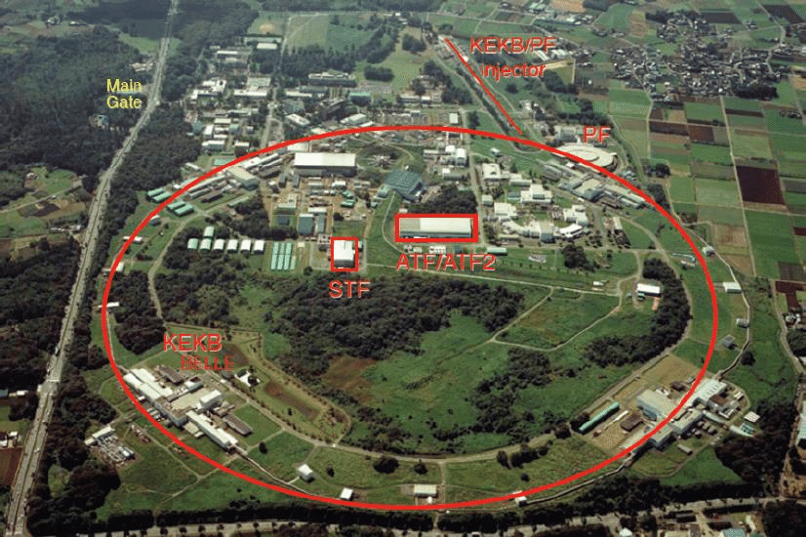
About myself
Bachelor's, Master's & PhD in Kyoto
1st postdoc in KEK, Tsukuba
born in Amagasaki
(next to Osaka)

Slide 3
About physics...
Although the SM is established by discovery of Higgs boson, there are still many problems.
Dark matter
Neutrino mass
Baryon asymmetry
strong CP problem
etc.
There must be new physics beyond SM!

Slide 4
Research topics
Functional (Wilsonian) renormalization group in QFT
DM phenomenology (pseudo Nambu-Goldstone DM)
$μ^{+}$ collider ( $μ$TRISTAN )
Topological soliton
today
seems like random...
but all of them are aimed to discover new physics

Slide 5
Topological Soliton
Particle：fluctuation around vacuum
Soliton：classical and coherent excitation (``lump’’)
KdV soliton: solution of non-linear wave eq.
Tsunami
``Collision of KdV solitons’’ (from YouTube)

Slide 6
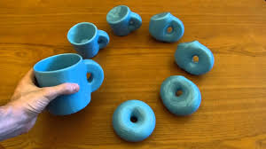
Topological Soliton
Topology $≃$ rough structure independent of details
Topological soliton
= soliton whose existence is ensured by topology of theory

Slide 7
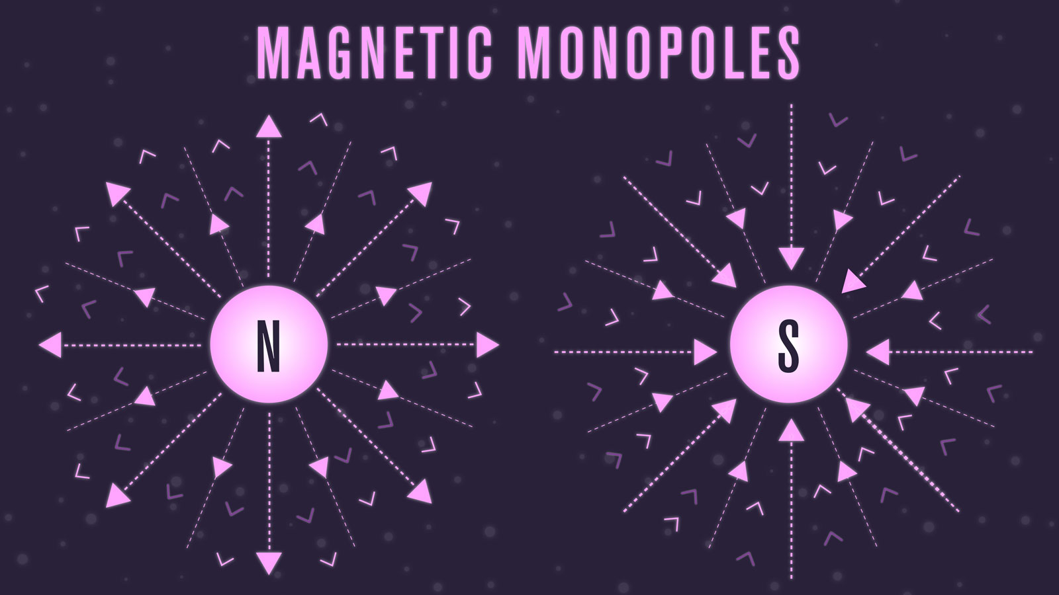
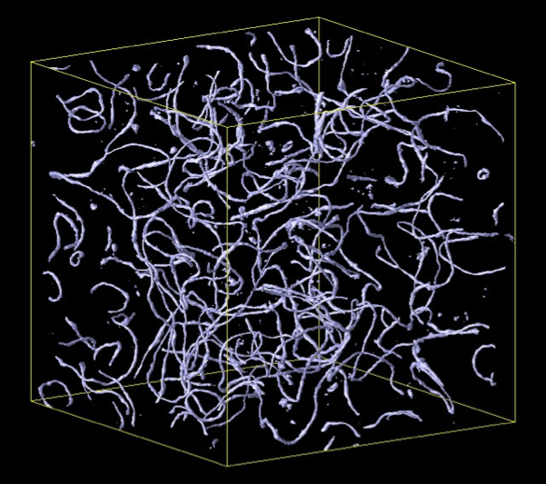
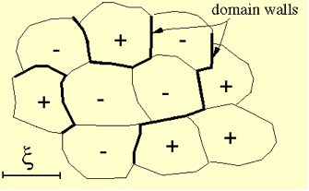
Topological Soliton
popular examples:
GUT monopole
exists when $G→U(1)×G^{′}$
Cosmic string (e.g. axion string)
exists when $U(1)→1$
Domain wall
exists when $Z_{n}→1$
might remain in the universe
→ probes of new physics!

Slide 8
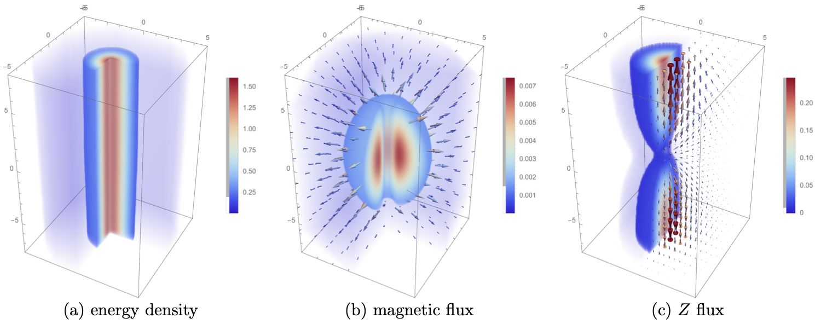
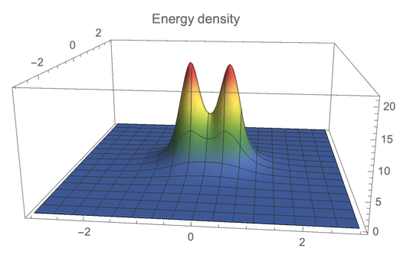
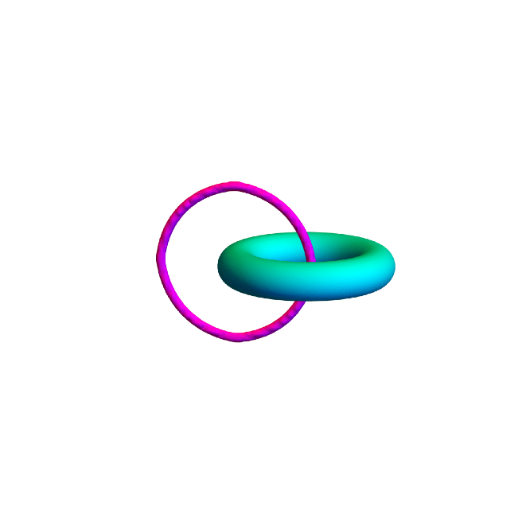
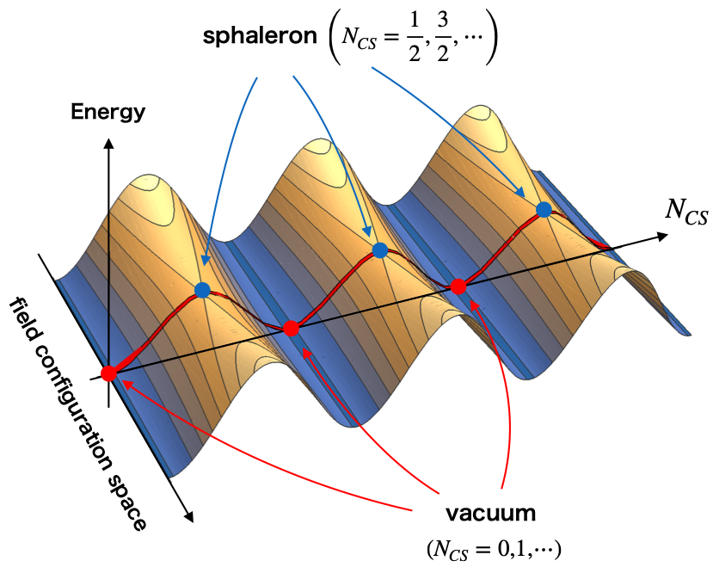
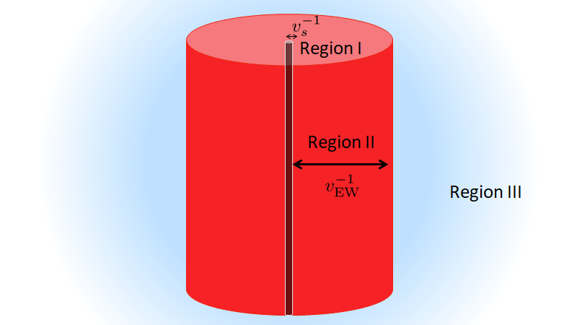
Some of our works
magnetic monopole in 2HDM
polarized cosmic string in 2HDM
knot soliton
electroweak axion string w/ superconductivity
sphaleron

