Slide 1
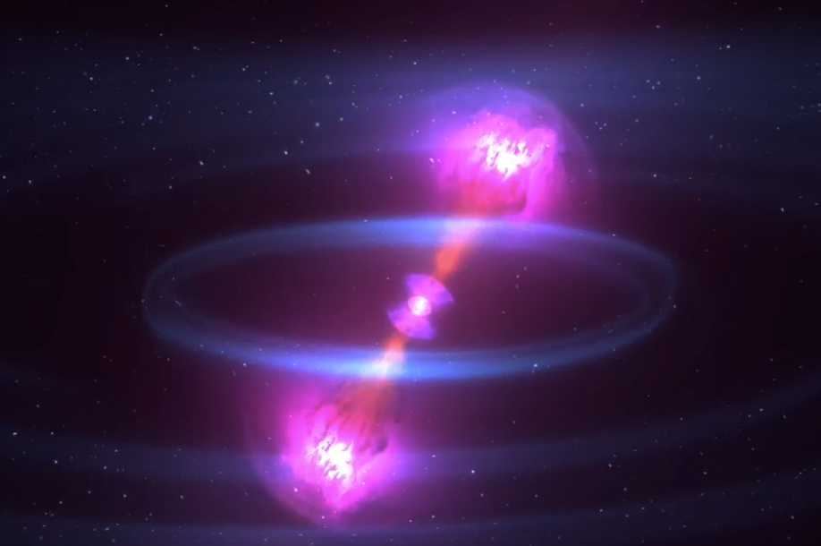
Welcome!
Einstein Telescope Community Meeting Germany 2024
23. April 2024 Michèle Heurs, Leibniz Universität Hannover, Germany

Slide 2
Where are we now?
After long „genesis“, ET Collaboration officially exists since June 2022
Structure (Collaboration and Organisation) is growing, committees being formed
Germany: now 12 (13?) RUs with 200+ members
Many successes in the past ~18 months!
New round of BMBF Verbundforschung
Community roadmap processes on the way (KAT & RdS)
Federal funding for ET-related investigations
DZA granted
...

Slide 3
Goals of today‘s meeting (non-exclusive)
Update on current status and new developments (organisationally and scientifically)
Connect (more) between groups in Germany
Collect input for next meeting(s)
This year?
In person?

Slide 4
Schedule and modalities
This is an online meeting – it lives from your participation!

Slide 5
Schedule (cont.)
This is an online meeting – it lives from your participation!

Slide 6
Schedule (cont.)

