Slide 1
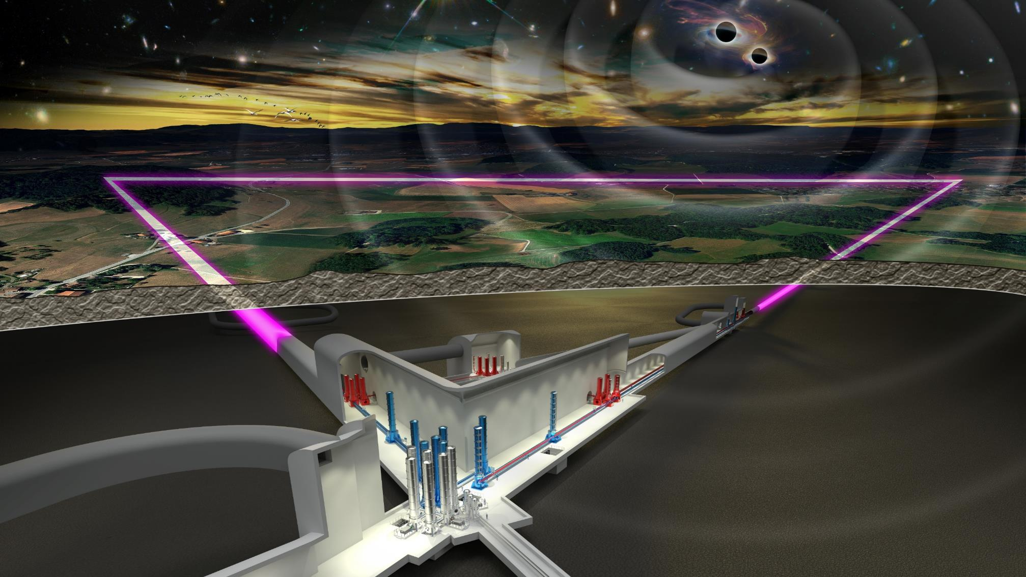
Einstein-Telescope
An overview
Harald Lück
AEI Hannover
Max-Planck Institute for Gravitational Physics
Leibniz Universität Hannover, Institute for Gravitational Physics
ET Germany Community Meeting 2024

Slide 2
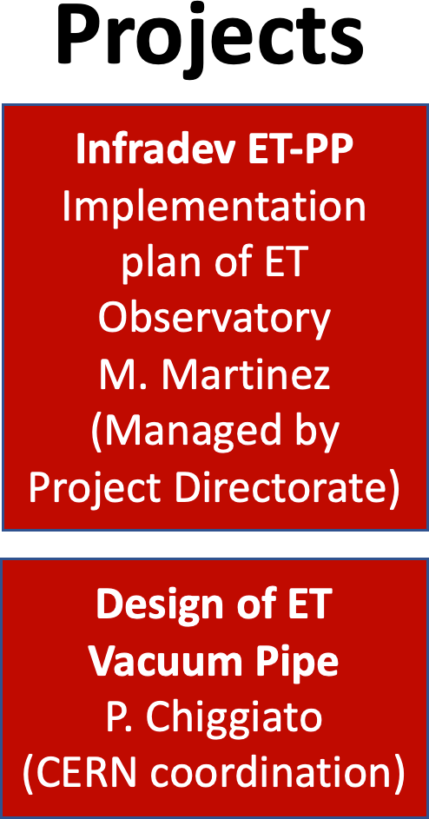
ET Project: Current Organization
ETO: ET Organization
ET Collaboration
ET Proto-Council
ESFRI
Coordinators
S. Bentvelsen
A. Zoccoli
BGR
Board of Government Representatives
Spokesperson: M. Punturo Deputy: H.Lück
CB
Collaboration Board
BSR
Board of Scientific Representatives
EB
Executive Board
SSB
Standard & Services Board
ISB
Instrument Science Board
EIB
E-Infrastructure Board
External Advisory Bodies
ET Project Directorate
A.Freise, F.Ferroni
M. Martinez
Civil Engineering
(CERN advisory)
OSB
Observational Science Board
SPB/SCB
Site Preparation/ Characterization
Admin. Offices
Eng. Dept
Project Off.
Communic.
Off.
National Host Teams
EMR
Host Team
Private companies
Sardinia Host Team
Private companies

Slide 3
ET Project: Current Organization
ETO: ET Organization
ET Collaboration
ET Proto-Council
ESFRI
Coordinators
S. Bentvelsen
A. Zoccoli
BGR
Board of Government Representatives
Spokesperson: M. Punturo Deputy: H.Lück
CB
Collaboration Board
BSR
Board of Scientific Representatives
EB
Executive Board
SSB
Standard & Services Board
ISB
Instrument Science Board
EIB
E-Infrastructure Board
External Advisory Bodies
ET Project Directorate
A.Freise, F.Ferroni
M. Martinez
Civil Engineering
(CERN advisory)
OSB
Observational Science Board
SPB/SCB
Site Preparation/ Characterization
Admin. Offices
Eng. Dept
Project Off.
Communic.
Off.
National Host Teams
EMR
Host Team
Private companies
Sardinia Host Team
Private companies

Slide 4
ET Project: Current Organization
ETO: ET Organization
Temporary groups, working towards becoming the ET governing body, such as a Council. Our most important link to governments and funding agencies (Austria, Belgium, France, Italy, Netherlands, Poland, Spain, UK are members with Germany as observer).
ET Proto-Council
ESFRI
Coordinators
S. Bentvelsen
A. Zoccoli
BGR
Board of Government Representatives
BSR
Board of Scientific Representatives
External Advisory Bodies
ET Project Directorate
A.Freise, F.Ferroni
M. Martinez
A small but active organisation with the formal responsibility to realise ET. A future legal entity for ET would be based on this structure.
Admin. Offices
Eng. Dept
Project Off.
Communic.
Off.
Credit: A. Freise

Slide 5
ET Project: Current Organization
German Contributions: WP3: Financial
WP4: Site Characterisation
WP6: Collaboration WP8: Computing WP10: Communication
Main activities:
Structuring the ET legal entity
Defining its governance
Defining its technical bodies
Financial aspects of ET
Manage the relationship of the ET project with the European Commission framework (ESFRI)
More than 120km of vacuum pipes
Define the technical design of the vacuum pipe with a clear target in the cost reduction
Propose innovative materials and solutions
Joint developments with CERN involving ET and CE
Profit of the CERN expertise in large civil and technical underground research facilities
Develop together, in collaboration with external companies, the design of the ET facilities
Civil Engineering
(CERN advisory)

Slide 6
ET Project: Current Organization
ETO: ET Organization
ET Collaboration
ET Proto-Council
ESFRI
Coordinators
S. Bentvelsen
A. Zoccoli
BGR
Board of Government Representatives
Spokesperson: M. Punturo Deputy: H.Lück
CB
Collaboration Board
BSR
Board of Scientific Representatives
EB
Executive Board
SSB
Standard & Services Board
ISB
Instrument Science Board
EIB
E-Infrastructure Board
External Advisory Bodies
ET Project Directorate
A.Freise, F.Ferroni
M. Martinez
Civil Engineering
(CERN advisory)
OSB
Observational Science Board
SPB/SCB
Site Preparation/ Characterization
Admin. Offices
Eng. Dept
Project Off.
Communic.
Off.
National Host Teams
EMR
Host Team
Private companies
Sardinia Host Team
Private companies

Slide 7
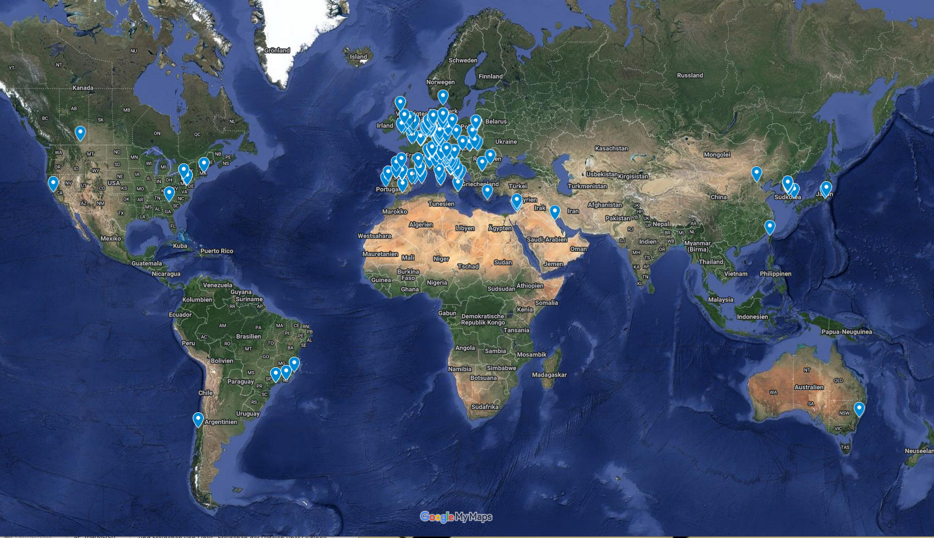
ET Member‘s Affiliation Map
1644 members (22.4.2024)
88 Research Units
Total: 238 Institutions
in 28 Countries
Notes:
https://www.google.com/maps/d/u/0/edit?mid=1GZXaOjNPYvHeVi_1EKBrwX9kkploa8M&ll=3.7269142217833036%2C0&z=3

Slide 8
The Einstein Telescope Collaboration
~200 members in Germany
Notes:
Message from Hungary: due to the present governmental and administrative situations at our university and in our country, some reorganization has become necessary in connection with the ET-related activities.
Therefore, the activity of the BME group will be discontinued starting with February, so I would like to ask you to delete the BME group from the ET database.
However, some of us from the BME group will join the Wigner group (Hungary), and the corresponding RU leader will register us accordingly.

Slide 9
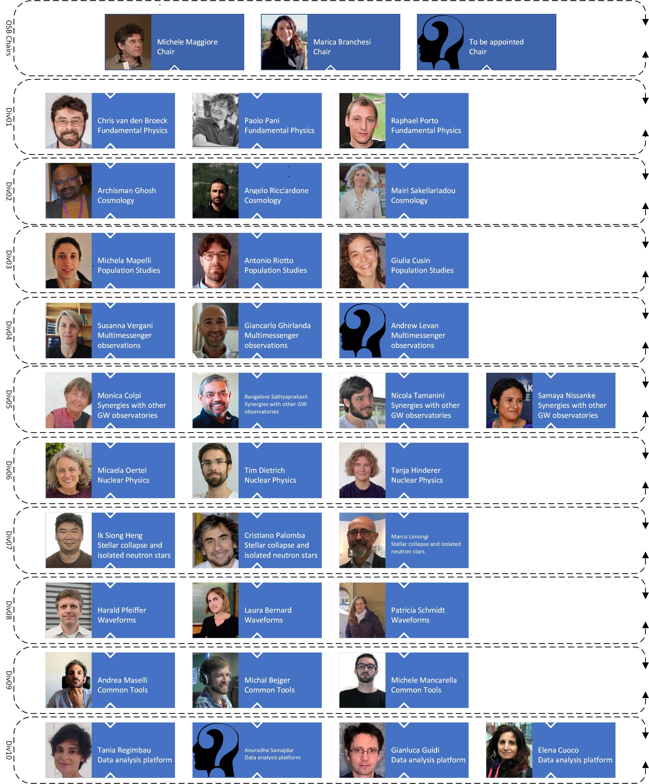
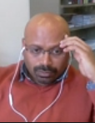
The Observational Science Board
Archisman Gosh Chair
Mandate:
develop the Einstein Telescope science case
start building the ET scientific community,
bring it to the maturity to exploit the data taken when ET will start operation
12

Slide 10
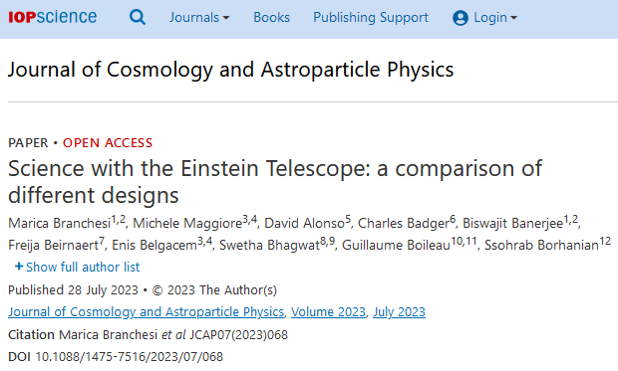
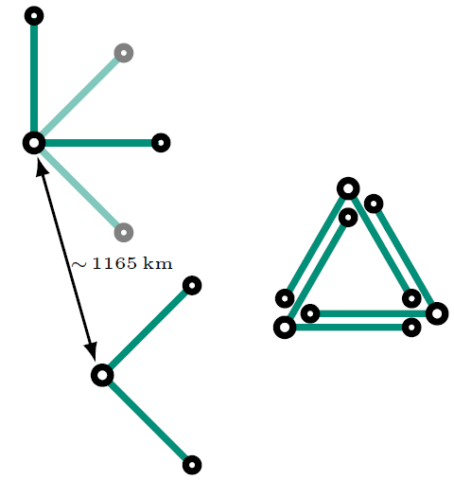
OSB Activities: Cost Benefit Analysis
Compares different geometries
2L vs triangle, Network capabilities (+CE40/20)
10 km, 15 km, 20 km length
ET-HFLF cryogenic vs ET-HF only
Influence on science cases:
Numbers of events (BBH,BNS,BHNS)
Pointing → Multi Messenger Astronomy
Impacts on specific science cases (near BH horizon physics, nuclear physics, population studies, cosmology, stochastic backgrounds, CW sources)
Null stream, correlated noises
Notes:
Mention ETRAC

Slide 11
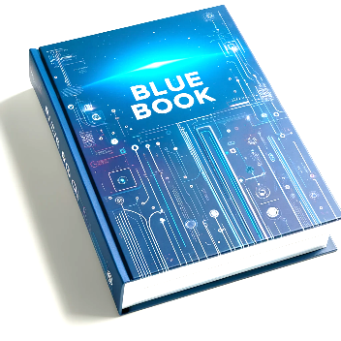
Activities: Observational Science Board
COBA study: Document to inform the detector design (triangular vs 2L) [Branchesi et al., JCAP 07 (2023) 068]
Blue Book:
Living document that summarizes and updates original work related to ET
Update to the ET science case
To be published in 2024
Address the optimization of the science return of ET
Start to develop data analysis tools and algorithms for ET
Strengthen the collaboration with partners in
multimessenger astronomy
13

Slide 12
The Instrument Science Board
ET Instrument Science Board (ISB) Organigram
ISB-cochair
ISB-cochair
Stefan Hild
Jan Harms
Division Cochair
Division Cochair
Division Cochair
Division Cochair
Division Cochair
Division Cochair
Division Cochair
Division Cochair
Division Cochair
Division Cochair
Alessandro Bertolini
Francesco Fidecaro
Edwige Tournefier
Stuart Reid
Jérôme Degallaix
Stefan Danilishin
Steffen Grohmann
Fulvio Ricci
Luca Naticchioni
Conor Mow-Lowry
WP Cochair
WP Cochair
WP Cochair
WP Cochair
WP Cochair
WP Cochair
WP Cochair
WP Cochair
WP Cochair
WP Cochair
Roberto Passaquieti
Oliver Gerberding
Alex Amato
Iain Martin
Mikhail Korobko
Teng Zhang
Antonio Pasqualetti
Philippe Rosier
Soumen Koley
Maria Tringali
Suspension chain
Core optics LF
Observatory design and noise budget
Tower Vacuum
Newtonian Noise
WP Cochair
WP Cochair
WP Cochair
WP Cochair
WP Cochair
WP Cochair
WP Cochair
WP Cochair
WP Cochair
WP Cochair
Paola Puppo
Jan-Simon Hennig
Jessica Steinlechner
Benoît Sassolas
Julia Casanueva
Daniel Brown
Paolo Chiggiato
Aniello Grado
Mariusz Suchenek
Rosario De Rosa
Payload design
Core optics HF
Optical layout, sensing and control scheme LF
Environmental Sensors
WP Cochair
WP Cochair
WP Cochair
WP Cochair
WP Cochair
Giles Hammond
Flavio Travasso
Margherita Turconi
Benno Willke
WP Cochair
WP Cochair
Nick van Remortel
WP Cochair
WP Cochair
Antonio Perreca
Anna Green
Barbara Garaventa
Irene Fiori
Test mass suspensions
Lasers
Optical layout, sensing and control scheme HF
Pipe Arm Vacuum
Magnetic Noise
WP Cochair
WP Cochair
WP Cochair
WP Cochair
WP Cochair
WP Cochair
WP Cochair
WP Cochair
WP Cochair
WP Cochair
Chrsitophe Collette
Alberto Gennai
Keiko Kokeyama
Michal Was
Bas Swinkels
Loïc Rolland
Christian Day
Roberto Cimino
Paolo Ruggi
Sina Koehlenbeck
Seismic isolation platform
Input and output optics
Data acquisition and real time control
Cryostats and Cryopumps
Inter-platform motion
WP Cochair
WP Cochair
WP Cochair
WP Cochair
WP Cochair
Division Cochair
WP Cochair
WP Cochair
Franco Frasconi
Joris van Heijningen
Giacomo Ciani
Henning Valbruch
Thierry Pradier
Steffen Grohmann
Kate Dooley
Artem Basalaev
Auxiliary optics suspensions
Squeezed light
Calibration
Cryogenic Infrastructure
LF control noise
WP Cochair
WP Cochair
WP Cochair
WP Cochair
WP Cochair
WP Cochair
Alessio Rocchi
Martin van Beuzekom
Lucia Trozzo
Nicolas Arnaud
Piero Rapagnani
Steffen Grohmann
Wave-front sensing and control
Noise characterisation
Detector Cooling
WP Cochair
WP Cochair
WP Cochair
WP Cochair
10
Active Noise Mitigation
Livia Conti
Mario Martinez
Sebastian Steinlechner
Oliver Gerberding
Scattered light
Optics
Modelling and design tools
Interferometer
Suspensions
Vacuum and Cryogenics

Slide 13
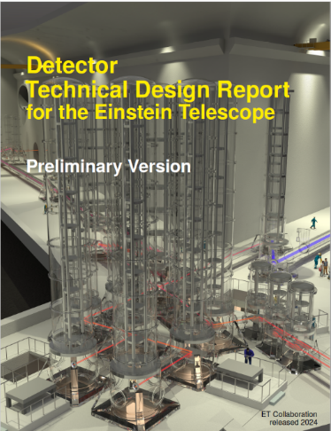
Activities: Instrument Science Board
Main target: Produce the Technical Design Report (TDR) of the ET detectors
Optical layout update
Provide input to the ETO engineering department to realize the civil infrastructure layout
Both triangular and L geometries to be provided
Product breakdown structure (PBS) produced in coordination with the Project Office
A list of about 1000 PBS elements for ET-LF and about 800 elements for ET-HF
Production of a parameter table for each PBS element
Structuring a relational database to manage information
Both triangular and L geometries to be managed
Table of content of the TDR almost defined
Preliminary TDR document due later in 2024
Coordination of the R&D activities to develop the ET enabling technologies
11
Notes:
CERN
Infrastructure TDR
Beam Pipe Vacuum TDR

Slide 14
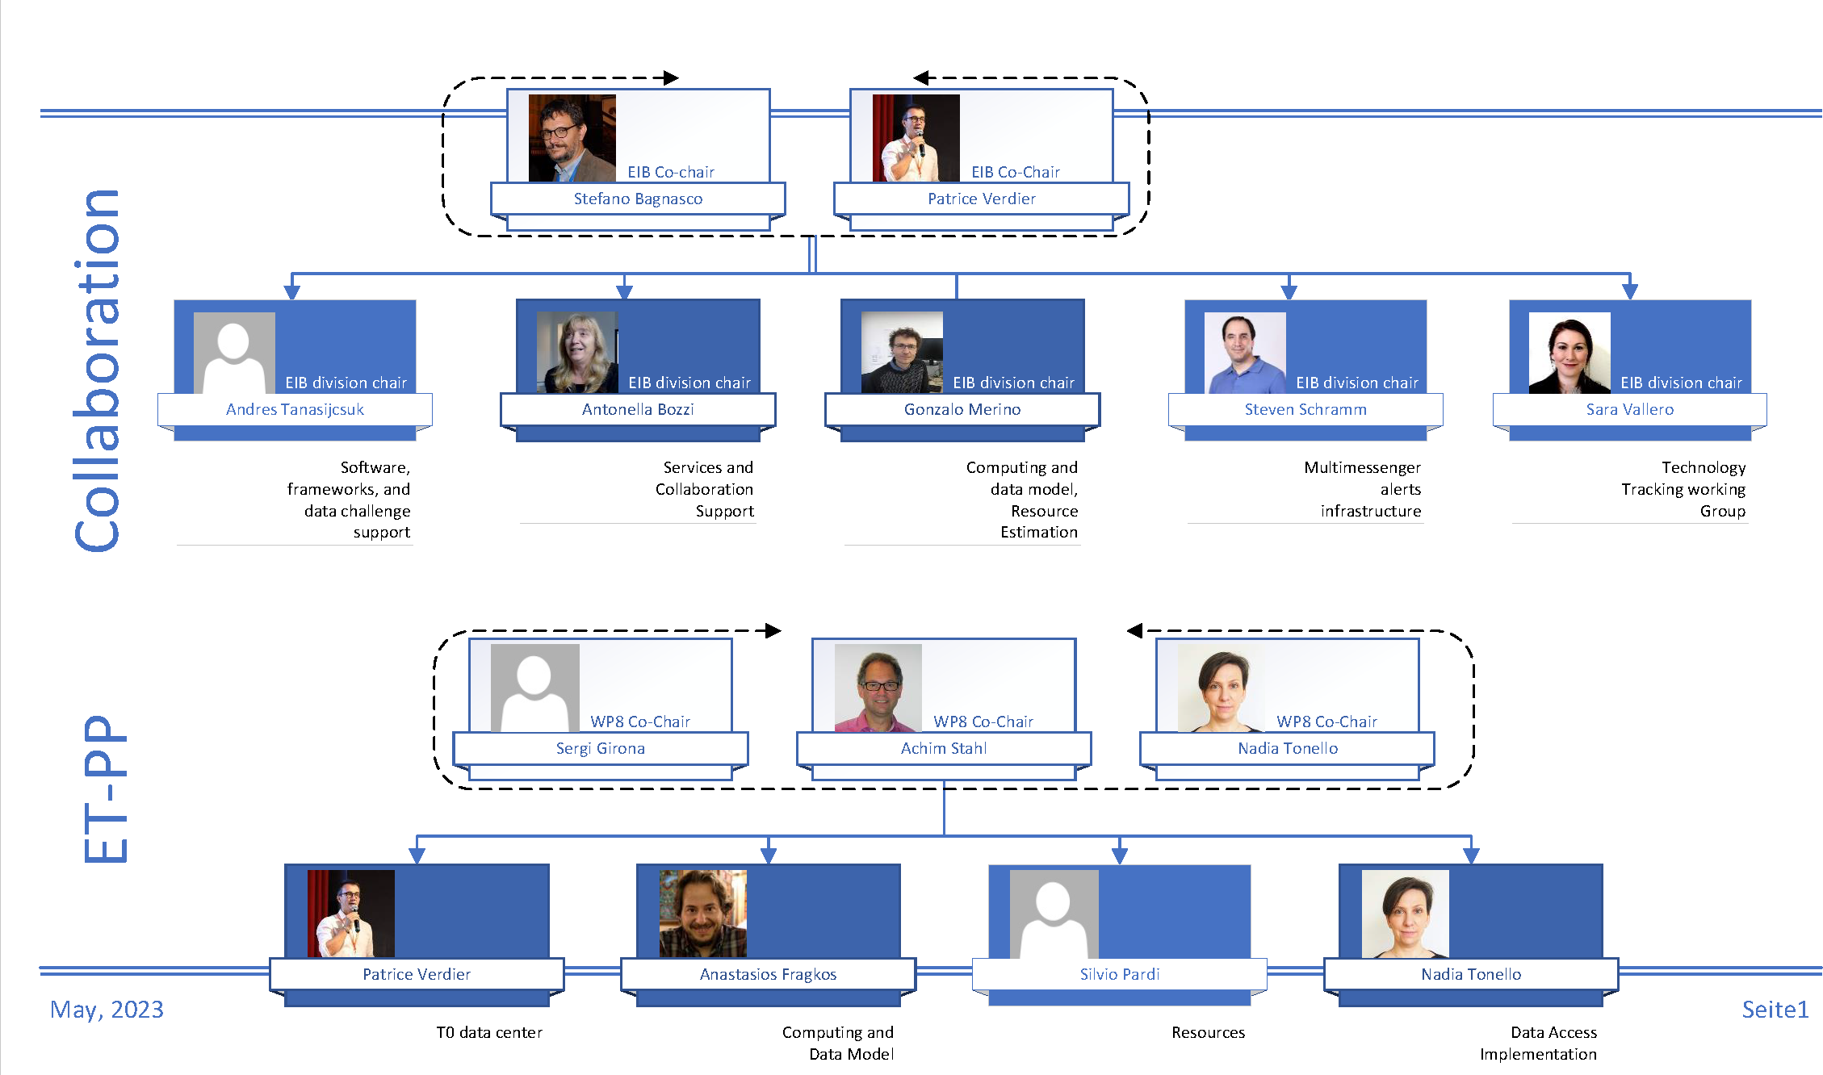
The e-Infrastructure Board
Mandate :
Design, create and operate an evolving, efficient and functional e-infrastructure environment at a reasonable cost
Initial focus is on the development of a computing model for the ET
14

Slide 15
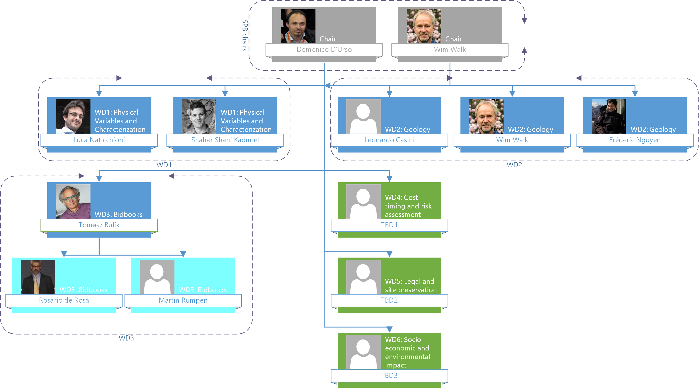
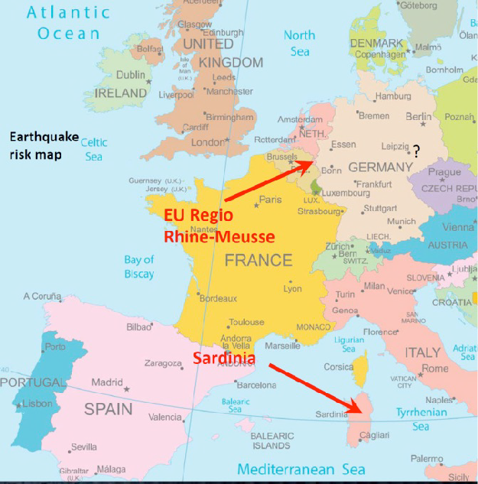
The Site Characterization/ Preparation Board
Current site characterisation activities, see Session @ 10:30
ET candidate sites
Two official host candidate sites:
EMR EUregio, border region between The Netherlands, Belgium and Germany
Sardinia (Lula area, Barbagia)
National host teams formed and are operative
Large contracts with private companies are signed
Geophysical, geologic and geotechnical evaluation of the site
Pre-feasibility engineering study
1
5

Slide 16
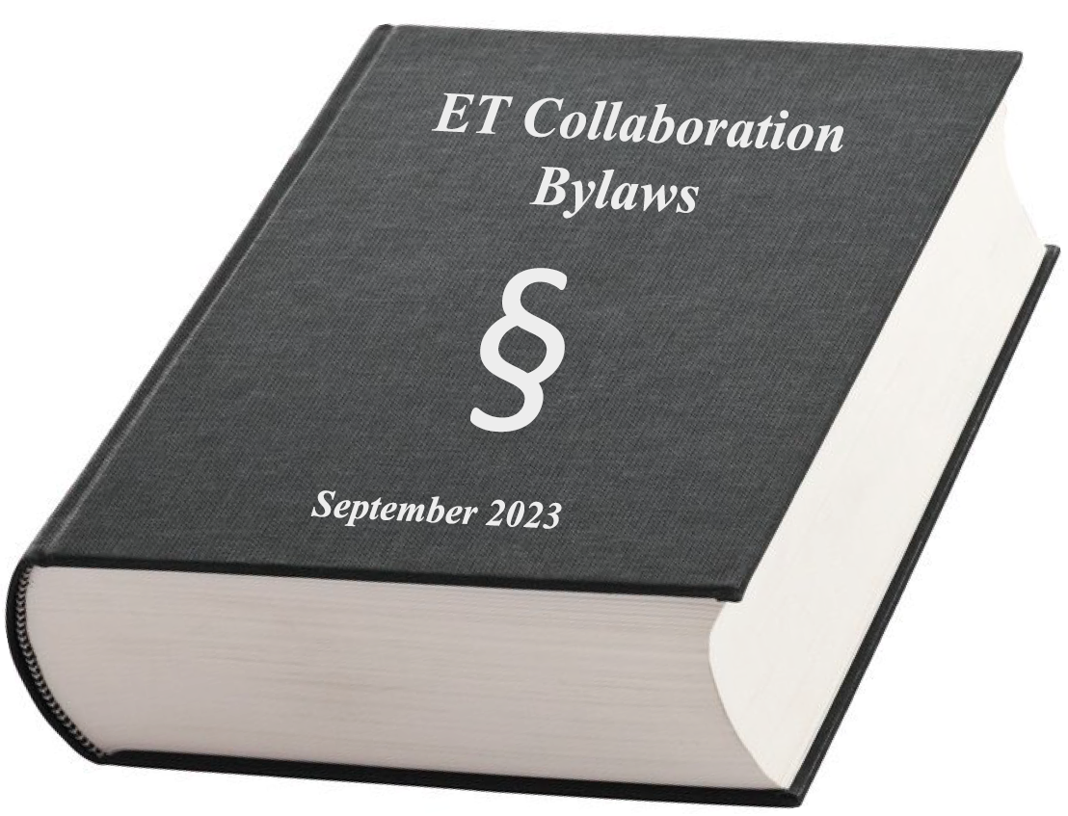
The ET Collaboration
Service and Standards Board: the elected Committee Chairs
Project Program Committee (PPC)
Ettore Majorana (ET-Roma1)
Early Career Scientists Support Committee (ECSS)
Anna Green (Vrije Universiteit Amsterdam)
Member Conduct and Ethics Committee (EMCC)
Monique Bossi (INFN Perugia)
Speakers and Awards Committee (SAC)
Luca Naticchioni (ET-Roma1)
Editorial Committee (EC)
Paola Leaci (ET-Roma1)
Election, Voting, and Membership Committee (EVMC)
Mariafelicia De Laurentis (Napoli)
Meetings and Symposia Committee (MSC)
Jessica Steinlechner (Maastricht University)
Communications and Education Committee (CEC)
Susanne Milde (Hannover)
Bylaws Updating Committee (BUC)
Harald Lück (Hannover)
https://apps.et-gw.eu/tds/?content=3&r=18634

Slide 17
ET Member Data Base (ETMDB)
ETMDB-how-to
https://wiki.et-gw.eu/Main/ETMD
Activate here: https://userprofile.ego-gw.it/
EGO Active Directory account needed, with which to access the ET web services.
Apply for an account here:
https://userprofile.ego-gw.it/accountrequest.aspx
choosing the 'ET member' option.
For those who have an account, but are unable to access their ETMD profile, please reset your password associated to the account, here:
https://userprofile.ego-gw.it/resetpwd.aspx
For all else - queries or general issues regarding the accounts or accessing any of the web services -
please send an email to service@ego-gw.it.
Maintain your profile!Check declared activities.
Lack of manpower; reported activities from WGs do not match pledged activities in ETMD
45 members from Germany never got an et-all mail and won‘t get any! (28%) 11 have not even got an ET account!

Slide 18
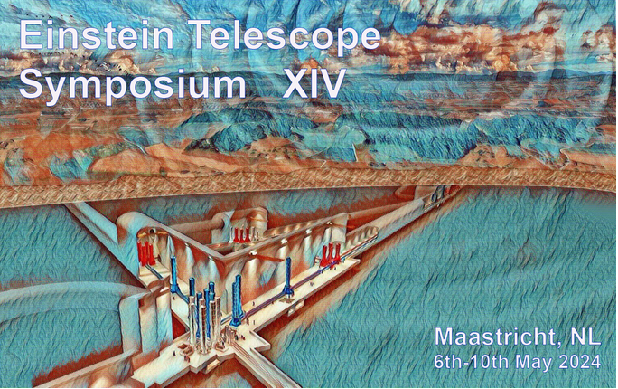
ET Symposium
XIV ET symposium, Maastricht: 6-10 May 2024 → registration open https://indico.ego-gw.it/event/710
Please participate
And if you have not yet registered, do so TODAY!

