Slide 1
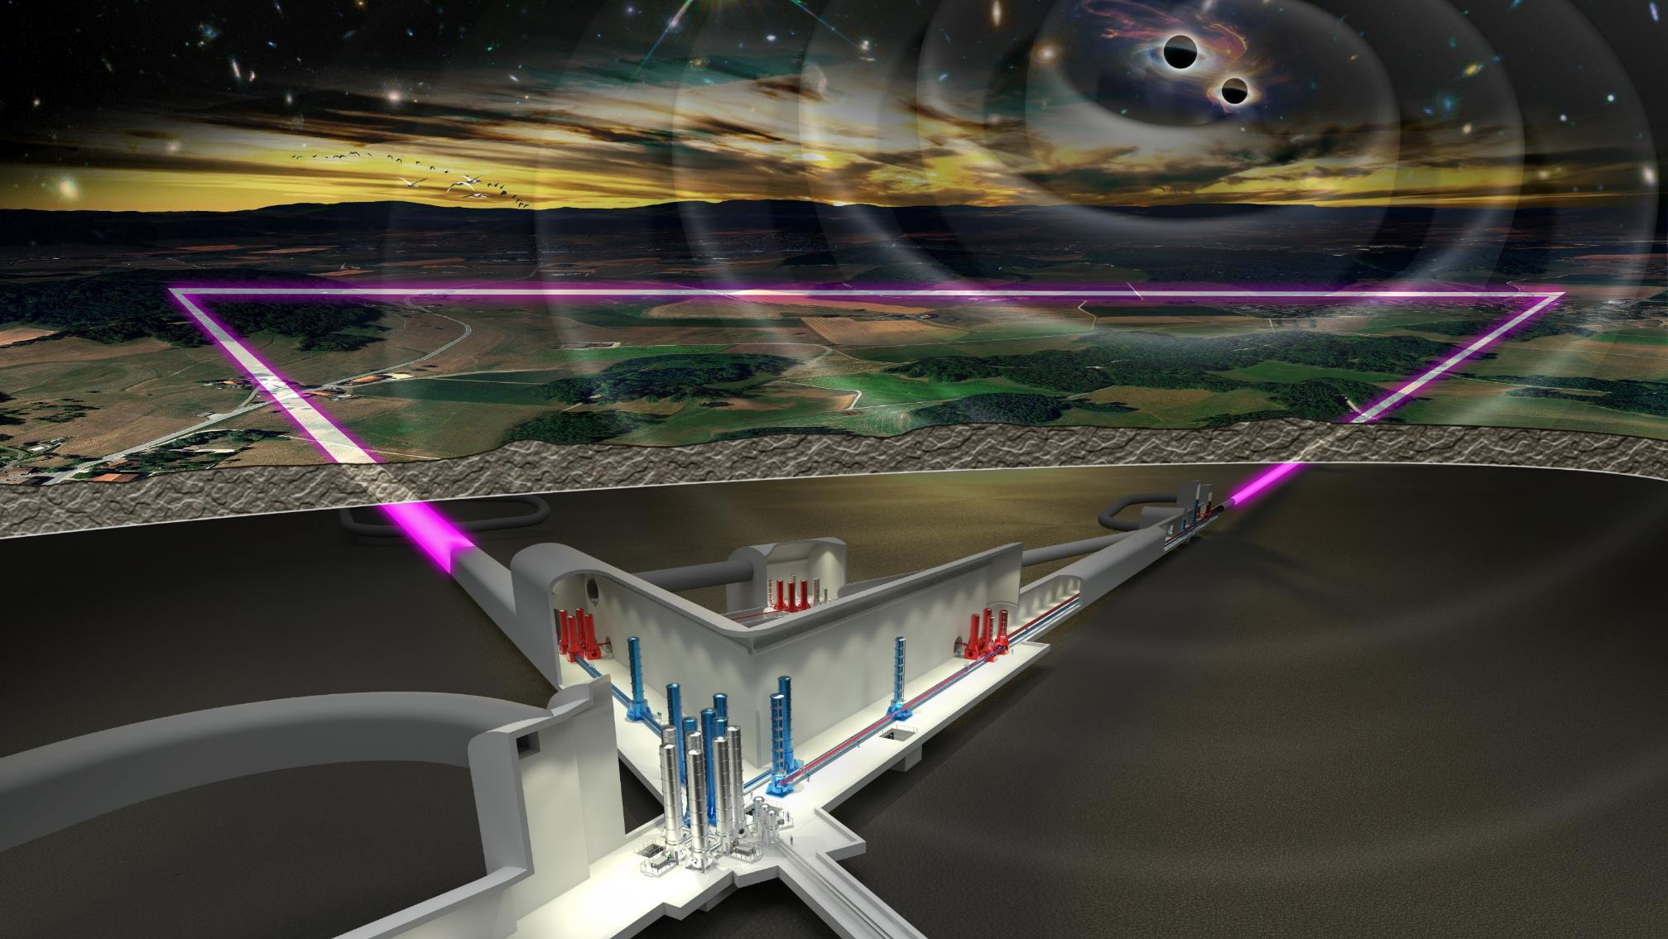



Einstein-Telescope
Interferometry
Harald Lück
AEI Hannover
Max-Planck Institute
for Gravitational Physics
Leibniz Universität Hannover,
Institute for Gravitational Physics
ET Germany
Community Meeting 2024
Notes:
I added notes to the presentation to make it more self explanatory

Slide 2


ET - Xylophone Concept
ET - LF
low-power, cryogenic
low-frequency detector
ET – HF
high-power, room-temperature
high-frequency detector
300 K
  ET-HF:
  1064 nm Laser (500W)
  High circulating light power, 3MW
  Thermal compensation
  Large test masses (SiO2, 200kg)
  New coatings
  Frequency dependent squeezing
10 – 20 K
  ET-LF:
  Cryogenics
  Long Seismic suspensions (17m towers)
  Silicon (Sapphire) test masses
  Large test masses (200kg, 45cm diam.)
  New coatings
  New laser wavelength (1550nm)
  + low power
  Frequency-dependent squeezing
Notes:
Why do we need these components?

Slide 3
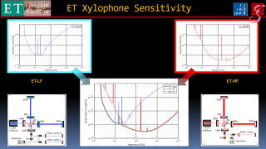
ET Xylophone Sensitivity
ET-LF
ET-HF

Slide 4
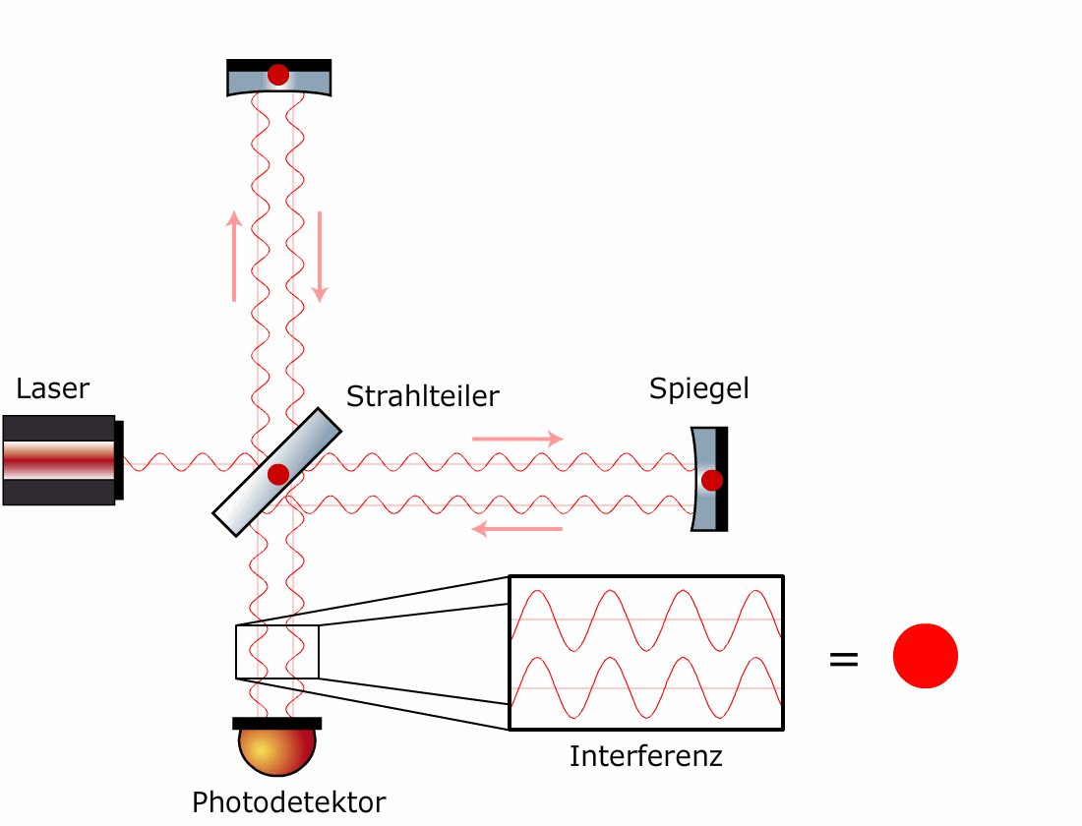
Operation Principle
The GW changes
differential arm lengths
Changes interference conditions at output
Michleson converts
Δphase in arms → amplitude @ output
Notes:
A simple Michelson Interferometer converts differential phase changes
into amplitude changes on the photodetector, such that we can measure them

Slide 5
Output port in the Phasor picture
- making one arm longer
(moving the mirror by ½ λ)
Im(E)
East arm
L
Laser
Re(E)
Photo diode
Notes:
The phase (depicted by the phasor here) of the light returning from one arm (here the east one) moves in one direction

Slide 6
Output port in the Phasor picture
- making the other arm shorter
(moving the mirror by ½ λ)
Im(E)
North arm
L
Laser
Re(E)
Photo diode
Notes:
While the light from the other arm, being changed by the gravitational wave in the opposite direction moves the other way.

Slide 7
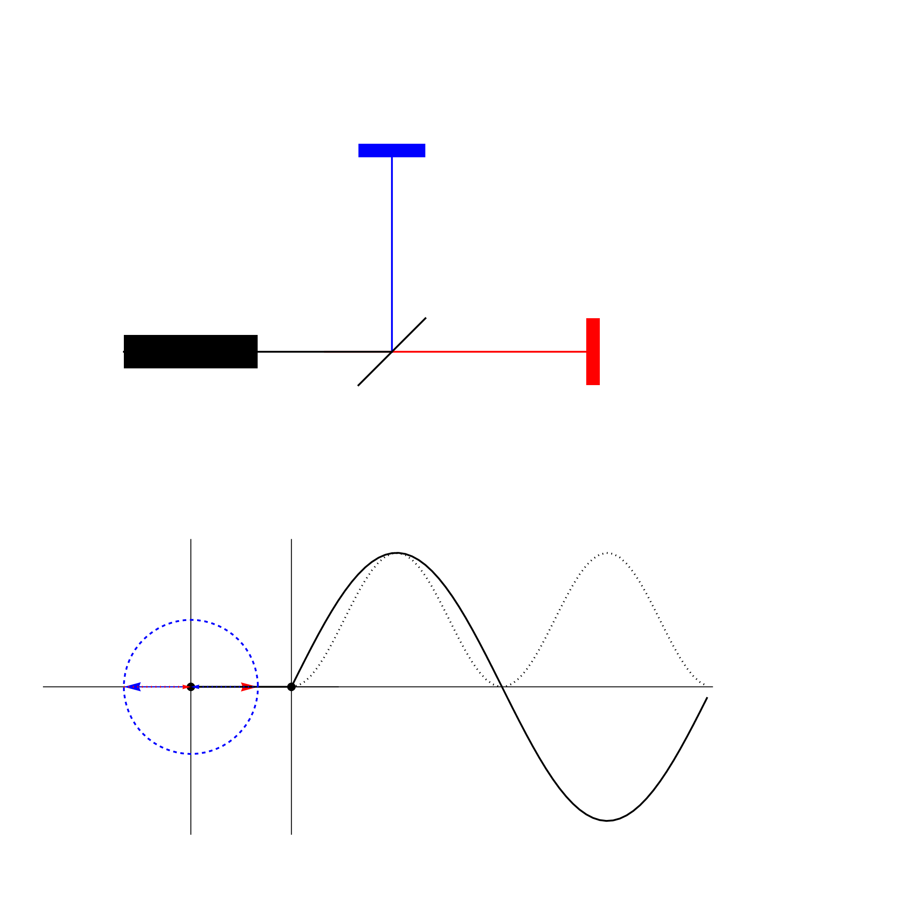
Output port in the phasor picture
Moving the mirrors by 1/2 l
Mirror 1
Field from North and East arm
add at the beam splitter
Resulting field = sum of the two partial fields
Detect Power by a Photo Detector
Beam
Splitter
Laser
Mirror 2
PD
Amplitude
Power @ PD
Time
Notes:
Adding the two oppositely phase modulated beams from the arms gives an amplitude modulated beam at the output.
The interferometer converts Phase modulation with the opposite signs into Amplitude modulation at the output port.

Slide 8
Operating points
Control arm length to a certain Δϕ ≙ ΔL
Above unity gain frequency signal in Error point
Below unity gain frequency signal in feedback point
Need accurate control: ~1pm rms
bright fringe
mid fringe
Laser
Photo diode
dark fringe
Notes:
We can operate the interferometer at different operation points.
Depending on the microscopic differential arm length of the arms. i.e. the phase of the partial beams after the beam splitter we can keep the output at any desired level between completely dark and all the light that we entered by the laser leaving the output port.

Slide 9
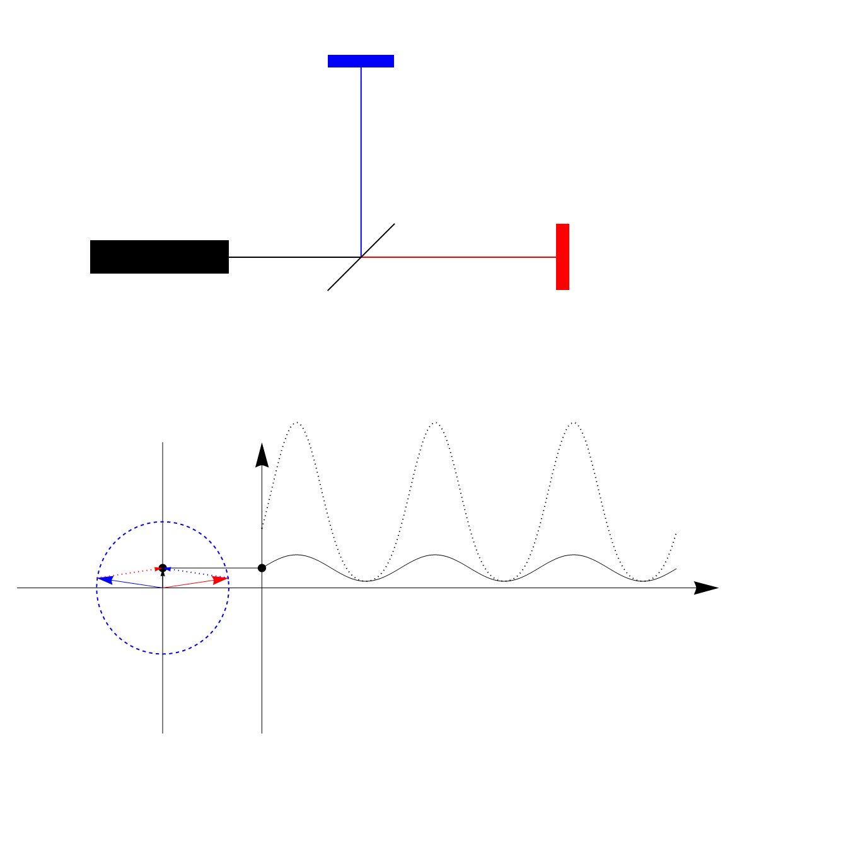
Michelson Interferometer - DC Readout
Mirror 1
Laser
BS
Mirror 2
PD
DFO
Amplitude
Power * 20
dark fringe
Time
More light → more signal
Notes:
We usually operate the interferometer close to the dark fringe with a slight offset (the dark fringe offset of a few pm) and then get a unipolar signal, i.e. the power depends on the differential length change in a monotonous way, and we obtain information on the sign of the length change.
Start with a powerful laser. Ca. 500W in ET-HF

Slide 10
Michelson Interferometer @ Dark Fringe
constructive Interference
full reflectance
Mirror
Im(E)
North
arm
East
arm
Re(E)
BS
Laser
Mirror
Im(E)
dark fringe
destructive Interference
North arm
East arm
Re(E)
10
Notes:
When the beams cancel at the output port
they constructively interfere at the input port (Energy conservation).
All Laser light gets reflected

Slide 11
Michelson Interferometer - DC Readout
@ dark fringe
interferometer = mirror
(for the laser carrier light)
Mirror
Laser light gets reflected
BS
Laser
Mirror
No input here?
Notes:
The interferometer acts like a mirror

Slide 12
Power Recycling for more power in the arms
ET-HF
R= 0.95
BS
LASER
PRM
PD
IMCs
Notes:
We can put a mirror in the input path and resonantly enhance the light power in the resulting optical resonator.
If the interferometer was highly reflecting, with the PRM parameters of ET we would get a resonant enhancement of a factor of 80, but we will have FP cavities in the ifo arms, which increase the losses and make the resulting PR roughly impedance matched, resulting in an anhancement factor of roughly 20. This is the optimal usage of Laser light because under ideal conditions int he impedance matched case no light is reflected.
The configuration is called a Power Recycled Michelson interferometer.

Slide 13
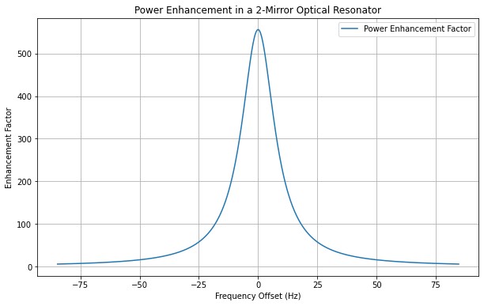
Fabry-Perot cavities
T_{ITM} = 7000ppm
T_{ETM} = 6ppm
RTL = 75ppm
Power Enhancement on Resonance = 556
Bandwidth = 17Hz
ITM
ETM
R≈0.993
T=7000ppm
R≈1
T=6ppm
Notes:
We can insert Resonators in the ifo arms, where the laser light is again resonantly enhanced (by a factor of about 500).

Slide 14
PRMI with FPs in arms
ETM
ET-HF
ca. 500W
ITM
ITM
ETM
BS
LASER
~20x
~550x
PRM
3 MW
PD
IMCs
Notes:
Implementing both enhancements gives a power recycled FP Michelson interferometer.
The laser power of ca. 500W is enhanced to a power of ca. 3MW in the interferometer arms.

Slide 15
Common modes – diff. modes
Laser carrier returning to the
bright port = in phase
Dark port = out of phase
Mirror
Laser light gets reflected
Laser
Mirror
BS
GW sidebands are created with 180° difference in both arms
returning to the
bright port = out of phase
Dark port = in phase
→ GW signals exit to the dark port
GW sidebands
exit here
Notes:
While the carrier light is reflected to the input port (and is recycled there) the gravitational wave sidebands, being created with opposite sign in the ifo arms by the GWs, constructively interfere at the output port. Hence the GW signals fully go to the output port and do not „see“ the PRM. We have nicely separated the carrier light from the GW sidebands and can treat them sparately.

Slide 16
Dual recycled Michelson
ETM
ITM
ITM
ETM
BS
LASER
PRM
SRM
IMCs
PD
Notes:
By placing a mirror here we can also sent them back into the interferometer and form a cavity from the SRM and the ifo.
Having Power- and Signal Recycling is called dual recycling.

Slide 17
Dual recycled FPMI
ETM
ITM
ITM
ETM
BS
LASER
PRM
SRM
IMCs
PD
Notes:
So in the full configuration with Power and Signal recycling and Fabry Perot resonators in the arms it is called a dual recycled Fabry-Perot Michelson Interferometer DRFPMI

Slide 18
Bandwidth too narrow
T_{ITM} = 7000ppm
T_{ETM} = 6ppm
RTL = 75ppm
Power Enhancement on Resonance = 556
Bandwidth = 17Hz
GW sideband
GW sideband
GW signals only get enhanced at low frequencies
☹
ITM
ETM
R≈0.993
T=7000ppm
R≈1
T=6ppm
Notes:
Now we have got high laser power in the arm cavities, but due to the small bandwidth of teh the arm cavities the GW signal sidebands are not resonantly enhanced.

Slide 19
Effective Ifo for the GW sidebands
ETM
ITM
ITM
ETM
BS
LASER
PRM
SRM
IMCs
PD
Notes:
As mentioned earlier, the GW sidebands fully go to the output port and do not „see“ the PRM.
The effective resonators for the GW sidebands is therefore a linear cavity with two mirrors in the output.

Slide 20
Effective Ifo for the GW sidebands
ETM
Assume there is some high carrier field in the arm cavity
GWs create sidebands.
ITM reflectivity too high → narrow bandwidth ☹
Tune SRM such, that it reduces (ITM/SRM) reflectivity
Increase bandwidth
Carrier does not „see“ SRM; is not affected
Same power in the arm cavities
GW sidebands resonantly enhanced
„Resonant Sideband Extraction“ RSE
ITM
IN ET-HF
SRM R= 0.9
SRM
PD
Notes:
Because the SRM and ITM are relatively close to each other we get a good approximate understanding by regarding them as one entity.
Depending on the microscopic tuning between them we can either enhance or reduce the reflectivity R of the compunt mirror.
Enhancing R would lead to a narrower bandwidth with better sensitivity within the bandwidth. This is called the Signal Recycling configuration.
Reducing R increases the bandwidth at the cost of lower resonant enhancement within the bandwidth. This configuration is called Resonant Sideband Extraction (RSE)

Slide 21
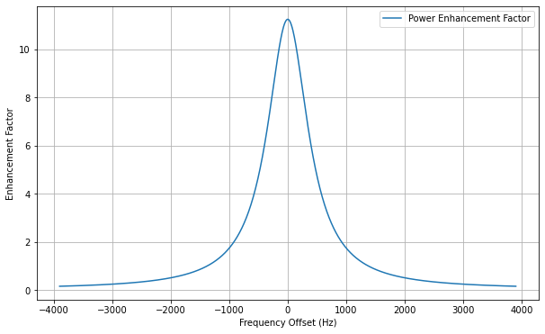
Resonant Sideband Extraction
ETM
GW Sidebands resonantly enhanced in effective arm cavity
Less enhancement; more bandwidth
ITM
ITM
ETM
BS
LASER
PRM
SRM
IMCs
GW sidebands
PD
Notes:
Mind the frequency axis
We can increase the bandwidth dramatically.
Now the Sidebands of the previous example are fully resonantly enhanced.
(This is only an example, not the real ET case)
In ET HF the bandwidth is ca. 1kHz

Slide 22
Michelson Interferometer - DC Readout
@ dark fringe
interferometer = mirror
Symmetric
Light entering the dark port
→ reflected
Mirror
Laser light
gets reflected, incl. noise
BS
Laser
Mirror
any light shone
in here gets reflected too
Vacuum fluctuations
Notes:
The light coming from the laser (including all its fluctuations and noise) destructively interfere to the output port. So we should not see any noise (shot noise from the laser) on the Photo Detector. As teh laser light injected to the input port is reflected to the laser all light fileds injected to the output port are also reflected and reach the photo detector.
The field entering there is the vacuum fluctuations, the zero point fluctuations for the EM field in the absence of any light.
This gets superimposed with the small amount of laser light (due to the dark fringe offset) and causes the shot noise on the PD.
Usually the fluctuations are equally distributed in the phase and amplitude quadrature (here depicted by the fussy circular ball)

Slide 23
Replace vacuum with a squeezed state
ETM
Squeezing:
Less noise in phase → better sensitivity (factor 3)
More noise in amplitude → more radiation pressure noise
ITM
ITM
ETM
BS
LASER
PRM
SRM
IMCs
Faraday
Isolator
Squeezer
PD
Squeezed vacuum fluctuations
Notes:
With a nonlinear process inside a crystal we can modify the distribution of the fluctuations, e.g. reducing the fluctuations in the phase quadrature at the cost of the amplitude quadrature (resulting in an ellipse, hence the term squeezing). The effect is, that we sense less noiise onthe photo detector corresponding to smaller phase noise int he ifo arms.
The price we pay, is higher amplitude noise in the ifo arms.

Slide 24

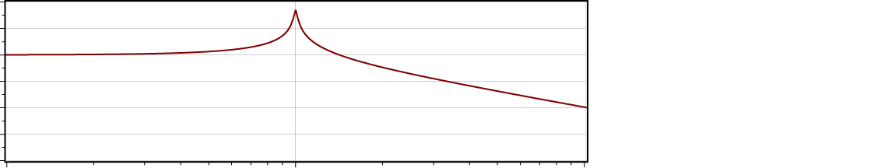
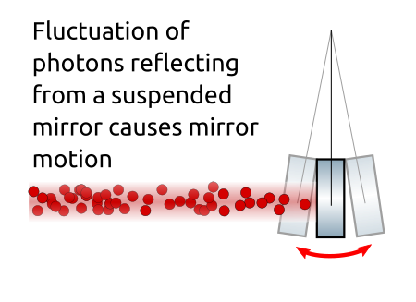


Radiation Pressure Noise
Transfer function of a pendulum
Force → Displacement
Photons transfer momentum to the mirror upon reflection
F = 2 δI / c
→ white force noise on mirrors
x/F
1/f²
→ 1/f² displacement noise of mirrors
1Hz
Frequency
The mirror converts amplitude fluctuations into phase fluctuations
$$E0=\sqrt{\text{I}\text{o} }$$
$Ie=(\sqrt{\text{I}\text{o}\text{/2}}+\text{a}\text{i}$)²
a_{i}
Notes:
The light, being reflected from the mirrors in the arms, transfers momentum onto the mirrors and causes movement of the mirror = radiation pressure noise. The resulting force has a white noise spectrum. The pendulum resonance freqencies of the suspensions for the mirrors are typically below or around 1Hz. Our frequencies of interest are therefore above the resonances, where the susceptibility of the mirrors, i.e. how much the move for a given force, falls of with 1/f^2. This is the reason why radiation pressure noise is most important at low frequencies and falls off with 1/f^2.

Slide 25
Replace vacuum with a squeezed state
ETM
Squeezing:
Less noise in phase → better sensitivity high frequencies
More noise in amplitude → more radiation pressure noise
low frequencies
ITM
ITM
ETM
BS
LASER
PRM
SRM
IMCs
Faraday
Isolator
Squeezer
PD
Desired squeezing for low frequencies
= rotated by 90°
Notes:
The squeezing gives us less shot noise, but more radiation pressure noise. Ideally we would have phase (in the ifo amrs) squeezing at high frequencies and amplitude squeezing at low frequencies.
This means we would like to have a different orientation of teh squeezing ellipse for different frequencies.

Slide 26
Frequency dependent Squeezing
ETM
frequency
ITM
ITM
ETM
BS
LASER
Frequency-dependent squeezing
Improved shot noise
Improved rad. press. noise
PRM
SRM
IMCs
PD
Filter Cavity
Squeezer
Notes:
This can be achieved by reflecting the squeezed states from a so called Filter Cavity, i.e. a detuned optical resonantor (with exquisitley low losses, not to destroy the squeezed state). The bandwidth and detuning have to match the desired frequency dependence of the rotation.
The result is called frequency dependent squeezing (FDS) in contrast to FIS.

Slide 27
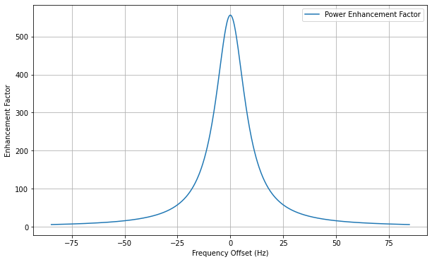
ET-LF detuned SRC
Detuned Recycling Cavity
T_{ITM} = 0.007
T_{ETM} = 6 ppm
→ BW 17Hz
Detuning SRC 0.75°
Notes:
In the ET-LF case we use a detuned Signal Recycling because other noises dominate at the lowest (<2Hz) frequencies anyway.
The SRM is detuned to give an optical resonance at ca 25Hz.
This causes a different frequency-dependent phase of the GW sidebands at the output port necessitating two filter cavities to rotate the squeezing ellipse in the desired way to minimize the quantum noise.

Slide 28
Detuned DRFPMI needs two FCs
ETM
ITM
ITM
ETM
BS
LASER
PRM
SRM
IMCs
PD
Filter Cavities
Squeezer
Notes:
Now we have got all the optical elements explained that are depicted in the sketches of the optical layout that are often used in slides, showing the ET-LF and ET-HF differences.

