Slide 1
Gravitational wave vertical cryostat
Udai Raj Singh, Jörn Schaffran, and Axel Lindner

Slide 2
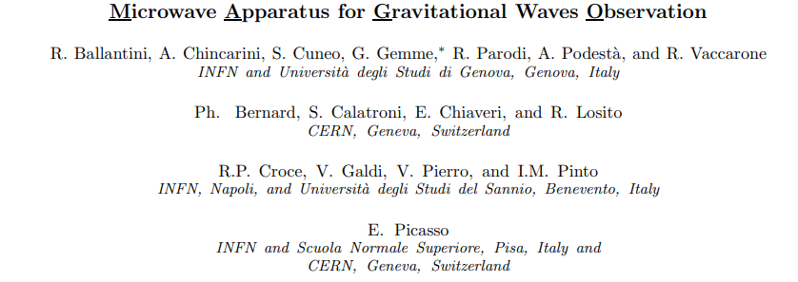
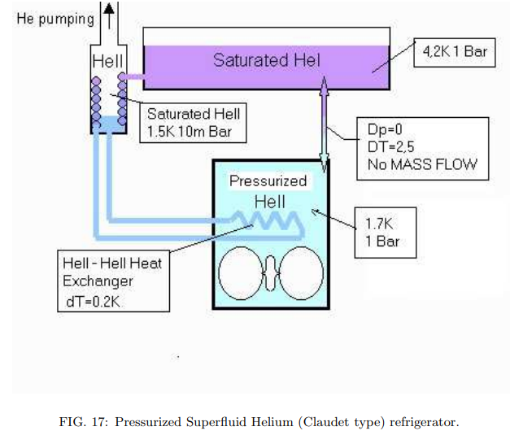
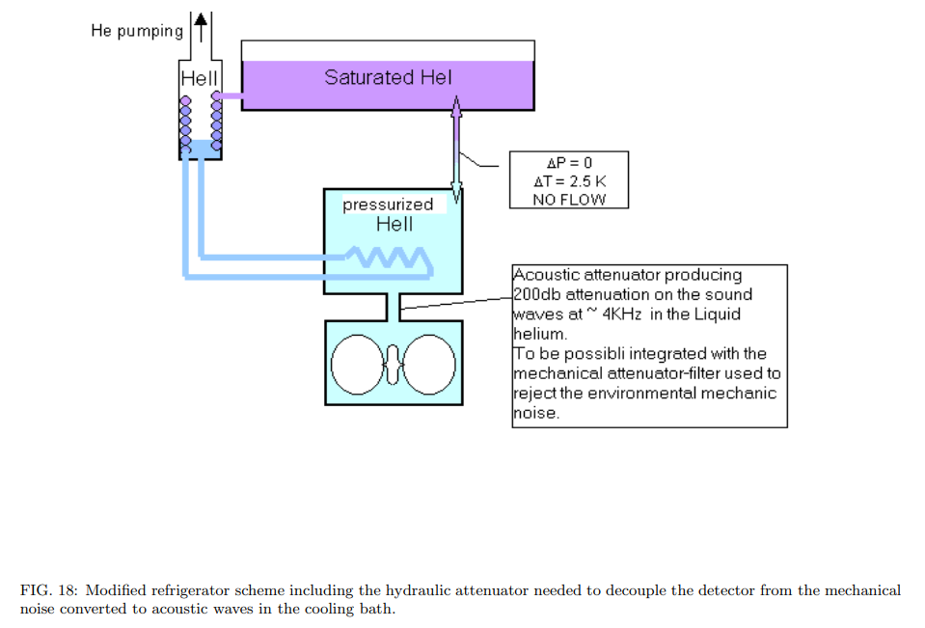
http://arxiv.org/abs/gr-qc/0502054v1

Slide 3
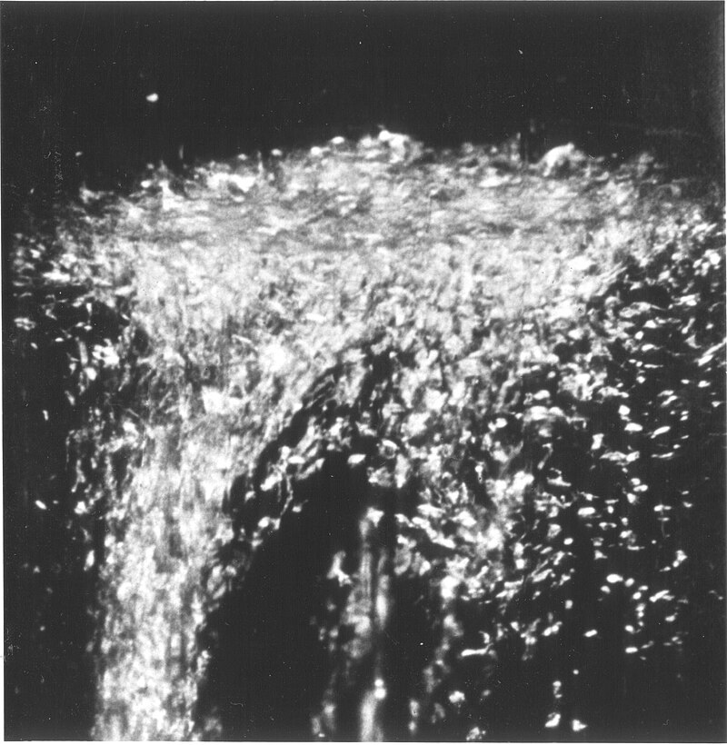
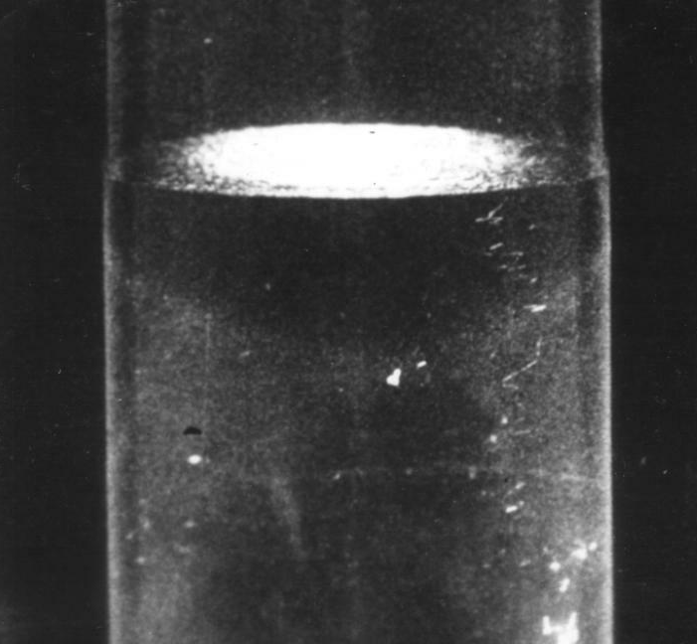
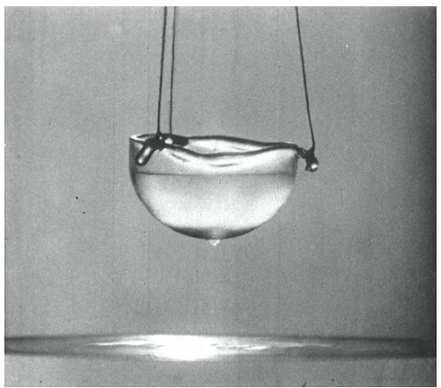
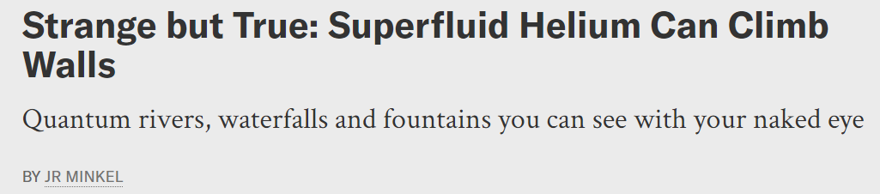
Discovery of superfluid helium in 1937 by Pyotr Kapitsa, John Allen, and Don Misener in 1937
Lambda point transition: 2.17 K
Superfluid phase below 2.17 K
SF He: fountain effect
boiling suddenly becoming violent for a moment
No gas bubbles in the body of the liquid
SF helium creeping up the inside wall and dripping down as droplets
https://www.scientificamerican.com/article/superfluid-can-climb-walls/

Slide 4
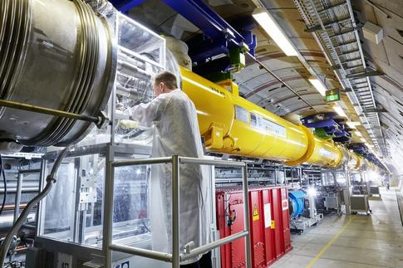
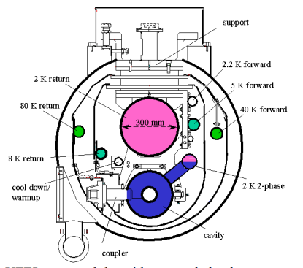
Applications of SF helium technology
European XFEL accelerator (two phase SF He)
AIP Conf. Proc. 1573, 1214-1221 (2014)

Slide 5
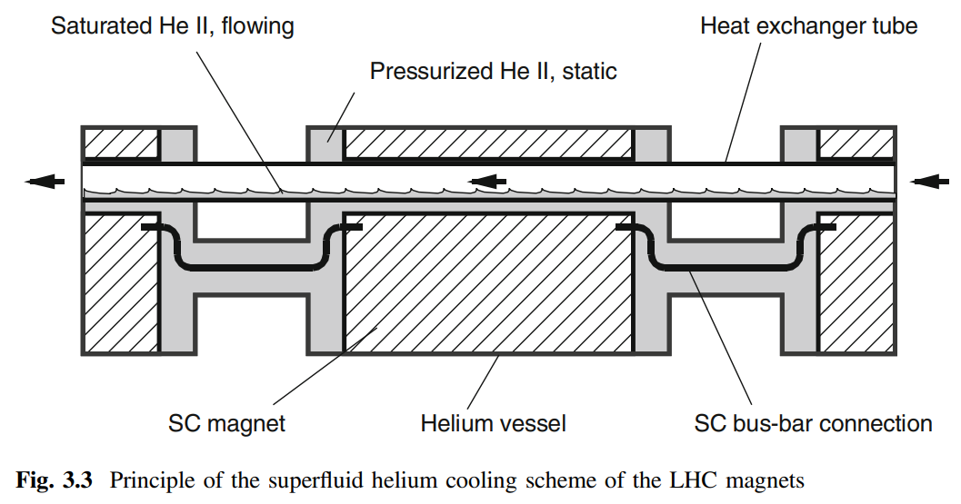
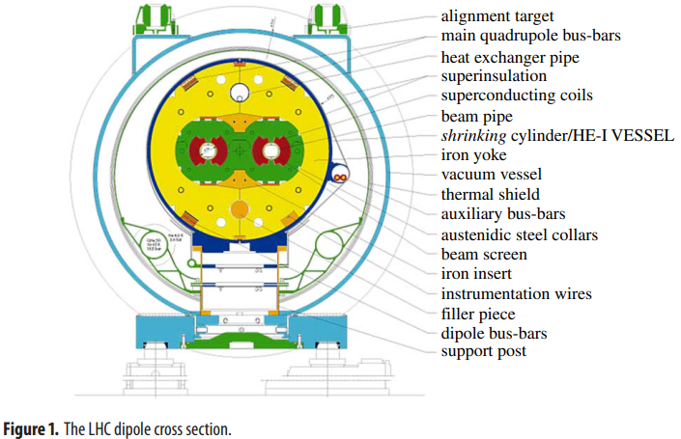
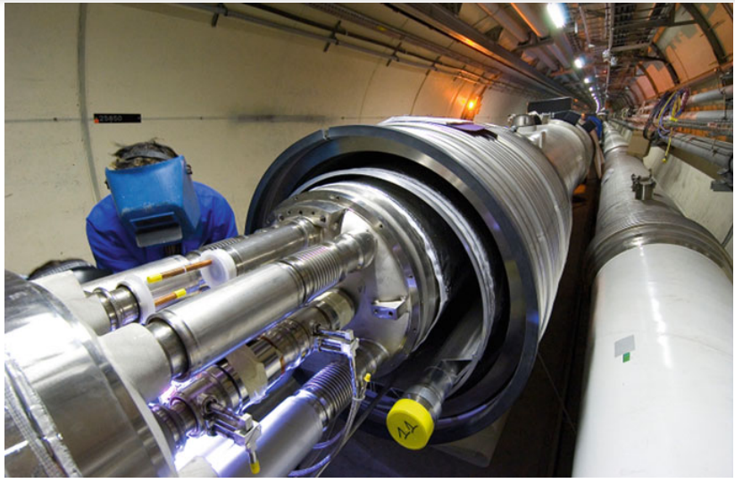
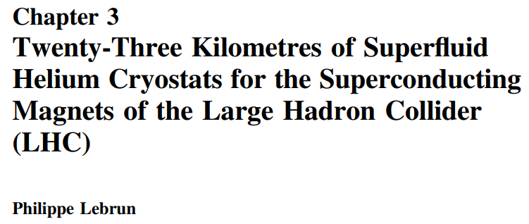
Applications of SF helium technology
LHC (one phase SF He)

Slide 6

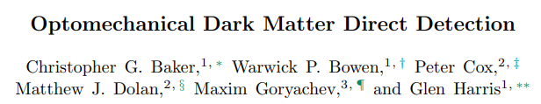
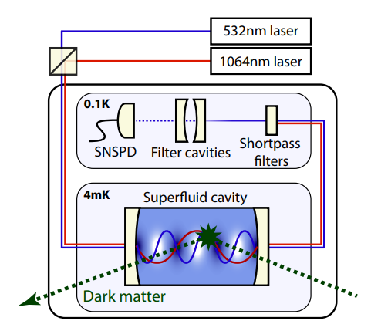
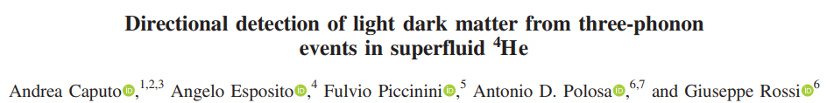
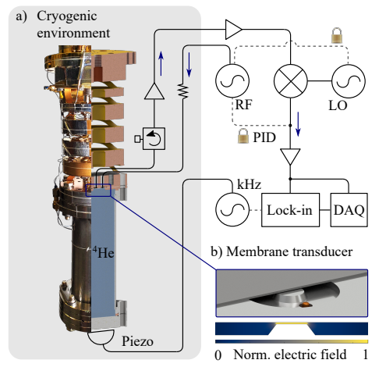
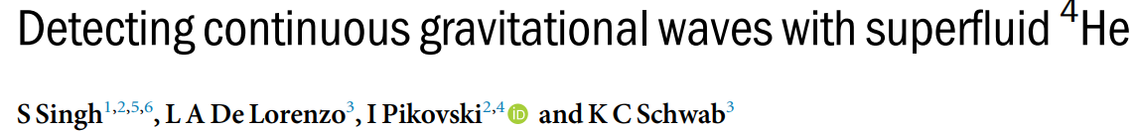
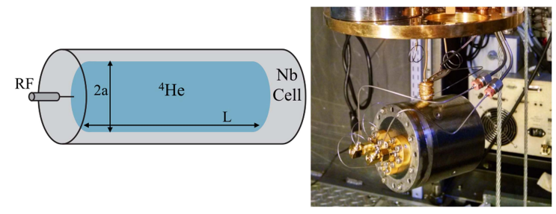
Applications of SF helium technology
Phys. Rev. D 100, 092007 (2019)
arXiv:2306.09726v1 (2023)
Phys. Rev. D 103, 055017 (2021)
arXiv:2309.07995v1 (2023)
SF He behaving as a qunatum fluid!
New J. Phys. 19 (2017) 073023

Slide 7
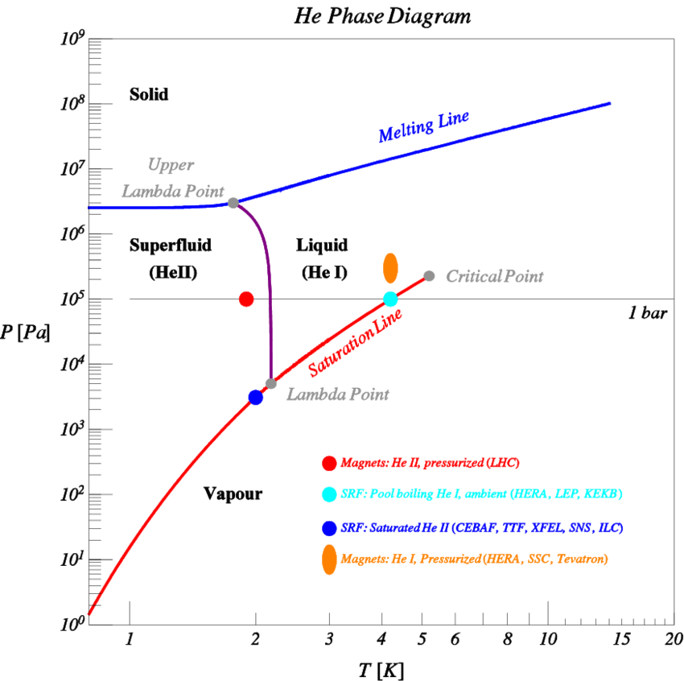

Pressure–temperature phase diagram of helium 4
Several phases are possible in the heat transfer to helium: superfluid He II, Solid, liquid, and vapor
arXiv:1307.8286 (2013)

Slide 8
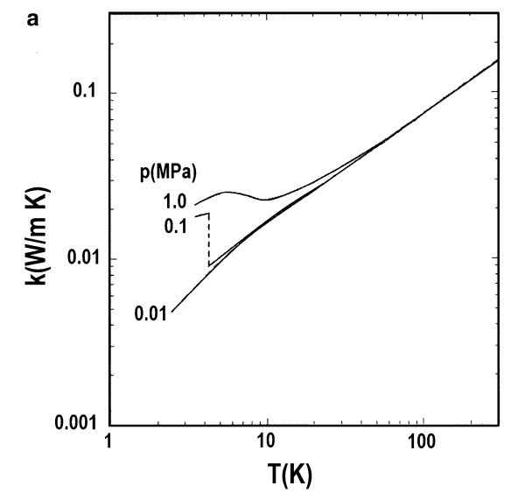
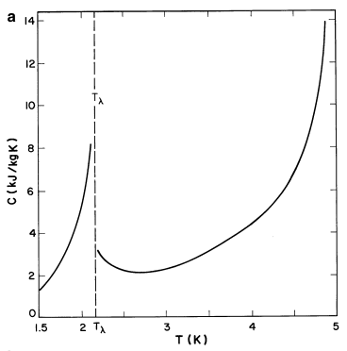
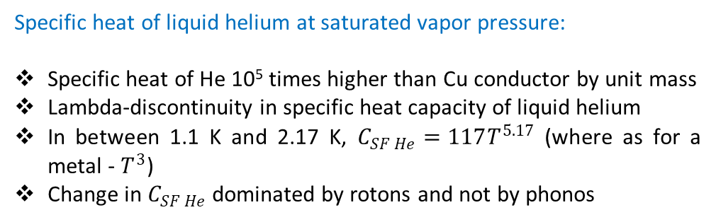
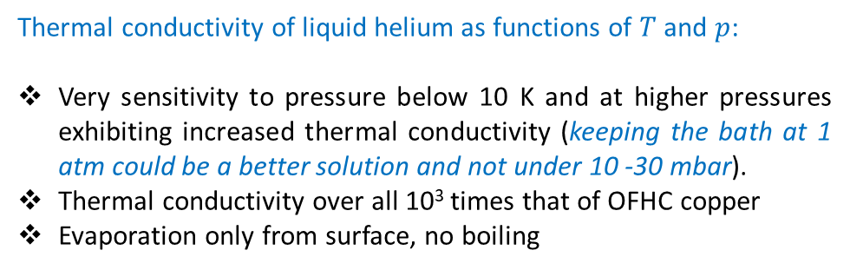
Properties of superfluid helium 4
SF He
LHe
Cu
Cu
Thermal conductivity of liquid helium as functions of $T$ and $p$:
Very sensitivity to pressure below 10 K and at higher pressures exhibiting increased thermal conductivity (keeping the bath at 1 atm could be a better solution and not under 10 -30 mbar).
Thermal conductivity over all 10³ times that of OFHC copper
Evaporation only from surface, no boiling
Specific heat of liquid helium at saturated vapor pressure:
Specific heat of He 10⁵ times higher than Cu conductor by unit mass
Lambda-discontinuity in specific heat capacity of liquid helium
In between 1.1 K and 2.17 K, $C_{SF He}=117T^{5.17}$ (where as for a metal - $T^{3}$)
Change in $C_{SF He}$dominated by rotons and not by phonos
Steven W. Van Sciver, Helium Cryogenics (2012)

Slide 9
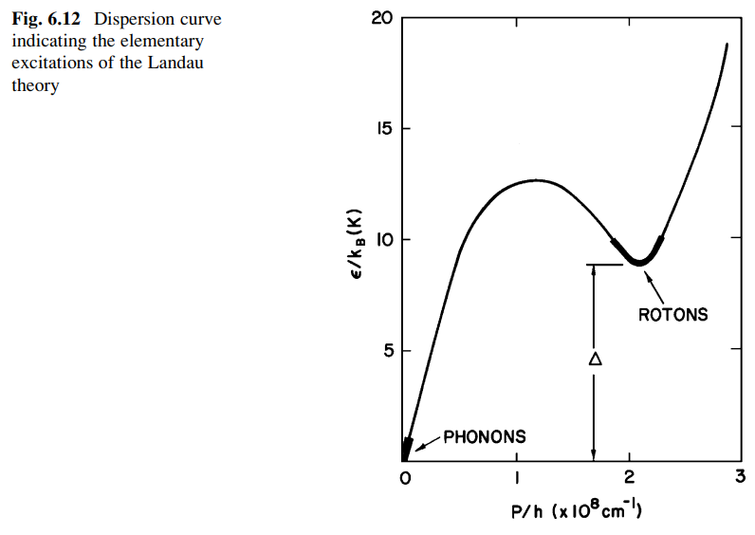
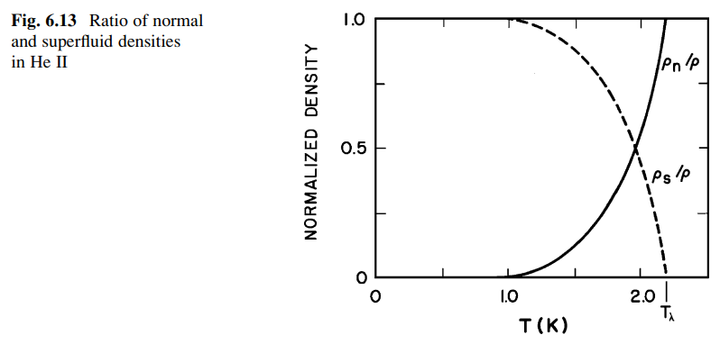
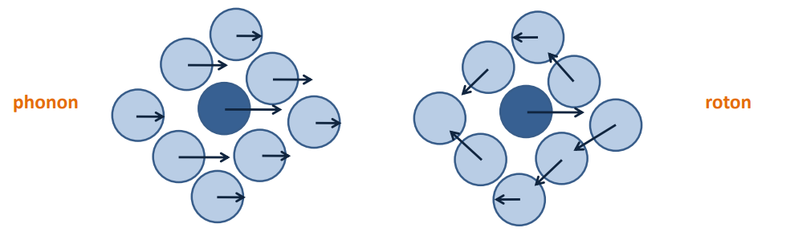


Properties of superfluid helium 4
Due to strong temperature dependence, the superfluid component composes about 99% of He II at 1 K.
Specific heat dominated by rotons between 1.1 and 2.1 K and not by phonons
Steven W. Van Sciver, Helium Cryogenics (2012)
Phys. Rev. B 103, 104516 (2021)

Slide 10
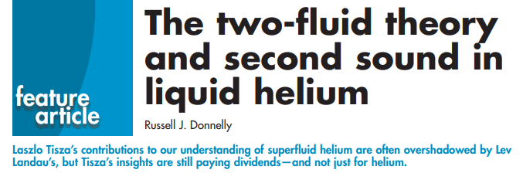
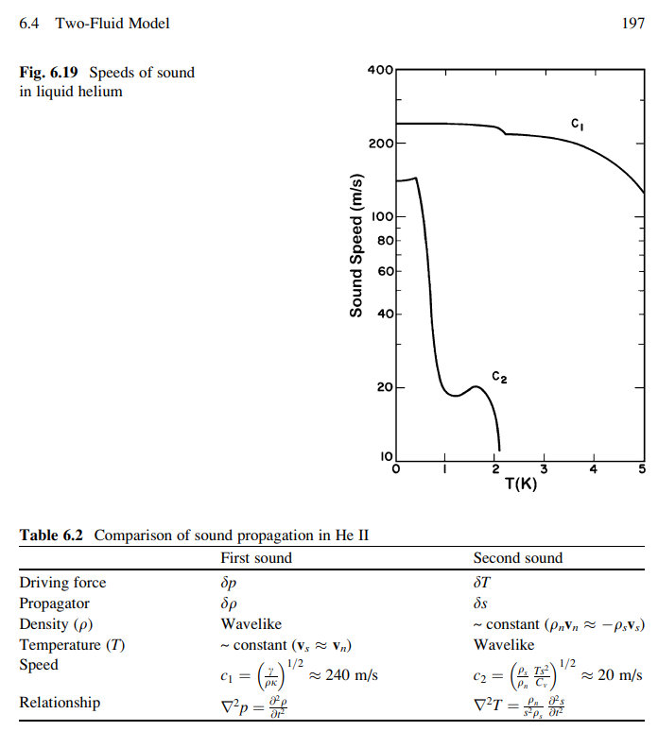
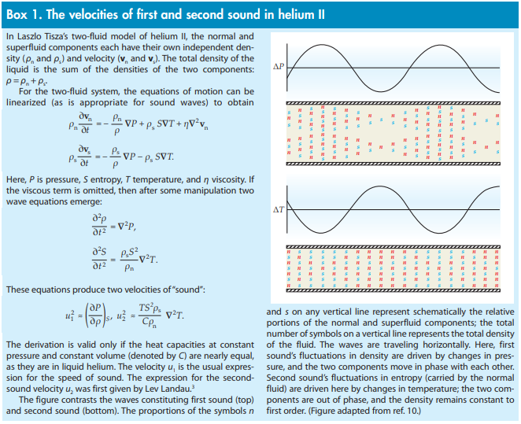
Russell J. Donnelly, Physics Today 62, 10, 34 (2009)
Steven W. Van Sciver, Helium Cryogenics (2012)

Slide 11

General superfluid (SF) helium properties
First sound wave: SF helium has an exceptionally low first sound wave speed of 238 m/s.
Excitations: It also shows unique kinds of excitations, such as quantized vortices, as well as second, third and fourth sound waves.
Density: The low density (ρHe = 145 kg/m3) and effective mass of SF helium contribute to a high zero-point fluctuation (ZPF) amplitude, resulting in significant optomechanical/electromechanical coupling.
Dielectric constant: The dielectric constant of SF Helium is 1.057, indicating its nature as a low-loss dielectric medium. It means that there is minimal light absorption or scattering, resulting in low optical loss.
Viscosity: The absence of viscosity in SF helium results in a very low sound attenuation (acoustic loss proportional to T⁴ ), which contributes to high mechanical quality factor.
Thermal conductivity: The high thermal conductivity of SF helium prevents any heating issues from RF/optical powers.
Band gap: SF helium does not exhibit linear absorption visible of infrared light, due to its large bandgap (19.9 eV), and the lack of chemical impurities which freeze to the walls of the container.
Tuning tool: SF helium can be employed as a tuning tool for resonators, allowing adjustments to the effective mass and resonance frequency.
In conclusion, the combination of low intrinsic absorption and the large thermal conductivity of superfluid helium contributes to improved RF/optical power handling.

Slide 12
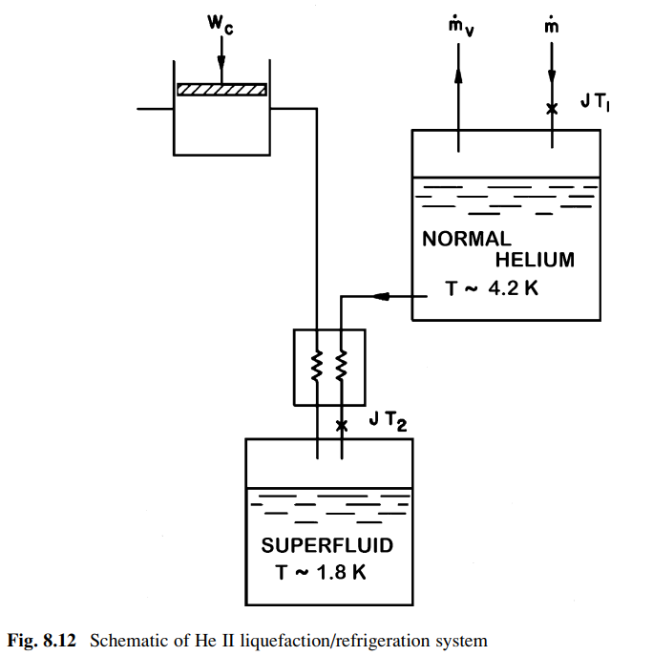
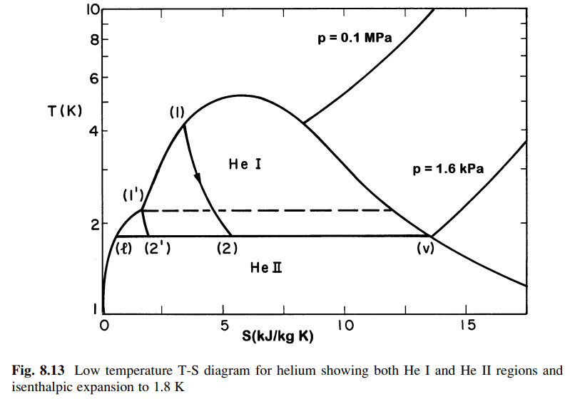
Production of 2 K superfluid helium via isenthalpic expansion
100% liq.
100% gas
Considering an isenthalpic expansion of helium from 0.1 MPa, 4.2 K to 1.6 kPa corresponding to the saturated vapor pressure at 1.8 K
Steven W. Van Sciver, Helium Cryogenics (2012)

Slide 13
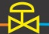
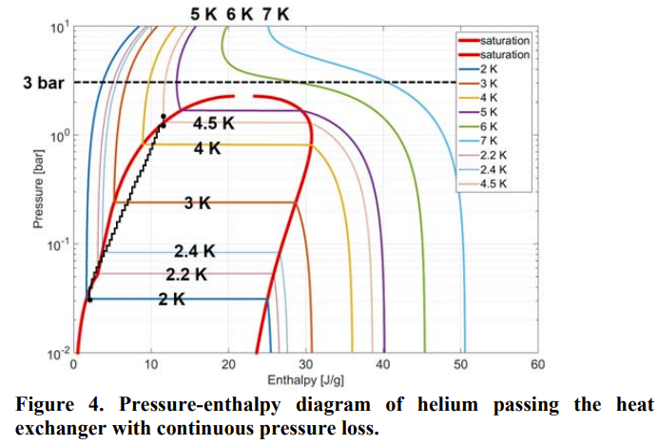

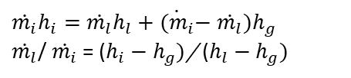
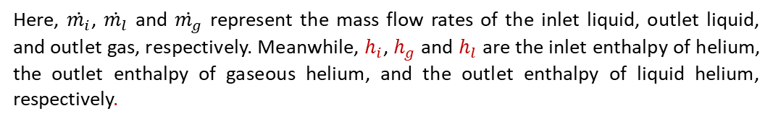



Joule-Thomson valve
$\dot{m_{i}}h_{i}$ ((liq. He )
$\dot{m_{l}}h_{l}+\dot{m_{g}}h_{g}$ (liq. He + gas He)
After the expansion of liquid helium (LHe) from high pressure to low pressure through the JT valve, the resulting helium exists in both liquid and gaseous phases, while conserving enthalpy across the valve:
$H_{i}$ = $H_{0}$
$\dot{m_{i}}h_{i}=$ $\dot{m_{l}}h_{l}+\dot{m_{g}}h_{g}$
Here, $\dot{m_{i}}$, $\dot{m_{l}}$ and $\dot{m_{g}}$ represent the mass flow rates of the inlet liquid, outlet liquid, and outlet gas, respectively. Meanwhile, $h_{i}$, $h_{g}$ and $h_{l}$ are the inlet enthalpy of helium, the outlet enthalpy of gaseous helium, and the outlet enthalpy of liquid helium, respectively.
Furthermore, the mass flow rate through the JT valve is determined by
$\dot{m_{i}}$= $\dot{m_{l}}+\dot{m_{g}}$. Consequently,
$\dot{m_{i}}h_{i}=$ $\dot{m_{l}}h_{l}+{\dot{{(m}_{i}}−\dot{m_{l}})h}_{g}$
$\dot{m_{l}}$/ $\dot{m_{i}}$ = ($h_{i}−$ $h_{g})$/ ($h_{l}−$ $h_{g})$
In addition, the fraction of mass flow liquefied or yield is defined,
$x= \dot{m_{l}}$/ $\dot{m_{i}}$
J. Phys.: Conf. Ser. 969 012084 (2008)

Slide 14
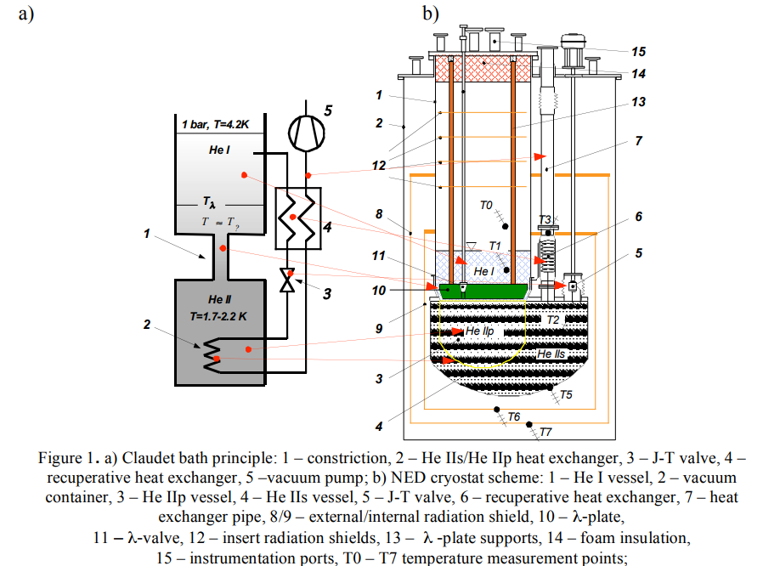
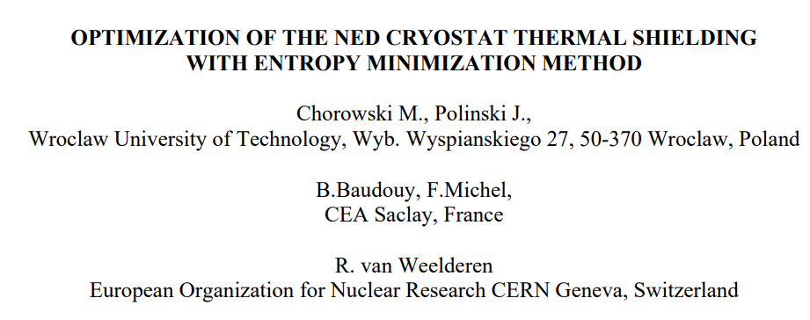
Lambda plate in the Claudet bath

Slide 15
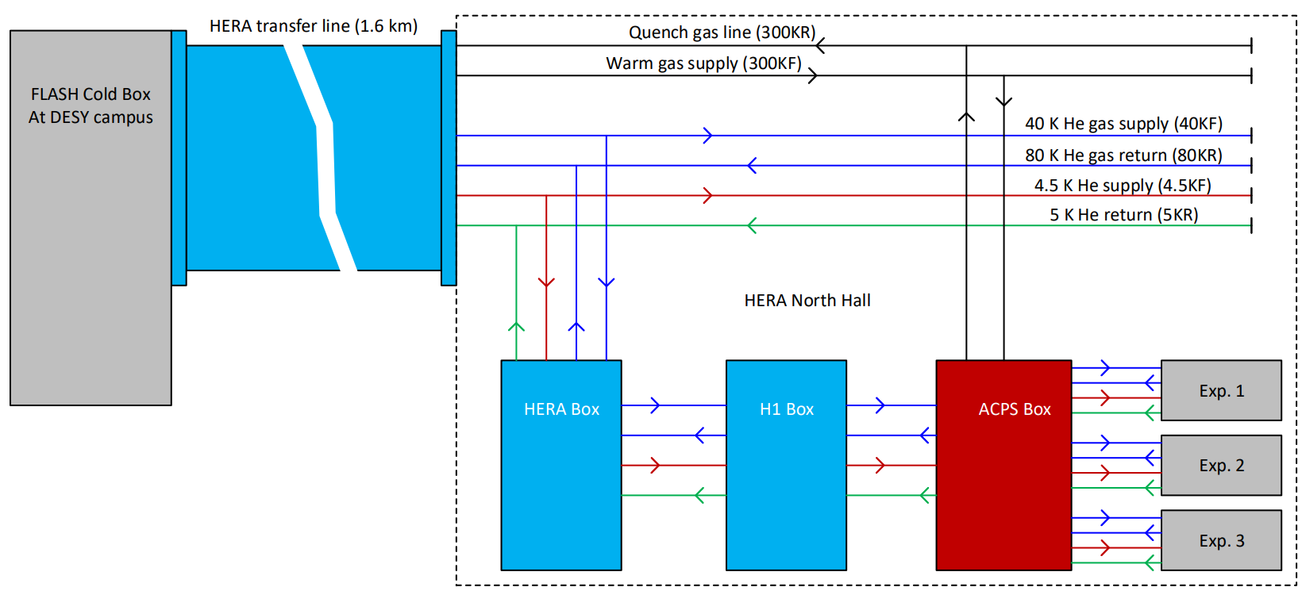
Developing a new test facility for future cryogenic experiments
1
General description of HB Box, H1 Box and ACPS in HERA North Hall

Slide 16
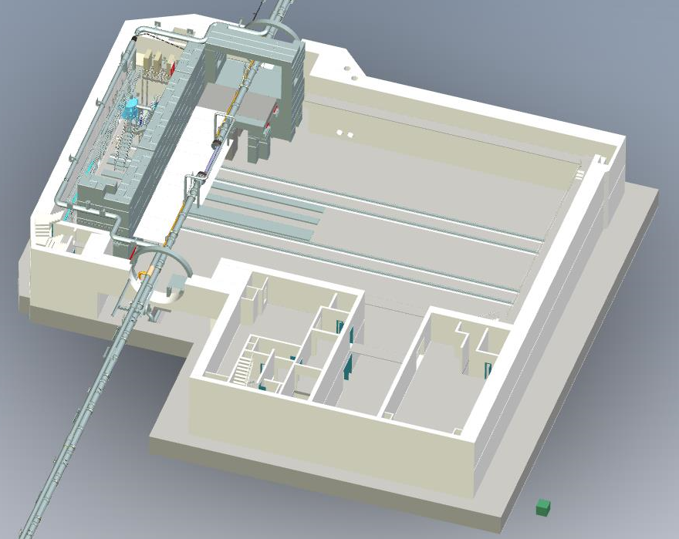
Design and construction of ACPS (ALPS cryo platform subcooler box) in HERA North Hall
Supplying supercritical helium as well as very high pressurized cold and warm helium gases to three different future experiments
Boundary conditions for helium supply and return in 4.5KF and 5KR circuits: (T_{in}≈ 4.5 K, P_{in}≈ 2.5-3.5 bar) and (T_{out}≈ 6.0 K, P_{out}≈ 1.0–1.3 bar)
Optimum mass flow rate of helium @4.5 K and 3.5 bar = 30 g/s
Optimal estimation of cooling power @4.5 K and 3.5 bar : 500 W@4.5 K
Helium gas supply and return in 40KF and 80KR circuits: (T_{in}≈ 40 - 80 K, P_{in}≈ 13-17 bar) and (T_{out}≈ 58-66 K, P_{out}≈ 12–16.6 bar)
Optimum mass flow rate of helium @ 40 K and 14 bar = 75 g/s
Optimal estimation of cooling power @ 40 K and 14 bar : 4400 W
Helium gas supply and return in 300KF and 300 KR circuits: (T_{in} ≈ 300 K, P_{in} ≈ 12 - 16 bar) and (T_{out} ≈ 300 K, P_{out} ≈ 1.0 – 1.3 bar)
location of ACPS
ALPS tunnel

Slide 17
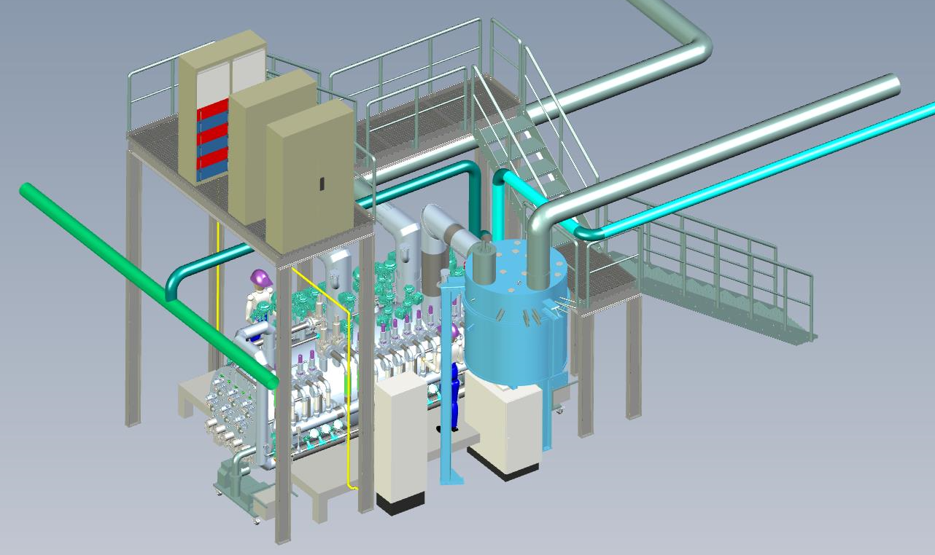
A detailed view of ACPS in HERA North Hall and transfer lines
ALPS quench protection
transfer lines
H1 Box
ACPS

Slide 18
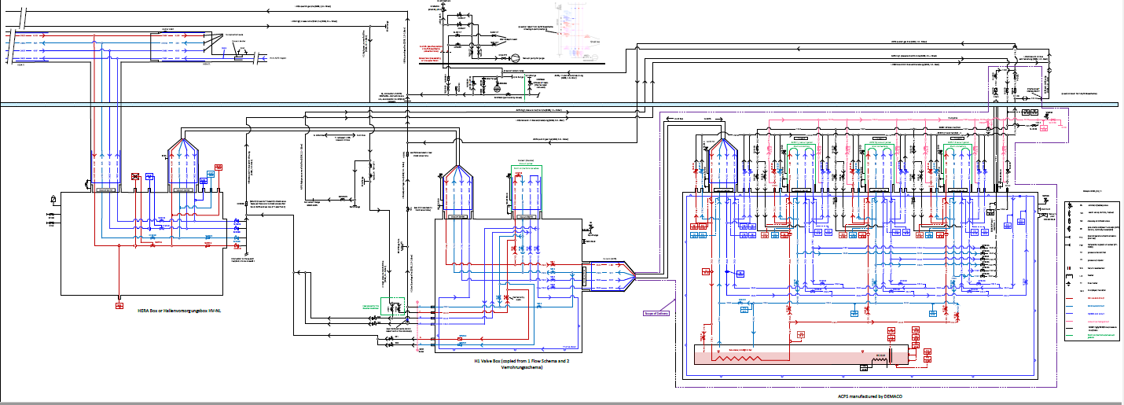
Refurbishment of HERA BOX, H1 Box and old transfer lines
HERA Box (existing)
H1 Box (existing)
ACPS subcooler Box (under constrcution)
Currently also working on the refurbishment of old cryogenic boxes and transfer lines in HERA North Hall

Slide 19
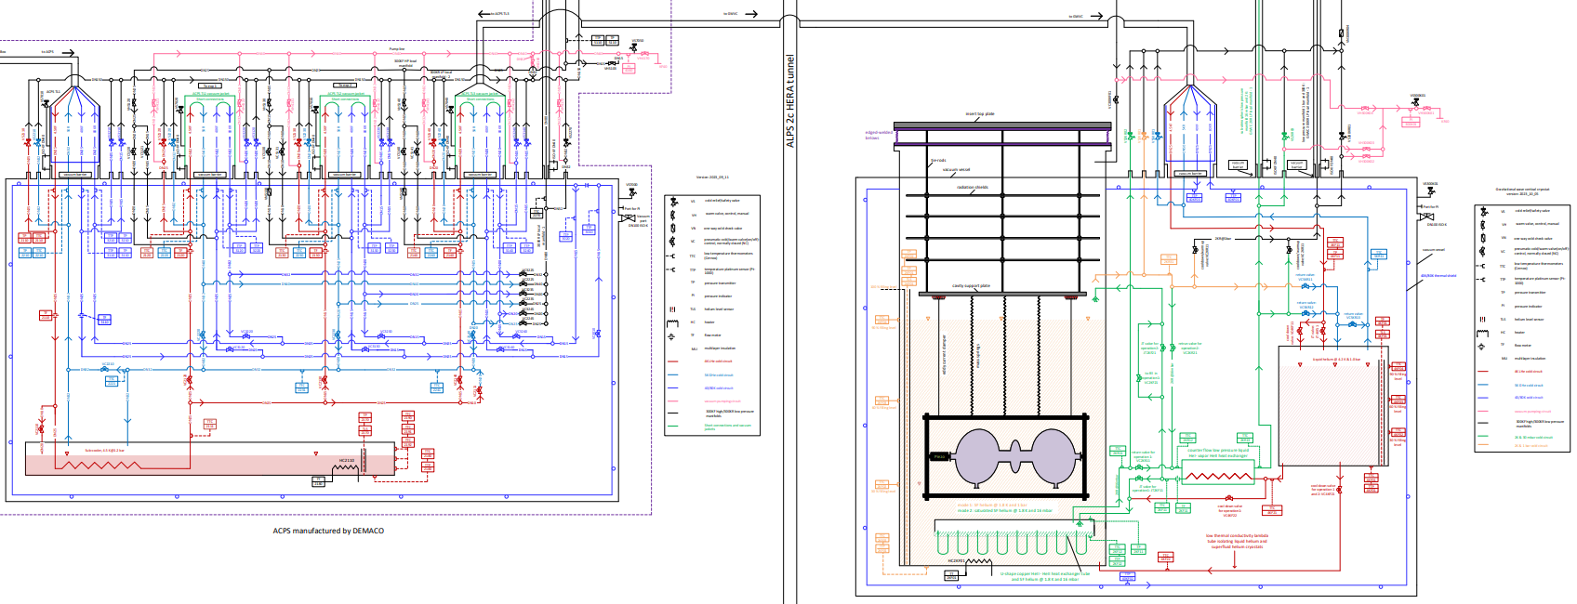
Flow scheme of GW vertical cryostat (GWVC)
ACPS
GWVC

Slide 20
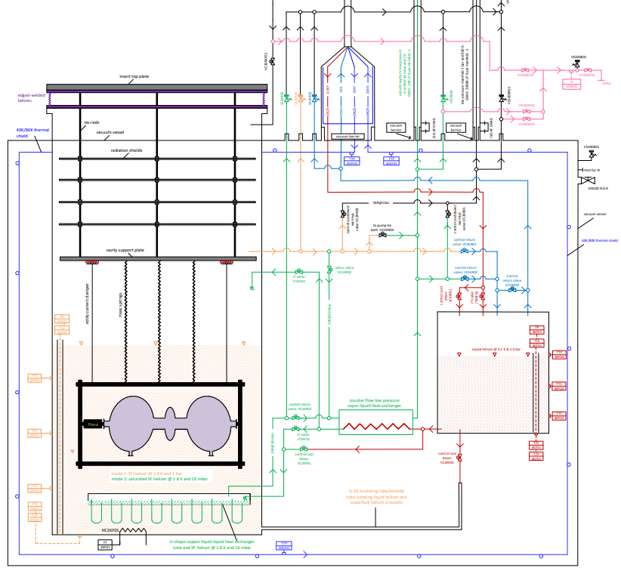
Flow scheme of GWVC
high pressure manifold line (300K, 12 – 16bar)
helium transfer lines (4.5KF, 5KR, 40KF and 80KR)
Vacuum pump line
sub-atmospheric low pressure manifold 30 mbar and 2 K
low pressure manifold (cooldown/warm-up)
radiation shields
vacuum vessel
40K/80K thermal shield
cavity support plate
JT valve 3 for producing SF He @ 1.8 K and 16 bar
JT valve 1 for producing LHe @ 4.2 K and 1 bar
vibration isolation
liquid He bath @ 4.2 K and 1 bar
2K low pressure heat exchanger
JT valve 2 for producing SF helium @ 1.8 K and 16 mbar
SRF cavity
PZT actuator
G-10 insulating tube/lambda tube
U-shape copper liquid-liquid heat exchanger tube
SF He bath @ 1.8 K and 16 mbar

Slide 21
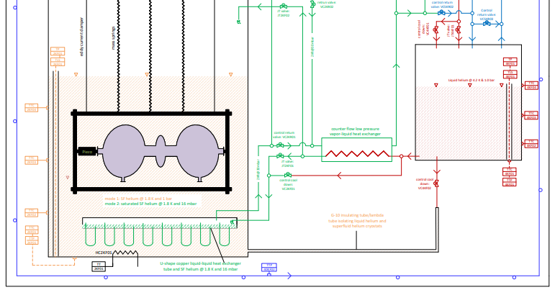
Heat exchangers and JT valves in GWVC
JT valve 3 for producing SF He @ 1.8 K and 16 bar
JT valve 1 for producing LHe @ 4.2 K and 1 bar
2K low pressure heat exchanger
JT valve 2 for producing SF He @ 1.8 K and 16 mbar
U-shape copper HeII - HeII heat exchanger tube

Slide 22
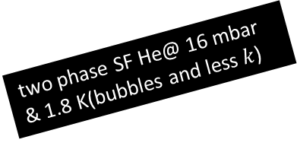
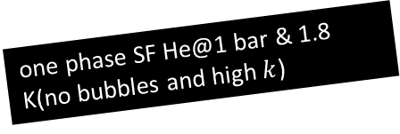
Two phase SF (flowing) and one phase helium (static) in GWVC
With one phase helium, it‘s easy to avoid bubble formation and other instabilities like TCOs, TFs, etc.
one phase SF He@1 bar & 1.8 K(no bubbles and high$k$)
two phase He@ 1 bar & 4.2 K
two phase SF He@ 16 mbar & 1.8 K(bubbles and less$k$)

Slide 23
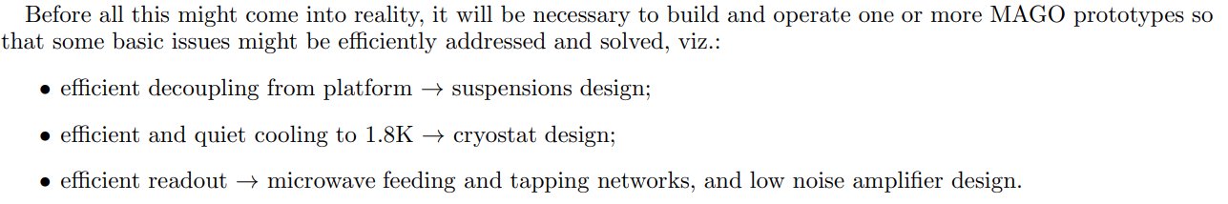
Operation modes of GWVC
Warm-up and cool-down of experiments can be conducted in the range of 1.8 K to 300 K, with specific temperature gradients.
The controlled production of superfluid helium using JT valves and heat exchangers will be either single-phase (at 1 bar) or two-phase (at 16 mbar) at 1.8 K.
The steady-state operating temperature will be maintained at 1.8 K.
To cool down the cryostat's thermal shield, helium supply at 40 K and a pressure of 14 bar will be utilized.
Pressure regulation inside the cryostat can be managed by opening and closing control valves.
In the case of a vacuum breakdown, helium will be collected through safety valves.
The cavity can be in direct contact with either single-phase or two-phase superfluid helium.

Slide 24
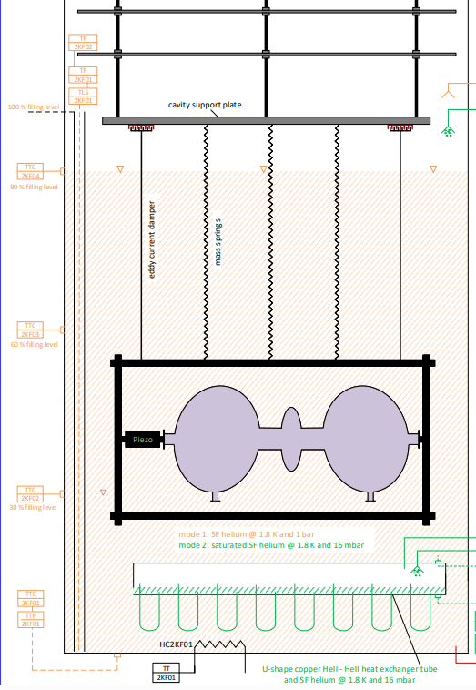
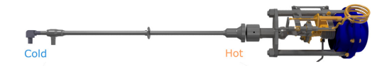


Suspensions design
PHYSICAL REVIEW ACCELERATORS AND BEAMS 22, 052002 (2019)
arXiv:2305.01419

Slide 25


Vapour pressure of helium 4
Minimum achievable temperature here 1.6K/1.7K

Slide 26


Minimum base temperature of GWVC
100 mbar
Achieving a minimum temperature of 1.6 K to 1.7 K is possible, provided specific conditions are met.
If we could operate the pump @10g/s and minimum inlet pressure 10 mbar/10 kPa.
However, under ideal conditions, the cryostat would operate at 1.8 K and under 16 mbar.
10 mbar

Slide 27



Warm sub-atmospheric compressor and sub-atmospheric pressure in GHe return line
The mass flow rate is defined as:
$\dot{m}=\int{ρvdA},$
where $ρ$ is the density of helium. $v$ and $A$ are the velocity and cross sectional area, respectively.
The volumertic flow rate is defined as:
${\dot{V}}_{pump}=\int{vdA}=\dot{m}$/$ρ(T=300 K, P=10mbar, 20mbar, 30mbar, 40mbar, 50mbar)$

Slide 28


Design and thermal analysis of LPCFHEX
Called as low pressure counter flow liquid HeI- vapor HeII heat exchanger (LPCFHEX)
The heat exchanger should ideally exhibit minimal pressure drop, ideally maximum 1 mbar.
Maximum mass flow rate through it ~ 15 -20 g/s
Its primary function is to precool incoming helium, enhancing the liquefaction rate in the cryostat.
Conceptual design and view of external coil of LPCFHEX
AIP Conf. Proc. 1573, 1214–1221 (2014)

Slide 29
Liquification rate via JT valve
The lower the inlet temperature, the higher the liquefaction rate!!!
A careful design of the LPHEX is required (effectiveness?, Ghe pressure drop?, tube size?.

Slide 30



Design and thermal analysis of U-shape copper HeII - HeII heat exchanger tube
We still need to design this part.

Slide 31



Electrical heater power for 2KR@16 mbar GHe return line
$$T_{in}=1.8 K, 4.2 K$$
$$P_{in}=16 mbar$$
$$T_{out}=300 K$$
$$P_{out}=16 mbar$$

Slide 32



Pipe diameter of 2KR@16 mbar GHe return line
Mean free path of helium molecules in the GHe return line:
$$λ= \frac{k_{B}T}{πδ^{2}P\sqrt{2}}$$
$δ$: molecular diameter (0.218 nm for helium-4)
$P$ = Pressure in pascal
$λ$ must be sufficiently smaller than the inner diameter of the pump (usually, 5 $λ$<d) .
DN80 or DN100 will be fine.

Slide 33
Heat load budgets for the GWVC
support structures
vacuum vessel@300 K
thermal shield@40 K
LHe @ 4.2 K & 1.0 bara
thermal radiation
penetration, convection, electric connections, etc.
SF He @1.8 K and 1 bar
RF power dissipation
MAGO cavity

Slide 34



Static RF heat load to SRF cavities in the GWVC
Power dissipation in the SRF cavity: At a finite temperature, the unpaired electrons in a superconductor experience the effect of the RF field, resulting in power dissipation on the metallic cavity walls based on their surface resistance and the surface magnetic field intensity.
Surface resistance: The Bardeen, Cooper and Schrieffer (BCS) theory of superconductivity can be used to develop expressions for the surface impedance of superconductors on the base of several fundamental material properties like mean free path, coherence length, London penetration depth, and other critical parameters.
where $T$ is expressed in Kelvin and$f$is expressed in gigahertz [H. Padamsee, RF Superconductivity (2009)].
SCRF Cavity fabrication technology:
The first term represents the BCS contribution, the second term accounts for increased losses resulting from trapped DC magnetic fields, such as Earth's magnetic field. The third term encompasses various sources, including chemical residues on surfaces, foreign material inclusions, condensed gases, and the presence of hydrides and oxide layers.

Slide 35




Radiation heat load to GWVC
The radiative heat transfer from one surface to another is expressed as following (doi:10.18429/JACoW-IPAC2015-WEPTY031):
${\dot{Q}}_{1→2}=$ $\frac{σ.(T_{1}^{4}−T_{2}^{4})}{\frac{1−ε_{1}}{A_{1}ε_{1}}+\frac{1−ε_{2}}{A_{2}ε_{2}}+\frac{1}{A_{1}F_{1→2}}}$
where ${\dot{Q}}_{1→2}$is radiative power on surface 2 from surface 1. $T$, $ε$, and $A$ are temperature, emissivity and area respectively for surface 1 and 2. $F_{1→2}$ is view factor that determines proportion of radiation from surface 1 reaching to surface 2. $σ$ is the Boltzmann constant.
The empirical formula for calculating the heat flux through the MLI layers sufficiently verified in practice:
$\dot{ { Q}_{1→2}}=$ $\frac{C_{S}{\overline{N}}^{2.56}T_{m}}{N_{S}+1}\left(T_{H}−T_{C}\right)+\frac{C_{R}ε_{RT}}{N_{S}}\left(T_{H}^{4.67}−T_{C}^{4.67}\right)$
Nuclear Instruments and Methods in Physics Research A 763 (2014) 701–710 703
$\dot{Q_{1→2}}:$ Heat flux (W/m²)
$C_{S}$ = 8.95$×$10⁻⁸, $C_{R}$ = 5$.39×$10⁻¹⁰
$\overline{N}$ : radiation shield layer density (layers/cm)
$N_{S}$: number of MLI layers,
$T_{H}$= hot side temperature (K)
$T_{C}$= cold side temperature (K)
T_{m}: mean insulation temperature, we take (T_{H}+T_{C})/2
$ε_{RT}:$ room temperature (300 K) emissivity of radiation shield (aluminum film emissivity = 0.03)

Slide 36
Radiation heat load to GWVC
T_{outer vessel} = 300 K
T_{shield} = 50 K
We need to calculate the area of the 40K, 4K, and 2K cold surface regions that are covered by MLI.
Radiation heat load of 1.55 W/m2 from 300 K to the shield temperature of 40 K with 30 MLI
0.1 W/m2 from the thermal shield at 40 K to 4K and 2K cold masses with 10 MLI.

Slide 37




Conduction heat load duo to support structures, RF components, cabling, etc.
For estimating $\dot{Q}$ in the case of heat flow within the cold mass, one can use the thermal conductivity (𝑘) and the following formula, $\dot{Q}=$ $\frac{A}{L}\int_{T_{L}}^{T_{H}}{k\left(T\right)dT},$ where $TH$ and $TL$are the temperatures at the hot end and the cold end respectively, $L$ is the length of the bar, and $A$ is the cross sectional area of the bar. The unit of $k$ is W/K-meter.
Thermal conductivity (and its integral) varies greatly with temperature and with material. A proper choice of materials and thermal intercept strategies for the conduction paths to the cold environment is therefore necessary in the design of the cryostat.

Slide 38


Different heat loads to GWVC
Radiative heat transfer from 300 K to 40 K = 1.5*3.14*0.5^2*3 = 3.53 W
Radiative heat transfer from 40 K to 4 K = 0.1*3.14*0.5^2*3 = 0.23 W
Heat load due to penetration, convection, electric connections, etc. ?
Heat load due to support structures?
Heat load due to RF power dissipation?
Maximum heat load on GWVC I see here is ~15 W, but the final value from Marc we assume ~30 W.

Slide 39






Ideal situation: Liquefaction rate via JT valve and helium return gas
ACPS TL3
$m_{i}$= 10 g/s, 4.5 K & 3.5 bar
${\dot{m}}_{l}$ = 9.62 g/s
${\dot{m}}_{g}$ = 0.38 g/s
JT valve: JT4KF01
LHe @ 4.2 K & 1.0 bara
SFHe @1.8 K and 16 mbar to warm compressor
Enthalpy values of helium supplied through JT4KF01:
Enthalpy of inlet supercritical helium, h_{i} @ (4.2 K, 3.5 bar) = 10.69 J/g
Enthalpy of outlet saturated LHe, $h_{l}$ @ (4.2 K, 1.0 bar) = 9.90 J/g
Enthalpy of outlet saturated GHe, $h_{g}$@ (4.2 K, 1.0 bar)$=30.74$J/g
JT valve: JT2KF01
LP CFHEX
${\dot{m}}_{l}$ of SF He = 5.89 g/s
${\dot{m}}_{g}$ of SF He = 3.72 g/s
HeII – HeII heat exchanger
Heat absorption = 5.89*22.98 = 135.5 W
Enthalpy values of helium supplied through JT2KF01:
Enthalpy of inlet saturated LHe, h_{i} @ (4.2 K, 1 bar) = 9.90 J/g
Enthalpy of outlet saturated SF He, $h_{l}$ @ (1.8 K, 16 mbar) = 0.84 J/g
Enthalpy of outlet saturated SF He, $h_{g}$@ (1.8 K, 16 mbar)$=24.24$J/g
Latent of saturated SF He, $h_{l}$ @ (1.8 K, 16 mbar) = 22.98 J/g
SF He @1.8 K and 1 bar
Enthalpy values of helium in the bath:
Enthalpy of single phase SF He, $h_{l}$ @ (1.8 K, 1 bar) = 1.52 J/g
MAGO cavity (heat load = 30 W)

Slide 40


THE GERSEMI VERTICAL CRYOSTAT AT FREIA
arXiv:2103.05265v1

Slide 41
Cryostat in two parts
Elevating this part to a greater height can help maintain hydraulic pressure during cryostat filling.
Additionally, it can assist in reducing vibrations and minimizing noise.
But it will strongly depend on the fund of the project.

Slide 42
Specific questions related to the project
In which orientation will the cavity be mounted on the cryogenic insert?
Will the MAGO cavity be submerged in SF helium or remain in a vacuum?
What quality factor and resonance frequency would be aimed for?
How do we plan to address the issues of microphonic noise, vibration isolation, flux pinning (very slow cooldown and magnetic shield) and electronic noise?
How can we estimate all potential sources of different heat loads?
Simulation and calculation of various physical parameters for the set-up, such as stress analysis, thermal analysis, etc.
Complete understanding of the flow scheme and translation into a 3D drawing.
Preparation of specifications for the insert, cold compressors, and cryostat.
How many different applications would you like to configure for the cryostat? For instance, applications involving an applied magnetic field or filling the cavity with SF helium.

Slide 43
Thank you for your attention!!!

Slide 44


Liquefaction of helium and discovery of superconductivity
1908: liquefied Helium and 1913: Nobel prize
1911: discovery of superconductivity
H. K. Onnes, Commun. Phys. Lab. 12,120, (1911)
Heike Kamerlingh Onnes (1853 –1926)

Slide 45






Applications of superconductors
Maglev trains-400 Km/hr
Superconducting magnet in MRI machine
Superconductor-based cables
Superconducting detectors
Quantum computers
Superconducting cavities
Notes:
Superconducting magnets for creating magnetic field inside the MRI machine.

Slide 46


FRESCA2 cryostat at CERN

