Slide 1
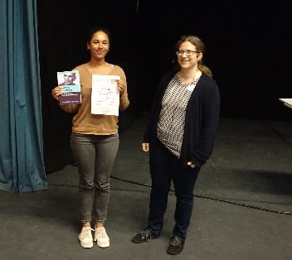
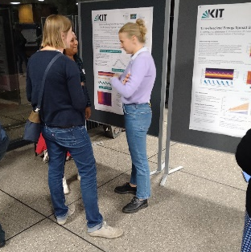
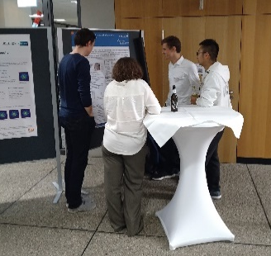
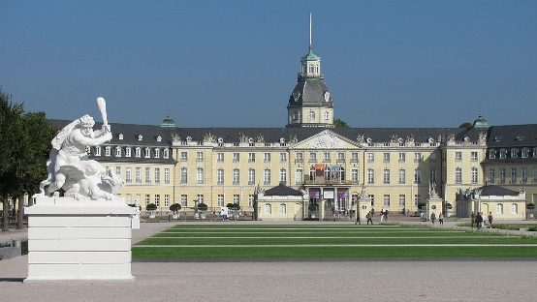
Matter and Technologies
DTS strategy meeting
Ties Behnke, Friederike Januschek

Slide 2
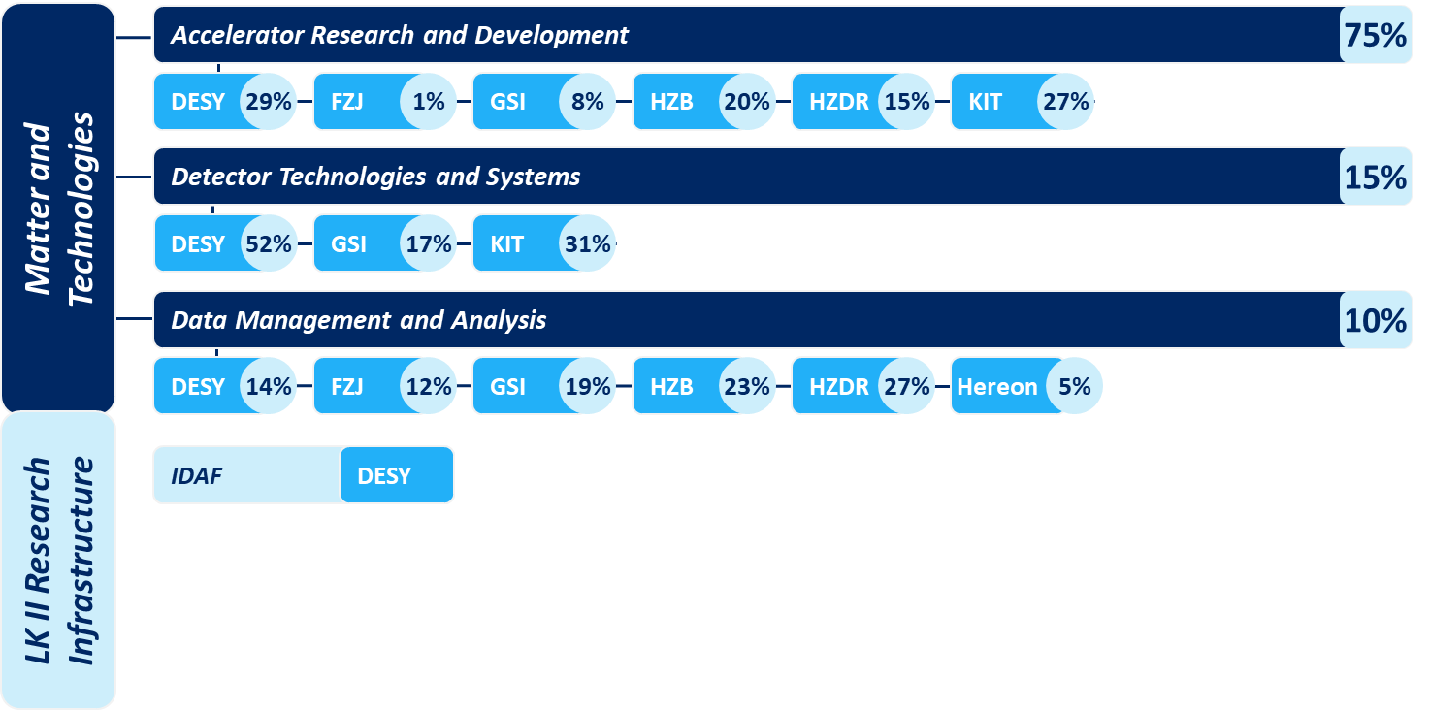

Our starting point
Matter and Technologies in PoF IV
Three topics
Accelerators / Detectors / Data M&A
Central Infrastructures
IDAF
Several LK I Infrastructures
in different access models
One Mission
Research the technologies
the Research Field Matter will need tomorrow
Research in technologies:
Curiosity-driven for Science and Society
Total Budget 83 Mio EUR in 2022
Effects from Covid
Impact of the Russian aggression with
effects on Russian cooperations and supply
line issues

Slide 3

Report from the SAB
SAB meeting May 2022
Final minutes not yet available
MT seen as very positive
  “carry on”
  No concrete recommendations
Ursula Bassler
Chair SAB
Matter and Technologies: The SAB acknowledges the combination of the program topics and the interplay with the innovation platform HI-ACT. In addition, the SAB recommends continuing to explore the aspects of sustainable use of the large-scale facilities, see also the action item below.

Slide 4
SAB on talent and sustainability
Report on talent management and sustainability
The SAB appreciates the generic discussion on both topics, but recommends quantifying the specific problem first. There is a clear need to know the related numbers to act effectively. CERN has very good examples (for both sustainability and talent management), which allows to learn from (e.g. the “25/25 initiative”). This means a status analysis, identification of measures and benchmarks, targets and objectives, diversity issues, and last but not least a strategy, how to achieve the objectives.

Slide 5

Evaluating and optimizing different options….
MT structural evolution towards PoF V
ARD
SCRF
Protoypes
DTS
Sensors
DAQ
Diagnostics
Plasma
Systems
DMA
Systems
Algorithms
Data
Programs in M
Research fields
Non-Helmholtz
Matter Management Board
supports the formation
of the new cross-topic structure
New structural element, reflects the nature of MT,
can be extended to other topics (e.g. quantum…)
X-topic network Frontiers of Optical Technologies (XTN OPT)
WG1
WG2
WG3

Slide 6
The Road towards PoF V
Development of MT
Preparations for PoF V are starting
  Strategy paper of the research area
    First draft due for SAB meeting 2024
    Input from MT: approx. 4-5 pages
  Program Video
    Input to center reviews
    To be prepared 2024 (first half)
Q1 23
Strategy discussions
within the topics
Q2 23
First drafting of MT
strategy for PoF V
Q3 23
Presentation and
iteration with Matter
Q1 24
Alignment with
central guidelines
Q3/4 24
Center review input

Slide 7
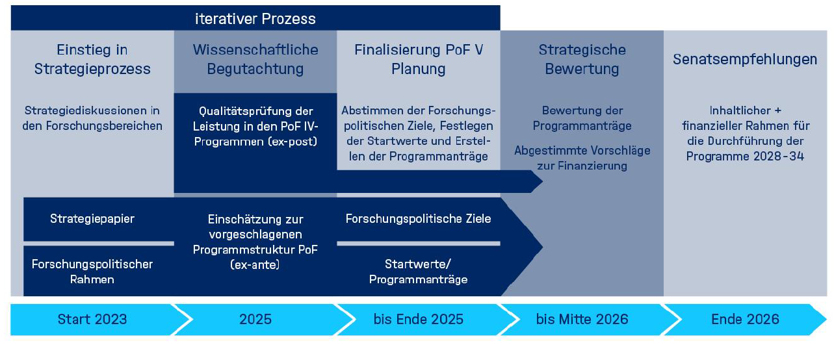
The PoF V process

Slide 8
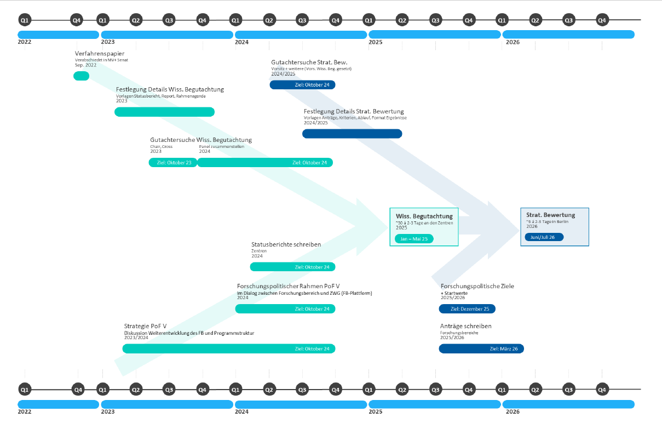
The PoF V process
Write center
reports
Center evaluation
in 2025

Slide 9
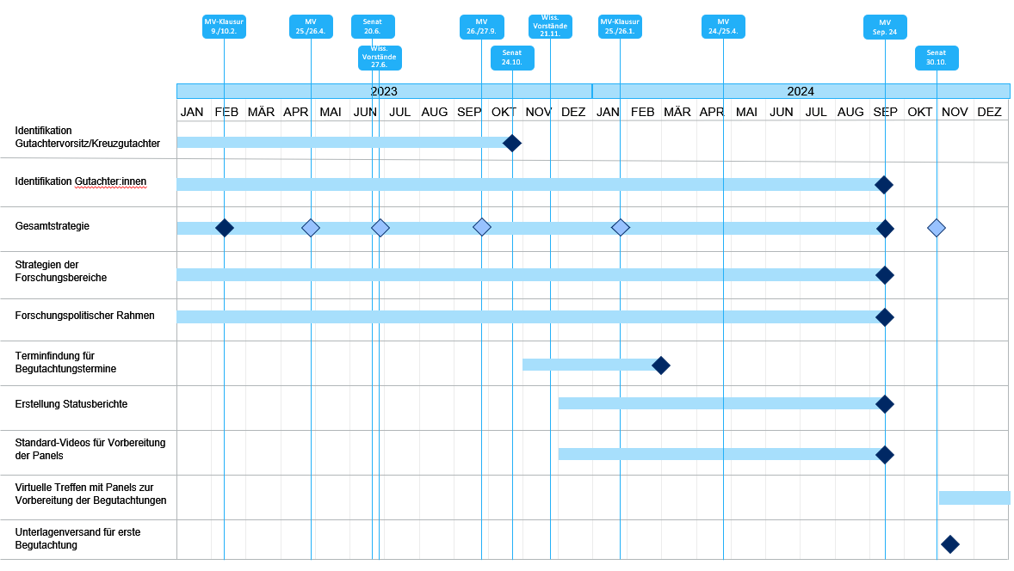
The PoF V Process: Preparation

Slide 10
Strategy Paper
  Aktuelles Forschungsportfolio (2 Seiten)
  Einordnung in den nationalen und internationalen Kontext
  Herausforderungen der nächsten 10 Jahre
  Mission und Forschungsziele des FB
  Zukünftige thematische und programmatische Aufstellung
  Wissenschaftlich-programmatische Ausrichtung
  - Struktur des FB
  - Rolle der Infrastrukturen im FB
  - Kooperationsstrategien (intern / extern)
  - Strategien zu programm- und FB-übergreifenden Themen wie z.B. Digitalisierung
  - Strategien zu zentrenbezogenen (forschungs-)politischen und/oder strukturellen Themen wie z.B. Innovation
  und Transfer / Talentmanagement, Nachhaltigkeit, Parität (Chancengerechtigkeit), Diversität, Digitalisierung
Das Strategiepapier wird in die Statusberichte für die wissenschaftliche Begutachtung (Zentren-begutachtung) und in die Programmanträge für die strategische Bewertung des FBM integriert
Matter draft
for the SAB: 5/2024

Slide 11
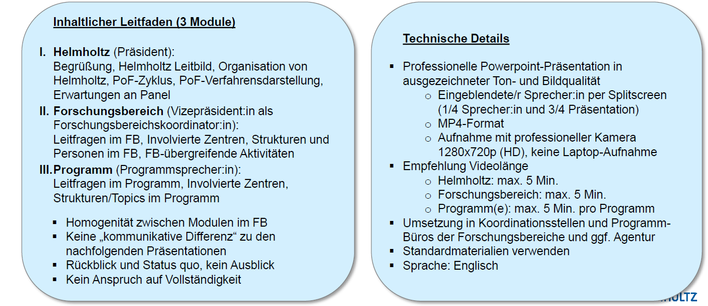
Program Videos

Slide 12
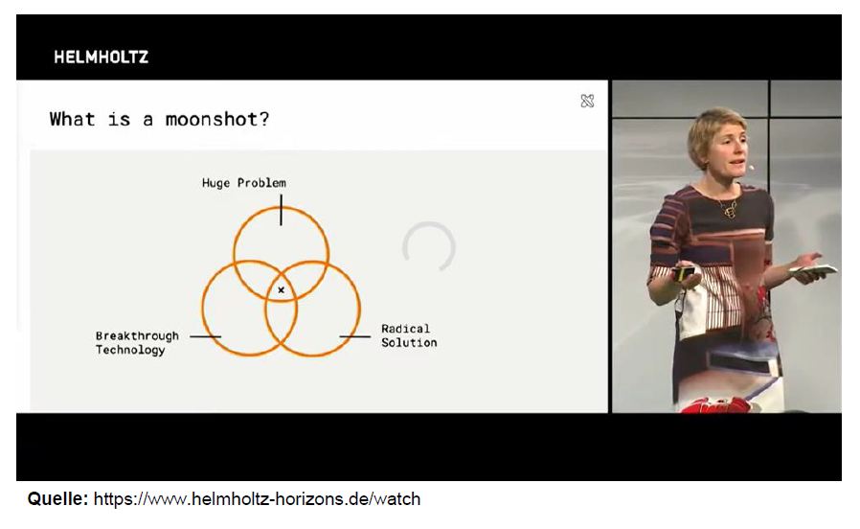
Program Videos

Slide 13
Next steps
Matter management board tomorrow
DTS in person meeting 24.1.2024
MT strategy meeting on 25.1.2024 in Kassel
Matter Lenkungsausschuss “retreat” on 29.1.2024

