Slide 1
Research Field Matter Matter and Technologies Topic 2 – Detector Technologies and Systems
Marc Weber and Silvia Masciocchi
January 11th 2024

Slide 2
Content of strategy paper
1 Research field Matter and its current research portfolio
2 National and international context
3 Challenges for the next ten years
4 Mission and research objectives
5 Future thematic and programmatic positioning
5.1 Scientific positioning
5.2 Structure of the research field
5.3 Role of infrastructures in the research field
5.4 Internal and external cooperation
5.5 Cross-cutting topics
5.6 Commitment to strengthening and advancing our workforce and infrastructures
6 Annex

Slide 3
3. Challenges for the next ten years
Total length for all of Matter: 1 page
General introduction of the Research Field: 1/3 page
Then approx. 9 major scientific challenges & technological questions
Also relate to societal challenges and grand challenges of RF matter
The challenges may not directly relate to DTS or ARD, etc. only, etc.
If they do: we need to suggest ~ 1 challenge/question for DTS
Which one??

Slide 4
4. Mission and research objectives
Total length for all of Matter: 1 page
¼ page for all of MT
This describes the general overarching approach of addressing the grand of RF challenges of Matter

Slide 5
5.1 Scientific positioning
Total length for all of Matter: 3 pages
1 page for all of MT
Max. 1/3 of a page for DTS
What is the essence of our DTS message??

Slide 6
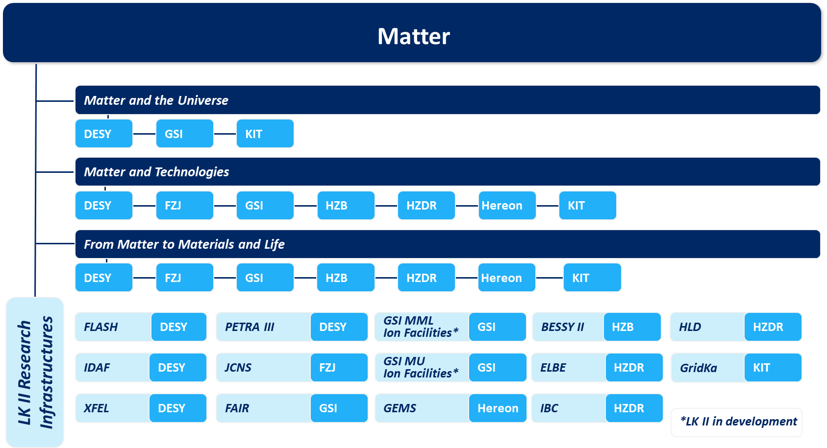
5.2 Structure of the research field
Total length for all of Matter: 1/2 page
Also the topic names will be given, but we still need to know the DTS subtopics
[Text]

Slide 7
5.3 Role of infrastructures in the research field
Total length for all of Matter: 1/2 page
“Describe the general importance of our different groups of infrastructures (e.g., computing centers, photon sources, neutron sources, etc.), LK I, LK II as well as the large international infrastructures which are essential especially for MU (e.g. CTA, Auger, KATRIN, …)”
This is also an opportunity for DTS, but space will be extremely limited.
Maybe we get a sentence or so.
What should we emphasize there??

Slide 8
Appendix

Slide 9
„Forschungspolitische Vorgaben DTS“ (PoF IV)
Optimizing the sensitivity, the time, space, and energy resolution of sensors which are needed in the context of novel accelerators and extreme sources: In addition to the currently dominant silicon semiconductor technology for sensors, the DTS portfolio will be significantly expanded in the area of superconducting sensors by the middle of the PoF IV period. New detectors designed for continuous wave operation will be developed for use at the EUXFEL.
Developing novel detector and readout concepts for extreme data rates and environments: The data rates that will be produced, for example, at the European XFEL or at the High‐Luminosity LHC in the PoF IV period require new data acquisition and trigger concepts. Research in the field of silicon photonics will be intensified in order to master the challenges involved in data transmission. The construction of highly integrated, application‐specific detectors with millions of pixels requires the developments of new materials, new integration concepts, as well as assembly and interconnection techniques. Within the next few years, prototypes will be built and characterized in order to successively establish a new generation of detector systems for highest data rates. Extreme demands are placed on the reliability of the systems in extreme environmental conditions, in almost all fields of application in the Research Field Matter, but especially so in astroparticle physics.

Slide 10
„Forschungspolitische Vorgaben DTS“ (PoF IV)
Consolidating technologies into application‐driven, integrated detector systems: Another essential role of the MT program is to transfer new technologies of the Helmholtz Association to applications. The concept envisages developing and deploying complete detector systems for specific applications, typically within a period of two to four years. This is also a natural starting point for feeding detector technologies into the innovation transfer process at the participating Centers.
In addition to the scientific goals mentioned above, a further declared goal of the program is to significantly improve the infrastructure by establishing a distributed detector laboratory (DDL).

