Slide 1
POF V
DTS ST1
A collection of current and future systems in DTS
Helmholtz Program: Matter and Technologies
PoF V Topic: Detector Developments and Systems
DTS contributing Centers

Slide 2

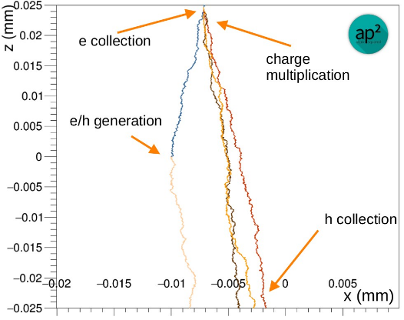
Semiconductor Monte Carlo Simulations Tools
Contact:
Simon Spannagel (DESY)
Developing a common & validated simulation tool for the community
Modern semiconductor radiation detectors are highly complex devices that require precise modeling of their performance
End-to-end Monte Carlo simulators such as Allpix Squared comprise every step from incident radiation to processed detector data
Development required towards adaptive/time-dependent detector fields & response for high charge densities, charge-up & plasma effect descriptions
Develop common framework for users in particle and nuclear physics, medical imaging, photon science & space-bourne experiments
Why?
Deep understanding of semiconductor detectors beneficial for all applications
Common, validated framework unfolds predictive power
Collection of algorithms & parametrizations (mobility, trapping, … ) in one code base
Who? Links to others? Collaborations?
ECFA DRD3 WG 4
Allpix Squared developer & user community
Particle physics & photon science applications
Applications possibly in DTS-ST3

Slide 3
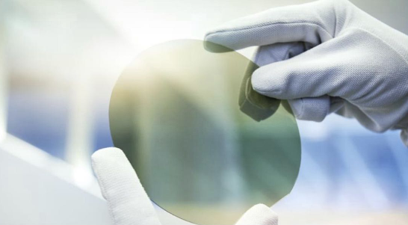
Silicon Carbide as Alternative Sensor Material
Contact:
Alexander Dierlamm (KIT)
Fast signals, no cooling, getting more common in industry
R&D ongoing within RD50, will continue in ECFA
  Will get first samples for us soon
Material also suitable for beam monitoring (FLASH irradiation)
Vision: combine 50µm thin SiC sensor with fast electronics
  smart pixels processed on SiC → charge coupled pixel detector (dielectric glue layer between smart sensor and ROC)
Why is this cool?
The wide bandgap allows operation without cooling which makes detector systems easier and lighter
Very high electrical breakdown field strength allows operation at high voltages mitigating signal loss after radiation damage
Processing similar to silicon sensors, so gain layer also an option (eventually more radiation hard)
Links to others?
MT-ARD or DMA? MT-ARD(?)
DTS-ST1/2/3 or DDL? DTS-ST1, (DTS-ST2)
Other science application fields? DRD3
List all involved partners, in particular all Helmholtz Centers
KIT

Slide 4
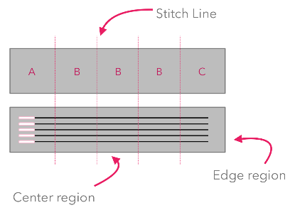
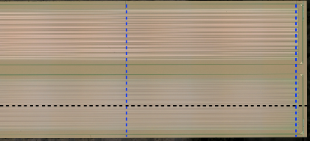
Active & Passive CMOS Strip Sensors
Contact:
Ingrid-Maria Gregor (DESY)
Designing flexible large-area sensors for particle physics & medical applications
Silicon sensors have become indispensable in many fields as imaging or tracking detectors
Strip sensors for large-area instrumentation of experiments only available from few foundries
Goal: vendor diversification through production of sensors using industrial CMOS processes, large-area sensors through reticle stitching
Integration of front-end into strip sensor periphery or embedded into strips
Applications in high-energy physics, beam diagnostics, medical imaging
Why?
Fast, cheap and wafer-scale production
Sensors with integrated readout circuitry & low bandwidth requirement
Possibility of radiation-hard designs
Who? Links to others? Collaborations?
ECFA DRD3 WG 1
Link to KIT
Beam diagnostics, particle physics & medical imaging
Possible applications in MT-ARD

Slide 5
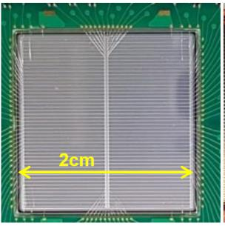
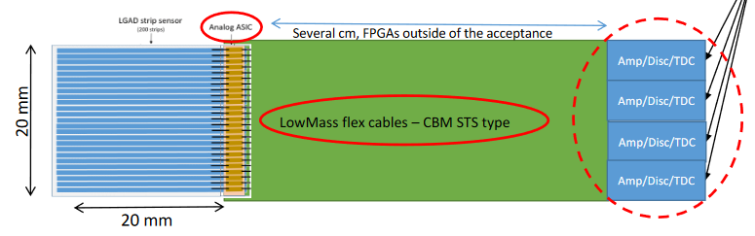
LGAD strip detectors
Contact:
J. Pietraszko (GSI)
…
Combine LGAD strips (external providers) with TDC FPGA/ASICs (GSI).
Use ultra-light cables for connections.
Aim for <100ps time resolution, up to 100 MHz/cm².
Aim for 100 µm pitch.
Strips => low power => light material budget.
Why is this cool?
May serve as start detector for ToF systems.
Proven as in-beam start detector.
Combines excellent time resolution with high rate capability and low power => May be integrated in tracking devices with limited power budget.
Links to others?
ECFA Roadmap: (DRD 3 RG 2.3)
  Synergies: GSI, KIT

Slide 6
Monolithic Active Pixel Sensors in ALICE
Contact:
Silvia Masciocchi (GSI)
Large-area high-granularity stitched monolithic pixel sensor
TPSCo 65 CMOS imaging technology
Smaller feature size: higher integration density
Stitching to repeat reticle and obtain large sensors
Truly cylindrical layers of a vertex detector
Extreme low-power, low-material budget (0.02–0.04% X₀)
Why is this cool?
High-granularity O(10µm)
Very wide range of applications, e.g.:
  ALICE ITS3 (2027-28)
  Future High Energy experiments (i.e: ALICE 3)
Links to others?
ECFA Roadmap: (DRD 7.6)
Synergies: DESY, GSI and KIT
Many potential application fields within and beyond MT

Slide 7
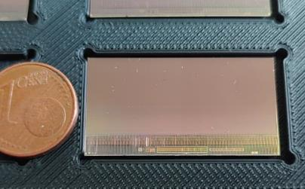
Configurable Monolithic Active Pixel Sensors
Contact:
M. Deveaux (GSI)
…
TPSCo 65 CMOS imaging technology
Device optimized for high rate – low material budget tracking.
Use one sensor hardware, configure rate vs. power depending on application by slow control.
Intended to support various tracking applications in the community incl. FAIR upgrades.
Aim for 5µm, 25-400 ns, 1-100 MHz/cm², 40-200 mW/cm²
Why is this cool?
Suited for precision tracking.
Aim for one common technology kit for various experiments (e.g. FAIR upgrades, Higgs Factories, smaller experiments)
Allows to reconfigure sensor properties within ~1s to adapt for needs of specific experiment, run and position of sensor in the experiment.
Links to others?
ECFA Roadmap: (DRD 3 RG1.3)
Synergies: GSI, DESY, KIT

Slide 8
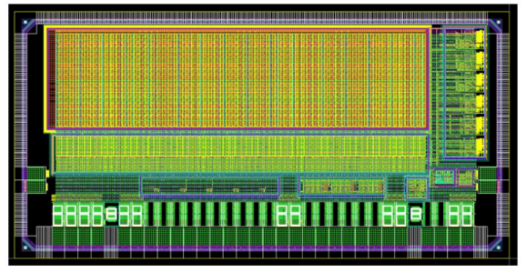
Fully-Integrated MAPS For Single-Particle Tracking
Contact:
Simon Spannagel (DESY)
Monolithic pixel sensors as vertex & tracking detectors for future Higgs factories
Experimental conditions at Higgs factories require vertex detector with high spatial/temporal resolution, combined with low mass and power consumption
Requires development and evaluation of monolithic fine-pitch pixel sensors
In advanced CMOS imaging processes, targeting Higgs factory requirements:
  Key targets include ~3µm single-point resolution, down to ~5ns time resolution, thinning to below 100µm, avg. power consumption <50mW/cm²
  Minimal inactive periphery & architecture scalable to large-area systems
Why?
R&D towards Higgs factory requires detector technology demonstrators
Monolithic sensors drastically reduce complexity of integration & module production
Combining high-resolution with low material & power consumption opens up many application scenarios
Possibility of wafer-scale sensors (stitching)
Who? Links to others? Collaborations?
ECFA DRD3 WG 1
Collaboration Paris, CERN, Strasbourg, Oxford, Zurich
Close connection with GSI, KIT
Relevant also for MU

Slide 9
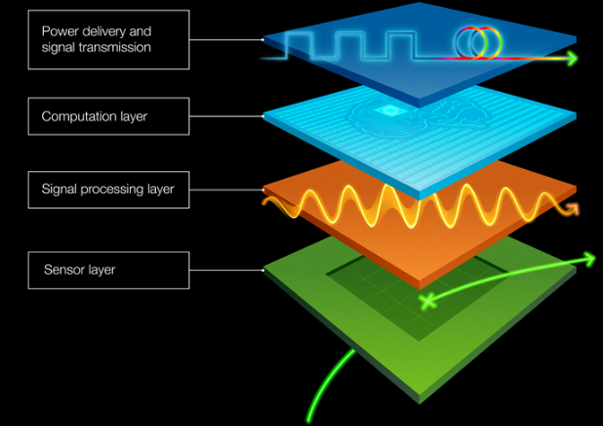
High density 3D integration of LGAD technologies
Contact:
Michele Caselle (KIT)
Ultimate detector with advanced on-detector processing from CMS@LHC to a Higgs factory
3D multi-stacking detectors based on LGAD or SiPM
  LGAD or SPAD layer → developed in LF 110 nm or TPSCo 65 nm
  Digital readout → TSMC 28 or 65 nm
  On-detector AI/ML (optionally) → ECFA Roadmap (DRD 7.2)
  Integration with Photonic Chip (PIC)
Photonic chip
AI –ML (opt.)
Digital layer
Sensor + analog layer (monolithic)
Why is this cool?
High-granularity O(10µm) combined time O(10ps)
Very wide range of applications, e.g.:
  Future High Energy experiments (i.e: ALICE 3)
  Higgs factory (SuperKEKB, ILC, CLIC, FCC-ee )
  Advanced photon sciences and quantum physics
  Novel Beam diagnostics
Links to others?
DTS-ST2: High data rate readout and 3D-ASIC integration
Medical: Potential applications in other fields, e.g. particle detection in hadron therapy (FLASH therapy)
MT-ARD: sophisticated beam diagnostic instrumentation
External partners and networking: INFN-Turin, CERN, etc. ECFA Roadmap (DRD 7.6a/b)
Synergies: DESY, GSI and KIT

Slide 10

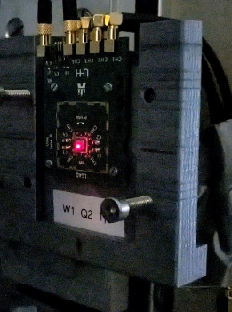
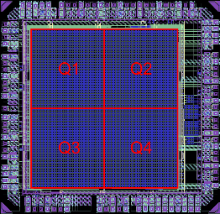
Timing Detectors for 4D tracking
Contact:
Simon Spannagel (DESY)
Marcel Stanitzki (DESY)
Development of versatile fast-timing sensors for different applications
Develop fast timing detectors for 4D-tracking in particle physics:
background suppression, track timestamping
Different technologies are suited for different application scenarios, such as LGADs, fully-integrated digital SiPMs
Direct application with beam telescopes; adding dedicated timing layers with a resolution below 100 ps will be essential to characterize 4D Tracking sensors
Why?
Timing is becoming a major technological avenue for tracking detectors
Tracking detectors at a Higgs factory will require precise timing for precision measurements
We need to provide reference timing layers to enable characterization of these 4D sensors for Testbeam users
Who? Links to others? Collaborations?
ECFA DRD3 WG 2
Particle physics & photon science applications (ST1)
Important for EU projects (AIDA-XXX)
Commonalities with other DESY, GSI & KIT projects

Slide 11
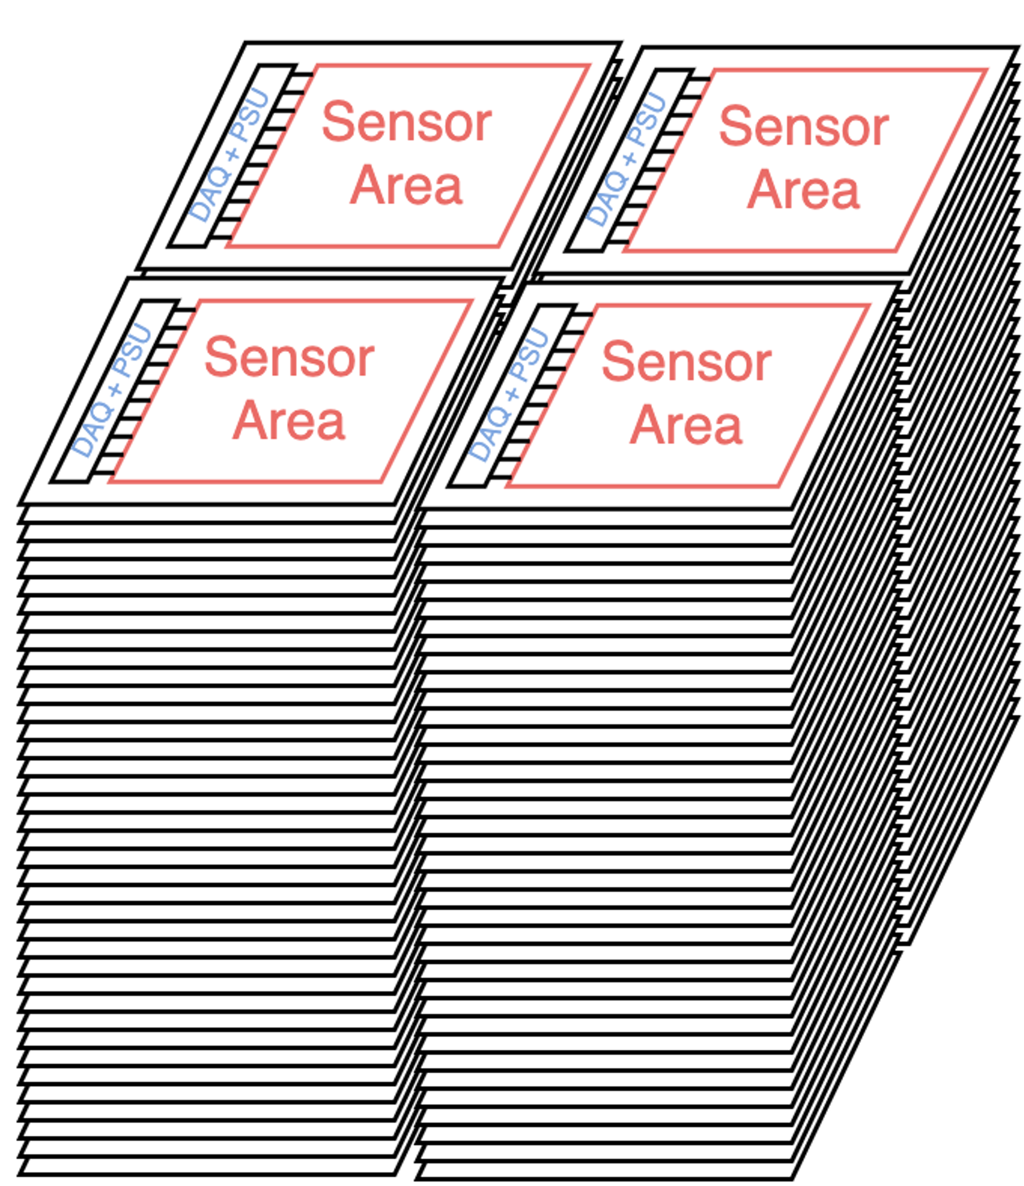
Advanced HVCMOS sensors
Contact:
Ivan Peric (KIT)
1. Fully depleted bulk and low power consumption for photon science
  multi layer detectors; detection of photons
  measurement of photon and particle energy
2. Higher radiation tolerance – Explore the use of wide band gap semiconductors such as SiC; hybrid and active SiC sensors
3. Pushing limits of time resolution
  BiCMOS MAPS, SiGe, deep junction LGAD
4. Very thin HVCMOS sensors in standard technologies (<30µm)
5. Stitching
6. Postprocessing
Large detector volume
Why is this cool?
HVCMOS sensors are MAPS designed with large collection electrodes, which provides the highest radiation tolerance and more uniform sensor timing
Applications:
  LHC, EIC collider,
  FCC-ee, Higgs-EW-Top factories, FCC-hh
  New: photon science, medicine
Links to others?
U Geneva

Slide 12
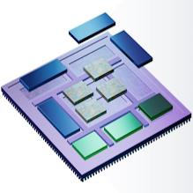
CMOS technologies for large quantum sensing/computing
RF-electronics (up/down converter)
Integration of CMOS on quantum sensing/computing by chiplet technology
Digital (SERDES, etc)
Enable large scalability of quantum sensing/computing 2.0
FD-SOI CMOS technologies (22nm or 28nm) fully qualified to operate @ 4K
Voltage threshold can be totally compensated by Forward BackBias (FBB)
Both p- and n- devices work as room temperature, keeping ft of 500 GHz
No leakage current (@ 4K) → no static power dissipation
Excellent immunity to SEU and good TID up to 100 Mrad
ARMs
Electrical/optical
connection
Large MMC
array
ADCs
DACs
2.5 D / chiplet
integration
Why is this cool?
Development of cryo-qualified CMOS IP-blocks will be needed for: DRD2 (Liquid Detectors) and DRD5 (Quantum and Emerging Technologies)
Results of this research project could generate potential for technology transfer
Links to others?
DTS-ST1: ASIC development
DTS-ST2: 2.5D integration
ECFA Roadmap: (DRD 7.4)
Synergies: DESY, KIT - IHE/IPE
Contact:
Michele Caselle, Andreas Kopmann, Prof Cagri Ulusoy, Prof Christian Enss

Slide 13
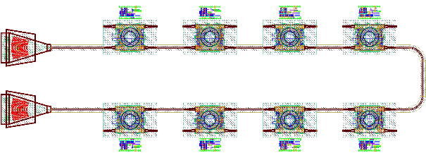
Silicon Photonics for Detectors
Contact:
Karsten Hansen (DESY)
The Monolithic Approach
High maturity of photonic devices in monolithic integration platforms:
path to innovative CMOS-based transceivers
Highest bandwidths and integration density at lowest material budget.
International photonics roadmap: deployment of integrated silicon electronic-photonic technology into mainstream/closing of remaining gaps expected within PoF V
Goal: universally applicable monolithic 100-Gbps DWDM transceiver chipset in 45-nm SOI CMOS technology.
Why?
Technology leadership, ultimate integration & bandwidth
Paradigm shift for detector readout
Core technology enabling new approaches in DTS-ST2 & DTS-ST3
Who? Links to others? Collaborations?
ECFA DRD7, WP 7.1a
Particle physics & photon science applications
Collaborations with CERN, KIT
Relevant to MU, MT-DMA

Slide 14
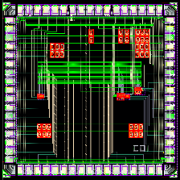
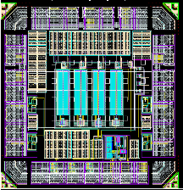
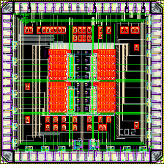
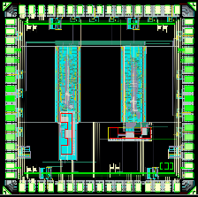
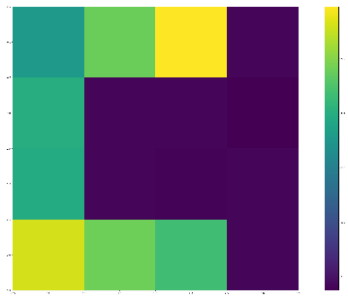
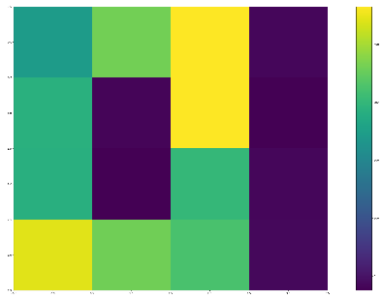
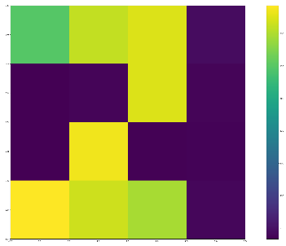
Continuous Readout Digitising Imager Array (CoRDIA)
150-kHz pixel detector for future light sources
Hybrid pixel integrating detector
Designed for 4th-generation synchrotrons and CW-FEL sources:
  Continuous operation at 150 kHz frame rate
  Adaptive Gain Front-end, on-chip ADCs, GWT high-speed data streamout
  Multi-megapixel tileable system with 110um pixel size
  Compatible with Silicon (for ~10keV ph) and High-Z sensors (for hard X-rays)
Prototypes designed, produced (MPW) & tested from 2021 to today
1st generation detector to be ready for first photons at Petra-IV (2029)
Why is this cool?
Crucial to efficient use of and diffraction-limited synchrotrons (PETRA-IV)
Could be an interim solution to the needs of the Eu.XFEL transition to CW regime
Single system can be a workhorse for many different experiments and sources
Links to others?
DMA: > 1 Tbit data rate means data processing and reduction are crucial to make data volume manageable
DTS-ST2: Data rate requires high-bandwidth optical links. Heterogeneous computing hardware likely to be most efficient as first layer of data processing
Possible application to compact FEL experiments
Collaboration between DESY and Bonn University
Under test using the Caribou system (DESY-FE)
Contact:
Alessandro Marras (DESY) and Cornelia Wunderer (DESY)
Calibration circuits, able to inject charge in in an arbitrary pattern of pixels, were used verify basic functionality (as shown in the images on the left)

Slide 15
Through Silicon Vias (TSVs) in X-Ray imagers
Contact:
Ulrich Tunk (DESY)
Project Subtitle / Brief Description
What?
Establish TSVs as standard interconnect for ASICs in X-ray imagers
Matrix of TSVs across the full chip
Local power supply like Intel’s backside powering
Easy or no RDL on backside
Peripery
PCS →GWT
TSVs, bias circuits, current mirrors
PCS →GWT
TSVs, bias circuits, current mirrors
PCS →GWT
Why?
Low or no dead area between sensor modules
Better (i.e. gradient-free) power distribution on chip
Easier implementation of multi-Gigabit interconnects
Who?
Implementation on CoRDIA
Collaboration with several vendors (IZM, ADVAfab…)
Relations to ST2: Interconnects and High-speed data transmission

Slide 16
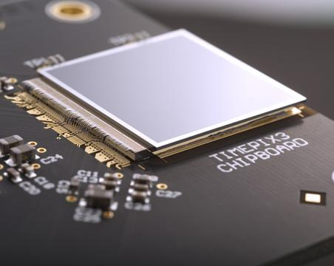
High-Z Senor Materials and Devices for Hard X-Rays
Contact:
Ulrich Trunk (DESY)
Material research and AGIPD 1M System at European XFEL HED
Establish high flux capable High-Z sensors for FELs and Synchrotrons
Material evaluation with AGIPD single chip sensors
Production of High-Z sensor (2×8 chip) Front-End modules for an 1M AGIPD detector at European FEL’s HED endstation
High-Z Sensor version of CoRDIA
GaAs(Cr)
CdTe
CZT
Why?
Essential to exploit capabilities of high-flux high-rate hard X-ray sources like Petra IV and European XFEL
Crucial for e.g. in-operando studies of new batteries or dynamic investigation of matter in extreme states
Who?
Actual sensor devices integrate with ST3 systems AGIPD and CoRDIA
Collaboration with STFC and European XFEL

Slide 17
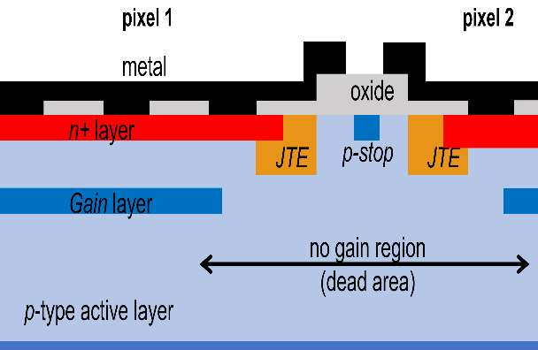
LGADs for Photon Science
Contact:
Ulrich Trunk (DESY)
Project Subtitle / Brief Description
What?
Develop 2D LGAD sensors for low energy x-rays
Evaluate rate and dynamic range performance of LGADs in photon science
Extend the energy range of (existing) high speed / high frame rate x-ray imagers to lower energies
Image fom G. Giacomini ‘LGAD-Based Silicon Sensors for 4D Detectors’, Sensors 2023, 23(4), 2132
Why?
Real fast (100kHz – 4.5MHz) imaging with tender x-rays
Cost efficient and easier to handle solution compared to PN-CCD and DEPFET sensors
Who?
Targeted detector systems: AGIPD and CoRDIA (ST1)
Remarks:
There is significant potential for collaboration with KIT. We offering wafer space on TI-LGAD engineering run for the production of sensors compatible with AGIPD and/or CoRDIA (POF IV)

Slide 18
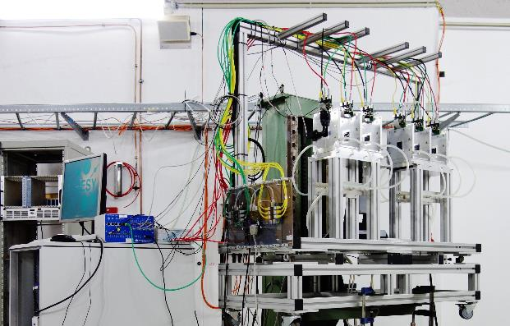
Next generation Pixel Beam Telescopes
Contact:
Marcel Stanitzki (DESY)
Workhorse for detector characterization at DESY ( and CERN, SLAC ...)
Beam telescopes provide precision reference tracks for characterizing sensors at test beams
The current system use MIMOSA and ALPIDE sensors
For POF-V we need a next generation beam telescope with better spatial resolution to thoroughly test the upcoming sensors.
Why?
Telescopes are an essential tool and the demands from the next generation sensors will require better telescopes
DESY has over 15 years of expertise in designing, building and operating telescopes
Many MT-DTS and MU projects have been relying on the current generation of beam telescopes
Who? Links to others? Collaborations?
Build on expertise at DESY ( GSI and KIT)
Telescopes are a cornerstone of EU projects (AIDA-XXX) and DRD3

