Slide 1
MT-DTS Project Collection
ST2: System Technologies
For the preparation of PoF V is is again essential to get an overview of the activities, that are planned by each center and group. During the preparation of the current funding period it was very helpful have the project collection available for structering the research program and find the right milestones.
Please fill in the project template.
Be precise, as this is already possible. Update the list during the course of the PoF V preparation

Slide 2
WP Advanced Data Transmission
Silicon photonics:
Photonic packaging for 3D-integration
Silicon photonics, wavelength division multiplexed data transmission
Demonstrator
Silicon Photonics for Detectors, the monolithic approach
Question: Should the work package be combined with the packaging topic?

Slide 3
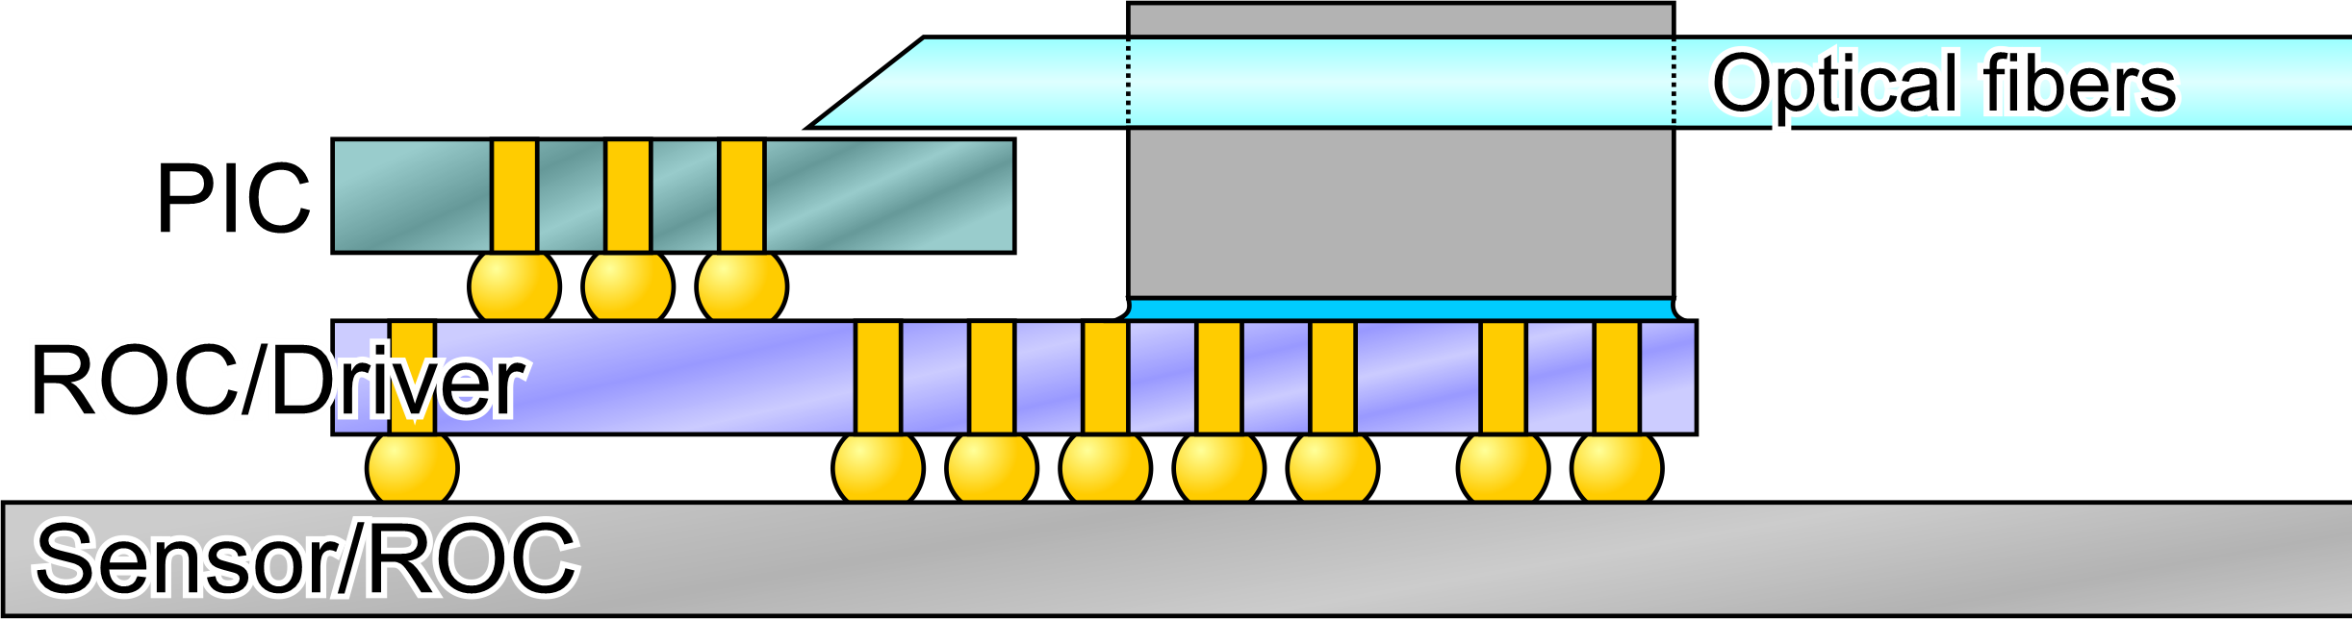
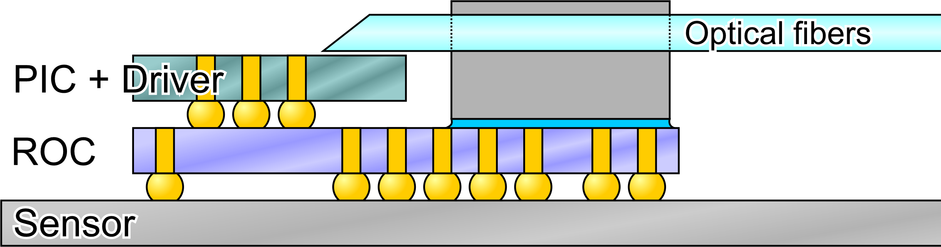
Silicon photonics
Photonic packaging for 3D-integration
Through silicon vias (TSVs) to enable vertical packaging of photonic chip (PIC) with ASICs (Driver, Read-out-chip (ROC)) or sensors
More compact fiber-chip coupling for reduced space requirements
Studies on ‘fibers first’ and ‘fibers last’ packaging techniques
Monolithically integrated drivers for higher speed, lower power consumption, and simplified integration with readout chips and sensors
Tighter integration of front-end electronics and data transmission
More compact design for less material
Shorter electrical traces for lower power consumption and higher signal quality
Timeline: very first laboratory setup might be available in 2026, first ‘production ready’ concepts 2028
Links to others?
DTS-ST2 , silicon photonics
ECFA DRD 7.1
IHE @ KIT
Desy???
Contact:
Marc Schneider, KIT, marc.schneider@kit.edu

Slide 4
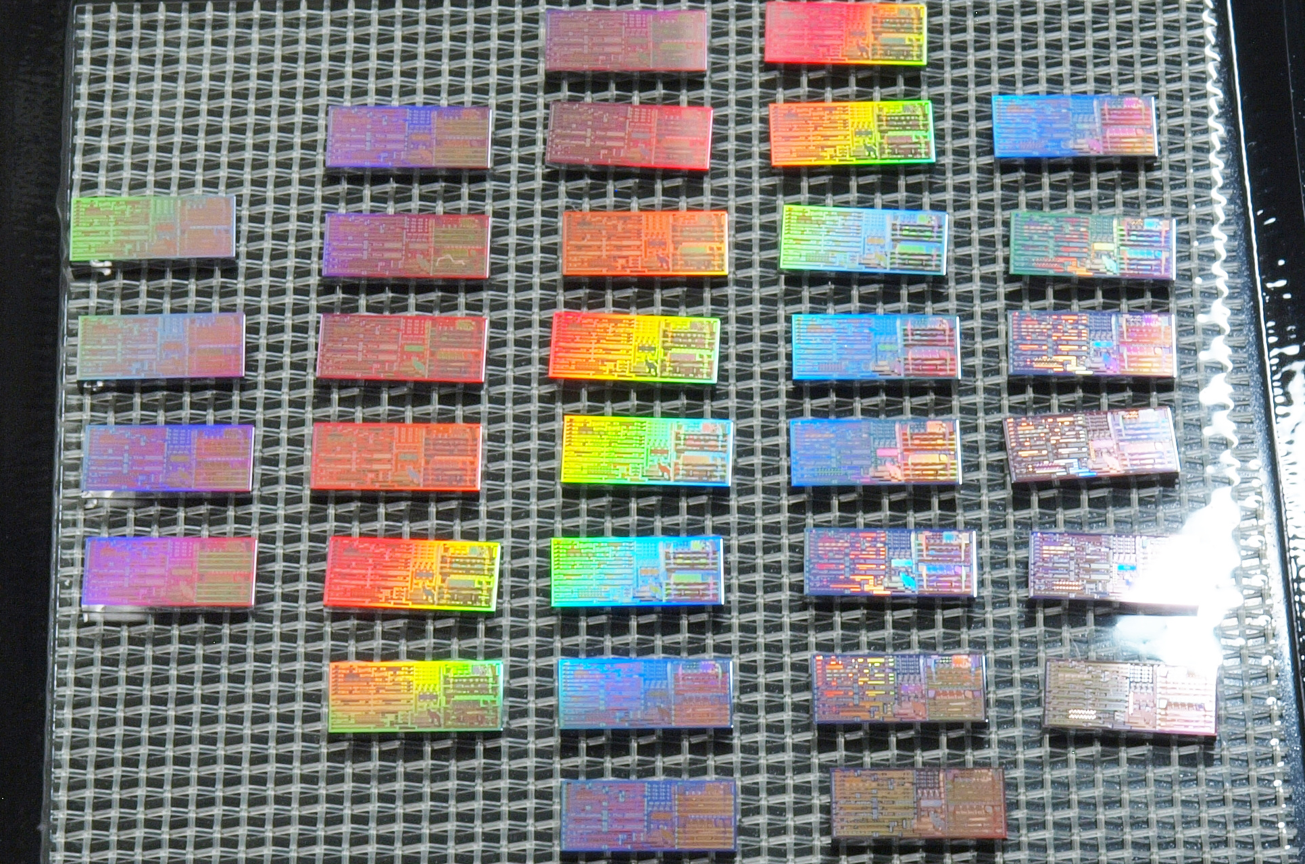
Silicon photonics
Silicon photonic, wavelength division multiplexed data transmission
Optical data transmission between silicon photonic transmitter chip and COTS receivers using wavelength division multiplexing (WDM)
Current transmitter chip includes several silicon photonic modulators, detectors, optical (de-)multiplexers, and 4-channel WDM transmitter systems
Future chips will include bidirectional WDM transceivers and focus on more compact modulators for the price of higher control complexity (ring modulators)
System setup also includes photonic and electronic packaging, driver- and control electronics
Data transmission bandwidths of 40 Gb/s/fiber to
>1 Tb/s/fiber
Scalable to many wavelength channels with destincted or configurable direction
Versatile for radiating and non-radiating environments
Links to others?
DTS-ST1
CERN DRD7
Desy???
Contact:
Marc Schneider, KIT, marc.schneider@kit.edu
Notes:
Would expect to focus in PoF V on ring modulators?!

Slide 5
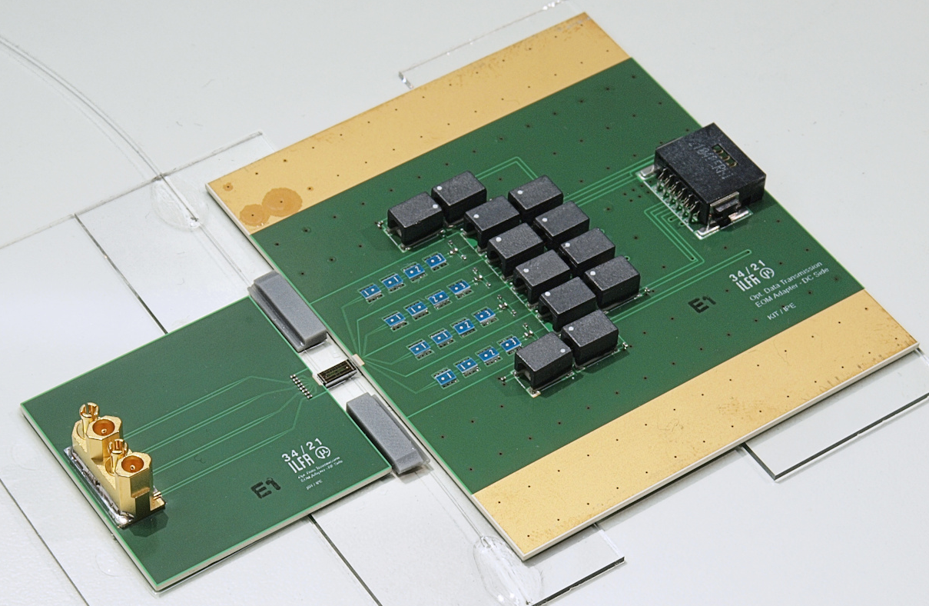
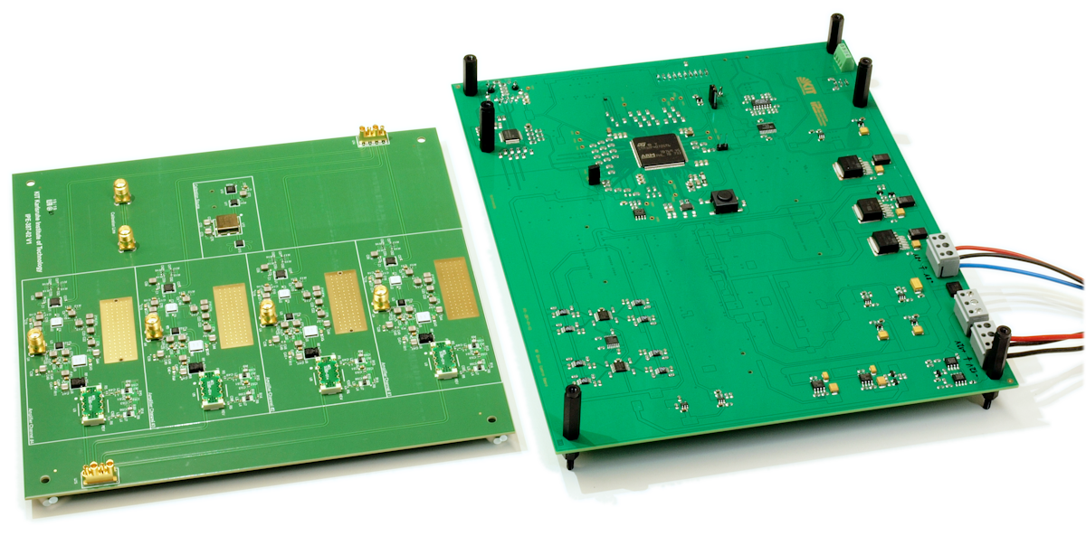
Silicon photonic demonstrator
Silicon photonic, wavelength division multiplexed data transmission
Optical data transmission between silicon photonic transmitter chip and COTS receivers using wavelength division multiplexing
Transmitter chip includes silicon photonic Mach-Zehnder modulators and optical (de-)multiplexers for 4 wavelength channels around 1550nm
Transmitter core ready with electrical connection boards and optical fiber-chip-coupling set up; electronic driver and slow control under test; single channel receiver ready, multi channel receiver in progress
First tests expected in Q1/2024, system running in Q3/2024
High bandwidth data transmission from detector to counting room (40 – 128 Gb/s/fiber)
Scalable to many more wavelength channels
Silicon photonic devices can be made extremely radiation hard (1.2 Grad(SiO₂) TID demonstrated)
Links to others?
DTS-ST1 and ST2
CERN DRD7
DESY???
Contact:
Marc Schneider, KIT, marc.schneider@kit.edu
Notes:
The project has the wrong timeline, everything realized in 2024 is not a topic for PoF V !!!
Better:
- Detector application for LHC-HL to be installed in LS4 2033/34
- Integration in detector for FCC

Slide 6
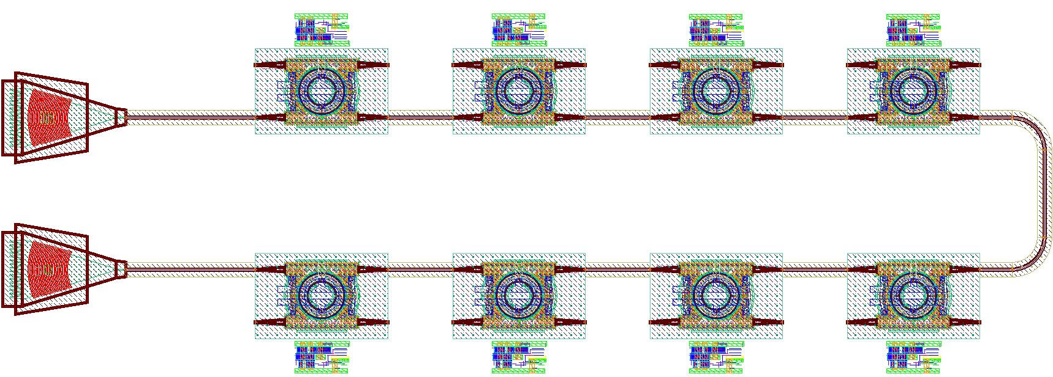
Silicon Photonics for Detectors
Contact:
Karsten Hansen (DESY)
The Monolithic Approach
High maturity of photonic devices in monolithic integration platforms:
path to innovative CMOS-based transceivers
Highest bandwidths and integration density at lowest material budget.
International photonics roadmap: deployment of integrated silicon electronic-photonic technology into mainstream/closing of remaining gaps expected within PoF V
Goal: universally applicable monolithic 100-Gbps DWDM transceiver chipset in 45-nm SOI CMOS technology.
Why?
Technology leadership, ultimate integration & bandwidth
Paradigm shift for detector readout
Core technology enabling new approaches in DTS-ST2 & DTS-ST3
Who? Links to others? Collaborations?
ECFA DRD7, WP 7.1a
Particle physics & photon science applications
Collaborations with CERN, KIT
Relevant to MU, MT-DMA

Slide 7
WP Digital Real-time Data Acquisition and Processing Systems
DAQ:
Data transfer and reduction for X-ray cameras;
receiving and reducing X-ray data using PCs with accelerator cards
Real-time data acquisition for ultrasound tomography
DAQ system for KATRIN++ with megapixel quantum sensors
Computing & Algorithms:
Software-defined DAQ
Low frequency 3D ultrasound tomography device for highly advanced imaging algorithms
Computer Aided Diagnosis using multimodal AI

Slide 8
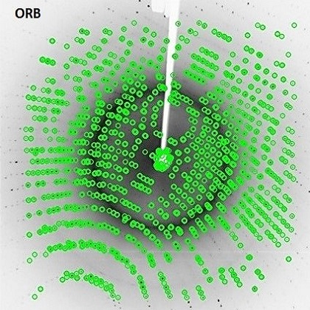
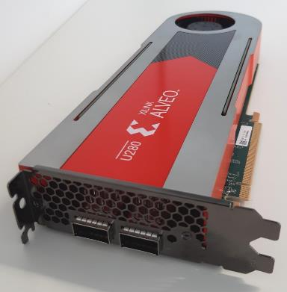
Data transfer and reduction for X-ray cameras
Receiving and reducing X-ray data using PCs with accelerator cards
Xilinx Alveo FPGA card with 2x100G links
What?
Goal – high-speed data transfer from an X-ray detector to a PC, then fast data reduction before data passes to storage
Software development – investigation of machine-learning-based data reduction by rejecting bad images
Hardware development – using datacenter accelerator cards to implement data reception, correction and reduction
Why?
Future synchrotron and FEL detectors will produce dramatically higher data rates (>1Tbit/s)
Other MT-DTS projects require similar elements, particularly adoption of new datacenter cards
Who?
DESY photon science detectors (FS-DS)
Links to European light sources in LEAPS
Links to Helmholtz in Innopool Data-X (currently limited due to difficulty hiring engineer)
Contact:
David Pennicard,DESY, david.pennicard@desy.de

Slide 9
DAQ system for KATRIN++
Scalable readout of a megapixel superconducting quantums sensors
Detailed project description
Key technologies
Timeline, milestones
Why is this cool?
Unique selling points
Application fields
Links to others?
Partner in MT-DTS, contributions of the partners, contact persons
Partner in Matter, contributions of the partners, contact persons
External partner, contributions of the partners, contact persons
Proposer: Name / Email, center, group

Slide 10
Software-defined DAQ
Unified
Detailed project description
Key technologies
Timeline, milestones
Why is this cool?
Unique selling points
Application fields
Links to others?
Partner in MT-DTS, contributions of the partners, contact persons
Partner in Matter, contributions of the partners, contact persons
External partner, contributions of the partners, contact persons
Proposer: Name / Email, center, group

Slide 11
Analysis enviroment (for KATRIN)
Unified
Detailed project description
Key technologies
Timeline, milestones
Why is this cool?
Unique selling points
Application fields
Links to others?
Partner in MT-DTS, contributions of the partners, contact persons
Partner in Matter, contributions of the partners, contact persons
External partner, contributions of the partners, contact persons
Proposer: Name / Email, center, group

Slide 12
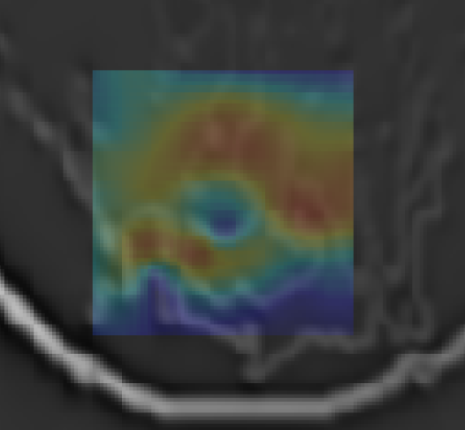
Real-time data acquisition for USCT (realTUS)
Doppler, contrast imaging and ultrasound therapy in 3D
Fast data acquisition in 3D for Doppler and contrast imaging with ultrasound tomography systems, which would enable multimodal breast diagnosis in 3D.
Together with beamforming this enables novel applications in tumor therapy: diagnosis and therapy of breast cancer could potentially be performed in the same device in one go.
Simulated multimodal breast imaging for USCT
Why is this cool?
Full 3D Doppler and contrast imaging for improved breast cancer diagnosis
Enables precise and fast 3D thermal ablation therapy of breast tumors
Links to others?
Medical technology in MT (cancer therapy, multimodal imaging, dedicated ASCIs)
Rapid parallel data acquisition
Nicole Ruiter / nicole.ruiter@kit.edu, KIT

Slide 13
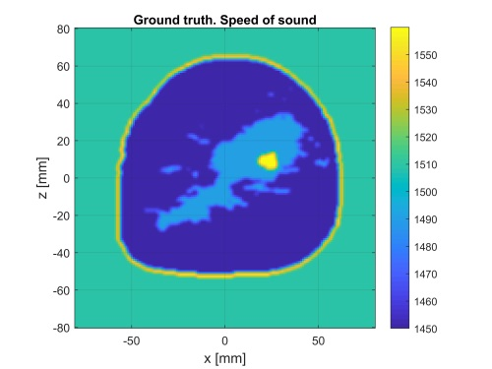

3D USCT for FWI and Paraxial (paraxUSCT)
Low frequency 3D ultrasound tomography device for highly advanced imaging algorithms
More advanced image reconstruction methods require ultrasound signals with significantly lower frequencies.
This is technically very demanding - suitable ultrasound transducers and electronics are not available.
Speed of sound and attenuation images in submillimeter resolution with MRI-like quality are possible
Enables extending the range of applications of ultrasound tomography systems: due to the lower absorption of frequencies below 1 MHz, structures containing bone can also be imaged, e.g. brain, joints, abdominal cavity
Ray-based reconstruction
Paraxial approximation
reconstruction
Why is this cool?
Low frequency ultrasound enables imaging of the brain, joints and abdomen with ultrasound in MRI image quality
Technology for low frequencies needs new developments, but will ultimately enable simpler and cheaper devices
AI driven reconstruction currently under development will enable advanced 3D image reconstruction in seconds
Links to others?
Medical technology in MT (dedicated ASICs, therapy planning,...)
Univ. Heidelberg / Mannheim (DE)
Barcelona Supercomputing center (ES), Imperial College (UK), Fraunhofer Dresden (DE)
Companies: Frontwave (ES), ARCTUR (SI)
Nicole Ruiter / nicole.ruiter@kit.edu, KIT

Slide 14
Computer Aided Diagnosis using multimodal AI (CADMAI)
Combining diagnostic imaging devices for automated cancer detection
Breast compression computed with
FEM (left) and based on Machine
Learning (right)
Diverse imaging devices used in clinical practice can greatly complement each other, yet diagnosis requires a lot of time from medical doctors
Computer-aided diagnosis can help, however, incorporating multimodality is challenging due to different imaging situations
Key technologies to solve this issue:
  AI for fast biomechanical simulation of different imaging situations
  AI for multimodal computer aided detection and diagnosis
  Fast computation by incorporating dedicated architectures (GPUs, FPGAs)
Why is this cool?
Multimodality in medical imaging evolves!
Reducing burden for medical doctors by AI of great interest → highly relevant field of research!
Research for society: can have direct implications on improving cancer diagnosis and treatment.
Example for multimodal CAD: lesion detection based
On MRI (left) and X-ray mammography (right) in combination
Links to others?
  Similar problems in other fields like particle physics: automatically combining measurements of different experiments and automated detection required due to huge amounts of data
Torsten Hopp / Torsten.hopp@kit.edu, KIT

Slide 15
WP Novel Engineering Techniques, Advanced Materials and Interconnects
Packaging and interconnect:
3D integration and fast prototyping
3D stacking and interposer technologies
CMUT based ultrasound transducer arrays
Application: wearable ultrasound tomography
Advanced materials:
Micro channel cooling
Superior thermal materials

Slide 16
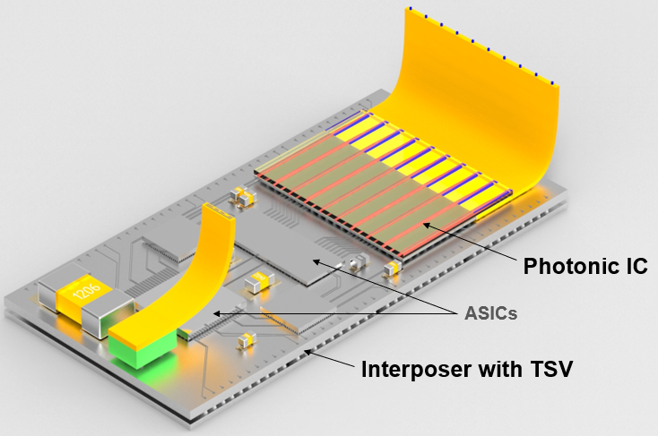
Packaging Technology for Detectors
3D integration and fast prototyping
What?
3D-integration, chip-stacking and co-integration of silicon photonics and electronics are key approaches to achieve highest performance at lowest form factors. Silicon interposers enable complex heterogeneous integration of multiple functionalities extending Moore’s law beyond current limitations. We aim to extend our in-house facilities to provide a complete assembly chain from multi-chip integration to fiber chip coupling. Establishing an interposer technology allows the construction of complex future detector systems.
Why?
Highest compactness, bandwidth and functional density
Key packaging technology for future detectors, fast prototyping
Relation to MT-DTS: ST1- ST3
Who?
DRD3, DRD7.6, particle physics & photon science applications
KIT, CERN
MU
Contact:
Sumera Kousar, DESY, sumera.kousar@desy.de
Karsten Hansen, DESY, karsten.hansen@desy.de

Slide 17
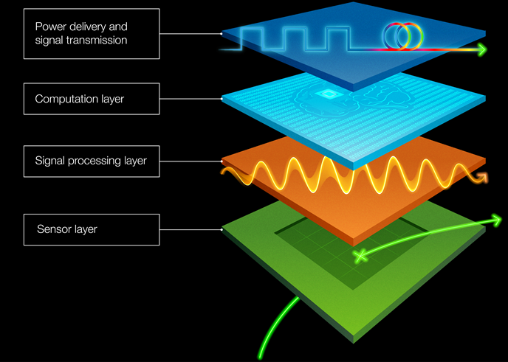
3D stacking and interposer technologies
Advanced integrations technologies for future detectors
3D multi-stacking ASIC on single assembly or MPW
2.5 D integration by passive or active interposer layers
Development of Through Silicon Vias (TSVs) and Redistribution Layer (RDL) for inter-chip connections
C2W and W2W direct bonding technologies
Direct integration of Photonic Chip (PIC) on detector module
Photonic chip
AI –ML (opt.)
Digital layer
(processing)
Sensor + analog layer (monolithic)
Why is this cool?
The heterogeneous 3D integration on single assembly or MPW is a key technology for fast prototyping of future detectors
Dedicated tiers can be developed in different CMOS technologies to cope with specific tasks
Future High Energy experiments (i.e: ALICE 3), Higgs factory (SuperKEKB, ILC, CLIC, FCC-ee / FCC-hh )
Links to others?
DTS-ST1: sensors and ASICs
External partners and networking: CERN, etc.
ECFA Roadmap (DRD 7.6b): Multi-stacking ASIC-3D integration
Synergies: DESY and KIT
Contact: Michele Caselle (KIT)

Slide 18
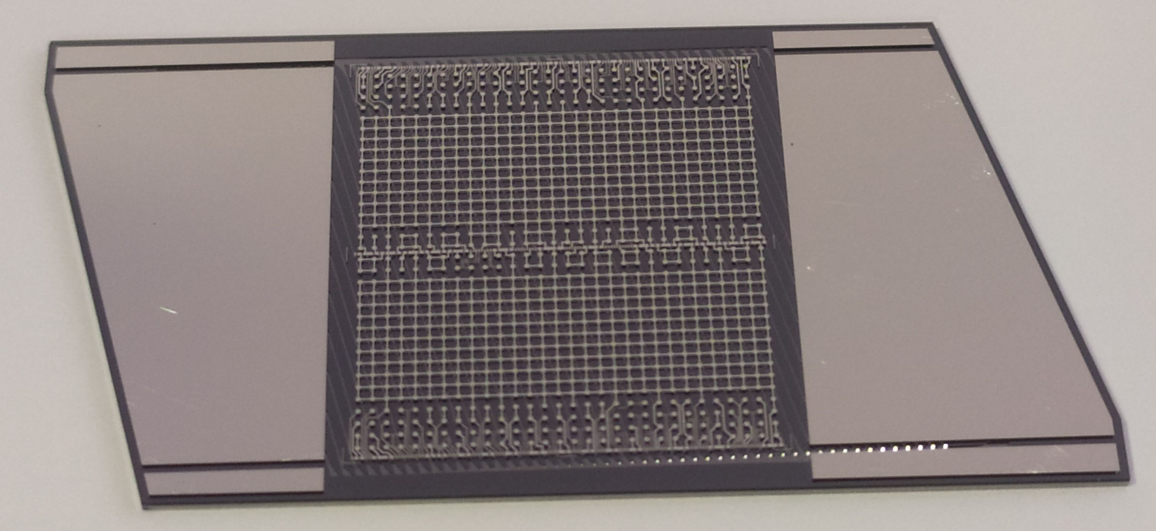
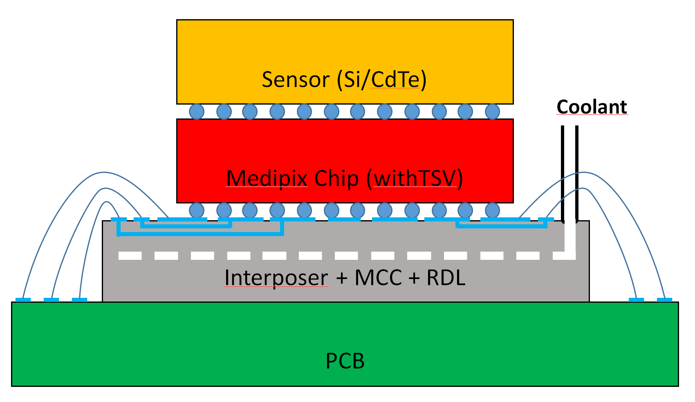
Silicon Interposers
Micro channel cooling for Photon Science detector systems
Current stage of the project:
Fluidic and thermodynamic simulations completed. MCC design updated
The production process has been optimised: both micro channels etching and wafer bonding
RDL metal mask already deposited on the silicon wafer
Mechanical and microfluidic tests in the lab of the new samples starting soon
Later stage / future collaborations:
In operando tests of the Timepix4 chip through the TSV of the interposer
Why is this cool?
If successful, it will combine mechanical support, cooling and signal rerouting in a single device
It can add value to solutions based on the upcoming TSV readout-chips
Potentially very interesting for HEP trackers where reducing the material budget is a high priority
Links to others?
Continuation on previous work made at DESY-FH
Extensive thermal simulation done by Eu.XFEL
The micro channel devices have been produced at CNM
Contact: Jonathan Correa, DESY, jonathan.correa@desy.de

Slide 19
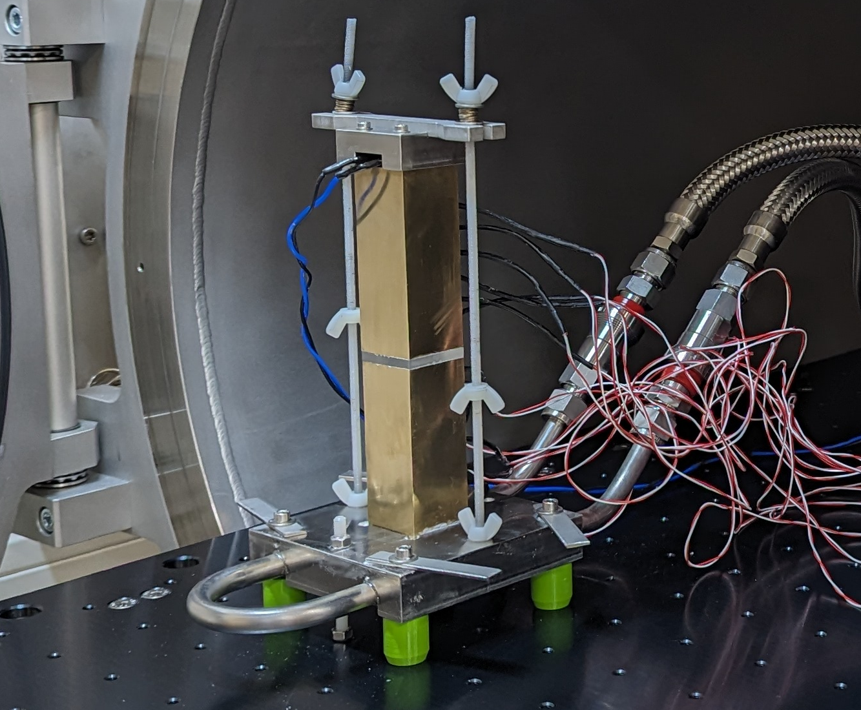
Superior thermal materials
Second line with sub title, application field
Investigations of modern materials for the use in detector cooling and integration. E.g. Carbon fiber composite, carbon foams, thermal interface materials.
Out of spec application of materials require re-evaluation of physical properties. E.g. different operational temperature, irradiated.
Employing various thermal test systems for highly precise thermal property measurement.
Measurements of mechanical properties needed to evaluate suitability for specific use cases.
Thermal test chamber at DESY
Why is this cool?
Many products on the market are designed for specific industry applications.
Evaluation of new materials for the use in detector cooling opens up possibilities to further increase detector performance (better cooling, less material budget).
Links to others?
Collaboration with DRD8 (mechanics and cooling)
Interesting for any system that needs cooling
Potentially with industry collaboration
Contact:
Andreas Mussgiller, DESY, andreas.mussgiller@desy.de
Moritz Guthoff, DESY, moritz.guthoff@desy.de

Slide 20
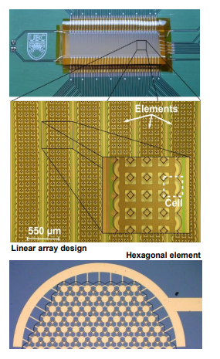
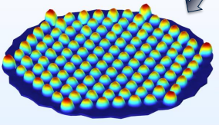
CMUT based ultrasound transducer arrays (CMUTArrays)
Integration of groundbreaking transducer technology for ultrasound imaging and inspection systems
Capacitive micromachined ultrasonic transducers (CMUT) ultrasonic transducers are a novel technology that offers many advantages over current piezo-based transducers, including wider bandwidth, better impedance matching, easier and cheaper production, and more integrated transducers.
Combined with customized USCT ASICs and IPE front end boards, more cost-effective and better transducer arrays could be developed for use in USCT, US sonography and materials testing. UBC's dedicated polyCMUTs have already shown great potential for use in USCT applications.
Why is this cool?
CMUTs are a disruptive technology for ultrasound transducers
CMUTs can be manufactured directly in combination with dedicated ASICs, which can lead to much denser arrays
The technology promises much cheaper and better ultrasound transducers
Applications: USCT, sonography, material testing
Links to others?
Medical technology in MT (ultrasound imaging, wearable applications,...)
MT-ST1, micro machining HSS, ASICs KIT-ADL
UBC Vancouver (CA)
Nicole Ruiter / nicole.ruiter@kit.edu, KIT

Slide 21
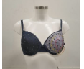

Wearable Ultrasound Tomography (USCT BH)
Wearable ultrasound tomography devices for frequent and long term monitoring
A miniaturized, wearable ultrasound tomography device significantly increases the application potential, availability and acceptance for the detection and monitoring of breast cancer. Although the technological challenges are great, an initial feasibility study has shown promising results and a roadmap for building a first system.
Why is this cool?
Wearable ultrasound imaging enables frequent and long-term monitoring
Comfortable for patient and less burden on doctors for repeated imaging
Tomographic principle has huge potential for sensitive and specific diagnosis
Links to others?
The development could benefit immensely from "CMUT-based ultrasound transducer arrays" that can be fabricated for integration into elastic materials.
Medical technology in MT (wearables)
ADL lab
Potential commercial partners: IcosaMed (CH) and partner (F)
Nicole Ruiter / nicole.ruiter@kit.edu, KIT

Slide 22
Project name, akronym
Second line with sub title, application field
Detailed project description
Key technologies
Timeline, milestones
Why is this cool?
Unique selling points
Application fields
Links to others?
Partner in MT-DTS, contributions of the partners, contact persons
Partner in Matter, contributions of the partners, contact persons
External partner, contributions of the partners, contact persons
Proposer: Name / Email, center, group

Slide 23
Project name, akronym
Second line with sub title, application field
Detailed project description
Key technologies
Timeline, milestones
Why is this cool?
Unique selling points
Application fields
Links to others?
Partner in MT-DTS, contributions of the partners, contact persons
Partner in Matter, contributions of the partners, contact persons
External partner, contributions of the partners, contact persons
Proposer: Name / Email, center, group

