Slide 1
News, next steps and prospects
…towards a fantastic 2024!
Regina Hinzmann
Hamburg, 18.12.2023

Slide 2
News

Slide 3
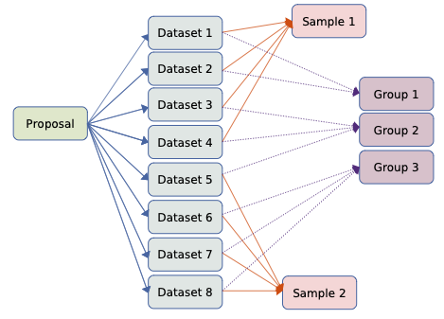
News
Highlight from SciCat bi-weekly collaboration meeting (12.12.2023)
1. Jobs migration (cart function)
Daphne van Dijk is lead of this release, kick-off at ESS (Oct‘23), split into several sub-tasks
Nicolas (job Dtos) and my parts (jobs schema) done
Spencer, Despina (configuration, endpoint implementation)
on hold due to unusual long sickness of one of the collaborators. Had a dedicated coding session about jobs on Wednesday (6th Dec)
This is for URL communication only. For DESY jobs are potentially relevant for DESY‘s DOI provision, but then with KAFKA mess.
2. Discussion of grouping datasets, see issue 805, needs to be followed up next year with a clearer use case as possible solutions were discussed.
3. Discussion of issue on patching a sub fields of scientific meta data, see issue 954, generally supported, but concrete example would help.
From SciCat coll. meeting notes 12-12-2023

Slide 4
Elastic search in SciCat
Status
From Max’ meeting notes of 12th Dec
Max reported that this release has been merged in master and official release 4.4 has been created.
▪ ESS has deployed release 4.4 on their staging environment for further testing.
▪ Elastic Search is an opt-in feature. Please check the documentation for more info:
https://scicatproject.github.io/documentation/Development/v4.x/elasticsearch/elasticsearch.html
◦ Release Search UI
▪ Igor is doing preliminary research
▪ Work will start at the beginning of January
▪ Volunteers are needed to help on this release
Tasks are followed up in https://github.com/orgs/SciCatProject/projects/5/views/1

Slide 5
Next steps and 2024 prospects

Slide 6
Framed
and what to expect
Our goals for 2024 regarding SciCat are now tracked in DESY gitlab.
More than anything else this is meant for documenting progress. The meetings are meant for discussions.
Open data test instance has been created: https://public-data.desy.de/ and been spread in the DAPHNE context (TA2)
Migration of FLASH data is in preparation, thanks Noel!
Are activities converging?
We continue to meet weekly in 2024! First meeting in 2024 is currently scheduled for Monday 8th Jan (tbc).
https://gitlab.desy.de/fs-sc/scicat-desy/consense/-/boards

