Slide 1
News from KET
Komitee für ElementarTeilchenphysik
DPG Fachverband Teilchenphysik, 07.03.2024
Lutz Feld (RWTH Aachen University, KET Chair)

Slide 2
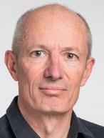
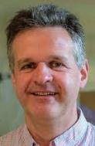
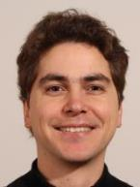

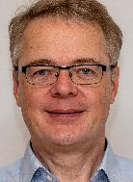
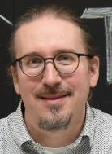
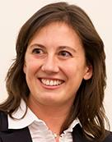
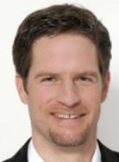
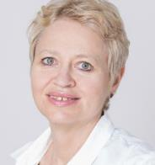
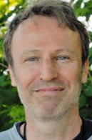
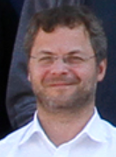
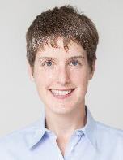
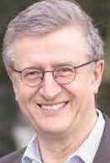
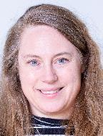
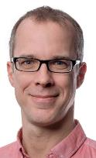
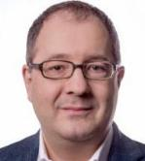
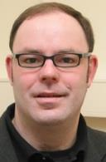
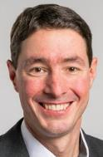
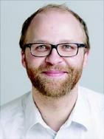
KET members and ex-officios
Prof. Dr. Allen Caldwell MPP Munich MPP Director | Prof. Dr. Klaus Desch Bonn University CERN Council Delegate | Dr. Michael Dührssen-Debling, CERN KET Member | Dr. Frank Ellinghaus Wuppertal University KET Member | Prof. Dr. Lutz Feld RWTH Aachen University KET Chair | Prof. Dr. Daniel Mohler TU Darmstadt KHuK Representative | Prof. Dr. Erika Garutti Hamburg University KET Member
Prof. Dr. Johannes Haller Hamburg University DPG-Fachverbandsvorsitzender | Prof. Dr. Beate Heinemann Hamburg DESY Director | Prof. Dr. Michael Krämer RWTH Aachen University KET Member | Prof. Dr. Heiko Lacker Humboldt University Berlin RECFA Representative | Dr. Ruth Jacobs DESY yHEP Representative | Prof. Dr. Manfred Lindner MPI-K Heidelberg KAT Representative | Dr. Jenny List DESY Hamburg KET Member
Prof. Dr. Tilman Plehn Heidelberg University KET Member | Prof. Dr. Hans-Christian Schultz-Coulon Universität Heidelberg GA Co-Chair | Prof. Dr. M. Schumacher Freiburg University KET Deputy Chair | Prof. Dr. Frank Simon KIT Karlsruhe KET Member | Dr. Marc Wenskat Hamburg University KfB Representative
www.ketweb.de
KET minutes
KET statements
annual meetings etc.
dhep_exp + dhep_theo email lists

Slide 3
Election of the next KET
Current KET in office until annual meeting 22.11.2024
KET has formed a „Wahlvorstand“: Erika Garutti, Jenny List, Frank Ellinghaus
In May: information about KET and voting procedure to dhep and yhep lists
Until end of May: register voters through the „Standortkontakte“
Until end of June: call for nominations
September/October: online vote (supported by DESY)
End of October: new KET elected

Slide 4

CERN70
Central event in Germany 02. to 04.09.2024 at the FUTURIUM in Berlin
  Supported by BMBF
  Exhibition and hands-on experiments
  „CERN Stories“ on 2.9.
  Ceremony with politicians on 3.9.
  Topics: Science and research, technology and innovation, training and education
  Organized by Sascha Schmeling, orga committee, KET, KfB, KHuK, LHC office
Local events in Germany in the week 16.-22.9.2024
  Make participation in CERN visible: research, technology, education, jobs, …
  Coordinated by Netzwerk Teilchenwelt, first meetings with community on 06. and 08.02.2024
  All institutes are encouraged to contribute with own events
  Please contact Uta Bilow (uta.bilow@tu-dresden.de) if you want to join
cern70.de (coming soon…)
Ceremony at CERN on 01.10.2024
Excellent opportunity to expose CERN and particle physics to politicians, the public, and the media
Promote the bright future of CERN

Slide 5
The future of CERN
A new collider project at CERN is of utmost importance for the German community
  Research into the Higgs sector and many other open questions
  Scientific diversity, technology development and sustainability are important aspects
In accordance with the 2020 European Particle Physics Strategy CERN is conducting a
feasibility study to build the FCC-ee as a Higgs/Top/EWK factory, and later the FCC-hh
  Midterm report: https://new-cds.cern.ch/records/zh1gz-52t41 (restricted to CERN users)
Update of the European Particle Physics Strategy 2027
  must be prepared from 2025 onwards

Slide 6
Future Collider @ CERN Community Event
as discussed and agreed at the KET Annual Meeting in November 2023
23.+24.05.2024 at Bonn University
  KET formed an organizing committee:
  Markus Schumacher (chair), Frank Simon, Georg Weiglein, Karsten Köneke, Jenny List, Tilman Plehn,
  Marumi Kado, Markus Klute, Michael Lupberger (yHEP), Erik Bründermann (KfB), Klaus Desch (local)
  preparatory session for young researchers on 22.05., as suggested by yHEP
  agenda will be circulated shortly
  survey on interests and possible contributions of German groups prior to the workshop
Scope and goals
  consultation on the results of the mid-term review of the FCC design study
  discussion of possible German contributions to the FCC-ee
    Physics: Physics case, new developments, weighing up the pros and cons
    Detectors: ECFA Detector Roadmap in Germany
    Accelerators: LDG Accelerator Roadmap in Germany
  preparation of German participation in the EPPS update 2027
FCC-ee focus of this workshop does not represent a pre-commitment of the community to this project

Slide 7
Implementation of the ECFA Detector Roadmap
Most DRD proposals are submitted and approved
4 consortia have formed in Germany and have submitted proposals in the ErUM-Pro call:
  Silicon Detectors
  (J. Dingfelder, Uni Bonn, E. Garutti, Uni Hamburg)
  Calorimetry
  (F. Simon, KIT)
  Gaseous Detectors
  (J. Kaminski, Uni Bonn, B. Ketzer, Uni Bonn)
  Quantum Detectors
  (S. Kempf, KIT)
ErUM-Pro funding (if granted) will be the basis for successful detector R&D in Germany and for the German participation in the DRD collaborations
[D. Contardo]
[Status December 2023]

Slide 8
ErUM-Data Strategiegespräch
BMBF invited to a „Strategiegespräch“
23./24.01.2024 in preparation of the
next ErUM-Data campaign
ErUM communities were represented through
DIG-UM and its topic boards
Input from KET community was collected by the KET-Software & Computing-Panel
(Günter Duckeck, Thomas Kuhr) and transmitted to DIG-UM boards
Fruitful discussion at the „Strategiegespräch“, KET input well represented

Slide 9
Sustainability
Presentation by Michael Düren at KET annual meeting (link)
Climate change is an acute and permanent danger to mankind
  …and to all HEP projects
HECAP+ repot „Environmental sustainability in basic research” arXiv:2306.02837v2
Our field must and can contribute
to tackle climate change!
FCC Timescale (as an example)

Slide 10
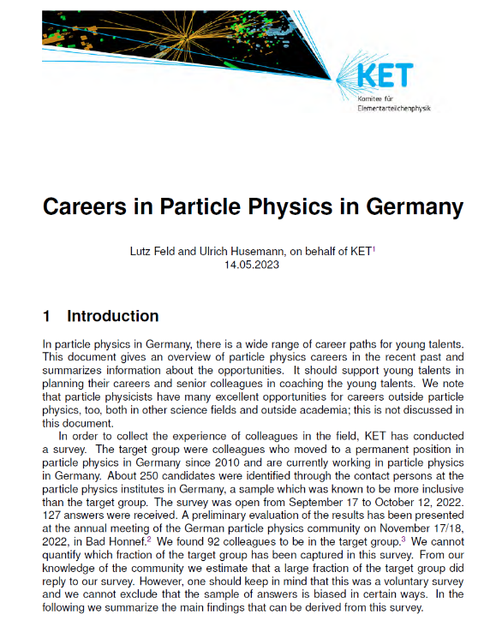
Careers in Particle Physics in Germany
KET survey in autum 2022 among colleagues who
obtained a permanent position in Germany since 2010
92 replies in target group
Important factors for a career in particle physics
Report availbale at https://www.ketweb.de/veroeffentlichungen/karrieren_2023/
Career options at CERN: https://careers.cern/zusatzliche-informationen-fur-deutsche-bewerberinnen

Slide 11
Next KET annual meetings
21. - 22.11.2024
20. - 21.11.2025
(see ketweb.de)

