Slide 1

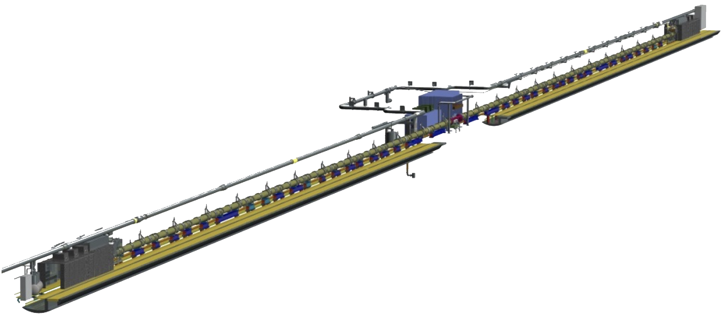
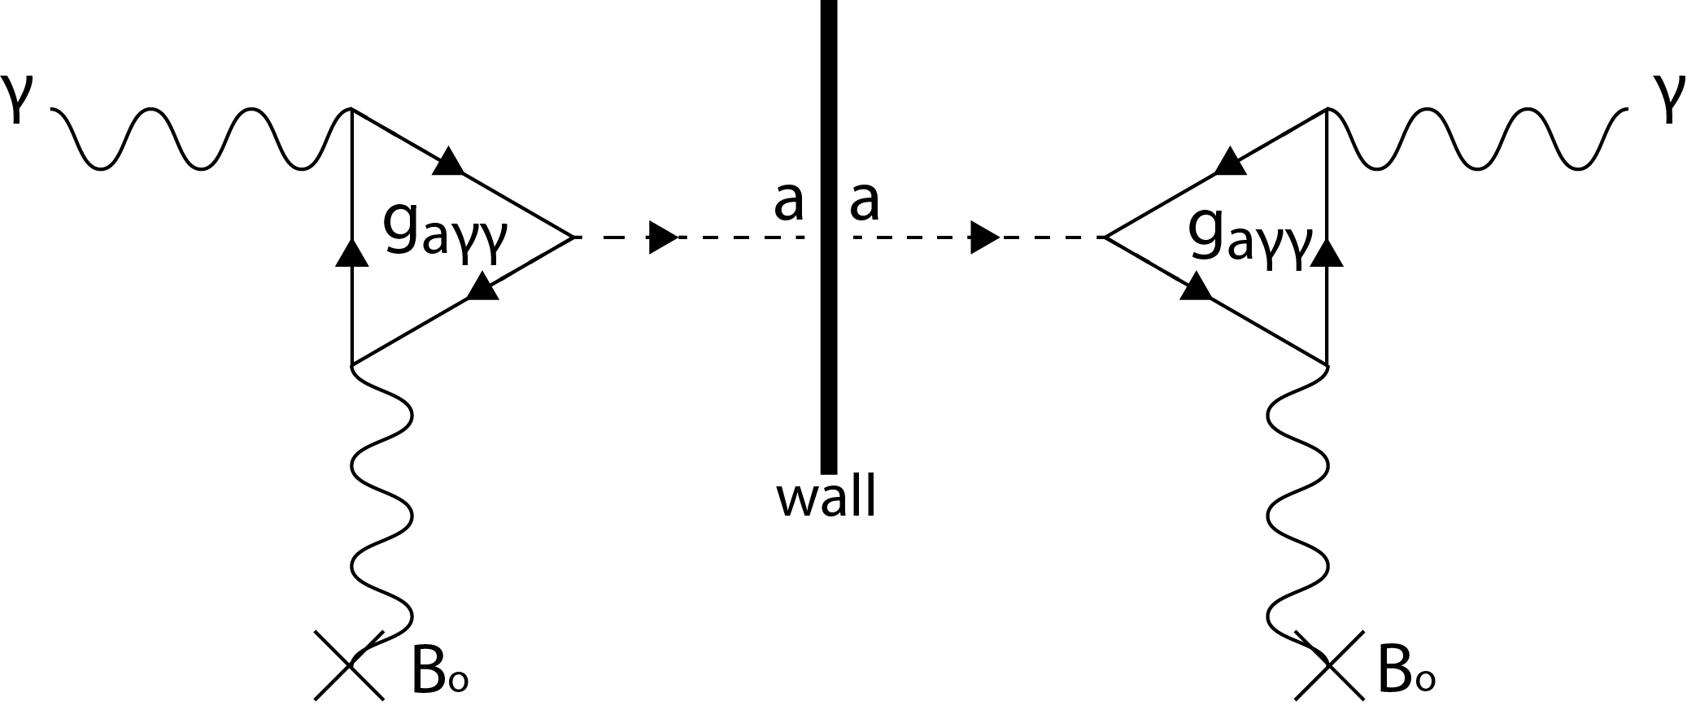
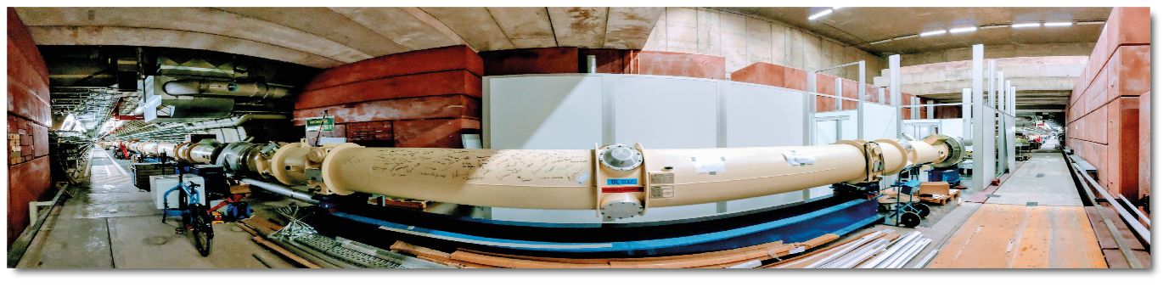
About ALPS IIc
Light Through The Wall experiment
Location: HERA North
Overall length: ~280m

Slide 2


ALPS IIc Needs / proposals
DOI Metadata
Digital Object Identifier
SciCat
manage and annotate scientific data,
public Metadata access
Invenio RDM
instance
repository/document management platform
EDMS
unique ID
eLogbook
existing
Metadata
- hardware
- json format
DOOCS
control system
Python script
(special Software)
HDF5 / NeXus
(dCache)
&
&

Slide 3
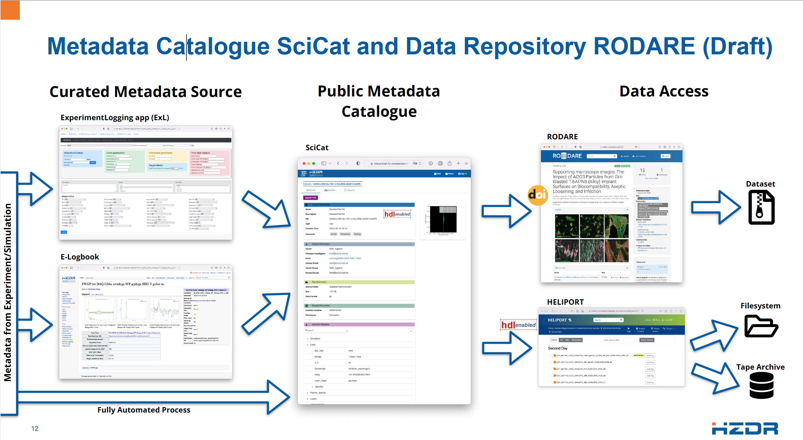
HZDR solution as a solution(?!)
Oliver Knodel, HZDR

Slide 4
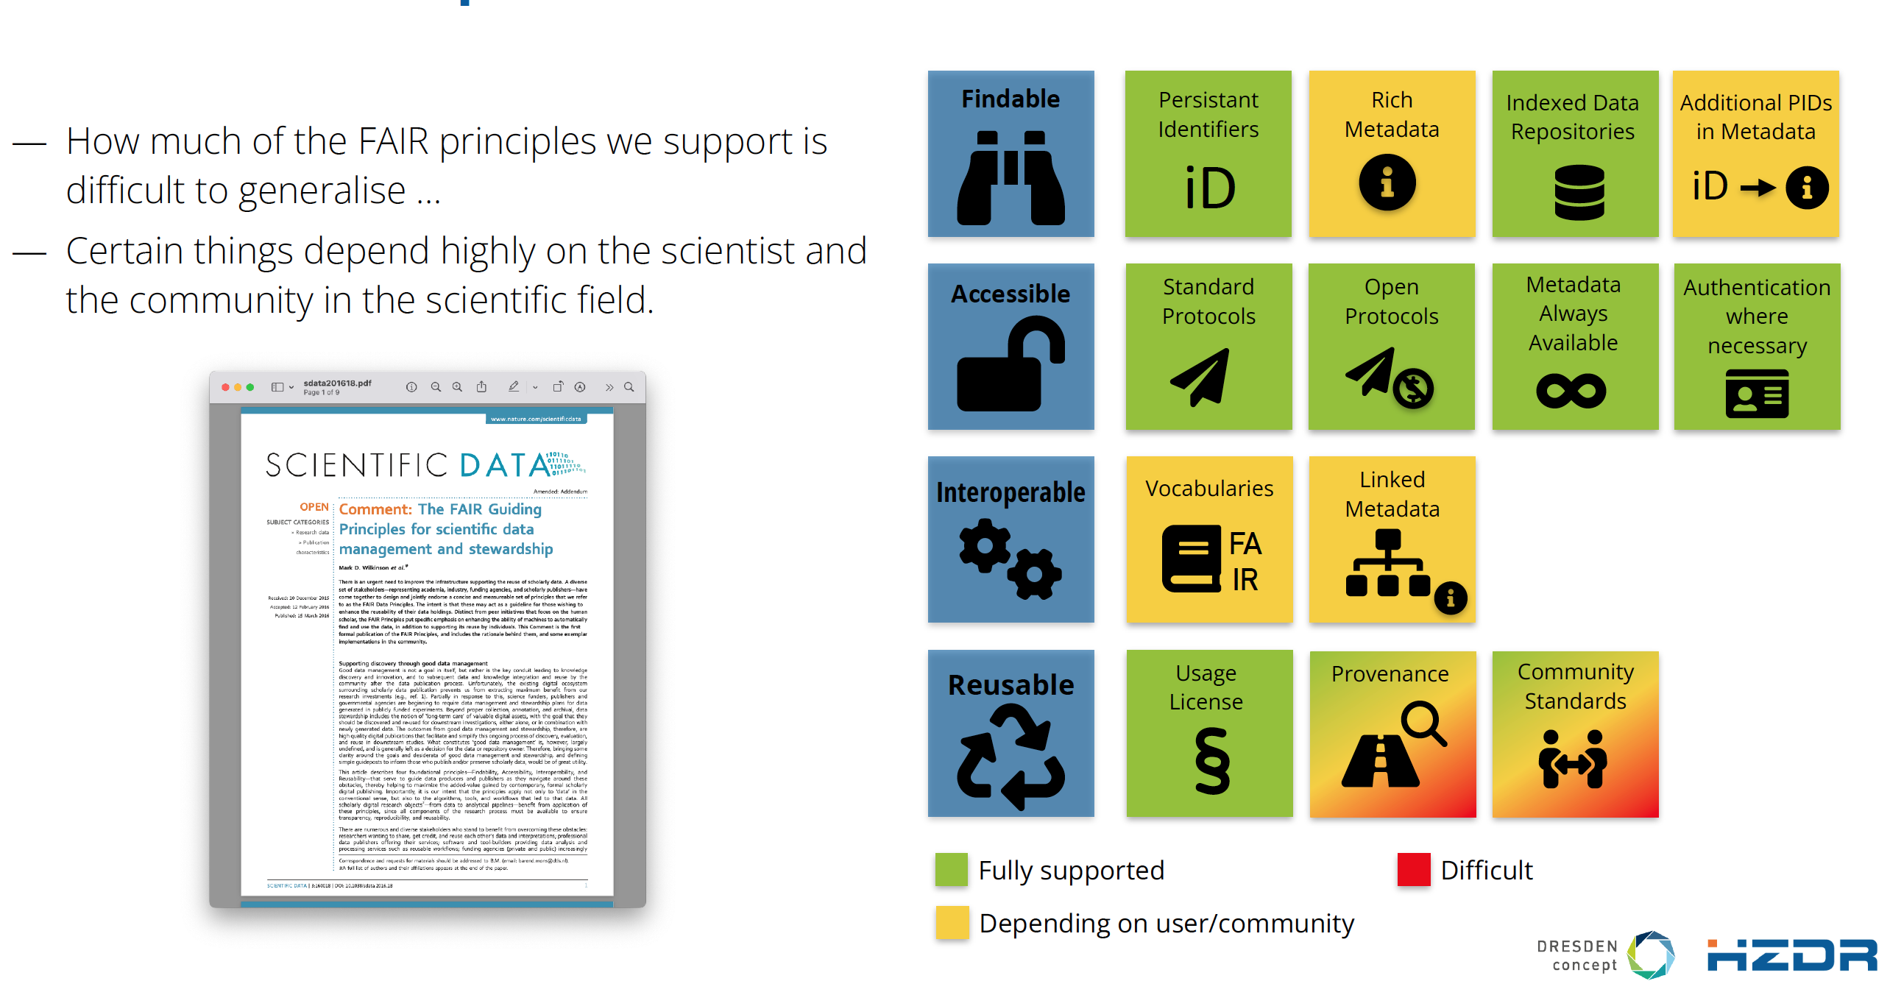
HZDR FAIR principles and RODARE in detail
Oliver Knodel, HZDR

