Slide 1
Opening Remarks
Particle physics at DESY
Beate Heinemann
DESY PRC97, 24 April 2024

Slide 2
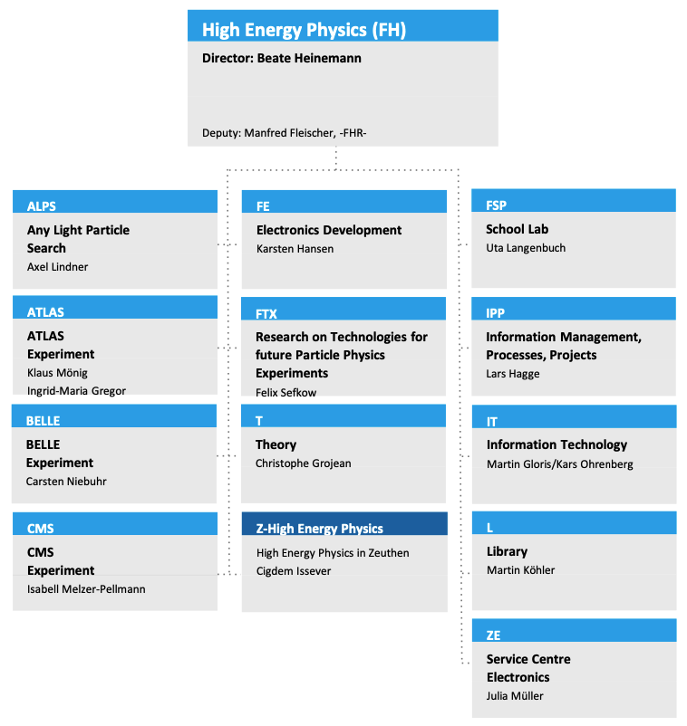
FH organisation
FH organisation:
12 groups in Hamburg
1 group in Zeuthen
New: horizontal platforms to foster exchange on common topics
Detector R&D: M. Guthoff, K. Krüger
Scientific Computing: F. Gaede, J. Reuter, C. Wissing
New: liaisons
Outreach, News and Events: F. Blekman, C. Schwanenberger
Technology and Transfer: L. Huth

Slide 3
PETRA IV Status
The world‘s best X-ray microscope
PETRA IV construction:
Major construction project: shutdown 2030/2031
Delayed by two years w.r.t. previously shown plans
Implies downtime for Test Beam 2030-2031
PETRA IV funding
Internal and external cost reviews successful (total: 1.5 B€)
Pre-proposal funding of 44M€ granted for 2024-2027 by federal budget committee
Includes 15M€ for design of plasma-based injector
Expect national roadmap process to be launched before July

Slide 4
Towards POF V
“Programm-orientierte Förderung” – 7-year funding cycle of Helmholtz.
Currently living in PoF IV period, starting to prepare for PoF V. Important for us: Topic “Fundamental particles and forces” (FPF) in program “Matter and the Universe”, and program “Matter and Technologies”
Definition of our strategy (PoF V proposal)
Fall 24: Status report
Dec 25: PoF V proposal
Scientific evaluation
Feb. 2024
Strategic evaluation
Final verdict
PoF V period
Definition of political & financial boundaries
2023
2024
2025
2026
2027
2028

Slide 5
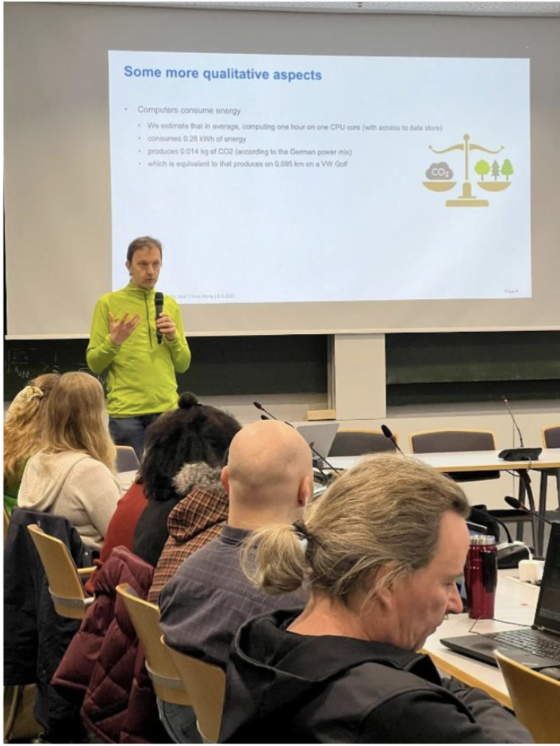
Sustainable Computing Workshops
A new series of workshops at DESY
Participants learn and practice sustainable computing methods and focus on efficient usage of resources
Examples of topics covered: unit testing, continuous integration, documenting code in GIT, working on the NAF, batch computing, best coding practices…
Organized by FH IT experts and the FH Sustainability Forum
Beginner workshops: Sep 2023, Jan 2024, Oct 2024 (planned)
Advanced workshop on software testing this Friday, Apr 26, 2024 https://indico.desy.de/event/44051/
About 20-30 PhD students and postdocs participated in each workshop
Y. Kemp at Sustainable
Computing Workshop
Organisers: Juliette Alimena, Ben Brueers, Nils Gilllwald, Eleanor Jones

Slide 6
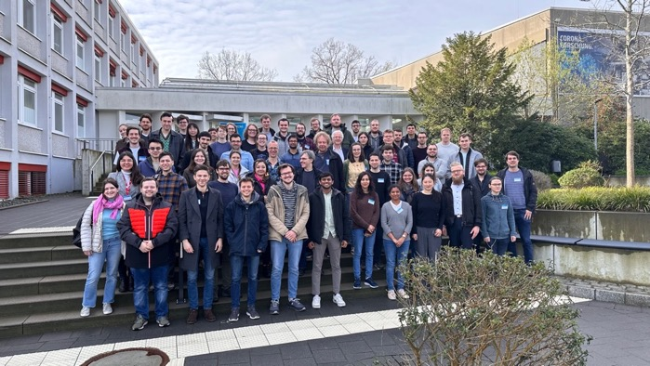
Schools in 2024
19.2.-23.2. Monte Carlo School (42 master/PhD/postdoc)
18.3.-22.3. Introduction to the Terascale (23 bachelor/master/fellows of the Netzwerk Teilchenwelt)
2.4.-5.4. Statistics School (64 master/PhD/postdoc)
Coordinated program by Erum-Data-Hub offering Machine Learning Schools
Next school in planning: Advanced programming topics
http://www.terascale.de/schools_and_workshops/
Statistics School 2024
Renowned international speakers: Glen Cowen, Roger Barlow, Torbjörn Sjöstrand (MC), …
Tutorials from big software tools: Pythia, Herwig, Sherpa, Combine (Stat.)

Slide 7
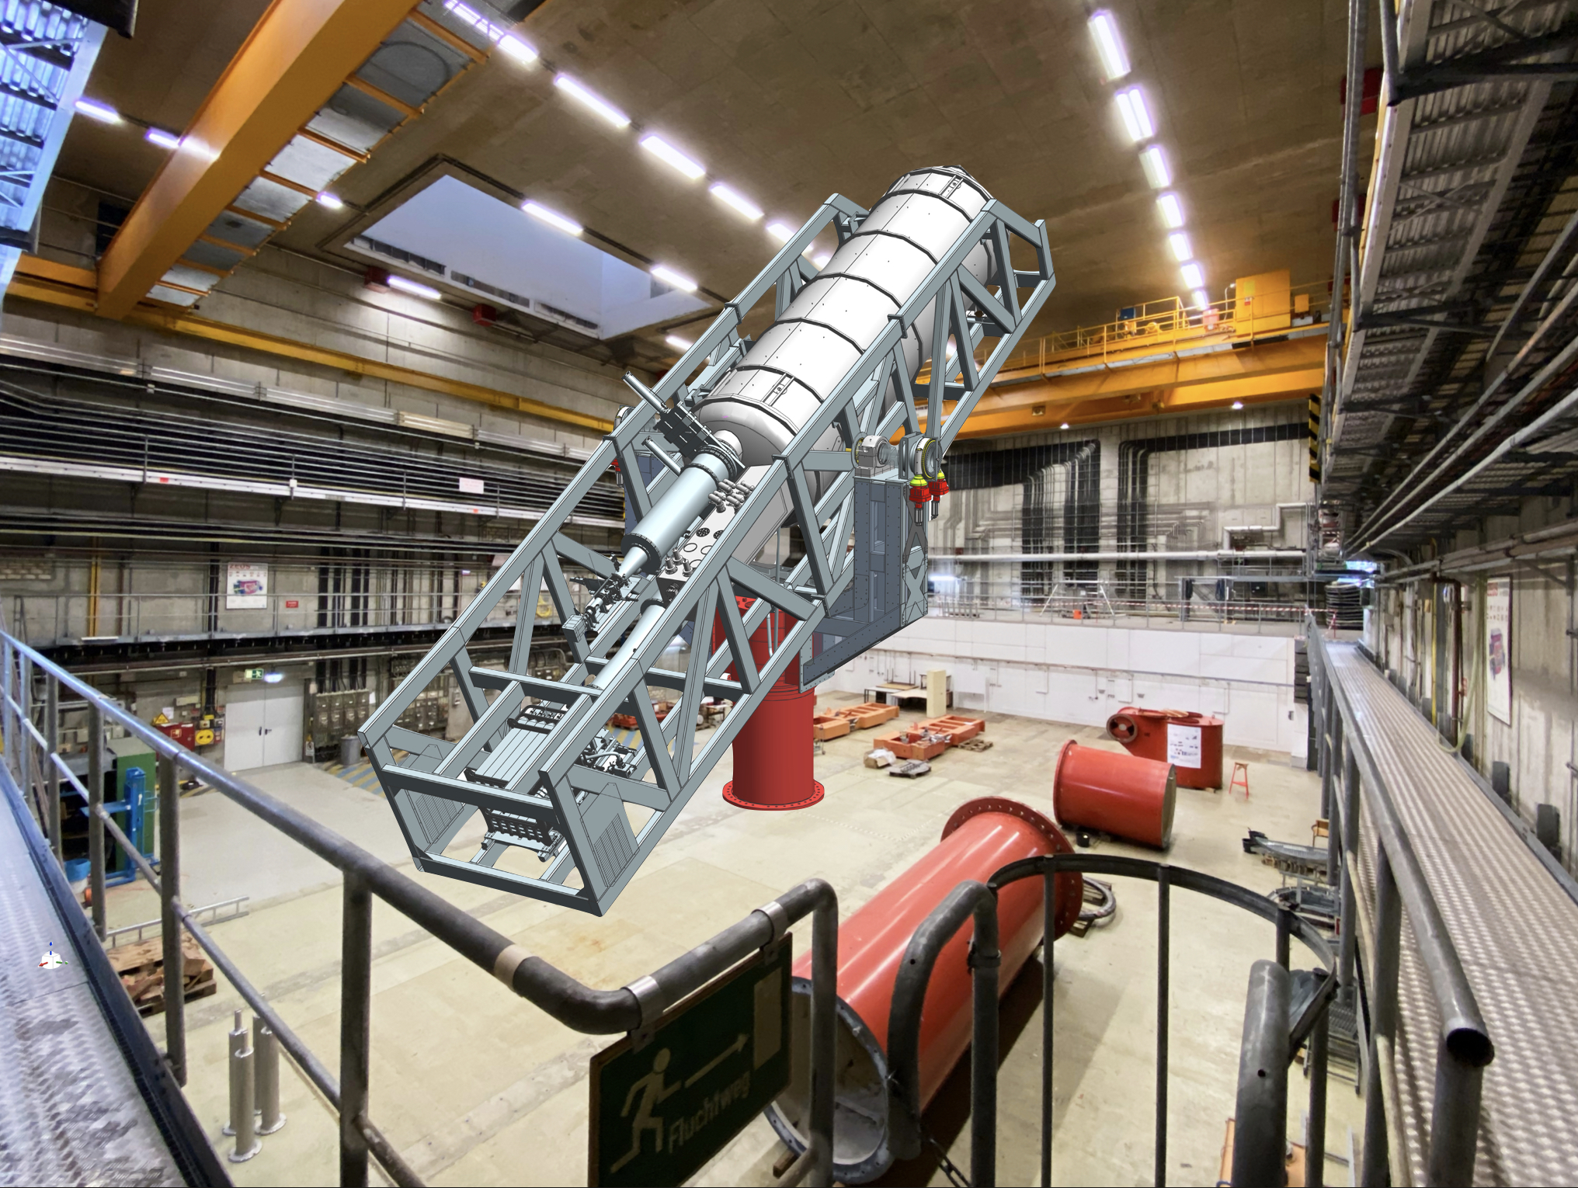
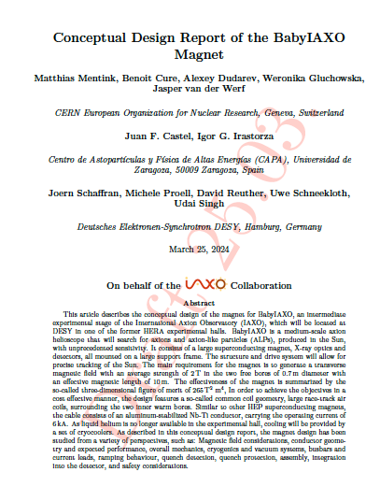
The BabyIAXO magnet
A strong magnet for many purposes?
BabyIAXO collaboration produced CDR for magnet: 2T, 10m, 0.7m bore
Review took place earlier this week
Thanks to both the reviewers and the people who prepared the CDR!!
New idea:
Use this magnet also for MADMAX technology with disks of ≈60cm diameter
Magnet could be seen as a “generic infrastructure” with several purposes, e.g.
solar axions
DM halo axions
Grav. Waves at high frequences
…
Strategic cooperation with FNAL under discussion

Slide 8
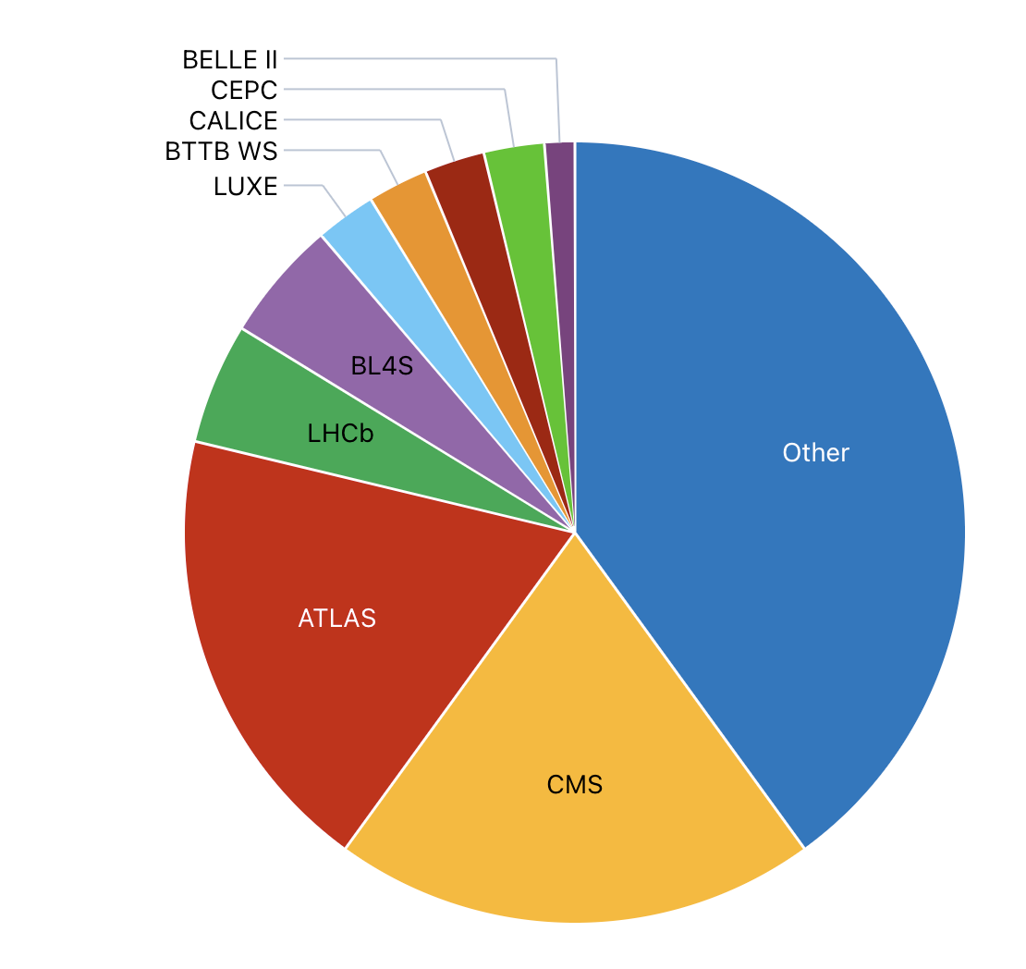
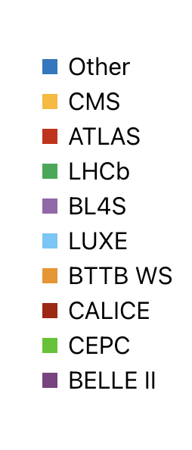
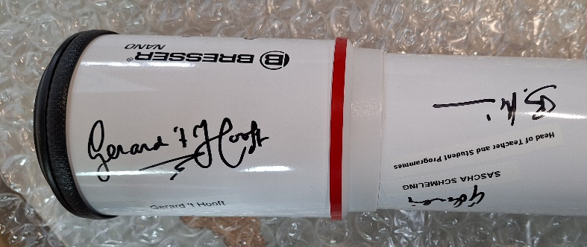
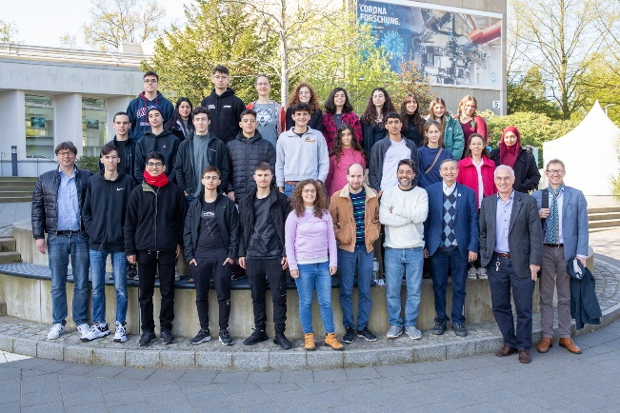
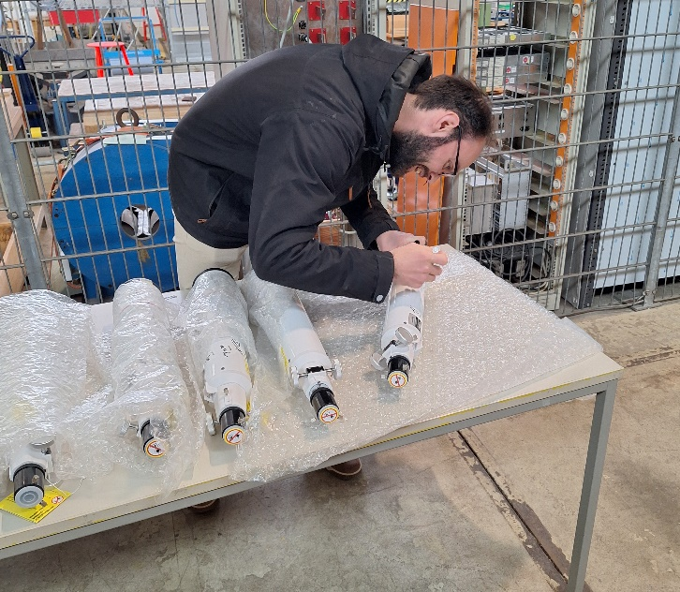
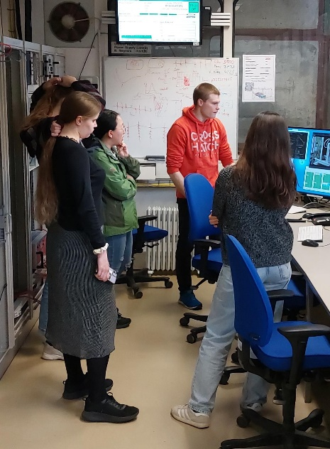
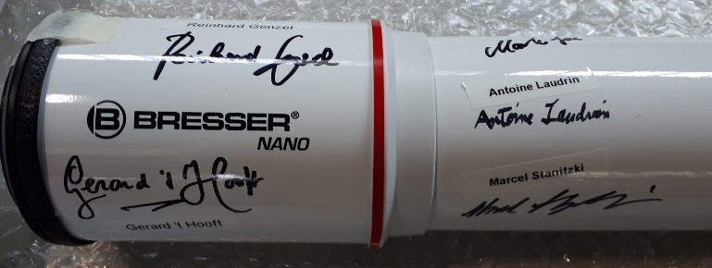
Test Beam Operations
2024 Run is ongoing ….
2023: 396 users - 231 from German Institutes
Wide portfolio from LHC to CEPC
2024: 111 slots already 53% booked
Education and Outreach key part of the facilities
Beamline4Schools 10th edition this summer (461 proposals!)
Special Price for the 13 best teams telescopes signed by Nobel Laureates, Directors and the BL4S team
Schwartz-Reisman School with High school students from Israel
HighRR School (Heidelberg) with 33 PhD and MSc students doing experiments at the beam lines
Schwartz-Reisman School
Schwartz-Weizmann
School
High-RR School

Slide 9
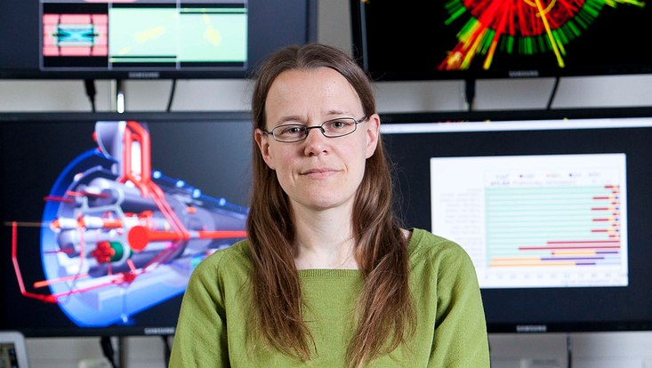
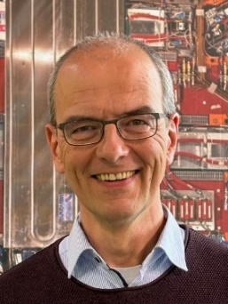
Two Physics Coordinators from DESY!
Kerstin Tackmann
Andreas Meyer
ATLAS and CMS will both have a (deputy) physics coordinator from Autumn 2024-2026

Slide 10
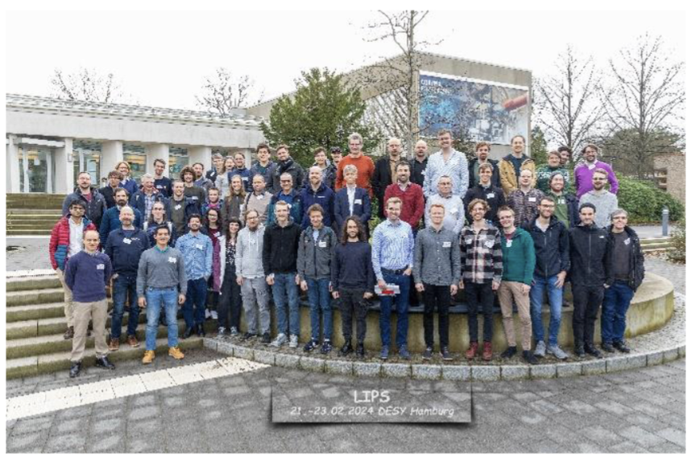
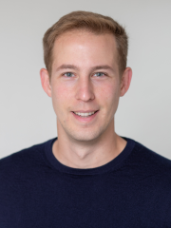
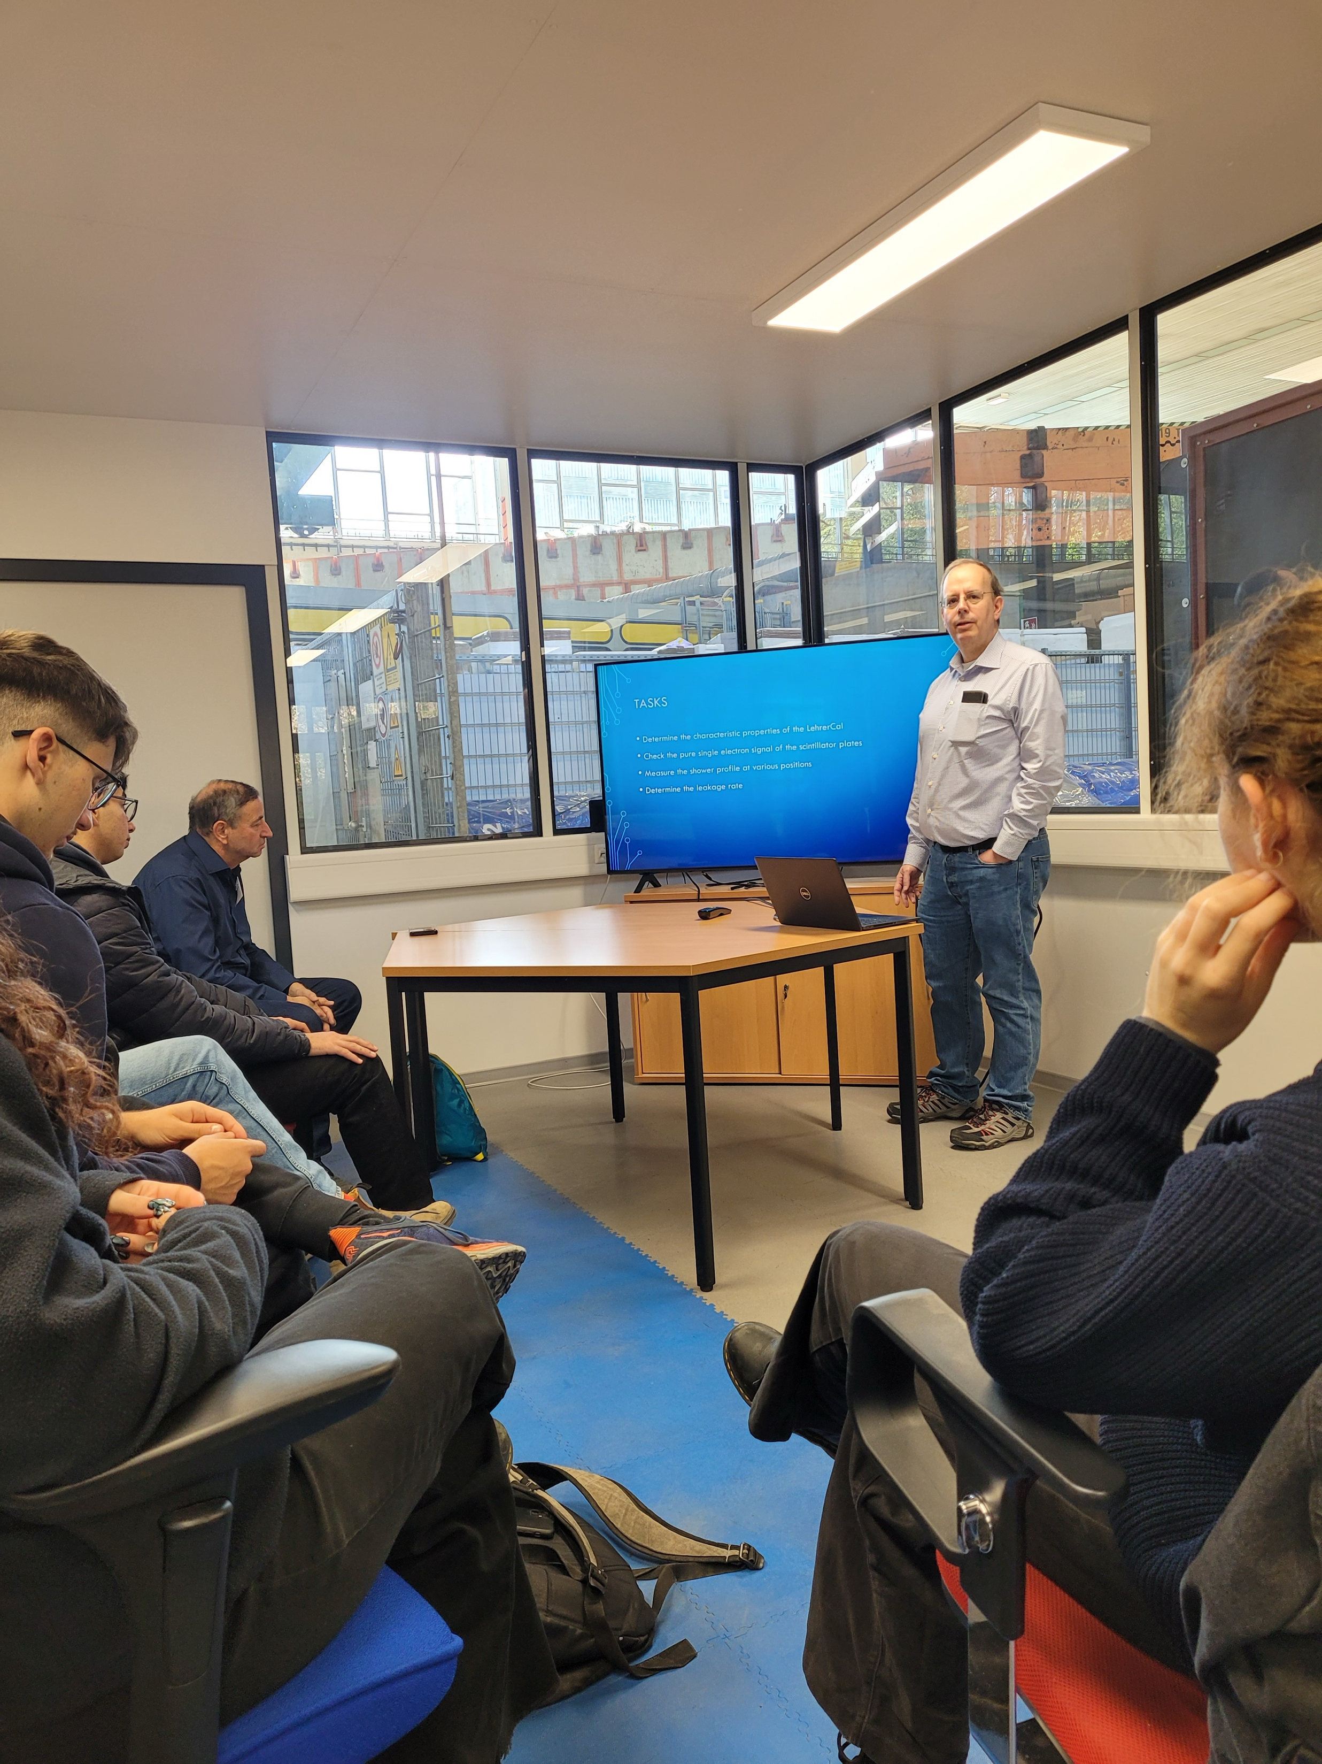
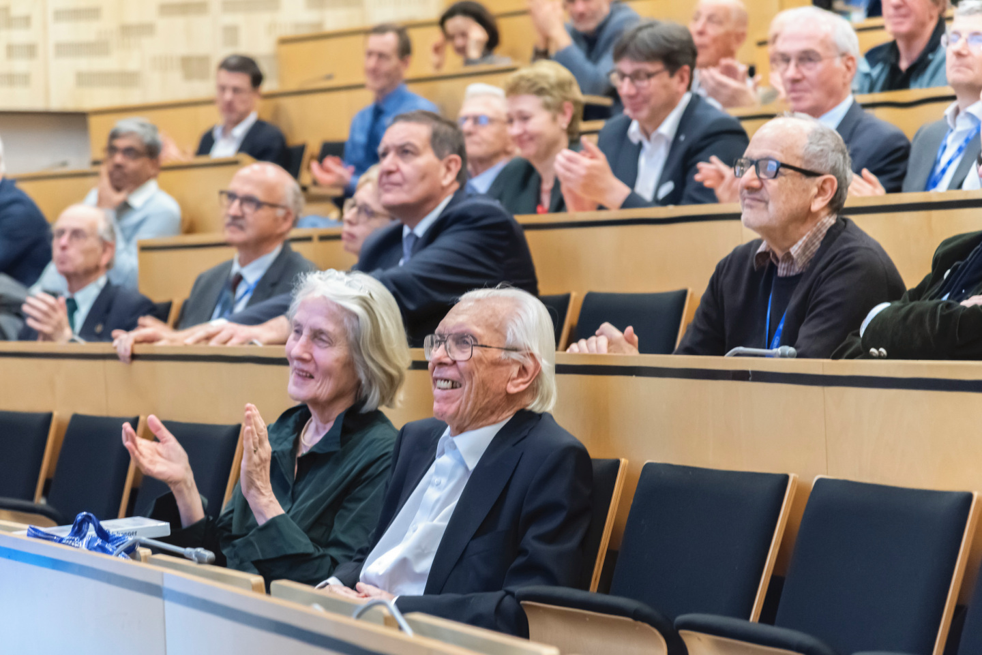
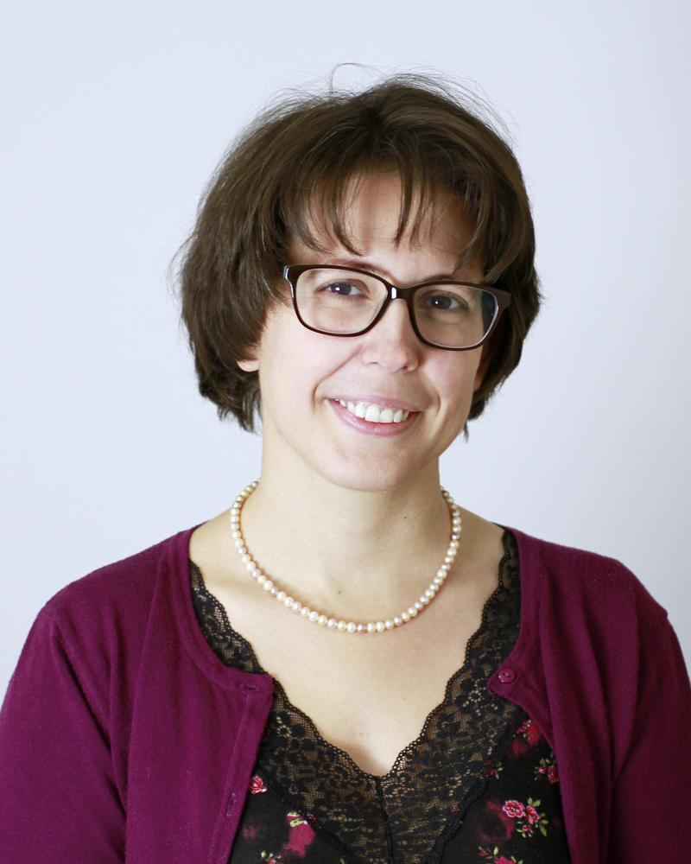
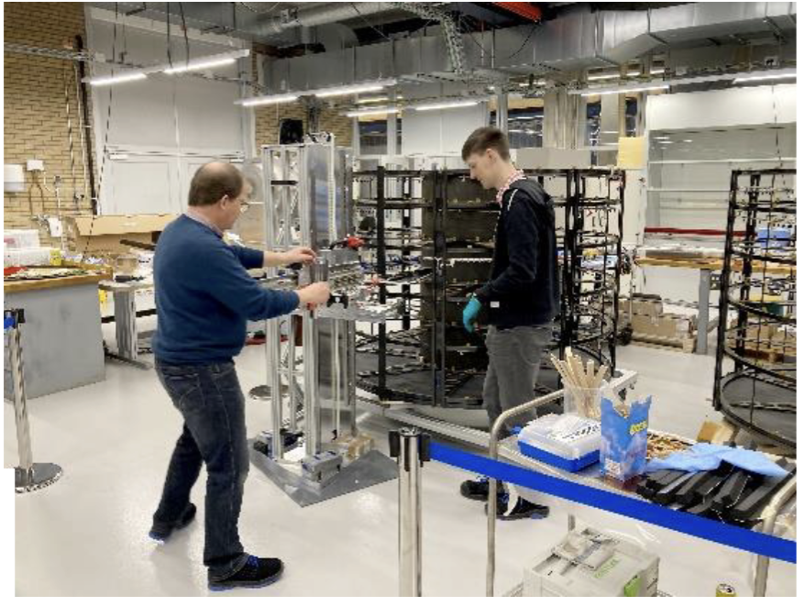
Events and People
Selected highlights since last PRC
Mathias Pierre:
Emmy-Noether Group
Workshop on LIPS Large Language Models in Physics (200 participants): 21-23/2
Visit of Israeli students (04/2024), incl. test beam use
ERC Stg Grant: Priscilla Pani
ITK endcap skeleton and insertion tool at NIKHEF
Herwig Schopper: 100th Birthday

Slide 11
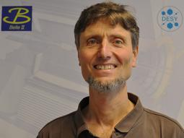
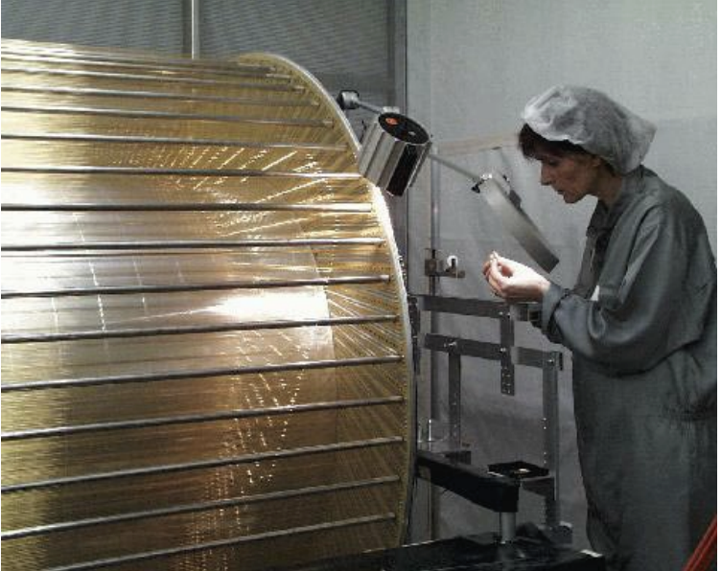
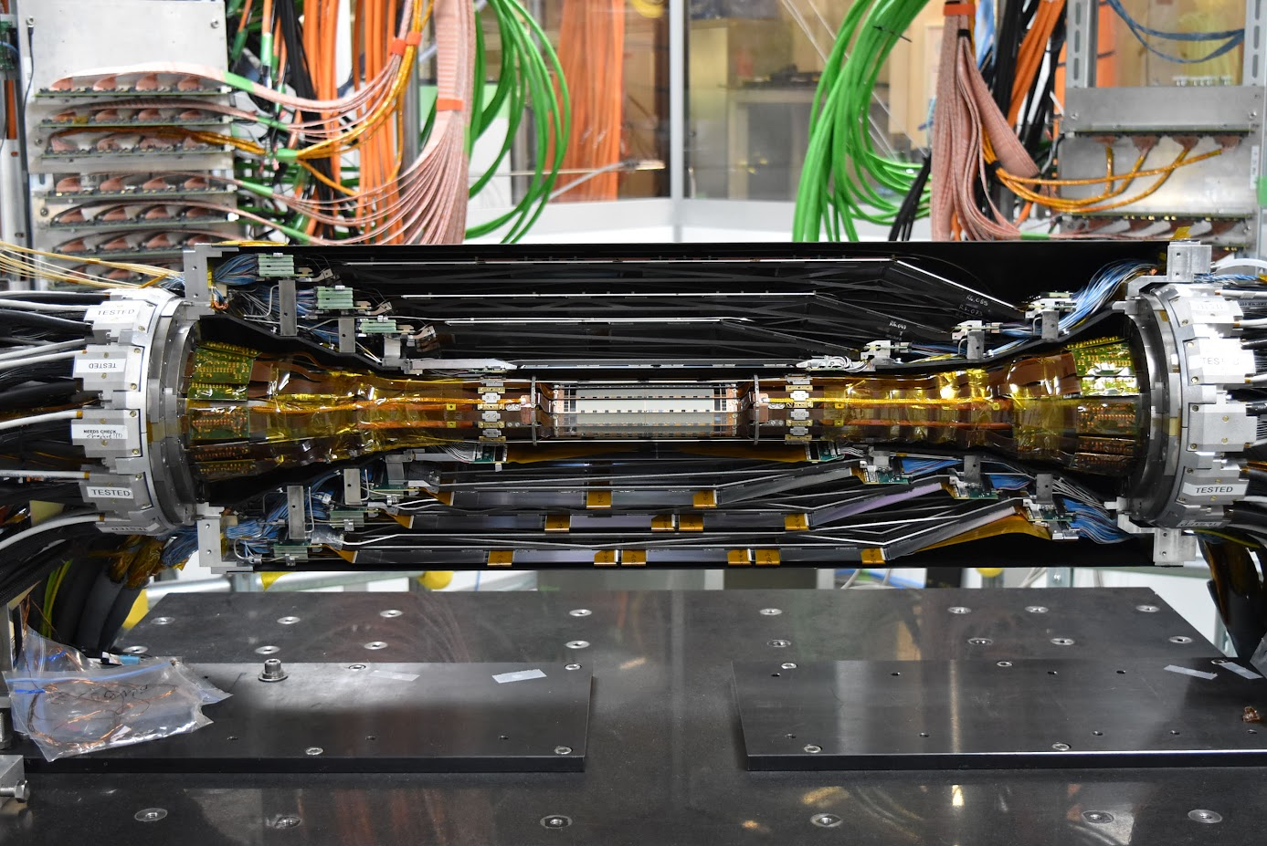
Thanks Carsten!
Belle II PXD2
Carsten Niebuhr
H1 CJC

Slide 12
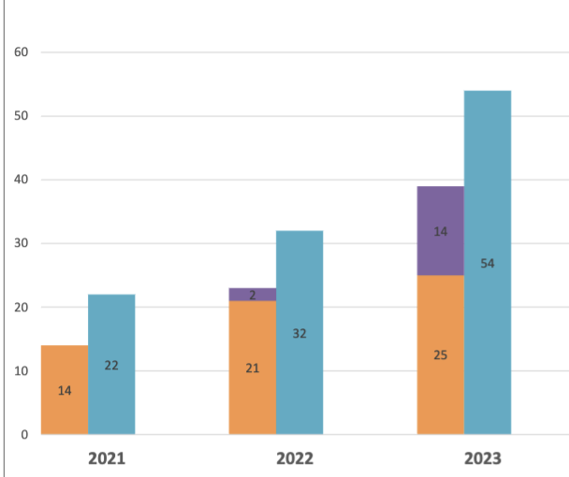
Conclusions
Challenging times as federal funding not keeping pace with cost and salary increases
Compensated in part through 3rd party funding!
HEP at DESY still strong and making good progress in many areas
About 120 PhD student, 100 Postdocs, 110 permanent scientists and 35 engineers & technicians in scientific groups
Important aspects for this PRC
Progress in ATLAS & CMS trackers
BabyIAXO magnet & MADMAX
Detector R&D platform
Computing Vision
QCD: lattice and pheno
Belle II startup
3rd party funding
applications
Total
Successful
To be decided

Slide 13
Beate Heinemann
Director for Particle Physics
beate.heinemann@desy.de
+49 40 8998 1446 / 1921

Slide 14
BACKUP

Slide 15
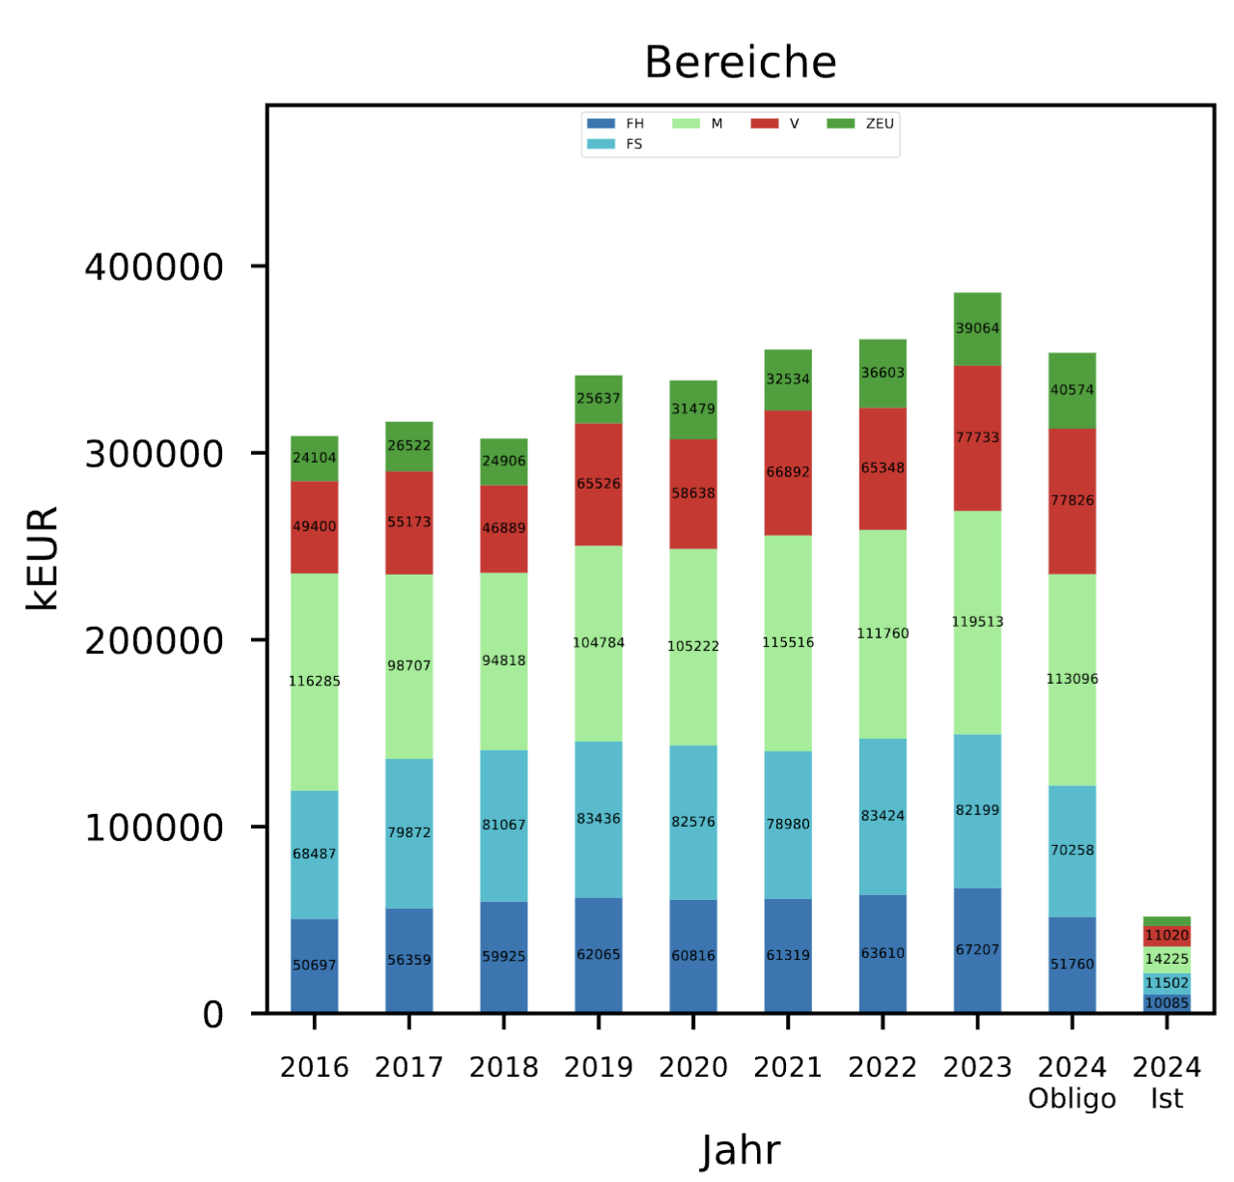
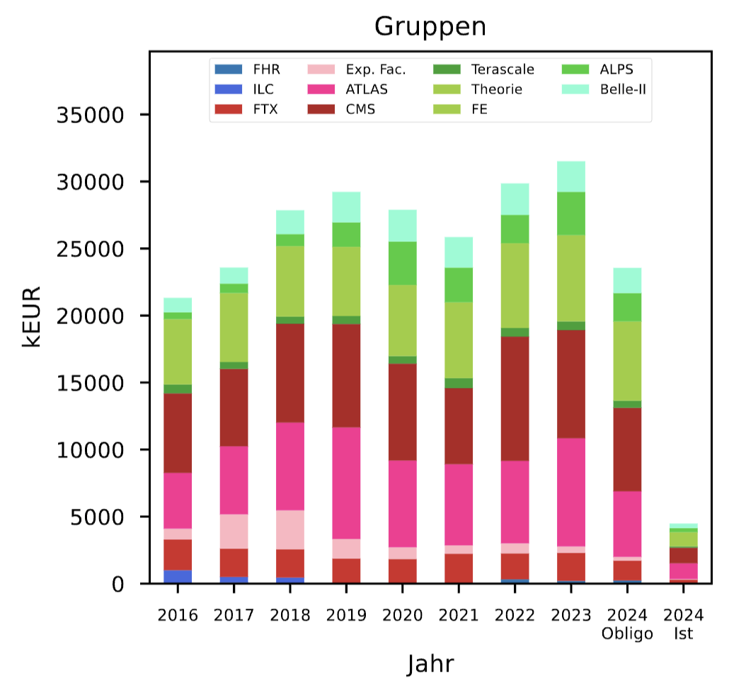
Budget Overview
Funding sources and personnel types

Slide 16
Personnel in HEP: Overview
 | PhD | Postdoc | Perm. Scientist | Engineer & Techn.
ALPS | 4 | 4 | 8 | 2
ATLAS | 32 | 25 | 24 | 12
Belle II | 6 | 10 | 10 | 5
CMS | 31 | 24 | 23 | 8
FTX | 27 | 12 | 14 | 11
Theory | 21 | 29 | 19 | 0
Sum | 121 | 104 | 108 | 36

