Slide 1
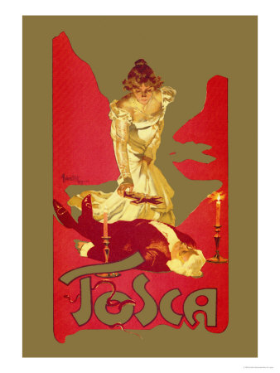

5th TOSCA Collaboration Meeting
08.04. 2024
Wolfgang Hillert on behalf of:
Floria Tosca (singer)
Cesare Angelotti (escaped political prisoner) / TU Darmstadt
Baron Scarpia (chief of police) / Univ. Hamburg
Count Palmieri (involved in a mock execution) / J.G. Univ. Mainz
Marchesa Attavanti (Angelotti‘s sister) / Univ. Rostock
Mario Cavaradossi (painter) / B. Univ. Wuppertal

Slide 2
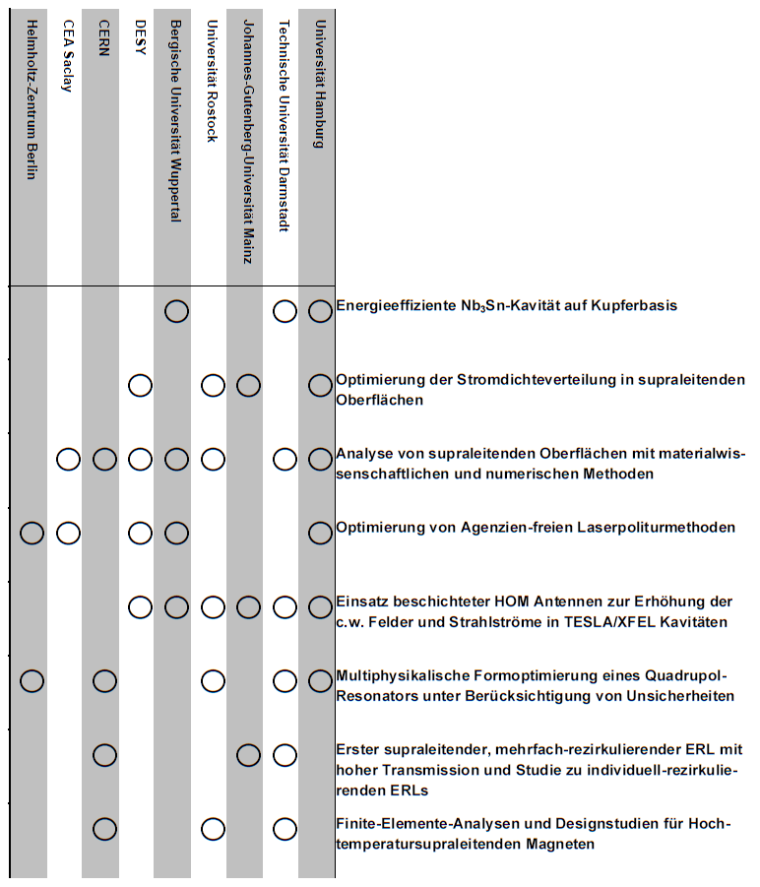
Overview work packages
Well advanced within project time
  Last collaboration meeting
Annual reports are due end of April
  Kooperationsübersicht already sent around
Looking forward to status reports today

Slide 3
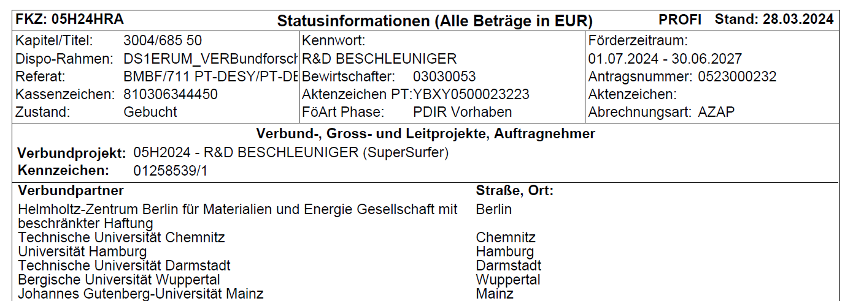
Status of SuperSurfer Proposal?
Original plan of PT/BMBF: Inaussichtsstellung 1.4. ☹
What we know:
  All non-successful proposals were asked to withdraw already
  First funding information already available for some partners in Profi-Online portal
We can expect funding – but the actual extent is yet unknown

